Slide 1
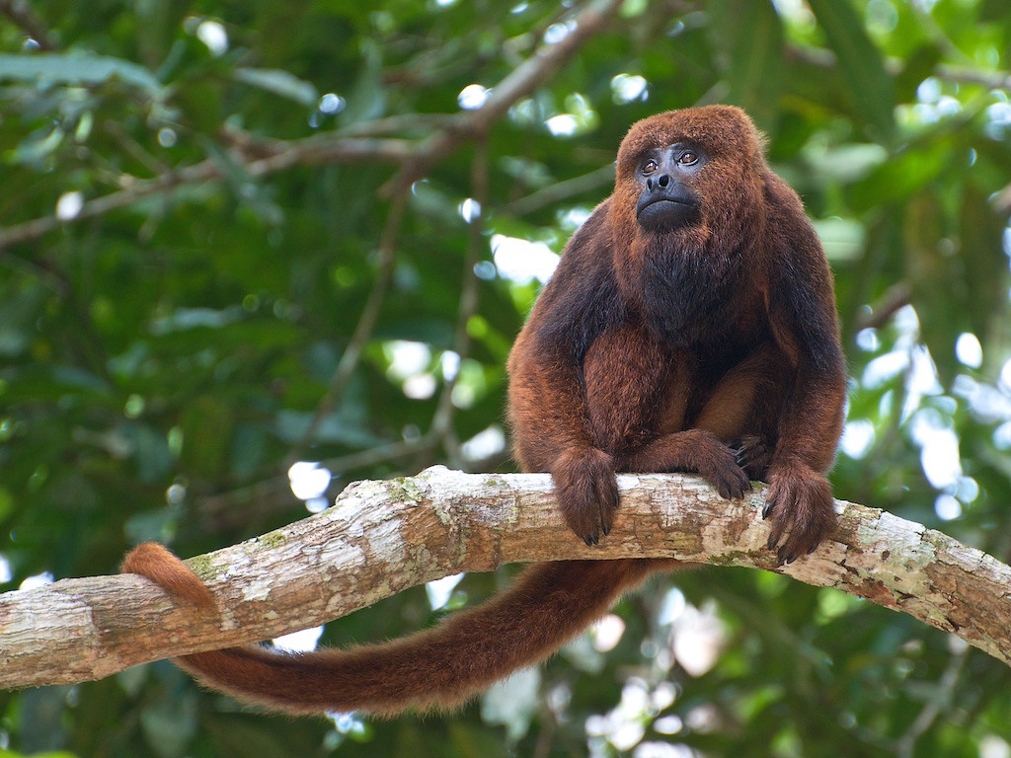
Estimating the basic reproduction number of yellow fever in Alouatta monkeys
Ben Lambert, University of Oxford

Slide 2
Talk aims
Present an individual stochastic modelling approach to estimating the basic reproduction number for yellow fever in Alouattas
Get feedback on modelling approach and, especially, the priors

Slide 3
São Paulo data characteristics
Data from observations on Alouattas in a park in São Paulo during a yellow fever outbreak
Fixed number of individuals in the population (n=86)
We observe corpses (some of which have estimated death dates) which are reported over time for 56 / 86 monkeys; others are unobserved
At t=50 (assumption), all 86 monkeys are assumed to have died
There is a big gap in between infections between the start of November and start of December, which hints at spatial effects and possible unobserved transmission trees

Slide 4
Corpses reported over time: only model after cutoff as assumed well-mixed after this point

Slide 5
Stochastic modelling framework
Since number of monkeys is so few and yellow fever eventually kills all monkeys,
We cannot use most out-of-the-box models to estimate R0 (e.g. Pagano-White or deterministic SIR etc models)
Also, because we do not directly observe deaths, the model needs to handle the duration from death to when corpse is reported (recognising that not all corpses were reported in the period)

Slide 6
Most basic model: S-I-D-Dobs
b S I
mu
pobs
S
I
D
Dobs
Susceptibles (S) become infectious at a rate b * I
Infectious (I) die at rate mu
Corpses of dead (D) become observed at rate Dobs

Slide 7
Model parameters
b: the infection rate. This is set so that we obtain a reasonable prior on R0
mu: estimated from Laemmert & Kumm (1950) and we use the posterior from this analysis as a prior for the R0 estimation model
pobs: we have estimated time of deaths from the data, so build a model for the delay from death to a corpse being observed. Then we use this posterior as a prior for the R0 estimation model
Initial conditions: assume only those monkeys observed before the cutoff date have died: S=79, I=1

Slide 8
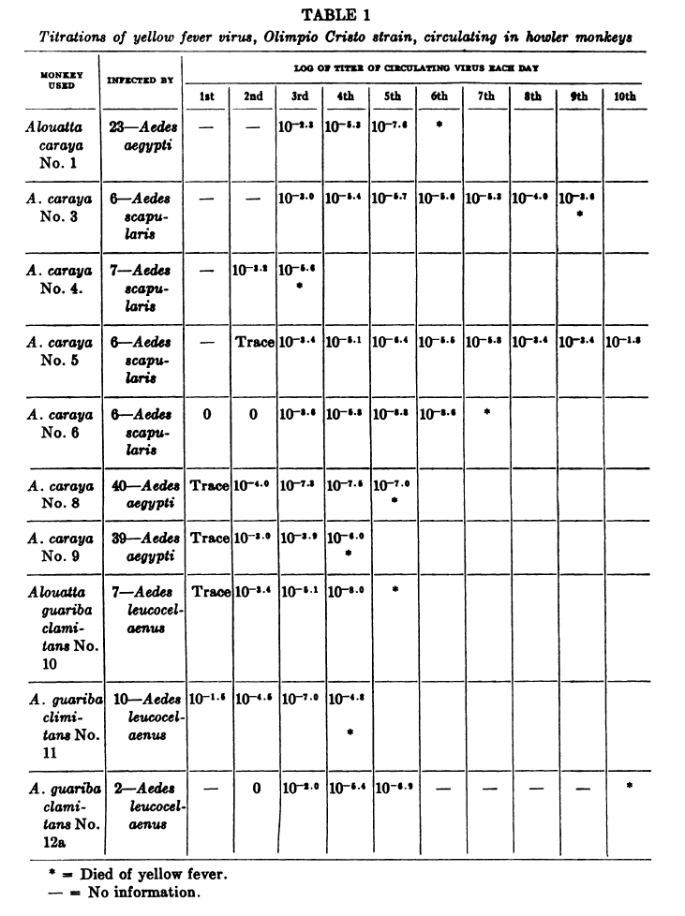
Laemmert & Kumm (1950): infected alouatta with yellow fever and recorded time to death

Slide 9
Use Laemmert & Kumm (1950) to estimate time from infection to death

Slide 10
Time from death to corpse observation: fit a gamma delay model

Slide 11
Inferential framework: ABC
Since model is stochastic and no closed form expression exists for the dynamic probability distribution, we use Approximate Bayesian Computation (ABC)
ABC requires a measure of ‘distance’ between simulated and real data. Here we use:
The root mean squared error between the cumulative simulated and cumulative real observed corpses. We also include in this vector the simulated and real deaths and assume that after t=50, all monkeys have died (this is 14 days after the end of the series)

Slide 12
Assumed prior distribution over R0

Slide 13
Posterior distribution over R0

Slide 14
Posterior predictive distribution

Slide 15
Issues with this approach
The S-I-D-Dobs model does not allow for a delay period between a monkey becoming infected and then being able to infect another monkey
The time period between being exposed and an ongoing infection occurring includes three elements:
The latency period in the monkey before they can transmit to a mosquito (~2 days?)
The extrinsic incubation period of yellow fever in the vector(?)
The time taken for an infectious vector to find an uninfected host(?)

Slide 16
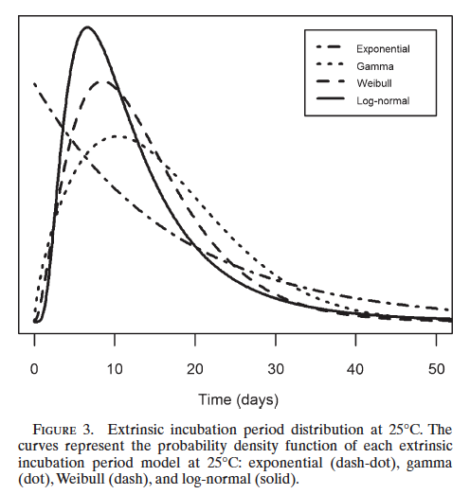
Estimating EIP: Johansson et al. 2010: EIP of yellow fever in Aedes aegypti

Slide 17
S-E-I-D-Dobs model
b S I
gamma
mu
pobs
S
E
I
D
Dobs
Model effectively includes a delay period between mosquitoes becoming infected then infectious
The duration of this delay period is governed by 1/gamma
Here we fix 1/gamma = 12 days (10 days EIP + 2 days latency)
We assume initial conditions: S=79, E=1, I=0

Slide 18
Assumed prior distribution over R0

Slide 19
Posterior distribution over R0

Slide 20
Posterior predictive distribution

Slide 21
Conclusions
Data are in a realm that is very stochastic due to the relatively small numbers of mosquitoes
The model incorporating an exposed compartment fits the data better than the one without it and makes more sense, biologically
Because of stochasticity, conclusions we draw are sensitive to the chosen priors: can we justify these?

Slide 22
Questions?

Slide 23
Sensitivity analysis: try distribution with weight on higher prior values

Slide 24
Shifts the posterior distribution

