Slide 1


Rscript: a Relational Approach to Program and System Understanding
Paul Klint

Slide 2
Structure of Presentation
Background and context
About program understanding
Roadmap: Rscript

Slide 3
Background
Application areas
Domain-specific
languages
Software renovation
System
understanding
System
transformation
Technology
This talk
ASF+SDF Meta-Environment ToolBus coordination Generalized LR parsing architecture
(Compiled) term rewriting Code Generators
Foundations
Formal languages Relational calculus Process Algebra
Term rewriting Module algebra

Slide 4
Compilation is a mature area
Some new developments
  just-in-time compilation
  energy-aware code generation
Many research results are not yet used widely
  interprocedural pointer analysis
  slicing
Why don't we just apply all these techniques to understanding and restructuring?

Slide 5
Compilation is a mature area
... of course, we do just that, but ...
there is a mismatch between
  standard compilation techniques and
  the needs for understanding and restructuring

Slide 6
Compilation is ...
A well-defined process with well-defined input, output and constraints
Input: source program in a fixed language with well-defined syntax and semantics
Output: a fixed target language with well-defined syntax and semantics
Constraints are known (correctness, performance)
A batch-like process

Slide 7
Compilation is ...
Single,
well defined,
source
Source
A batch-like process with
clear constraints
Single,
well defined,
target
Target

Slide 8
Understanding is ...
An exploration process with as input
  system artifacts (source, documentation, tests, ...)
  implicit knowledge of its designers or maintainers
There is no clear target language
An interactive process:
  Extract elementary facts
  Abstract to get derived facts needed for analysis
  View derived facts through visualization or browsing

Slide 9
Extract-Enrich-View Paradigm
Source code
Documentation
...
Extract
Application area
of Rscript
Facts
Enrich
View
Web pages
Graphics
...

Slide 10
Examples of understanding problems
Which programs call each others?
Which programs use which databases?
If we change this database record, which programs are affected?
Which programs are more complex than others?
How much code clones exist in the code?

Slide 11
Examples of the results of understanding
Textual reports indicating properties of system parts (complexity, use of certain utilities, ...)
Same, but in hyperlinked format
Graphs (call graphs, use def graphs for databases)
More sophisticated visualizations

Slide 12
Other aspects of Understanding
Systems consist of several source languages
Analysis techniques over multiple language => a language-independent analysis framework is needed
A very close link to the source text is needed

Slide 13
Related approaches
Generic dataflow frameworks exist but are not used widely
Relations have been used for querying of software (Rigi, GROK, RPA, ...)
  All based on untyped, binary, relation algebra
  Mostly used for architectural, coarse grain, queries

Slide 14
Relation-based analysis
What happens if we use relations for fine grain software analysis (ex: find uninitialized variables)
What happens if we use a relational calculus (as opposed to the relational algebra approaches)?
What happens if we use term rewriting as basic computational mechanism?
  relations can represent graphs in the rewriting world
Could yield a unifying framework for analysis and transformation

Slide 15
Roadmap
Rscript in a nutshell
Example 1: call graph analysis
Example 2: component structure
Example 3: Java analysis
Example 4: a toy language
A vizualization experiment

Slide 16
Roadmap
Rscript in a nutshell
Example 1: call graph analysis
Example 2: component structure
Example 3: Java analysis
Example 4: a toy language
A vizualization experiment

Slide 17
Rscript in a Nutshell
Basic types: bool, int, str, loc (text location in specific file with comparison operators)
Sets, relations and associated operations (domain, range, inverse, projection, ...)
Comprehensions
User-defined types
Fully typed
Functions and sets of equations over the above

Slide 18
Rscript: examples
Set: {3, 5, 3}
  type: set[int]
Set: {”y”, ”x”,”z”}
  type: set[str]
Relation: {<”y”,3>, <”x”,3>, <”z”, 5>}
  type: rel[str,int]

Slide 19
Rscript: examples
rel[str,int] U = {<”y”,3>, <”x”,3>, <”z”, 5>}
int Usize = #U
  3
rel[int,str] Uinv = inv(U)
  {<3, ”y”>, <3, ”x”>, <5, ”z”>}
set[str] Udom = domain(U)
  {”y”, ”x”, ”z”}

Slide 20
Comprehensions
Comprehensions: {Exp | Gen1, Gen2, ... }
  A generator is an enumerator or a test
  Enumerators: V : SetExp or <V1,V2> : RelExp
  Tests: any predicate
  consider all combinations of values in Gen1, Gen2,...
  if some Geni is false, reject that combination
  compute Exp for all legal combinations

Slide 21
Comprehensions
{X | int X : {1,2,3,4,5}}
  yields {1,2,3,4,5}
{X | int X : {1,2,3,4,5}, X > 3}
  yields {4,5}
{<Y, X> | <int X, int Y> : {<1,10>,<2,20>}}
  yields {<10,1>,<20,2>}

Slide 22
Functions
rel[int, int] inv(rel[int,int] R) = { <Y, X> | <int X, int Y> : R }
  inv({1,10>, <2,20>} yields {<10,1>,<20,2>}
rel[&B, &A] inv(rel[&A, &B] R) = { <Y, X> | <&A X, &B Y> : R}
  inv({<1,”a”>, <2,”b”>}) yields {<”a”,1>,<”b”,2>}

Slide 23
Roadmap
Rscript in a nutshell
Example 1: call graph analysis
Example 2: component structure
Example 3: Java analysis
Example 4: a toy language
A vizualization experiment

Slide 24
Roadmap
Rscript in a nutshell
Example 1: call graph analysis
Example 2: component structure
Example 3: Java analysis
Example 4: a toy language
A vizualization experiment

Slide 25
Analyzing the call structure of an application
a
f
b
c
d
e
g
rel[str, str] calls = {<"a", "b">, <"b", "c">, <"b", "d">, <"d", "c">,
<"d","e">, <"f", "e">, <"f", "g">, <"g", "e">}

Slide 26
Some questions
a
f
b
c
d
e
g
How many calls are there?
  int ncalls = # calls
  8
How many procedures are there?
  int nprocs = # carrier(calls)
  7

Slide 27
Some questions
a
f
b
c
d
e
g
What are the entry points?
  set[str] entryPoints = top(calls)
  {“a”, “f”}
What are the leaves?
  set[str] bottomCalls = bottom(calls)
  {“c”, “e”}

Slide 28
Intermezzo: Top
The roots of a relation viewed as a graph
top({<1,2>,<1,3>,<2,4>,<3,4>}) yields {1}
Consists of all elements that occur on the lhs but not on the rhs of a tuple
set[&T] top(rel[&T, &T] R) = domain(R) \ range(R)

Slide 29
Intermezzo: Bottom
The leaves of a relation viewed as a graph
bottom({<1,2>,<1,3>,<2,4>,<3,4>}) yields {4}
Consists of all elements that occur on the rhs but not on the lhs of a tuple
set[&T] bottom(rel[&T, &T] R) = range(R) \ domain(R)

Slide 30
Some questions
a
f
b
c
d
e
g
What are the indirect calls between procedures?
  rel[str,str] closureCalls = calls+
  {<"a", "b">, <"b", "c">, <"b", "d">, <"d", "c">, <"d","e">, <"f", "e">, <"f", "g">, <"g", "e">, <"a", "c">, <"a", "d">, <"b", "e">, <"a", "e">}
What are the calls from entry point a?
  set[str] calledFromA = closureCalls["a"]
  {"b", "c", "d", "e"}

Slide 31
Intermezzo: right image
Right-image of a relation: all elements that have a given value as left element (resembles array access)
Notation: relation followed by [Value]
Ex. Rel = {<1,10>,<2,20>,<1,11>,<3,30>,<2,21>}
Rel[1] yields {10,11}
Rel[{1,2}] yields {10, 11, 20, 21}

Slide 32
Intermezzo: left image
Left-image of a relation: all elements that have a given value as right element
Notation: relation followed by [-,Value]
Ex. Rel = {<1,10>,<2,20>,<1,11>,<3,30>,<2,21>}
Rel[-,10] yields {1}
Rel[-,{10,20}] yields {1,2}

Slide 33
Some questions
a
f
b
c
d
e
g
What are the calls to procedure e?
  set[str] callsToE = closureCalls[-,"e"]
  {"a", "b", "d", "f", "g"}

Slide 34
Some questions
a
f
b
c
d
e
g
What are the calls from entry point f?
  set[str] calledFromF = closureCalls["f"]
  {"e", "g"}
What are the common procedures?
  set[str] commonProcs = calledFromA inter calledFromF
  {"e"}

Slide 35
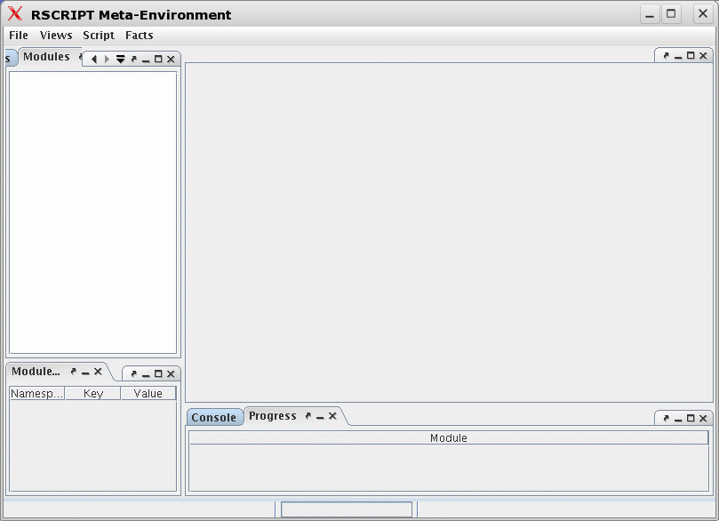
Running Rscript using rscript-meta
Facts
tab
Modules
tab
Navigator
pane
Edit pane
Message
pane

Slide 36
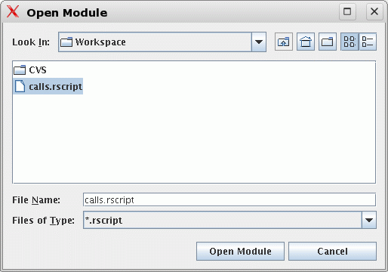
Script -> Open...

Slide 37
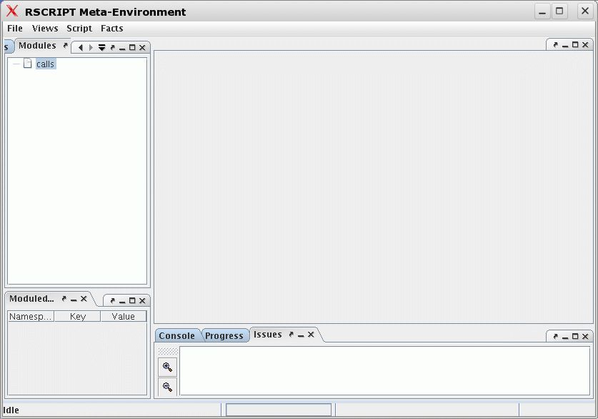
File calls has been opened
Right click -> Edit script

Slide 38
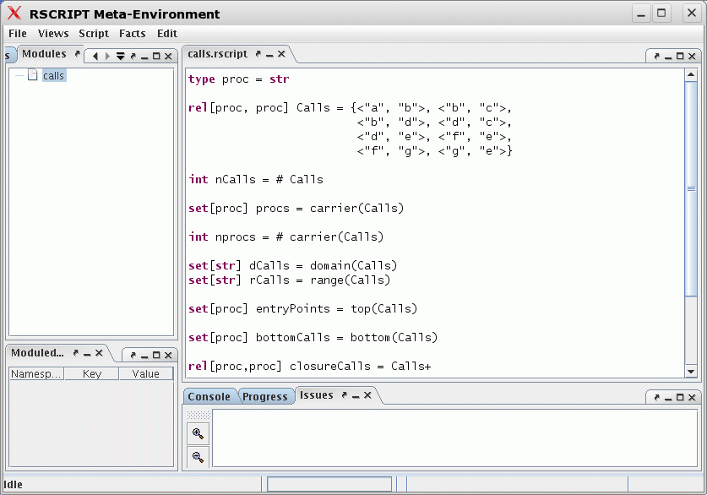
Editing calls.rscript

Slide 39
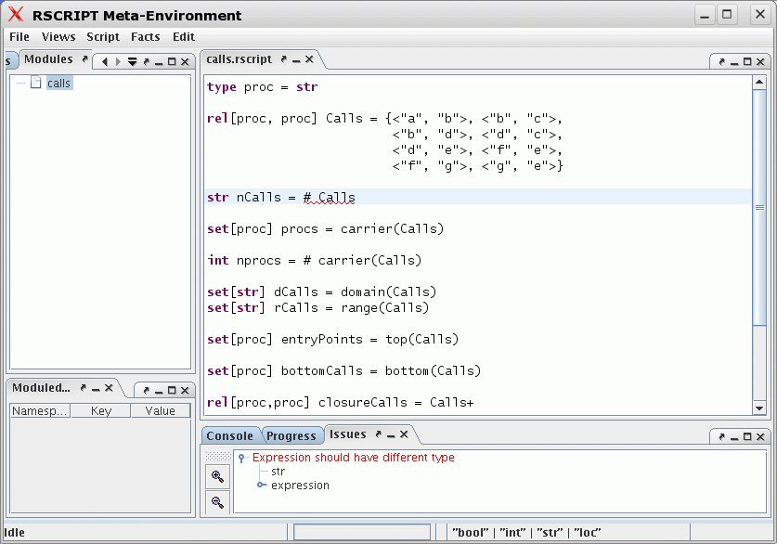
Making errors ...

Slide 40
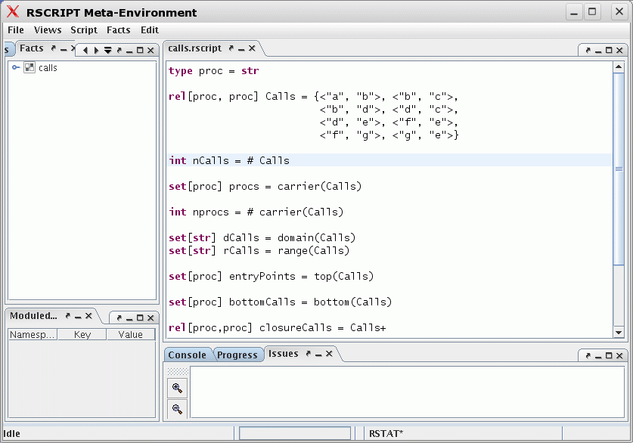
Script -> Run

Slide 41
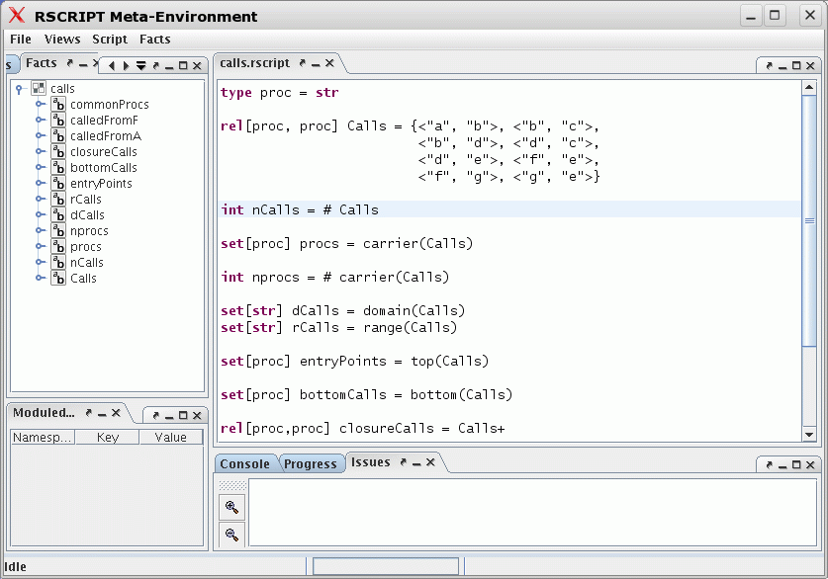
Unfolding the rstore ...

Slide 42
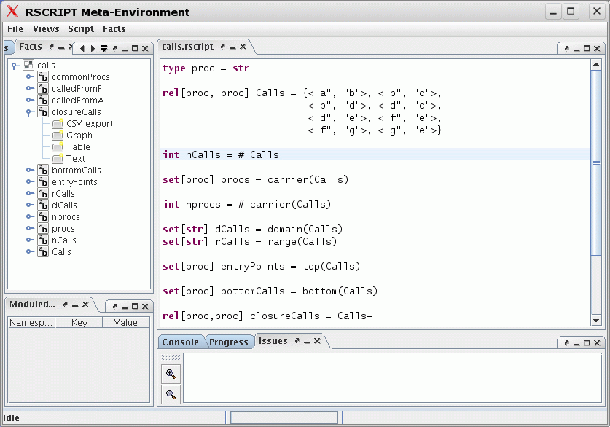
Unfolding closureCalls

Slide 43
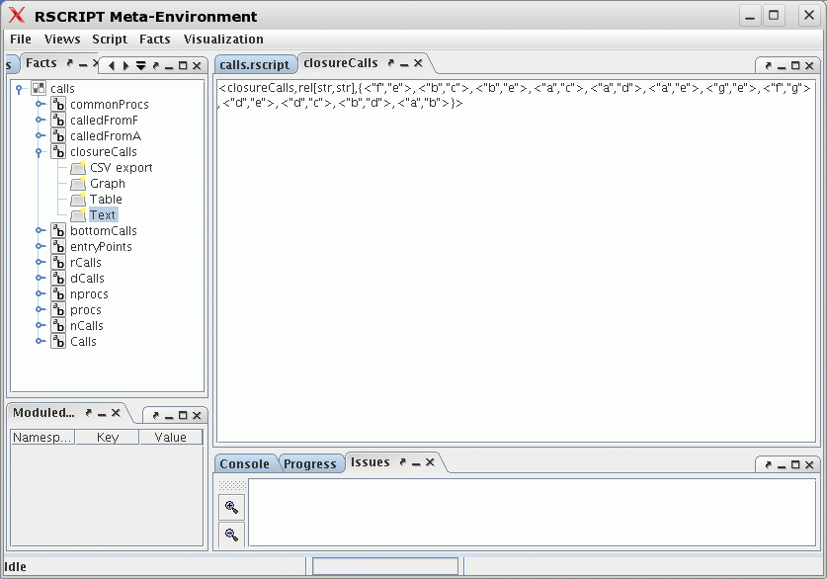
closureCalls as Text

Slide 44
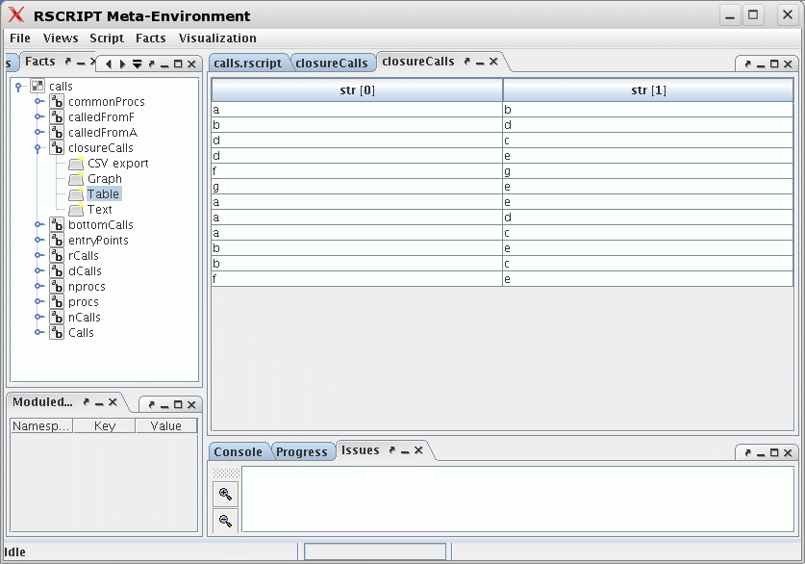
closureCalls as Table

Slide 45
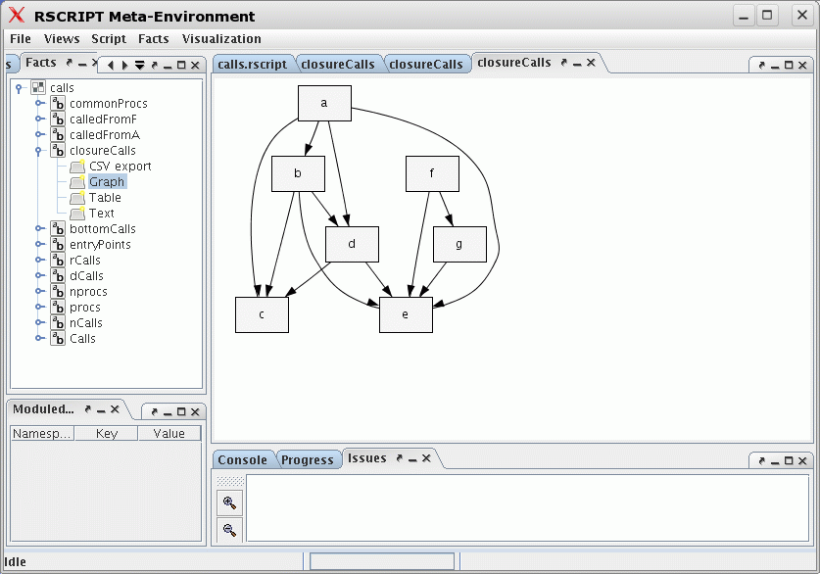
closureCalls as Graph

Slide 46
Roadmap
Rscript in a nutshell
Example 1: call graph analysis
Example 2: component structure
Example 3: Java analysis
Example 4: a toy language
A vizualization experiment

Slide 47
Roadmap
Rscript in a nutshell
Example 1: call graph analysis
Example 2: component structure
Example 3: Java analysis
Example 4: a toy language
A vizualization experiment

Slide 48
Component Structure of Application
Suppose, we know:
  the call relation between procedures (Calls)
  the component of each procedure (PartOf)
Question:
  Can we lift the relation between procedures to a relation between components (ComponentCalls)?
This is usefull for checking that real code conforms to architectural constraints

Slide 49
Calls
main
a
b
c
d
type proc = str
type comp = str
rel[proc,proc] Calls = {<"main", "a">, <"main", "b">, <"a", "b">,
<"a", "c">, <"a", "d">, <"b", "d">}

Slide 50
PartOf
main
main
DB
Appl
a
b
a
b
c
d
c
Lib
d
set[comp] Components = {"Appl", "DB", "Lib"}
rel[proc, comp] PartOf =
{<"main", "Appl">, <"a", "Appl">, <"b", "DB">,
<"c", "Lib">, <"d", "Lib">}

Slide 51
lift
main
main
DB
Appl
Appl
DB
a
b
a
b
c
d
c
Lib
d
Lib
rel[comp,comp] lift(rel[proc,proc] aCalls, rel[proc,comp] aPartOf) =
{ <C1, C2> | <proc P1, proc P2> : aCalls,
<comp C1, comp C2> : aPartOf[P1] x aPartOf[P2] }
rel[comp,comp] ComponentCalls = lift(Calls2, PartOf)
Resultaat: {<"DB", "Lib">, <"Appl", "Lib">, <"Appl", "DB">, <"Appl", "Appl">}

Slide 52
Roadmap
Rscript in a nutshell
Example 1: call graph analysis
Example 2: component structure
Example 3: Java analysis
Example 4: a toy language
A vizualization experiment

Slide 53
Roadmap
Rscript in a nutshell
Example 1: call graph analysis
Example 2: component structure
Example 3: Java analysis
Example 4: a toy language
A vizualization experiment

Slide 54
Cyclic Dependencies
A class uses (directly or indirectly) itself
Use = methods calls, inheritance, containment
  class ContainedClass { }
  class SuperClass {}
  class SubClass extends SuperClass { ContainedClass C;
  }
Example of
a contained class
Motivation: cyclic class dependencies are difficult
to understand/maintain

Slide 55
Cyclic Dependencies: Examples
class A { B B1; ... }
class B extends A { ... }
class A { C C1; ... }
class B extends A{ ... }
class C { B B1; ...}

Slide 56
Java analysis: classes in cycles
Assume the following extracted information:
  rel[str,str] CALL
    method call from first class to the second
  rel[str,str] INHERITANCE
    extends and implements
  rel[str,str] CONTAINMENT
    attribute of first class is of the type of the second class
Question: which classes occur in a cyclic dependency?

Slide 57
Java analysis: cycles in classes
Define the USE relation between two classes:
  rel[str,str] USE = CALL union CONTAINMENT union INHERITANCE
  set[str] ClassesInCycle = {C1 | <str C1, str C2> : USE+, C1 == C2}
In this way we get a set of classes that occur in a cyclic dependency, but ...
... which classes are in the cycle?

Slide 58
Java analysis: cyclic classes
rel[str,str] USE = CALL union CONTAINMENT union INHERITANCE
set[str] CLASSES = carrier(USE)
rel[str,str] USETRANS = USE+
rel[str,set[str]] = {<C, USETRANS[C]> | str C : CLASSES, <C, C> in USETRANS}
Each cyclic class is associated with a set of classes that form a cycle

Slide 59
Applications of this approach
Search for “similar” classes
Search for design patterns (as characterized by specific relations between the classes in the pattern)
...

Slide 60
Roadmap
Rscript in a nutshell
Example 1: call graph analysis
Example 2: component structure
Example 3: Java analysis
Example 4: a toy language
A vizualization experiment

Slide 61
Roadmap
Rscript in a nutshell
Example 1: call graph analysis
Example 2: component structure
Example 3: Java analysis
Example 4: a toy language
A vizualization experiment

Slide 62
Toy program
begin declare x : natural, y : natural,
z : natural;
x := 3;
if 3 then
z := y + x
else
x := 4
fi
y := z
end

Slide 63
Toy program
rel[int,str] DEFS = {<1,”x”>, <3,”z”>, <4,”x”>, <5,”y”>}
begin declare x : natural, y : natural,
z : natural;
x := 3;
if 3 then
z := y + x
else
x := 4
fi
y := z
end
[1]
[2]
[3]
[4]
[5]
rel[int,str] USES = {<3,”y”>, <3,”x”>, <5,”z”>}
rel[int,int] PRED = {<0,1>, <1,2>, <2,3>,<2,4>,
<3,5>,<4,5>}

Slide 64
Finding uninitialized variables
Start of program
Def 1 of x
Def 2 of x
Use of x

Slide 65
Intermezzo: reachX
Reachability with exclusion of certain elements
set[&T] reachX(
  set[&T] Start,
  set[&T] Excl,
  rel[&T,&T] Rel)
reachX({1}, {2}, {<1,2>,<1,3>,<2,4>,<3,4>}) yields {<3,4>}
2
1
4
3

Slide 66
The undefined query
rel[int,str] DEFS = ...
rel[int,str] USES = ...
rel[int,int] PRED = ...
rel[int,str] UNINIT =
{ <N,V> | <int N, str V>:USES, N in reachX({0}, DEFS[-,V],PRED)}

Slide 67
Applying the undefined query
begin declare x : natural, y : natural,
z : natural;
x := 3;
if 3 then
z := y + x
else
x := 4
fi
y := z
end
[1]
[2]
[3]
[4]
[5]
Result:
{<5,”z”>, <3,”y”>}

Slide 68
Some Questions
There are several additional questions:
  In the example so far we have worked with statement numbers but how do we make a connection with the source text? (Discussed now)
  How do we extract relations like PRED and USE from the source text? (Discussed later)

Slide 69
Use locations to connect with the source text
rel[int,str] DEFS = ...
rel[int,str] USES = ...
rel[int,int] PRED = ...
Use location instead of number
rel[loc,str] DEFS
rel[loc,str] USES
rel[loc,loc] PRED
rel[str, loc] OCCURS
Variable occurrence
in a statement

Slide 70
Example Rstore
rstore(
)
<PRED, rel[loc,loc],
{<area-in-file("/home/paulk/.../example.pico", area(4, 2,4, 8,84, 6)),
area-in-file("/home/paulk/.../example.pico", area(5, 2,5, 8,94, 6))>,
<area-in-file("/home/paulk/.../example.pico", area(5, 2,5, 8, 94, 6)),
area-in-file("/home/paulk/.../example.pico", area(6, 2,10, 4, 104, 56))>,
... }>,
<DEFS, {
<OCCURS, rel[str,loc],
{<"y", area-in-file("/home/paulk/.../example.pico",area(11, 2,11, 3,164, 1))>, <"z", area-in-file("/home/paulk/.../example.pico", area(11, 7,11, 8,169, 1))>, ... }
}

Slide 71
Extracting Facts
Goal: extract facts from source code and use as input for queries
How should fact extraction be organized?
How to write a fact extractor?

Slide 72
Workflow Fact Extraction
Grammar
Obtain sources of SUI
Obtain grammar for
source language of SUI
Improve
Validate grammar
Write queries
Queries
Facts
Determine needed facts
Obtain fact extractor
Improve
Improve
Validate extracted facts
SUI
=
System
Under
Investigation
Execute queries
Improve
Validate answers
Use answers

Slide 73
Roadmap
Rscript in a nutshell
Example 1: call graph analysis
Example 2: component structure
Example 3: Java analysis
Example 4: a toy language
A vizualization experiment

Slide 74
Roadmap
Rscript in a nutshell
Example 1: call graph analysis
Example 2: component structure
Example 3: Java analysis
Example 4: a toy language
A vizualization experiment

Slide 75
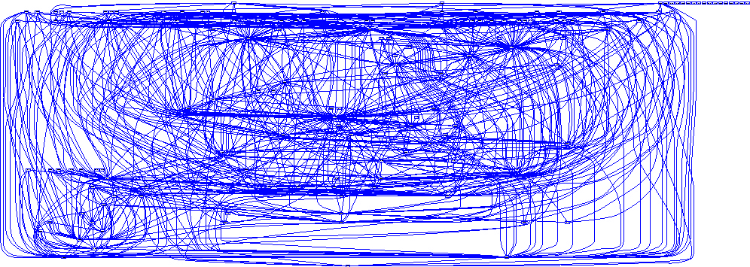
Issues in Program Visualization
Small graphs are nice, large graph are a disaster
(Courtesy: Arie van Deursen)

Slide 76
Issues in Program Visualization
Howto display information related to source text?
Approach (Steven Eick): use a pixel-based image of the source text
Over 100.000 LOC on one screen!
Experiment: visualize an Rstore for JHotDRaw (15.000 LOC)

Slide 77
Visualization Workflow
Extract facts from SUI:
extract -i SUISrcDir -o SUI.rstore.pt
SUI.rstore.pt
Enrich the extracted facts:
rscript -i enr.rscript -s SUI.rstore.pt \
-o enr.SUI.rstore.pt
enr.SUI.rstore.pt
Convert to .rviz format:
rstore2rviz -i enr.SUI.rstore.pt -o SUI.rviz
SUI.rviz
Visualize SUI:
rviz SUI.rviz

Slide 78
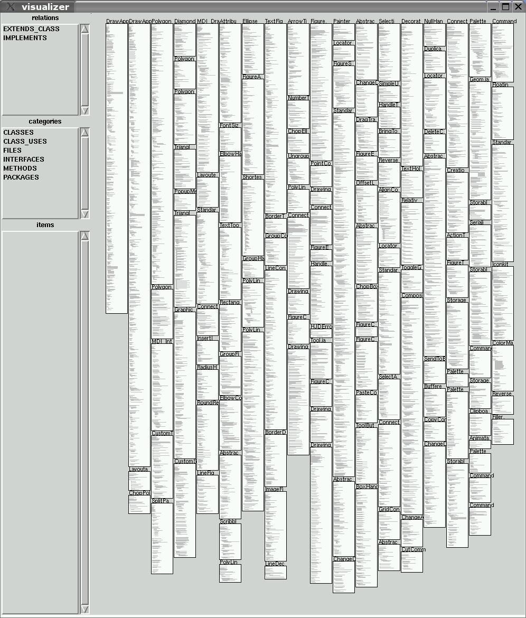

Slide 79
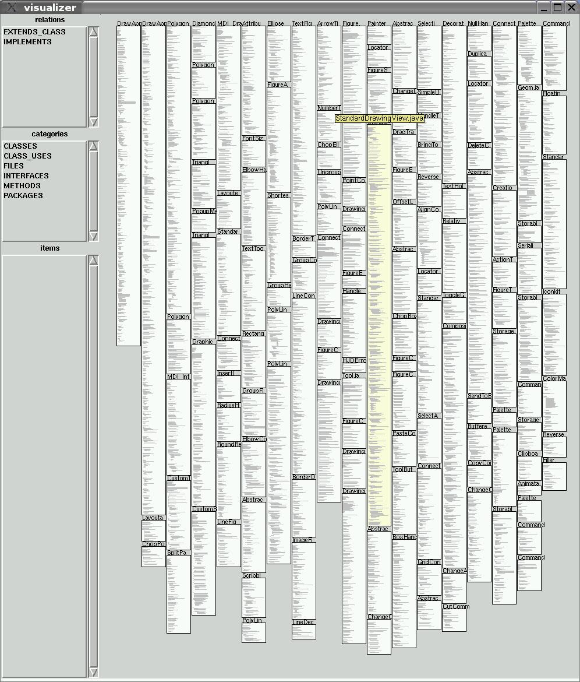

Slide 80
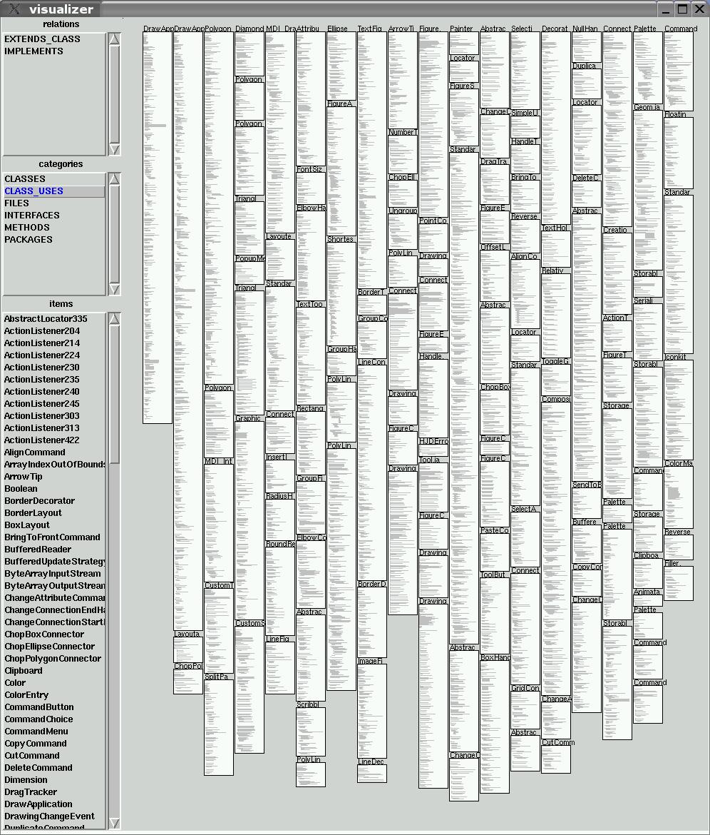

Slide 81
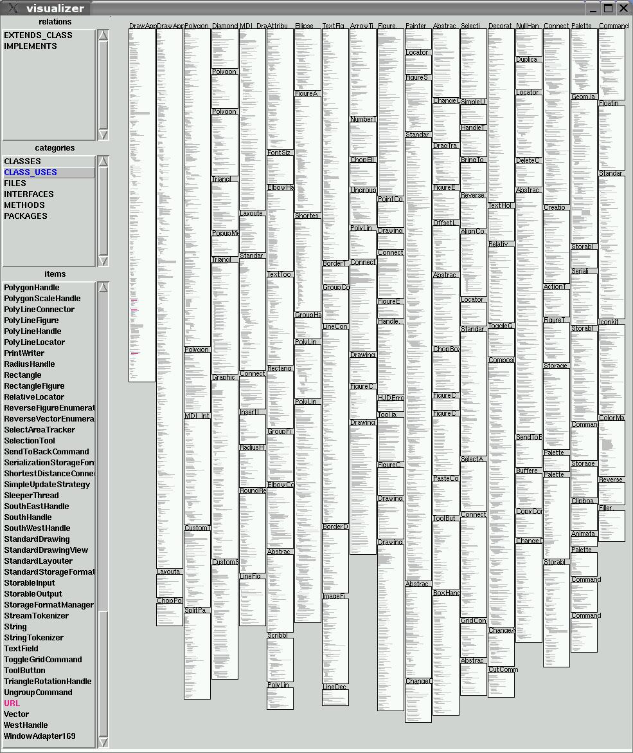

Slide 82
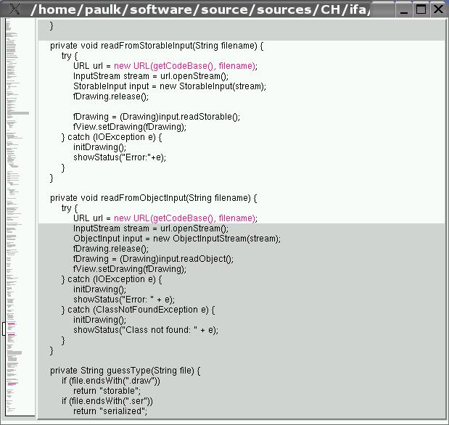

Slide 83
Wrap up: Rscript
A simple, language-independent, relational calculus
Fully typed
Equation solver (=> dataflow equations)
Areas allow close link with source text
Implementation: ASF+SDF
IDE: rscript-meta
  an instance of The Meta-Environment

Slide 84
Wrap up : Rscript
Calls analysis
Lifting of procedure calls to component relations
Unitialized/unused variables
McCabe & friends
Clones in C code
Dataflow analysis
  reaching definitions
  live variables
Program slicing
Java &ToolBus analysis
Feature Descriptions/ package dependencies

Slide 85
Wrap up: visualization
A lot of work to do but promising start
Alternative pixel representations?
Treemaps for directory structure of files?
Colormaps for displaying metrics?
Implementation: Tcl/Tk but may change to Swing
Some simple visualizations are included in rscript-meta

Slide 86
Further reading
P. Klint, How understanding and restructuring differ from compiling: a rewriting approach, IWPC03
P. Klint, A tutorial introduction to Rscript on www.meta-environment.org
www.cwi.nl/~paulk/publications/all.html

