Slide 1

EASY Programming with Rascal
Paul Klint
Joint work with
Emilie Balland, Bas Basten, Jeroen van den Bos, Mark Hills, Arnold Lankamp, Bert Lisser, Tijs van der Storm, Jurgen Vinju
ICTDelta 2010

Slide 2


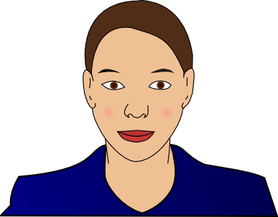


Cast of Heroes
Alice, system administrator
Bernd, forensic investigator
Charlotte, financial engineer
Daniel, multi-core specialist
Elisabeth, model-driven engineering specialist

Slide 3
What are their Common Problems?
How to parse source code/data files
How to extract facts from it
How to perform computations on these facts
How to generate new source code
How to synthesize other information
EASY: Extract-Analyze-SYnthesize Paradigm

Slide 4
?
EASY
Paradigm
System
Under
Investigation
(SUI)
Extract
Internal Representation
Analyze
Synthesize
Results

Slide 5
What tools are available to our heroes?
Lexical tools: Grep, Awk, Perl, Python, Ruby
  Regular expressions have limited expressivity
  Hard to maintain
Compiler tools: yacc, bison, CUP, ANTLR
  Only automate front-end part
  Everything else programmed in C, Java, ..
Attribute Grammar tools: FNC2, JastAdd, …
  Mostly analysis, weak in transformation

Slide 6
What tools are available to our heroes?
Relational Analysis tools: Grok, Rscript
  Strong in analysis
Transformation tools: ASF+SDF, Stratego, TOM, TXL
  Strong in transformation
Logic languages: Prolog
Many others …
Apologies if
your favorite tool
does not
appear in this list

Slide 7
 | Extract | Analyze | Synthesize
Lexical tools | ++ | +/- | --
Compiler tools | ++ | +/- | +/-
Attribute grammar tools | ++ | +/- | --
Relational tools | -- | ++ | --
Transformation tools | -- | +/- | ++
Our Goal: Rascal | ++ | ++ | ++

Slide 8

Here comes Rascal to the Rescue

Slide 9

Rascal ...
... is a new language for meta-programming
… supports the EASY paradigm
... is based on Syntax Analysis, Term Rewriting, Relational Calculus
... extended superset of ASF+SDF and Rscript
... easily extensible with Java code
... embedded in Eclipse IDE (and REPL!)

Slide 10
Design Guidelines
Principle of least surprise
  Familiar syntax
  Imperative core
What you see is what you get
  No heuristics (or as few as possible)
  Explicitness over implicitness
Learnability
  Layered design
  Low barrier to adoption

Slide 11

Rascal Elevator Pitch

Slide 12
Rascal Elevator Pitch
Sophisticated built-in data types
Immutable data
Static safety
Generic types
Local type inference
Pattern Matching
Syntax definitions and parsing
Concrete syntax
Visiting/traversal
Comprehensions
Higher-order
Familiar syntax
Java and Eclipse integration
Read-Eval-Print (REPL)

Slide 13


Slide 14

Information
Latest version of
Rascal Documentation
Rascal Download (Linux, MacOS, Windows)
See http://www.rascal-mpl.org/
Related information:
http://www.meta-environment.org

Slide 15

Welke kant gaat het op met het nieuwe programmeren?

