Slide 1
EASY Meta-Programming with Rascal
Leveraging the Extract-Analyze-SYnthesize Paradigm
Paul Klint
Joint work with: Emilie Balland, Bas Basten, Arnold Lankamp, Tijs van der Storm, Jurgen Vinju

Slide 2


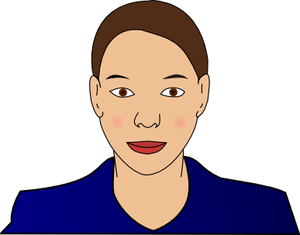


Cast of Our Heroes
Alice, system administrator
Bernd, forensic investigator
Charlotte, financial engineer
Daniel, multi-core specialist
Elisabeth, model-driven engineering specialist

Slide 3
Meet Alice
Alice is security administrator at a large online marketplace
Objective: look for security breaches
Solution:
  Extract relevant information from system log files, e.g. failed login attempts in Secure Shell
  Extract IP address, login name, frequency, …
  Synthesize a security report

Slide 4
Meet Bernd
Bernd: investigator at German forensic lab
Objective: finding common patterns in confiscated digital information in many different formats. This is very labor intensive.
Solution:
  design DERRICK a domain-specific language for this type of investigation
  Extract data, analyze the used data formats and synthesize Java code to do the actual investigation

Slide 5
Meet Charlotte
Charlotte works at a large financial institution in Paris
Objective: connect legacy software to the web
Solution:
  extract call information from the legacy code, analyze it, and synthesize an overview of the call structure
  Use entry points in the legacy code as entry points for the web interface
  Automate these transformations

Slide 6
Meet Daniel
Daniel is concurrency researcher at one of the largest hardware manufacturers worldwide
Objective: leverage the potential of multi-core processors and find concurrency errors
Solution:
  extract concurrency-related facts from the code (e.g., thread creation, locking), analyze these facts and synthesize an abstract automaton
  Analyze this automaton with third-party verification tools

Slide 7
Meet Elisabeth
Elisabeth is software architect at an airplane manufacturer
Objective: Model reliability of controller software
Solution:
  describe software architecture with UML and add reliability annotations
  Extract reliability information and synthesize input for statistics tool
  Generate executable code that takes reliability into account

Slide 8
What are their Common Problems?
How to parse source code
How to extract facts from it
How to perform computations on these facts
How to generate new source code
How to synthesize other information
EASY: Extract-Analyze-SYnthesize Paradigm

Slide 9
?
EASY
Paradigm
System
Under
Investigation
(SUI)
Extract
Internal Representation
Analyze
Synthesize
Results

Slide 10
What tools are available to our heroes?
Lexical tools: Grep, Awk, Perl, Python, Ruby
  Regular expressions have limited expressivity
  Hard to maintain
Compiler tools: yacc, bison, CUP, ANTLR
  Only automate front-end part
  Everything else programmed in C, Java, ..
Attribute Grammar tools: FNC2, JastAdd, …
  Only analysis, no transformation

Slide 11
What Tools are Available to our heroes?
Relational Analysis tools: Grok, Rscript
  Strong in analysis
Transformation tools: ASF+SDF, Stratego, TOM, TXL
  Strong in transformation
Logic languages: Prolog
Many others …
Apologies if
your favorite tool
does not
appear in this list

Slide 12
 | Extract | Analyze | Synthesize
Lexical tools | ++ | +/- | --
Compiler tools | ++ | +/- | +/-
Attribute grammar tools | ++ | +/- | --
Relational tools | -- | ++ | --
Transformation tools | -- | +/- | ++
Logic languages | +/- | +/- | +/-
Rascal | ++ | ++ | ++

Slide 13
Our Background
ASF+SDF Meta-Enviroment
  SDF: Syntax Definition Formalism
    Modular syntax definitions
    Integrated scanning and parsing
    Generalized LR parsing
  ASF: Algebraic Specification Formalism
    Conditional rewrite rules
    User-defined syntax
Rscript: a relational calculus language
See http://www.meta-environment.org

Slide 14
Some code snippets
to illustrate our
ASF+SDF
and
Rscript
background

Slide 15
ASF+SDF snippets

Slide 16
Boolean Constants (in ASF+SDF)
module basic/BoolCon
exports
sorts BoolCon
context-free syntax
"true" -> BoolCon
"false" -> BoolCon
module basic/BoolCon
exports
sorts BoolCon
context-free syntax
"true" -> BoolCon
"false" -> BoolCon

Slide 17
Booleans (1)
module basic/Booleans
imports basic/BoolCon
exports
sorts Boolean
context-free syntax
BoolCon -> Boolean
module basic/Booleans
imports basic/BoolCon
exports
sorts Boolean
context-free syntax
BoolCon -> Boolean

Slide 18
Booleans (2)
Boolean "|" Boolean -> Boolean {left}
Boolean "&" Boolean -> Boolean {left}
“not” (Boolean) -> Boolean
"(" Boolean ")" -> Boolean {bracket}
context-free priorities
Boolean "&" Boolean -> Boolean >
Boolean "|" Boolean -> Boolean
Boolean "|" Boolean -> Boolean {left}
Boolean "&" Boolean -> Boolean {left}
“not” (Boolean) -> Boolean
"(" Boolean ")" -> Boolean {bracket}
context-free priorities
Boolean "&" Boolean -> Boolean >
Boolean "|" Boolean -> Boolean

Slide 19
Booleans (3)
context-free syntax
“not” (Boolean) -> Boolean
"(" Boolean ")" -> Boolean {bracket}
context-free priorities
Boolean "&" Boolean -> Boolean {left} >
Boolean "|" Boolean -> Boolean {left}
context-free syntax
“not” (Boolean) -> Boolean
"(" Boolean ")" -> Boolean {bracket}
context-free priorities
Boolean "&" Boolean -> Boolean {left} >
Boolean "|" Boolean -> Boolean {left}

Slide 20
Booleans (4)
hiddens
context-free start-symbols
Boolean
imports
basic/Comments
variables
"Bool"[0-9\']* -> Boolean
hiddens
context-free start-symbols
Boolean
imports
basic/Comments
variables
"Bool"[0-9\']* -> Boolean

Slide 21
Booleans (5)
equations
[B1] true | Bool = true
[B2] false | Bool = Bool
[B3] true & Bool = Bool
[B4] false & Bool = false
[B5] not ( false ) = true
[B6] not ( true ) = false
equations
[B1] true | Bool = true
[B2] false | Bool = Bool
[B3] true & Bool = Bool
[B4] false & Bool = false
[B5] not ( false ) = true
[B6] not ( true ) = false

Slide 22
Fixed versus user-defined syntax
true | Bool true
false | Bool Bool
true & Bool Bool
false & Bool false
not ( false ) true
not ( true ) false
equations
[B1] =
[B2] =
[B3] =
[B4] =
[B5] =
[B6] =

Slide 23
Booleans (6)
The term
not(true & not(false | true))
Rewrites to
true

Slide 24
Booleans (7)
not(true & not(false | true))
[B2] false | Bool = Bool
not(true & not( true ))
[B6] not ( true ) = false
not(true & false )
[B3] true & Bool = Bool
not( false )
[B5] not( false ) = true
true

Slide 25
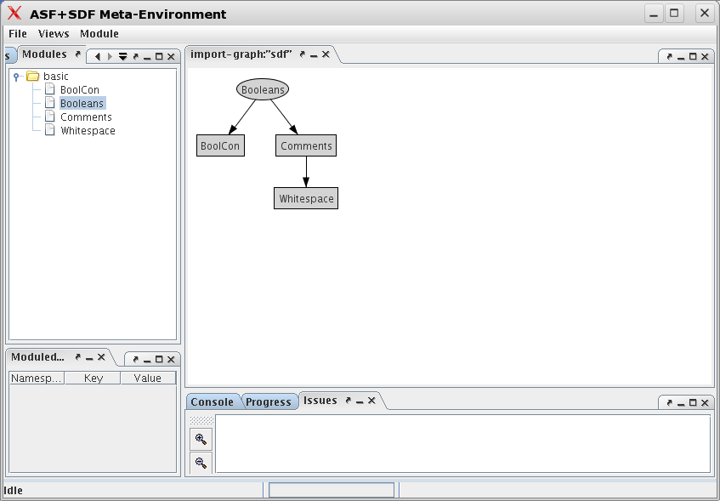
Opening Booleans in the
Meta-Environment

Slide 26
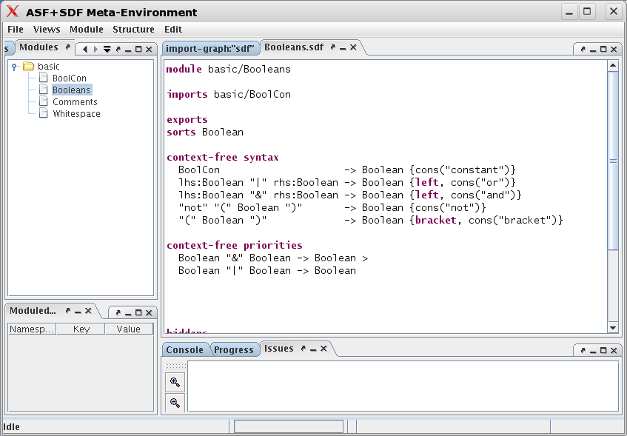
Editing Booleans.sdf

Slide 27
Points to Ponder
Don't be misled by this simple example!
SDF is being used to define the grammar of real languages (COBOL, Java, C, ...)
ASF has been used for real mass transformations
Lesson
Using concrete syntax in transformations
avoids the need to define/remember/use
Hundreds of abstract syntax constructors

Slide 28
A real example: Cobol transformation
Cobol 75 has two forms of conditional:
  “IF” Expr “THEN” Stats “END-IF”?
  “IF” Expr “THEN” stats “ELSE” Stats “END-IF”?
These are identical (dangling else problem):
IF expr THEN
IF expr THEN
stats
ELSE
stats
IF expr THEN
IF expr THEN
stats
ELSE
stats

Slide 29
Example: Cobol transformation
module End-If-Trafo
imports Cobol
exports
context-free syntax
addEndIf(Program)-> Program {traversal(trafo,continue,top-down)}
variables
"Stats"[0-9]* -> StatsOptIfNotClosed
"Expr"[0-9]* -> L-exp
"OptThen"[0-9]* -> OptThen
equations
[1] addEndIf(IF Expr OptThen Stats) =
IF Expr OptThen Stats END-IF
[2] addEndIf(IF Expr OptThen Stats1 ELSE Stats2) =
IF Expr OptThen Stats1 ELSE Stats2 END-IF
Impossible to do with regular
expression tools like grep since
conditionals can be nested
module End-If-Trafo
imports Cobol
exports
context-free syntax
addEndIf(Program)-> Program {traversal(trafo,continue,top-down)}
variables
"Stats"[0-9]* -> StatsOptIfNotClosed
"Expr"[0-9]* -> L-exp
"OptThen"[0-9]* -> OptThen
equations
[1] addEndIf(IF Expr OptThen Stats) =
IF Expr OptThen Stats END-IF
[2] addEndIf(IF Expr OptThen Stats1 ELSE Stats2) =
IF Expr OptThen Stats1 ELSE Stats2 END-IF

Slide 30
Rscript snippets

Slide 31
Rscript
A simple relational calculus language with
sets/relations
Functions
Built-in operators: sets, lists
Built-in functions: domain, range, ...

Slide 32
Rscript: examples
rel[str,int] U = {<”y”,3>, <”x”,3>, <”z”, 5>}
int Usize = #U
  3
rel[int,str] Uinv = inv(U)
  {<3, ”y”>, <3, ”x”>, <5, ”z”>}
set[str] Udom = domain(U)
  {”y”, ”x”, ”z”}

Slide 33
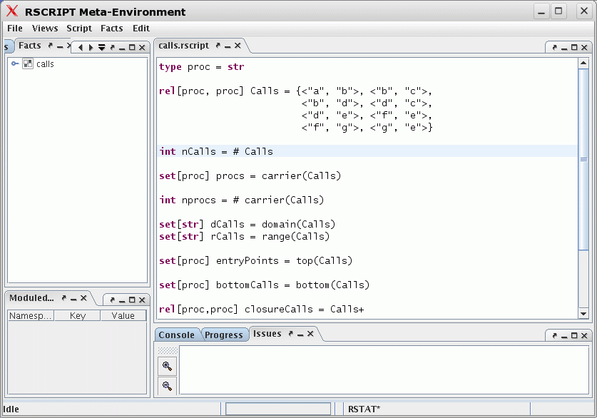
Rscript IDE

Slide 34
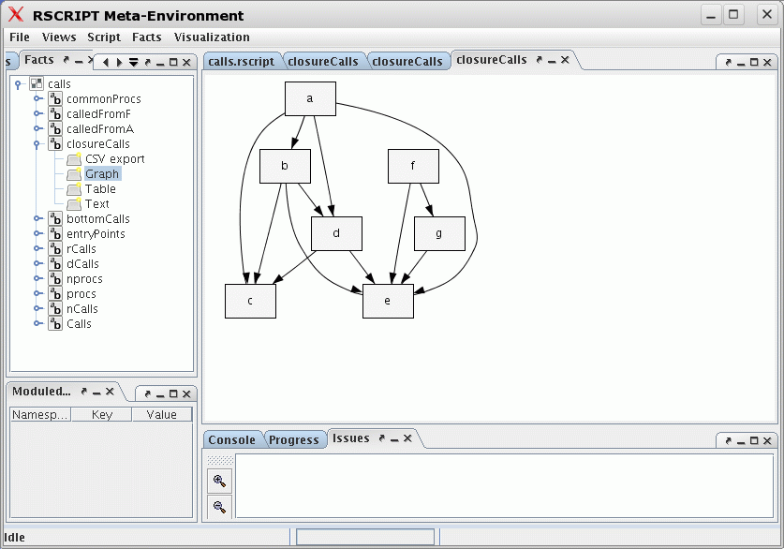
Graphical display of Results

Slide 35
End of
ASF+SDF
and
Rscript
snippets

Slide 36
Lessons
SDF-like definitions are essential for defining the syntax of programming languages/DSLs
Rewrite rules are excellent for transformations
Concrete syntax helps simplifying rules
Relational calculus is well-suited for computing with facts
Fact extraction is very labour-intensive
Glueing the above together requires much boilerplate

Slide 37
Where is our ASF+SDF and Rscript background applicable?
 | Extract | Analyze | Synthesize
ASF: rewrite rules | -- | +/- | ++
SDF: grammar rules | ++ | +/- | --
Rscript: relational calculus | -- | ++ | --

Slide 38
Why a new Language?
No current technology spans the full range of EASY steps
There are many fine technologies but they are
  highly specialized
  hard to learn
  not integrated with a standard IDE
  Hard to extend
  ...

Slide 39

Here comes Rascal to the Rescue

Slide 40

Rascal is ...
... a new language for meta-programming
... based on
  Syntax Analysis
  Term Rewriting
  Relational Calculus
... embedded in the Eclipse development enviroment

Slide 41

Rascal Elevator Pitch

Slide 42
Rascal Elevator Pitch
Sophisticated built-in data types
Immutable data
Static safety
Generic types
Local type inference
Pattern Matching
Syntax definitions and parsing
Concrete syntax
Visiting/traversal
Comprehensions
Higher-order
Familiar syntax
Java and Eclipse integration
Read-Eval-Print (REPL)

Slide 43


Slide 44
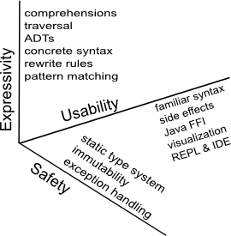
Dimensions of requirements

Slide 45
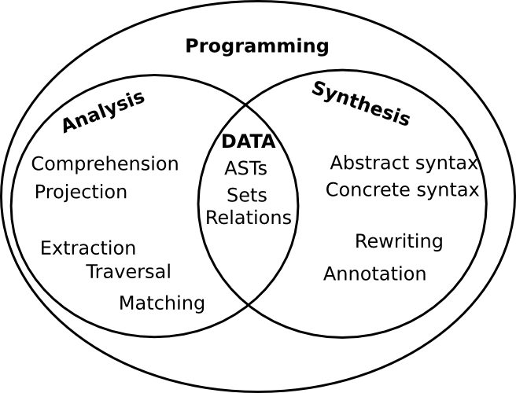
Bridging analysis and synthesis

Slide 46
Design Guidelines
Principle of least surprise
  Familiar syntax
  Imperative core
What you see is what you get
  No heuristics (or few)
  Explicitness over implicitness
Learnability
  Layered design
  Low barrier to adoption

Slide 47
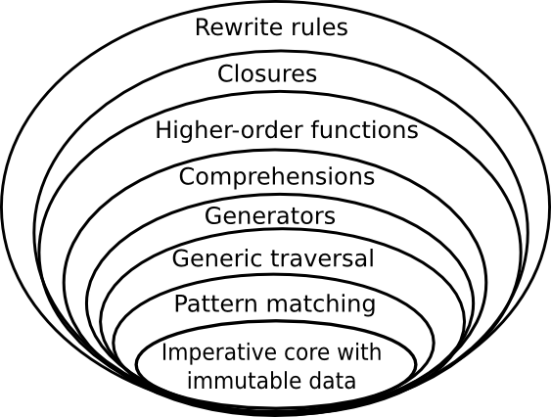
Rascal's layered design

Slide 48
Rascal Concepts
Values and Types
Data structures
Syntax and Parsing
Pattern Matching
Enumerators
Comprehensions
Control structures
Switching
Visiting
Functions
Rewrite rules
Constraint solving
Typechecking
Execution

Slide 49
 | Extract | Analyze | Synthesize
Values, Types, Datatypes | ++ | ++ | ++
Syntax analysis and parsing | ++ | +/- | --
Pattern matching | ++ | ++ | +/-
Visitors and Switching | ++ | ++ | ++
Relations, Enumerators Comprehensions | +/- | ++ | +/-
Rewrite rules | -- | ++ | ++

Slide 50
Some Classical Examples
Hello
Factorial
ColoredTrees

Slide 51
Hello (on the command line)
rascal > import IO;
ok
rascal> println(“Hello, my first Rascal program”);
Hello, my first Rascal program
ok

Slide 52
Hello (as function in module)
module demo::Hello
import IO;
public void hello() {
println(“Hello, my first Rascal program”);
}
rascal > import demo::Hello;
ok
rascal> hello();
Hello, my first Rascal program
ok

Slide 53
Factorial
module demo::Factorial
public int fac(int N){
return N <= 0 ? 1 : N * fac(N - 1);
}
rascal> import demo::Factorial;
ok
rascal> fac(47);
int: 25862324151116818064296435515361197996
9197632389120000000000

Slide 54
Types and Values
Atomic: bool, int, real, str, loc (source code location)
Structured: list, set, map, tuple, rel (n-ary relation), abstract data type, parse tree
Type system:
  Types can be parameterized (polymorphism)
  All function signatures are explicitly typed
  Inside function bodies types can be inferred (local type inference)

Slide 55
Type | Example
bool | true, false
int | 1, 0, -1, 123456789
real | 1.0, 1.0232e20, -25.5
str | “abc”, “values is <x>”
loc | !file:///etc/passwd
tuple[t1, ..., tn] | <1,2>, <”john”, 43, true>
list[t] | [], [1], [1,2,3], [true, 2, “abc”]
set[t] | {}, {1,3,5,7}, {“john”, 4.0}
rel[t1, ..., tn] | {<1,10,100>,<2,20,200>}
map[t, u] | (), (“a”:1, “b”:2,”c”:3)
node | f, add(x,y), g(“abc”,[2,3,4])

Slide 56
User-defined datastructures
Named alternatives
  name acts as constructor
  can be used in patterns
Named fields (access/update via . notation)
All datastructures are a subtype of the standard type node
  Permits very generic operations on data
Parse trees resulting from parsing source code are represented by the datatype ParseTree

Slide 57
ColoredTrees: CTree
data CTree = leaf(int N)
| red(CTree left, CTree right)
| black(Ctree left, Ctree right) ;
rb = red(black(leaf(1), red(leaf(2), leaf(3))),
black(leaf(4), leaf(5)));
1
4
5
2
3

Slide 58
Abstract Syntax
data STAT = asgStat(Id name, EXP exp)
| ifStat(EXP exp,list[STAT] thenpart,
list[STAT] elsepart)
| whileStat(EXP exp, list[STAT] body)
;

Slide 59
Type Hierarchy
bool
= subtype-of
int
real
str
loc
list
void
value
map
tuple
set
rel
node
A1
An
ADT1
ADTn
alias
data

Slide 60

Pattern matching
Given a pattern and a value:
  Determine whether the pattern matches the value
  If so, bind any variables occurring in the pattern to corresponding subparts of the value

Slide 61
Pattern matching
Pattern matching is used in:
  Explicit match operator Pattern := Value
  Switch: matching controls case selection
  Visit: matching controls visit of tree nodes
  Rewrite rules: determine whether a rule should be applied

Slide 62
Patterns
Regular: Grep/Perl like regular expressions
Abstract: match data types
Concrete: match parse trees
/^<before:\W*><word:\w+><after:.*$>/
whileStat(Exp, Stats*)
[| while <Exp> do <Stats*> od |]

Slide 63
Patterns
Abstract/Concrete patterns support:
List matching: [ P1, ..., Pn]
Set matching: {P1, ..., Pn}
Named subpatterns: N:P
Anti-patterns: !P
Descendant: /N
Can be combined/nested in arbitrary ways

Slide 64
Pattern Examples

Slide 65

Enumerators and Tests
Enumerate the elements in a value
Tests determine properties of a value
Enumerators and tests are used in comprehensions

Slide 66
Enumerators
Elements of a list or set
The tuples in a relation
The key/value pairs in a map
The elements in a datastructure (in various orders!)
int x <- { 1, 3, 5, 7, 11 }
int x <- [ 1 .. 10 ]
asgStat(Id name, _) <- P

Slide 67
Comprehensions
Comprehensions for lists, sets and maps
Enumerators generate values; tests filter them
rascal> {n * n | int n ← [1 .. 10], n % 3 == 0};
set[int]: {9, 36, 81}
rascal> [ n | leaf(int n) ← rb ];
list[int]: [1,2,3,4,5]
rascal> {name | asgStat(id name, _) ← P};
{ ... }
1
4
5
2
3

Slide 68
Control structures
Combinations of enumerators and tests drive the control structures
for, while, all, one
rascal> for(int n ← rb, n > 3){ println(n);}
4
5
ok
rascal> for(asgStat(Id name, _) ← P, size(name)>10){
println(name);
}
...
...

Slide 69
Counting words in a string
public int countWords(str S){
int count = 0;
for(/[a-zA-Z0-9]+/: S){
count += 1;
}
return count;
}
"'Twas brillig, and the slithy toves"
countWords( ) => 6

Slide 70
Switching
A switch does a top-level case distinction
switch (P){
case whileStat(EXP Exp, Stats*):
println("A while statement");
case ifStat(Exp, Stats1*, Stat2*):
println("An if statement");
}

Slide 71
Visiting
Recall the visitor design pattern:
  Decouples traversal, and
  Action per visited node
A visit does a complete traversal
Recall the coloured trees (CTree):
1
4
5
2
3

Slide 72
Count all Red Nodes
Visit traverses the
complete tree and
modifies c
public int cntRed(CTree t) {
int c = 0;
visit(t){
case red(_,_): c += 1;
};
return c;
}
cntRed( ) => 2
1
4
5
2
3

Slide 73
Increment all leaves in a CTree
Visit traverses the
complete tree and returns
modified tree
public CTree inc(CTree T) {
return visit(T) {
case int N => N + 1;
};
}
Matching by cases and
local subtree replacement
inc( ) =>
1
4
5
2
5
6
2
3
3
4

Slide 74
Note
This code is insensitive to the number of constructors
  Here 3: leaf, black and red
  In Java or Cobol: hundreds
Lexical/abstract/concrete matching
List/set matching
Visits can be parameterized with a strategy

Slide 75
Let's add green nodes
data CTree green(CTree left, CTree right);
Problem: convert red nodes into green nodes

Slide 76
Full/shallow/deep replacement
1
4
5
2
3
public CTree frepl(CTree T) {
return visit (T) {
case red(CTree T1, Ctree T2) => green(T1, T2)
};
}
1
4
5
2
3
public Ctree srepl(CTree T) {
return top-down-break visit (T) {
case red(NODE T1, NODE T2) => green(T1, T2)
};
}
1
4
5
2
3
public Ctree drepl(Ctree T) {
return bottom-up-break visit (T) {
case red(NODE T1, NODE T2) => green(T1, T2)
};
}
1
4
5
2
3

Slide 77
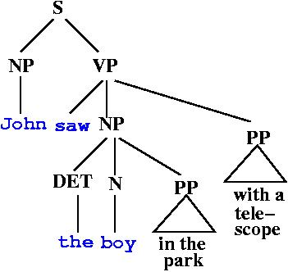
Syntax and Parsing
Given a grammar and a sentence find the structure of the sentence and discover its parse tree

Slide 78
Syntax and Parsing
Reuses the Syntax Definition Formalism (SDF)
Modular grammar definitions
Integrated lexical and context-free parsing
A complete SDF grammar can be imported and can be used for:
  Parsing source code (parse functions)
  Matching concrete code patterns
  Synthesizing source code

Slide 79
Importing an SDF module
module M
import Various;
import languages::syntax::Java;
Various.rsc
Java.sdf
In M we can now use:
Quoted Java fragments : [| ... |]
Unquoted Java fragments
(when unambiguous)
Parse functions for all start symbols

Slide 80
Result of importing an SDF module
A typed parse function becomes available for all start symbols in the grammar, e.g.
  CompilationUnit parseCompilationUnit(str file)
module Count
import languages::syntax::Java;
public int countMethods(str file){
int n = 0;
for(MethodDeclaration md <- parseCompilationUnit(file))
n += 1;
return n;
}

Slide 81
Finding date-related variables
Import the COBOL grammar
module DateVars
import Cobol;
set[Var] getDateVars(CobolProgram P){
return {V | Var V <- P,
/^.*(date|dt|year|yr).*$/i := toString(V)
};
}
Traverse P and
return all occurrences
of variables
Put variables that
match in result
Variable name
matches a date-related
heuristic

Slide 82
Concrete syntax example
Class generate(Id name, map[Id,Type] fields) {
Decl* decls = [| |];
for (id <- domain(fields)) {
type = fields[id]; <get, set> = getSetIds(id);
decls = [| <decls>
private <id> <type>;
public <type> <get>() { return <id>;}
public void <set>(<type> x) {
this.<id> = x;
} |];
}
return public class <name> { <decls> };
}
Syntactic type
Quoted concrete
syntax expression
Variable
interpolation
Unquoted concrete
syntax expression

Slide 83
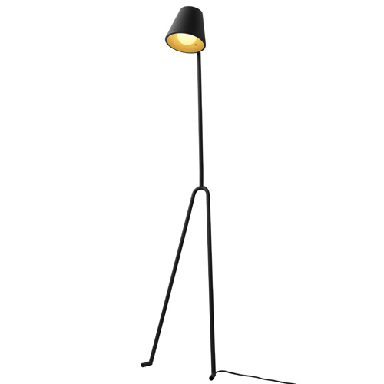
Is there a Rascal Design Methodology?

Slide 84
Rascal Workflow
Extraction?
No
Define Extraction
Analysis?
No
Define Analysis
Synthesis?
Define Synthesis

Slide 85
Requirements Analysis
Determine Synthesis Requirements
Determine Analysis Requirements
Determine Extraction Requirements

Slide 86
Validation
Solve (sub)problem
Validate results
Improve
Acceptable?
No

Slide 87
Extraction
Workflow
Determine needed facts
Facts available?
Yes
Obtain sources of SUI
Improve
Extraction tools available?
Yes
No
Syntax Analysis needed?
Obtain grammars for
source languages of SUI
Improve
Lexical Analysis needed?
No
Write regular expressions
Improve

Slide 88
Analysis Workflow
Determine needed results
Write queries
Improve

Slide 89
Synthesis
Workflow
Determine needed synthesis results
No
Generate source code?
Obtain grammar for
Target source language
Improve
Other output?
No
Write data declarations
Improve
Write functions and
rewrite rules
to produce results
Improve

Slide 90
Analyzing the call structure of an application
a
f
b
c
d
e
g
rel[str, str] calls = {<"a", "b">, <"b", "c">, <"b", "d">, <"d", "c">,
<"d","e">, <"f", "e">, <"f", "g">, <"g", "e">};

Slide 91
Some questions
a
f
b
c
d
e
g
How many calls are there?
  int ncalls = size(calls);
  8
How many procedures are there?
  int nprocs = size(carrier(calls));
  7

Slide 92
Some questions
a
f
b
c
d
e
g
What are the entry points?
  set[str] entryPoints = top(calls)
  {“a”, “f”}
What are the leaves?
  set[str] bottomCalls = bottom(calls)
  {“c”, “e”}

Slide 93
Intermezzo: Top
The roots of a relation viewed as a graph
top({<1,2>,<1,3>,<2,4>,<3,4>}) yields {1}
Consists of all elements that occur on the lhs but not on the rhs of a tuple
set[&T] top(rel[&T, &T] R) = domain(R) - range(R)

Slide 94
Intermezzo: Bottom
The leaves of a relation viewed as a graph
bottom({<1,2>,<1,3>,<2,4>,<3,4>}) yields {4}
Consists of all elements that occur on the rhs but not on the lhs of a tuple
set[&T] bottom(rel[&T, &T] R) = range(R) - domain(R)

Slide 95
Some questions
a
f
b
c
d
e
g
What are the indirect calls between procedures?
  rel[str,str] closureCalls = calls+
  {<"a", "b">, <"b", "c">, <"b", "d">, <"d", "c">, <"d","e">, <"f", "e">, <"f", "g">, <"g", "e">, <"a", "c">, <"a", "d">, <"b", "e">, <"a", "e">}
What are the calls from entry point a?
  set[str] calledFromA = closureCalls["a"]
  {"b", "c", "d", "e"}

Slide 96
Some questions
a
f
b
c
d
e
g
What are the calls from entry point f?
  set[str] calledFromF = closureCalls["f"];
  {"e", "g"}
What are the common procedures?
  set[str] commonProcs = calledFromA & calledFromF
  {"e"}

Slide 97
Component Structure of Application
Suppose, we know:
  the call relation between procedures (Calls)
  the component of each procedure (PartOf)
Question:
  Can we lift the relation between procedures to a relation between components (ComponentCalls)?
This is usefull for checking that real code conforms to architectural constraints

Slide 98
Calls
main
a
b
c
d
alias proc = str;
alias comp = str;
rel[proc,proc] Calls = {<"main", "a">, <"main", "b">, <"a", "b">,
<"a", "c">, <"a", "d">, <"b", "d">};

Slide 99
PartOf
main
main
DB
Appl
a
b
a
b
c
d
c
Lib
d
set[comp] Components = {"Appl", "DB", "Lib"};
rel[proc, comp] PartOf =
{<"main", "Appl">, <"a", "Appl">, <"b", "DB">,
<"c", "Lib">, <"d", "Lib">};

Slide 100
lift
main
main
DB
Appl
Appl
DB
a
b
a
b
c
d
c
Lib
d
Lib
rel[comp,comp] lift(rel[proc,proc] aCalls, rel[proc,comp] aPartOf) =
{ <C1, C2> | <proc P1, proc P2> <- aCalls,
<comp C1, comp C2> <- aPartOf[P1] x aPartOf[P2] };
rel[comp,comp] ComponentCalls = lift(Calls2, PartOf)
Result: {<"DB", "Lib">, <"Appl", "Lib">, <"Appl", "DB">, <"Appl", "Appl">}

Slide 101
Pico Abstract Syntax (1)
module demo::PicoAbstract::PicoAbstractSyntax
public data TYPE =
natural | string;
public alias PicoId = str;
public data EXP =
id(PicoId name)
| natCon(int iVal)
| strCon(str sVal)
| add(EXP left, EXP right)
| sub(EXP left, EXP right)
| conc(EXP left, EXP right)
;

Slide 102
Pico Abstract Syntax (2)
public data STATEMENT =
asgStat(PicoId name, EXP exp)
| ifStat(EXP exp, list[STATEMENT] thenpart, list[STATEMENT] elsepart)
| whileStat(EXP exp, list[STATEMENT] body)
;
public data DECL =
decl(PicoId name, TYPE tp);
public data PROGRAM =
program(list[DECL] decls, list[STATEMENT] stats);
module demo::PicoAbstract::PicoAbstractSyntax
public data TYPE =
natural | string;
public alias PicoId = str;
public data EXP =
id(PicoId name)
| natCon(int iVal)
| strCon(str sVal)
| add(EXP left, EXP right)
| sub(EXP left, EXP right)
| conc(EXP left, EXP right)
;

Slide 103
Assembly
module demo::PicoAbstract::Assembly
import demo::PicoAbstract::PicoAbstractSyntax;
import Integer;
public data Instr =
dclNat(PicoId Id) | dclStr(PicoId Id)
| pushNat(int intCon)| pushStr(str strCon)
| rvalue(PicoId Id) | lvalue(PicoId Id)
| pop | copy | assign | add | sub | mul | label(str label)
| go(str label) | gotrue(str label) | gofalse(str label);

Slide 104
Compile Expressions
private list[Instr] compileExp(EXP exp) {
switch (exp) {
case natCon(int N): return [pushNat(N)];
case strCon(str S): return [pushStr(S)];
case id(PicoId Id): return [rvalue(Id)];
case add(EXP E1, EXP E2):
return [compileExp(E1), compileExp(E2), add];
case sub(EXP E1, EXP E2): ...
case conc(EXP E1, EXP E2): ...
}
}

Slide 105
Label Generation
private int nLabel = 0;
private str nextLabel(){
nLabel += 1;
return "L" + toString(nLabel);
}
private list[Instr] compileExp(EXP exp) {
switch (exp) {
case natCon(int N): return [pushNat(N)];
case strCon(str S): return [pushStr(S)];
case id(PicoId Id): return [rvalue(Id)];
case add(EXP E1, EXP E2):
return [compileExp(E1), compileExp(E2), add];
case sub(EXP E1, EXP E2): ...
case conc(EXP E1, EXP E2): ...
}
}

Slide 106
Compile Statements (1)
private list[Instr] compileStatement(STATEMENT Stat){
switch (Stat) {
case asgStat(PicoId Id, EXP Exp):
return [lvalue(Id), compileExp(Exp), assign];
… (on next slides)
}
}
private int nLabel = 0;
private str nextLabel(){
nLabel += 1;
return "L" + toString(nLabel);
}

Slide 107
Compile Statement (2)
private list[Instr] compileStatement(STATEMENT Stat){
switch (Stat) {
… (on previous slide)
case ifStat(EXP Exp, list[STATEMENT] Stats1,
list[STATEMENT] Stats2):{
nextLab = nextLabel(); falseLab = nextLabel();
return [compileExp(Exp),
gofalse(falseLab),
compileStatements(Stats1),
go(nextLab),
label(falseLab), compileStatements(Stats2),
label(nextLab)];
}
… (on next slide)

Slide 108
Compile Statement (3)
private list[Instr] compileStatement(STATEMENT Stat){
switch (Stat) {
… (on previous slide)
case whileStat(EXP Exp, list[STATEMENT] Stats1): {
entryLab = nextLabel();
nextLab = nextLabel();
return [label(entryLab), compileExp(Exp),
gofalse(nextLab),
compileStatements(Stats1),
go(entryLab),
label(nextLab)];
}
}
}
private list[Instr] compileStatement(STATEMENT Stat){
switch (Stat) {
… (on previous slide)
case ifStat(EXP Exp, list[STATEMENT] Stats1,
list[STATEMENT] Stats2):{
nextLab = nextLabel(); falseLab = nextLabel();
return [compileExp(Exp),
gofalse(falseLab),
compileStatements(Stats1),
go(nextLab),
label(falseLab), compileStatements(Stats2),
label(nextLab)];
}
… (on next slide)

Slide 109
Compile Statements
private list[Instr] compileStatements(list[STATEMENT] Stats){
return [ compileStatement(S) | S <- Stats ];
}
private list[Instr] compileStatement(STATEMENT Stat){
switch (Stat) {
… (on previous slide)
case whileStat(EXP Exp, list[STATEMENT] Stats1): {
entryLab = nextLabel();
nextLab = nextLabel();
return [label(entryLab), compileExp(Exp),
gofalse(nextLab),
compileStatements(Stats1),
go(entryLab),
label(nextLab)];
}
}
}

Slide 110
Compile Declarations
private list[Instr] compileDecls(list[DECL] Decls){
return [ (type == natural) ? dclNat(Id) : dclStr(Id) |
decl(PicoId Id, TYPE type) <- Decls];
}
private list[Instr] compileStatements(list[STATEMENT] Stats){
return [ compileStatement(S) | S <- Stats ];
}

Slide 111
Compile Pico Program
public list[Instr] compileProgram(PROGRAM P){
nLabel = 0;
if(program(list[DECL] Decls, list[STATEMENT] Series) := P){
return [compileDecls(Decls), compileStatements(Series)];
} else
throw Exception("Cannot happen");
}
private list[Instr] compileDecls(list[DECL] Decls){
return [ (type == natural) ? dclNat(Id) : dclStr(Id) |
decl(PicoId Id, TYPE type) <- Decls];
}

Slide 112
Example of Compilation
P = program([decl("x", natural)],
[ifStat(natCon(5), [asgStat("x", natCon(3))],
[asgStat("x", natCon(4))])]);
compileProgram(P) =>
[dclNat("x"),
pushNat(5), gofalse("L4"),
lvalue("x"),
pushNat(3),
assign(),
go("L3"),
label("L4"),
lvalue("x"),
pushNat(4),
assign(),
label("L3")];
private list[Instr] compileStatements(list[STATEMENT] Stats){
return [ compileStatement(S) | S <- Stats ];
}

Slide 113
The Rascal Standard Library
Benchmark
Boolean
Exception
Graph
Integer
IO
JDT (Eclipse only)
Labelled Graph
List
Location
Map
Node
Real
Relation
RSF
Resource (Eclipse only)
Set
String
Tuple
ValueIO
View (Eclipse only)

Slide 114
Rascal Status
An interpreter for the core language is well underway.
All the above examples (and many more!) run.
Standalone version and Eclipse version
Eclipse version: debugger and JDT integration
Launch: at GTTSE summerschool in Braga Portugal

Slide 115
Rascal Implementation
Rascal Grammar
(SDF)
Fixed (generated)
Java classes
for Rascal ASTs
Parser
generator
Rascal
Program
Rascal parser
Rascal
interpreter
Results
IMP
Eclipse

Slide 116
Implementation SDF modules
Imported
Syntax Module L
(SDF)
Fixed
Rascal Grammar
(SDF)
L-Parser
Parser
generator
ADT
Rascal
Module
L+Rascal
parser
Disambiguate
Rascal
interpreter

Slide 117
About disambiguation
We use a number of fixed heuristics
In the future we will also use type information from the Rascal programitself

Slide 118
Rascal Implementation
(some metrics)
PDB (23 Kloc)
Rascal (92 KLoc)
  incl 7 Kloc tests (2200 tests)
  incl. 18 Kloc generated ASTs
Rascal-eclipse (32 KLoc)
  incl. Debugger
Total, circa 147 KLoc

Slide 119

Rascal library that uses JDT from Eclipse and enables Java analysis and transformation
Parsing library
De Facto: extraction by grammar annotation
Various graph algorithms
Bisimulation algorithms
Concept analysis
Automata extraction/generation

Slide 120
Long-term Perspective
The proposed language enables the creation and execution of fact analysis and transformation tools
Enables mass transformations
Provides meta-programming for the software composition domain
This is relevant for industrial applications
Eclipse integration ensures a large user base

Slide 121

Information
General information:
http://www.meta-environment.org
Latest version of Rascal
documentation:
http://www.meta-environment.org/doc/books/analysis/rascal-manual/rascal-manual.[html|pdf]
Download Rascal implementation:
http://www.meta-environment.org/Meta-Environment/Rascal

Slide 122

Questions

Slide 123
Computing Dominators
A node M dominates other nodes S in the flow graph iff all path from the root to a node in S contain M
public rel[&T, set[&T]] dominators(
rel[&T,&T] PRED, // control flow graph
&T ROOT // entry point)
{
set[&T] VERTICES = carrier(PRED);
return { <V, (VERTICES - {V, ROOT})
- reachX({ROOT}, {V}, PRED)> | &T V : VERTICES};
}

