Slide 1



Introduction to ASF+SDF
Mark van den Brand
Paul Klint
Jurgen Vinju

Slide 2
ASF+SDF
Goal: defining languages & manipulating programs
SDF: Syntax definition Formalism
  lexical & context-free syntax
ASF: Algebraic Specification Formalism
  static & dynamic semantics; fact extraction
ASF+SDF Meta-Environment: IDE for ASF+SDF
Manuals/documentation: www.meta-environment.org

Slide 3
What is a Program Generator?
Definition of
problem P
Declarative program
Generator
Generated program that solves P
Operational program

Slide 4
Programming Environment Generator
Formal definition
of language L
Generator
Dedicated environment
for editing, manipulating and executing
L programs

Slide 5
Programming Environment Generator = collection of program generators
Definition of
L syntax
Definition of
L static semantics
Definition of
L dynamic semantics
Parser
Generator
Typechecker
Generator
Evaluator
Generator
L-parser
L-typechecker
L-evaluator
Integrated L-programming environment

Slide 6
ASF+SDF Meta-Environment
ASF+SDF Meta-Environment
Interactive
Development
Environment
for Language
definitions
Formal definition of language L
(written in ASF+SDF)
Generator
Stand-alone,
generated,
environment
Generated L
programming environment

Slide 7
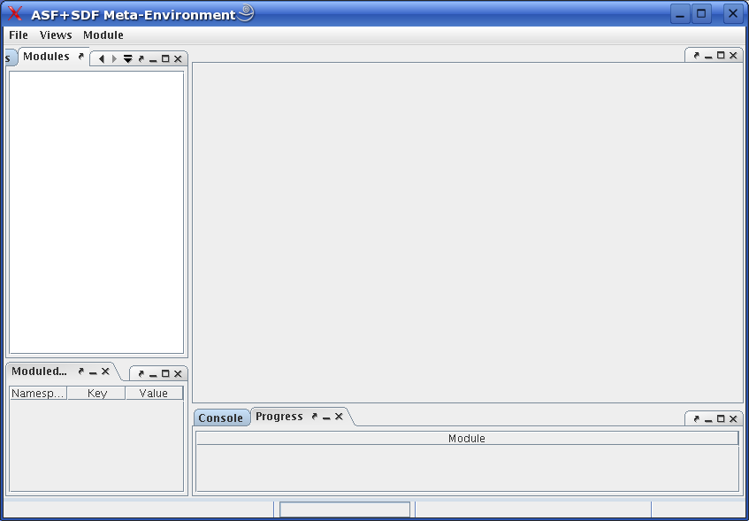
Typing asfsdf-meta ...

Slide 8
Anatomy of an ASF+SDF Specification
module A
...
imports B C
...
module C
...
module B
...
imports D
...
module D
...

Slide 9
Anatomy of an ASF+SDF Module
module ModuleName
ImportSection*
ExportOrHiddenSection*
equations
ConditionalEquation*

Slide 10
Plan
Booleans
Steps towards a Pico environment
  Step 1: define syntax
  Step 2: define a typechecker
  Step 3: define an evaluator
  Step 4: define a compiler
Traversal functions
  Step5: define a fact extractor

Slide 11
BoolCon: Boolean Constants
module basic/BoolCon
exports
sorts BoolCon
context-free syntax
"true" -> BoolCon
"false" -> BoolCon

Slide 12
Booleans (1)
module basic/Booleans
imports basic/BoolCon
exports
sorts Boolean
context-free syntax
BoolCon -> Boolean

Slide 13
Booleans (2)
Boolean "|" Boolean -> Boolean {left}
Boolean "&" Boolean -> Boolean {left}
“not” (Boolean) -> Boolean
"(" Boolean ")" -> Boolean {bracket}
context-free priorities
Boolean "&" Boolean -> Boolean >
Boolean "|" Boolean -> Boolean

Slide 14
Booleans (3)
context-free syntax
“not” (Boolean) -> Boolean
"(" Boolean ")" -> Boolean {bracket}
context-free priorities
Boolean "&" Boolean -> Boolean {left} >
Boolean "|" Boolean -> Boolean {left}

Slide 15
Booleans (4)
hiddens
context-free start-symbols
Boolean
imports
basic/Comments
variables
"Bool"[0-9\']* -> Boolean

Slide 16
Booleans (5)
equations
[B1] true | Bool = true
[B2] false | Bool = Bool
[B3] true & Bool = Bool
[B4] false & Bool = false
[B5] not ( false ) = true
[B6] not ( true ) = false

Slide 17
Fixed versus user-defined syntax
true | Bool true
false | Bool Bool
true & Bool Bool
false & Bool false
not ( false ) true
not ( true ) false
equations
[B1] =
[B2] =
[B3] =
[B4] =
[B5] =
[B6] =

Slide 18
Booleans (6)
The term
not(true & not(false | true))
Rewrites to
true

Slide 19
Booleans (7)
not(true & not(false | true))
[B2] false | Bool = Bool
not(true & not( true ))
[B6] not ( true ) = false
not(true & false )
[B3] true & Bool = Bool
not( false )
[B5] not( false ) = true
true

Slide 20
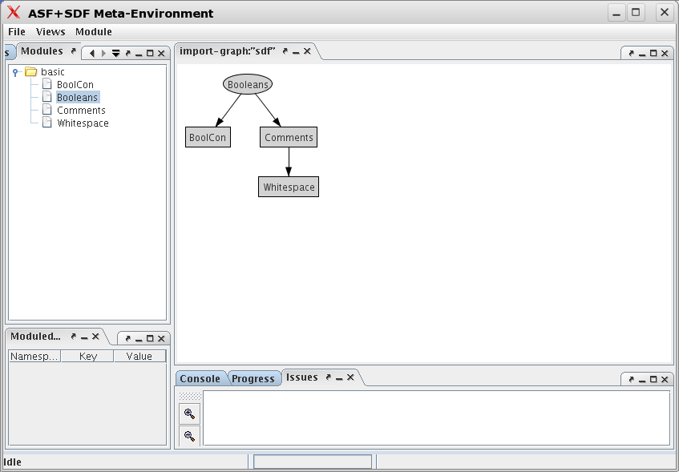
Opening Booleans

Slide 21
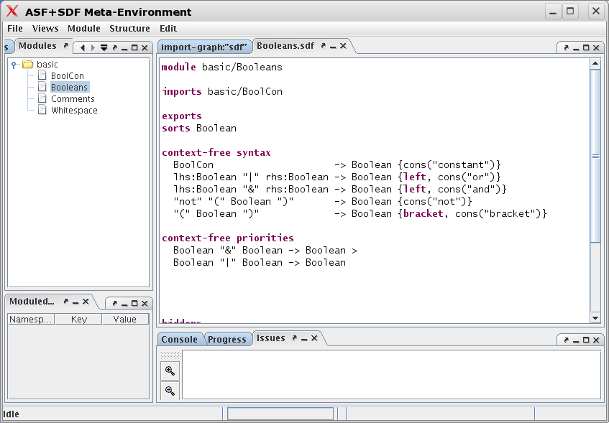
Editing Booleans.sdf

Slide 22
Booleans: summary
Each module defines a language; in this case the language of Booleans (synonym: datatype)
We can use this language definition to
  Create a syntax-directed editor for the Boolean language and create Boolean terms
  Apply the equations to this term and reduce it to normal form
  Import it in another module; this makes the Boolean language available for the importing module

Slide 23
Plan
Booleans
Steps towards a Pico environment
  Step 1: define syntax
  Step 2: define a typechecker
  Step 3: define an evaluator
  Step 4: define a compiler
Traversal functions
  Step5: define a fact extractor

Slide 24
The Toy Language Pico
Pico has two types: natural number and string
Variables have to be declared
Statements: assign, if-then-else, while-do
Expressions: natural, string, +, - and ||
+ and - have natural operands; the result is natural
|| has string operands and the result is string
Tests (if, while) should be of type natural

Slide 25
A Pico Program
begin declare input : natural,
output : natural,
repnr: natural,
rep: natural;
input := 14;
output := 1;
while input - 1 do
rep := output;
repnr := input;
while repnr - 1 do
output := output + rep;
repnr := repnr - 1
od;
input := input - 1
od
end
14! = 14 * 13 * ... * 1
(a) Pico has no input/output
statements
(b) Pico has no multiplication
operator

Slide 26
Plan
Booleans
Steps towards a Pico environment
  Step 1: define syntax
  Step 2: define a typechecker
  Step 3: define an evaluator
  Step 4: define a compiler
Traversal functions
  Step5: define a fact extractor

Slide 27
Step 1: Define syntax for Pico
basic/NatCon
basic/StrCon
languages/pico/syntax/Types
languages/pico/syntax/Pico
basic/Whitespace
languages/pico/syntax/Identifiers

Slide 28
Pico-syntax, 1
module languages/pico/syntax/Pico
imports
languages/pico/syntax/Identifiers
languages/pico/syntax/Types
basic/NatCon
basic/StrCon
exports
sorts
PROGRAM DECLS ID-TYPE STATEMENT EXP
context-free start-symbols
PROGRAM
context-free syntax
"begin" DECLS {STATEMENT ";"}* "end" -> PROGRAM
"declare" {ID-TYPE ","}* ";" -> DECLS
                PICO-ID ":" TYPE -> ID-TYPE

Slide 29
Pico-syntax, 2
                PICO-ID ":=" EXP -> STATEMENT
                "if" EXP "then" {STATEMENT ";"}*
                "else" {STATEMENT ";"}* "fi" -> STATEMENT
                "while" EXP "do" {STATEMENT ";"}* "od" -> STATEMENT

Slide 30
Pico-syntax, 3
                PICO-ID -> EXP
                NatCon -> EXP
                StrCon -> EXP
                EXP "+" EXP -> EXP {left}
                EXP "-" EXP -> EXP {left}
                EXP "||" EXP -> EXP {left}
                "(" EXP ")" -> EXP {bracket}
context-free priorities
EXP "||" EXP -> EXP >
EXP "-" EXP -> EXP >
EXP "+" EXP -> EXP

Slide 31
Identifiers
module languages/pico/syntax/Identifiers exports
sorts PICO-ID
lexical syntax
[a-z] [a-z0-9]* -> PICO-ID
lexical restrictions
PICO-ID -/- [a-z0-9]

Slide 32
Pico-Types
module languages/pico/syntax/Types
exports
sorts TYPE
context-free syntax
"natural" -> TYPE
"string" -> TYPE
"nil-type" -> TYPE

Slide 33
Pico: factorial program
begin declare input : natural,
output : natural,
repnr: natural,
rep: natural;
input := 14;
output := 1;
while input - 1 do
rep := output;
repnr := input;
while repnr - 1 do
output := output + rep;
repnr := repnr - 1
od;
input := input - 1
od
end

Slide 34
Syntax for Pico: summary
The modules languages/pico/syntax/Pico defines (together with the imported modules) the syntax for the Pico language
This syntax can be used to
  Generate a parser that can parse Pico programs
  Generate a syntax-directed editor for Pico programs
  Generate a parser that can parse equations containing fragments of Pico programs

Slide 35
Intermezzo: Symbols (1)
An elementary symbol is:
  Literal: “abc”
  Sort (non-terminal) names: INT
  Character classes: [a-z]: one of a, b, ..., z
    ~: complement of character class.
    /: difference of two character classes.
    /\: intersection of two character classes.
    \/: union of two character classes.

Slide 36
Intermezzo: Symbols (2)
A complex symbol is:
  Repetition:
    S* zero or more times S; S+ one or more times S
    {S1 S2}* zero or more times S1 separated by S2
    {S1 S2}+ one or more times S1 separated by S2
  Optional: S? zero or one occurrences of S
  Alternative: S | T an S or a T
  Tuple: <S,T> shorthand for “<” S “,” T “>”
  Parameterized sorts: S[[ P1, P2 ]]

Slide 37
Intermezzo: productions (functions)
General form of a production (function):
  S1 S2 ... Sn -> S0 Attributes
Lexical syntax and context-free syntax are similar, but
  Between the symbols in a production optional layout symbols may occur in the input text.
  A context-free production is equivalent with:
    S1 LAYOUT? S2 LAYOUT? ... LAYOUT? Sn -> S0

Slide 38
Example: floating point numbers
sorts UnsignedInt SignedInt UnsignedReal Number
lexical syntax
[0] | ([1-9][0-9]*) -> UnsignedInt
[\+\-]? UnsignedInt -> SignedInt
UnsignedInt "." [0-9]+ ([eE] SignedInt)? -> UnsignedReal
UnsignedInt [eE] SignedInt -> UnsignedReal
UnsignedInt | UnsignedReal -> Number
0 1 14 0.1 3e4 3.014e-7
00 01 04.1 3e04 3.14e-07

Slide 39
Intermezzo: lists, lists, lists, ...
Assume: “a” -> A
A+
{A “;”}+
(A “;”)+
(A “;”?)+
a a a a
a
a ; a
a ; a; a
a ; a; a;
a ;
a ; a;
a ; a; a;
a ; a; a
a
a a
a ; a
a ; a;

Slide 40
Plan
Booleans
Steps towards a Pico environment
  Step 1: define syntax
  Step 2: define a typechecker
  Step 3: define an evaluator
  Step 4: define a compiler
Traversal functions
  Step5: define a fact extractor

Slide 41
Step 2: Define typechecker for PICO
The types are natural and string
All variables should be declared before use
Lhs and Rhs of assignment should have equal type
The test in while and if-then should be natural
Operands of + and – should be natural; result is natural
Operands of || should be string; result string

Slide 42
Pico typechecker: modules
basic/Booleans
languages/pico/syntax/Pico
basic/Errors
utilities/PosInfo
languages/pico/check/Pico
languages/pico/check/Type-environments
languages/pico/syntax/Identifiers
containers/Table
languages/pico/syntax/Types

Slide 43
Type-environments
module Type-environments
imports
languages/pico/syntax/Identifiers
languages/pico/syntax/Types
containers/Table[PICO-ID TYPE]
exports
sorts TENV
aliases
Table[[PICO-ID,TYPE]] -> TENV

Slide 44
Table[Key Value]
module containers/Table[Key Value]
imports basic/Booleans
imports containers/List[Key]
imports containers/List[Value]
imports containers/List[<Key, Value>]

Slide 45
Table[Key Value]
exports
context-free syntax
List[[<Key, Value>]] -> Table[[Key,Value]]
"not-in-table" -> Value {constructor}
"new-table" -> Table[[Key,Value]]
lookup(Table[[Key,Value]],Key) -> Value
store(Table[[Key,Value]],Key,Value) -> Table[[Key,Value]]
delete(Table[[Key,Value]],Key) -> Table[[Key,Value]]
element(Table[[Key,Value]],Key) -> Boolean
keys(Table[[Key,Value]]) -> List[[Key]]
values(Table[[Key,Value]]) -> List[[Value]]

Slide 46
Pico-typechecking (1)
module languages/pico/check/Pico
imports basic/Booleans
basic/Errors
languages/pico/syntax/Pico
languages/pico/check/Type-environments
utilities/PosInfo[EXP]
utilities/PosInfo[PICO-ID]
utilities/PosInfo[PROGRAM]
exports
context-free syntax
tcp(PROGRAM) -> {Error “,”}*

Slide 47
Pico-typechecking (2)
hiddens
context-free syntax
tcd(DECLS) -> TENV
tcits({ID-TYPE ","}*, TENV) -> TENV
tcit(ID-TYPE, TENV) -> TENV
tcs({STATEMENT ";"}*, TENV) -> {Error “,”}*
tcst(STATEMENT, TENV) -> {Error “,”}*
tce(EXP, TYPE, TENV) -> {Error “,”}*

Slide 48
Pico-typechecking (3)
hiddens
variables
“Message”[0-9\']* -> StrCon
“Error*” [0-9\']* -> {Error “,”}*
"Decls"[0-9\']* -> DECLS
"Exp"[0-9\']* -> EXP
"Id"[0-9\']* -> PICO-ID
"Id-type*"[0-9\']* -> { ID-TYPE ","}*
"Nat-con"[0-9\']* -> NatCon
"Series"[0-9\']* -> {STATEMENT ";"}+
"Stat"[0-9\']* -> STATEMENT
"Stat*"[0-9\']* -> {STATEMENT ";"}*
"Str-con"[0-9\']* -> StrCon
"Tenv"[0-9\']* -> TENV
"Type"[0-9\']* -> TYPE
“Program” [0-9\']* -> PROGRAM

Slide 49
Pico-typechecking (4)
equations
[Tc1] tcp(begin Decls Series end) = tcs(Series, tcd(Decls))
[Tc2] tcd(declare Id-type*;) = tcits(Id-type*,new-table)
[Tc3a] tcits(Id:Type, Id-type*, Tenv) = tcits(Id-type*, tcit(Id:Type, Tenv))
[Tc3b] tcits(,Tenv) = Tenv

Slide 50
Pico-typechecking (5)
[Tc3a] tcits(Id:Type, Id-type*, Tenv) = tcits(Id-type*, tcit(Id:Type, Tenv))
[Tc3b] tcits(,Tenv) = Tenv

Slide 51
Pico-typechecking (6)
[Tc4a] lookup(Tenv, Id) == not-in-table
=======================================
tcit(Id:Type, Tenv) = store(Tenv, Id, Type)
[default]
tcit(Id:Type, Tenv) = Tenv
[Tc5a] tcs(Stat ; Stat*, Tenv) =
tcst(Stat,Tenv), tcs(Stat*,Tenv)
[Tc5b] tcs( ,Tenv) =

Slide 52
Pico-typechecking (7)
[Tc6a] lookup(Tenv, Id) == not-in-table
==========================================================
tcst(Id := Exp, Tenv) = error(“Variable not declared”,
[localized(“Id”, get-location(Id))])
[default] tcst(Id := Exp, Tenv) = tce(Exp, lookup(Tenv, Id), Tenv)

Slide 53
Pico-typechecking (8)
[Tc6b] tcst(if Exp then Series1 else Series2 fi, Tenv) =
tce(Exp,natural,Tenv) , tcs(Series1, Tenv), tcs(Series2, Tenv)

Slide 54
Pico-typechecking (9)
[Tc6c] tcst(while Exp do Series od, Tenv) =
tce(Exp, natural, Tenv), tcs(Series, Tenv)

Slide 55
Pico-typechecking (10)
[Tc7a] Type == lookup(Tenv, Id)
======================
tce(Id, Type, Tenv) =
[Tc7b] tce(Nat-con, natural, Tenv) =
[Tc7c] tce(Str-con, string, Tenv) =

Slide 56
Pico-typechecking (11)
[Tc7d] tce(Exp1 + Exp2, natural, Tenv) =
tce(Exp1, natural, Tenv), tce(Exp2, natural, Tenv)

Slide 57
Pico-typechecking (12)
[Tc7e] tce(Exp1 - Exp2, natural,Tenv) =
tce(Exp1, natural, Tenv), tce(Exp2, natural, Tenv)
[Tc7f] tce(Exp1 || Exp2, string, Tenv) =
tce(Exp1, string, Tenv), tce(Exp2, string, Tenv)
[default]
tce(Exp,natural, Tenv) =error(“Expression should be of type natural”,
[localized{“Expression”, get-location(Exp))])
[default]
tce(Exp,string, Tenv) =error(“Expression should be of type string”,
[localized{“Expression”, get-location(Exp))])

Slide 58
Pico-typechecking (13)
[Main] start(PROGRAM, Program) =
start(Summary, summary(“pico-check”,
get-file-name(get-location(Program)),
[tcp(Program)]))

Slide 59
Typechecking an erroneous program
tcp(
)
begin
declare
x : natural;
x := "abc"
end
The term
reduces to
summary("pico-check",
"/home/paulk/pico.trm",
[error("Expression should be of type natural",
[localized("Expression",
area-in-file("/home/paulk/pico.trm",
area(4, 4, 12, 38, 5)))])])

Slide 60
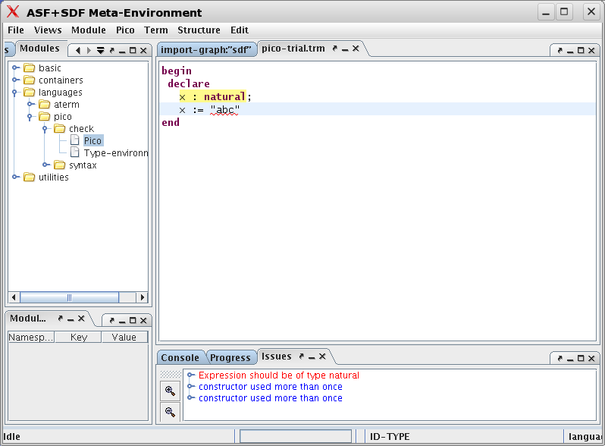
In the Meta-Environment

Slide 61
Intermezzo: equations (1)
Left-hand side may never consist of a single variable:
[B1] Bool = true & Bool
Right-hand side may not contain uninstantiated variables:
[B1] true & Bool1 = Bool2

Slide 62
Intermezzo: equations (2)
Rules are not ordered, so this program either
executes B1, or B2, but you don't know which!
[B1] true & Bool = Bool
[B2] true & false = false
Solution: default rule is tried when all other rules fail:
[B1] true & Bool = Bool
[default-B1]
Bool1 & Bool2 = Bool1
Or.. add conditions to make them mutually exclusive

Slide 63
Intermezzo: equations (3)
A conditional equation succeeds when left-hand side matches and all conditions are successfully evaluated
An equation may have zero or more conditions:
  equality: “==”; no uninstantiated variables may be used on either side
  inequality: “!=”; no uninstantiated variables
  match: “:=”; rhs may not contain uninstantiated variables, lhs may contain new variables,
  and not-match: “!:=”; guess what it does...

Slide 64
Intermezzo: equations (4)
List matching:
  set equation, removing double elements from a set in one equation
  for more operations on Sets see containers/Set[X]
module Sets
exports
imports basic/Whitespace
context-free start-symbols Set
sorts Elem Set
lexical syntax
[a-z]+ -> Elem
context-free syntax
“{“ {Elem “,”}* “}” -> Set
hiddens
variables
“Elem”[0-9]* -> Elem
“Elem*”[0-9]* -> {Elem “,”}*

Slide 65
Intermezzo: equations (5)
equations
[set] {Elem*1, Elem, Elem*2, Elem, Elem*3} =
{Elem*1, Elem, Elem*2, Elem*3}

Slide 66
Typechecking Pico: summary (1)
The module languages/pico/check/Pico defines (together with the imported modules) the typechecking rules for the Pico language
They can be used to
  Generate a stand-alone Pico typechecker
  Add a typecheck button to a syntax-directed editor for Pico programs

Slide 67
Typechecking Pico: summary (2)
ASF+SDF: provides syntax and data-structures for analyzing and manipulating programs
Does not assume anything about the language you manipulate (no heuristics)
You can, and have to, “define” the static semantics of Pico
An implementation is generated from the definition

Slide 68
Plan
Booleans
Steps towards a Pico environment
  Step 1: define syntax
  Step 2: define a typechecker
  Step 3: define an evaluator
  Step 4: define a compiler
Traversal functions
  Step5: define a fact extractor

Slide 69
Step 3: Define evaluator for PICO
Natural variables are initialized to 0
String variables are initialized to “”
Variable on lhs of assignment gets value of lhs
Variable evaluates to its current value
Test in while and if-then equal to 0 => false
Test in while and if-then not equal to 0 => true

Slide 70
Pico evaluator
The Pico evaluator/runner/interpreter simply “transforms” a Pico program to the output it generates, by stepwise reduction. This is called an “operational” semantics.
A transformation like this is similar to any other transformation, like for example a transformation from a Java class to a report of identified “code smells”.

Slide 71
Pico evaluator
languages/pico/syntax/Pico
languages/pico/run/Pico
languages/pico/run/Value-environments
languages/pico/syntax/Identifiers
Containers/Table
languages/pico/run/Values
basic/StrCon
basic/Integers

Slide 72
Pico-Values
module languages/pico/run/Values
imports basic/Integers
basic/StrCon
exports
sorts VALUE
context-free syntax
Integer -> VALUE
StrCon -> VALUE
"nil-value" -> VALUE

Slide 73
Value-environments (1)
module languages/pico/run/Value-environments
imports languages/pico/syntax/Identifiers
languages/pico/run/Values
containers/Table[PICO-ID VALUE]
exports
sorts VENV
aliases
Table[[PICO-ID, VALUE]] -> VENV

Slide 74
Pico-evaluator (1)
module languages/pico/run/Pico
imports languages/pico/syntax/Pico
languages/pico/run/Value-environments
basic/Strings
exports
context-free syntax
evp(PROGRAM) -> VENV
evd(DECLS) -> VENV
evits({ID-TYPE ","}*) -> VENV
evs({STATEMENT ";"}*, VENV) -> VENV
evst(STATEMENT, VENV) -> VENV
eve(EXP, VENV) -> VALUE

Slide 75
Pico-evaluator (2)
hiddens
imports basic/Comments
context-free start-symbols
VALUE-ENV PROGRAM

Slide 76
Pico-evaluator (3)
hiddens
variables
"Decls"[0-9\']* -> DECLS
"Exp"[0-9\']* -> EXP
"Id"[0-9]* -> PICO-ID
"Id-type*"[0-9\']* -> {ID-TYPE ","}*
"Nat"[0-9\']* -> Natural
"Nat-con"[0-9\']* -> NatCon
"Series"[0-9\']* -> {STATEMENT ";"}+
"Stat"[0-9\']* -> STATEMENT
"Stat*"[0-9\']* -> {STATEMENT ";"}*
"Str” “-con"? [0-9\']* -> StrCon
"Str"[0-9\']* -> String
"Value"[0-9\']* -> VALUE
"Venv"[0-9\']* -> VENV
“Program” [0-9\']* -> PROGRAM

Slide 77
Pico-evaluator (4)
equations
[Ev1] evp(begin Decls Series end) = evs(Series,
evd(Decls))

Slide 78
Pico-evaluator (5)
[Ev2] evd(declare Id-type*;) = evits(Id-type*)
[Ev3a] evits(Id:natural, Id-type*) = store(evits(Id-type*),Id,0)
[Ev3b] evits(Id:string, Id-type*) = store(evits(Id-type*), Id,””)
[Ev3c] evits() = new-table

Slide 79
Pico-evaluator (6)
[Ev4a] Venv' := evst(Stat, Venv),
Venv'' := evs(Stat*, Venv')
=======================
evs(Stat ; Stat*, Venv) = Venv''
[Ev4b] evs( , Venv) = Venv

Slide 80
Pico-evaluator (7)
[Ev5a] evst(Id := Exp, Venv) = store(Venv, Id, eve(Exp, Venv))

Slide 81
Pico-evaluator (8)
[Ev5b] eve(Exp, Venv) != 0
===================================
evst(if Exp then Series1 else Series2 fi, Venv) =
evs(Series1, Venv)
[Ev5c] eve(Exp, Venv) == 0
=================================
evst(if Exp then Series1 else Series2 fi, Venv) =
evs(Series2, Venv)

Slide 82
Pico-evaluator (9)
[Ev5d] eve(Exp, Venv) == 0
======================================
evst(while Exp do Series od, Venv) = Venv
[Ev5e] eve(Exp, Venv) != 0,
Venv' := evs(Series, Venv)
=================================
evst(while Exp do Series od, Venv) =
evst(while Exp do Series od, Venv')

Slide 83
Pico-evaluator (10)
[Ev6a] eve(Id, Venv) = lookup(Venv, Id)
[Ev6b] eve(Nat-con, Venv) = Nat-con
[Ev6c] eve(Str-con, Venv) = Str-con

Slide 84
Pico-evaluator (11)
[Ev6d] Nat1 := eve(Exp1, Venv),
Nat2 := eve(Exp2, Venv)
==================================
eve(Exp1 + Exp2, Venv) = Nat1 + Nat2

Slide 85
Pico-evaluator (12)
[Ev6e] Nat1 := eve(Exp1, Venv),
Nat2 := eve(Exp2, Venv)
========================
eve(Exp1 - Exp2, Venv) = Nat1 -/ Nat2
[Ev6f] Str1 := eve(Exp1, Venv),
Str2 := eve(Exp2, Venv)
=======================
eve(Exp1 || Exp2, Venv) = Str1 || Str2
[default-Ev6] eve(Exp,Venv) = nil-value

Slide 86
Evaluating the factorial program
evp(
)
begin declare input : natural,
output : natural,
repnr: natural,
rep: natural;
input := 14;
output := 1;
while input - 1 do
rep := output;
repnr := input;
while repnr - 1 do
output := output + rep;
repnr := repnr - 1
od;
input := input - 1
od
end
The term
reduces to
[<input,1>,
<repnr,1>,
<output,87178291200>,
<rep,43589145600>]

Slide 87
Evaluating Pico: summary (1)
The module languages/pico/run/Pico (together with the imported modules) define the evaluation rules for the Pico language
They can be used to
  Generate a stand-alone Pico evaluator
  Add an evaluation button to a syntax-directed editor for Pico programs

Slide 88
Evaluating Pico: summary (2)
ASF+SDF is used to define a rather complex transformation
No assumptions about the transformation, it is just a convenient language for manipulating trees
But.. there is more!

Slide 89
Plan
Booleans
Steps towards a Pico environment
  Step 1: define syntax
  Step 2: define a typechecker
  Step 3: define an evaluator
  Step 4: define a compiler
Traversal functions
  Step5: define a fact extractor

Slide 90
Pico compiler
A simple compiler:
  input a Pico program
  output: Assembly for a stack based instruction set (in the same spirit as Java bytecode)
This is a classic example of a program transformation

Slide 91
Pico compiler
languages/pico/syntax/Pico
languages/pico/compile/NextLabel
languages/pico/compile/Pico
languages/pico/compile/Assembly-language
basic/Integers
basic/Strings
languages/pico/syntax/Identifiers

Slide 92
AssemblyLanguage (1)
module languages/pico/compile/AssemblyLanguage
imports basic/Integers
basic/Strings
languages/pico/syntax/Identifiers
exports
sorts Label Instr
lexical syntax
[a-z0-9]+ -> Label
context-free syntax
"dclnat" PICO-ID -> Instr
"dclstr" PICO-ID -> Instr

Slide 93
AssemblyLanguage (2)
"push" NatCon -> Instr
"push" StrCon -> Instr
"rvalue" PICO-ID -> Instr
"lvalue" PICO-ID -> Instr
"assign" -> Instr
"add" -> Instr
"sub" -> Instr
"conc" -> Instr
"label" Label -> Instr
"goto" Label -> Instr
"gotrue" Label -> Instr
"gofalse" Label -> Instr
"noop" -> Instr
aliases
{Instr ";"}+ -> Instrs

Slide 94
NextLabel
module languages/pico/compile/NextLabel
imports AssemblyLanguage
exports
context-free syntax
"nextlabel" "(" Label ")" -> Label
hiddens
lexical variables
"Char*"[0-9]* -> [a-z0-9]+
equations
[1] nextlabel(label(Char+)) = label(Char+ x)

Slide 95
Pico-compiler (1)
module languages/pico/compile/Pico
imports languages/pico/syntax/Pico
languages/pico/compile/AssemblyLanguage
languages/pico/compile/NextLabel
exports
context-free syntax
trp( PROGRAM ) -> Instrs
hiddens
context-free syntax
trd(DECLS) -> {Instr “;”}+
trits({ID-TYPE ","}*) -> {Instr “;”}+
trs({STATEMENT ";"}*, Label) -> <{Instr “;”}+, Label>
trst(STATEMENT, Label) -> <{Instr “;”}+, Label>
tre(EXP) -> {Instr “;”}+

Slide 96
Pico-compiler (2)
hiddens
context-free start-symbols
PROGRAM Instrs

Slide 97
Pico-compiler (3)
hiddens
variables
"Decls"[0-9\']* -> DECLS
"Exp"[0-9\']* -> EXP
"Id"[0-9]* -> PICO-ID
"Id-type*"[0-9\']* -> {ID-TYPE ","}*
"Nat-con"[0-9\']* -> NatCon
"Series"[0-9\']* -> {STATEMENT ";"}+
"Stat"[0-9\']* -> STATEMENT
"Stat*"[0-9\']* -> {STATEMENT ";"}*
"Str-con"[0-9\']* -> StrCon
"Str"[0-9\']* -> String
"Instr*"[0-9\']* -> {Instr “;”}+
"Label" [0-9\']* -> Label
“Program” -> PROGRAM

Slide 98
Pico-compiler (4)
equations
[Tr1] Instr*1 := trd(Decls),
<Instr*2, Label> := trs(Series, x)
==========================================
trp(begin Decls Series end) = Instr*1; Instr*2
[Tr2] trd(declare Id-type*;) = trits(Id-type*)
[Tr3a] trits(Id:natural, Id-type*) = dclnat Id;
trits(Id-type*)
[Tr3b] trits(Id:string, Id-type*) = dclstr Id;
trits(Id-type*)
[Tr3c] trits() = noop

Slide 99
Pico-compiler (5)
[Tr4a] <Instr*1, Label'> := trst(Stat, Label),
<Instr*2, Label''> := trs(Stat*, Label')
===================================
trs(Stat ; Stat*, Label) =
< Instr*1 ; Instr*2, Label'' >
[Tr4b] trs( , Label) = <noop, Label>

Slide 100
Pico-compiler (6)
[Tr5a] Instr*:= tre(Exp)
=====================
trst(Id := Exp, Label) =
< lvalue Id;
Instr*;
assign
,
Label >

Slide 101
Pico-compiler (7)
[Tr5b] Instr*:= tre(Exp),
<Instr*1, Label'>:= trs(Series1, Label),
<Instr*2, Label''>:= trs(Series2, Label'),
Label1 := nextlabel(Label''),
Label2 := nextlabel(Label1)
============================================
trst(if Exp then Series1 else Series2 fi, Label) =
< Instr*;
gofalse Label1;
Instr*1;
goto Label2;
label Label1;
Instr*2;
label Label2
,
Label2 >

Slide 102
Pico-compiler (8)
[Tr5c] Instr*1:= tre(Exp),
<Instr*2, Label'>, := trs(Series, Label),
Label1 := nextlabel(Label'),
Label2 := nextlabel(Label1)
====================================
trst(while Exp do Series od, Label) =
< label Label1;
Instr*1;
gofalse Label2;
Instr*2;
goto Label1;
label Label2
,
Label2 >

Slide 103
Pico-compiler (9)
[Tr6a] tre(Nat-con) = push Nat-con
[Tr6b] tre(Str-con) = push Str-con
[Tr6c] tre(Id) = rvalue Id
[Trcd] Instr*1:= tre(Exp1), Instr*2:= tre(Exp2)
======================================
tre(Exp1 + Exp2) = Instr*1; Instr*2; add
[Tr6e] Instr*1:= tre(Exp1), Instr*2:= tre(Exp2)
======================================
tre(Exp1 - Exp2) = Instr*1; Instr*2; sub
[Tr6f] Instr*1:= tre(Exp1), Instr*2 := tre(Exp2)
======================================
tre(Exp1 || Exp2) = Instr*1; Instr*2; conc

Slide 104
Compiling the factorial program
The term
reduces to
dclnat input;
dclnat output;
dclnat repnr;
dclnat rep;
noop; lvalue input;
push 14;
assign ;
lvalue output;
push 1;
assign ;
label xxxx;
rvalue input; push 1; sub;
gofalse xxxxx;
lvalue rep;
rvalue output;
assign ;
lvalue repnr;
rvalue input;
assign ;
label xx;
rvalue repnr; push 1; sub;
gofalse xxx;
lvalue output;
rvalue output; rvalue rep; add;
assign ;
lvalue repnr;
rvalue repnr; push 1; sub;
assign ;
noop;
goto xx;
label xxx ;
lvalue input;
rvalue input; push 1; sub;
assign ;
noop;
goto xxxx;
label xxxxx ;
noop
trp(
)
begin declare input : natural,
output : natural,
repnr: natural,
rep: natural;
input := 14;
output := 1;
while input - 1 do
rep := output;
repnr := input;
while repnr - 1 do
output := output + rep;
repnr := repnr - 1
od;
input := input - 1
od
end

Slide 105
Intermezzo:
Lexical Constructor Functions (1)
module Nats
imports basic/Whitespace
exports
context-free start-symbols Nat-con
sorts Nat-con
lexical syntax
[0-9]+ -> Nat-con
hiddens
lexical variables
“Char+”[0-9]* -> [0-9]+

Slide 106
Intermezzo:
Lexical Constructor Functions (2)
equations
[nat] nat-con(0 Char+) = nat-con(Char+)
equations
[nat] nat-con(a Char+) = nat-con(Char+)

Slide 107
Intermezzo:
Lexical Constructor Functions (3)
module basic/IdentifierCon
exports
sorts IdCon
lexical syntax
head:[A-Za-z] tail:[A-Za-z\-0-9]* -> IdCon
lexical restrictions
IdCon -/- [A-Za-z\-0-9]
module basic/StrCon
exports
sorts StrCon StrChar
lexical syntax
"\\n" -> StrChar
"\\t" -> StrChar
"\\\"" -> StrChar
"\\\\" -> StrChar
"\\" a:[0-9]b:[0-9]c:[0-9] -> StrChar
~[\0-\31\n\t\"\\] -> StrChar
[\"] chars:StrChar* [\"] -> StrCon

Slide 108
Intermezzo:
Lexical Constructor Functions (4)
module basic/Identifiers
imports basic/IdentifierCon
imports basic/StrCon
exports
context-free syntax
idcon2strcon(IdCon) -> StrCon
strcon2idcon(StrCon) -> IdCon
hiddens
lexical variables
"head"[0-9]* -> [A-Za-z]
"middle"[0-9]* -> [A-Za-z0-9\-]
"tail"[0-9]* -> [A-Za-z0-9\-]*
"char*"[0-9]* -> StrChar*
"char+"[0-9]* -> StrChar+
"char"[0-9]* -> StrChar

Slide 109
Lexical Constructor Functions (5)
equations
[done] idcon2strcon(idcon(head)) = strcon(\" strchar(head) \")
[loop] strcon(\" char char* \") := idcon2strcon(idcon(head tail))
===>
idcon2strcon(idcon(head middle tail)) =
strcon(\" char strchar(middle) char* \")

Slide 110
Intermezzo:
Lexical Constructor Functions (6)
equations
[done] strcon2idcon(strcon(\" strchar(head) \")) = idcon(head)
[loop] idcon(head tail) := strcon2idcon(strcon(\" strchar(head) char* \"))
===>
strcon2idcon(strcon(\" strchar(head) strchar(middle) char* \")) =
idcon(head middle tail)

Slide 111
Compiling Pico: summary
The module languages/pico/compile/Pico defines (together with the imported modules) the compilation rules for the Pico language
They can be used to
  Generate a stand-alone Pico compiler
  Add an compilation button to a syntax-directed editor for Pico programs
This is just another transformation

Slide 112
Plan
Booleans
Steps towards a Pico environment
  Step 1: define syntax
  Step 2: define a typechecker
  Step 3: define an evaluator
  Step 4: define a compiler
Traversal functions
  Step5: define a fact extractor

Slide 113
Traversal Functions (1)
Many functions have the characteristic that they traverse the tree recursively and only do something interesting at a few nodes
Example: count the identifiers in a program
Using a recursive (inductive) definition:
  # of equations is equal to number of syntax rules
  think about Cobol or Java with hundreds of rules
Traversal functions automate recursion

Slide 114
Traversal Functions (2)
There are two important aspects of traversal functions:
  the kind of traversal
    accumulate a value during traversal
    transform the tree during traversal
  the order of traversal
    top-down versus bottom-up
    left-to-right versus right-to-left (we only have the first)
    break or continue after a visit

Slide 115
Top-down versus Bottom-up
Top-down
Bottom-up
1
7
2
5
3
6
3
4
6
7
1
2
5
4

Slide 116
Three kinds of traversals
Accumulator: traversal(accu)
  accumulate a value during traversal
Transformer: traversal(trafo)
  perform local transformations
Accumulating transformer: traversal(accu, trafo)
  accumulate and transform

Slide 117
Traversal Cube: visiting behaviour
Top-down
Bottom-up
Right-to-left
Left-to-right
Break
Continue

Slide 118
Simple Trees
module Tree-syntax
imports Naturals
exports
sorts TREE
context-free syntax
NAT -> TREE
f(TREE, TREE) -> TREE
g(TREE, TREE) -> TREE
h(TREE, TREE) -> TREE
variables
“N”[0-9]* -> NAT
“T”[0-9]* -> TREE

Slide 119
Count nodes (classical)
module Tree-cnt
imports Tree-syntax
exports
context-free syntax
cnt(TREE) -> NAT
equations
[1] cnt(N) = 1
[2] cnt(f(T1,T2)) = 1+cnt(T1)+cnt(T2)
[3] cnt(g(T1,T2)) = 1+cnt(T1)+cnt(T2)
[4] cnt(h(T1,T2)) = 1+cnt(T1)+cnt(T2)
cnt( f( g( f(1,2), 3 ),
g( g(4,5), 6 )),
)
11

Slide 120
Example
cnt( f( g( 7, 8), 9) )
Left-most innermost reduction:
[2] cnt(f(T1,T2)) = 1+cnt(T1)+cnt(T2)
1 + cnt(g( 7, 8)) + cnt(9)
[3] cnt(g(T1,T2)) = 1+cnt(T1)+cnt(T2)
1 + 1 +cnt(7) + cnt(8) + cnt(9)
Addition of integers
2 +cnt(7) + cnt(8) + cnt(9)
[1] cnt(N) = 1
2 + 1 + cnt(8) + cnt(9)
... Similar reductions
5

Slide 121
Using Accumulators
Goal: traverse term and accumulate a value
fun(Tree, Accu) -> Accu {traversal(accu, ...)}
Tree: term to be traversed (always the first argument)
Accu: value to be accumulated (always second argument)
Important: the sorts of second argument and result are always equal.
Optional: extra arguments
fun(Tree, Accu, A1, ...) -> Accu {traversal(...)}

Slide 122
Count nodes (traversals)
module Tree-cnt
imports Tree-syntax
exports
context-free syntax
cnt(TREE, NAT) -> NAT {traversal(accu,bottom-up,continue)}
equations
[1] cnt(T, N) = N + 1
cnt( f( g( f(1,2), 3 ),
g( g(4,5), 6 )),
0)
11

Slide 123
Example: accu,bottom-up,continue
cnt( f( g( 7, 8), 9), 0 )
5
cnt( , 0)
f
g
9
7
8
[1] cnt(T,N) = N + 1

Slide 124
Example: accu,bottom-up,continue
cnt( f( g( 7, 8), 9), 0 )
5
cnt( , 0)
f
cnt( , 4)
g
9
cnt( , 2)
cnt( , 3)
cnt( , 0)
7
8
cnt( , 1)
[1] cnt(T, N) = N + 1

Slide 125
Using Transformers
fun(Tree) -> Tree {traversal(trafo, ...)}
Tree: term to be traversed (always the first argument)
Important: the sorts of the first argument and result are always equal.
Optional: extra arguments
fun(Tree, A1, A2, ...) -> Tree {traversal(...)}

Slide 126
Increment leaves
module Tree-inc
imports Tree-syntax
exports
context-free syntax
inc(TREE) -> TREE {traversal(trafo,bottom-up,continue)}
equations
[1] inc(N) = N + 1
inc( f( g( f(1,2), 3 ),
g( g(4,5), 6 )) )
f( g( f(2,3), 4 ),
g( g(5,6), 7 ))

Slide 127
Example
trafo,bottom-up,continue
inc( f( g( 7, 8), 9))
f( g( 8, 9), 10)
f
inc( )
f
inc( )
g
9
g
inc( )
inc( )
10
7
8
inc( )
inc( )
8
9
[1] inc(N) = N + 1

Slide 128
Increment leaves with explicit amount
module Tree-incp
imports Tree-syntax
exports
context-free syntax
inc(TREE, NAT) -> TREE {traversal(trafo,bottom-up,continue)}
equations
[1] inc(N1, N2) = N1 + N2
inc( f( g( f(1,2), 3 ),
g( g(4,5), 6 )),
7 )
f( g( f( 8, 9), 10),
g( g(11,12), 13))

Slide 129
Example
trafo,bottom-up,continue
inc( f( g( 7, 8), 9), 5)
f( g( 12, 13), 14)
f
inc( , 5)
inc( , 5)
f
g
9
inc( , 5)
inc( , 5)
g
14
7
8
inc( , 5)
inc( , 5)
12
13
[1] inc(N1, N2) = N1 + N2

Slide 130
Term Replacement
Deep replacement: replace only occurrences close to the leaves
Shallow replacement: replace only occurrences close to the root
Full replacement: replace all occurrences
Shallow
Full
Deep

Slide 131
Deep replacement
module Tree-drepl
imports Tree-syntax
exports
context-free syntax
i(TREE, TREE) -> TREE
drepl(TREE) -> TREE {traversal(trafo,bottom-up,break)}
equations
[1] drepl(g(T1, T2)) = i(T1, T2)
drepl( f( g( f(1,2), 3 ),
g( g(4,5), 6 )) )
f( i( f(1,2), 3 ),
g( i(4,5), 6 ))

Slide 132
Example
trafo,bottom-up,break
drepl( g( g( 7, 8), 9))
g( i( 7, 8), 9)
drepl( )
g
g
g
9
drepl( )
drepl( )
i
9
7
8
drepl( )
drepl( )
7
8
[1] drepl(g(T1, T2)) = i(T1, T2)

Slide 133
Shallow replacement
module Tree-srepl
imports Tree-syntax
exports
context-free syntax
i(TREE, TREE) -> TREE
srepl(TREE) -> TREE {traversal(trafo, top-down, break)}
equations
[1] srepl(g(T1, T2)) = i(T1, T2)
srepl( f( g( f(1,2), 3 ),
g( g(4,5), 6 )) )
f( i( f(1,2), 3 ),
i( g(4,5), 6 ))

Slide 134
Example
trafo, top-down, break
srepl( g( g( 7, 8), 9))
i( g( 7, 8), 9)
srepl( )
g
i
g
9
g
9
7
8
7
8
[1] srepl(g(T1, T2)) = i(T1, T2)

Slide 135
Full replacement
module Tree-frepl
imports Tree-syntax
exports
context-free syntax
i(TREE, TREE) -> TREE
frepl(TREE) -> TREE {traversal(trafo,top-down,continue)}
equations
[1] frepl(g(T1, T2)) = i(T1, T2)
frepl( f( g( f(1,2), 3 ),
g( g(4,5), 6 )) )
f( i( f(1,2), 3 ),
i( i(4,5), 6 ))

Slide 136
Example
trafo, top-down, continue
frepl( g( g( 7, 8), 9))
i( i( 7, 8), 9)
frepl( )
g
i
frepl( )
g
9
frepl( )
i
9
frepl( )
frepl( )
7
8
7
8
[1] frepl(g(T1, T2)) = i(T1, T2)

Slide 137
Example
trafo, bottom-up, continue
frepl( g( g( 7, 8), 9))
i( i( 7, 8), 9)
frepl( )
g
i
frepl( )
g
9
frepl( )
i
9
frepl( )
frepl( )
7
8
7
8
[1] frepl(g(T1, T2)) = i(T1, T2)

Slide 138
A real example: Cobol transformation
Cobol 75 has two forms of conditional:
  “IF” Expr “THEN” Stats “END-IF”?
  “IF” Expr “THEN” stats “ELSE” Stats “END-IF”?
These are identical (dangling else problem):
  IF expr THEN
  IF expr THEN
  stats
  ELSE
  stats
    IF expr THEN
    IF expr THEN
    stats
    ELSE
    stats

Slide 139
A real example: Cobol transformation
module End-If-Trafo
imports Cobol
exports
context-free syntax
addEndIf(Program)-> Program {traversal(trafo,continue,top-down)}
variables
"Stats"[0-9]* -> StatsOptIfNotClosed
"Expr"[0-9]* -> L-exp
"OptThen"[0-9]* -> OptThen
equations
[1] addEndIf(IF Expr OptThen Stats) =
IF Expr OptThen Stats END-IF
[2] addEndIf(IF Expr OptThen Stats1 ELSE Stats2) =
IF Expr OptThen Stats1 ELSE Stats2 END-IF
Impossible to do with regular
expression tools like grep since
conditionals can be nested

Slide 140
A funny Pico typechecker
Replace all variables by their declared type:
  x +3 ⇒ type(natural) + type(natural)
Simplify type correct expressions:
  type(natural) + type(natural) ⇒ type(natural)
Remove all type correct statements:
  type(natural) := type(natural)
A type correct program reduces to empty
Otherwise, only incorrect statements remain

Slide 141
Example
begin
declare x : natural,
y : natural,
s : string;
x := 10; s := "abc";
if x then
x := x + 1
else
s := x + 2
fi;
y := x + 2;
end
Yields after typechecking:
begin
declare;
type(string) := type(natural);
end
Erroneous statement leaves a residue

Slide 142
Pico-typecheck (1)
module Pico-typecheck
imports Pico-syntax
exports
context-free syntax
type(TYPE) -> ID
replace(STATS, ID-TYPE) -> STATS {traversal(trafo,bottom-up,break)}
replace(EXP , ID-TYPE) -> EXP {traversal(trafo,bottom-up,break)}

Slide 143
Pico-typecheck (2)
equations
[0] begin declare Id-type, Decl*; Stat* end =
begin declare Decl*; replace(Stat*, Id-type)
end
[1] replace(Id , Id : Type) = type(Type)
[2] replace(Nat-con, Id : Type) = type(natural)
[3] replace(Str-con, Id : Type) = type(string)
[4] type(string) || type(string) = type(string)
[5] type(natural) + type(natural) = type(natural)
[6] type(natural) - type(natural) = type(natural)

Slide 144
Pico-typecheck (3)
[7] Stat*1; if type(natural) then Stat*2 else Stat*3 fi ; Stat*4
= Stat*1; Stat*2; Stat*3; Stat*4
[8] Stat*1; while type(natural) do Stat*2 od; Stat*3
= Stat*1; Stat*2; Stat*3
[9] Stat*1; type(Type) := type(Type); Stat*2
= Stat*1; Stat*2

Slide 145
Traversal functions ...
... automate common kinds of tree traversals
... reduce number of required equations significantly
... lead to easier to understand specifications
... can be implemented efficiently
... have been applied in a lot of applications

Slide 146
Plan
Booleans
Steps towards a Pico environment
  Step 1: define syntax
  Step 2: define a typechecker
  Step 3: define an evaluator
  Step 4: define a compiler
Traversal functions
  Step5: define a fact extractor

Slide 147
Extracting Facts using ASF+SDF
Dump-and-Merge: Facts can be extracted per file and be merged later
Extract-and-Update: Facts are extracted per file and merged with previously extracted RStore
Both styles can be used, matter of taste

Slide 148
Extracting Facts using ASF+SDF
Write traversal functions that extract facts from source file
All-in-One: one function extracts all facts in one traversal
  typically an accumulator that returns an Rstore
  makes contribution to named relations in Rstore
Separation-of-Concerns: separate function for each fact to be extracted
SoC is more modular and preferred

Slide 149
All-in-One Strategy
Parse source file
Extract contribution to R1 and add to RStore
...
Extract contribution to Rn and add to RStore
Return partial RStore
or
merge with previous RStore

Slide 150
Separation of Concerns Strategy
Parse source file
Extract
contribution
to R1
Extract
contribution
to Rn
…
Combine into contribution to RStore
Return partial RStore
or
merge with previous RStore

Slide 151
Extracting Facts from Pico Programs
Use RStore for creating and extending Rstores
Use utilities/PosInfo[Sort] for getting position information for specific sorts
Use utilities/Parse[Sort] for unparsing a tree to a string (unparse-to-string)
Write (example) functions
  cflow for extracting control flow
  countStatements for making a statement histogram

Slide 152
Fact extractor
languages/pico/syntax/Pico
utilities/RStores
languages/pico/extract/Pico
basic/Integers
utilities/PosInfo
utilities/Parsing

Slide 153
RStores
A set of typed set/relational variables (see Rscript)
Primitives for
  Creating a new Rstore (create-store)
  Declaring a new variable with its type (declare)
  Setting/getting the value of a variable (set/get)
  Modifying the value of a variable by inserting, deleting or replacing elements (insert, replace, delete, lookup)
  Changing integer variables (inc, dec)

Slide 154
Sets-and-Relations
Provides most of the Rscript functionality inside ASF+SDF
Uses one common element type: Relem
  less type-safe than RScript
Provides all Rscript primitives:
  union, difference, intersection
  size, subset, superset, element-of, ...

Slide 155
Fact extractor
module languages/pico/extract/Pico
imports utilities/RStores
imports languages/pico/syntax/Pico
imports basic/Integers
imports utilities/Parsing[PICO-ID]
imports utilities/Parsing[STATEMENT]
imports utilities/Parsing[EXP]
imports utilities/PosInfo[STATEMENT]
imports utilities/PosInfo[EXP]
hiddens
context-free syntax
controlFlow(PROGRAM, RStore) -> RStore
statementHistogram(PROGRAM, RStore) -> RStore

Slide 156
Fact extractor
context-free syntax
countStatements(PROGRAM, RStore) -> RStore
{traversal(accu, bottom-up, continue)}
countStatements(STATEMENT, RStore) -> RStore
{traversal(accu, bottom-up, continue)}
cflow({STATEMENT ";"}*) -> <RElem,RElem,RElem>
context-free start-symbols
PROGRAM RStore RElem

Slide 157
Fact extractor
variables
"Program" [0-9]* -> PROGRAM
"Decls" [0-9]* -> DECLS
"Stat" [0-9]* -> STATEMENT
"Stat*" [0-9]* -> {STATEMENT ";"}*
"Stat+" [0-9]* -> {STATEMENT ";"}+
"Exp" [0-9]* -> EXP
"Id" [0-9]* -> PICO-ID
"Entry" [0-9]* -> RElem
"Exit" [0-9]* -> RElem
"Rel" [0-9]* -> RElem
"Control" [0-9]* -> RElem
variables
"Store"[0-9]* -> RStore {strict}
"Int" [0-9]* -> Integer {strict}

Slide 158
Histogram
equations
[hist] statementHistogram(Program, Store) =
countStatements(Program,
declare(Store,
StatementHistogram,
rel[str,int]))
equations
[] countStatements(Id := Exp, Store) =
inc(Store, StatementHistogram, "Assignment")
[] countStatements(if Exp then Stat*1 else Stat*2 fi, Store) =
inc(Store, StatementHistogram, "Conditional")
[] countStatements(while Exp do Stat* od, Store) =
inc(Store, StatementHistogram, "Loop")

Slide 159
Cflow: series
equations
[cfg] Store1 := declare(Store, ControlFlow, rel[<str,loc>,<str,loc>]),
<Entry, Rel, Exit> := cflow(Stat*)
========================================================
controlFlow(begin Decls Stat* end, Store) =
set(Store1, ControlFlow, Rel)
[cfg-1]
<Entry1, Rel1, Exit1> := cflow(Stat),
<Entry2, Rel2, Exit2> := cflow(Stat+)
=================================
cflow(Stat ; Stat+) =
< Entry1, union(Rel1, union(Rel2, product(Exit1, Entry2))), Exit2 >
[cfg-2] cflow() = <{}, {}, {}>

Slide 160
Cflow: while
equations
[cfg-3]
<Entry, Rel, Exit> := cflow(Stat*),
Control := <unparse-to-string(Exp), get-location(Exp)>
=================================================
cflow(while Exp do Stat* od) =
<
{Control},
union(product({Control}, Entry), union(Rel, product(Exit, {Control}))),
{Control}
>

Slide 161
Cflow: if
[cfg-4]
<Entry1, Rel1, Exit1> := cflow(Stat*1),
<Entry2, Rel2, Exit2> := cflow(Stat*2),
Control := <unparse-to-string(Exp), get-location(Exp)>
=================================================
cflow(if Exp then Stat*1 else Stat*2 fi) =
< {Control},
union(product({Control}, Entry1),
union(product({Control}, Entry2),
union(Rel1, Rel2))),
union(Exit1, Exit2) >
[default-cfg]
Control := <unparse-to-string(Stat), get-location(Stat)>
===================================================
cflow(Stat) = <{Control}, {}, {Control}>

Slide 162
Connecting the pieces ...
[main] Store1 := create-store(),
Store2 := statementHistogram(Program, Store1),
Store3 := controlFlow(Program, Store2)
==============================================
start(PROGRAM, Program) = start(RStore, Store3)

Slide 163
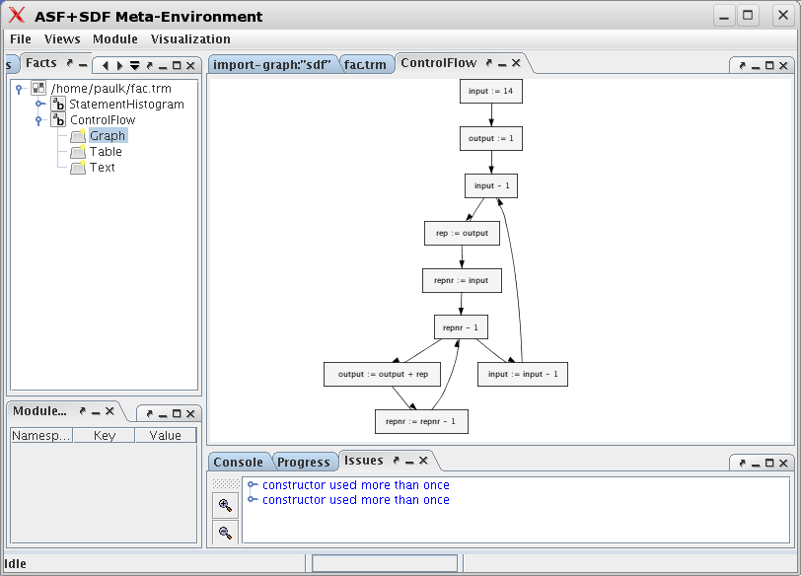
Graph view (factorial)

Slide 164
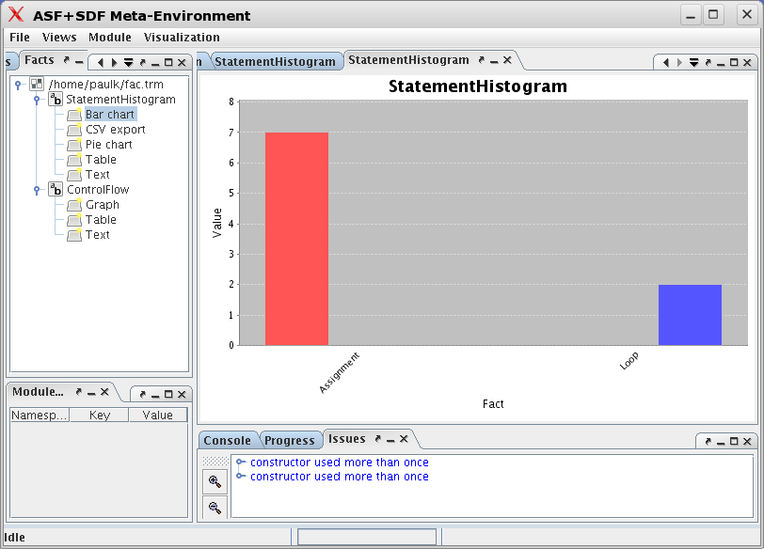
Barchart view (factorial)

Slide 165
Further reading
www.meta-environment.org (select Documentation):
  Guided Tour: Playing with Booleans (flash)
  ASF+SDF by Example
  Writing Language Definitions in ASF+SDF
  The Language Specification Formalism ASF+SDF
  The Syntax Definition Formalism SDF
  An Explanation of Error Messages of SDF (draft)
  An Explanation of Error Messages of ASF (draft)
  The Architecture of The Meta-Environment

