Slide 1



EASY Programming with Rascal
Paul Klint
Joint work with
Emilie Balland, Bas Basten, Jeroen van den Bos, Mark Hills, Arnold Lankamp, Bert Lisser, Tijs van der Storm, Jurgen Vinju
Opening BLDL, November 4, 2009, Bergen, Norway

Slide 2


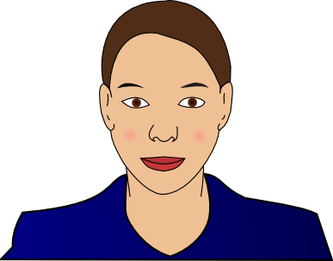


Cast of Heroes
Alice, system administrator
Bernd, forensic investigator
Charlotte, financial engineer
Daniel, multi-core specialist
Elisabeth, model-driven engineering specialist

Slide 3
Meet Alice
Alice is security administrator at a large online marketplace
Objective: look for security breaches
Solution:
  Extract relevant information from system log files, e.g. failed login attempts in Secure Shell
  Extract IP address, login name, frequency, …
  Synthesize a security report

Slide 4
Meet Bernd
Bernd: investigator at German forensic lab
Objective: finding common patterns in confiscated digital information in many different formats. This is very labor intensive.
Solution:
  design DERRICK a domain-specific language for this type of investigation
  Extract data, analyze the used data formats and synthesize Java code to do the actual investigation

Slide 5
Meet Charlotte
Charlotte works at a large financial institution in Paris
Objective: connect legacy software to the web
Solution:
  extract call information from the legacy code, analyze it, and synthesize an overview of the call structure
  Use entry points in the legacy code as entry points for the web interface
  Automate these transformations

Slide 6
Meet Daniel
Daniel is concurrency researcher at one of the largest hardware manufacturers worldwide
Objective: leverage the potential of multi-core processors and find concurrency errors
Solution:
  extract concurrency-related facts from the code (e.g., thread creation, locking), analyze these facts and synthesize an abstract automaton
  Analyze this automaton with third-party verification tools

Slide 7
Meet Elisabeth
Elisabeth is software architect at an airplane manufacturer
Objective: Model reliability of controller software
Solution:
  describe software architecture with UML and add reliability annotations
  Extract reliability information and synthesize input for statistics tool
  Generate executable code that takes reliability into account

Slide 8
What are their Common Problems?
How to parse source code/data files
How to extract facts from it
How to perform computations on these facts
How to generate new source code
How to synthesize other information
EASY: Extract-Analyze-SYnthesize Paradigm

Slide 9
?
EASY
Paradigm
System
Under
Investigation
(SUI)
Extract
Internal Representation
Analyze
Synthesize
Results

Slide 10
What tools are available to our heroes?
Lexical tools: Grep, Awk, Perl, Python, Ruby
  Regular expressions have limited expressivity
  Hard to maintain
Compiler tools: yacc, bison, CUP, ANTLR
  Only automate front-end part
  Everything else programmed in C, Java, ..
Attribute Grammar tools: FNC2, JastAdd, …
  Mostly analysis, weak in transformation

Slide 11
What tools are available to our heroes?
Relational Analysis tools: Grok, Rscript
  Strong in analysis
Transformation tools: ASF+SDF, Stratego, TOM, TXL
  Strong in transformation
Logic languages: Prolog
Many others …
Apologies if
your favorite tool
does not
appear in this list

Slide 12
 | Extract | Analyze | Synthesize
Lexical tools | ++ | +/- | --
Compiler tools | ++ | +/- | +/-
Attribute grammar tools | ++ | +/- | --
Relational tools | -- | ++ | --
Transformation tools | -- | +/- | ++
Rascal | ++ | ++ | ++

Slide 13
Why a new Language?
No current technology spans the full range of EASY steps
There are many fine technologies but they are
  highly specialized
  hard to learn
  not integrated with a standard IDE
  hard to extend
  ...

Slide 14

Here comes Rascal to the Rescue

Slide 15

Rascal ...
... is a new language for meta-programming
… supports the EASY paradigm
... is based on
  Syntax Analysis, Term Rewriting, Relational Calculus
... extended superset of ASF+SDF and Rscript
... easily extensible with Java code
... embedded in Eclipse IDE (and REPL!)

Slide 16
Design Guidelines
Principle of least surprise
  Familiar syntax
  Imperative core
What you see is what you get
  No heuristics (or as few as possible)
  Explicitness over implicitness
Learnability
  Layered design
  Low barrier to adoption

Slide 17

Rascal Elevator Pitch

Slide 18
Rascal Elevator Pitch
Sophisticated built-in data types
Immutable data
Static safety
Generic types
Local type inference
Pattern Matching
Syntax definitions and parsing
Concrete syntax
Visiting/traversal
Comprehensions
Higher-order
Familiar syntax
Java and Eclipse integration
Read-Eval-Print (REPL)

Slide 19


Slide 20
 | Extract | Analyze | Synthesize
Values, Types, Datatypes | ++ | ++ | ++
Syntax analysis and parsing | ++ | +/- | --
Pattern matching | ++ | ++ | +/-
Visitors and Switching | ++ | ++ | ++
Relations, Enumerators Comprehensions | +/- | ++ | +/-
Rewrite rules | -- | ++ | ++

Slide 21
Example
A Domain-specific
Language
for
State Machines

Slide 22
State Machine
a
a
S1
S2
S3
canReach(
)
finite-state machine
state S1;
state S2;
state S3;
trans a: S1 -> S2;
trans b: S2 -> S1;
trans a: S2 -> S3
b
= ( S1 : {S1, S2, S3},
S2: {S1, S2, S3},
S3: {})

Slide 23
State Machine Concrete Syntax
module demo/StateMachine/Syntax
...
"state" Id -> State
"trans" Id ":" Id "->" Id -> Trans
State -> Decl
Trans -> Decl
“finite-state” “machine” {Decl ";"}+ -> FSM

Slide 24
CanReach (1)
module demo::StateMachine::CanReach
import demo::StateMachine::Syntax;
import Graph;
FSM example =
finite-state machine
state S1;
state S2;
state S3;
trans a: S1 -> S2;
trans b: S2 -> S1;
trans a: S2 -> S3;
… (next sheet)
A concrete,
unquoted,
FSM text fragment.

Slide 25
CanReach (2)
module demo::StateMachine::CanReach
… (previous sheet)
public map[str, set[str]] canReach(FSM fsm){
transitions = getTransitions(fsm);
closure = transitions+;
return ( s : closure[s] | str s <- carrier(transitions) );
}
Extract transitions
as a graph
Transitive closure
Map comprehension
Enumerate all states
return a map in which each state
is associated with all states
that can be reached from it

Slide 26
CanReach (3)
module demo::StateMachine::CanReach
… (previous sheet)
public graph[str] getTransitions(FSM fsm){
return {
{ < ”<from>”, “<to>” > |
/`trans <Id a>: <Id from> -> <Id to>` <- fsm
}
}
Enumerate all transitions in the FSM
Convert a tree element to a string
Concrete pattern with variables

Slide 27
Example
Generating
Getters
and
Setters

Slide 28
Generating Getters and Setters
Given:
  A class name
  A mapping from names to types
Required:
  Generate the named class with getters and setters

Slide 29
Generating getters and setters: Input
public map[str, str] fields = (
"name" : "String",
"age" : "Integer",
"address" : "String"
);
Field name of type String
Field age of type Integer
Field address of type String
genClass("Person", fields)
Generate class person
with these fields

Slide 30
Generting getters and setters
Expect Output
public class Person {
private Integer age;
public void setAge(Integer age) { this.age = age; }
public Integer getAge() { return age; }
private String name;
public void setName(String name) { this.name = name; }
public String getName() { return name; }
private String address;
public void setAddress(String address) {
this.address = address; }
public String getAddress() { return address; }
}

Slide 31
Generating Getters and Setters
public str genClass(str name, map[str,str] fields) {
return "
public class <name > {
<for (f <- fields) {
str t = fields[f];
str n = capitalize(f);>
private <t> <f>;
public void set<n>(<t> <f>) { this.<f> = <f>; }
public <t> get<n>() { return <f>; }
<}>
}
";
}
String with computed interpolations
Red is interpolated
Blue is literal

Slide 32
Example
Fact extraction
and
visualization

Slide 33
While working on a Java project ...
For example, jspwiki
What are the different file types used in this project?

Slide 34
What are the file types in this project?
Access to Eclipse resources
module demo::filetypes
import Resources;
import viz::Chart;
public void main(){
jspwiki = getProject(|project://jspwiki|);
extensions = ();
visit(jspwiki){
case file(loc l): extensions[l.extension]? 0 += 1;
}
pieChart("Extensions", extensions, dim3());
}
Charting tools
Get all file names from project “jspwiki”
Empty map to count extensions
Visit all filenames and count extensions
Draw them as 3D pieChart

Slide 35
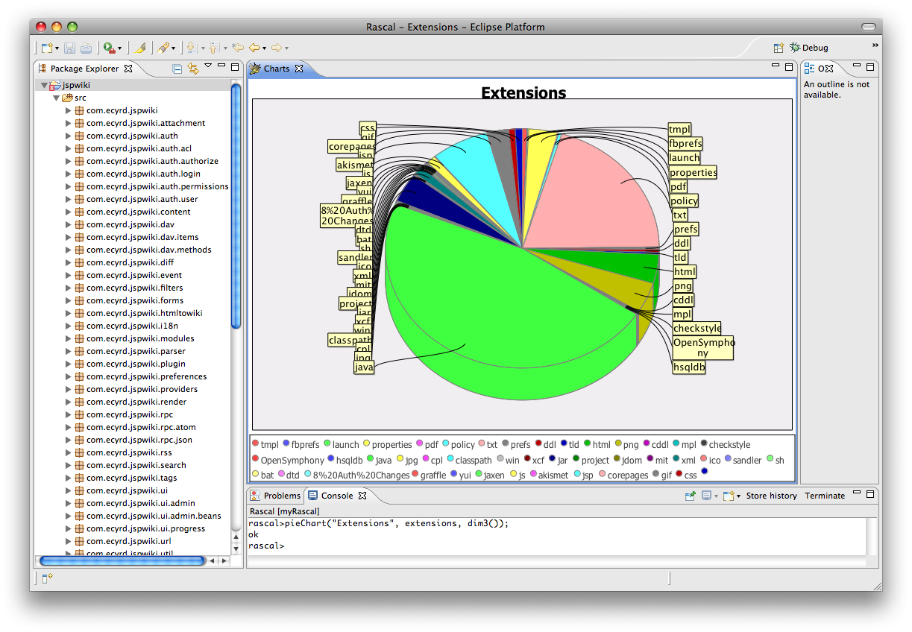

Slide 36
The Rascal Standard Library
Benchmark
Boolean
Exception
(Labelled) Graph
Integer
IO
JDT (Eclipse only)
List
Location
Map
Node
Real
Relation
RSF
Resource (Eclipse only)
Set
String
Subversion
Tuple
ValueIO
viz::Figure, viz::Chart
viz::View (Eclipse only)

Slide 37

Long-term Perspective
The Rascal language supports the EASY paradigm:
  creation and execution of fact analysis and transformation tools
  DSLs
  meta-programming
Familiar notation and Eclipse integration lower barrier to entry
Work in progress

Slide 38
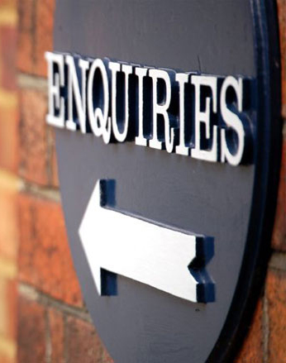
Information
Latest version of
Rascal Documentation
Rascal Download
See http://www.rascal-mpl.org/
Related information:
http://www.meta-environment.org

