Slide 1



Using Grammars and Relations to Formalize Models
Paul Klint
Joint work with
Emilie Balland, Bas Basten, Jeroen van den Bos, Mark Hills, Arnold Lankamp, Bert Lisser, Tijs van der Storm, Jurgen Vinju

Slide 2
Model-Driven Development
Model essential elements of a domain
Derive low level code
Increase level of abstraction
Reduce accidental complexity (boilerplate)
Be more productive
Achieve better quality

Slide 3
Domain-specific Languages
MDD development where model ~ textual notation
Old idea (APT from the 50's)
Active research area: SLE, MoDELS, LDTA, PLDI, OOPSLA, IFIP DSL, ECOOP

Slide 4
How to Describe a Model?
Text-based
  Specify: Grammar, Abstract Data Type, ...
  Result: tree
  Manipulate: term rewriting
Diagram-based:
  Specify: UML, ....
  Result: graph
  Manipulate: graph rewriting

Slide 5
Observations
Textual description less verbose, better scaleable
Textual description can reuse many existing technologies
  Parsing, type checking, rewriting, code generation, ...
Textual approach promising, but ...
What to do with cycles in diagram?

Slide 6
Equivalence graph and relation
Diagram-based
Text-based
{ <1,2>, <1,4>, <1,5>,
<2,3>,
<3,6>,
<4,1>, <4,3>,
<5, 6>
}
1
4
2
5
3
6

Slide 7
Example: Expressions
Text-based
Diagram-based
<expr> ::= <id>
| “(“ <expr> “)”
| <expr> “+” <expr>
| <expr> “*” <expr>
<expr> ::= <id>
| “(“ <expr> “)”
| <expr> “+” <expr>
| <expr> “*” <expr>
<expr> ::= <id>
| “(“ <expr> “)”
| <expr> “+” <expr>
| <expr> “*” <expr>
expr
id
par
+
*
data expr = id(str name)
| par(expr E)
| add(expr L, expr R)
| mul(expr L, expr R)
;

Slide 8
Example: Finite State Machines

Slide 9
Exploration
Treat Models
as
Grammars + Relations

Slide 10
What are their Common Problems?
How to parse source code/data files
How to extract facts from it
How to perform computations on these facts
How to generate new source code
How to synthesize other information
EASY: Extract-Analyze-SYnthesize Paradigm

Slide 11
?
EASY
Paradigm
System
Under
Investigation
(SUI)
Extract
Internal Representation
Analyze
Synthesize
Results

Slide 12
What tools are available to our heroes?
Lexical tools: Grep, Awk, Perl, Python, Ruby
  Regular expressions have limited expressivity
  Hard to maintain
Compiler tools: yacc, bison, CUP, ANTLR
  Only automate front-end part
  Everything else programmed in C, Java, ..
Attribute Grammar tools: FNC2, JastAdd, …
  Mostly analysis, weak in transformation

Slide 13
What tools are available to our heroes?
Relational Analysis tools: Grok, Rscript
  Strong in analysis
Transformation tools: ASF+SDF, Stratego, TOM, TXL
  Strong in transformation
Logic languages: Prolog
Many others …
Apologies if
your favorite tool
does not
appear in this list

Slide 14
 | Extract | Analyze | Synthesize
Lexical tools | ++ | +/- | --
Compiler tools | ++ | +/- | +/-
Attribute grammar tools | ++ | +/- | --
Relational tools | -- | ++ | --
Transformation tools | -- | +/- | ++
Our Goal: Rascal | ++ | ++ | ++

Slide 15
Why a new Language?
No current technology spans the full range of EASY steps
There are many fine technologies but they are
  highly specialized
  hard to learn
  not integrated with a standard IDE
  hard to extend
  ...

Slide 16

Here comes Rascal to the Rescue

Slide 17

Rascal ...
... is a new language for meta-programming
… supports the EASY paradigm
... is based on Syntax Analysis, Term Rewriting, Relational Calculus
... extended superset of ASF+SDF and Rscript
... easily extensible with Java code
... embedded in Eclipse IDE (and REPL!)

Slide 18
Design Guidelines
Principle of least surprise
  Familiar syntax
  Imperative core
What you see is what you get
  No heuristics (or as few as possible)
  Explicitness over implicitness
Learnability
  Layered design
  Low barrier to adoption

Slide 19

Rascal Elevator Pitch

Slide 20
Rascal Elevator Pitch
Sophisticated built-in data types
Immutable data
Static safety
Generic types
Local type inference
Pattern Matching
Syntax definitions and parsing
Concrete syntax
Visiting/traversal
Comprehensions
Higher-order
Familiar syntax
Java and Eclipse integration
Read-Eval-Print (REPL)

Slide 21


Slide 22
 | Extract | Analyze | Synthesize
Values, Types, Datatypes | ++ | ++ | ++
Syntax analysis and parsing | ++ | +/- | --
Pattern matching | ++ | ++ | +/-
Visitors and Switching | ++ | ++ | ++
Relations, Enumerators Comprehensions | +/- | ++ | +/-
Rewrite rules | -- | ++ | ++

Slide 23
Read-Eval-Print
rascal>1 + 1
int: 2
rascal>[1,2,3]
list[int]: [1,2,3]
rascal>{1,1,1}
set[int]: {1}
rascal>{ <i,i*i> | i <- [1..10]}
rel[int,int]: {<1,1>,<2,4>,
<3,9>,...

Slide 24
Read-Eval-Print
rascal>import IO;
ok
rascal>for (i <- [1..10]) {
>>>>>>> println("<i> * <i> = <i * i>");
>>>>>>>}
1 * 1 = 1
2 * 2 = 4
3 * 3 = 9
4 * 4 = 16
5 * 5 = 25
6 * 6 = 36
7 * 7 = 49
8 * 8 = 64
9 * 9 = 81
10 * 10 = 100
list[void]: []

Slide 25
Example
A Domain-specific
Language
for
State Machines

Slide 26
State Machine
a
a
S1
S2
S3
canReach(
)
finite-state machine
state S1;
state S2;
state S3;
trans a: S1 -> S2;
trans b: S2 -> S1;
trans a: S2 -> S3
b
= ( S1 : {S1, S2, S3},
S2: {S1, S2, S3},
S3: {})

Slide 27
State Machine Concrete Syntax
module demo/StateMachine/Syntax
...
"state" Id -> State
"trans" Id ":" Id "->" Id -> Trans
State -> Decl
Trans -> Decl
“finite-state” “machine” {Decl ";"}+ -> FSM

Slide 28
CanReach (1)
module demo::StateMachine::CanReach
import demo::StateMachine::Syntax;
import Graph;
FSM example =
finite-state machine
state S1;
state S2;
state S3;
trans a: S1 -> S2;
trans b: S2 -> S1;
trans a: S2 -> S3;
… (next sheet)
A concrete,
unquoted,
FSM text fragment.

Slide 29
CanReach (2)
module demo::StateMachine::CanReach
… (previous sheet)
public map[str, set[str]] canReach(FSM fsm){
transitions = getTransitions(fsm);
closure = transitions+;
return ( s : closure[s] | str s <- carrier(transitions) );
}
Extract transitions
as a graph
Transitive closure
Map comprehension
Enumerate all states
return a map in which each state
is associated with all states
that can be reached from it

Slide 30
CanReach (3)
module demo::StateMachine::CanReach
… (previous sheet)
public graph[str] getTransitions(FSM fsm){
return {
{ < ”<from>”, “<to>” > |
/`trans <Id a>: <Id from> -> <Id to>` <- fsm
}
}
Enumerate all transitions in the FSM
Convert a tree element to a string
Concrete pattern with variables

Slide 31
Example
Generating
Getters
and
Setters

Slide 32
Generating Getters and Setters
Given:
  A class name
  A mapping from names to types
Required:
  Generate the named class with getters and setters

Slide 33
Generating getters and setters: Input
public map[str, str] fields = (
"name" : "String",
"age" : "Integer",
"address" : "String"
);
Field name of type String
Field age of type Integer
Field address of type String
genClass("Person", fields)
Generate class person
with these fields

Slide 34
Generating getters and setters
Expected Output
public class Person {
private Integer age;
public void setAge(Integer age) { this.age = age; }
public Integer getAge() { return age; }
private String name;
public void setName(String name) { this.name = name; }
public String getName() { return name; }
private String address;
public void setAddress(String address) {
this.address = address; }
public String getAddress() { return address; }
}

Slide 35
Generating Getters and Setters
public str genClass(str name, map[str,str] fields) {
return "
public class <name > {
<for (f <- fields) {
str t = fields[f];
str n = capitalize(f);>
private <t> <f>;
public void set<n>(<t> <f>) { this.<f> = <f>; }
public <t> get<n>() { return <f>; }
<}>
}
";
}
String with computed interpolations
Red is interpolated
Blue is literal

Slide 36
Example
Fact extraction
and
visualization

Slide 37
While working on a Java project ...
For example, prefuse
What are the different file types used in this project?

Slide 38
What are the file types in this project?
Access to Eclipse resources
module demo::filetypes
import Resources;
import viz::Chart;
public void main(){
prefuse = getProject(|project://prefuse|);
extensions = ();
visit(prefuse){
case file(loc l): extensions[l.extension]? 0 += 1;
}
render(pieChart("Extensions in Prefuse", extensions));
}
Charting tools
Get all file names from project “prefuse”
Empty map to count extensions
Visit all filenames and count extensions
Draw them as pieChart

Slide 39

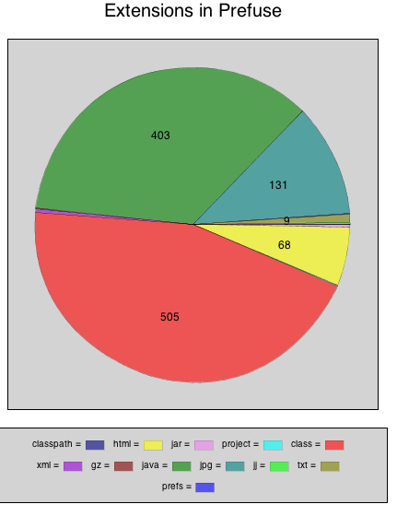

Slide 40

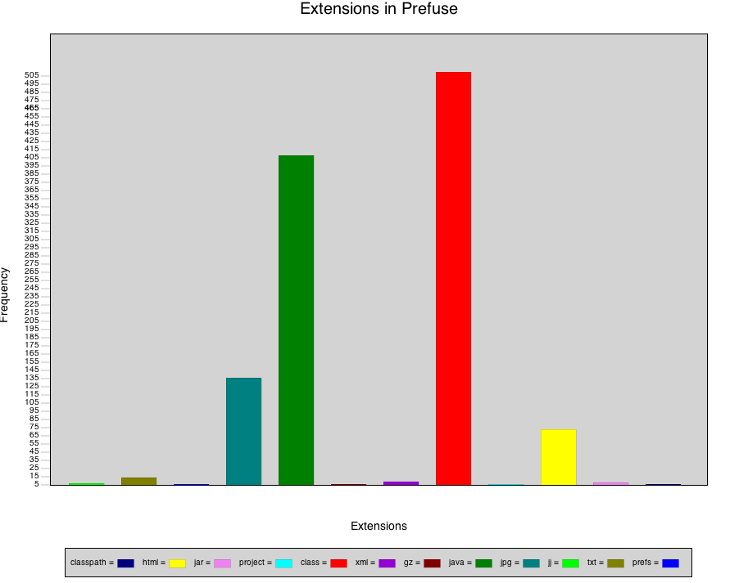

Slide 41
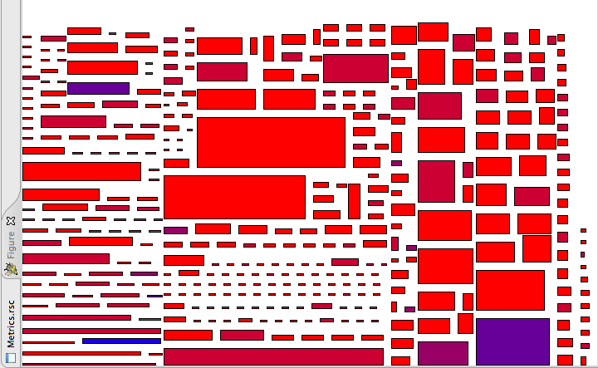


Slide 42
The Rascal Standard Library
Benchmark
Boolean
Exception
(Labelled) Graph
Integer
IO
JDT (Eclipse only)
List
Location
Map
Node
Real
Relation
RSF
Resource (Eclipse only)
Set
String
Subversion
Tuple
ValueIO
viz::Figure, viz::Chart
viz::View (Eclipse only)

Slide 43

Long-term Perspective
The Rascal language supports the EASY paradigm:
  creation and execution of fact analysis and transformation tools
  DSLs
  meta-programming
Familiar notation and Eclipse integration lower barrier to entry
Work in progress

Slide 44
Current Projects
DSL for forensics (with NFI)
DSL for computational auditing with PWC and Dutch Tax Authority
Model transformation (XML, BPMN, …)
Low level source code metrics with Software Improvement Group
Analysis of software repositories
Optimize Hibernate performance (KPMG)

Slide 45

Case: Waebric
DSL for XML markup
Interpreter
AST based
700 SLOC
Tijs van der Storm

Slide 46
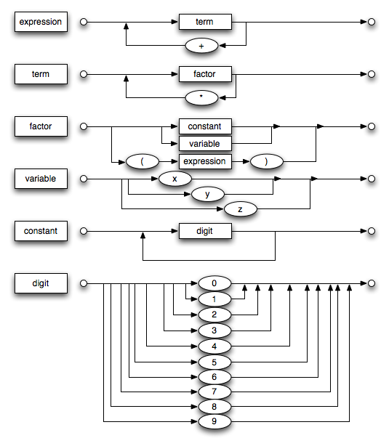

Case: Parser Front-end Rascal
DSL for parsing
Code generator
~ 1000 SLOC
To replace SDF
Jurgen Vinju

Slide 47

Case: Rascal Type Checker
Developed in Rascal
Uses concrete uses concret syntax of Rascal within Rascal
~ 8000 SLOC
Mark Hills

Slide 48
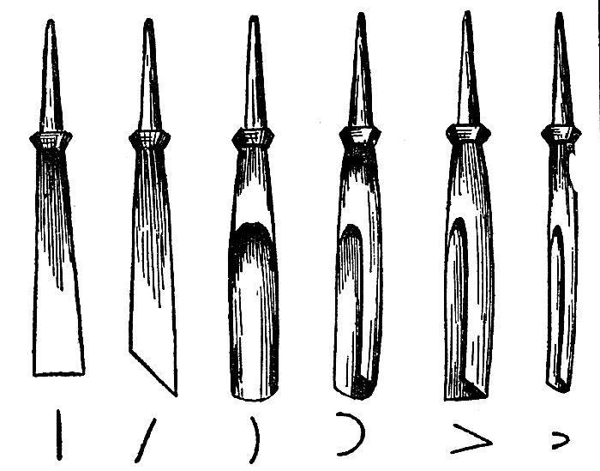

Case: REMICS
DSL for file carving
AST based
Code generator
Around 800 SLOC
As good as industry tools
With National Forensics Institute
Jeroen van den Bos

Slide 49
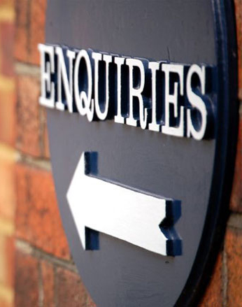
Information
Latest version of
Rascal Documentation
Rascal Download (Linux, MacOS, Windows)
See http://www.rascal-mpl.org/
Related information:
http://www.meta-environment.org

Slide 50
From coding to declaring
list[int] even(int max) {
list[int] result = [];
for (int i <- [0..max]) {
if (i % 2 == 0) {
result += i;
}
}
return result;
}

Slide 51
From coding to declaring
list[int] even(int max) {
list[int] result = [];
for(int i <- [0..max], i%2 == 0){
result += i;
}
return result;
}

Slide 52
From coding to declaring
list[int] even(int max) {
result = [];
for(i <- [0..max], i%2 == 0) {
result += i;
}
return result;
}

Slide 53
From coding to declaring
list[int] even(int max) {
return
for (i <- [0..max], i%2 == 0)
append i;
}

Slide 54
From coding to declaring
list[int] even(int max) {
return
[i | i <- [0..max], i%2 == 0];
}

