Slide 1
Rascal Overview
Joint work with:
Ali Afroozeh, Bas Basten, Anastasia Izmaylova, Davy Landman, Arnold Lankamp, Bert Lisser, Atze van der Ploeg, Michael Steindorfer, Jouke Stoel, Tijs van der Storm, Vadim Zaytsev and many others

Slide 2
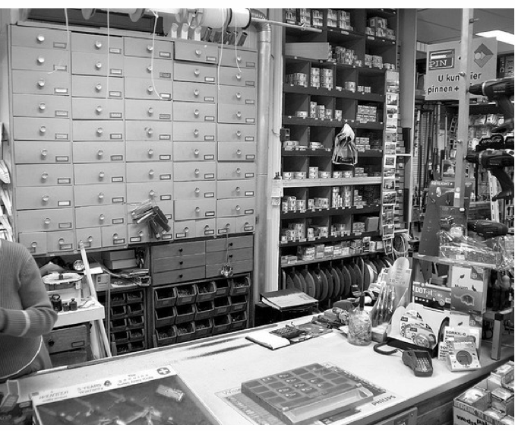
One-stop-shop
Cool parsers
Code generators
Deal of the day:
Cheap type checkers
IDE features
DSL tools
Fancy visualization
Just in: new modeling gadgets

Slide 3
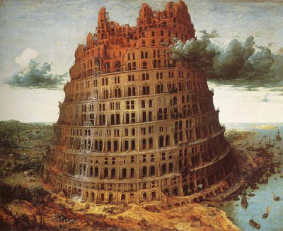
Meta-Programming in Rascal
Software Analysis
Software Transformation
DSL Design & Implementation

Slide 4

What are the
Technical Challenges?
How to parse source code/data files/models?
How to extract facts from them?
How to perform computations on these facts?
How to generate new source code (trafo, refactor, compile)?
How to synthesize other information?
EASY: Extract-Analyze-SYnthesize Paradigm

Slide 5
?
EASY
Paradigm
System
Under
Investigation
(SUI)
Extract
Internal Representation
Analyze
Synthesize
Results
Source code, tables, html, CSV, charts, figures, ...

Slide 6

Here comes Rascal to the Rescue
A unified, extensible, teachable framework without boilerplate
A “One-stop shop” for
  Meta-programming: analysis, trafo, DSLs
  Data analysis
  Visualization
Lab infrastructure
Knowledge Transfer medium
http://www.rascal-mpl.org/

Slide 7
Rascal ...
Based on Syntax Analysis, Term Rewriting, Relational Calculus
Built-in grammars and parser generation
Rich pattern matching: concrete/abstract values
Locations to identify source code fragments
Uses relations for sharing and merging of facts for different languages/modules
Statically typed with local type inference
Integrated in Eclipse, extended using Java

Slide 8
Rascal in One Minute
Rich built-in types
Immutable data
Comprehension & traverse & transform
Pattern Matching and pattern-based dispatch
String templates
Concrete syntax
Syntax definitions and parsing
Higher-order
Built-in random testing
REPL
Many libraries

Slide 9
Example
Even numbers:
In many flavors

Slide 10
Even0: initial version
list[int] even0(int max) {
list[int] result = [];
for (int i <- [0..max])
if (i % 2 == 0)
result += i;
return result;
}
rascal>even0(25);
list[int]: [0,2,4,6,8,10,12,14,16,18,20,22,24]

Slide 11
Even1: remove type declarations
list[int] even0(int max) {
list[int] result = [];
for (int i <- [0..max])
if (i % 2 == 0)
result += i;
return result;
}

Slide 12
Even1: remove type declarations
list[int] even1(int max) {
result = [];
for (i <- [0..max])
if (i % 2 == 0)
result += i;
return result;
}
rascal>even1(25);
list[int]: [0,2,4,6,8,10,12,14,16,18,20,22,24]

Slide 13
Even2: merge for and if
list[int] even1(int max) {
result = [];
for (i <- [0..max])
if (i % 2 == 0)
result += i;
return result;
}

Slide 14
Even2: merge for and if
list[int] even2(int max) {
result = [];
for (i <- [0..max], i % 2 == 0)
result += i;
return result;
}
rascal>even2(25);
list[int]: [0,2,4,6,8,10,12,14,16,18,20,22,24]

Slide 15
Even3: for returns the list
(using append)
list[int] even3(int max) {
result = [];
for (i <- [0..max], i % 2 == 0)
result += i;
return result;
}

Slide 16
Even3: for returns the list
(using append)
list[int] even3(int max) {
result = for (i <- [0..max], i % 2 == 0)
append i;
return result;
}
rascal>even3(25);
list[int]: [0,2,4,6,8,10,12,14,16,18,20,22,24]

Slide 17
Even4: eliminate result variable
list[int] even3(int max) {
result = for (i <- [0..max], i % 2 == 0)
append i;
return result;
}

Slide 18
Even4: eliminate result variable
list[int] even4(int max) {
return for (i <- [0..max], i % 2 == 0)
append i;
}
rascal>even4(25);
list[int]: [0,2,4,6,8,10,12,14,16,18,20,22,24]

Slide 19
Even5: use comprehension
list[int] even4(int max) {
return for (i <- [0..max], i % 2 == 0)
append i;
}

Slide 20
Even5: use comprehension
list[int] even5(int max) {
return [i | i <- [0..max], i % 2 == 0];
}
rascal>even5(25);
list[int]: [0,2,4,6,8,10,12,14,16,18,20,22,24]

Slide 21
Even6: use abbreviated function declaration
list[int] even5(int max) {
return [i | i <- [0..max], i % 2 == 0];
}

Slide 22

Even6: use abbreviated function declaration
list[int] even6(int max) = [i | i <- [0..max], i % 2 == 0];
rascal>even5(25);
list[int]: [0,2,4,6,8,10,12,14,16,18,20,22,24]
This was just a small teaser:
many aspects of Rascal
not mentioned
In the exercises you will see more.

Slide 23

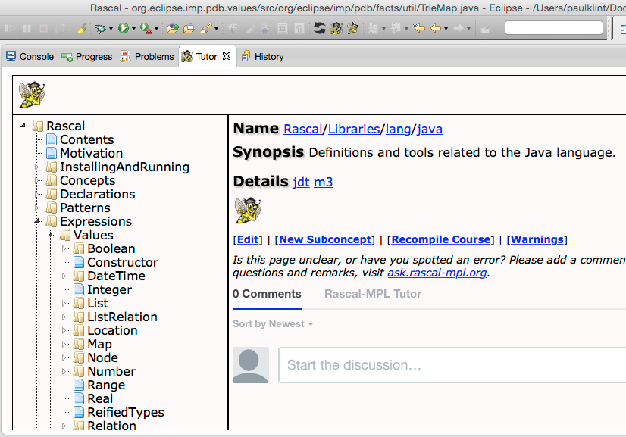
Further reading
http://www.rascal-mpl.org
http://tutor.rascal-mpl.org
http://stackoverflow.com/questions/tagged/rascal
Rascal tutor is always one click away

Slide 24
Exercises
Extending JavaScript (Paul)
Java Analysis (Jurgen)
PHP Analysis (Mark)

