Slide 1
Code Analysis:
Scaling to
PLDI
With
M3

Slide 2
M³: The “Metrics” Meta-Model
Goal: collect information about source code in
  Relations between source code entities
  Abstract Syntax Trees (ASTs)
Idea: use URI (loc) to identify code entities
Implement specific analyses on top
  Initial M3 models represents visible code
  Elaborated M3 models represent PL semantics
  Immutable models as reusable data

Slide 3
Identifying Code entities
Structure of a location (extends URIs):
  |<scheme>://<auth>/<path>?<qry>|(<off>,<len>)
Examples of physical locations:
  |file:///tmp/Hello.java| – absolute path
  |http://foo.com/index.html|
  |project://MyPrj/Hello.java| – relative to Eclipse project MyPrj

Slide 4
Identifying Source Code Entities
Introduce new schemes to represent Java entities:
  |java+class://myPrj/java/util/List|
Notions like containment, inheritance can now be represented by a relation of type rel[loc, loc]
Given a project an M³ model can be extracted automatically:
  Using a Rascal generated parser, visit, etc.
  By marshalling AST data from an open compiler

Slide 5
M³: The Metrics Meta-Model
|project://myproject|
extractor
ASTs
ASTs
ASTs
M3
Elaborate
Analysis
Numbers
Tables
Charts

Slide 6
Scaling to Java
M³ Core
Access Java facts
via annotations and
functions on
the M³ model
M³ Java Extension
@declarations
@types
@uses
@containment
@messages
@names
@documentation
@modifiers
@extends
@implements
@methodInvocation
@fieldAccess
@typeDependency
@methodOverrides
@annotations
M³ model
M³ Java convenience
functions
classes
interfaces
packages
variables
parameters
fields
methods
Java Project

Slide 7
Creating an M³ Model
Take a project in your Eclipse workspace
rascal>loc project = |project://snakesAndLadders|;
loc: |project://snakesAndLadders|
rascal>import lang::java::jdt::m3::Core;
ok
rascal>m = createM3FromEclipseProject(project)
Create M3 model for the project

Slide 8
Creating an M³ Model
M3: m3(|project://org.eclipse.imp.pdb.values|)[
@annotations={
<|java+method:///org/eclipse/imp/pdb/facts/util/TrieMap/Map2To2Node/sizePredicate()|,|java+interface:///java/lang/Override|>,
<|java+method:///org/eclipse/imp/pdb/facts/util/TrieMap/Map0To0Node/sizePredicate()|,|java+interface:///java/lang/Override|>,
<|java+method:///org/eclipse/imp/pdb/facts/type/SetType/carrier()|,|java+interface:///java/lang/Override|>,
<|java+method:///org/eclipse/imp/pdb/facts/util/TrieSet/Set0To2Node/hasPayload()|,|java+interface:///java/lang/Override|>,
<|java+method:///org/eclipse/imp/pdb/facts/util/Map2/asTransient()|,|java+interface:///java/lang/Override|>,
<|java+method:///org/eclipse/imp/pdb/facts/util/TrieSet/Set0To3Node/nodeIterator()|,
|java+interface:///java/lang/SuppressWarnings|>,
<|java+method:///org/eclipse/imp/pdb/facts/type/ValueType/isSubtypeOfNode(org.eclipse.imp.pdb.facts.type.Type)|,
|java+interface:///java/lang/Override|>,
<|java+method:///org/eclipse/imp/pdb/facts/util/TrieSet/HashCollisionSetNode/containsKey(java.lang.Object,int,int)|,
|java+interface:///java/lang/Override|>,
<|java+method:///org/eclipse/imp/pdb/facts/impl/reference/ValueFactory/listRelationWriter(org.eclipse.imp.pdb.facts.type.Type)|,
|java+interface:///java/lang/Override|>,
<|java+method:///org/eclipse/imp/pdb/facts/util/TrieSet/Set1To3Node/hasPayload()|,|java+interface:///java/lang/Override|>,
<|java+method:///org/eclipse/imp/pdb/facts/impl/fast/RelationViewOnSet/range()|,|java+interface:///java/lang/Override|>,
<|java+method:///org/eclipse/imp/pdb/facts/util/Map1/keySet()|,|java+interface:///java/lang/Override|>,
<|java+method:///org/eclipse/imp/pdb/facts/util/TrieMap/Map2To2Node/findByKey(java.lang.Object,int,int)|,
|java+interface:///java/lang/Override|>,
...
Method sizePredicate has an Override annotation

Slide 9
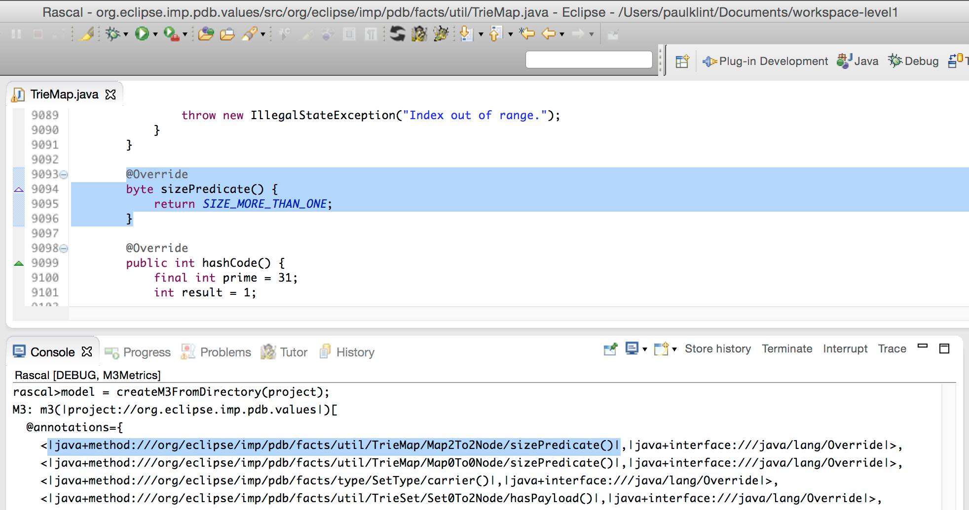
Model elements are hyperlinked

Slide 10
Exploring an M³ Model
Import the Rascal standard library
rascal>import Prelude;
ok
rascal> size(model@annotations);
int: 3035
rascal>classes(model);
set[loc]: {
|java+class:///org/eclipse/imp/pdb/facts/exceptions/NullTypeException|,
|java+class:///org/eclipse/imp/pdb/test/persistent/TestList|,
|java+class:///org/eclipse/imp/pdb/facts/type/IntegerType|,
|java+class:///org/eclipse/imp/pdb/facts/type/SourceLocationType|,
|java+class:///org/eclipse/imp/pdb/facts/util/Set4|,
|java+class:///org/eclipse/imp/pdb/test/random/DataIterable|,
…
rascal> size(classes(model));
int: 429

Slide 11
Projecting elements
rascal>model@extends
rel[loc from,loc to]: {
<|java+class:///snakes/Snake|,|java+class:///snakes/Ladder|>,
<|java+class:///snakes/Ladder|,|java+class:///snakes/Square|>,
<|java+class:///snakes/FirstSquare|,|java+class:///snakes/Square|>,
<|java+class:///snakes/LastSquare|,|java+class:///snakes/Square|>
}
rascal>model@extends[|java+class:///snakes/Snake|]
set[loc]: {|java+class:///snakes/Ladder|}

Slide 12
Printing Methods per Class
void methodsPerClass(M3 model){
for(c <- classes(model)){
println("<c>: <size(methods(model, c))>");
}
}
Iterate over all classes
String interpolation
The set of all methods in class c
Compute the size of that set
rascal>methodsPerClass(model)
|java+class:///snakes/Game|: 20
|java+class:///snakes/SimpleGameTest|: 12
|java+class:///snakes/DieTest|: 4
|java+class:///snakes/Square|: 15
|java+class:///snakes/Player|: 8
|java+class:///snakes/Ladder|: 6
...

Slide 13
Find Classes with Most Methods
Map comprehension
All methods in c
All classes c
set[loc] classesWithMostMethods(M3 model){
methodCount = ( c : size(methods(model, c)) | c <- classes(model));
largest = max(range(methodCount));
return { c | c <- classes(model), methodCount[c] == largest };
}
Maximum element in set
Range of a key/value map returns a set of the values
The set of all classes with the largest method count
rascal>classesWithMostMethods(model)
set[loc]: {|java+class:///org/eclipse/imp/pdb/facts/type/Type|}

Slide 14
Composing and Filtering Relations
// Is A contained somewhere nested in B?
A in (model@containment+)[B]
// Which concrete methods are reachable from main?
R = model@invocation o model@methodOverrides<1,0>
+ model@invocation;
// which methods in interfaces have superfluous modifiers?
{ m | m ← methods(model),
<i,m> ← model@containment,
i.scheme == “java+interface”,
\public() in model@modifiers[m] }

Slide 15
The Java AST datatype lang::java::m3::AST
It is possible to create Abstract Syntax Trees (ASTs) for all declarations in a project.
Described by the datatypes:
  Declaration
  Expression
  Statement
  Type & Modifier

Slide 16
Declaration
data Declaration
= \compilationUnit(list[Declaration] imports, list[Declaration] types)
| \compilationUnit(Declaration package, list[Declaration] imports, list[Declaration] types)
| \enum(str name, list[Type] implements, list[Declaration] constants, list[Declaration] body)
| \enumConstant(str name, list[Expression] arguments, Declaration class)
| \enumConstant(str name, list[Expression] arguments)
| \class(str name, list[Type] extends, list[Type] implements, list[Declaration] body)
| \class(list[Declaration] body)
| \interface(str name, list[Type] extends, list[Type] implements, list[Declaration] body)
| \field(Type \type, list[Expression] fragments)
| \initializer(Statement initializerBody)
| \method(Type \return, str name, list[Declaration] parameters, list[Expression] exceptions, Statement impl)
| \method(Type \return, str name, list[Declaration] parameters, list[Expression] exceptions)
| \constructor(str name, list[Declaration] parameters, list[Expression] exceptions, Statement impl)
| \import(str name)
| \package(str name)
| \package(Declaration parentPackage, str name)
| \variables(Type \type, list[Expression] \fragments)
| \typeParameter(str name, list[Type] extendsList)
| \annotationType(str name, list[Declaration] body)
| \annotationTypeMember(Type \type, str name)
| \annotationTypeMember(Type \type, str name, Expression defaultBlock)
// initializers missing in parameter, is it needed in vararg?
| \parameter(Type \type, str name, int extraDimensions)
| \vararg(Type \type, str name)
;

Slide 17
Expression
data Expression
= \arrayAccess(Expression array, Expression index)
| \newArray(Type \type, list[Expression] dimensions, Expression init)
| \newArray(Type \type, list[Expression] dimensions)
| \arrayInitializer(list[Expression] elements)
| \assignment(Expression lhs, str operator, Expression rhs)
| \characterLiteral(str charValue)
| \newObject(Expression expr, Type \type, list[Expression] args, Declaration class)
| \newObject(Expression expr, Type \type, list[Expression] args)
| \newObject(Type \type, list[Expression] args, Declaration class)
| \newObject(Type \type, list[Expression] args)
| \conditional(Expression expression, Expression thenBranch, Expression elseBranch)
| \fieldAccess(bool isSuper, Expression expression, str name)
| \fieldAccess(bool isSuper, str name)
| \methodCall(bool isSuper, str name, list[Expression] arguments)
| \methodCall(bool isSuper, Expression receiver, str name, list[Expression] arguments)
| \number(str numberValue)
| \booleanLiteral(bool boolValue)
| \stringLiteral(str stringValue)
| \type(Type \type)
| \variable(str name, int extraDimensions)
| \variable(str name, int extraDimensions, Expression \initializer)
| \bracket(Expression expression)
| \this(Expression thisExpression)
| \infix(Expression lhs, str operator, Expression rhs)
| \postfix(Expression operand, str operator)
| \prefix(str operator, Expression operand)
| \simpleName(str name)
...

Slide 18
Statement
data Statement
= \assert(Expression expression)
| \assert(Expression expression, Expression message)
| \block(list[Statement] statements)
| \break()
| \continue()
| \do(Statement body, Expression condition)
| \empty()
| \foreach(Declaration parameter, Expression collection, Statement body)
| \for(list[Expression] initializers, Expression condition, list[Expression] updaters, Statement body)
| \for(list[Expression] initializers, list[Expression] updaters, Statement body)
| \if(Expression condition, Statement thenBranch)
| \if(Expression condition, Statement thenBranch, Statement elseBranch)
| \return(Expression expression)
| \return()
| \switch(Expression expression, list[Statement] statements)
| \case(Expression expression)
| \defaultCase()
| \synchronizedStatement(Expression lock, Statement body)
| \throw(Expression expression)
| \try(Statement body, list[Statement] catchClauses)
| \try(Statement body, list[Statement] catchClauses, Statement \finally)
| \catch(Declaration exception, Statement body)
| \declarationStatement(Declaration declaration)
| \while(Expression condition, Statement body)
| \expressionStatement(Expression stmt)
| \constructorCall(bool isSuper, Expression expr, list[Expression] arguments)
| \constructorCall(bool isSuper, list[Expression] arguments)
...

Slide 19
Type & Modifier
data Type
= arrayType(Type \type)
| parameterizedType(Type \type)
| qualifiedType(Type qualifier,
Expression simpleName)
| simpleType(Expression name)
| unionType(list[Type] types)
| wildcard()
| upperbound(Type \type)
| lowerbound(Type \type)
| \int()
| short()
| long()
| float()
| double()
| char()
| string()
| byte()
| \void()
| \boolean()
;
data Modifier
= \private()
| \public()
| \protected()
| \friendly()
| \static()
| \final()
| \synchronized()
| \transient()
| \abstract()
| \native()
| \volatile()
| \strictfp()
| \annotation(Expression \anno)
| \onDemand()
;

Slide 20
Creating ASTs
rascal>import lang::java::jdt::m3::AST;
ok
rascal>m = |java+constructor:///snakes/LastSquare/LastSquare(snakes.Game,int)|;
rascal>getMethodASTEclipse(, model=model)
Declaration: constructor(
"LastSquare",
[
parameter(
simpleType(simpleName("Game")[
@src=|file:///Users/jurgenv/Workspaces/PLDI2015/snakesAndLadders/...|
@decl=|java+class:///snakes/Game|,
@typ=class(
|java+class:///snakes/Game|,
...

Slide 21
Count number of casts
int countCasts1(set[Declaration] decls){
int cnt = 0;
visit(decls){
case \cast(_, _): cnt += 1;
}
return cnt;
}
rascal>countCasts1(decls)
int: 1169
int countCasts2(set[Declaration] decls) =
size([c | /c:\cast(_,_) := decls]);
pattern match operator
rascal>countCasts2(decls)
int: 1169
/ does a deep match, assigns every match to c

Slide 22
Early applications of M3
http://www.ossmeter.org
  EU project on incremental quality monitoring of open-source projects (code, issues, community)
https://github.com/cwi-swat/rascal-OFG
  Language independent object flow graph analysis
https://github.com/ruudvanderweijde/php-analysisPHP
  Type inference masters thesis

Slide 23
Exercise
Use static call relation to approximate test coverage report
  What code is tested and what code is not?
  How much?
Report directly in IDE problems view
You improve recall and/or precision by:
  Dead code detection
  Filtering trivial cases (getter methods)
  Elaborating the Java model with implicit constructor calls

