Slide 1
Under the hood of Rascal
Fast Immutable Collections
Michael Steindorfer
Jurgen J. Vinju
Centrum Wiskunde & Informatica

Slide 2

Collections are ubiquitous
Language perspective:
  Builtin
  Standard library
Adoption success factor
Drives polymorphism
Application perspective:
  Versatile
  Easy to use
  Performance issues
[Vik Muniz]

Slide 3

Immutable Collections
Immutability implies safety
  sharing with referential integrity
  equational reasoning
  co-variant sub-typing
Overhead
  Copying
  More encoding and traversal
  Unused data
Special opportunities for optimization
  Structural equality
  Hash-consing/maximal sharing
  Persistence (differencing)
[Michelangelo di Lodovico Buonarroti Simoni]

Slide 4
PhD Challenge
Design and implement fastest & leanest collections
  on the JVM
  sets, maps, relations, vectors, etc.
  staged [im]mutability
  “versatile”
  equals, insert, delete, lookup, union, intersection, diff, iteration
For under-the-hood of Rascal MPL

Slide 5

Variability
For experimentation & comparison
  simulate published data-structures
  scala simulation
  closure simulation
For versatility
  builtin data-types
  hard, soft, weak references
  ordered/unordered
  sets vs. maps
  staged/immediate immutability
Solution:
Generative Programming
(and you really don’t want to (re)write this code)

Slide 6

Results
Measuring and profiling [submitted] (not today)
  “Object Redundancy and Equals-Call Profiling”
  Precisely modeling JVM object footprints and alignment
Leaner [GPCE 2014, ongoing work]
  “Code Specialization for Memory Efficient Hash Tries”
Faster [OOPSLA 2015 (hopefully)]
  “Highly Efficient Hash Array Mapped Tries on the JVM”

Slide 7
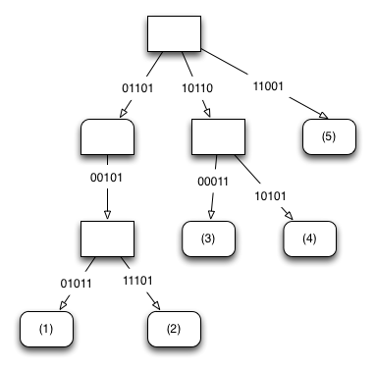
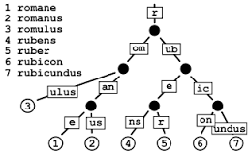
Hash-array Mapped Tries
[Bagwell 2001], Scala, Clojure
What is a HAMT?
  Radix tree with hashes
  Prefix/postfix tree
  DFA without cycles
Only expand if prefix overlaps
Keys are encoded, step-by-step, inside
Keys are ordered explicitly

Slide 8
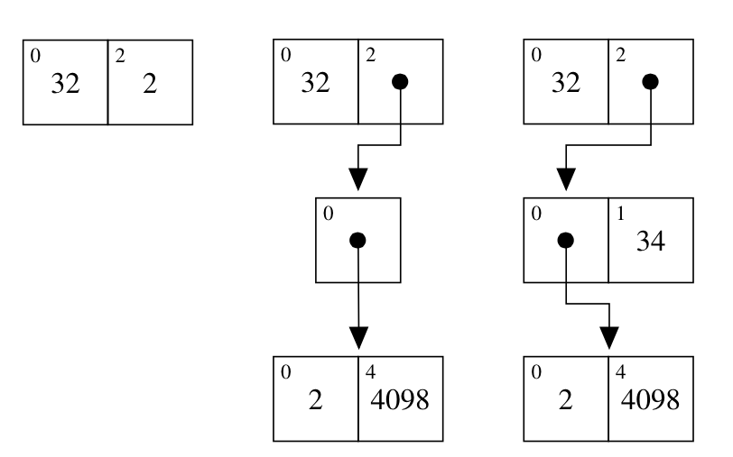
Canonical Code
inserting 32, 2, 4098, 34
class TrieSet implements java.util.Set {
TrieNode root;
int size;
class TrieNode {
int bitmap; // 32 bits
Object[] contentAndSubTries;
…
}
}
Insert does this:
take 5 bits from hash
check position
store value or recurse

Slide 9


Memory of HAMT
Compared to hash-tables, hamts have:
  fewer null array elements
  possible persistence
  no resizing
Compared to dense arrays, hamts have:
  Bitmaps (on every level)
  Arrays (on every level)
Compared to a flat object, hamts have:
  Extra array
  Extra bitmap
After deletion, HAMTs may be non-optimal

Slide 10
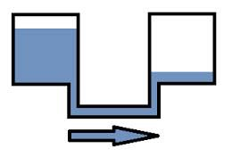
Speed of HAMT
Reasonable cache locality
Bit-level operations
hashCode() and equals()
Sub-optimal shape of the tree
Fixed maximal depth = 7

Slide 11


Normalize on delete
Removes unnecessary overhead
Improves locality
Can assume canonical form
  allows short-circuiting equals more often
Faster and leaner

Slide 12
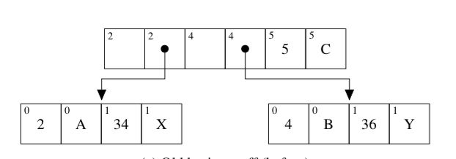
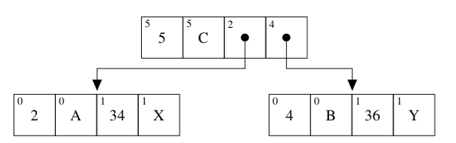
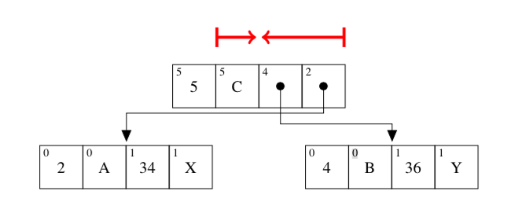
Different ordering
Sets and maps do not need all this ordering
Much better locality for generators/iteration
Things to mitigate now:
  storing the boundary
  more bit operations
  moving pointers acros the boundaries

Slide 13
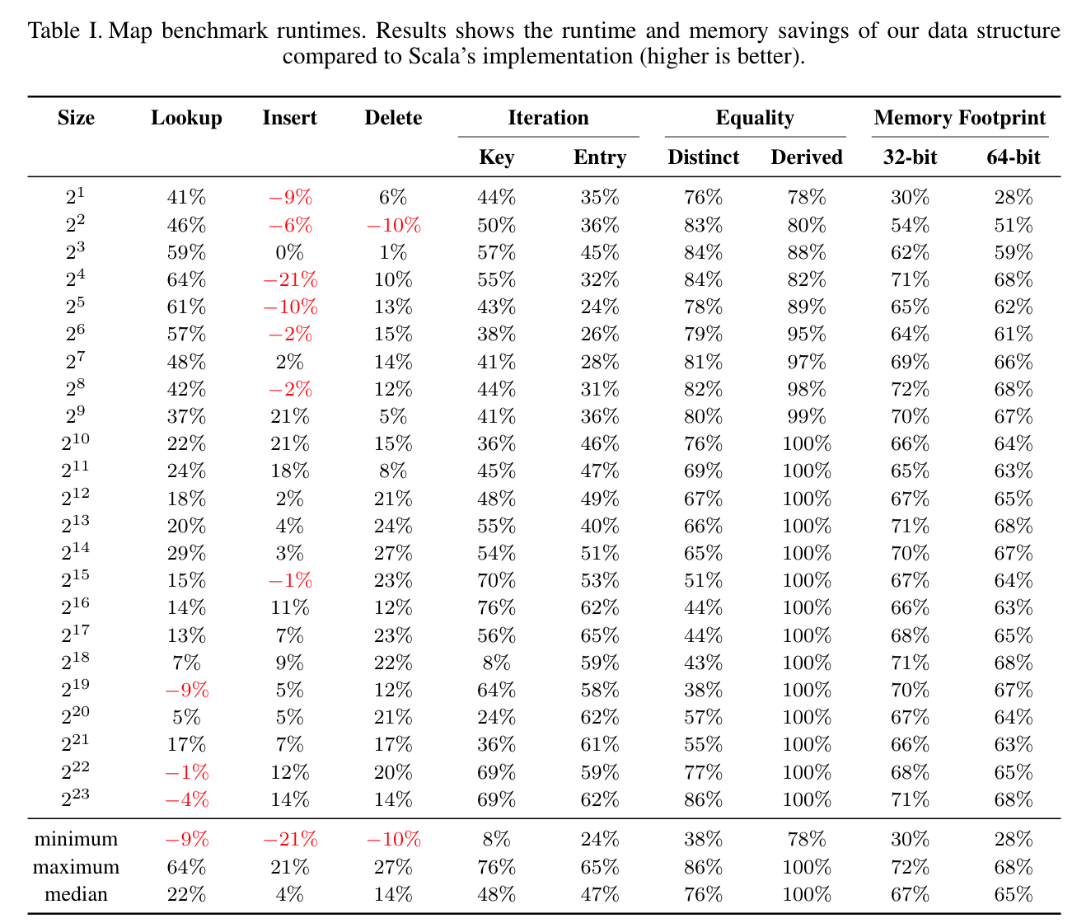

Slide 14
Squeezing space
The HAMT overhead is
  bitmap
  array
For both the sparsity is defined by node arity:
  distribution of the input integers/hash-code
  details like chunk size
Hypothesis: we can specialize for node arity

Slide 15
Specializing Node Arity
For the ordered version: exponential amount
  infeasible due to memory, cache, code size
For the re-ordered version: polynomial amount
  but we pay in bit-level operations
For which sizes do we specialize?

Slide 16
Specialized code
code to switch between specialized and generic code
lookup, insert, delete are more complex
miminize code generation by having a fragile base class
class TrieSet implements java.util.Set {
TrieNode root; int size;
interface TrieNode { ... }
...
class NodeNode extends TrieNode {
byte pos1; TrieNode nodeAtPos1;
byte pos2; TrieNode nodeAtPos2;
…
}
class ElementNode extends TrieNode {
byte pos1; Object key;
byte pos2; TrieNode node;
…
}
class ElementElement extends TrieNode {
byte pos1; Object key1;
byte pos2; Object key2;
…
}
class GenericNode implements TrieNode {
…
}
}

Slide 17
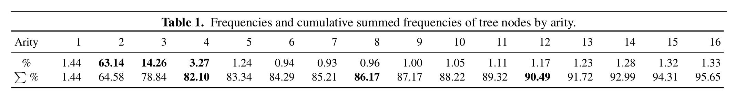
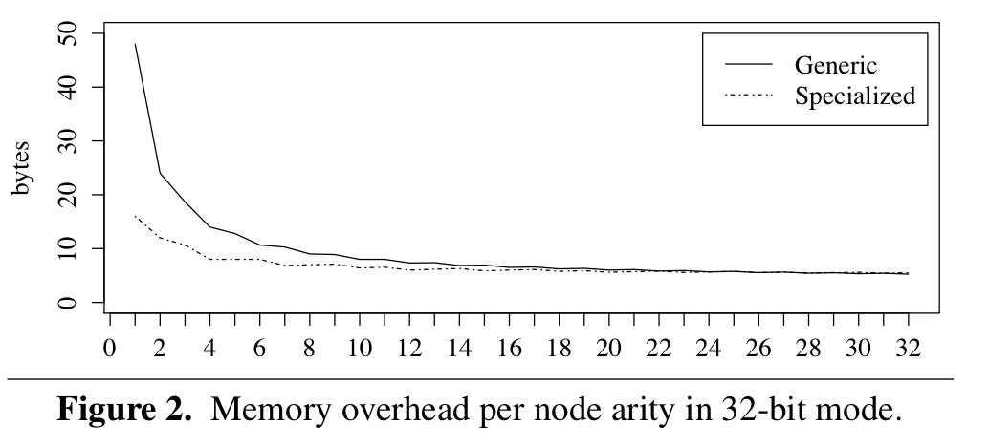
Experiment
Random integers
simulating good
hash codes

Slide 18
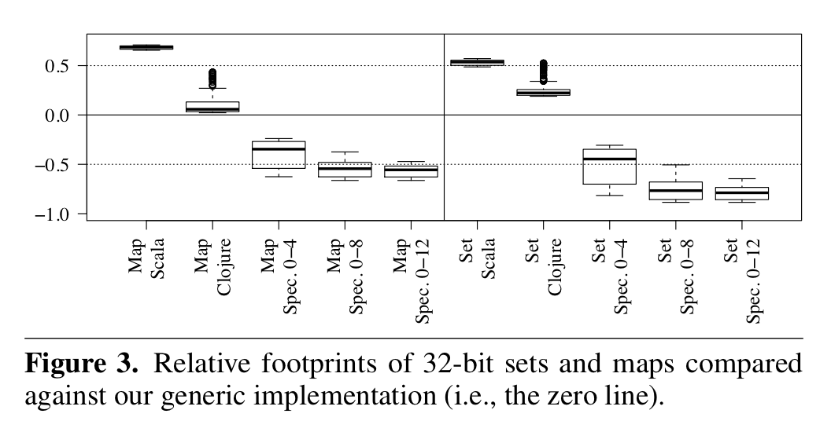
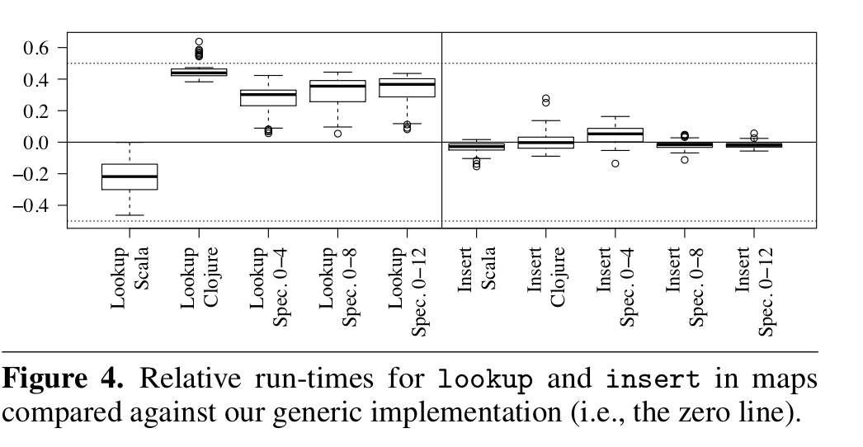
Leaner
a lot leaner
but not much slower

Slide 19
Summary
Currently we get, compared to the state-of-the-art
  50%-100% speedups
  50%-80% memory savings
Generated Java code
  very low level, intrinsic complexity
  many variants for features, few specializations for optimization
Current work:
  Experimental evaluation on real code
  Integrating different optimizations
  Squeezing more out of iteration
  Squeezing more out of incrementality and staged immutability

