Slide 1
PLDI 2015 Tutorial
Program Analysis and Transformation with Rascal
Wrapping Up

Slide 2
Summary
Rascal: a rich language for meta-programming
Growing number of libraries and extensions: visualization, concept analysis, integrating existing solvers and model checkers
Used in real projects
Rascal type checker and compiler in full development
Actively maintained by a growing community

Slide 3
Typical Applications
Analysis
  Metrics
  Java, PHP, ECORE
  Repositories (SVN,GIT)
  Assertion checking
  Type checking
Transformation
  Refactoring
  Compilation
DSL design & implementation
  Forensics (NFI)
  Games
  Questionnaires
  Financial Auditing
Education:
  UvA, OU, TU/e, U Bergen, U Namur, ECU, ...

Slide 4
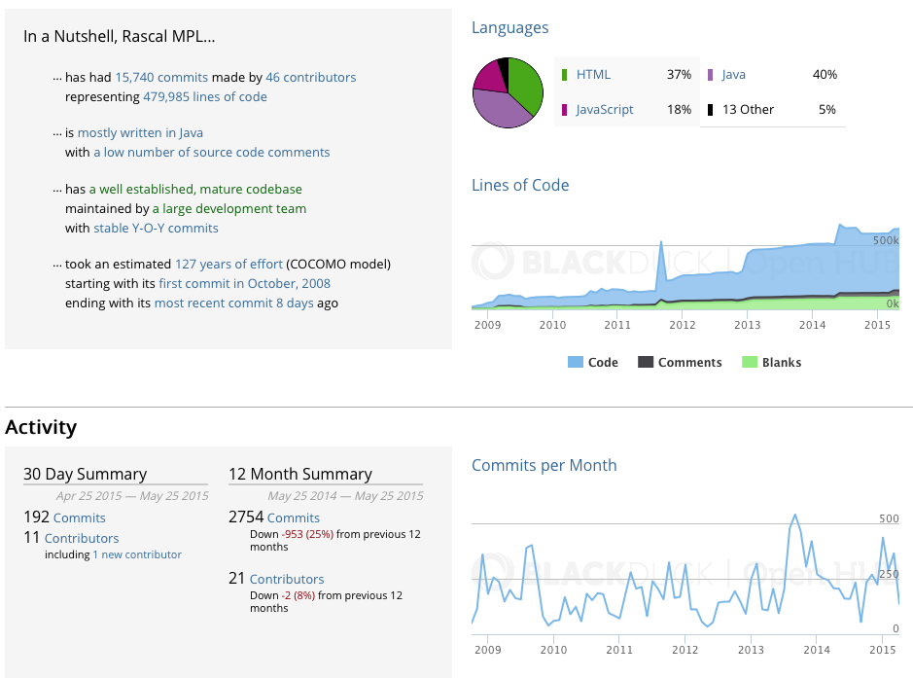
Rascal on OpenHub (Ohloh)

Slide 5
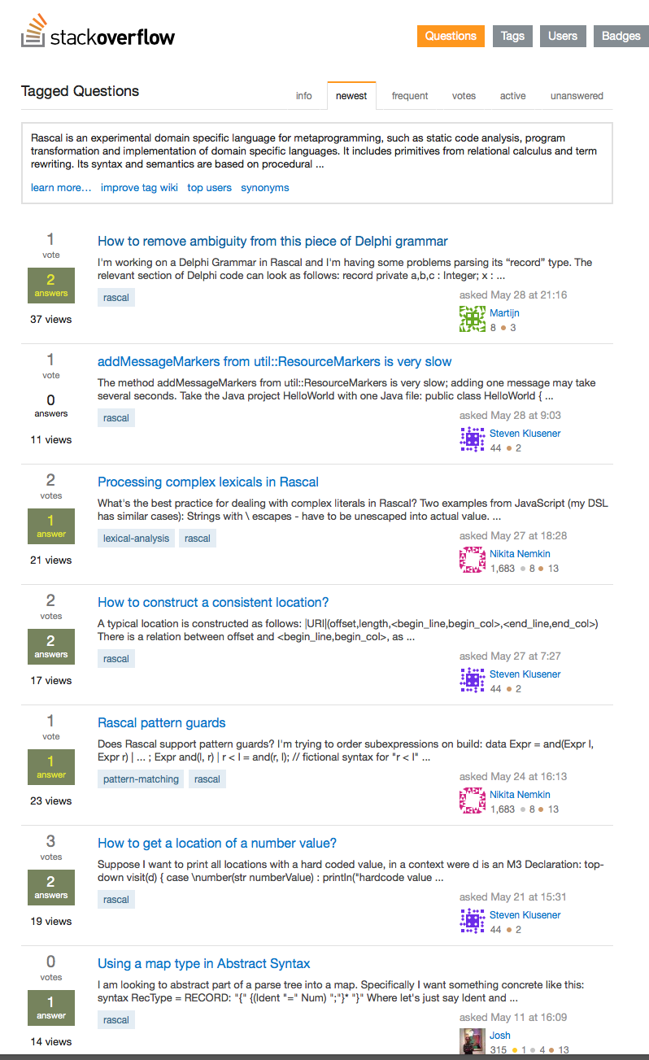

Slide 6

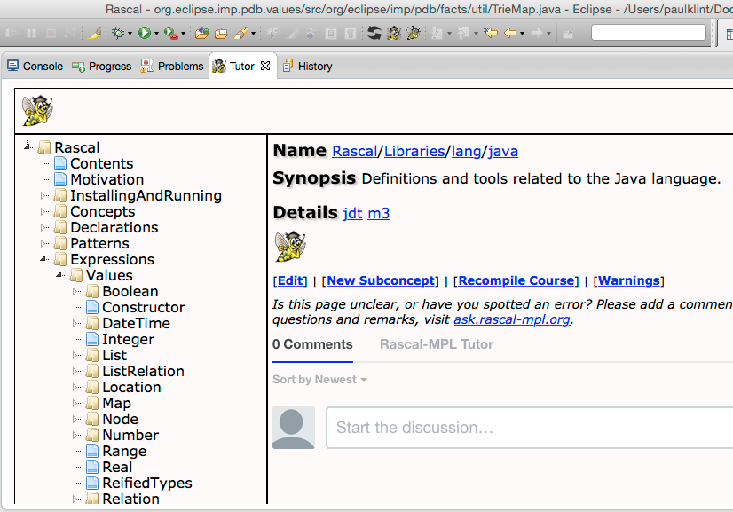
Further reading
http://www.rascal-mpl.org
http://tutor.rascal-mpl.org
http://stackoverflow.com/questions/tagged/rascal
Rascal tutor is always one click away

Slide 7

Thank you for Attending
If you are as excited about Rascal as we are:
Consider contributing!
We are happy
to answer questions or to cooperate

Slide 8
Some Ideas for Contributing
Integrating existing libraries (Weka)
Integrating existing tools (bridges to SMT solvers, R, proof tools, …)
Integrating with compiler frameworks (LLVM)
Designing a package manager for contributed code
...

