Slide 1
PLDI 2015 Workshop
Program Analysis and Transformation with Rascal aka
“EASY Meta-Programming with Rascal”
Mark Hills
Paul Klint
Jurgen Vinju
Joint work with:
Bas Basten, Anastasia Izmaylova, Davy Landman, Arnold Lankamp, Bert Lisser, Atze van der Ploeg, Michael Steindorfer, Jouke Stoel, Tijs van der Storm, Vadim Zaytsev and many others

Slide 2
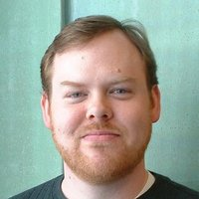
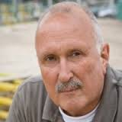
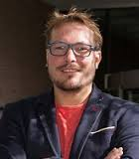
The Presenters
Mark Hills
Paul Klint
Jurgen Vinju

Slide 3
What We Planned ...
When | What |  | Who
14:00-14:10 | Welcome |  | Mark
14:10-14:30 | Overview Rascal |  | Paul
14:30-14:50 | Overview Exercises | Hack Your Javascript | Paul
14:50-15:10 |  | Java Analysis | Jurgen
15:10-15:30 |  | PHP Analysis | Mark
15:30-16:00 | Break | We can help you installing Rascal
16:00-16:45 | Work on exercises |  | You
16:45:17:15 | Q & A |  | All
17:15-17:25 | Current & Future work | Under the Hood: faster immutable datatypes | Jurgen
17:25-17:35 |  | PHP Analysis | Mark
17:35-17:45 |  | The Rascal Compiler | Paul
17:45-18:00 | Closing Discussion |  | All

