Slide 1
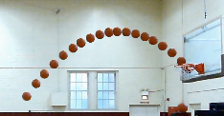

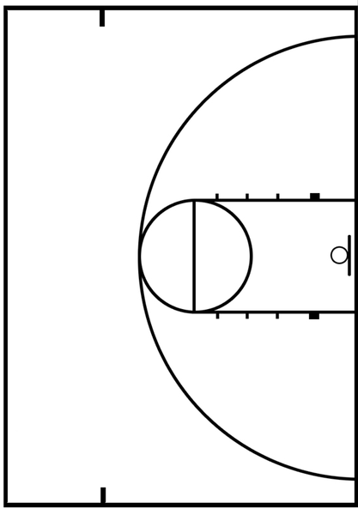
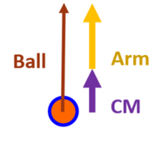

Ball Trajectory Defined at Release
Ball
Vertical
Velocity
Ball
Horizontal
Velocity
at Release
Shot Distance
Long (6.02, American high school three-point)
Required Ball Velocity
at Release
Medium (4.57, free throw)
Close (<2.5 m)
Notes:
Theoretical release and entry angles
Each shot type potentially affords different center of mass vertical velocities

Slide 2
Hypothesis:
Center of Mass vertical velocity contribution to Ball vertical velocity at Release
Free Throw
<
<
Step In
Jump Shot
Arm
Ball
Arm
CM
Ball
Ball
Arm
CM
CM

Slide 3
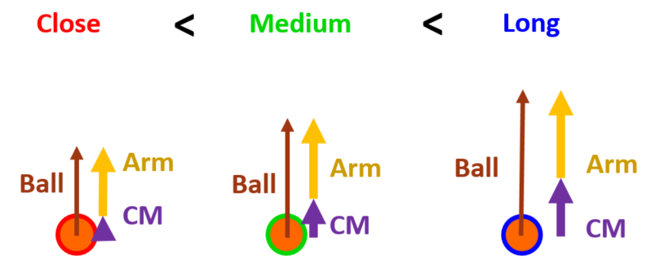
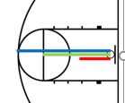
Known:
Ball velocity at release increases with shot distance
CM vertical velocity at release increases with shot distance
Unknown:
Does the increased CM velocity at release reduce the contribution from the arms

Slide 4
Ball
Arm
Ball
Arm
CM
CM

Slide 5
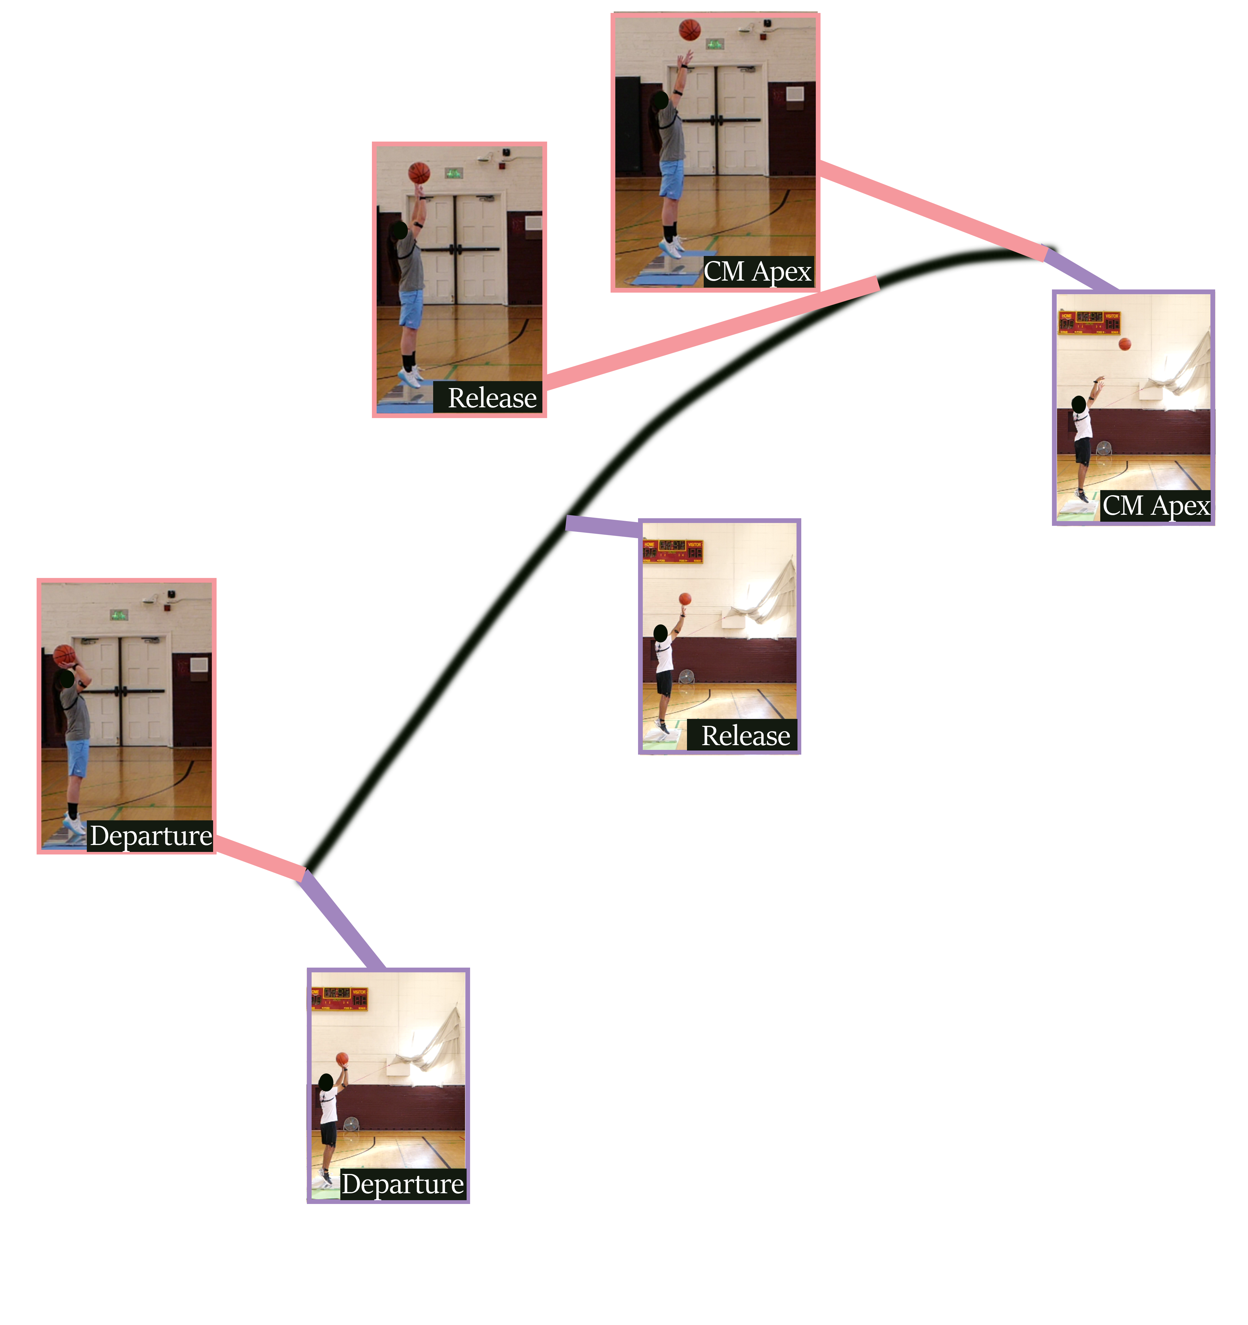
Ball Released Near Apex
Ball Released Further from Apex

