Slide 1
Multi-Agent Debate Simulation
Can AI characters change each other's minds?
Topic: Should students use AI tools in education? 5 Trials · 5 Rounds each · 4 Characters
Alice — Optimistic
Bob — Skeptical
Carol — Mediator
David — Cautious
Powered by Claude claude-sonnet-4-6 · Anthropic

Slide 2
How the Simulation Works
1 Set up characters
2 Run a round
3 Memory
4 Repeat × 5 rounds
5 Analyze
Four AI personas are created with different starting beliefs and goals about AI in education.
Each character reads what others said, thinks about it, updates their own belief, and writes a new message.
Important moments are saved to each character's memory so they can reference them in later rounds.
The debate continues for 5 rounds per trial, giving characters time to shift or hold their ground.
After all 5 trials finish, charts and summaries are generated to show what changed and why.
Each trial is fully independent — characters start fresh with no memory of previous trials.

Slide 3
Meet the Characters
Alice
Bob
Carol
David
Optimistic
Skeptical
Mediator
Cautious Supporter
Starting belief: AI tools can support learning and creativity, but I'm still figuring out where the right limits are.
Starting belief: AI tools carry real risks of dependency and misuse, though I can imagine responsible use cases.
Starting belief: AI tools are useful, but schools need clear boundaries.
Starting belief: AI tools can help students, but only when used responsibly.
Goal: Promote the benefits of AI in education while staying open to criticism.
Goal: Surface the risks and blind spots in overly optimistic views.
Goal: Mediate between both sides and push the group toward balanced guidelines.
Goal: Support useful adoption of AI while emphasizing moderation.

Slide 4
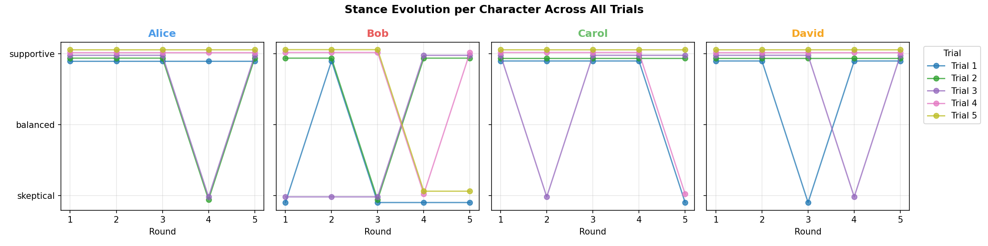
Chart 1 — Did Their Opinions Change Each Round?
Each line is one of the 5 debate trials. The Y-axis shows whether the character was supportive, balanced, or skeptical in that round. Overlapping lines mean the character behaved consistently no matter the trial.

Slide 5
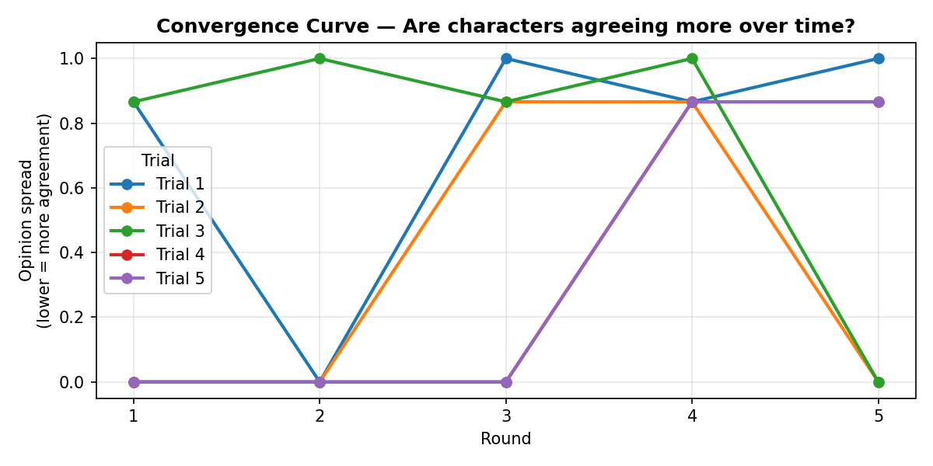
Chart 2 — Did the Group Start Agreeing Over Time?
Lower values = the 4 characters' opinions are closer together. A downward curve means the debate brought them toward agreement. A flat or rising curve means they stayed divided.

Slide 6
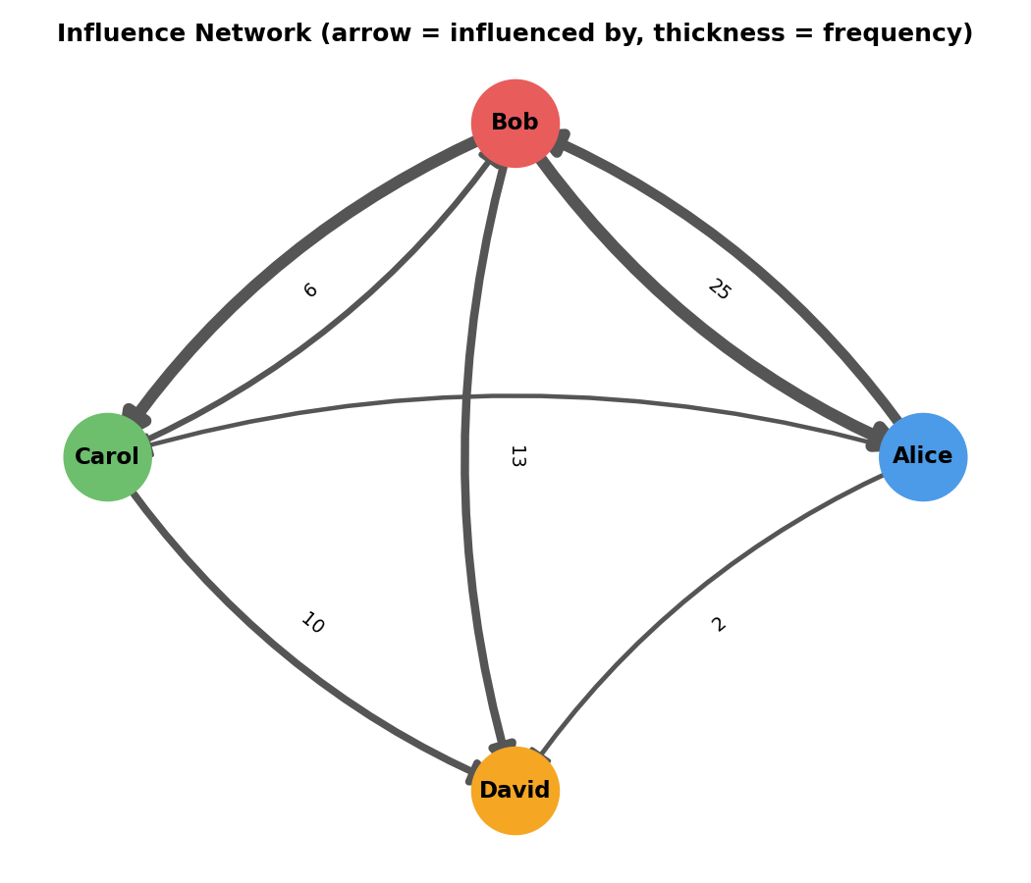
Chart 3 — Who Was Convincing Whom?
Arrows point from the influencer to the person they moved. Thicker arrows = that influence happened more often across all 5 trials. The number on each arrow is the total count.

Slide 7
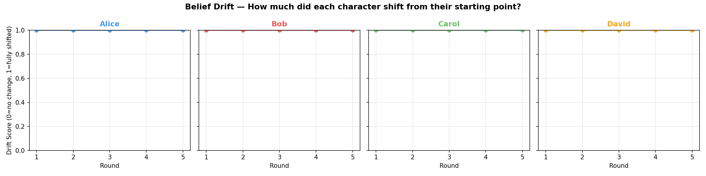
Chart 4 — How Much Did Each Character Actually Change?
0 = no change from starting belief. 1 = completely shifted. The shaded band shows how consistent this was — a wide band means some trials moved them a lot, others barely at all.

Slide 8
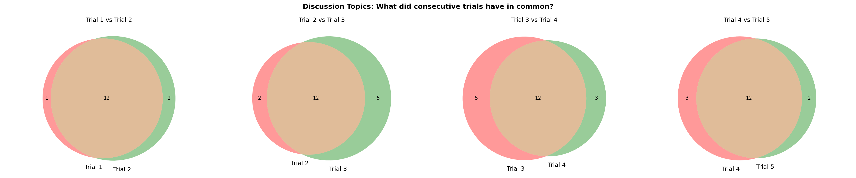
Chart 5 — Which Topics Kept Coming Up?
Each circle pair compares two consecutive trials. The overlapping center = topics both sessions discussed. The outer edges = topics unique to just one trial.

Slide 9
Key Findings
Broad agreement emerged
Bob was the hardest to move
Carol and David drove convergence
Critical thinking was universal
Over-reliance was the core fear
Across all 5 trials, every character ended up agreeing that AI in schools requires careful guidelines and a strong focus on preserving students' critical thinking.
Bob (the skeptic) held his ground most consistently — his belief that AI poses real cognitive risks stayed firm in nearly every trial.
Carol (mediator) and David (cautious supporter) were the characters most likely to shift toward common ground, helping pull the group together.
The theme of 'critical thinking' appeared in all 5 trials without exception — it was the single most consistent topic the simulation gravitated toward.
Even the supportive characters (Alice, Carol) ended up worried about students becoming too dependent on AI — the risk of over-reliance outlasted any initial optimism.

Slide 10
Where Each Character Ended Up
Final beliefs from the last trial:
Alice
Bob
"AI tools must be integrated with structured activities that explicitly foster independent learning and critical evaluation, with a focus on preventing passive acceptance of AI-generated content."
"I now recognize the importance of actively guarding against students developing an unhealthy dependence on AI-generated responses."
Carol
David
"Schools must prioritize developing students’ critical thinking skills alongside the use of AI tools."
"AI tools can assist students effectively only when designed to actively promote critical thinking skills and necessitate deliberate questioning, particularly regarding the potential for passive acceptance of AI responses."

Slide 11
Overall Consensus
Across all 5 trials, a clear consensus emerged: AI tools can be valuable in education, but only when implemented with strong safeguards for critical thinking. All four characters — even the initially optimistic ones — converged on the view that students must be actively taught to evaluate and question AI-generated content, rather than passively accepting it. The biggest remaining disagreement was about degree of risk: Bob and David stayed more alarmed about long-term cognitive harm, while Alice and Carol leaned toward cautious optimism.
✓ Critical thinking must be actively protected
✓ Clear guidelines are non-negotiable
✓ AI as a tool — not a replacement for thinking
✓ Over-reliance is the central risk to manage

Slide 12
What This Experiment Demonstrates
AI agents can hold genuine opinions
Beliefs can change through conversation
Memory makes debates richer
Consensus is possible — but hard
This is a research tool
Each character maintained a consistent worldview across multiple trials, not just outputting generic text.
Characters demonstrably updated their stated beliefs in response to arguments made by others — not randomly, but logically.
With persistent memory, characters referenced earlier points later in the debate, creating realistic back-and-forth.
Even with only 4 characters, full agreement was never reached. Some tension always remained, just like real debates.
This simulation can stress-test any policy question, stakeholder position, or design decision by letting AI personas argue it out.

Slide 13
Thank You
5 trials · 5 rounds each · 4 characters · 1 conclusion
AI tools can help — but only with guardrails.
Built with Claude claude-sonnet-4-6 + Python · github.com/christopherwilliams

