Slide 1
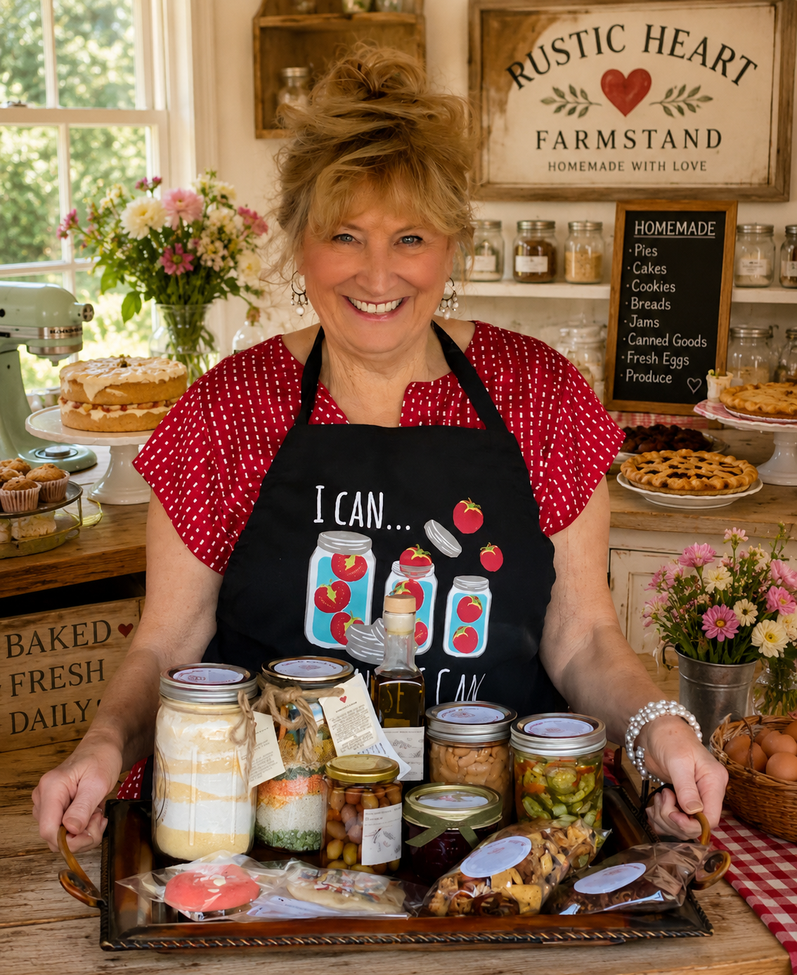

RUSTIC HEART
Homemade food. Proven recipes. A business in a box.
Rustic Heart pairs a working farmstand with a licensing arm that sells home cooks the recipes, playbook, and web presence to skip years of trial and error.
Debbie Crick · Founder · Cornville, Arizona
Preliminary pitch deck · July 2026 · Confidential

Slide 2
THE STORY
Meet Debbie Crick
Debbie built The Rustic Heart Farmstand on Cornville Road, Arizona — a roadside stand selling pies, cakes, cookies, jams, preserves, farm eggs, and jar mixes, all made from scratch. Open Thursday through Saturday, it has become a proven local business with sell-out products and a recognizable brand.
Along the way she solved every problem a home food business faces: which recipes sell, how to price them, how to comply with cottage-food rules, how to present a stand, and how to keep customers coming back.
“That hard-won know-how is the product. Rustic Heart sells the food — and licenses everything I learned making it.”

Slide 3



THE PROBLEM
Great home cooks fail as businesses — not as cooks
Years of trial and error
New producers burn seasons testing recipes, prices, packaging, and venues before anything reliably sells.
THE TYPICAL COTTAGE-FOOD BUSINESS
$2,000
median annual sales
$500
median annual profit
15 hrs/week
typical time invested for that return
No playbook exists
Cottage-food rules, labeling, costing, and display know-how are scattered — most learn by expensive mistakes.
Invisible online
Most home food businesses never get a real web presence, so discovery stops at the end of their street.
Institute for Justice survey of 775 cottage-food producers

Slide 4




THE OPPORTUNITY
The market is opening up fast
34 states
No sales cap
have created or expanded homemade-food laws since 2015 — a nationwide deregulation wave.
in Arizona: free registration, no permit fees, no kitchen inspection, and expanded wholesale under HB 2509.
1,400+
49%
new cottage-food businesses formed in Texas in the first year after legalization; 1,200+ in California.
of new U.S. business owners in 2023 were women (up from 29% in 2019) — the core cottage-food demographic.
Sources: Institute for Justice; Food Business Pros 50-state survey; Arizona Dept. of Health Services / HB 2509.

Slide 5


THE MODEL
One brand, two engines
THE FARMSTAND
THE LICENSE
Sell the food
Sell the know-how
Retail sales Thu–Sat on Cornville Road
Proven, differentiated products
Test kitchen for every new recipe
Cash flow and brand proof today
License proven recipes to home cooks
Business guidance that skips years of trial and error
Optional web domain + ready-built website
High-margin, scalable revenue
The flywheel: the farmstand proves what sells — every license ships recipes the stand has already perfected in front of paying customers.

Slide 6



THE PRODUCT
A license that skips the years of trial and error
STARTER
SIGNATURE
TURNKEY
Recipe Library
Recipes + Playbook
Business in a Box
Battle-tested recipe collection
Ingredient costing + sourcing notes
Scaling and shelf-life guidance
Everything in Starter
Pricing, packaging, and labeling guides
Cottage-food compliance walkthrough
Stand setup, sampling, and mentoring
Everything in Signature
Your own web domain
Ready-built brand website
Social + menu templates
Head start: two complete Rustic Heart website concepts are already designed — the web package ships from day one.

Slide 7


BUSINESS MODEL
Five ways Rustic Heart earns
Farmstand retail
Pies, cakes, preserves, eggs, coffee, jar mixes sold Thu–Sat
Recurring · today
License fees
One-time fee per home cook joining a tier (Starter / Signature / Turnkey)
One-time · high margin
Annual renewals
Yearly renewal for updated recipes, seasonal menus, and continued support
Recurring · compounding
Web packages
Domain + site build, plus modest annual hosting and upkeep
One-time + recurring
Wholesale & kits (future)
Jar-mix kits and branded goods supplied to licensees and local retailers
Future upside

Slide 8
ILLUSTRATIVE ECONOMICS
What the two engines could look like
Placeholder assumptions for discussion only — to be replaced with actual farmstand figures and validated license pricing.
ASSUMPTIONS (ILLUSTRATIVE)
Starter / Signature / Turnkey pricing
$1,500 / $4,500 / $7,500
Annual renewal
$500 per licensee
Licensees signed
Yr 1: 6 · Yr 2: 15 · Yr 3: 28
Farmstand gross (est.)
$60k, growing ~10%/yr

Slide 9



TRACTION
The flagship already works
Operating now
Open Thursday–Saturday on Cornville Road, with regulars and roadside traffic
Sell-out demand
Farm eggs routinely sell out; samples convert passers-by into customers
Differentiated goods
Gluten-free carrot cake, Lemon Buttermilk pie, $22 local-roast coffee, soup & salad jar mixes
Brand already built
Logo, voice, and two complete website concepts designed and ready to deploy

Slide 10
PRECEDENTS
Home kitchens have scaled before
Nothing Bundt Cakes
Auntie Anne’s
Mrs. Fields
Started in a Las Vegas home kitchen (1997)
Began at a Pennsylvania farmers-market stand (1988)
One home chocolate-chip cookie recipe (1977)
Grew into 500+ bakeries across North America on the strength of a tight, proven product line.
One perfected pretzel recipe became a global franchise with thousands of locations.
Later pivoted to a licensing-driven model — proof that the recipe and brand, not the storefronts, carry the value.
The Rustic Heart twist: instead of $250k+ franchises, license the recipes and playbook at a price a home cook can actually afford — and grow with a thousand small kitchens.

Slide 11
ROADMAP
From one stand to a thousand kitchens
1
Formalize the IP
2
Pilot licensees
3
Expand the table
NOW – 6 MONTHS
6 – 18 MONTHS
18 MONTHS +
Document recipes, costing, and the playbook
Trademark Rustic Heart brand
Draft license agreements with counsel
Keep flagship revenue growing
Sign 3–5 pilot home cooks in Arizona
Launch the Turnkey web package
Refine support + renewal model
Capture testimonials and results
Roll out across food-freedom states
Licensee community and seasonal menus
Wholesale jar-mix and kit line
Explore regional farmstand partners

Slide 12


EYES OPEN
Risks and how the structure answers them
License vs. franchise line
Recipes are weak IP alone
A trademark license + significant assistance + a fee can legally be a franchise under the FTC Franchise Rule, triggering FDD disclosure. Structure the license deliberately with counsel — or comply as a low-cost franchise.
Recipes per se are not copyrightable. Value is protected by bundling: trade-secret playbook, trademarked brand, ongoing support, and renewals.
Cottage-food rules vary by state
Food safety & liability
Arizona is highly favorable; other states cap revenue or venues. Licensee eligibility must be screened state-by-state as the map expands.
Licensees are independent businesses — agreements must require training and insurance, and disclaim any agency relationship with Rustic Heart.
Preliminary business summary — not legal advice. Licensing structure to be confirmed with franchise counsel.

Slide 13


RUSTIC HEART
Let’s set a bigger table.
Validate pricing
Engage counsel
Package the IP
Replace placeholders
Interview 10 prospective home-cook licensees on tier pricing and demand
Franchise/licensing attorney to structure the license the right way
Finish documenting recipes, costing, and the operating playbook
Load actual farmstand financials into this deck
[ The ask — funding amount or partnership terms — to be added once financials are final ]
Debbie Crick · Rustic Heart · Cornville, Arizona · Homemade with love

