Slide 1
Moody's for Compliance
Commercial Model Proposal
1 / 12

Slide 2
Legacy SKU Architecture Is Creating Commercial Friction Across Compliance
📄
💰
Expansion Triggers New Contracts
Inconsistent Pricing
Every add-on requires a full procurement cycle — legal review, new terms, weeks of delay
Same data, different rates depending on delivery method — API vs platform vs bulk feeds
📋
🔀
Disparate Terms
Fragmented SKUs
Different overage clauses, usage definitions, and renewal terms across legacy products
Orbis Global, EVA Essentials, GRID Review, AI Review — customers see 4-5 line items for one solution
The Result
Confused sellers • Expansion friction • Revenue leakage • Lost deals to competitors with more flexible models
2 / 12

Slide 3
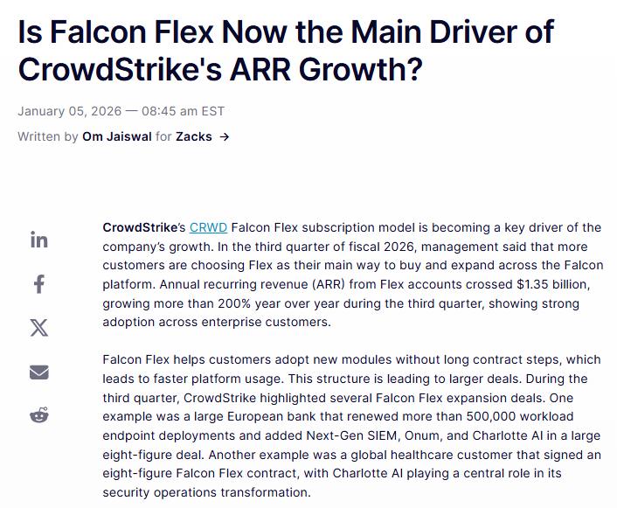
The Market is Converging on Modular Packaging and Pricing by Consumption to Drive Growth
GARTNER, 2024
MONEVATE B2B SAAS PRICING STUDY, 2025
Enterprises Demand Composable Architectures
Base + Modular Packaging Driving Superior Growth
Medium to large enterprises are shifting to modular, flexible architectures — and they expect pricing models that match.
Companies using Base + Modular packaging grow 2x faster with >100% NRR (vs companies deploying traditional tiered G/B/B models)
Compliance
Dun & Bradstreet
LexisNexis (RiskNarrative)
LSEG WorldCheck
Fenergo
Winning Deals
Platform + Bundles
Usage Points
Platform License x Entity Volumes
Packages data into modular "data blocks" that customers select and consume via APIs & flat files for specific use cases.
Base annual license fee for platform access, plus prepaid data bundles for KYC/AML, drawn down as and when consumed.
Annual points-based model — customers purchase a single pool that can be consumed across multiple screening products.
Base platform license with additional fees for specific CLM/KYC modules and workflows, adjusted around client/entity volumes & scope.
Adjacent
Palantir
Crowdstrike Falcon Flex
Platform + Usage
Modular ‘all in’ subscription model
Platform licenses sold separately from usage-based consumption modules.
Committed annual spend subscription model where customers purchase a flexible pool of subscription value that can be allocated across Falcon modules freely.
3 / 12

Slide 4
OUR PROPOSAL
1
Access Package
+
2
Usage Allowance
One Agreement.
Two Line Items.
Built for Land & Expand.
4 / 12

Slide 5
Everything Starts with One Access Package Selection
Select delivery infrastructure based on how you want to consume M’ Compliance capabilities
Integrate
Express
Scale
Enterprise
UI, API & MCP
+ Pre-configured workflows
+ Custom builder
+ Bulk feeds
+ Dedicated support
From $10k
From $25k
From $75k
From $150k
All package names, pricing, and features shown are illustrative for presentation purposes only. Final pricing and packaging subject to change.
5 / 12

Slide 6
Customers Commit to an Annual Spend Based on Entity Volumes & Use Case
Higher commitment = deeper discounts.
Level 1
$10k – $49k
Entry
Level 2
$50k – $149k
Growth
Level 3
$150k – $399k
Scale
Level 4
$400k – $749k
Expansion
Level 5
$750k – $1M
Enterprise
Level 6
$1M+
Strategic
Step-Up Only
Customers can increase commitment anytime. Discounts apply immediately.
6 / 12
All spend bands, discount levels, and level names shown are illustrative for presentation purposes only.

Slide 7




All Consumption Burns Down from the Same Allowance
One pool of credits. Three consumption categories. No silos.
Entity Data
Screening & Risk
Agents
Company profiles, ownership structures, financials, registry data
Sanctions, PEPs, adverse media checks
AI-powered IDD reports, screening agents
🖥️
🔌
🤖
→
Same Price
Platform
API
MCP
Delivery-agnostic pricing: capabilities cost the same regardless of channel consumed through
Future-Proof: Allowances Work Toward New Capabilities
As Moody's releases new capabilities — including AI agents & risk insights — customers can leverage their existing usage allowance.
No new contracts required.
7 / 12
Consumption categories, unit rates and module names shown are illustrative for presentation purposes only. Final modules and pricing subject to change.

Slide 8



Designed to Scale Seamlessly from Long‑Tail SMBs to Enterprise Level
Illustrative configurations — not packages.
Customers activate only what they need at a price point they are willing to pay.
KYC Onboarding
Client Due Diligence & KYC
Enterprise Compliance Program
Screen individuals for sanctions exposure at onboarding
Conduct KYC/KYB, monitoring & generate EDD reports
Centralised compliance across jurisdictions
MODULES: SCREENING AGENT, SANCTIONS, PEPS
MODULES: IDD AGENT, SANCTIONS, PEPS, ADVERSE MEDIA
MODULES: ALL AGENTS, ALL SCREENING, ENTITY DATA
Integrate + Level 1
Scale + Level 3
Enterprise + Level 5
$10k–$49k/yr
$150k–$399k/yr
$750k–$1M/yr
Example ACV
$30k/yr
Example ACV
$200k/yr
Example ACV
$850k/yr
All configurations, example ACVs, package names, and pricing shown are illustrative for presentation purposes only.
8 / 12

Slide 9
The Result Is a Simplified Order Form with Consolidated SKUs
Before: Legacy Order Form
After: Moody's for Compliance
LINE ITEMS REQUIRED:
Orbis Global: $45,000
LINE ITEMS REQUIRED:
Orbis National: $25,000
Access Package (Express): $25,000
GRID Review: $35,000
Usage Allowance (Level 3): $125,000
AI Review: $20,000
Screening Agent: $15,000
Total: $150,000
ESG Data: $10,000
Benefits:
Total: $150,000
Activate modules without re-negotiation. Delivery-agnostic pricing. Allowances for future AI capabilities.
6 separate SKUs, different terms, new order forms needed for expansion
All pricing shown is illustrative for presentation purposes only.
9 / 12

Slide 10
Pricing Configurator
Demo
10 / 12

Slide 11
The Decision
Move to Unified Model
Continue with Legacy SKUs
Two line items
Streamlined expansion
Delivery-agnostic pricing
Competitive parity
Multiple line items
New contracts for expansion
Inconsistent pricing
GTM friction continues
✓ Approve as Default
11 / 12

Slide 12




Next Steps & Key Enablers
Key Enablers
Timeline
Metering Across All Delivery Channels
January (In Progress)
Platform, API, MCP — centralised tracking
Define M4C scope, access packages and consumption events. Finalise by end of month.
Self-Serve Reporting
February
Customer usage and allowance visibility
Set pricing. Finalise requirements and submit for April Phase 1 release.
Automated Billing
Streamlined invoicing tied to consumption at scale
April — Phase 1 Apttus Release (Target)
New codes for access package pricing and consumption through platform/API (MCP phase 2).
Simplified Contracting
Two-line items, one master agreement, online/appended rate cards
12 / 12

