Slide 1
Project Valence
October 23rd, 2023
Nicolas Ansell, Julian Gonzales Michael Osachoff, Cameron Wilson

Slide 2
What is Project Valence
Project Valence is a casual strategy game based on chemistry where you make products to fulfil a contract daily (in game day).
Reframing as a “Casual Strategy Game” as we felt these labels fit better
Chemistry has complex equipment and nearly endless “products” that can be made in game

Slide 3
Individual Contributions
Nicolas
Business Case
low-fi prototype
Vlog editing / posting
Story Boarding
Julian
Stakeholder Engagement Plan and Stakeholder Register
Jira setup
Low-fi prototyping
Michael
Scope Statement
low-fi prototype
Story Boarding
Cameron
Raci Chart, Requirements and Communication Plan
low-fi prototype
Scrum Visual Aid creation
Story board

Slide 4
Similar Games to Project Valence
Plate Up, our main inspiration
Binding of Issac
Ideas taken from For the King
Factorio (different machines for different things)
Stardew Valley (inspiration for some assets)

Slide 5

Documentation
Business Case
Communication Management
Project Requirements
Project Scope Statement
RACI Chart
Stakeholder Register
Stakeholder Engagement Plan

Slide 6
Business Case
Create a relaxing and casual game based on chemistry inspired by ‘Plate Up’
Contract Based system
Randomness is desired to keep the game interesting
Record the ‘story’ of the run to have a record of all runs completed

Slide 7
Requirements
Technical
8gb Ram max usage
Runs on low power GPUs
Controller support
Runs on Windows and Linux
Functional
Room is randomly generated at the start of each playthrough
Unlock order is pseudorandom (need to meet minimum requirement before its random)
Tutorial Level

Slide 8
Scope Statement
Detailed level design desires
New laboratory walls each run (not each day)
Explore and re-arrange the laboratory
Player Mechanics
Tired contracts
Build Phase
End of game if contract is failed
Post Game
See paths taken
See what I could not create in a run
Spend currency

Slide 9
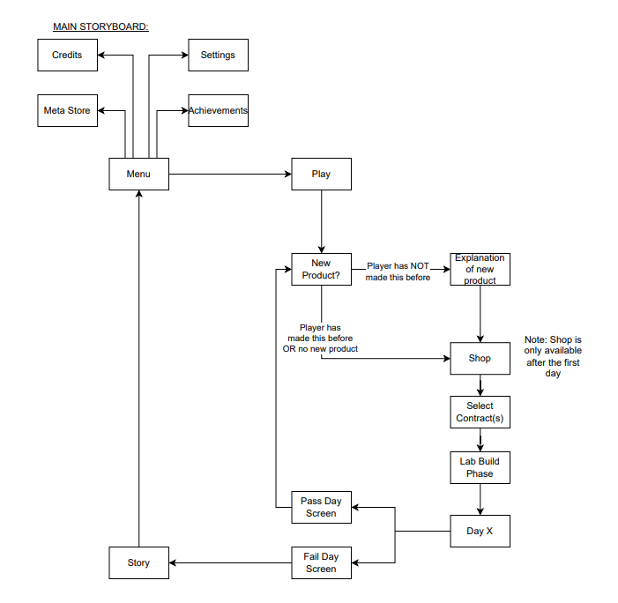
Storyboard

Slide 10
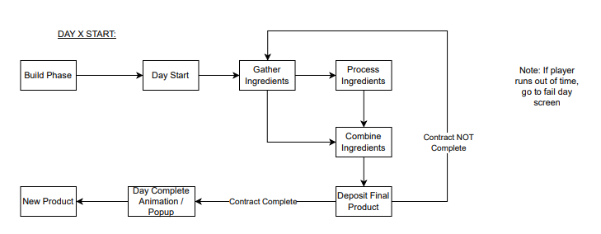
Storyboard cont.

Slide 11
Roadmap
MVP #1 – Playtest, Completed by November 20th
Tutorial Level Complete
Basic products (~2) that can be made within 2 machines
Contract Selections (~4 contract options)
Single lab layout (not yet random)
Post play screen implementation for pass and failure
Simple Audio assets (music nice to have, not need to have)
MVP #2 – Increase Randomness! Completed by January 20th
Random Level Generation
More verbose story creation
Increase products
Add 2 More machines (TBD the machines)
Store implementation
Master list of unlockable items
Add Machine animations

Slide 12
Roadmap cont.
MVP #3 – Implement RAMS! Completed sometime in early March
Player has increased methods of failure (slips, trips, falls, explosions?)
Add more dangerous machines and recipes
Clients are now characters instead of abstract names
Mini Game implementation for 2 machines
MVP #4 – Beta release, Completed before project day
6 Machines, 25 recipes (loose numbers)
Character augmentations / customizations
Tired Machines
Meta store
In game store
Mini Game implementation for most machines
Music for menus, normal play and “near failure” states
MVP #5 – Version 1.0, More fun with friends!
Multiplayer!
Stock is no longer infinite, it costs money (in-game, not real)!
Product Purity
Mini Game implementation for all machines

Slide 13
Future
Obtain Visual Asset Pack (within the next few days)
Prioritization of tasks for MVP #1 (after this scrum)
Finalize the set of code style guidelines
Planning Machines / Products to implement in future MVPs
Make a ubiquitous language sheet
Most of MVP #1 should be completed

Slide 14
Reflection
Colour status
Yellow
No running code, very little proof of concept work
How to get back to green
Increase in meeting time allocation
Group working sessions planned weekly

