Slide 1
BinaryKids
Meghan Anand, Chris Wing,
Julia Kieserman, De’Ahna Johnson
COSC 150
Spring 2015

Slide 2
The Problem
Computer science courses in K-12 education are fading from the national landscape at the very moment they are needed most. Introductory secondary school computer science courses have decreased in number by 17 percent from 2005. The number of Advanced Placement (AP) Computer Science Courses has similarly decreased by 33 percent.
Despite its critical and growing importance, computer science is taught in only a small minority of U.S. schools. There currently are just over 42,000 high schools in the United States. But only 2,100 of them were certified to teach the AP computer science course in 2011, and in fact only 21,139 students took the AP exam.

Slide 3
The Problem
The percentage of U.S. high school students taking STEM courses has increased over the last 20 years across all STEM disciplines except computer science where it dropped from 25% to 19%
Nearly all college computer science majors (98%) reported being exposed to CS prior to college, compared to less than half of non-CS majors (45%). Exposure varies from reading about CS, after school programs, camps, or classes.
By 2020, the United States will have more than 1 million vacant programming/computing jobs with only 400,000 computer science graduates available to fill them.

Slide 4
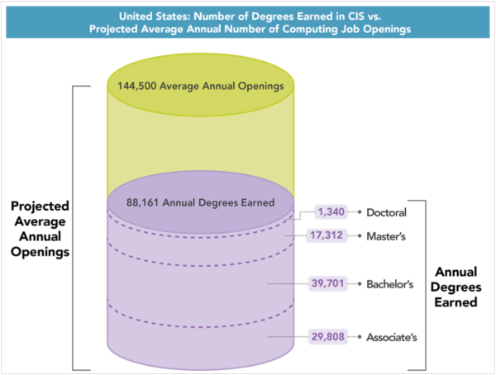

Slide 5
The Solution
Teach middle school-aged children about binary numbers and their importance to computing/electronics
Introduce them to conversions between binary and decimal numbers with interactive tutorials and practice problems
Allow them to apply their skills with a multi-level game
Suitable for in-class math instruction or at-home enrichment
Concept learning and skills learning

Slide 6
BinaryKids
Learning module on binary numbers and their importance to computing
Learning module on relationship between binary numbers and decimal numbers
Interactive learning module on how to convert from decimal to decimal numbers
Interactive learning module on how to convert from binary to decimal numbers
Game (needs name)

Slide 7
The Audience
Middle school aged students
Basic math and algebraic knowledge
Basic computer knowledge
Lesson could be integrated to algebra (I or II) units on exponents or logarithms

Slide 8
BinaryKids Design Principles
MVC (controller class extends applet)
Model
View: different Jpanels
Controller: controller class handles page navigation and communication between views
Interfaces for learning modules, practice problems
Animations done using timers, action listeners
Separate package for game and tutorials

Slide 9
Sources
http://www.computinginthecore.org/facts-resources
2009 NAEP High School Transcript Study
Source: A National Talent Strategy: Ideas for Securing U.S. Competitiveness and Economic Growth
TechCrunch “Closing the Computer Science Gap, From Classroom to Career.” http://techcrunch.com/2015/02/01/integrate-california-schools-with-computer-science/
Source: COLLEGE BOARD, IS AP EXAM PARTICIPATION AND PERFORMANCE RELATED TO CHOICE OF COLLEGE MAJOR? (RESEARCH REPORT 2011-06, 2011), available at http://professionals.collegeboard.com/profdownload/pdf/RR2011-6.pdf. Google, Survey Results of U.S. Employees (2010) (unpublished).
http://www.exploringcs.org/resources/cs-statistics

Slide 10
Demo

