Slide 1
Markov Logic Networks An Introduction
Prepared by
Chris Winsor
6/9/2022

Slide 2
Agenda
Motivation and Overview
Declarative Representation and First Order Languages
Probabilistic Representation and Graphs
Markov Logic Networks
Examples

Slide 3
About Me
PhD Student at University of Massachusetts, Lowell
Statistical Relational Learning
Probabilistic Graphical Models
Markov Logic Networks
Consultant at www.cwinsorconsulting.com
Proof-of-Concepts, Benchmarking, Algorithms
Software Engineer at Rapid Micro Biosystems in Lowell, MA

Slide 4
References
Richardson, Matthew, and Pedro Domingos. "Markov logic networks." Machine learning 62.1 (2006): 107-136.
Domingos, Pedro, and Daniel Lowd. "Markov logic: An interface layer for artificial intelligence." Synthesis lectures on artificial intelligence and machine learning 3.1 (2009): 1-155.
Judea Pearl. 1988. Probabilistic Reasoning in Intelligent Systems: Networks of Plausible Inference. Morgan Kaufmann Publishers Inc., San Francisco, CA, USA.
Koller, Daphne, and Nir Friedman. Probabilistic graphical models: principles and techniques. MIT press, 2009.
Russell, Stuart, and Peter Norvig. "Artificial intelligence: a modern approach." (2002).
Neapolitan, Richard E. Learning bayesian networks. Vol. 38. Upper Saddle River: Pearson Prentice Hall, 2004.
Kolmogorov, A. N. "Foundations of the Theory of Probability, trans." Nathan Morrison (1956). Chelsea, New York (1933).
Genesereth, Michael R., and Nils J. Nilsson. Logical foundations of artificial intelligence. Morgan Kaufmann, 2012.
Friedman, Nir, et al. "Learning probabilistic relational models." IJCAI. Vol. 99. 1999.
URLs:
Alchemy: http://alchemy.cs.washington.edu
Coursera PGM: https://www.coursera.org/specializations/probabilistic-graphical-models
Stanford ML with Graphs: https://web.stanford.edu/class/cs224w/
Notes:
Get a hard copy !

Slide 5
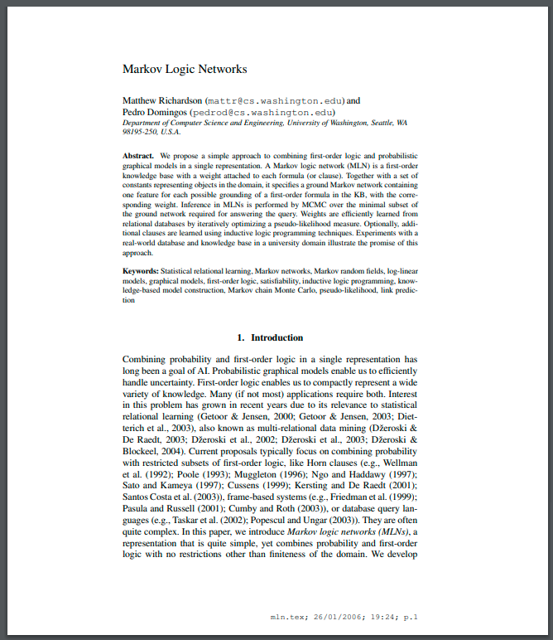
Markov Logic Networks What are they?
A probabilistic logic which applies the ideas of a Markov Network to first-order logic, enabling uncertain inference. (source: Wikipedia)
Research led by Pedro Domingos, Matt Richardson at University of Washington (first published in 2006)

Slide 6
Terminology and Motivation Logic + Probability
First-order Language:
A formal language for representing logical (True/False) knowledge
Rules and algorithms for inference (deriving new facts from existing facts)
Probabilistic Graphical Model:
Graph for representing uncertainty and probabilistic relations
Algorithms for learning and inference in the face of uncertainty.
Motivation:
Combine power of FOL with flexibility of Probabilistic Representation

Slide 7
Declarative Knowledge and First Order Language

Slide 8
Declarative Knowledge Conceptualization
A conceptualization is the objects and relationships that define the domain of interest
A set of Objects
A set of Relations
A set of Functions
Objects are things (Confucius, the sun, the number 2, justice)
Relations take in Object/s and evaluate to True/False
Functions take in Object/s and evaluate to an Object
Formally a conceptualization is the triple: ({objects}, {relations}, {functions})
Reference: Genesereth and Nilsson

Slide 9
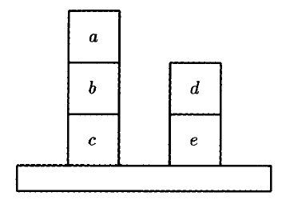
Example: Blocks World
Reference: Genesereth and Nilsson

Slide 10
Example: Blocks World
Objects:
Relations:
Functions:
Reference: Genesereth and Nilsson

Slide 11
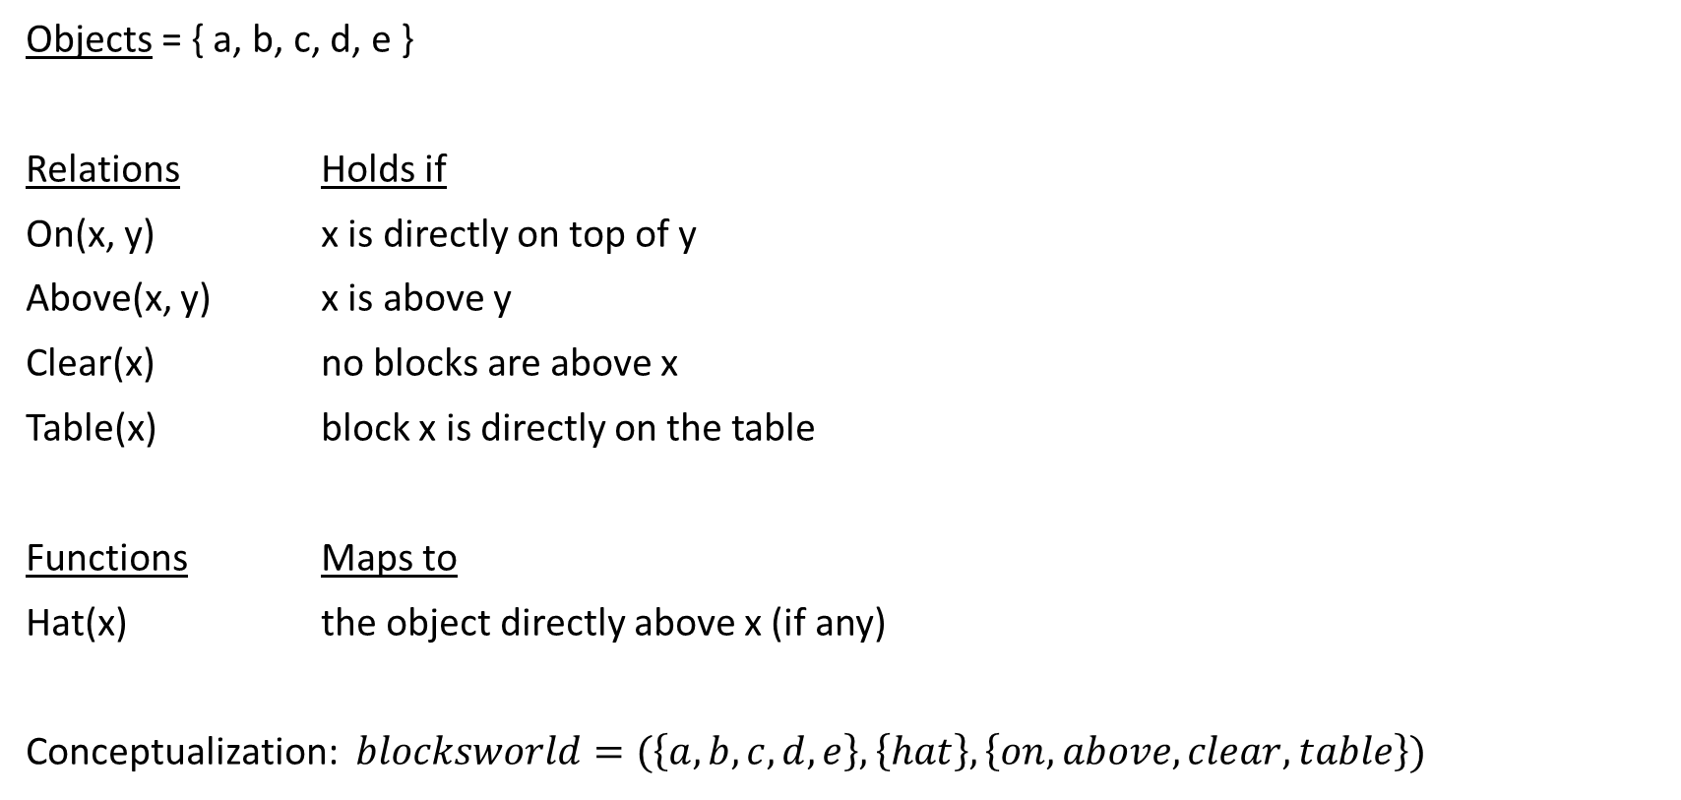
Example: Blocks World
Objects = { a, b, c, d, e }
Relations Holds if
On(x, y) x is directly on top of y
Above(x, y) x is above y
Clear(x) no blocks are above x
Table(x) block x is directly on the table
Functions Maps to
Hat(x) the object directly above x (if any)
Conceptualization: $blocksworld=(\left\{a, b, c, d, e\right\}, \left\{hat\right\}, \left\{on, above, clear, table\right\})$
Reference: Genesereth and Nilsson

Slide 12


Predicate Calculus Knowledge Expressed as Sentences
Confucius is not 100 years old
If George is at home, then George is sick
Reference: Genesereth and Nilsson

Slide 13

Predicate Calculus Logical Operators and Quantifiers...
Negation
Conjunction, Disjunction
Implication
Equivalence
Universal Quantifier (“for all...”)
Existential Quantifier (“there exists...”)
Reference: Genesereth and Nilsson

Slide 14
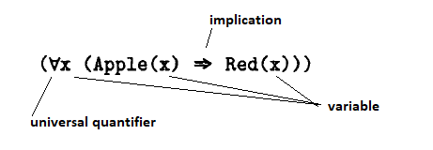

More examples
All apples in the world are red
There exists at least one red apple in the world
Reference: Genesereth and Nilsson

Slide 15
Inference in a Declarative Representation (an example)
We know that horses are faster than dogs
There is a greyhound that is faster than every rabbit
Harry is a horse and Ralph is a rabbit
Is Harry faster than Ralph?
Reference: Genesereth and Nilsson

Slide 16
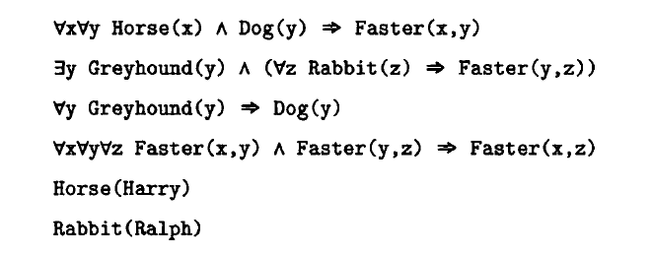

Inference in a Declarative Representation
Horses are faster than dogs
There is a greyhound that is faster than every rabbit
Harry is a horse and Ralph is a rabbit
Is Harry faster than Ralph?
Derive →
Reference: Genesereth and Nilsson

Slide 17
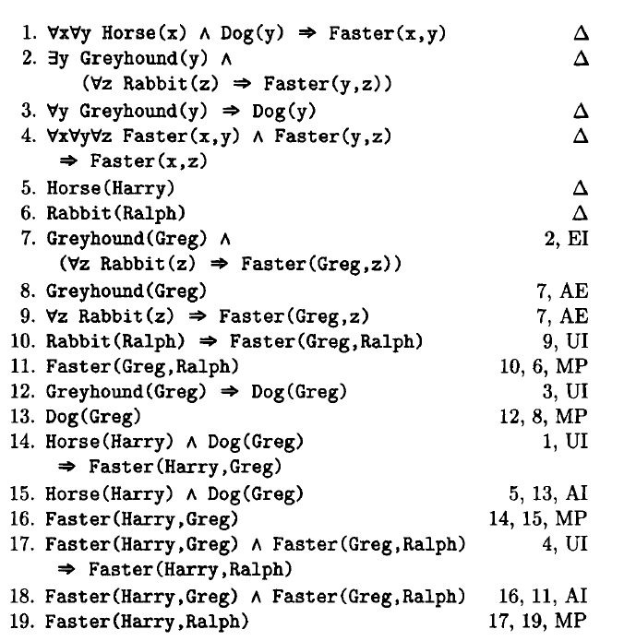
and the answer is...
Harry is indeed faster than Ralph
Note:
Inference uses only standard rules of deduction – nothing specific to the domain.
Reference: Genesereth and Nilsson

Slide 18
but there’s more...
Ask any question...
Are all horses faster than all rabbits?
Is there any horse that is slower than Greg?
Add knowledge, extend the domain...
If turtles are slower than dogs, can we conclude all turtles are slower than rabbits?
Represent partial knowledge
Waldo is faster than Ralph and slower than Greg. (We don’t know what animal Waldo is, but we can add this partial knowledge to the Knowledgebase)

Slide 19
Declarative Representation + Logical Reasoning In Summary:
A Conceptualization establishes the domain of interest (objects, functions, relations)
Rules of inference are domain independent (no custom code)
New knowledge can be added to the model easily (as a new sentence)
Any domain-related question can be asked of the model – its not purpose-built

Slide 20
Declarative vs Procedural Representation
Task | Procedural Code | Declarative / FOL
Deriving facts from other facts | Domain-specific procedure | Entirely domain independent
Adding new knowledge | Implementation dependent | Add sentence to KB
Adding partial knowledge (stoplight #4 is not green) | Re-code | Add sentence to KB
Reference: Russell, Norvig Chapter 8

Slide 21
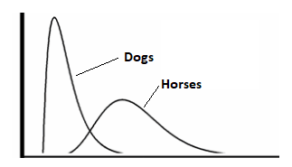

The problem w/ FOL
Sensors are unreliable...
Data is messy...
A rule may not hold for all cases.
One bad observation can spoil a model

Slide 22
Probabilistic Representation

Slide 23
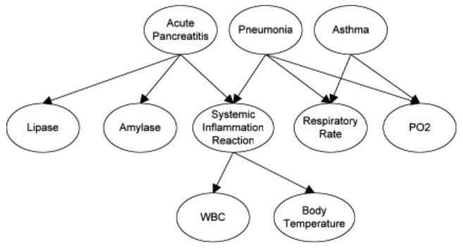
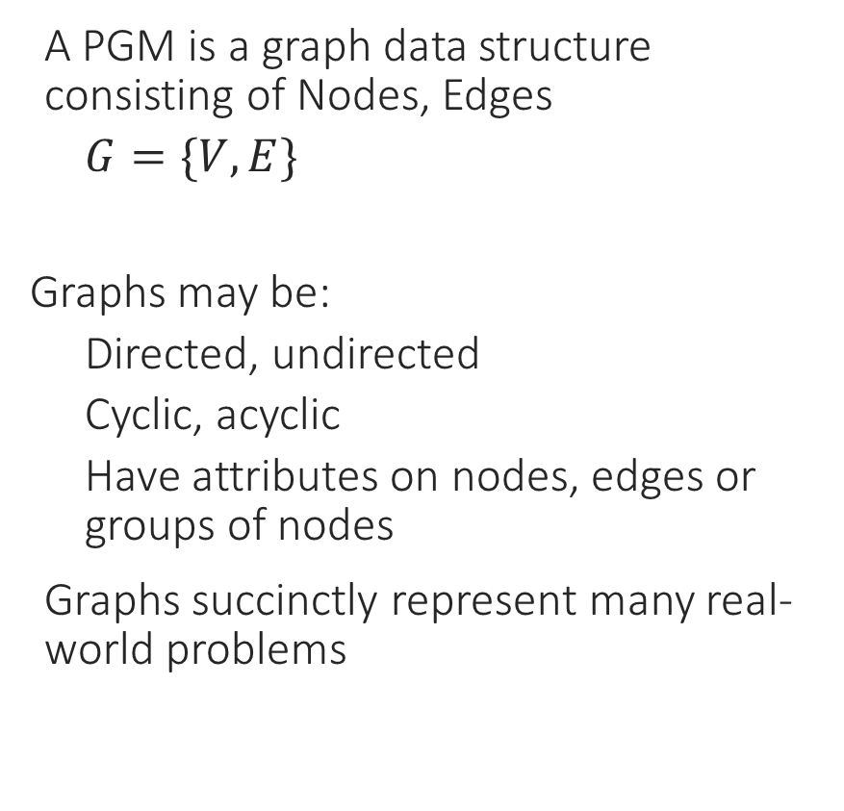
Probabilistic Graphical Models (PGMs)
A PGM is a graph data structure consisting of Nodes, Edges
$G=\{V, E\}$
Graphs may be:
Directed, undirected
Cyclic, acyclic
Have attributes on nodes, edges or groups of nodes
Graphs succinctly represent many real-world problems
Medical Diagnosis (directed, acyclic)
Jau-Huei Lin, Peter J. Haug, Exploiting missing clinical data in Bayesian network modeling for predicting medical problems, Journal of Biomedical Informatics, Volume 41, Issue 1, 2008, Pages 1-14, ISSN 1532-0464, https://doi.org/10.1016/j.jbi.2007.06.001.

Slide 24
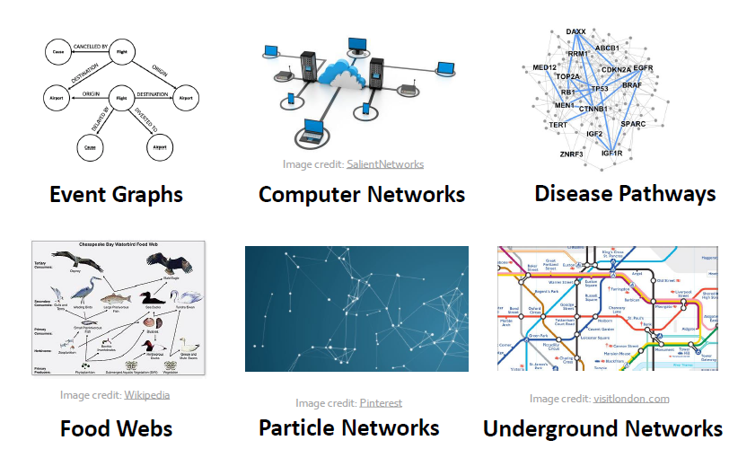
Graphs

Slide 25
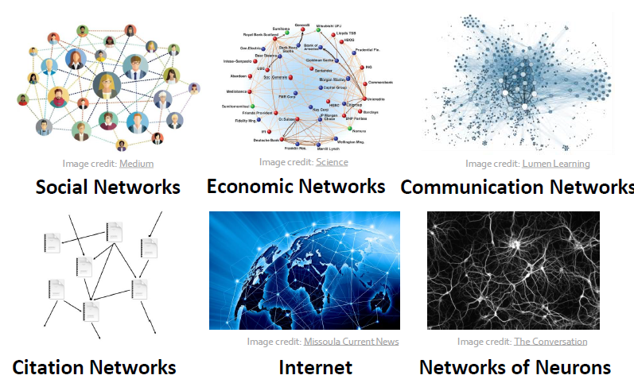
Graphs

Slide 26
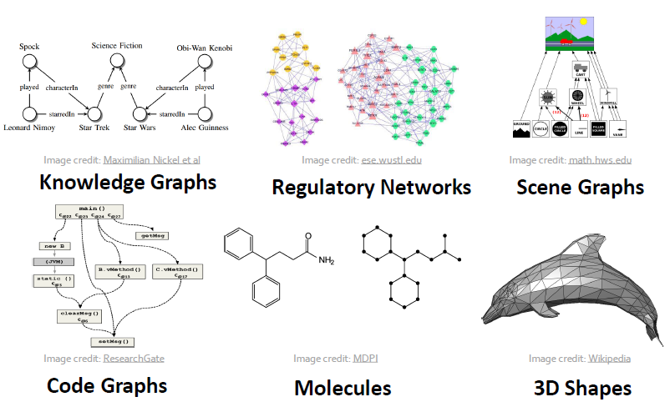
Graphs

Slide 27
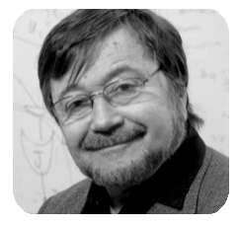
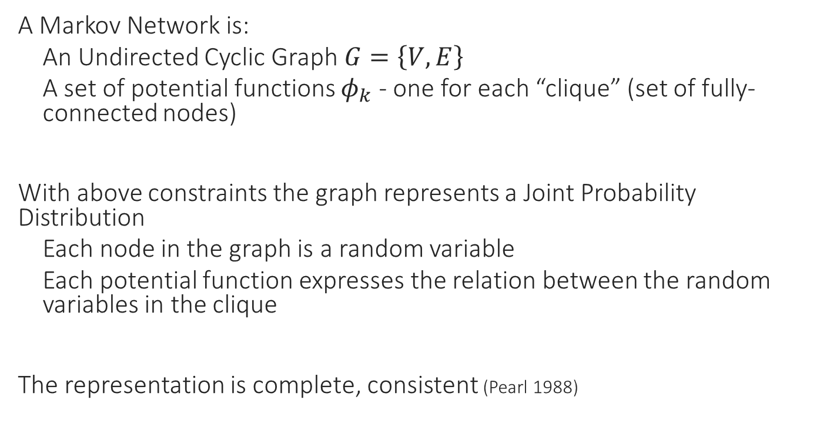
Markov Network A Graph representing a Joint Probability Distribution
A Markov Network is:
An Undirected Cyclic Graph $G=\left\{V,E\right\}$
A set of potential functions $φ_{k}$ - one for each “clique” (set of fully-connected nodes)
With above constraints the graph represents a Joint Probability Distribution
Each node in the graph is a random variable
Each potential function expresses the relation between the random variables in the clique
The representation is complete, consistent (Pearl 1988)
Judea Pearl

Slide 28
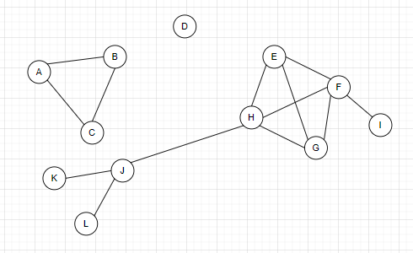
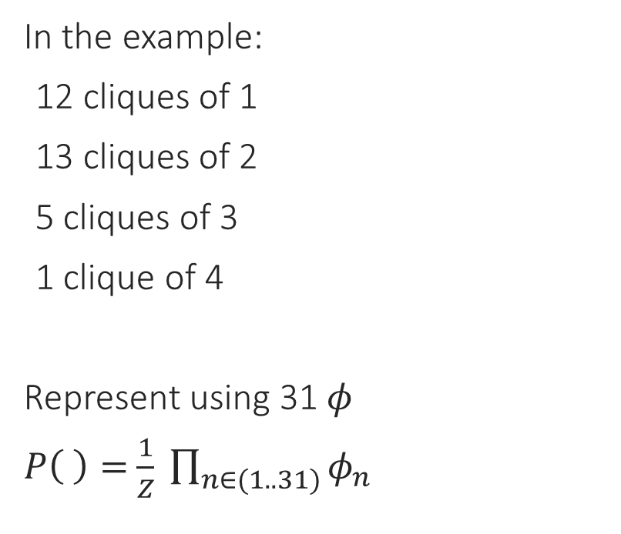
Clique a fully connected subgraph
In the example:
12 cliques of 1
13 cliques of 2
5 cliques of 3
1 clique of 4
Represent using 31 $φ$
$P\left( \right)=$ $\frac{1}{Z} \prod_{n∈(1..31)}{φ_{n}}$
$\{φ\}$ is a complete and consistent expression of relationships

Slide 29
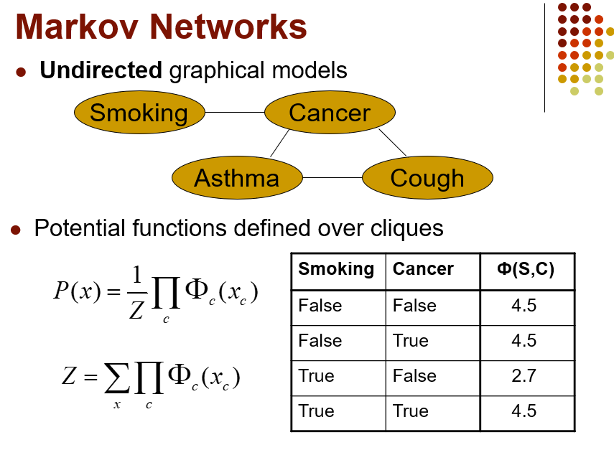
http://alchemy.cs.washington.edu/alchemy1.html

Slide 30
Features of Markov Networks
Markov network is based on probability theory - peer accepted in scientific communities and regulatory institutions
Structure of an MLN graph can have intuitive meaning - help in understanding the domain.
“Probabilistic models are liberating. Instead of a rigid formalism that needs to enumerate every possibility and exception we can sweep these under the probabilistic rug as something unusual happened” (1)
(1) Coller, Friedman 2009

Slide 31
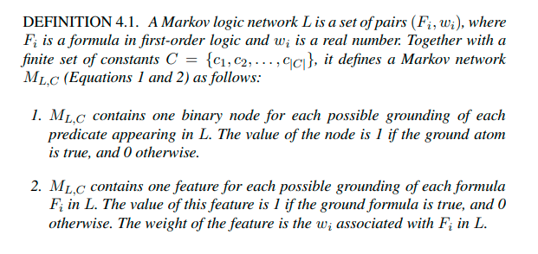
Markov Logic Networks Combine FOL + Markov Network
MLN “softens” the constraints of the FOL. Each formula has a ‘weight’. The fewer constraints a world violates the more probable it is.
Richardson, M., Domingos, P. Markov logic networks. Mach Learn 62, 107–136 (2006). https://doi.org/10.1007/s10994-006-5833-1
https://homes.cs.washington.edu/~pedrod/papers/mlj05.pdf

Slide 32
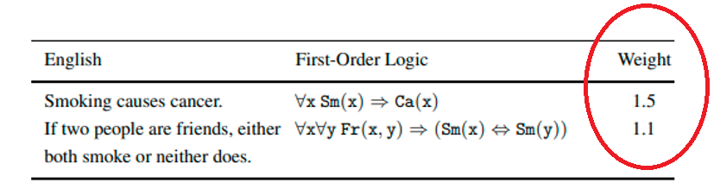
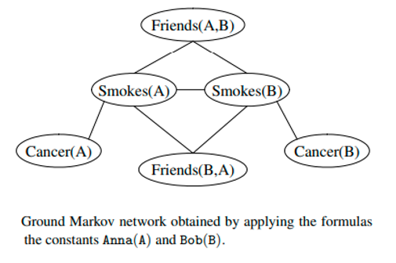
Example
https://homes.cs.washington.edu/~pedrod/papers/mlj05.pdf

Slide 33
Exercises

Slide 34
Alchemy
A tool for MLN research by University of Washington (Domingos et al.)
Intended for:
Tutorials and Learning about MLN
Experimenting with Algorithms
Structure Learning
Weight learning
Inference
Version 1.0 ← Initial version
Version 2.0 ← Lifted Inference
Light ← “Tractable MLN”

Slide 35
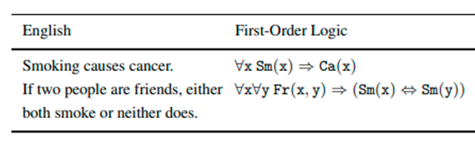
Example 1: Social Network
Domingos, Lowd, 2009 Appendix A

Slide 36
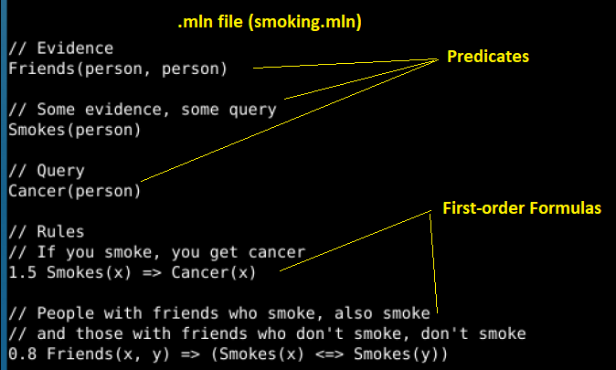
.mln file establishes the model predicates, functions, first-order formulas
Elicitation from Knowledge Expert

Slide 37
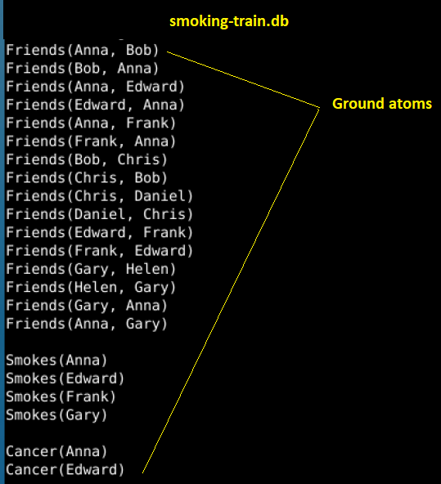
.db file grounds the model

Slide 38
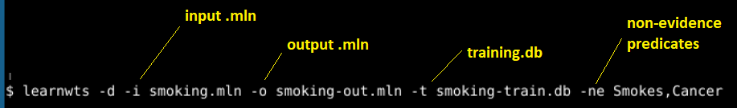
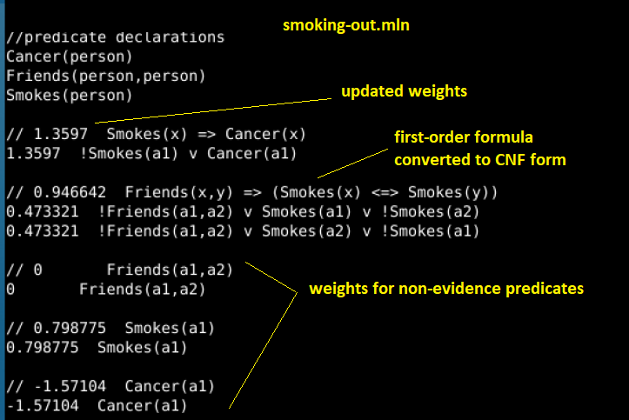
Weight learning

Slide 39
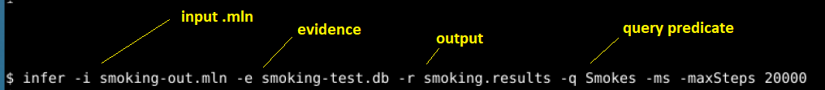
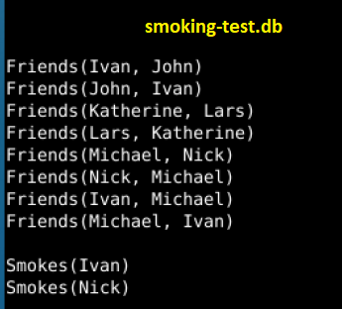
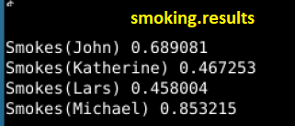
Inference

Slide 40

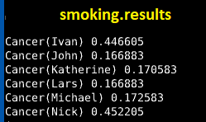
Inference

Slide 41
Key Points (example 1)
No Data Required. Elicitation from Knowledge Expert is a valid and good starting point.
Model is transferrable. Structure from and weights from group (Anna, Bob, Chris) is applied to the (Katherine, Ivan, John) group.
Query is not pre-defined – can query on any predicate
Structure succinct – expressed in just a few lines

Slide 42
Example 2: University Students Learning Structure from Data
The previous model came from Knowledge Expert. If we want structure from data...
“University” database is:
Students, Professors, “AdvisedBy” relationship.
Publication Title (identifies student and professor)
Faculty members have “position”, student has “phase”
Start with empty .mln

Slide 43
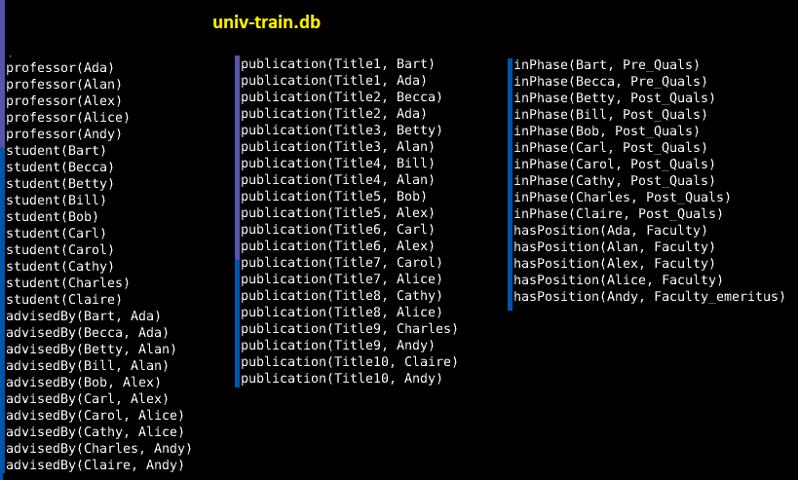
Example 2: University Students The Data

Slide 44
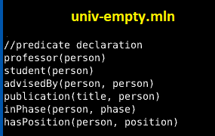

Example 2: University Students The Data

Slide 45
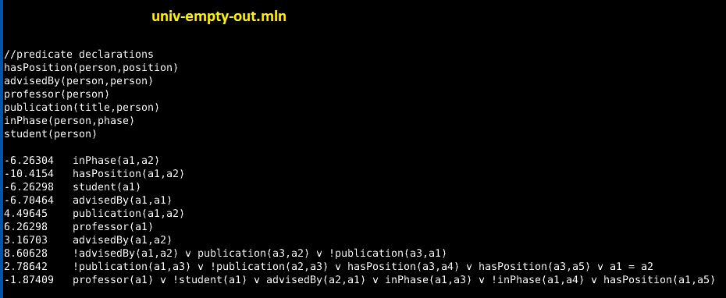
Example 2: University Students The Structure

Slide 46
Key Points (example 2)
Structure from Data
Model expressed in CNF form – marginally human readable

Slide 47
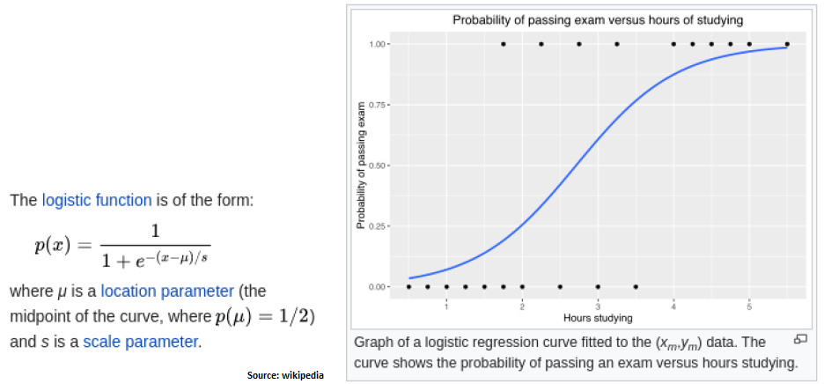
Example 3: Logistic Regression
Logistic Regression
Maps attributes (numeric or ordinal) to nominal (categorical).
Output sums to 1.0 and is between 0 and 1.0

Slide 48
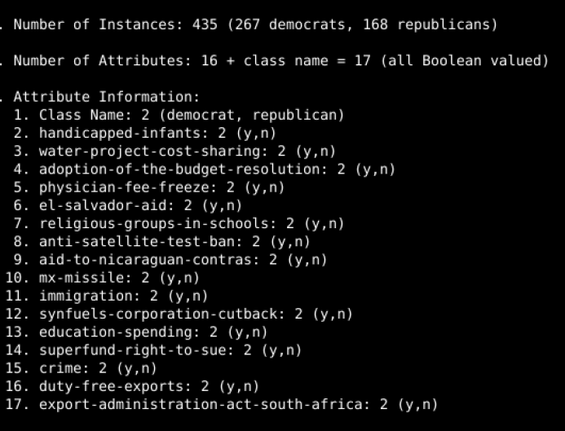
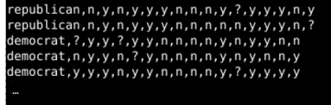
Example 3: UCI “voting-records” Dataset
Logistic Regression
Yea/Nay votes for 232 congresspersons on 16 topics
Class to be determined is “Republican” or “Democrat”
Each vote is a binary predictor

Slide 49
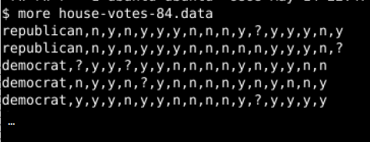
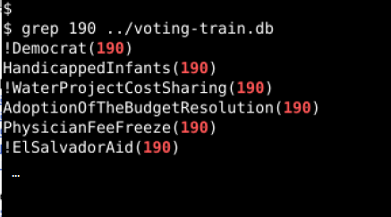
Example 3: Step 1: Attributes become Grounding Predicates
Logistic Regression
As received: standard table format
In MLN each vote becomes a grounding predicate
Congressperson 190 voted against WaterProjectCostSharing
common_sm_ui
common_sm_ui
common_sm_ui

Slide 50
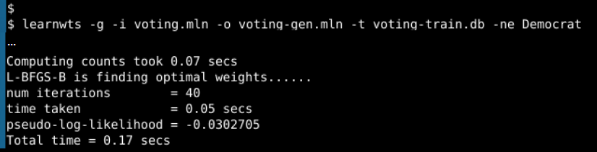
Example 3: Learn Weights
Logistic Regression

Slide 51
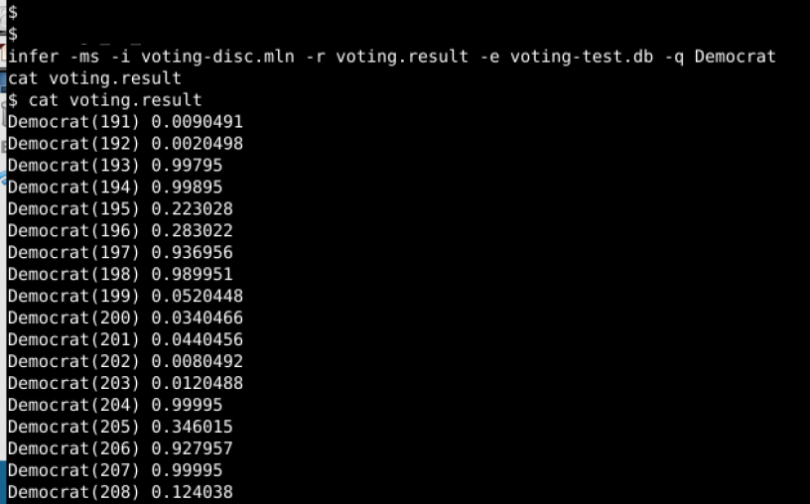
Example 3: Inference
Logistic Regression

Slide 52
Key Points (example 3)
Common machine learning design patterns can be implemented in MLN using recipe.

Slide 53
Example (# from tutorial) | Dataset | Purpose | Predicates and Functions | Ground- ings | Run time
1 – Social Network | Smoking | Basic learnstruct, learnweights, Infer | 5 hand crafted | 22 | 15 sec
2 – Student/Advisor | University | Structure and weights from data | From Data
3 – Logistic Regression | Voting | Logistic Regression (numeric/ordinal to nominal) | 5 hand crafted | 22 | 6 sec
5.1 – Text Classification | WebKB | Classification by bag-of-words | 2 | 6100 | 22 min
6 – Entity Resolution | CORA | Matching items across image frames, documents | 10 basic 28 sentence | 56000 | 19 hours learning 21 hours total
7 – Hidden Markov Model | Traffic | Sequential pattern (toy dataset) | 7 | 32 | 1hr 40
9.1 - NLP | Dogs and cats | Grammar and lexicon | 20 | 230 | 6 min
10 – Bayes Net | Alarm | Bayesian/PGM to MLN | 37 | n/a | n/a
11 - Hybrid | Robot range | Numeric attributes | 5 | 295

Slide 54
In Summary
Markov Logic Networks combine the logic of a First Order Language with the probabilistic representation of a Markov Network.
Structure can be established from data or knowledge expert
Knowledgebase is flexible - can be easily updated or extended
Allows representing partial knowledge
Inference from rules engine
Inference accepts any question (not purpose-built)
Succinctly represents complicated relationships

Slide 55
Thank You

