Slide 1
Django Python backend for Web Applications
Chris Winsor
2/26/2020
Prepared for Metrowest Boston Developers Machine Learning Group
Available from https://github.com/cwinsor/django_102_pluralsight

Slide 2
References...
Django:
"Django Fundamentals“ (Reindert-Jan Ekker) https://app.pluralsight.com This is the “tictactoe” application – excellent
Django Tutorial https://docs.djangoproject.com/en/3.0/intro/tutorial01/ Intro from The Source
Node, Postgres, Express:
“Build a CRUD single page application with Node, Express, Angular, Postgres” (Michael Herman) https://mherman.org/blog/postgresql-and-nodejs/ This is an example frontend/backend javascript web app with postgres db. It uses express web server/routing and (a little) angular on the front-end. You will use npm, express, node, browser trace/debug features. You will see javascript used on both client and server. This is very standard (server-side javascript) architecture.
Front-end:
“Front-End Web Development Quick Start With HTML5, CSS, and JavaScript” (Shawn Wildermuth) https://app.pluralsight.com/course-player?clipId=e5482b13-c204-4d52-89ec-94a1099592b0 Beginner HTML5, CSS, JavaScript – excellent

Slide 3
Alternatives
Server-side Javascript
More common than server-side Python
Many many libraries
And certainly can hook into Python on the back-end
Flask
Server-side Python – light

Slide 4
Why Django?
Python is the language of Machine Learning
ONE language on the server, not two
Is robust and suitable for commercial sites (vs Flask)
Well documented, well structured (DRY principle)
Python is fun!

Slide 5
Setup (hint - you’ve seen this before) Visual Studio Code, setup script, virtualenv+pip for modules
mkdir myfolder; cd myfolder
git clone https://github.com/cwinsor/django_102_pluralsight
cd django_102_pluralsight\project
./setup.ps1
to start visual studio code:
cd .\tictactoe; code -n .
to run the application:
cd tictactoe; python manage.py runserver
URLs are:
http://127.0.0.1:8000 (user login)
http://127.0.0.1:8000/admin/ (admin login)

Slide 6
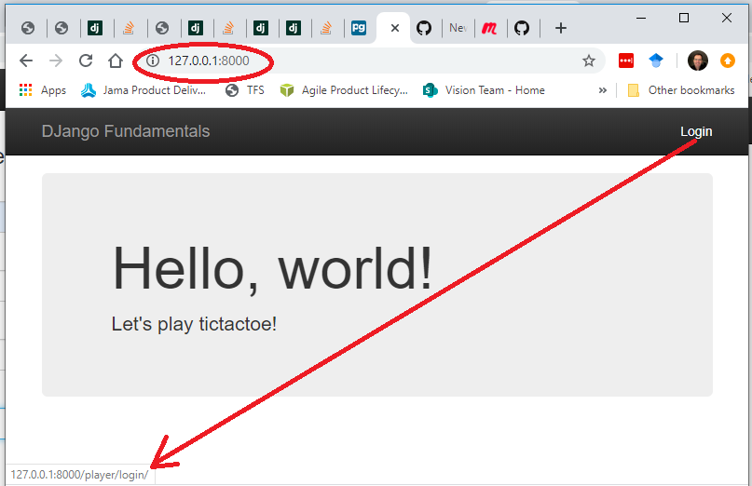
Explore the app...

Slide 7
Explore the app...
python manage.py runserver 0.0.0.0:9595
http://x.x.x.x:9595
alice aabbddcc
bob aabbddcc

Slide 8
Model Template View Similar to MVC
Receives Request, talks to Model/Template, send Response
Model
Request (GET,POST)
Response
url
map
View
Database Tables/Attributes
Template
Generates HTML (presentation only)

Slide 9
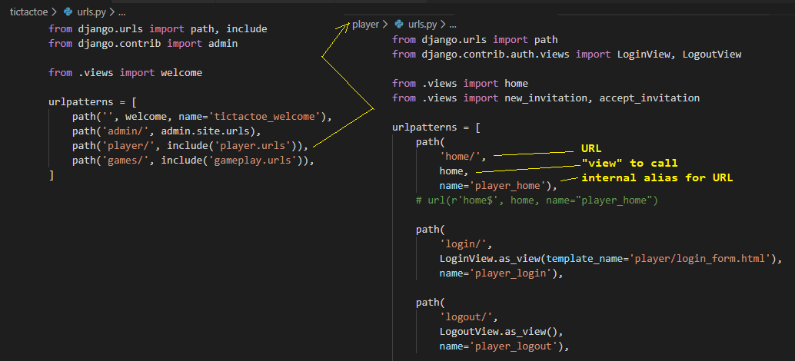
Mapping URL to View

Slide 10
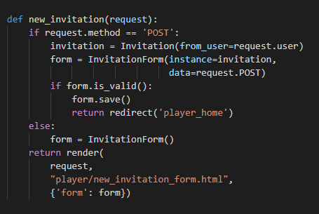
View
Receive request
If GET:
Create a blank form and return it
If POST:
Create a form using data from the POST (i.e. validate the data)
If valid – save to DB and redirect to player_home page
If not valid – send form back to user (with errors)

Slide 11
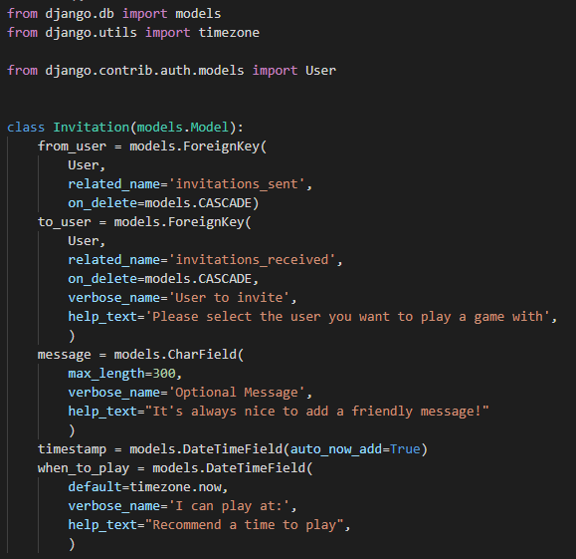
Model
Game(models.Model)
firstPlayer = models.ForeignKey(User)
startTime = models.DateTimeField()
status = models.CharField()
Move(models.Model)
x, y = models.IntegerField()
game = models.ForeignKey(Game)
Invitation(models.Model)
from_user = models.ForeignKey(User)
to_user = models.ForeignKey(User)
message = models.CharField()
time_to_play = models.DateTime()

Slide 12
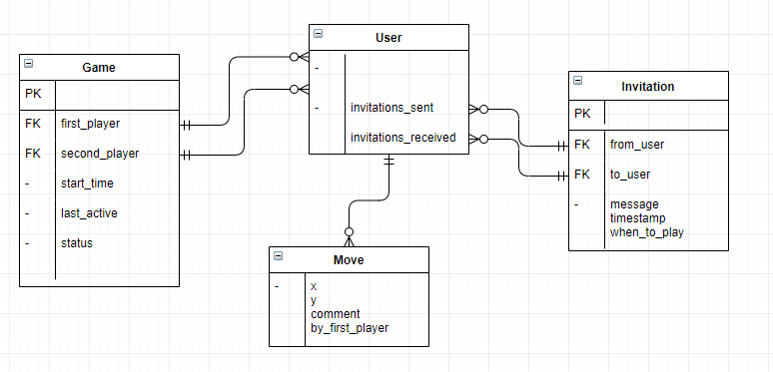
Desired Schema

Slide 13
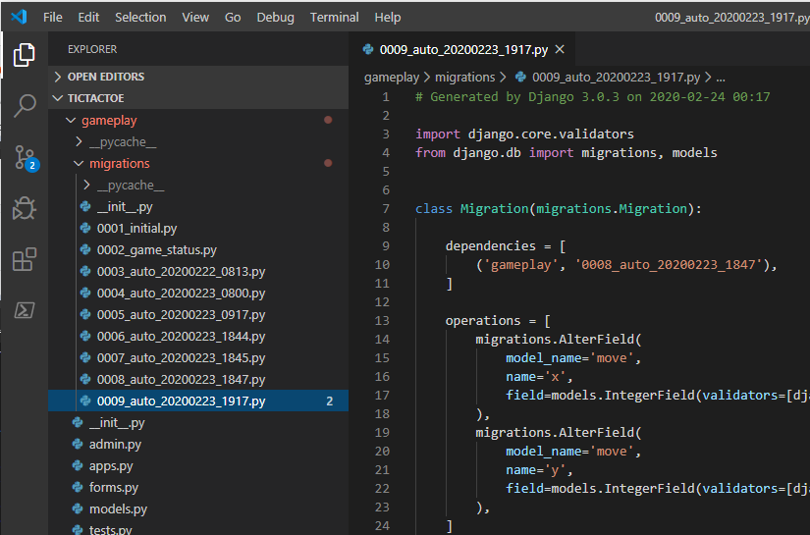
Models: The Schema Delivered (and migrating an existing schema) (and providing an API for Views) (and abstracts db-specifics)
The Model is everything needed to create database tables
Django creates “migrations” which implement the tables.
This works for both initial and UPDATES to existing schema
Model also provides an API for the View (as we will see)
Is database independent

Slide 14
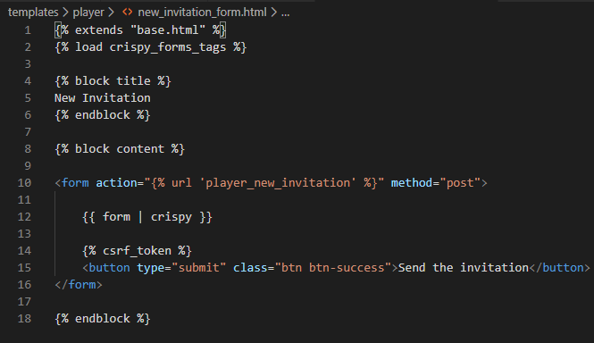
Templates
Template is the structure to render the page.
HTML + Bootstrap markup
Extend “base.html” (the author got this from Initializr.com)
“crispy” is CSS
Form comes from View and knows how to render its elements.

Slide 15
In Summary
Django is Python + DB backend (can you say ML language and models...)
User Authentication w/ forms
/admin to view/edit project or user DB tables
Migrations
Apache/PostgreSQL for production (starter DB/WS provided)
Crispy forms
In summary – Django is production ready Python backend, perfect for exposing ML and data science via web applications.

Slide 16
Next steps ...
PLaSTiCC database...
2 tables
Maybe a dozen or so attributes
Make a List View Page, Detail View Page
How hard can it be!
THEN:
Plug in (Python) predictive model from Kaggle from B. Trotta or Kyle Boone
Make a game of it ...
SO:
Pick a star from the (List View) of stars
Display detail view (macro data + timeseries data) in tabular form (bonus points for a chart)
Have user make a prediction
Push button to reveal predictive model, and actual result.
Keep score

Slide 17
Thank You

Slide 18
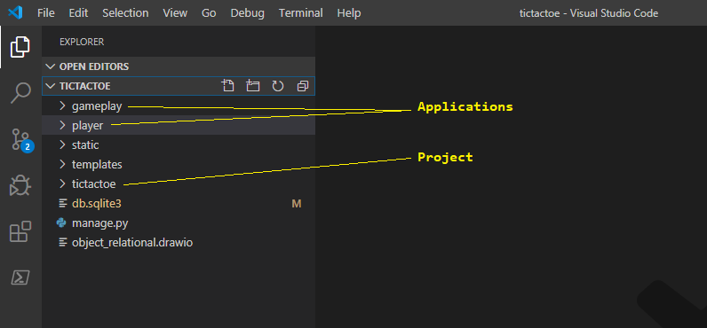
Code Structure and Walkthrough ...

Slide 19
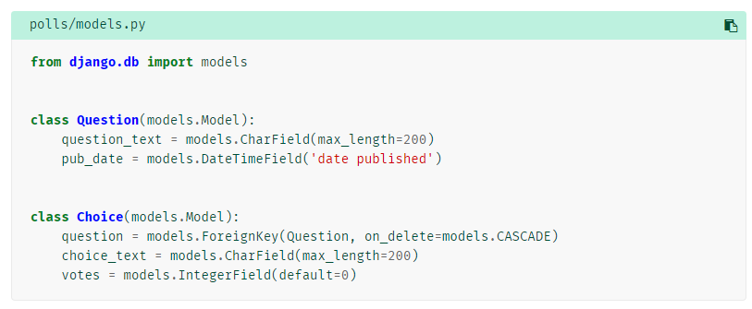
Creating Models
A model is the single, definitive source of truth about your data. It contains the essential fields and behaviors of the data you’re storing. Django follows the DRY (Don’t Repeat Yourself) Principle.
The goal is to define your data model in one place and automatically derive things from it.
This includes the migrations - migrations are entirely derived from your models file, and are essentially a history that Django can roll through to update your database schema to match your current models.
With this, Django is able to:
Create a database schema (CREATE TABLE statements) for this app.
Create a Python database-access API for accessing Question and Choice objects.

Slide 20
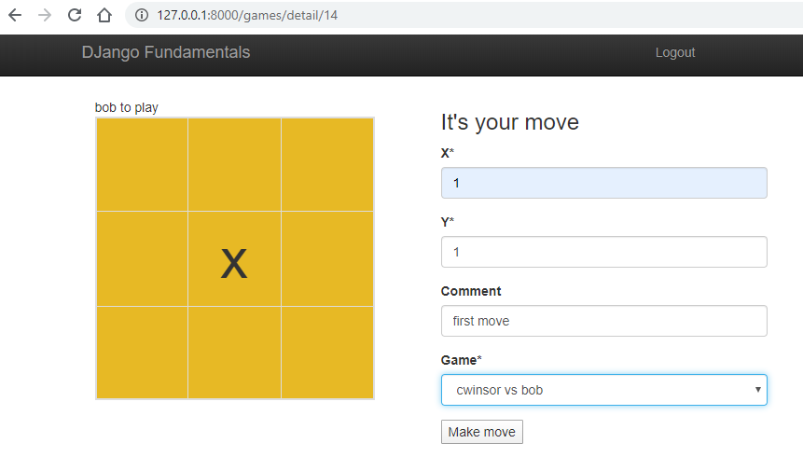
Explore the app...

