Slide 1
Django/Python/Machine Learning Web Application (#2)
Chris Winsor
3/11/2020
Prepared for Metrowest Boston Developers Machine Learning Group
Available from https://github.com/cwinsor/django_103_plasticc_and_ux

Slide 2
Where we are...
Last Time:
Django Overview and Tic-Tac-Toe Application
https://github.com/cwinsor/django_102_pluralsight/blob/master/django_web_app_framework_intro.pdf
https://github.com/cwinsor/django_102_pluralsight
This time:
“Star Chaser”
Requirements
Personas
Wireframes
Code (Django, Postgres, TensorFlow, Kaggle)
<stretch: front-end Javascript for charting>

Slide 3
Goals:
Show Machine Learning deployed as Web Application
Demonstrate Best-Practice Web App Design
Make it available for Anyone (with access to the web)
Practice, Practice, Practice

Slide 4
But there’s more...
Platform for future ML-based web-apps (browser-based)
Platform for Internet-of-Things applications (device-based)
Front-end is device (Raspberry Pi running Python)
Back-end is “smarts” (database, ML algorithm)
To do this:
Back-end exposes non-browser POST and GETs as “API”
Device running Python does POST and GET to the “API” urls
We can even:
Access OTHER web APIs
Google Maps
Geolocation
NASA
Chuck Norris Jokes
Speech-to-Text
Lots of Amazing Stuff

Slide 5
What does that mean... Today...
Our DB, App, ML
http urls
Database
Browser
ML Model
Game Application
GET, POST site.com/home
Internet
HTML Form

Slide 6
What does that mean... Tomorrow...
Our DB, App, ML
http urls
Database
Browser
ML Model
Game Application
GET, POST site.com/home
api urls
Internet
HTML Form
Raspberry Pi + Python
Device
GET, POST site.com/api

Slide 7
What does that mean... Day 3
Our DB, App, ML
http urls
Database
Browser
ML Model
Game Application
GET, POST site.com/home
api urls
Internet
HTML Form
Raspberry Pi + Python
Device
GET, POST site.com/api
IBM Watson/Alchemy
Face Recognition
Natural Language Processing
Chuck Norris Jokes
Facebook/Twitter
Geolocation (Google)

Slide 8
There’s so much out there... For your Application, for your Device
18 Fun APIs For Your Next Project https://medium.com/@vicbergquist/18-fun-apis-for-your-next-project-8008841c7be9
15 APIs developers need to know https://www.creativebloq.com/web-design/apis-developers-need-know-121518469
9 free/cool web APIs to use in your next project https://rapidapi.com/collection/cool-apis
...the list goes on
“If you need some intelligence in your app, you'd be silly to build the NLP and other technology on your own. Instead, focus on what your app will do with that intelligence.” https://www.creativebloq.com/web-design/apis-developers-need-know-121518469

Slide 9
But we digress
One step at a time...

Slide 10

“Star Chaser”
Game where you compete to classify Supernovas (exploding stars)
Leaderboard with head-to-head competition
Python/Django backend with:
Kiras/Tensorflow Machine Learning (classification)
Kaggle dataset, Postgres
References and Links to explain what’s going on

Slide 11
Best Practices
Define the Problem
Identify Needs of User, Organization
Do Some Research
Define Your Solution
Test Your Design
To Include:
Identify Audience and Key Points
Wireframe and Review
References:
Getting Started in UX Design by Kurt Krumme https://app.pluralsight.com/library/courses/getting-started-ux-design/table-of-contents
UX Design Creating Wireframes by Susan Simkins https://app.pluralsight.com/library/courses/ux-design-creating-wireframes/table-of-contents

Slide 12
Target Audience:
Engineering Manager (Hiring Manager)
Machine Learning / Vision Architect
General Passers-by (recruiters, friends, networking contacts)

Slide 13



Personas
Data / ML Architect
Expanding team to develop and deploy new algorithms
Needs to preserve current tools and process
Needs to define metrics/success
Needs infrastructure/tool roadmap
Needs trained/skilled hands
Director of Engineering
Wants to add Machine Learning to Web App
Needs to deliver on schedule
Needs to deliver quality
Predictability is paramount
Passers-by
Professional Contacts / Network
Recruiters
Top Level: “What does he do?”

Slide 14
Proposed Site Map
Login
Admin
Home
Leaderboard
References
About
Users/Groups
Database
Choose a Star
Analyze / Classify

Slide 15
Wireframes
<link to .pdf on github>

Slide 16
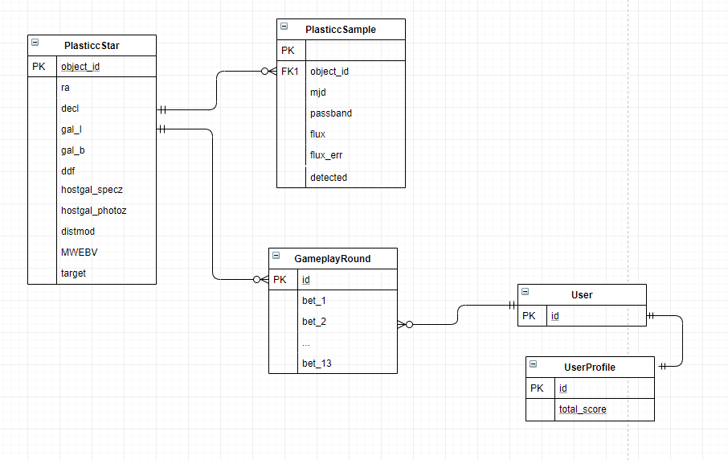
Schema

Slide 17
Go Live!
<link to URL>

Slide 18
Level of Effort
Took about 5 days
Detailed steps in the git <URL>
Django Background:
Tic-Tac-Toe at <URL>
A full featured Web App (admin, login, database, forms)
Follows the Pluralsight training
Web Application (UX/UI)
Getting Started in UX Design by Kurt Krumme https://app.pluralsight.com/library/courses/getting-started-ux-design/table-of-contents
UX Design Creating Wireframes by Susan Simkins https://app.pluralsight.com/library/courses/ux-design-creating-wireframes/table-of-contents

Slide 19
Thank You

