Slide 1
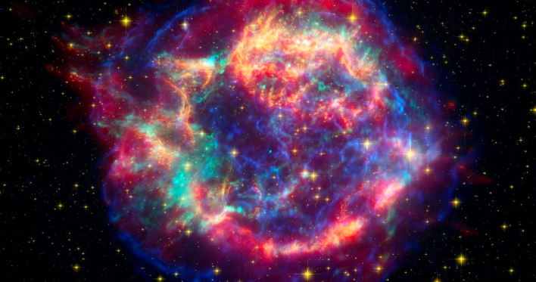
“StarChaser” Development of a Django/Python/Machine Learning Web Application
Chris Winsor
5/27/2020
Prepared for Metrowest Boston Developers Machine Learning Group
Available from https://github.com/cwinsor/django_103_plasticc_and_ux

Slide 2
What is it?
Game where you compete to classify stars (Supernova, Pulsar, etc)
Based on real astronomical data (flux/passband)
Leaderboard with head-to-head competition
Python/Django backend with:
Kiras/Tensorflow Machine Learning
Kaggle dataset, Postgres
References and Links to explain what’s going on

Slide 3
Goals:
Basic Web App Design with Server-side Python (Django)
Integrating ML into Web Application
Deploy to cloud
A bit of client-side (Google Charts, Bootstrap)
Why:
A means to express your work (anyone with a browser) vs
Jupyter Notebook, .ppt/.doc, Vimeo, Kaggle
Practice, Practice, Practice (web app development)

Slide 4
Best Practices in Web App Design
Define the Problem
Identify Needs of User, Organization
Do Some Research
Define Your Solution
Test Your Design
To Include:
Identify Audience
Key Points
Wireframe and Review
References:
Getting Started in UX Design by Kurt Krumme https://app.pluralsight.com/library/courses/getting-started-ux-design/table-of-contents
UX Design Creating Wireframes by Susan Simkins https://app.pluralsight.com/library/courses/ux-design-creating-wireframes/table-of-contents

Slide 5
Target Audience:
Engineering Manager (Hiring Manager)
Machine Learning / Vision Architect
General Passers-by (recruiters, friends, networking contacts)

Slide 6



Personas
Data / ML Architect
Expanding team to develop and deploy new algorithms
Needs to preserve current tools and process
Needs to define metrics/success
Needs infrastructure/tool roadmap
Needs trained/skilled hands
Director of Engineering
Wants to add Machine Learning to Web App
Needs to deliver on schedule
Needs to deliver quality
Predictability is paramount
Passers-by
Recruiters:
“Can I place him?”
“What does he do?”
Professional Contacts / Network
Elevator pitch

Slide 7
Priority Content
“Info” panels explaining what/why
Context (why) of the application (first page)
Background on PLAsTiCC
Metrics – why important and reference
Data Processing – constructing the model (slide)
Dataset – timeseries and size/scale
Tensorflow Model – B.Trotta and K.Boone approach summary and other approaches used. Reference/link to my other slidesets.
Tensorflow background
Structure of website (slides from this presentation)
“Popup” on make_bid page:
Highlight merge of TensorFlow ML results with local database

Slide 8
Proposed Site Map
Login
Home
Info Panel
.
.
.
.
.
.
.
.
.
Admin
Leaderboard
Users/Groups
Database
Choose a Star
Popup
Analyze / Classify

Slide 9
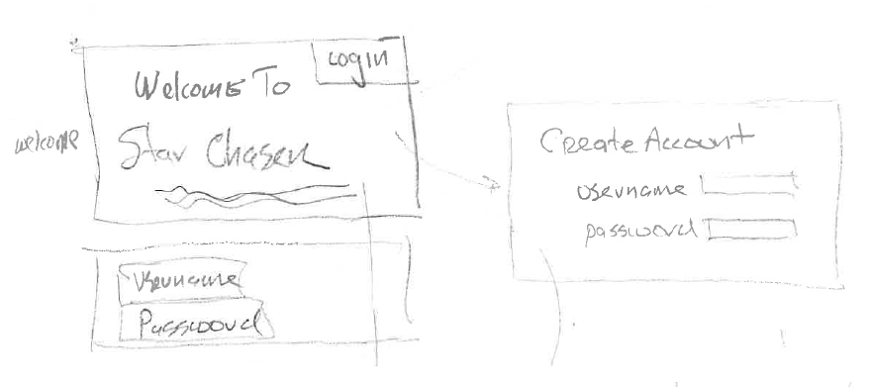
Wireframes

Slide 10
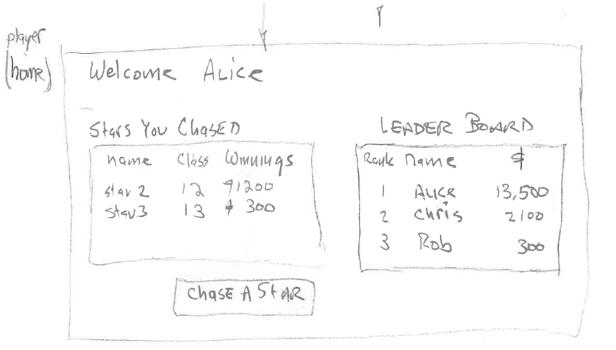

Slide 11
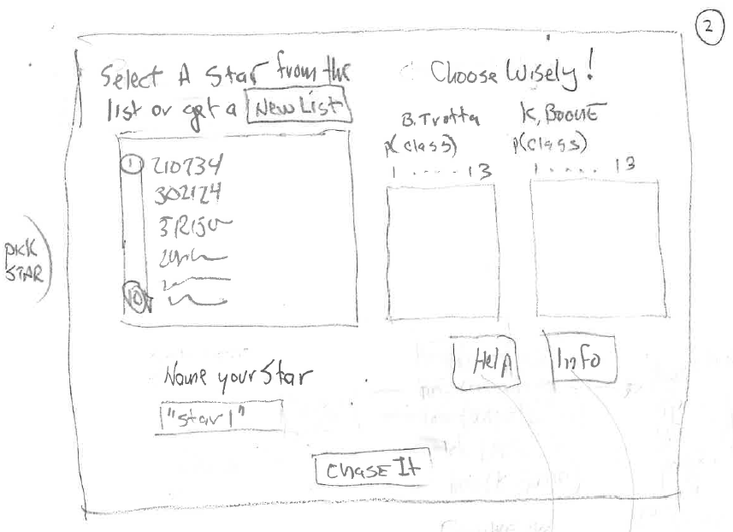

Slide 12
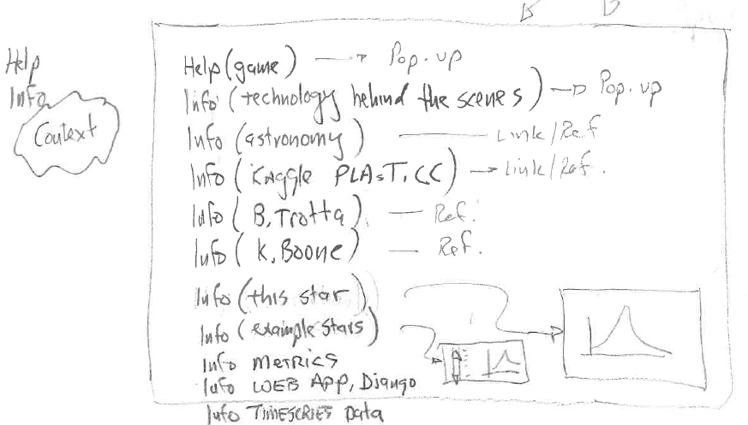

Slide 13
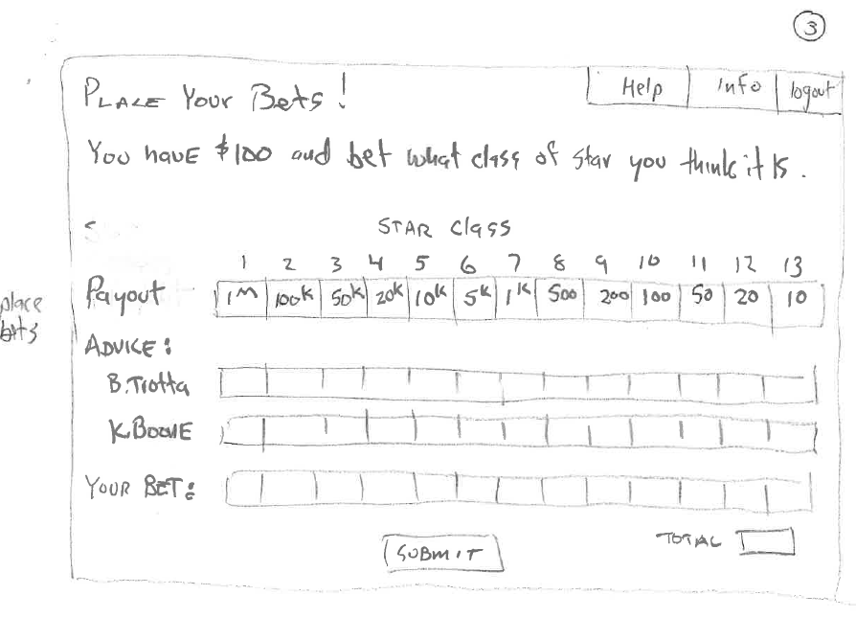

Slide 14
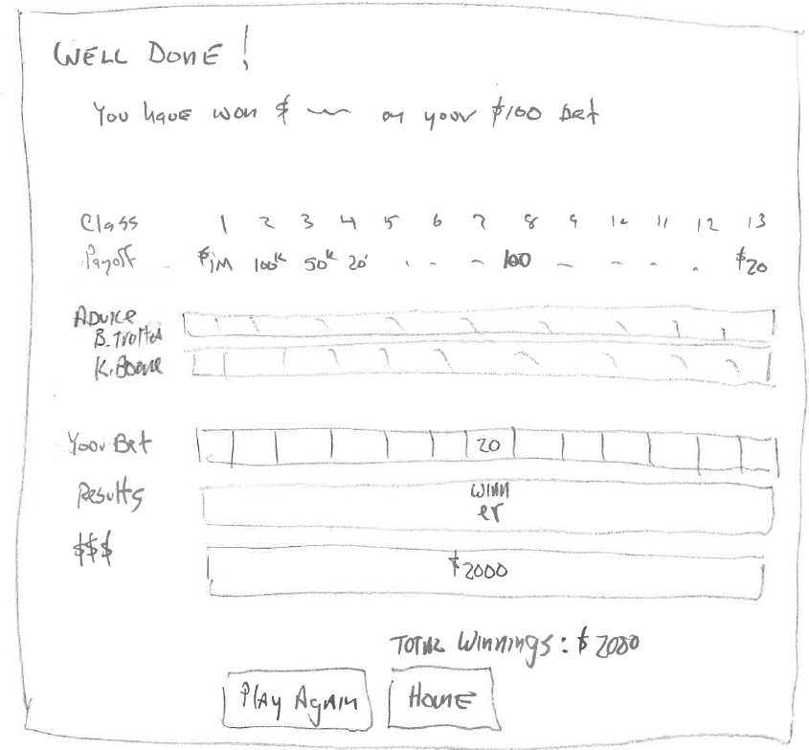

Slide 15
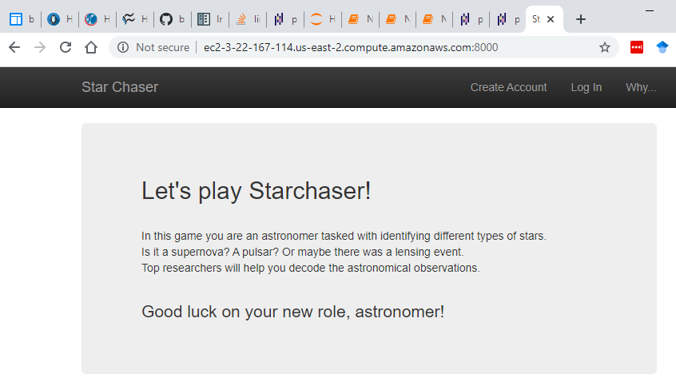

Slide 16
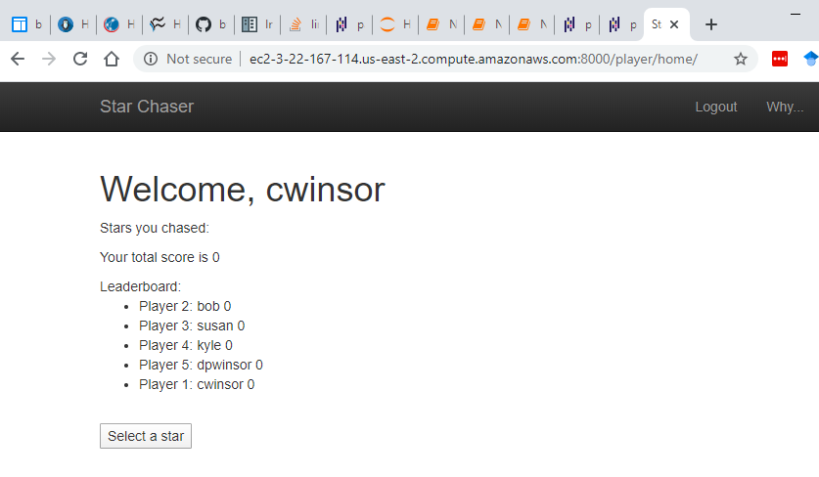

Slide 17
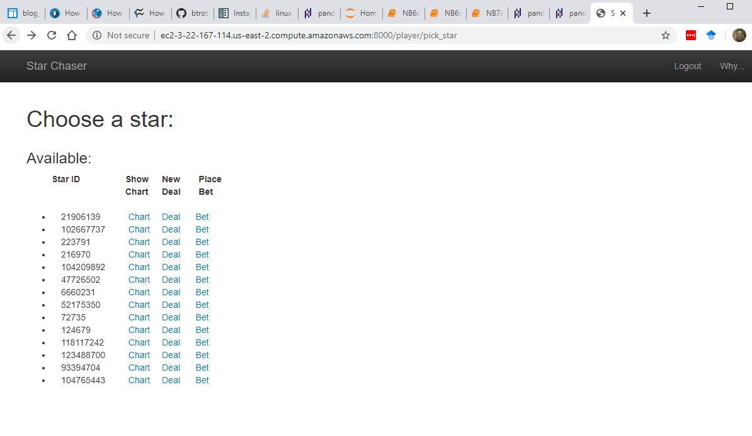

Slide 18
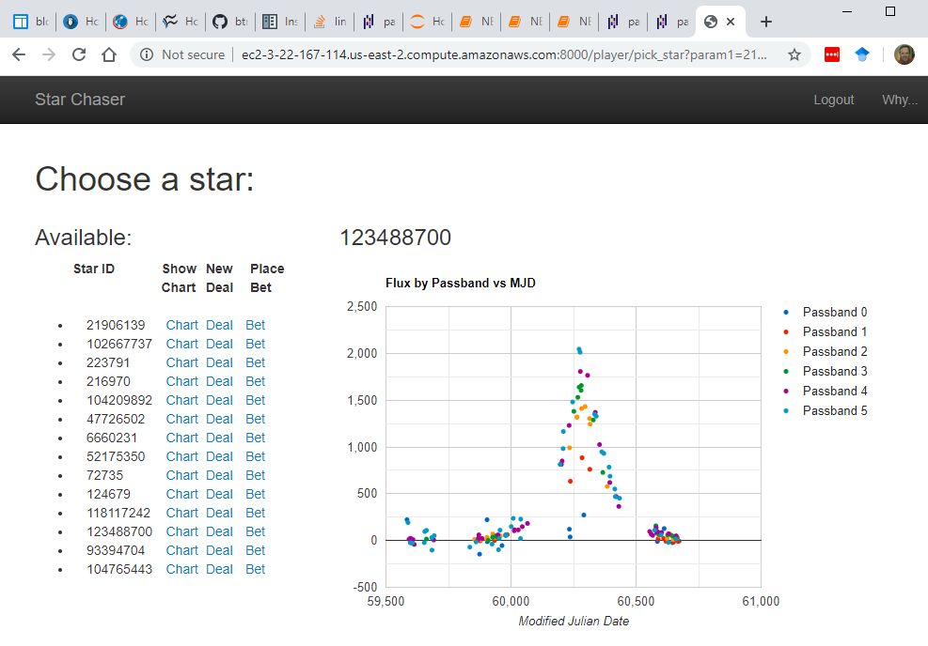

Slide 19
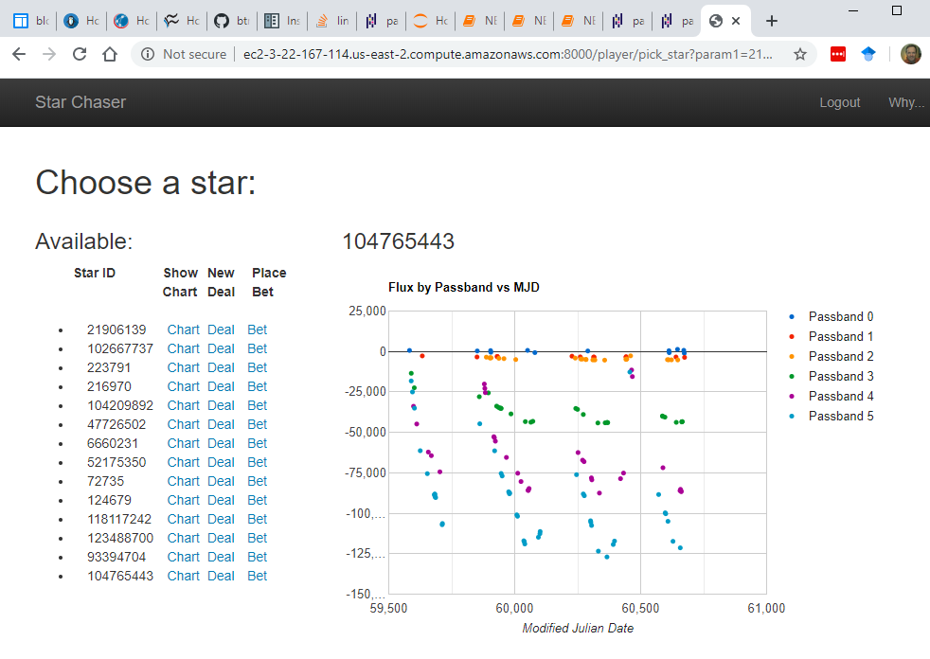

Slide 20
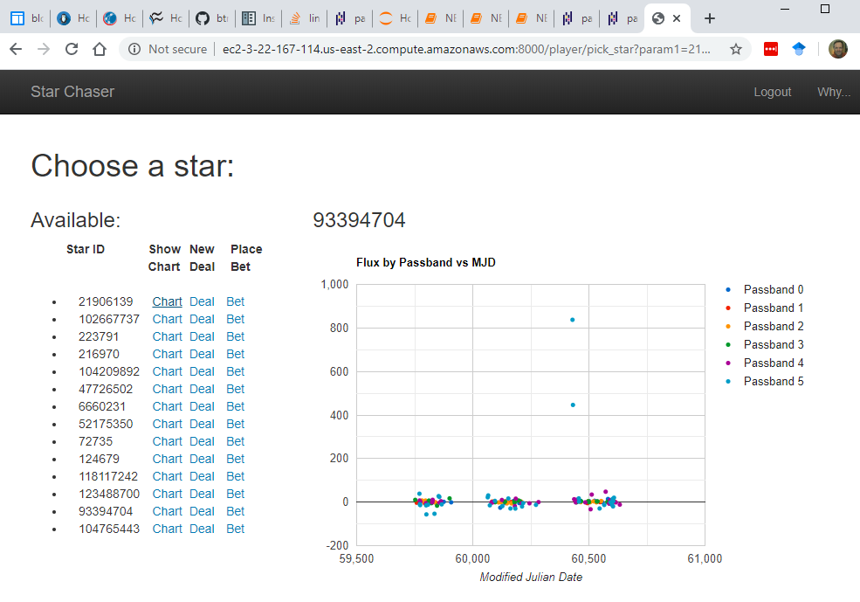

Slide 21
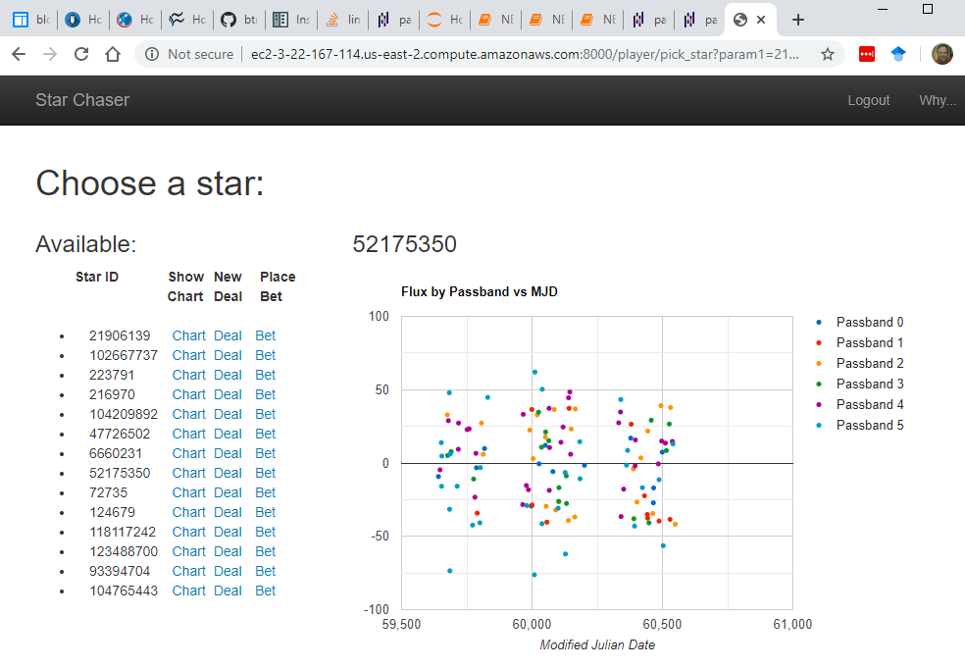

Slide 22
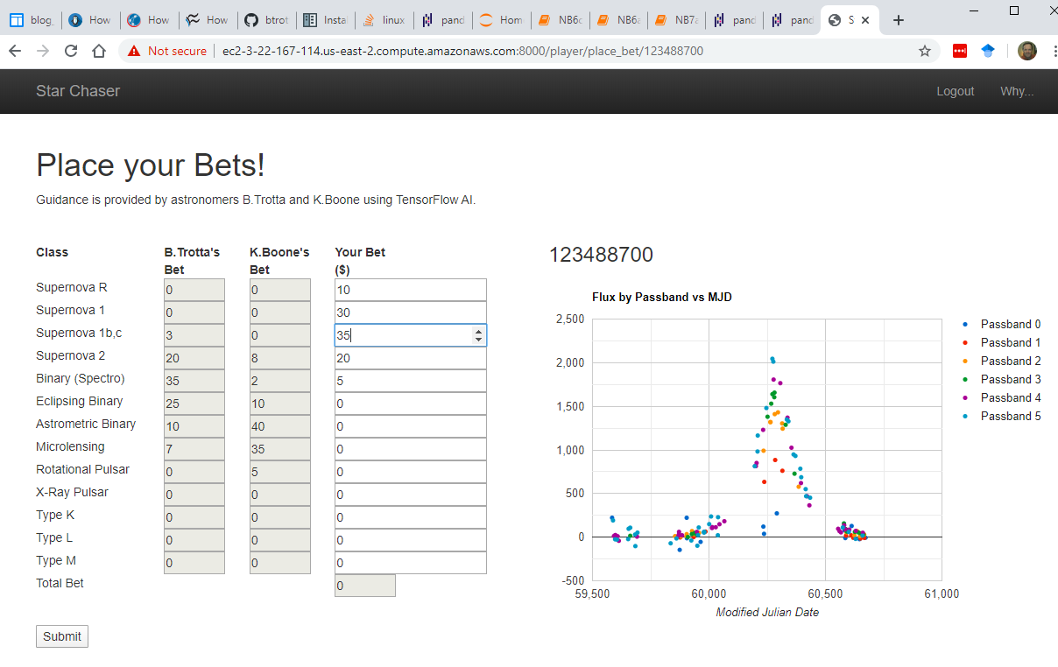

Slide 23
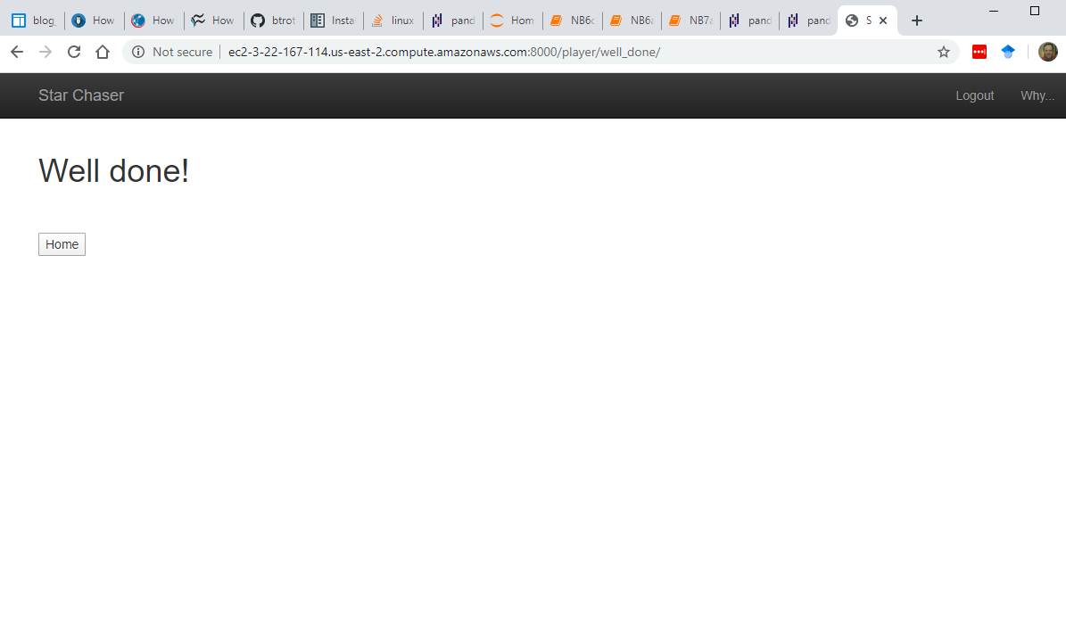

Slide 24
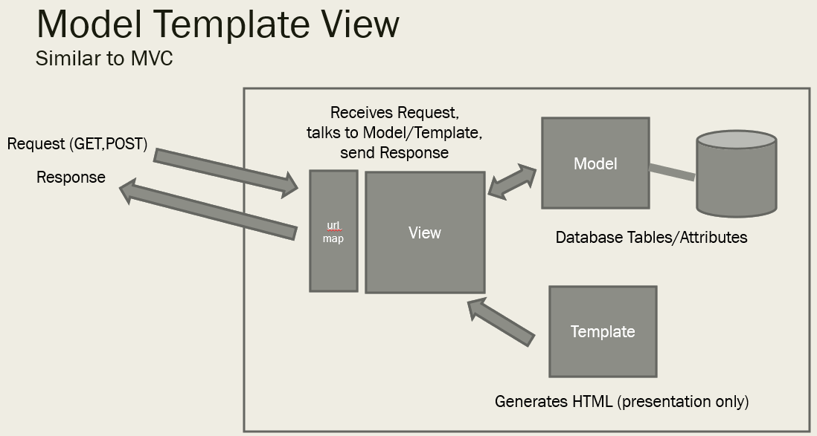
From last time

Slide 25
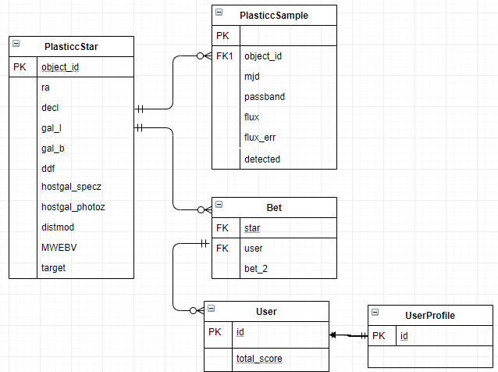
Schema

Slide 26
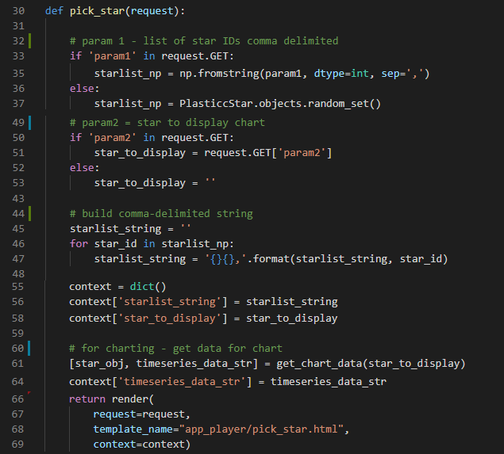
pick_star (view)
GET only (no template/POST)
Display a list of stars to choose from
Chart one star (chosen by user from list)
Two parameters on URL
http://...?p1=x&p2=y

Slide 27
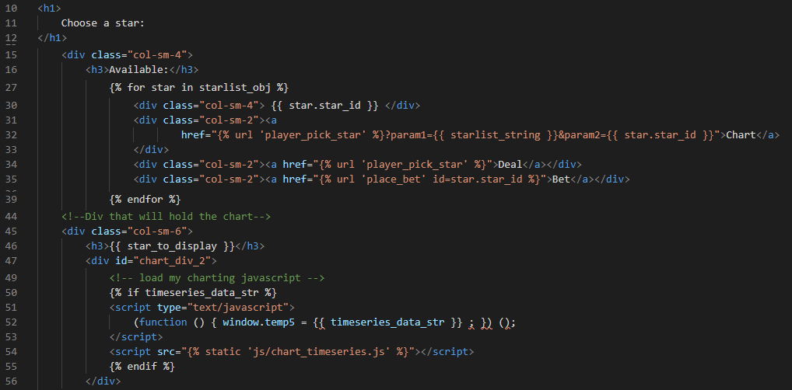
pick_star (html)

Slide 28
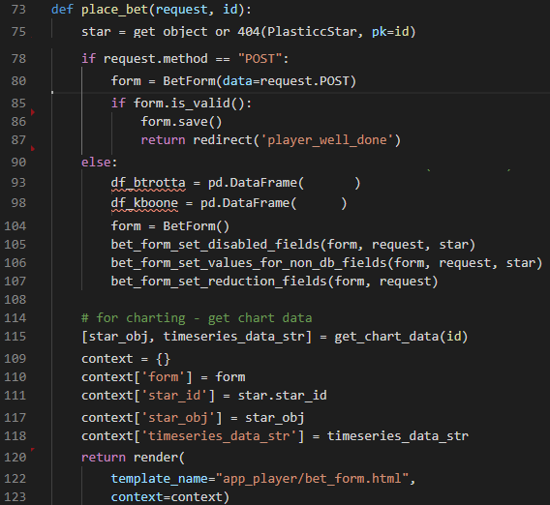
place_bets (view)
Template/POST
Get:
Call ML modes for recommendations
Create form and populate
POST
Receive filled in form from request.POST
Validate
Save and redirect, or
Re-display w/ errors from “is_valid()”
URL has form
http://xyz.com/starid

Slide 29
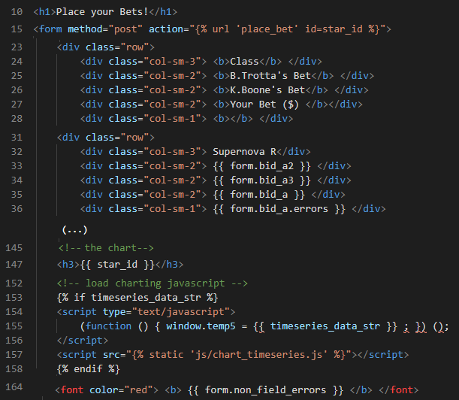
place_bets (html)

Slide 30
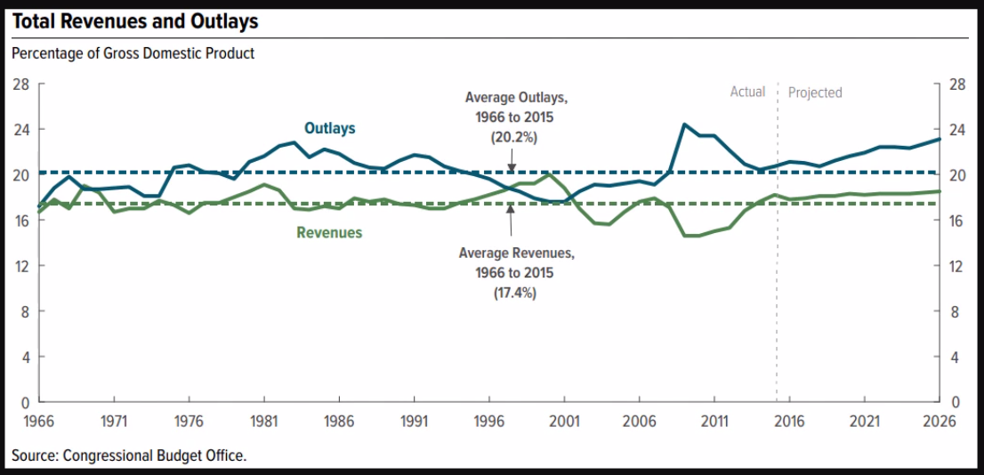
“Data Visualization”
Tons of libraries. High end (D3.js) to basic (Google Charts)
Initial exploration is by Jupyter Notebook and/or Pandas/MatplotLib... see Titanic and PLAsTiCC #1
For Web App I went with Google Charts
References:
https://app.pluralsight.com/library/courses/build-first-data-visualization-google-charts
https://www.sitepoint.com/best-javascript-charting-libraries/

Slide 31
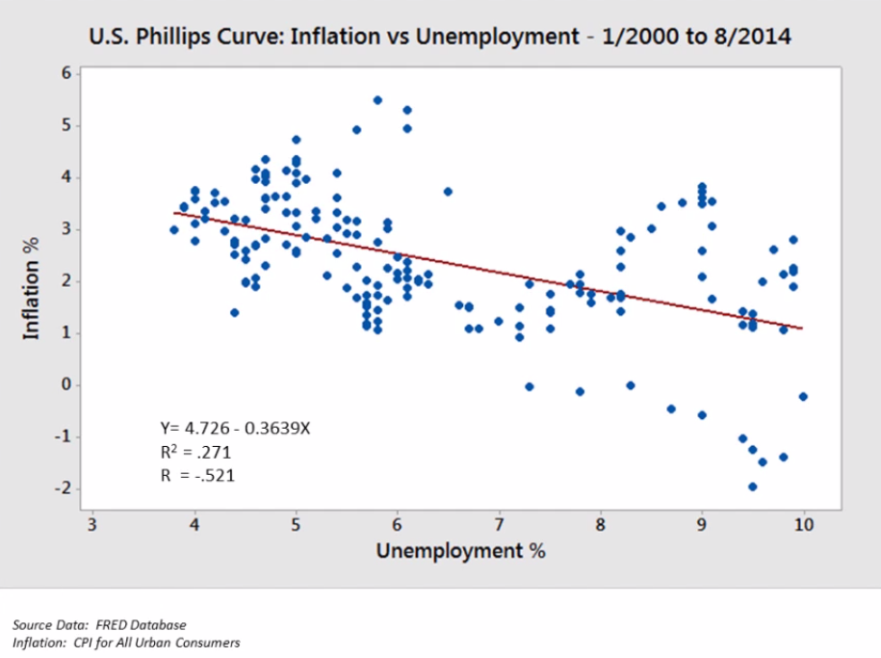
Why this is important...
Reference:
https://app.pluralsight.com/library/courses/build-first-data-visualization-google-charts

Slide 32
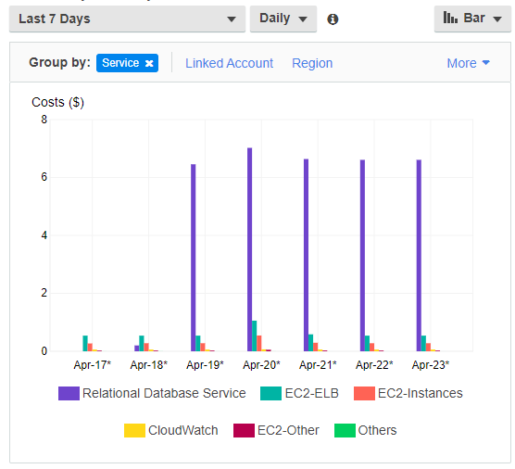
AWS EB (Elastic Beanstalk) vs ES2
EB = EC2 + RDS + S3
Scales with demand
Follow instructions from https://realpython.com/deploying-a-django-app-and-postgresql-to-aws-elastic-beanstalk/
Straightforward but not really...
Baseline = $8/day with no traffic and minimal data (ARRGH!)

Slide 33
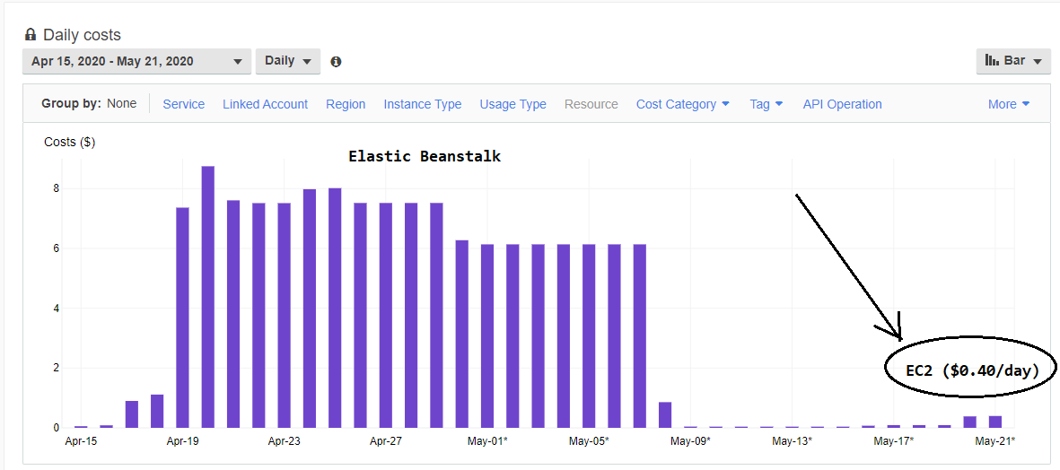
Second Try: Postgres directly on EC2

Slide 34
Go Play !
www.cwinsor.us (look for StarChaser)
Or directly...
http://ec2-3-22-167-114.us-east-2.compute.amazonaws.com:8000/

Slide 35
Level of Effort and Takeaways
A full featured Web App (admin, user accounts, Postgres, M.L., AWS)
2/23 to 5/22 (3 months). Lots of learning curve
Started with Tic-tac-toe and:
Replaced out-of-box database with Postgres
Added external ML models, Kaggle dataset
Added Google Charts
Pushed to AWS
Wireframe and personas super important for focus

Slide 36
References
Django:
Tic-Tac-Toe (Django Fundamentals by Reindert-Jan Ekker on Pluralsight) https://app.pluralsight.com/library/courses/django-fundamentals-update/table-of-contents
Web UX/UI:
Getting Started in UX Design by Kurt Krumme https://app.pluralsight.com/library/courses/getting-started-ux-design/table-of-contents
UX Design Creating Wireframes by Susan Simkins https://app.pluralsight.com/library/courses/ux-design-creating-wireframes/table-of-contents
Node, Postgres, Express (background only - could skim this)
“Build a CRUD single page application with Node, Express, Angular, Postgres” (Michael Herman)
https://mherman.org/blog/postgresql-and-nodejs/ This is an example frontend/backend javascript web app with postgres db. It uses express web server/routing and (a little) angular on the front-end. You will use npm, express, node, browser trace/debug features. You will see javascript used on both client and server. This is very standard (server-side javascript) architecture.
Front-end (suspect this will be handy in the future)
“Front-End Web Development Quick Start With HTML5, CSS, and JavaScript” (Shawn Wildermuth) https://app.pluralsight.com/course-player?clipId=e5482b13-c204-4d52-89ec-94a1099592b0 Beginner HTML5, CSS, JavaScript – excellent

Slide 37
Thank You

Slide 38
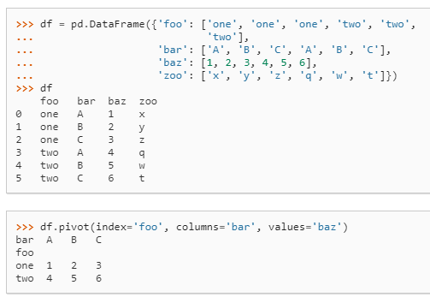
Best Pandas methods...
.pivot() given a nominal attribute, create an attribute for each value
.merge() merges two DataFrames
(example...)
Boolean indexing...
filter = reviews['score'] > 6.95
reviews.loc[filter]

Slide 39
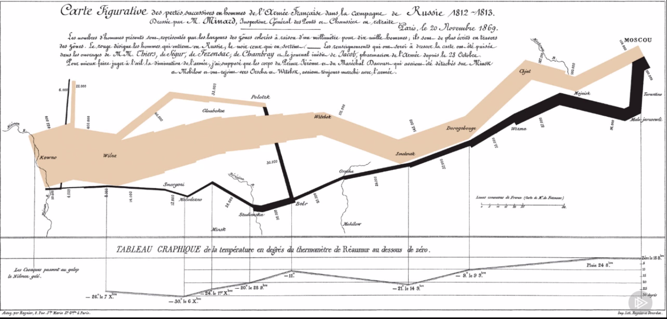
Visualization
Reference:
https://app.pluralsight.com/library/courses/build-first-data-visualization-google-charts

Slide 40
But we digress
One step at a time...

Slide 41
Django Framework
Game Application
Server-side Python
Our DB, App, ML
http urls
Database
GET, POST site.com/home
Browser
Internet
ML Model
HTML Form

Slide 42
Where we can take this...
Today
ML as part of web application
Tomorrow: Internet-of-Things
Front-end is Raspberry Pi running Python
POST data to back-end
GET classifications/recommendations from backend database, ML model
Day 3: Access OTHER web APIs
Google Maps
Geolocation
NASA
Chuck Norris Jokes
Speech-to-Text
Day 4: Offer our OWN api to subscribers
see Gene’s presentation <LINK?> https://github.com/MetrowestBostonDevelopersMLGroup/MeetingPresentations
and article https://a16z.com/2020/02/16/the-new-business-of-ai-and-how-its-different-from-traditional-software/

Slide 43
Framework 2
Internet of Things
Our DB, App, ML
http urls
Database
Browser
ML Model
GET, POST site.com/home
api urls
Internet
HTML Form
Raspberry Pi + Python
GET, POST site.com/api

Slide 44
Framework 3
Our DB, App, ML
Application with Third-party Source
http urls
Database
Browser
ML Model
GET, POST site.com/home
api urls
Internet
HTML Form
Raspberry Pi + Python
GET, POST site.com/api
IBM Watson/Alchemy
Face Recognition
Natural Language Processing
Chuck Norris Jokes
Facebook/Twitter
Geolocation (Google)

Slide 45
Framework 4
Our API to Subscribers
Our DB, App, ML
Application with Third-party Source
http urls
Database
Browser
ML Model
GET, POST site.com/home
api urls
Internet
HTML Form
Raspberry Pi + Python
GET, POST site.com/api
IBM Watson/Alchemy
Face Recognition
Natural Language Processing
Chuck Norris Jokes
Facebook/Twitter
Geolocation (Google)

Slide 46
There’s so much out there...
18 Fun APIs For Your Next Project https://medium.com/@vicbergquist/18-fun-apis-for-your-next-project-8008841c7be9
15 APIs developers need to know https://www.creativebloq.com/web-design/apis-developers-need-know-121518469
9 free/cool web APIs to use in your next project https://rapidapi.com/collection/cool-apis
...the list goes on
“If you need some intelligence in your app, you'd be silly to build the NLP and other technology on your own. Instead, focus on what your app will do with that intelligence.” https://www.creativebloq.com/web-design/apis-developers-need-know-121518469

Slide 48
Where we are...
Last Time:
Django Basic Web Application (Tic-Tac-Toe)
https://github.com/cwinsor/django_102_pluralsight/blob/master/django_web_app_framework_intro.pdf
https://app.pluralsight.com/library/courses/django-fundamentals-update/table-of-contents
This time:
Django Web Application with Machine Learning model, Kaggle dataset, Postgres, Google Charts
https://github.com/cwinsor/django_103_plasticc_and_ux/blob/master/presentation.pptx

