Slide 1
Django/Python/Machine Learning Web Application (Presentation #2)
Chris Winsor
3/11/2020
Prepared for Metrowest Boston Developers Machine Learning Group
Available from https://github.com/cwinsor/django_103_plasticc_and_ux

Slide 2
Where we are...
Last Time:
Django Overview and Tic-Tac-Toe Application
https://github.com/cwinsor/django_102_pluralsight/blob/master/django_web_app_framework_intro.pdf
https://github.com/cwinsor/django_102_pluralsight
This time: “StarChaser” Web Application
Planning
Requirements
Personas
Wireframes
Priority Content
Code (Django, Postgres, TensorFlow, Kaggle)
AWS EB (Elastic Beanstalk) Deploy
Data Visualization (Google Charts)

Slide 3
Goals:
Show Machine Learning deployed as Web Application
Demonstrate Best-Practice Web App Design
Make it available for Anyone (with access to the web)
Practice, Practice, Practice

Slide 4
Why
Looking for work in Python, Machine Learning
“AI Architect” (high reach)
“Machine Learning Engineer” (too generic)
Web Development with ML application (possible)
Example of work
Web as a medium
The ability for others to access your work
Template infrastructure (in Python) for (your ML model)
Hiring manager, PHD Research Professor, or (your audience)
Platform for future projects
Practice, practice, practice. Be prepared when the time comes.
Practice, practice, practice. (in a controlled risk-free environment)

Slide 5
Where can we go with this...
Today: Platform to deploy ML as web application
Tomorrow: Platform for Internet-of-Things applications
Front-end is Raspberry Pi running Python
Back-end is “smarts” (database, ML model)
Day 3: Access OTHER web APIs
Google Maps
Geolocation
NASA
Chuck Norris Jokes
Speech-to-Text
Lots of Amazing Stuff

Slide 6
What does that mean... Today...
Our DB, App, ML
http urls
Database
Browser
ML Model
Game Application
GET, POST site.com/home
Internet
HTML Form

Slide 7
What does that mean... Tomorrow...
Our DB, App, ML
http urls
Database
Browser
ML Model
Game Application
GET, POST site.com/home
api urls
Internet
HTML Form
Raspberry Pi + Python
Device
GET, POST site.com/api

Slide 8
Django Web Application Today, Day2, Day 3
Our DB, App, ML
http urls
Database
Browser
ML Model
Game Application
GET, POST site.com/home
api urls
Internet
HTML Form
Raspberry Pi + Python
Device
GET, POST site.com/api
IBM Watson/Alchemy
Face Recognition
Natural Language Processing
Chuck Norris Jokes
Facebook/Twitter
Geolocation (Google)

Slide 9
There’s so much out there... For your Application, for your Device
18 Fun APIs For Your Next Project https://medium.com/@vicbergquist/18-fun-apis-for-your-next-project-8008841c7be9
15 APIs developers need to know https://www.creativebloq.com/web-design/apis-developers-need-know-121518469
9 free/cool web APIs to use in your next project https://rapidapi.com/collection/cool-apis
...the list goes on
“If you need some intelligence in your app, you'd be silly to build the NLP and other technology on your own. Instead, focus on what your app will do with that intelligence.” https://www.creativebloq.com/web-design/apis-developers-need-know-121518469

Slide 10
But we digress
One step at a time...

Slide 11
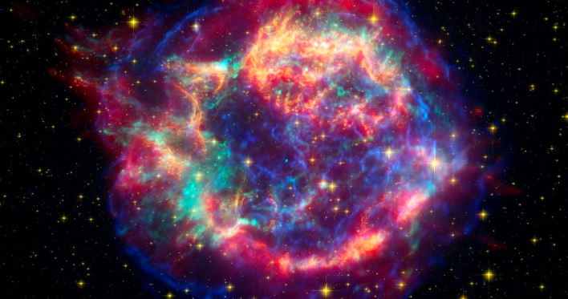
“Star Chaser”
Game where you compete to classify Supernovas (exploding stars)
Leaderboard with head-to-head competition
Python/Django backend with:
Kiras/Tensorflow Machine Learning (classification)
Kaggle dataset, Postgres
References and Links to explain what’s going on

Slide 12
Best Practices
Define the Problem
Identify Needs of User, Organization
Do Some Research
Define Your Solution
Test Your Design
To Include:
Identify Audience and Key Points
Wireframe and Review
References:
Getting Started in UX Design by Kurt Krumme https://app.pluralsight.com/library/courses/getting-started-ux-design/table-of-contents
UX Design Creating Wireframes by Susan Simkins https://app.pluralsight.com/library/courses/ux-design-creating-wireframes/table-of-contents

Slide 13
Target Audience:
Engineering Manager (Hiring Manager)
Machine Learning / Vision Architect
General Passers-by (recruiters, friends, networking contacts)

Slide 14



Personas
Data / ML Architect
Expanding team to develop and deploy new algorithms
Needs to preserve current tools and process
Needs to define metrics/success
Needs infrastructure/tool roadmap
Needs trained/skilled hands
Director of Engineering
Wants to add Machine Learning to Web App
Needs to deliver on schedule
Needs to deliver quality
Predictability is paramount
Passers-by
Recruiters:
“Can I place him?”
“What does he do?”
Professional Contacts / Network
Elevator pitch

Slide 15
Priority Content
“Info” panels explaining what/why
Context (why) of the application (first page)
Background on PLAsTiCC
Metrics – why important and reference
Data Processing – constructing the model (slide)
Dataset – timeseries and size/scale
Tensorflow Model – B.Trotta and K.Boone approach summary and other approaches used. Reference/link to my other slidesets.
Tensorflow background
Structure of website (slides from this presentation)
“Popup” on make_bid page - highlight merge of TensorFlow ML results with local database

Slide 16
Proposed Site Map
Login
Home
Info Panel
.
.
.
.
.
.
.
.
.
Admin
Leaderboard
Users/Groups
Database
Choose a Star
Popup
Analyze / Classify

Slide 17
Wireframes
<link to .pdf on github>

Slide 18
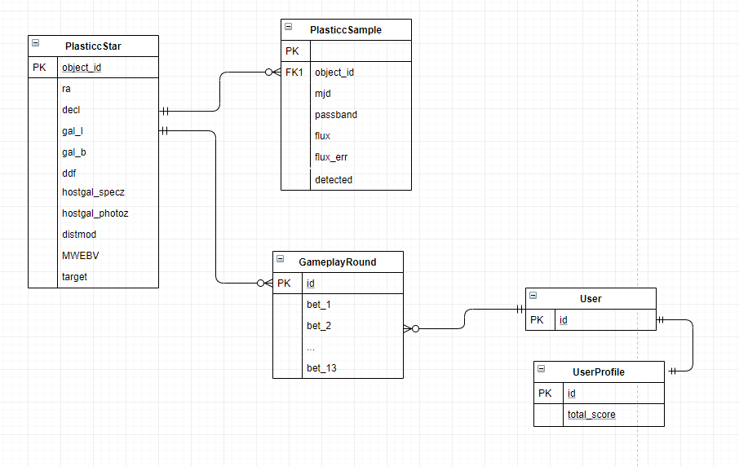
Schema

Slide 19
Development...

Slide 20
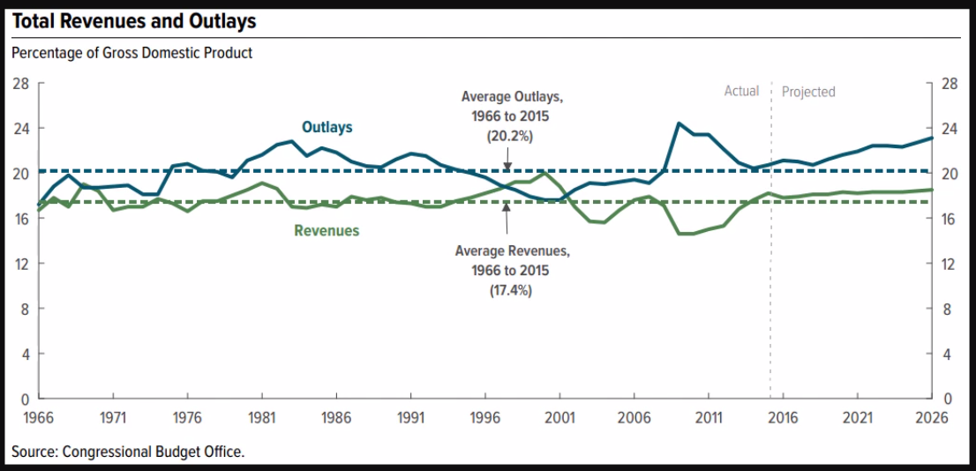
Data Visualization
Tons of libraries. High end (D3.js) to basic (Google Charts)
Initial exploration is by Jupyter Notebook and/or Pandas/MatplotLib... see Titanic and PLAsTiCC #1
For Web App I went with Google Charts
References:
https://app.pluralsight.com/library/courses/build-first-data-visualization-google-charts
https://www.sitepoint.com/best-javascript-charting-libraries/

Slide 21
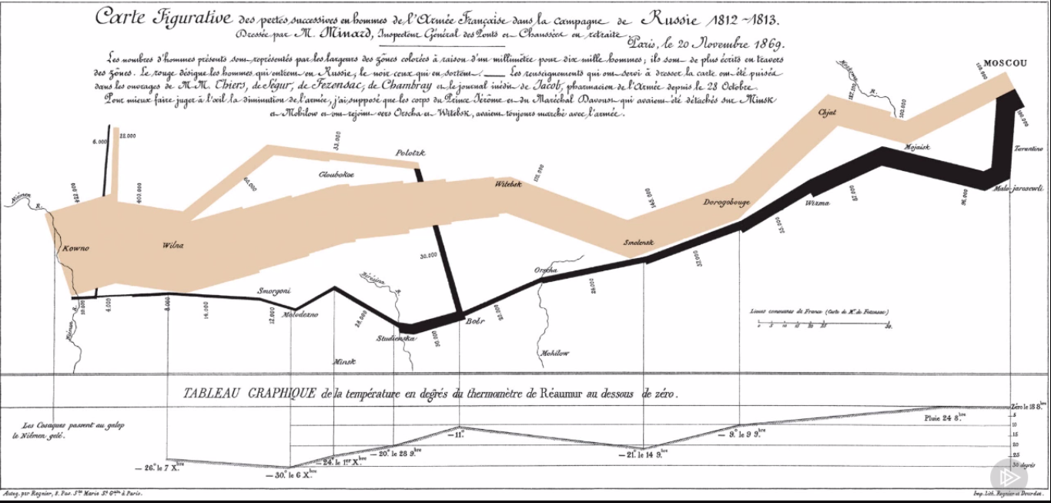
Visualization
Reference:
https://app.pluralsight.com/library/courses/build-first-data-visualization-google-charts

Slide 22
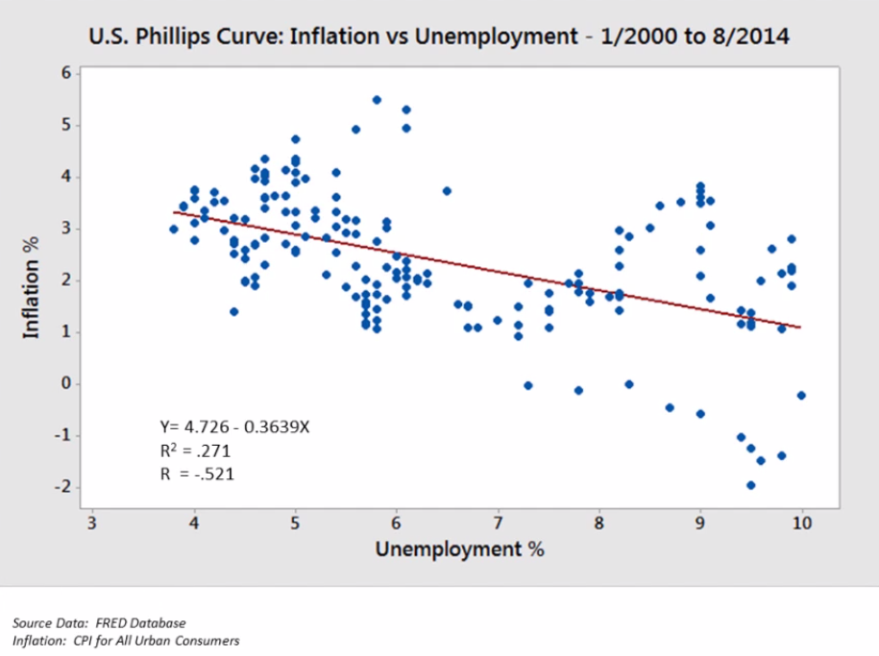
Reference:
https://app.pluralsight.com/library/courses/build-first-data-visualization-google-charts

Slide 23
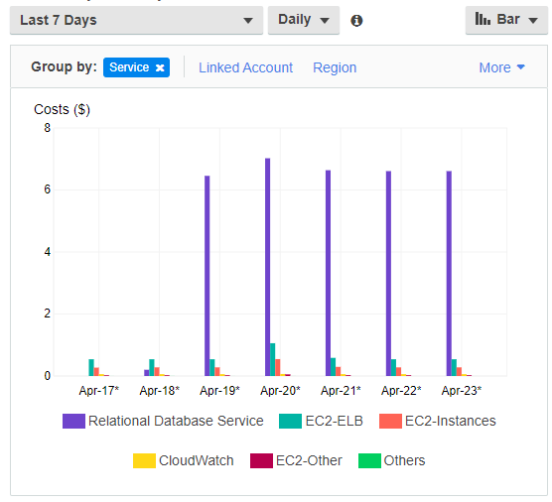
AWS EB (Elastic Beanstalk)
EB = EC2 + RDS + S3
Scales with demand
Follow instructions from https://realpython.com/deploying-a-django-app-and-postgresql-to-aws-elastic-beanstalk/
Straightforward but not really...
Baseline = $8/day with no traffic and minimal data. All RDS. (ARRGH!)
<possible workaround - yank RDS and deploy Postgres directly on EC2...?>

Slide 24
Go Live!
<link to URL>

Slide 25
Level of Effort and Takeaways
A full featured Web App (admin, login, database, forms, Python/ML backend)
6-8 days deploy with learning curve
Less complicated than Tic-tac-toe, but my own work.
Wireframe and personas super important because...

Slide 26
References
Django:
Tic-Tac-Toe (Django Fundamentals by Reindert-Jan Ekker on Pluralsight) https://app.pluralsight.com/library/courses/django-fundamentals-update/table-of-contents
Web UX/UI:
Getting Started in UX Design by Kurt Krumme https://app.pluralsight.com/library/courses/getting-started-ux-design/table-of-contents
UX Design Creating Wireframes by Susan Simkins https://app.pluralsight.com/library/courses/ux-design-creating-wireframes/table-of-contents
Node, Postgres, Express (background only - could skim this)
“Build a CRUD single page application with Node, Express, Angular, Postgres” (Michael Herman)
https://mherman.org/blog/postgresql-and-nodejs/ This is an example frontend/backend javascript web app with postgres db. It uses express web server/routing and (a little) angular on the front-end. You will use npm, express, node, browser trace/debug features. You will see javascript used on both client and server. This is very standard (server-side javascript) architecture.
Front-end (suspect this will be handy in the future)
“Front-End Web Development Quick Start With HTML5, CSS, and JavaScript” (Shawn Wildermuth) https://app.pluralsight.com/course-player?clipId=e5482b13-c204-4d52-89ec-94a1099592b0 Beginner HTML5, CSS, JavaScript – excellent

Slide 27
Thank You

