Slide 1
Kaggle PLAsTiCC
Dataset and Models

Slide 2
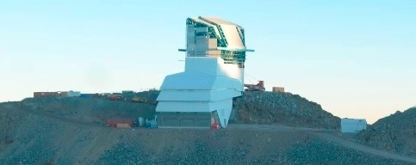
PLAsTiCC, LSST and Kaggle
LSST: “Large Synoptic Survey Telescope” [1] (expected 2023)
PLAsTiCC: Photometric LSST Astronomical Time Series Classification Challenge” [2]
Transients: stars that are actively changing such as:
Supernova that explodes over a 100 day period
Pulsar that flashes once every 12 hours
Lensing Event (a planet goes in front of a star) that occurs... occasionally!
(1) https://www.lsst.org/
(2) https://arxiv.org/abs/1810.00001

Slide 3
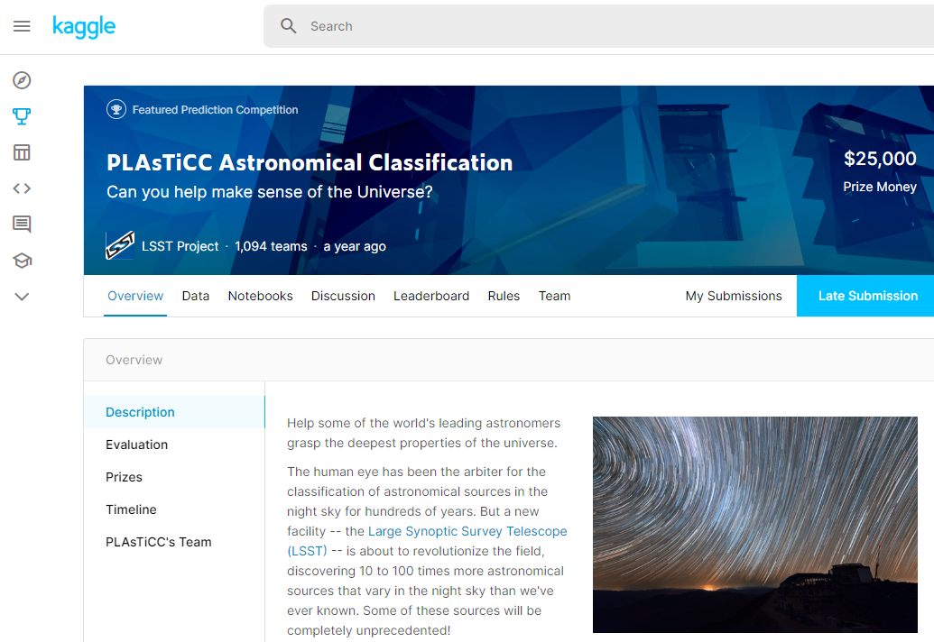
Goals:
Goal of LSST is to detect transients and notify astronomers
Goal of PLAsTiCC is to design classifier to find transients in data stream
Kaggle competition held in 2018 in preparation for first light of LSST

Slide 4
Scale
Growth Direct LSST
Camera Density ? 3B pixels
Data Rate: 1.3TB/Week(1) 20TB/Night
Objects: ~100 2.5 billion
Schedule: periodic (4hr) aperiodic (season, weather, schedule)
Time to Notification: 20 seconds 60 minutes
Class Target binary (alive y/n) 15 classes
(1) 660 * 6 * 3 * 50MB

Slide 5
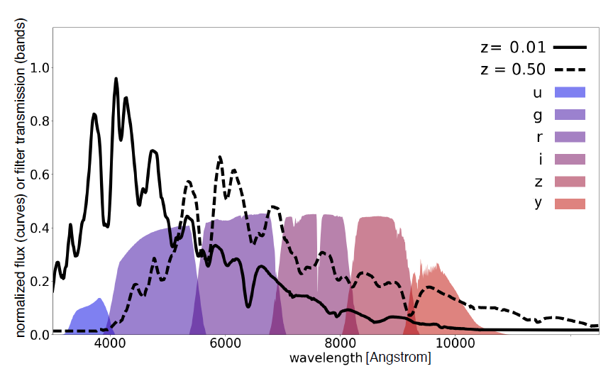
Passbands
https://arxiv.org/abs/1810.00001

Slide 6
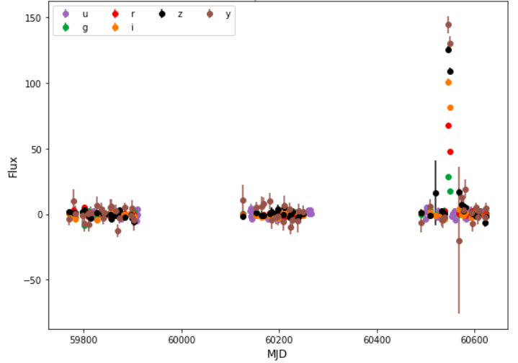
Some examples object_id 3910

Slide 7
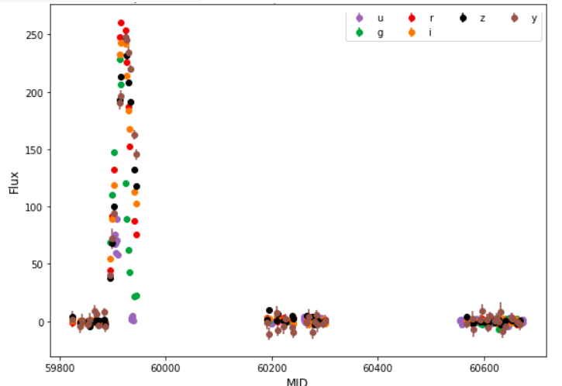
10757

Slide 8
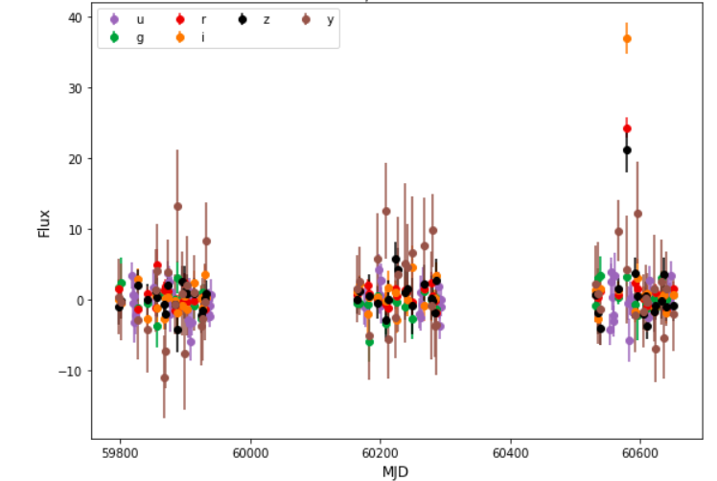
62187

Slide 9
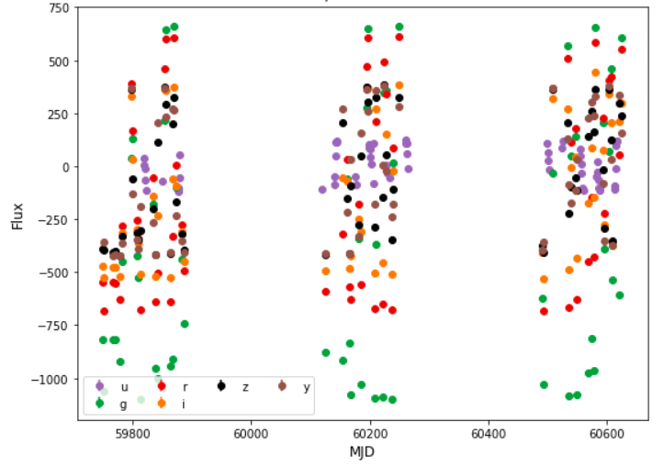
615

Slide 10
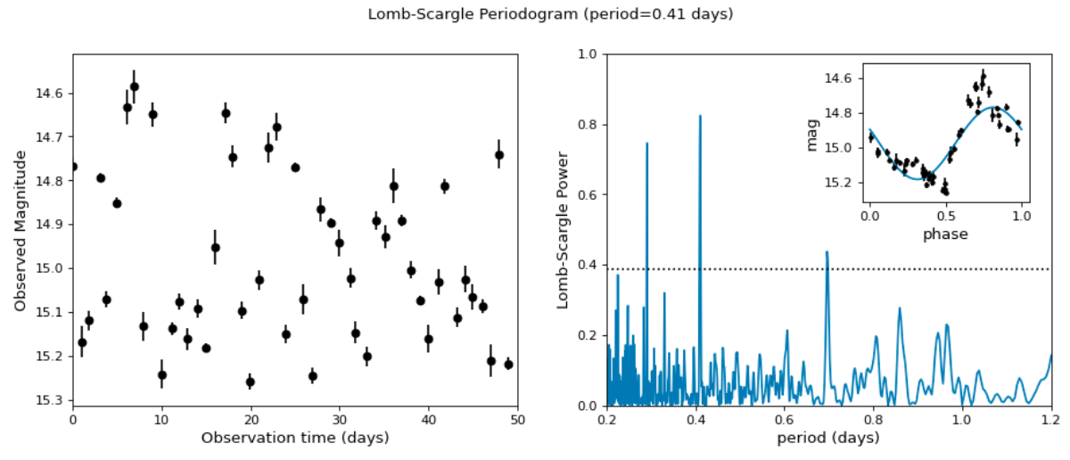
Periodicity
https://docs.astropy.org/en/stable/timeseries/lombscargle.html

Slide 11
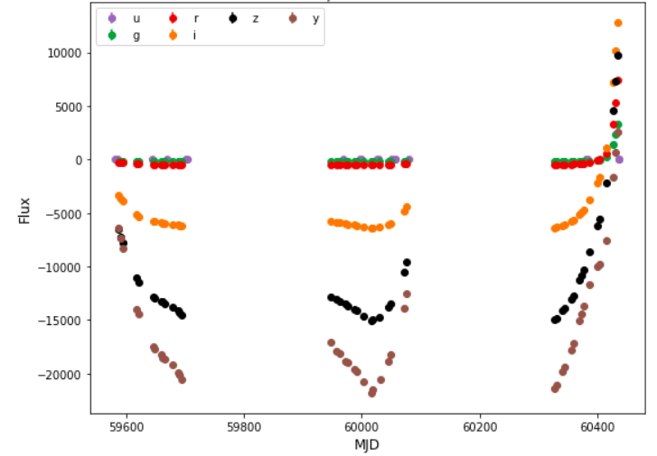
133773

Slide 12
The Data
Two tables – metadata, timeseries
Training and Test

Slide 13
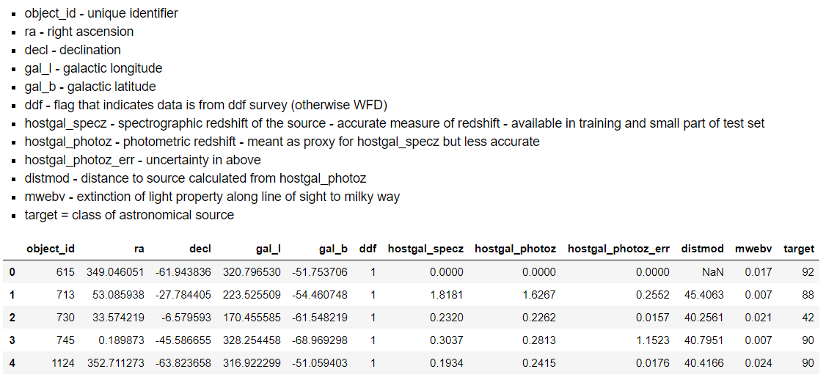
Metadata information about the object that doesn’t change

Slide 14
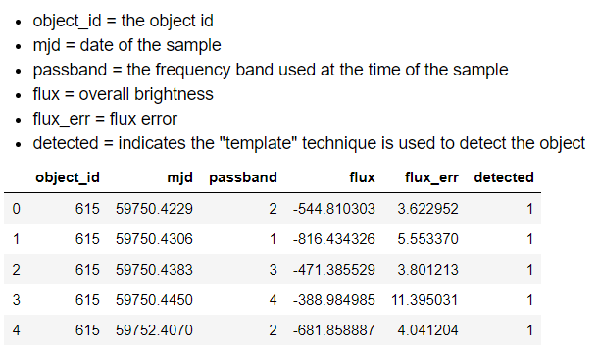
Timeseries Intensity (flux) by passband

Slide 15
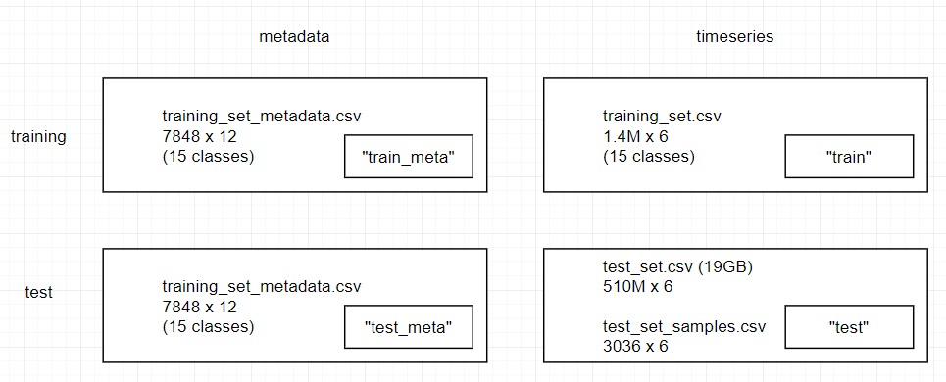
Large Dataset (19GB, 500M samples)

Slide 16
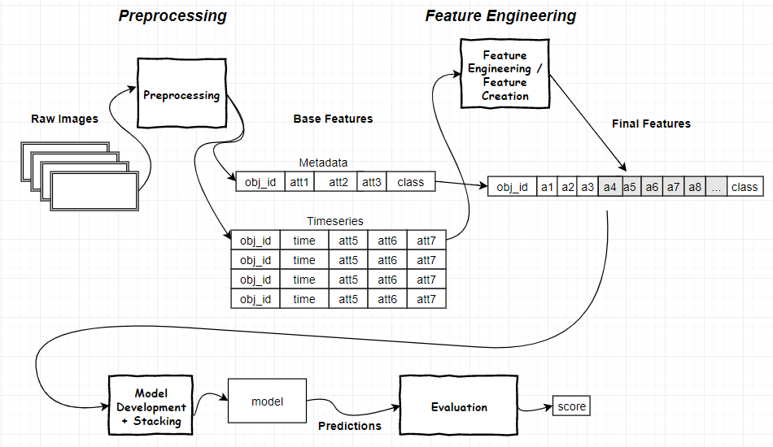
Data Flow

Slide 17
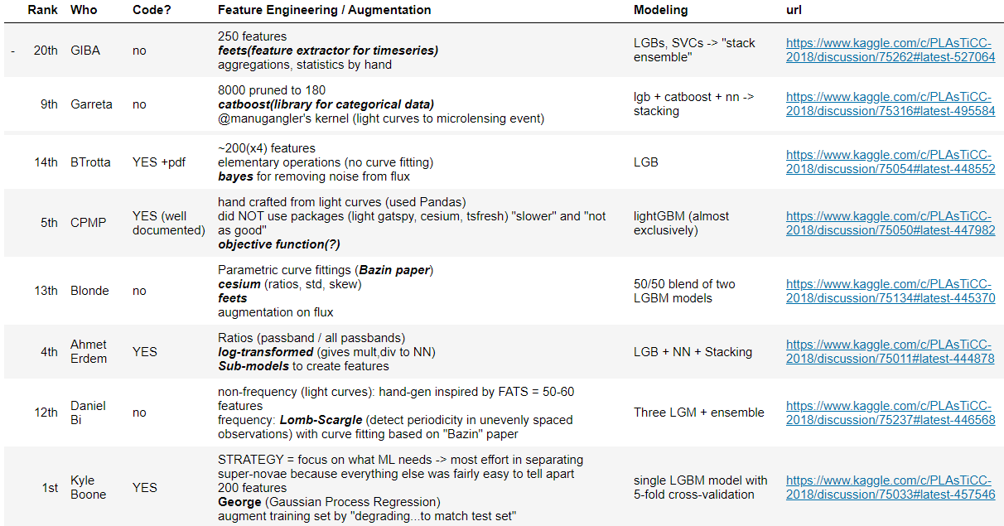
A Variety of Approaches

Slide 18
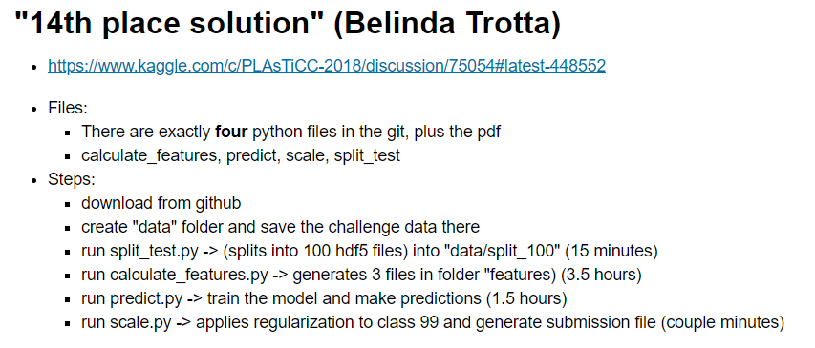

Slide 19
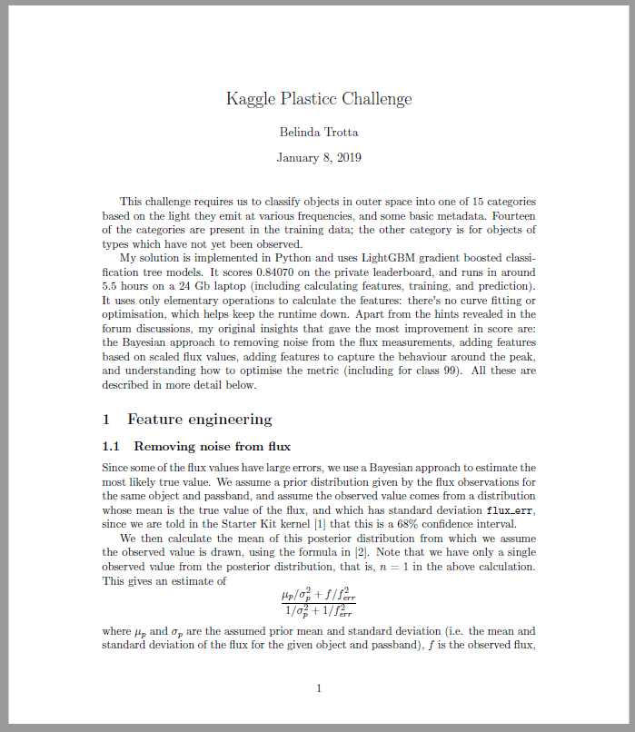
14th Place Solution B. Trotta

Slide 20
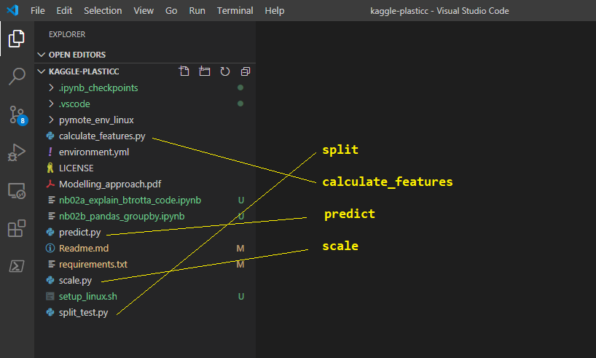

Slide 21
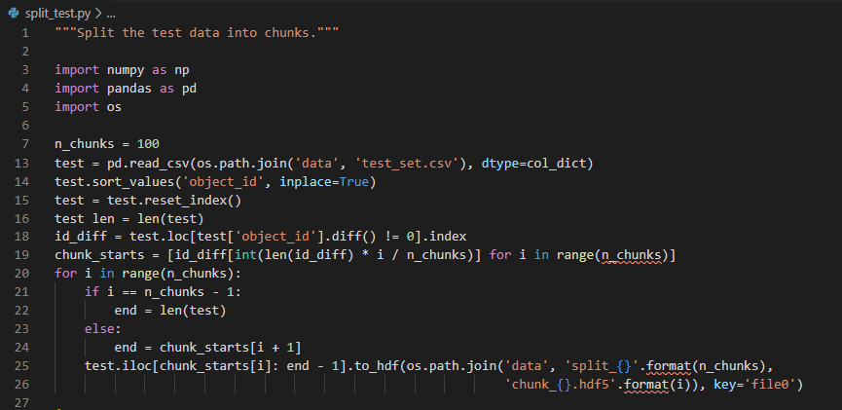
split

Slide 22
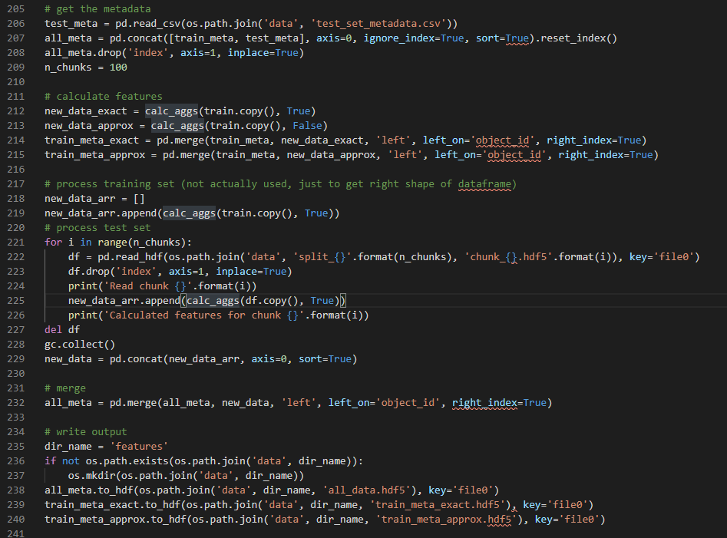
calculate_features.py a.k.a. “feature engineering”
For chunk 1..N
get data from file
calc_aggs()
Merge w/metadat
Write .hdf

Slide 23
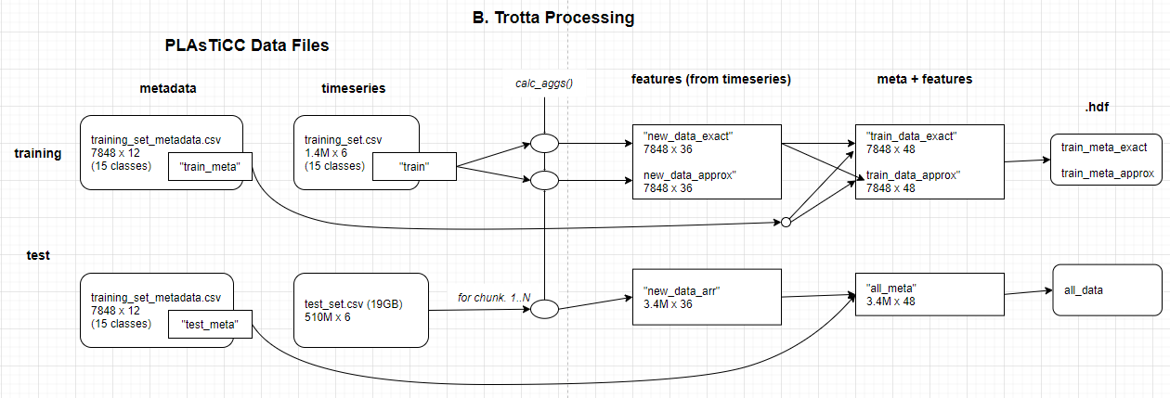
as a picture...

Slide 24
all the work...

