Slide 1
Kaggle PLAsTiCC
The Competition, Dataset and
Top Leaderboard Strategies
PLUS
Code walkthrough of the B. Trotta Submission
Chris Winsor
6/10/2020
https://github.com/cwinsor/kaggle_plasticc
www.cwinsor.us

Slide 2
Agenda:
Overview of Kaggle PLAsTiCC Competition and LSST
Review Top Leaderboard (Approaches Taken / Common Themes)
Detailed Code Walkthrough of B. Trotta submission

Slide 3

PLAsTiCC, LSST and Kaggle
LSST: “Large Synoptic Survey Telescope” [1]
A new telescope focusing on detecting and studying “Transients” - expected completion in 2023
PLAsTiCC: Photometric LSST Astronomical Time Series Classification Challenge” [2]
The Kaggle competition to classify star timeseries data anticipated from LSST
Transients: stars that are actively changing such as:
Supernova that explodes over a 100 day period
Pulsar that flashes once every 12 hours
Lensing Event (a planet goes in front of a star) that occurs... occasionally!
(1) https://www.lsst.org/
(2) https://arxiv.org/abs/1810.00001

Slide 4
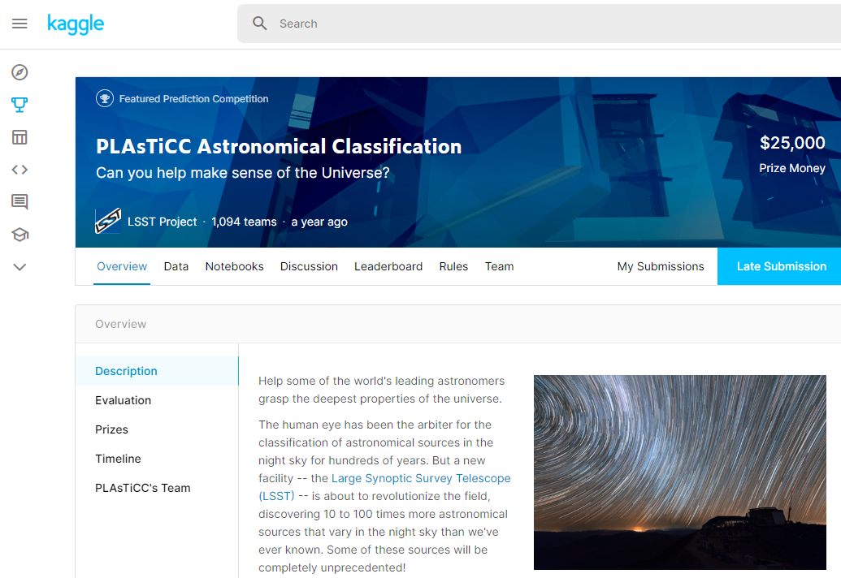
Goals:
Goal of LSST is to detect transients and notify astronomers
Goal of PLAsTiCC Kaggle competition is to design classifier to find transients in data stream
Competition held in 2018 in preparation for first light of LSST

Slide 5
LSST Data Size/Scale
Camera Density 3.2B pixels
Data Rate: 20TB/night
Objects in Database: 37 billion
Class Target: 15 classes
Detection/Notification Rate: 10M/night
Latency Goal (observation to notification): 60 minutes
Additional challenges:
Observations are aperiodic due to season (Earth’s axis) weather and telescope schedule
Observations are by passband, one band captured per observation.

Slide 6
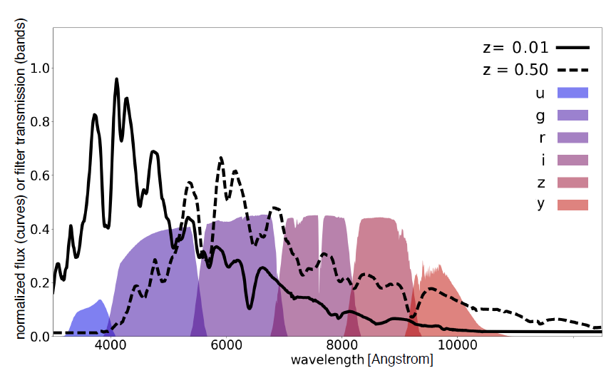
Passbands
https://arxiv.org/abs/1810.00001

Slide 7
Template (differential sampling)
A “template” technique is used to measure intensity
Expressed as “flux” - intensity relative to template
This allows detecting very small changes
A reference image (template) has been previously established for each star
A new image (sample) is captured
A simple difference is computed: flux = sample – template
Flux can be negative
Flux_error is computed (no details here)

Slide 8
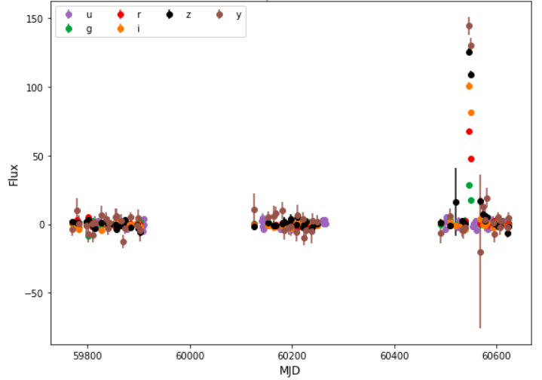
Impact of Schedule object_id 3910

Slide 9
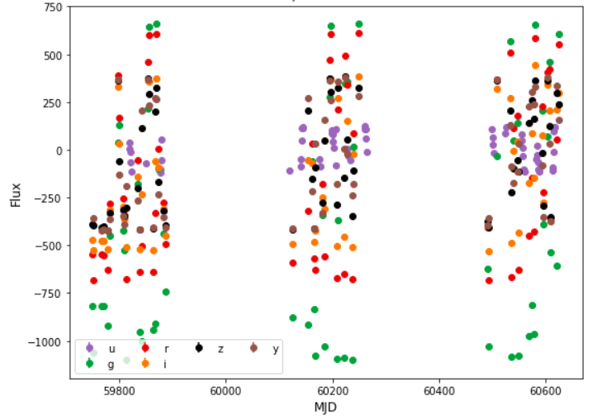
Impact of Sample Rate < Signal Rate object_id 615

Slide 10
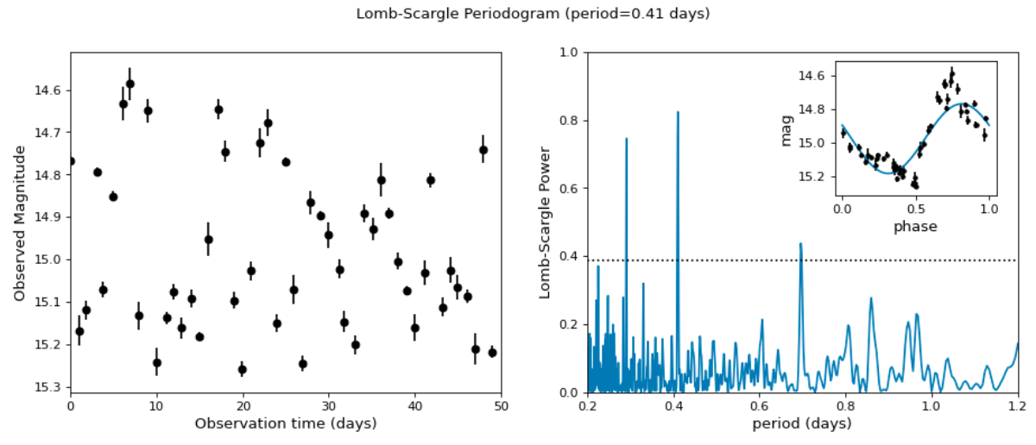
Periodicity Unrolled
https://docs.astropy.org/en/stable/timeseries/lombscargle.html

Slide 11
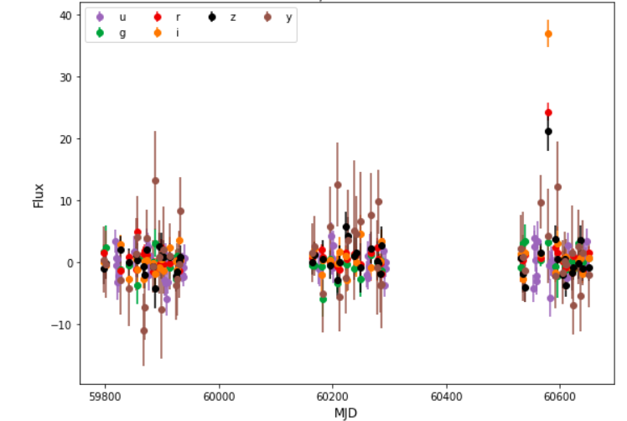
Signal-to-noise object_id 62187

Slide 12
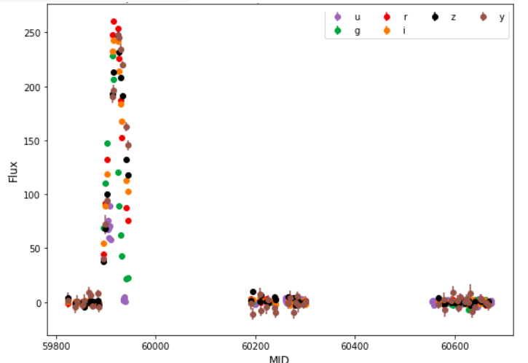
10757

Slide 13
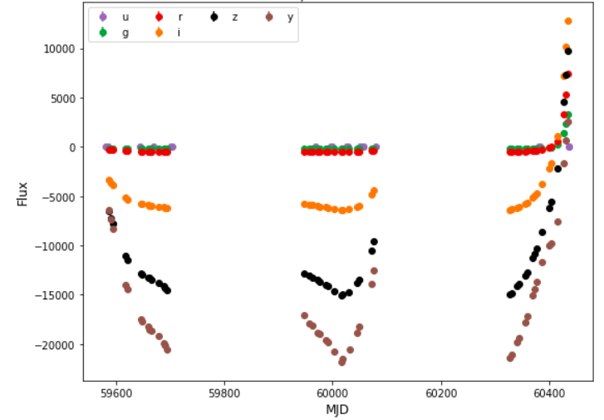
133773

Slide 14
The Data
Two tables – metadata, timeseries
Two datasets – training, test

Slide 15
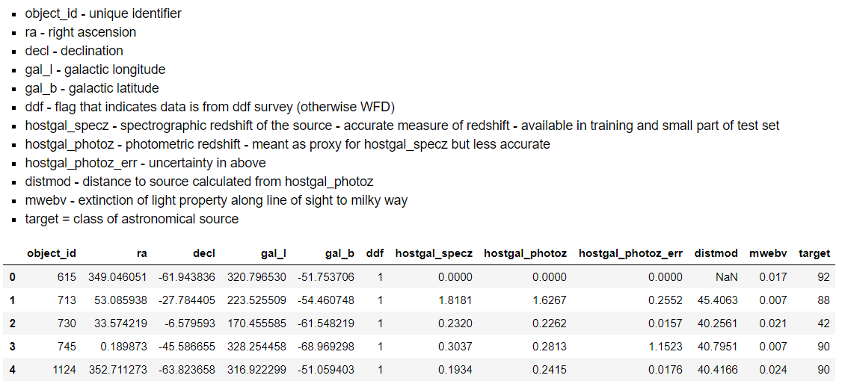
Metadata information about the object that doesn’t change

Slide 16
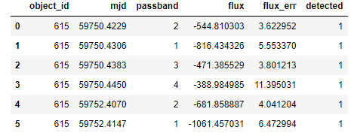
Timeseries Intensity (flux) by passband
Object_id = the object id
MJD = date of sample (Modified Julian Date)
Passband = frequency band of sample
Flux = brightness
Flux_err - = uncertainty on measurement of flux
Detected = 1 means brightness differs from the “template” by 3 sigma

Slide 17
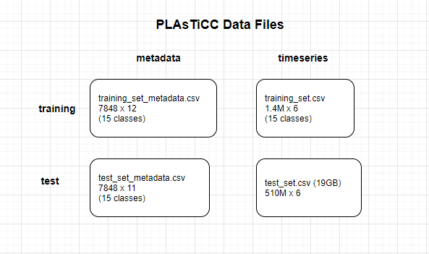
19GB, 510M samples

Slide 18
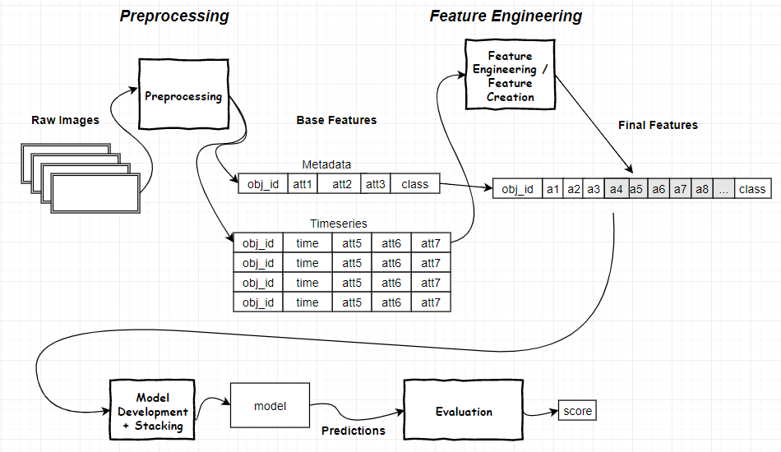
Data Flow (big picture)

Slide 19
Approaches Taken

Slide 20
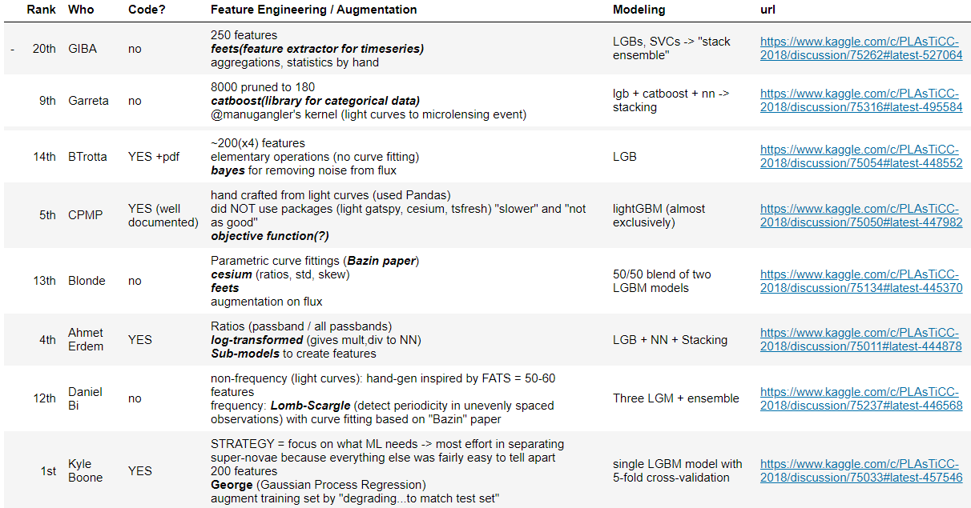
Variety, and Commonality

Slide 21
Takeaways:
Feature Engineering is The Task. Between 200 and 8000 features into ML
Focusing on what ML needs is key:
“most effort in separating Super-Novae (types) because everything else was fairly easy to tell apart” (K. Boone #1)
“log-transformed to allow CNN to do multiply, divide” (A. Erdem #4)
Libraries...
100% use LGB to stack lower-level models, some exclusively. A few CNNs.
Feature extraction libraries: feets, catboost, cesium, george
Periodicity: Lomb-Scargle
Much hand-crafting of features

Slide 22
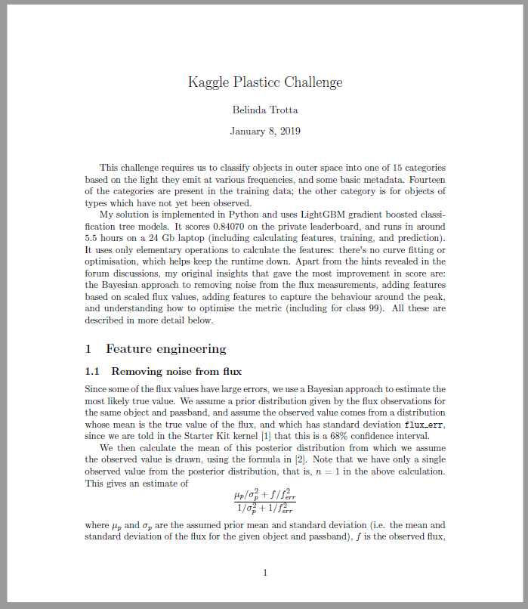
14th Place Solution B. Trotta
Pandas Gold

Slide 23
14th Place Solution B. Trotta https://www.kaggle.com/c/PLAsTiCC-2018/discussion/75054
Exactly 4 python files
Procedure:
Download from git
Create “data” folder and download challenge data there
Run “split_test.py” Splits data into 100 .hdf5 files (about 15 minutes)
Run “calculate_features.py” generates 3 features files (about 3.5 hours)
Run “predict.py” train the model and make predictions (1.5 hours)
Run “scale.py applies regularization and creates submission file (couple minutes)

Slide 24
If you want to follow along..
A Jupyter Notebook is available that “code walks” B.Trotta. To use this a git of B.Trotta is populated within the cwinsor git workarea.
Git clone https://github.com/cwinsor/kaggle_plasticc.git
cd kaggle_plasticc/code_kaggle_plasticc_btrotta/
You will see
Jupyter notebook NB99_EXPLAIN_BTROTTA_CODE_WALK.ipynb
requirments.txt
setu_linux_btrotta.sh
Use them
From there, git clone https://github.com/btrotta/kaggle-plasticc.git
Run the Jupyter Notebook – you will find it uses files in the B.Trotta sub-git. It should work!

Slide 25
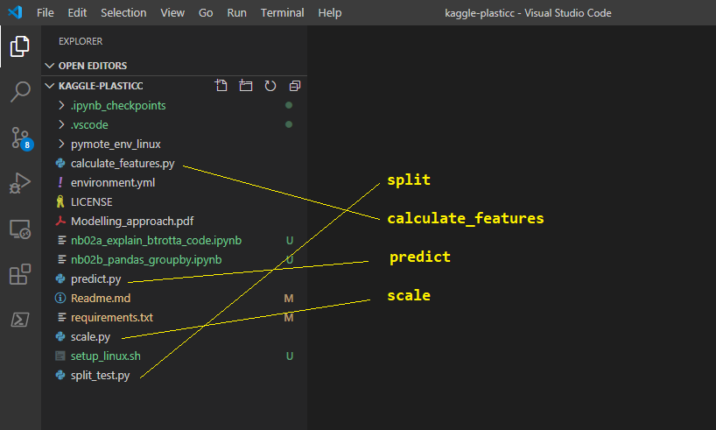
Procedure Parts 1,2,3,4

Slide 26
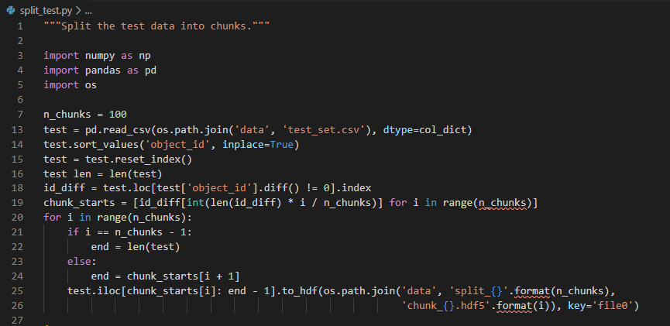
Part 1: split

Slide 27
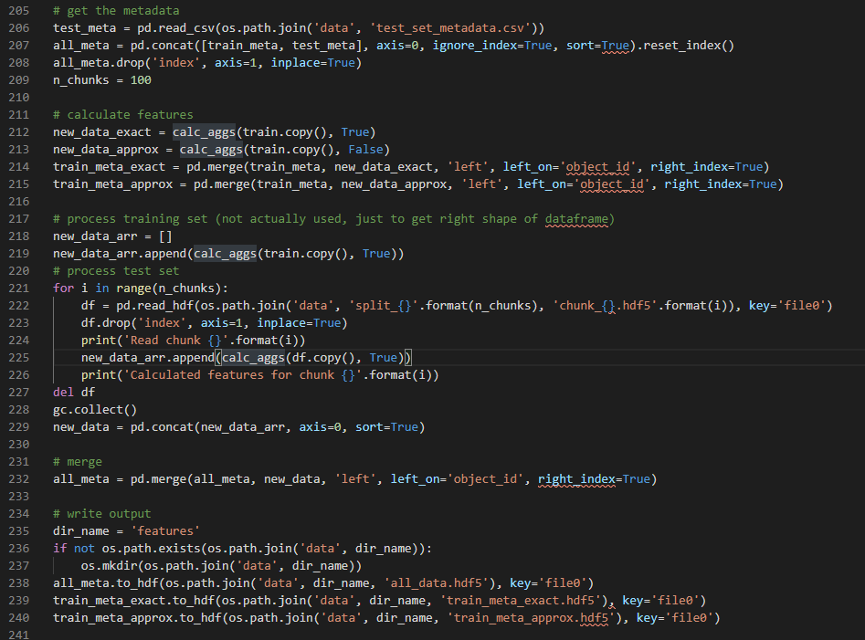
Part 2: calculate_features a.k.a. “feature engineering”
For chunk 1..N
get data from file
calc_aggs()
Merge w/metadat
Write .hdf

Slide 28
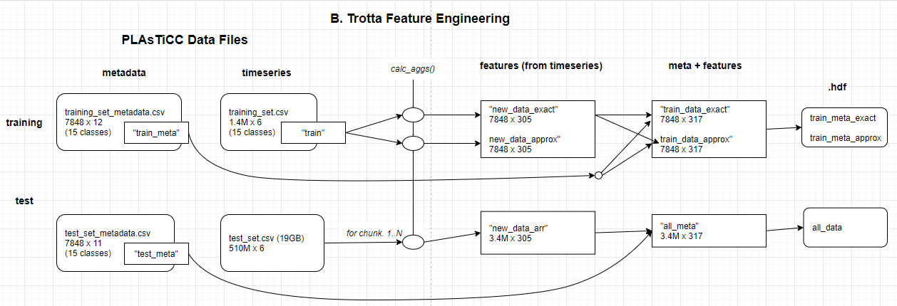
as a picture...

Slide 29
all the work...

Slide 30
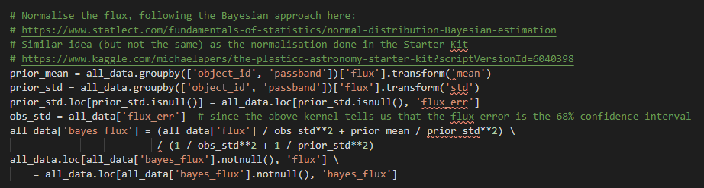
Normalize the flux
For each [object, passband], calculate reductions mean and std
Use that to scale the flux (Bayes calculation)
Add “bayes_flux” as new feature to timeseries and overwrite “flux”

Slide 31
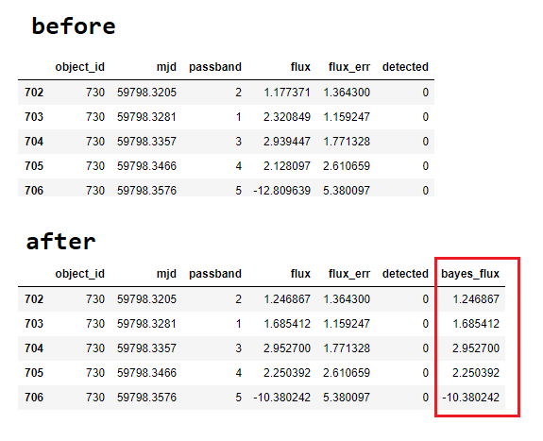

Slide 32
DataFrame.groupby() https://pandas.pydata.org/pandas-docs/stable/user_guide/groupby.html
Pandas Gold
Split -> Apply -> Combine
Split (grouping) establishes “a mapping of labels to group names” (keys)
Can be done via function, list, dict, string indicating df column
Apply can be:
Aggregation: (compute reduction statistic and apply to the group)
Filtration: (compute reduction True/False and discard some groups based on it)
Transformation (compute element-wide function - returns a like-index object)
Example:
df = pd.DataFrame({'A': ['one', 'one', 'two', 'three', 'three', 'one'], 'B': range(6)})
gb = df.groupby(‘A’)
gb.display(), gd.count(), gb.transform(‘mean’) gb.transform(lambda x:x+1)

Slide 33
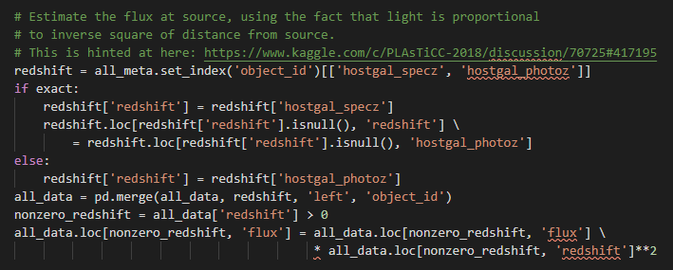
Estimate Flux at Source
Redshift is in the metadata (not timeseries) so no groupby needed. Just copy specz or photoz
Apply the inverse-square calculation to “flux”

Slide 34
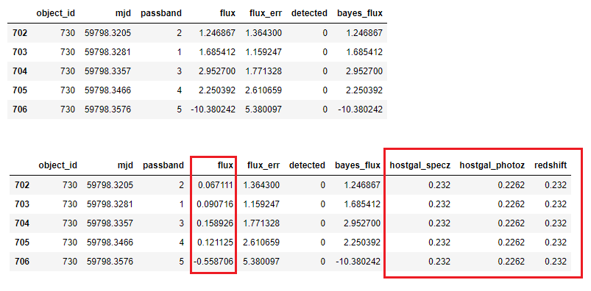

Slide 35
pd.merge() super powerful...
Pandas Gold
DataFrame.merge(self, right, how, on, suffixes, validate)
Right: other DataFrame
How: inner, left, right, outer
On: merge key
Suffixes: if merge results in duplicate column names
Validate: optional check for 1-1, 1:m, m:1

Slide 36
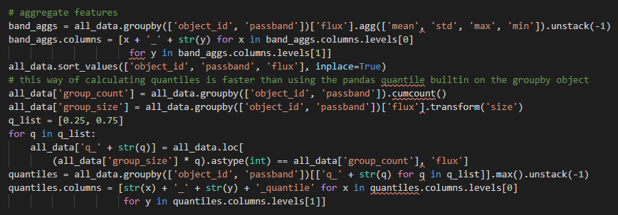
Aggregate Features
Mean, STD, Max and Min for each [object,passband]
25% and 75% quantiles

Slide 37
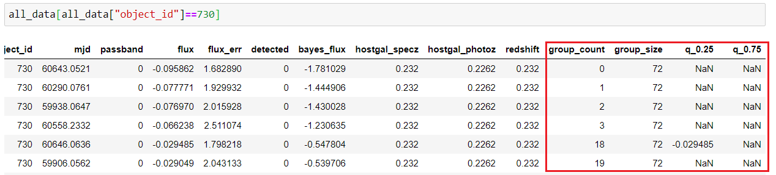

Slide 38
DataFrame.agg() https://pandas.pydata.org/pandas-docs/stable/reference/api/pandas.DataFrame.agg.html
Pandas Gold
“Aggregate using one or more operations over the specified axis”
DataFrame.agg(self, func, axis=0, *args, **kwargs)
Func: function, list of functions, dictionary of label->function
Axis: 0-> apply to columns, 1-> apply to rows

Slide 39
“most_extreme()”
Find the "most extreme" time for each object and each band
Retrieve the k data points on either side
Procedure:
for each passband - translate to it's median
find the date of the peak (largest value)
for each sample identify the number of days to/from the peak
sort by days before/after in order to find the n preceding, and n following

Slide 40
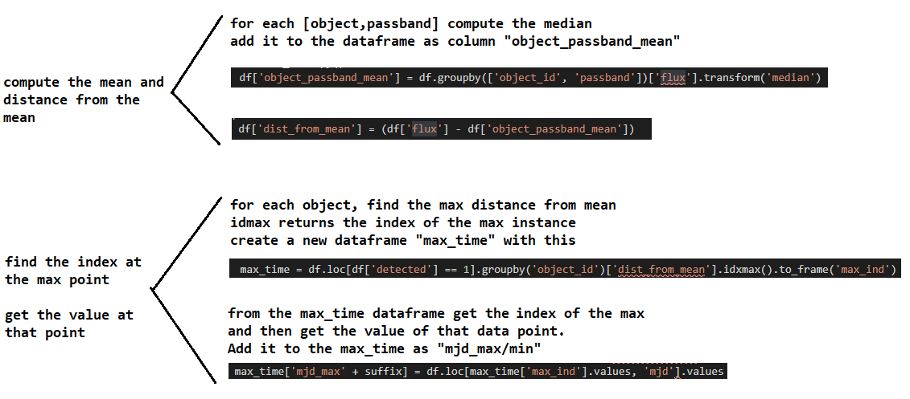
most_extreme (1) find the max value

Slide 41
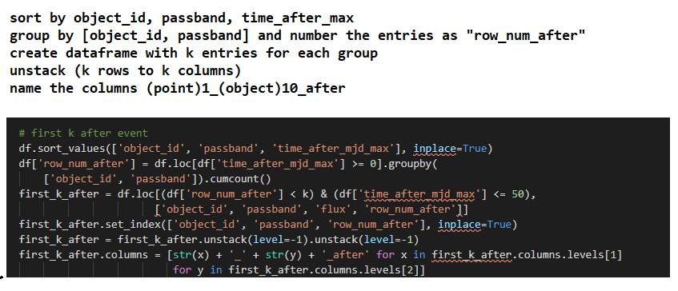
“most_extreme()” (2) get first K after max

Slide 42
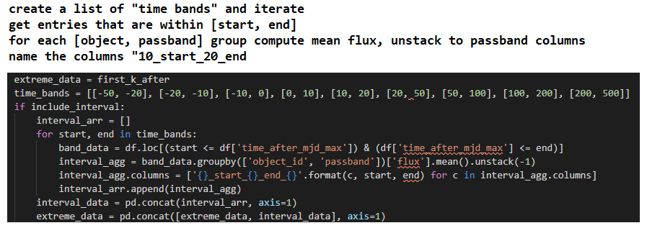
“most_extreme()” (3) calculate mean flux for “time bands” around the max

Slide 43
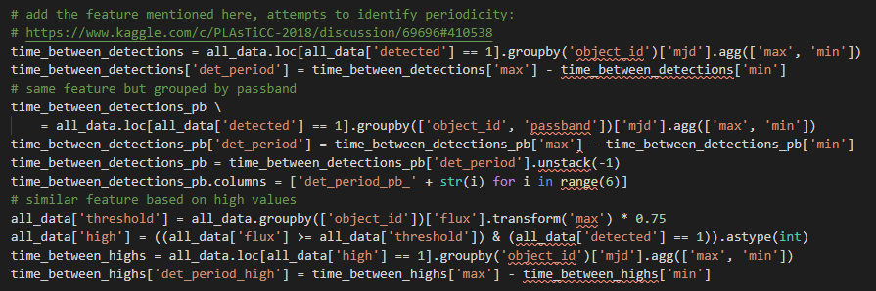
Periodicity identification
Strategy - do not need period, only a flag (periodic vs episodic/cataclysmic)
Roll-your own (vs library) satisfies w/ much lower computes

Slide 44
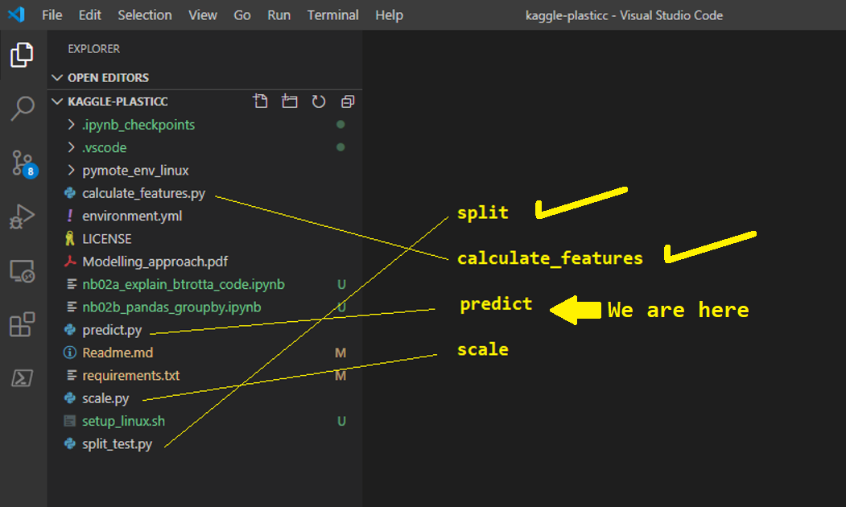
Where we are... We engineered features. Now create model using LGB.

Slide 45
Part 3: Train (in predict.py)
This is where we:
Train
Validate
(optionally) save the model for later use in predicting
Make predictions
B.Trotta does not save the model. For StarChaser we will need this.

Slide 46
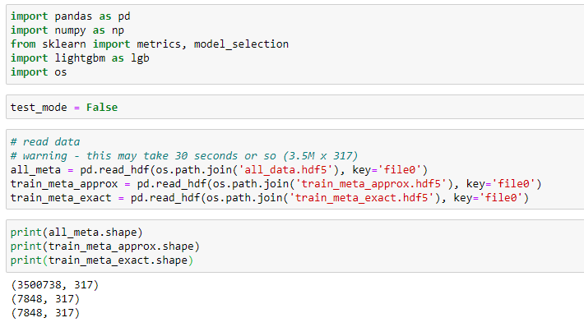
Train [1] Read features data from file Will be creating separate models (galactic, non-galactic) using “hostgal” as delimiter

Slide 47
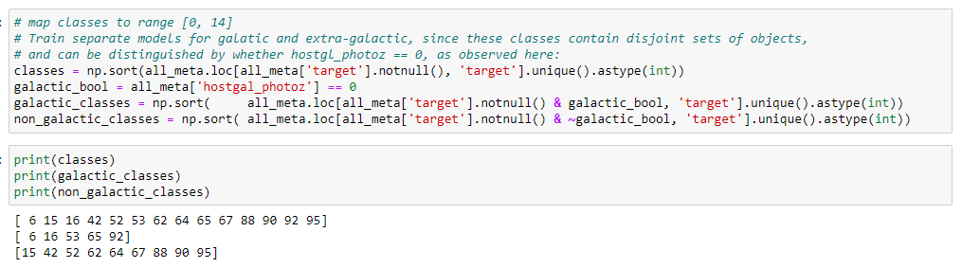
Train [2] Map classes to integer range

Slide 48
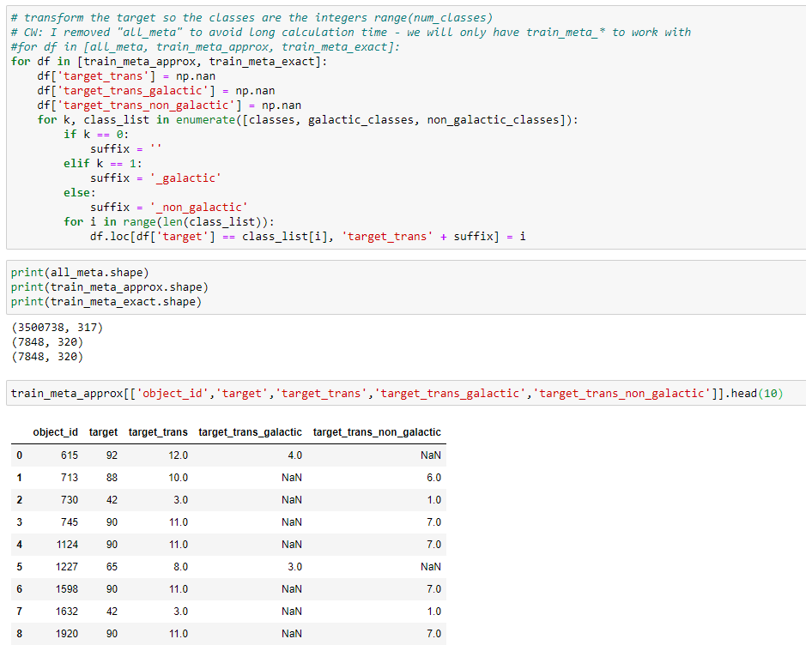
Train [3] Prepare target_trans_ for galactic, non-galactic models

Slide 49
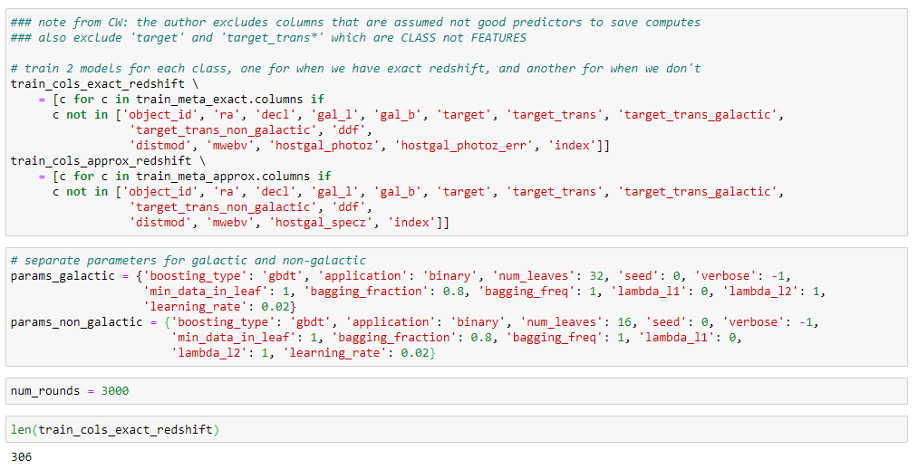
Train [4] Choose columns to be used in training

Slide 50
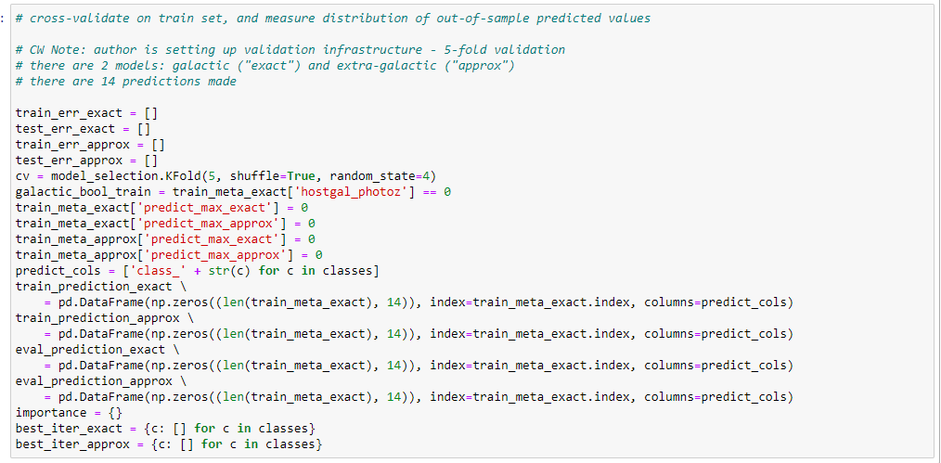
Train [5] Prepare cross-validation infrastructure. This uses sklearn (Scikit-learn) model_selection.Kfold nfolds=5

Slide 51
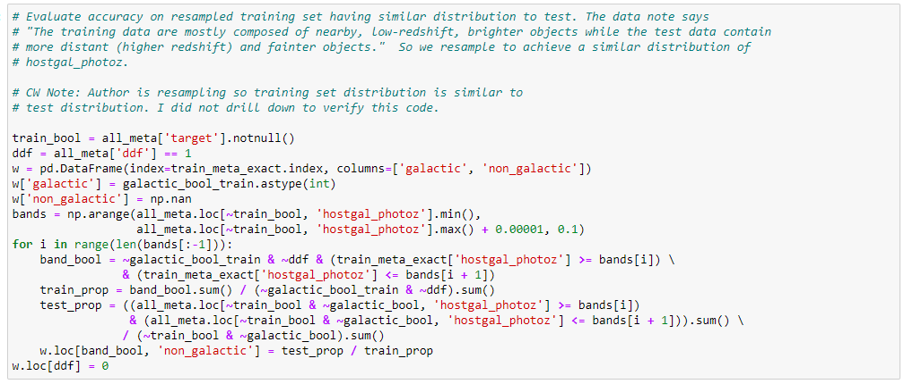
Train (6)
The training set is not representative of the test set.
Author resamples training set to reflect test.

Slide 52
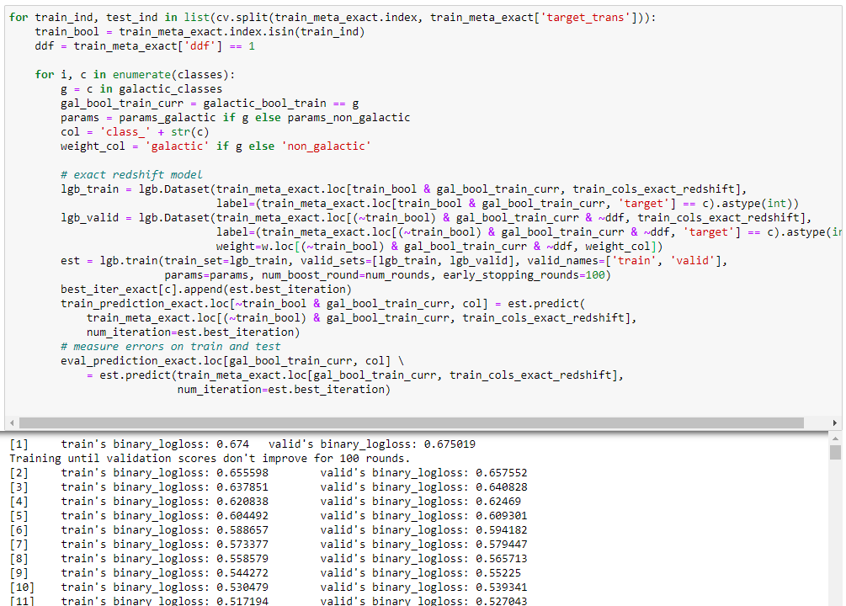
Train [7] (train and evaluate) library = lgb (lightGBM by Microsoft) A “cv” was previously created For each train/test split and for each class: prepare lgb dataset (training and validation) train model “est” from the iterations, take the best and append to best_iter[c] make prediction using test data (“train_prediction”) evaluate performance

Slide 53
In Summary
PLAsTiCC is a great example of a timeseries dataset
Challenging in size and sampling (periodicity and passbands)
Rich in underlying structure (types of stars and characteristics)
Tractable in concept
Competitors show strong consistency (LGB), with differences in underlying ML models, approach and libraries
B.Trotta code is wonderfully structured and documented
A rich source for Pandas examples

Slide 54
Thank You

