Slide 1
Inference

Slide 2
Overview
The MC-SAT algorithm
Knowledge-based model construction
Lazy inference
Lifted inference

Slide 3
MCMC: Gibbs Sampling
state ← random truth assignment
for i ← 1 to num-samples do
for each variable x
sample x according to P(x|neighbors(x))
state ← state with new value of x
P(F) ← fraction of states in which F is true

Slide 4
But … Insufficient for Logic
Problem:
Deterministic dependencies break MCMC
Near-deterministic ones make it very slow
Solution:
Combine MCMC and WalkSAT
→ MC-SAT algorithm

Slide 5
The MC-SAT Algorithm
MC-SAT = MCMC + SAT
  MCMC: Slice sampling with an auxiliary variable
  for each clause
  SAT: Wraps around SampleSAT (a uniform sampler)
  to sample from highly non-uniform distributions
Sound: Satisfies ergodicity & detailed balance
Efficient: Orders of magnitude faster than
Gibbs and other MCMC algorithms
Notes:
In this talk, I will talk about a new inf alg, MC-SAT, that we developed to meet this challenge.
MC-SAT combines ideas in MCMC and SAT.
From the MCMC perspective, MC-SAT is a slice sampling method using an aux var for each clause.
From the SAT perspective, MC-SAT wraps around SampleSAT, a uniform SAT sampler, to sample from highly non-uniform dist.
MC-SAT is sound and our experiments show that it is much faster than existing MCMC methods like Gibbs and ST.
MC-SAT accepts problems defined in ML, which is a very general language that subsumes finite FOL and MN. So MC-SAT is applicable to any S.R.L. problems.

Slide 6
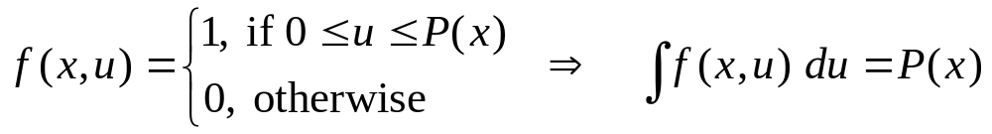
Auxiliary-Variable Methods
Main ideas:
  Use auxiliary variables to capture dependencies
  Turn difficult sampling into uniform sampling
Given distribution P(x)
Sample from f (x,u), then discard u
Notes:
An attractive solution is to use aux-var methods. The idea is to introduce auxiliary var to capture dependencies and turn diff sampling into uniform sampling.
Given a dist p(x), we introduce a var u, and define joint dist over x, u, so that it is 1 iff u is btw 0 and p(x).
Now if we marginalize over u, it becomes precisely p(x).
So in order to sample p(x), we can instead sample from f(x,u), and discard the samples of u.

Slide 7
Slice Sampling [Damien et al. 1999]
U
P(x)
Slice
u^{(k)}
X
x^{(k)}
x^{(k+1)}
Notes:
A representative of aux var methods is slice sampling.
we are given a diff dist. Note the low-prob region between the two modes. This is exactly the type that cause trouble for Gibbs, because it is very slow to traverse thru this area.
Now we see how slice sampling gets around this problem. It begins with a random start point.
Now, suppose we have reached the kth-sample.
We first sample the next U uniformly from the vertical bar from 0 to p(x).
Then, we gather all x such that p(x) is above U, which comprise of the slice.
We then sample the next x uniformly from this slice. And the process goes on.
So w. slice sampling, we can jump from one mode to another mode in just one sampling, bypassing the low-prb region.

Slide 8
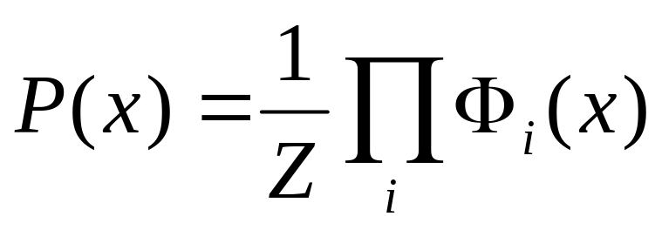
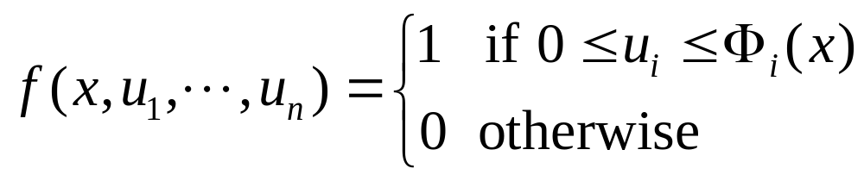
Slice Sampling
Identifying the slice may be difficult
Introduce an auxiliary variable u_{i} for each Ф_{i}
Notes:
The diff of slice sampling is in identifying the slice.
E.g. p may be a product of a number of potentials, as in a GM.
In this case, we can do is to introduce an aux var for each potential.
In particular, as we shall see later, in MC-Sat, we introduce an aux var for the potential corresponding to each clause.

Slide 9
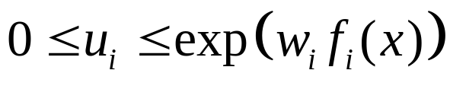
The MC-SAT Algorithm
Approximate inference for Markov logic
Use slice sampling in MCMC
  Auxiliary var. u_{i} for each clause C_{i}:
  C_{i} unsatisfied: 0 ≤ u_{i} ≤ 1
  ⇒ exp ( w_{i} f_{i} ( x ) ) ≥ u_{i} for any next state x
  C_{i} satisfied: 0 ≤ u_{i} ≤ exp ( w_{i} )
  ⇒ With prob. 1 – exp ( – w_{i} ), next state x must satisfy C_{i}
  to ensure that exp ( w_{i} f_{i}(x) ) ≥ u_{i}
Notes:
MC-SAT is an approx inf method for ML.
It is an MCMC method using slice sampling.
For each clause, we introduce an aux var for the corresponding potential.
To determine the slice, first we do some analysis. For simplicity, below we assume the weights are positive.
An unsat clause C_i means that f_i=0, and therefore u_i will be drawn from 0 to 1. Since w_i is positive, whatever the next state x, the potential of e to w_i f_i will be above 1, and so the slice requirement is trivially sat.
Now If C_i is sat, f_i is 1, and so u_i is drawn uniformly btw 0 and e to w_i.
We know that the next potential is at least 1, so the question is when u_i is above 1, which has prb 1-e to –w_i. In this case, the next f_i must be 1, meaning that next state x must sat C_i.
So for a sat clause, w. prb 1-e^-w_i, the next state also need to sat it.

Slide 10
The MC-SAT Algorithm
Select random subset M of satisfied clauses
Larger w_{i} ⇒ C_{i} more likely to be selected
Hard clause (w_{i} → ∞): Always selected
Slice = States that satisfy clauses in M
Sample uniformly from these
Notes:
In sum, the slice is decided by a random subset of sat clauses, M.
For each sat clause, it is selected w. prb 1-e^-w_i.
Larger weight means that the prb is higher, and so the clause is more likely to be selected.
In the limit of infinite wt, i.e., for a hard clause, prb is 1 and it’s always selected.
The slice comprises of all states that sat clauses in this set M.
And we sample uniformly from these.

Slide 11
The MC-SAT Algorithm
X ( 0 ) ← A random solution satisfying all hard clauses
for k ← 1 to num_samples
M ← Ø
forall C_{i} satisfied by X ( k – 1 )
With prob. 1 – exp ( – w_{i} ) add C_{i} to M
endfor
X ( k ) ← A uniformly random solution satisfying M
endfor
Notes:
So! we arrive at the MC-SAT alg, simple and elegant.
We init w. a random sol that sat all hard clauses.
In each sampling, we first choose a random subset M of the sat clauses, subj to each prb of 1-e^-w_i.
Then, the next sample is drawn uniformly from solution to M.

Slide 12
The MC-SAT Algorithm
Sound: Satisfies ergodicity and detailed balance
  (Assuming we have a perfect uniform sampler)
Approximately uniform sampler [Wei et al. 2004]
  SampleSAT = WalkSAT + Simulated annealing
  WalkSAT: Find a solution very efficiently
    But may be highly non-uniform
  Sim. Anneal.: Uniform sampling as temperature → 0
    But very slow to reach a solution
Trade off uniformity vs. efficiency
by tuning the prob. of WS steps vs. SA steps
Notes:
It is easy to prove that MC-SAT satisfies ergodicity and DB, assuming we have a perfect uniform sampler.
In practice, there is no efficient uniform sampler. Otherwise prb inf won’t be #P-complete.
So we use an approx sampler, the samplesat alg, developed by Wei et al
SS combines WS and SA. WS …; whereas SA …
SS works by, at each step, w. certain prob, running a WS step, and otherwise running an SA step.
And it achieves efficiency close to WS, and uniformity close to SA.
This prb can be used to trade off …
Now the question is whether MC-SAT will work w. the imperfect uniformity provided by SS. In exp, we find out that the answer is yes.

Slide 13
Combinatorial Explosion
Problem:
If there are n constants
and the highest clause arity is c,
the ground network requires O(n ) memory
(and inference time grows in proportion)
Solutions:
  Knowledge-based model construction
  Lazy inference
  Lifted inference
c

Slide 14
Knowledge-Based
Model Construction
Basic idea:
  Most of ground network may be unnecessary,
  because evidence renders query independent of it
  Assumption: Evidence is conjunction of ground atoms
Knowledge-based model construction (KBMC):
  First construct minimum subset of network needed
  to answer query (generalization of KBMC)
  Then apply MC-SAT (or other)

Slide 15
Ground Network Construction
network ← Ø
queue ← query nodes
repeat
node ← front(queue)
remove node from queue
add node to network
if node not in evidence then
add neighbors(node) to queue
until queue = Ø

Slide 16

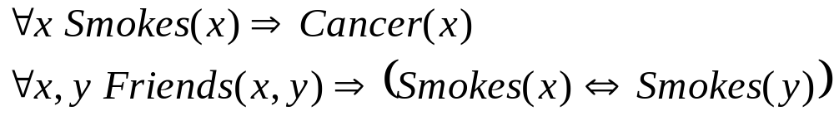
Example Grounding
Friends(A,B)
Friends(A,A)
Smokes(A)
Smokes(B)
Friends(B,B)
Cancer(A)
Cancer(B)
Friends(B,A)
P( Cancer(B) | Smokes(A), Friends(A,B), Friends(B,A))

Slide 17
Example Grounding
Friends(A,B)
Friends(A,A)
Smokes(A)
Smokes(B)
Friends(B,B)
Cancer(A)
Cancer(B)
Friends(B,A)
P( Cancer(B) | Smokes(A), Friends(A,B), Friends(B,A))

Slide 18
Example Grounding
Friends(A,B)
Friends(A,A)
Smokes(A)
Smokes(B)
Friends(B,B)
Cancer(A)
Cancer(B)
Friends(B,A)
P( Cancer(B) | Smokes(A), Friends(A,B), Friends(B,A))

Slide 19
Example Grounding
Friends(A,B)
Friends(A,A)
Smokes(A)
Smokes(B)
Friends(B,B)
Cancer(A)
Cancer(B)
Friends(B,A)
P( Cancer(B) | Smokes(A), Friends(A,B), Friends(B,A))

Slide 20
Example Grounding
Friends(A,B)
Friends(A,A)
Smokes(A)
Smokes(B)
Friends(B,B)
Cancer(A)
Cancer(B)
Friends(B,A)
P( Cancer(B) | Smokes(A), Friends(A,B), Friends(B,A))

Slide 21
Example Grounding
Friends(A,B)
Friends(A,A)
Smokes(A)
Smokes(B)
Friends(B,B)
Cancer(A)
Cancer(B)
Friends(B,A)
P( Cancer(B) | Smokes(A), Friends(A,B), Friends(B,A))

Slide 22
Example Grounding
Friends(A,B)
Friends(A,A)
Smokes(A)
Smokes(B)
Friends(B,B)
Cancer(A)
Cancer(B)
Friends(B,A)
P( Cancer(B) | Smokes(A), Friends(A,B), Friends(B,A))

Slide 23
Example Grounding
Friends(A,B)
Friends(A,A)
Smokes(A)
Smokes(B)
Friends(B,B)
Cancer(A)
Cancer(B)
Friends(B,A)
P( Cancer(B) | Smokes(A), Friends(A,B), Friends(B,A))

Slide 24
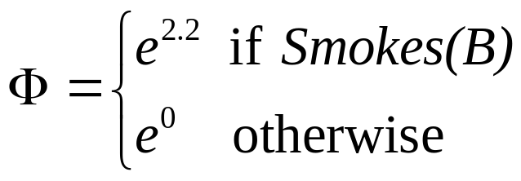
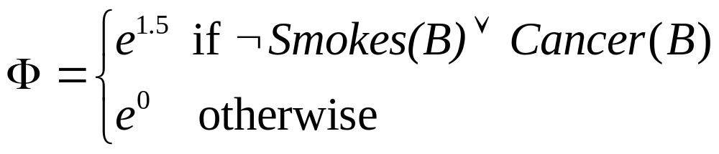
Example Grounding
Friends(A,B)
Friends(A,A)
Smokes(A)
Smokes(B)
Friends(B,B)
Cancer(A)
Cancer(B)
Friends(B,A)
P( Cancer(B) | Smokes(A), Friends(A,B), Friends(B,A))

Slide 25
Lazy Inference
Most domains are extremely sparse
  Most ground atoms are false
  Therefore most clauses are trivially satisfied
We can exploit this by
  Having a default state for atoms and clauses
  Grounding only those atoms and clauses with non-default states
Typically reduces memory (and time) by many orders of magnitude

Slide 26
Example: Scientific Research
1000 Papers , 100 Authors
Author(person,paper)
100,000 possible groundings …
But only a few thousand are true
Author(person1,paper) ∧ Author(person2,paper)
⇒ Coauthor(person1,person2)
10 million possible groundings …
But only tens of thousands are unsatisfied

Slide 27
Lazy Inference
Here: LazySAT (lazy version of WalkSAT)
Method is applicable to many other algorithms (including MC-SAT)

Slide 28
Naïve Approach
Create the groundings and keep in memory
  True atoms
  Unsatisfied clauses
Memory cost is O(# unsatisfied clauses)
Problem
  Need to go to the KB for each flip
  Too slow!
Solution Idea : Keep more things in memory
  A list of active atoms
  Potentially unsatisfied clauses (active clauses)

Slide 29
LazySAT: Definitions
An atom is an Active Atom if
  It is in the initial set of active atoms
  It was flipped at some point during the search
A clause is an Active Clause if
  It can be made unsatisfied by flipping zero or more active atoms in it

Slide 30
LazySAT: The Basics
Activate all the atoms appearing in clauses unsatisfied by evidence DB
Create the corresponding clauses
Randomly assign truth value to all active atoms
Activate an atom when it is flipped if not already so
Potentially activate additional clauses
No need to go to the KB for calculating the change in cost for flipping an active atom

Slide 31
LazySAT
for i ← 1 to max-tries do
active_atoms ← atoms in clauses unsatisfied by DB
active_clauses ← clauses activated by active_atoms
soln = random truth assignment to active_atoms
for j ← 1 to max-flips do
if ∑ weights(sat. clauses) ≥ threshold then
return soln
c ← random unsatisfied clause
with probability p
v_{f} ← a randomly chosen variable from c
else
for each variable v in c do
compute DeltaGain(v), using weighted_KB if v_{f} ∉ active_atoms
v_{f} ← v with highest DeltaGain(v)
if v_{f} ∉ active_atoms then
activate v_{f} and add clauses activated by v_{f}
soln ← soln with v_{f} flipped
return failure, best soln found

Slide 32
LazySAT
for i ← 1 to max-tries do
active_atoms ← atoms in clauses unsatisfied by DB
active_clauses ← clauses activated by active_atoms
soln = random truth assignment to active_atoms
for j ← 1 to max-flips do
if ∑ weights(sat. clauses) ≥ threshold then
return soln
c ← random unsatisfied clause
with probability p
v_{f} ← a randomly chosen variable from c
else
for each variable v in c do
compute DeltaGain(v), using weighted_KB if v_{f} ∉ active_atoms
v_{f} ← v with highest DeltaGain(v)
if v_{f} ∉ active_atoms then
activate v_{f} and add clauses activated by v_{f}
soln ← soln with v_{f} flipped
return failure, best soln found

Slide 33
LazySAT
for i ← 1 to max-tries do
active_atoms ← atoms in clauses unsatisfied by DB
active_clauses ← clauses activated by active_atoms
soln = random truth assignment to active_atoms
for j ← 1 to max-flips do
if ∑ weights(sat. clauses) ≥ threshold then
return soln
c ← random unsatisfied clause
with probability p
v_{f} ← a randomly chosen variable from c
else
for each variable v in c do
compute DeltaGain(v), using weighted_KB if v_{f} ∉ active_atoms
v_{f} ← v with highest DeltaGain(v)
if v_{f} ∉ active_atoms then
activate v_{f} and add clauses activated by v_{f}
soln ← soln with v_{f} flipped
return failure, best soln found

Slide 34
LazySAT
for i ← 1 to max-tries do
active_atoms ← atoms in clauses unsatisfied by DB
active_clauses ← clauses activated by active_atoms
soln = random truth assignment to active_atoms
for j ← 1 to max-flips do
if ∑ weights(sat. clauses) ≥ threshold then
return soln
c ← random unsatisfied clause
with probability p
v_{f} ← a randomly chosen variable from c
else
for each variable v in c do
compute DeltaGain(v), using weighted_KB if v_{f} ∉ active_atoms
v_{f} ← v with highest DeltaGain(v)
if v_{f} ∉ active_atoms then
activate v_{f} and add clauses activated by v_{f}
soln ← soln with v_{f} flipped
return failure, best soln found

Slide 35
Example
Coa(C,A) ∧ Coa(A,A) ⇒ Coa(C,A)
False
Coa(A,A)
Coa(A,B) ∧ Coa(B,C) ⇒ Coa(A,C)
False
Coa(A,B)
Coa(C,A) ∧ Coa(A,B) ⇒ Coa(C,B)
False
Coa(A,C)
Coa(C,B) ∧ Coa(B,A) ⇒ Coa(C,A)
Coa(C,B) ∧ Coa(B,B) ⇒ Coa(C,B)
. . .
. . .

Slide 36
Example
Coa(C,A) ∧ Coa(A,A) ⇒ Coa(C,A)
False
Coa(A,A)
Coa(A,B) ∧ Coa(B,C) ⇒ Coa(A,C)
True
Coa(A,B)
Coa(C,A) ∧ Coa(A,B) ⇒ Coa(C,B)
False
Coa(A,C)
Coa(C,B) ∧ Coa(B,A) ⇒ Coa(C,A)
Coa(C,B) ∧ Coa(B,B) ⇒ Coa(C,B)
. . .
. . .

Slide 37
Example
Coa(C,A) ∧ Coa(A,A) ⇒ Coa(C,A)
False
Coa(A,A)
Coa(A,B) ∧ Coa(B,C) ⇒ Coa(A,C)
True
Coa(A,B)
Coa(C,A) ∧ Coa(A,B) ⇒ Coa(C,B)
False
Coa(A,C)
Coa(C,B) ∧ Coa(B,A) ⇒ Coa(C,A)
Coa(C,B) ∧ Coa(B,B) ⇒ Coa(C,B)
. . .
. . .

Slide 38
LazySAT Performance
Solution quality
  Performs the same sequence of flips
  Same result as WalkSAT
Memory cost
  O(# potentially unsatisfied clauses)
Time cost
  Much lower initialization cost
  Cost of creating active clauses amortized over many flips

Slide 39
Lifted Inference
We can do inference in first-order logic without grounding the KB (e.g.: resolution)
Let’s do the same for inference in MLNs
Group atoms and clauses into “indistinguishable” sets
Do inference over those
First approach: Lifted variable elimination
(not practical)
Here: Lifted belief propagation

Slide 40
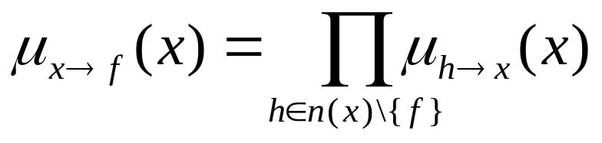
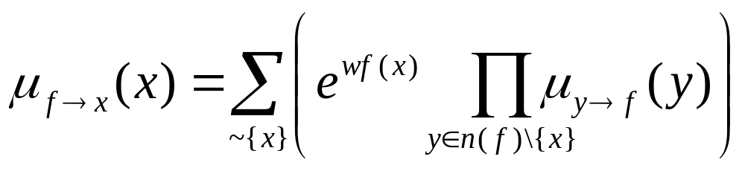
Belief Propagation
Nodes (x)
Features (f)

Slide 41
Lifted Belief Propagation
Nodes (x)
Features (f)

Slide 42
Lifted Belief Propagation
Nodes (x)
Features (f)

Slide 43
Lifted Belief Propagation
α,β :
Functions of edge counts
α
β
Nodes (x)
Features (f)

Slide 44
Lifted Belief Propagation
Form lifted network composed of supernodes
and superfeatures
  Supernode: Set of ground atoms that all send and
  receive same messages throughout BP
  Superfeature: Set of ground clauses that all send and receive same messages throughout BP
Run belief propagation on lifted network
Guaranteed to produce same results as ground BP
Time and memory savings can be huge

Slide 45
Forming the Lifted Network
1. Form initial supernodes
One per predicate and truth value
(true, false, unknown)
2. Form superfeatures by doing joins of their supernodes
3. Form supernodes by projecting
superfeatures down to their predicates
Supernode = Groundings of a predicate with same number of projections from each superfeature
4. Repeat until convergence

Slide 46
Example
Evidence: Smokes(Ana)
Friends(Bob,Charles), Friends(Charles,Bob)
N people in the domain

Slide 47
Example
Evidence: Smokes(Ana)
Friends(Bob,Charles), Friends(Charles,Bob)
Intuitive Grouping :
Smokes(Bob)
Smokes(Charles)
Smokes(James)
Smokes(Harry)
…
Smokes(Ana)

Slide 48
Initialization
Supernodes
Superfeatures
Smokes(Ana)
Smokes(X)
X ≠ Ana
Friends(Bob, Charles)
Friends(Charles, Bob)
Friends(Ana, X)
Friends(X, Ana)
Friends(Bob,X)
X ≠ Charles
….

Slide 49
Joining the Supernodes
Supernodes
Superfeatures
Smokes(Ana)
Smokes(Ana)
Smokes(X)
X ≠ Ana
Friends(Bob, Charles)
Friends(Charles, Bob)
Friends(Ana, X)
Friends(X, Ana)
Friends(Bob,X)
X ≠ Charles
….

Slide 50
Joining the Supernodes
Supernodes
Superfeatures
Smokes(Ana) ∧
Friends(Ana, X)
Smokes(Ana)
Smokes(X)
X ≠ Ana
Friends(Bob, Charles)
Friends(Charles, Bob)
Friends(Ana, X)
Friends(X, Ana)
Friends(Bob,X)
X ≠ Charles
….

Slide 51
Joining the Supernodes
Supernodes
Superfeatures
Smokes(Ana) ∧
Friends(Ana, X) ⇒ Smokes(X)
X ≠ Ana
Smokes(Ana)
Smokes(X)
X ≠ Ana
Friends(Bob, Charles)
Friends(Charles, Bob)
Friends(Ana, X)
Friends(X, Ana)
Friends(Bob,X)
X ≠ Charles
….

Slide 52
Joining the Supernodes
Supernodes
Superfeatures
Smokes(Ana) ∧
Friends(Ana, X) ⇒ Smokes(X)
X ≠ Ana
Smokes(Ana)
Smokes(X)
X ≠ Ana
Smokes(X) ∧ Friends(X, Ana)
⇒ Smokes(Ana)
X ≠ Ana
Friends(Bob, Charles)
Friends(Charles, Bob)
Friends(Ana, X)
Friends(X, Ana)
Friends(Bob,X)
X ≠ Charles
….

Slide 53
Joining the Supernodes
Supernodes
Superfeatures
Smokes(Ana) ∧
Friends(Ana, X) ⇒ Smokes(X)
X ≠ Ana
Smokes(Ana)
Smokes(X)
X ≠ Ana
Smokes(X) ∧ Friends(X, Ana)
⇒ Smokes(Ana)
X ≠ Ana
Friends(Bob, Charles)
Friends(Charles, Bob)
Smokes(Bob) ∧ Friends(Bob, Charles)
⇒ Smokes(Charles)
…
Friends(Ana, X)
Friends(X, Ana)
Friends(Bob,X)
X ≠ Charles
….

Slide 54
Joining the Supernodes
Supernodes
Superfeatures
Smokes(Ana) ∧
Friends(Ana, X) ⇒ Smokes(X)
X ≠ Ana
Smokes(Ana)
Smokes(X)
X ≠ Ana
Smokes(X) ∧ Friends(X, Ana)
⇒ Smokes(Ana)
X ≠ Ana
Friends(Bob, Charles)
Friends(Charles, Bob)
Smokes(Bob) ∧ Friends(Bob, Charles)
⇒ Smokes(Charles)
…
Friends(Ana, X)
Friends(X, Ana)
Friends(Bob,X)
X ≠ Charles
….
Smokes(Bob) ∧ Friends(Bob, X)
⇒ Smokes(X)
X ≠ Charles
…

Slide 55
Projecting the Superfeatures
Supernodes
Superfeatures
Smokes(Ana) ∧ Friends(Ana, X)
⇒ Smokes(X)
X ≠ Ana
Smokes(X) ∧ Friends(X, Ana)
⇒ Smokes(Ana)
X ≠ Ana
Smokes(Bob) ∧ Friends(Bob, Charles)
⇒ Smokes(Charles)
…
Smokes(Bob) ∧ Friends(Bob,X)
⇒ Smokes(X)
X ≠ Charles
…

Slide 56
Projecting the Superfeatures
Supernodes
Superfeatures
Smokes(Ana)
Smokes(Ana) ∧ Friends(Ana, X)
⇒ Smokes(X)
X ≠ Ana
Smokes(X) ∧ Friends(X, Ana)
⇒ Smokes(Ana)
X ≠ Ana
Smokes(Bob) ∧ Friends(Bob, Charles)
⇒ Smokes(Charles)
…
Smokes(Bob) ∧ Friends(Bob,X)
⇒ Smokes(X)
X ≠ Charles
…

Slide 57
Projecting the Superfeatures
Supernodes
Superfeatures
Smokes(Ana)
Smokes(Ana) ∧ Friends(Ana, X)
⇒ Smokes(X)
X ≠ Ana
Smokes(X) ∧ Friends(X, Ana)
⇒ Smokes(Ana)
X ≠ Ana
Populate with
projection counts
Smokes(Bob) ∧ Friends(Bob, Charles)
⇒ Smokes(Charles)
…
Smokes(Bob) ∧ Friends(Bob,X)
⇒ Smokes(X)
X ≠ Charles
…

Slide 58
Projecting the Superfeatures
Supernodes
Superfeatures
Smokes(Ana)
Smokes(Ana) ∧ Friends(Ana, X)
⇒ Smokes(X)
X ≠ Ana
N-1
Smokes(X) ∧ Friends(X, Ana)
⇒ Smokes(Ana)
X ≠ Ana
Smokes(Bob) ∧ Friends(Bob, Charles)
⇒ Smokes(Charles)
…
Smokes(Bob) ∧ Friends(Bob,X)
⇒ Smokes(X)
X ≠ Charles
…

Slide 59
Projecting the Superfeatures
Supernodes
Superfeatures
Smokes(Ana)
Smokes(Ana) ∧ Friends(Ana, X)
⇒ Smokes(X)
X ≠ Ana
N-1 | 0
Smokes(X) ∧ Friends(X, Ana)
⇒ Smokes(Ana)
X ≠ Ana
Smokes(Bob) ∧ Friends(Bob, Charles)
⇒ Smokes(Charles)
…
Smokes(Bob) ∧ Friends(Bob,X)
⇒ Smokes(X)
X ≠ Charles
…

Slide 60
Projecting the Superfeatures
Supernodes
Superfeatures
Smokes(Ana)
Smokes(Ana) ∧ Friends(Ana, X)
⇒ Smokes(X)
X ≠ Ana
N-1 | 0 | 0
Smokes(X) ∧ Friends(X, Ana)
⇒ Smokes(Ana)
X ≠ Ana
Smokes(Bob) ∧ Friends(Bob, Charles)
⇒ Smokes(Charles)
…
Smokes(Bob) ∧ Friends(Bob,X)
⇒ Smokes(X)
X ≠ Charles
…

Slide 61
Projecting the Superfeatures
Supernodes
Superfeatures
Smokes(Ana)
Smokes(Ana) ∧ Friends(Ana, X)
⇒ Smokes(X)
X ≠ Ana
N-1 | 0 | 0 | 0
Smokes(X) ∧ Friends(X, Ana)
⇒ Smokes(Ana)
X ≠ Ana
Smokes(Bob) ∧ Friends(Bob, Charles)
⇒ Smokes(Charles)
…
Smokes(Bob) ∧ Friends(Bob,X)
⇒ Smokes(X)
X ≠ Charles
…

Slide 62
Projecting the Superfeatures
Supernodes
Superfeatures
Smokes(Ana)
Smokes(Ana) ∧ Friends(Ana, X)
⇒ Smokes(X)
X ≠ Ana
N-1 | 0 | 0 | 0
Smokes(X) ∧ Friends(X, Ana)
⇒ Smokes(Ana)
X ≠ Ana
Smokes(Bob)
Smokes(Charles)
Smokes(Bob) ∧ Friends(Bob, Charles)
⇒ Smokes(Charles)
…
0 | 1 | 1 | N-3
Smokes(Bob) ∧ Friends(Bob,X)
⇒ Smokes(X)
X ≠ Charles
…

Slide 63
Projecting the Superfeatures
Supernodes
Superfeatures
Smokes(Ana)
Smokes(Ana) ∧ Friends(Ana, X)
⇒ Smokes(X)
X ≠ Ana
N-1 | 0 | 0 | 0
Smokes(X) ∧ Friends(X, Ana)
⇒ Smokes(Ana)
X ≠ Ana
Smokes(Bob)
Smokes(Charles)
Smokes(Bob) ∧ Friends(Bob, Charles)
⇒ Smokes(Charles)
…
0 | 1 | 1 | N-3
Smokes(X)
X ≠ Ana, Bob, Charles
Smokes(Bob) ∧ Friends(Bob,X)
⇒ Smokes(X)
X ≠ Charles
…
0 | 1 | 0 | N-2

Slide 64
Theorem
There exists a unique minimal lifted network
The lifted network construction algo. finds it
BP on lifted network gives same result as
on ground network

Slide 65
Representing Supernodes
And Superfeatures
List of tuples: Simple but inefficient
Resolution-like: Use equality and inequality
Form clusters (in progress)

Slide 66
Open Questions
Can we do approximate KBMC/lazy/lifting?
Can KBMC, lazy and lifted inference be combined?
Can we have lifted inference over both probabilistic and deterministic dependencies? (Lifted MC-SAT?)
Can we unify resolution and lifted BP?
Can other inference algorithms be lifted?

