Slide 1
First-Order Logic and Inductive Logic Programming

Slide 2
Overview
First-order logic
Inference in first-order logic
Inductive logic programming

Slide 3
First-Order Logic
Constants, variables, functions, predicates
E.g.: Anna, x, MotherOf(x), Friends(x, y)
Literal: Predicate or its negation
Clause: Disjunction of literals
Grounding: Replace all variables by constants
E.g.: Friends (Anna, Bob)
World (model, interpretation):
Assignment of truth values to all ground predicates

Slide 4
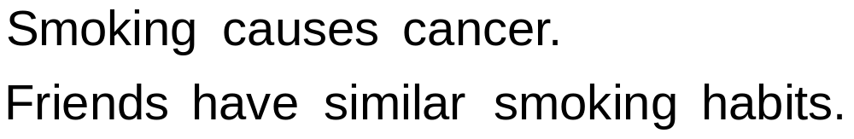
Example: Friends & Smokers

Slide 5
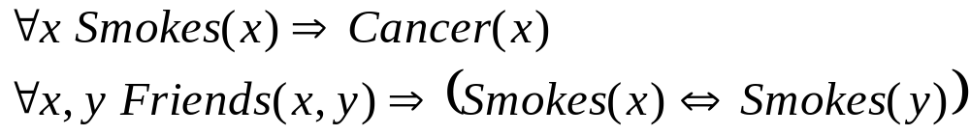
Example: Friends & Smokers

Slide 6
Inference in First-Order Logic
Traditionally done by theorem proving
(e.g.: Prolog)
Propositionalization followed by model checking turns out to be faster (often a lot)
Propositionalization:
Create all ground atoms and clauses
Model checking: Satisfiability testing
Two main approaches:
  Backtracking (e.g.: DPLL)
  Stochastic local search (e.g.: WalkSAT)

Slide 7
Satisfiability
Input: Set of clauses
(Convert KB to conjunctive normal form (CNF))
Output: Truth assignment that satisfies all clauses, or failure
The paradigmatic NP-complete problem
Solution: Search
Key point:
Most SAT problems are actually easy
Hard region: Narrow range of
#Clauses / #Variables

Slide 8
Backtracking
Assign truth values by depth-first search
Assigning a variable deletes false literals
and satisfied clauses
Empty set of clauses: Success
Empty clause: Failure
Additional improvements:
  Unit propagation (unit clause forces truth value)
  Pure literals (same truth value everywhere)

Slide 9
The DPLL Algorithm
if CNF is empty then
return true
else if CNF contains an empty clause then
return false
else if CNF contains a pure literal x then
return DPLL(CNF(x))
else if CNF contains a unit clause {u} then
return DPLL(CNF(u))
else
choose a variable x that appears in CNF
if DPLL(CNF(x)) = true then return true
else return DPLL(CNF(¬x))

Slide 10
Stochastic Local Search
Uses complete assignments instead of partial
Start with random state
Flip variables in unsatisfied clauses
Hill-climbing: Minimize # unsatisfied clauses
Avoid local minima: Random flips
Multiple restarts

Slide 11
The WalkSAT Algorithm
for i ← 1 to max-tries do
solution = random truth assignment
for j ← 1 to max-flips do
if all clauses satisfied then
return solution
c ← random unsatisfied clause
with probability p
flip a random variable in c
else
flip variable in c that maximizes
number of satisfied clauses
return failure

Slide 12
Rule Induction
Given: Set of positive and negative examples of some concept
  Example: (x₁, x₂, … , x_{n}, y)
  y: concept (Boolean)
  x₁, x₂, … , x_{n}: attributes (assume Boolean)
Goal: Induce a set of rules that cover all positive examples and no negative ones
  Rule: x_{a} ^ x_{b} ^ … ⇒ y (x_{a}: Literal, i.e., x_{i} or its negation)
  Same as Horn clause: Body ⇒ Head
  Rule r covers example x iff x satisfies body of r
Eval(r): Accuracy, info. gain, coverage, support, etc.

Slide 13
Learning a Single Rule
head ← y
body ← Ø
repeat
for each literal x
r_{x} ← r with x added to body
Eval(r_{x})
body ← body ^ best x
until no x improves Eval(r)
return r

Slide 14
Learning a Set of Rules
R ← Ø
S ← examples
repeat
learn a single rule r
R ← R U { r }
S ← S − positive examples covered by r
until S contains no positive examples
return R

Slide 15
First-Order Rule Induction
y and x_{i} are now predicates with arguments
E.g.: y is Ancestor(x,y), x_{i} is Parent(x,y)
Literals to add are predicates or their negations
Literal to add must include at least one variable
already appearing in rule
Adding a literal changes # groundings of rule
E.g.: Ancestor(x,z) ^ Parent(z,y) ⇒ Ancestor(x,y)
Eval(r) must take this into account
E.g.: Multiply by # positive groundings of rule
still covered after adding literal

