Slide 1
Multimodal Machine Learning:
Flamingo
CLIP
ViLBERT
Chris Winsor
UMass Lowell CS5300: Deep Learning for NLP
4/2023

Slide 2
What is Multimodal Machine Learning (MMML)?
MMML is machine learning that involves multiple sensory modalities. Most commonly (but not exclusively):
  Natural language
  Images or videos
MMML can offer the following advantages:
  Performance of each modality often outperforms single-modal baselines
  Allows for a wide variety of downstream tasks and data formats

Slide 3
Flamingo

Slide 4
Flamingo
DeepMind 2022 - a “Visual Language Model”
How different:
  Can accept arbitrarily interleaved text and images as input
  Can perform different tasks and be “prompted” on task to be performed
  Outputs free-form text
  Requires only a handful of examples to fine tune
Alayrac, J.-B., Donahue, J., Luc, P., Miech, A., Barr, I., Hasson, Y., Lenc, K., Mensch, A., Millican, K., Reynolds, M., Ring, R., Rutherford, E., Cabi, S., Han, T., Gong, Z., Samangooei, S., Monteiro, M., Menick, J., Borgeaud, S., … Simonyan, K. (2022). Flamingo: A Visual Language Model for Few-Shot Learning (arXiv:2204.14198). arXiv.

Slide 5
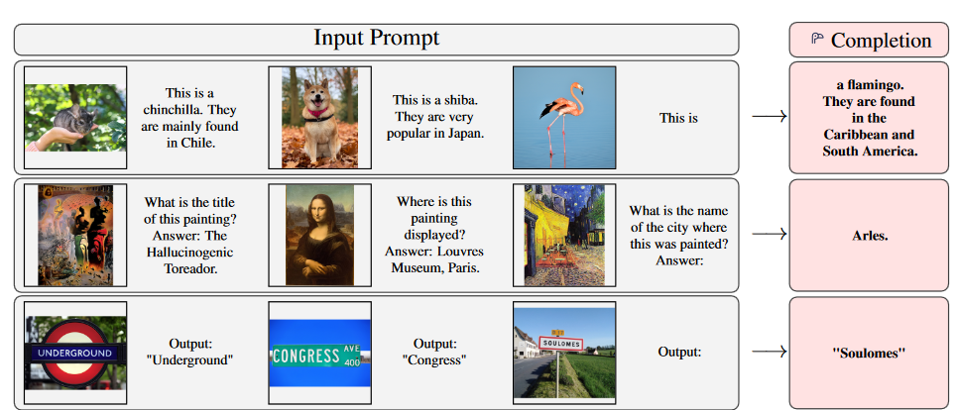
Interleaved Text/Image Prompting

Slide 6
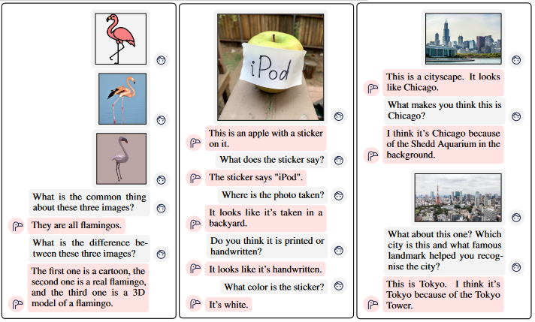
Multi-image visual dialog

Slide 7
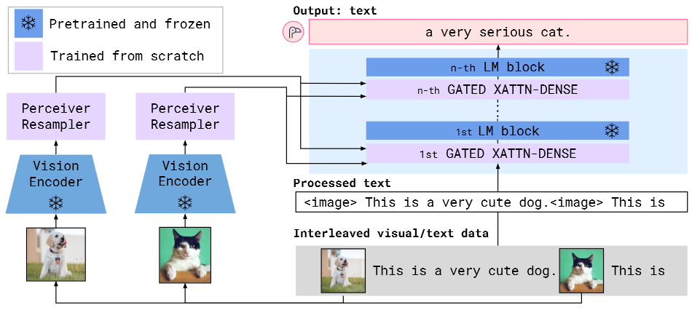
Flamingo Architecture
Starts with pretrained language and vision models (frozen)
Add trainable GATED XATTN-DENSE and Perceiver Resampler

Slide 8
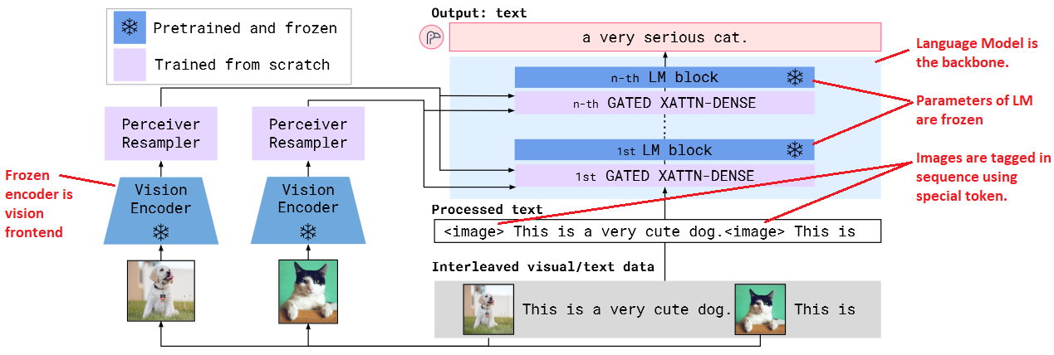
Pretrained and Frozen Components

Slide 9
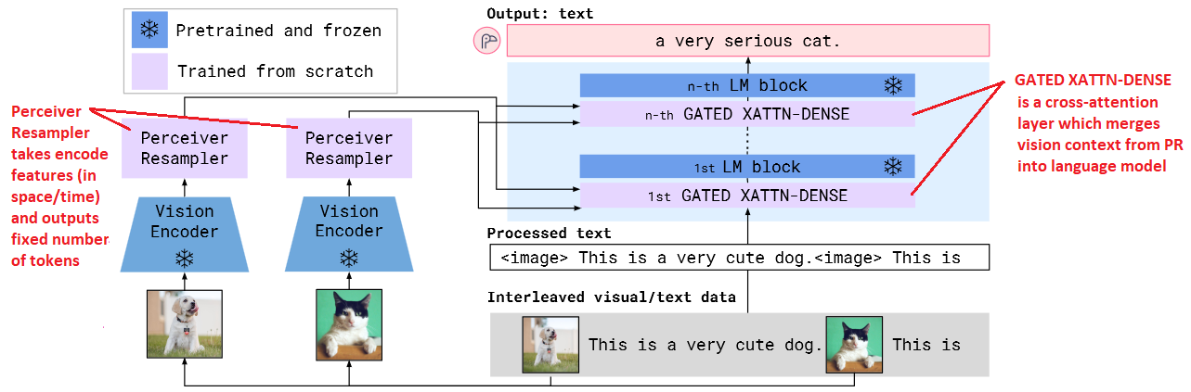
Trainables

Slide 10
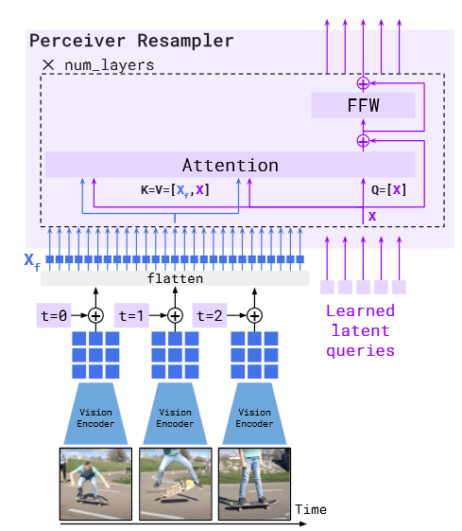
Perceiver/Resampler
Perceiver (Jaegle et al. 2021)(1) maps features to latent query units, similar to decoder-only transformer
Transforms variable-size grid/time to fixed number of tokens
Key, Value from data
(1) Jaegle, A., Gimeno, F., Brock, A., Zisserman, A., Vinyals, O., & Carreira, J. (2021). Perceiver: General Perception with Iterative Attention (arXiv:2103.03206).

Slide 11
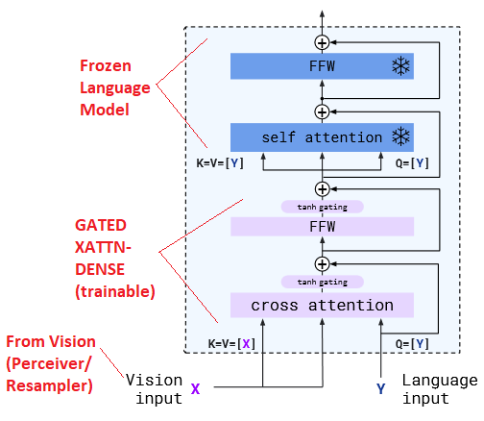
GATED XATTN-DENSE
A cross-attention layer inserted into frozen Language Model
Used to condition LM on Vision inputs
K,V come from Vision while Q comes from Language

Slide 12
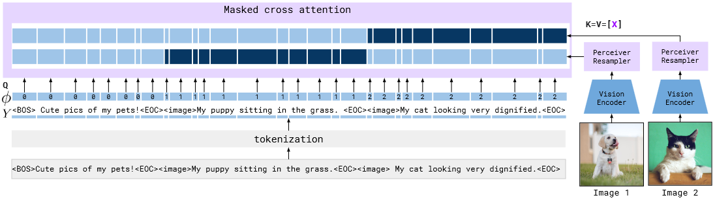
Interleaving Visual Data and Text

Slide 13
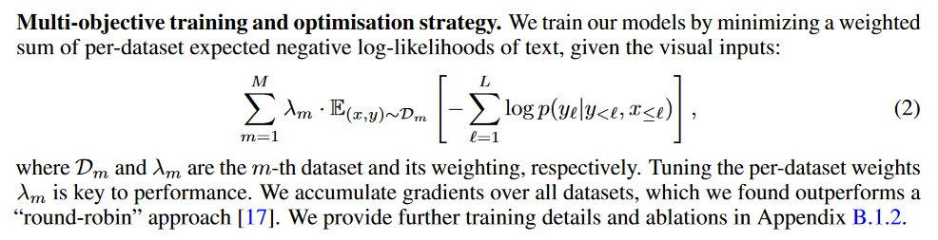
Training Datasets and
Baseline Multi-Objective Task
MultiModal Massive Web (M3W)
  Interleaved Image and Text
  Scraped from 43M web page (text + image)
  256 tokens of text, up to 5 images
ALIGN dataset
  Paired Image/Video and Text
  1.5B images paired w/ text (+ an additional 350M in-house)

Slide 14
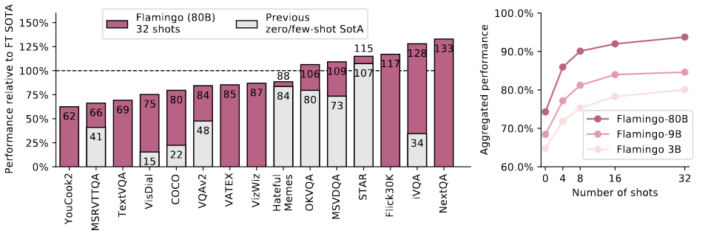
Results
Out-of-the-box beats fine-tuned SOTA (6/16 cases)
On few-shot it outperforms all 9 peers

Slide 15
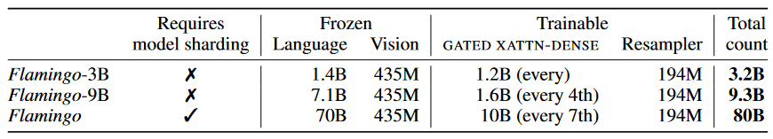
3 Model Sizes

Slide 16
Task Adaption
(to be provided)
This slide needs work

Slide 17
ViLBERT

Slide 18
ViLBERT
“Vision and Language BERT” - Facebook Research 2019
“Learning a joint representation of language and visual content from paired data (…) specifically static images and corresponding descriptive text” (1)
Applies BERT architecture to both NL and Vision data, adding a co-attention bridge between them
Lu, J., Batra, D., Parikh, D., & Lee, S. (2019). ViLBERT: Pretraining Task-Agnostic Visiolinguistic Representations for Vision-and-Language Tasks (arXiv:1908.02265). arXiv.

Slide 19
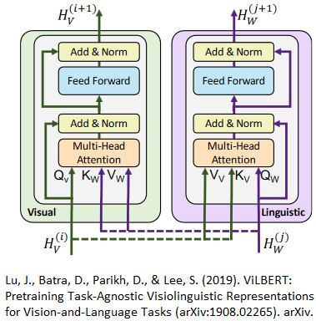
ViLBERT Approach
Parallel transformers (modalities mostly independent)
“Co-attention” layers pass keys and values across modalities
Depth is different for each modality

Slide 20
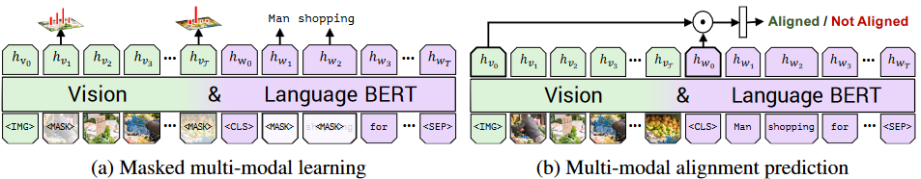
ViLBERT Training Tasks
Two tasks: a)Masked multi-modal learning, b) Multi-modal alignment prediction
  a) reconstruct masked image region categories, masked words
  b) predict whether caption describes the image content
Lu, J., Batra, D., Parikh, D., & Lee, S. (2019). ViLBERT: Pretraining Task-Agnostic Visiolinguistic Representations for Vision-and-Language Tasks (arXiv:1908.02265). arXiv.

Slide 21
ViLBERT Pre-training Dataset
Conceptual Captions dataset (3.3M images w/ captions)
  Language stream: Start with BERT-Base pretrained on BookCorpus and Wikipedia.
  Vision stream: start with Faster R-CNN pretrained on VisualGenome
This slide needs work

Slide 22
ViLBERT Pre-Training
Masked word, masked image (predict the masked word/image)
  15% masked (90/10 zero, unaltered)
Predicting text segment / image correlation (does the text go with the image)
This slide needs work

Slide 23
ViLBERT Downstream tasks:
VQA, VCR
Visual Question Answering:
  Choosing single word answer from dictionary, given image and NL question (a multi-class classification problem)
  VQA 2.0 (Virginia Tech, Georgia Tech) is 260K images, 5 questions and 10 answers per image.
Visual Commonsense Reasoning
  Given image and NL question, select answer and rationale where A and R are NL (a pair of multi-choice selection problems)
  VCR dataset (U.Washington et al) is 110K images, 290K questions, answers and rationales. Q,A,R are natural language.

Slide 24
3.2 – ViLBERT Downstream tasks:
Referring Expressions, Caption-based Retrieval
Referring expressions
  Localize an image region based on natural language expression
  RefCOCO dataset is 142k referring expressions for 50k objects in 20k images
  ViLBERT fine tuning uses IoU on the area, 20 epochs
Caption-based image retrieval
  Choosing an image from a pool based on caption
  Flickr30k dataset is a 31K image dataset with 5 human annotated natural language captions per image (150K captions)
  Fine tuning uses 4-way multi choice (3 distractors) per image (1 pos, 3 negative)

Slide 25
Results
ViLBERT is better than single-stream models (i.e. ViLBERT vs BERT)
Pre-training improves performance (ViLBERT vs ViLBERT*)
Fine tuned ViLBERT extends state of art on all 4 target tasks

Slide 26
CLIP

Slide 27
CLIP
”Contrastive Language – Image Pre-training”
OpenAI 2021
Radford, A., Kim, J. W., Hallacy, C., Ramesh, A., Goh, G., Agarwal, S., Sastry, G., Askell, A., Mishkin, P., Clark, J., Krueger, G., & Sutskever, I. (2021). Learning Transferable Visual Models From Natural Language Supervision (arXiv:2103.00020).

Slide 28
Dataset and Training
Ground truth data:
  Start with a paired image and text (found on internet)
Create a pretext task:
  Given 32,768 randomly sampled text snippets ask which was actually paired with it
To solve this task CLIP models need to learn to recognize a wide variety of visual concepts in images and associate them with their names.

Slide 29
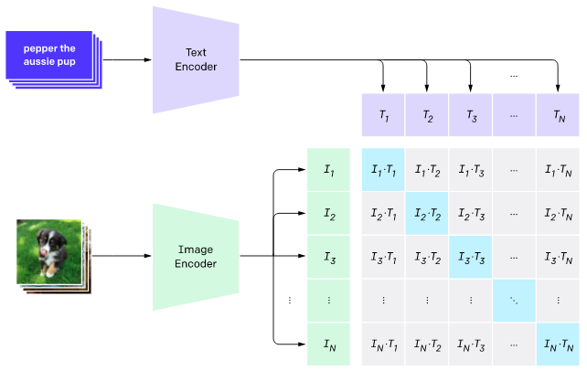
Contrastive Pre-training
(image and text encoders + cross-correlation)

Slide 30
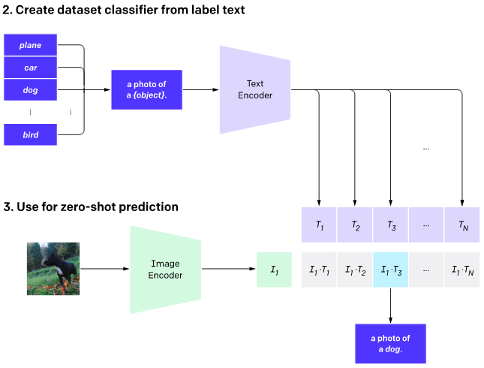
Zero-shot Prediction
Each class converted to a caption, model predicts caption

Slide 32
Thank you!

