Slide 1
Multimodal Machine Learning:
Flamingo, CLIP, ViLBERT
Chris Winsor
4/26/2023
UMass Lowell CS5300: Deep Learning for NLP

Slide 2
What is Multimodal Machine Learning?
Multimodal Machine Learning involves multiple sensory modalities. Most commonly (but not exclusively):
  Natural language
  Images or videos
Cross-modal learning has the following advantages:
  Performance of each modality by itself often outperforms single-modal baseline
  Allows for a widely expanded variety of tasks and data formats
Baltrušaitis, T., Ahuja, C., & Morency, L.-P. (2017). Multimodal Machine Learning: A Survey and Taxonomy https://doi.org/10.48550/arXiv.1705.09406
UML CS5300 Slideset:https://docs.google.com/presentation/d/1lEAS8VaogfMCs8F44uNDzQ6e84aFUzAYxeZN3cxO8tQ/

Slide 3
Flamingo
Flamingo - DeepMind 2022 – a “Visual Language Model”
How different:
  Requires only “a handful” of examples to fine tune
  Can accept arbitrarily interleaved text and images as input
  Single model can perform different tasks, and be “prompted” on task to be performed
  Outputs free-form text
Can perform:
  Open-ended visual question-answering (open text response)
  Captioning (describe scene or event)
  Multiple-choice visual question answering

Slide 4
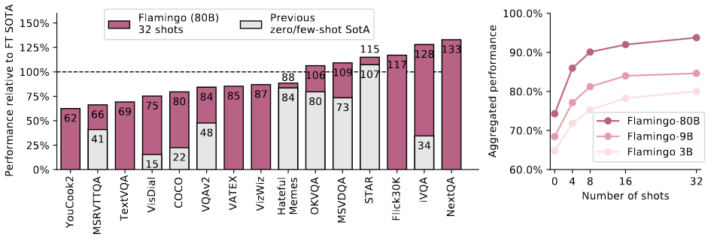
Flamingo Results
Out-of-the-box beats fine-tuned SOTA (6/16 cases)
On few-shot it outperforms all 9 peers

Slide 5
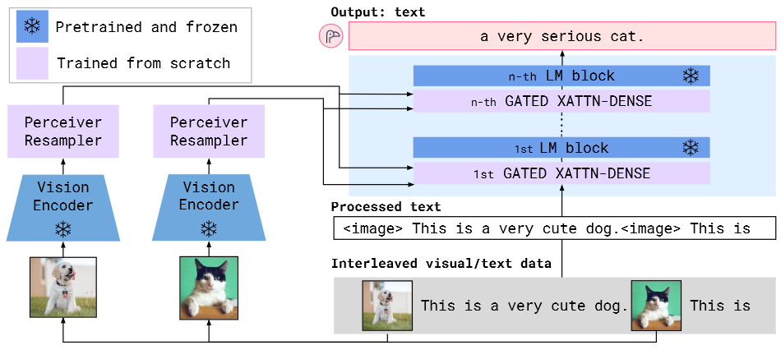
Flamingo Architecture

Slide 6
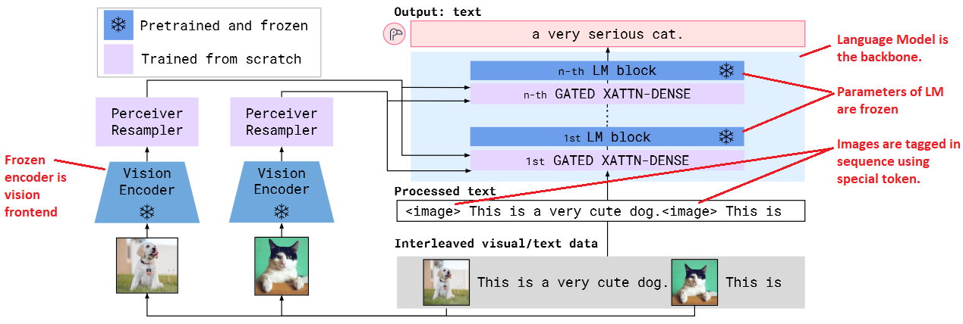
Flamingo Architecture (frozen blocks)

Slide 7
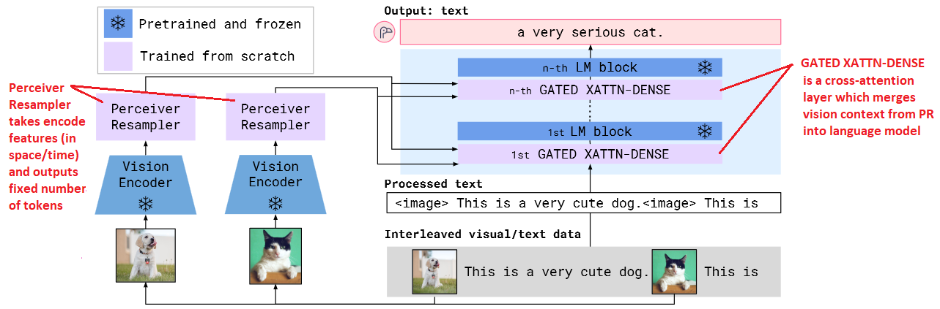
Flamingo Architecture (trainable parameters)

Slide 8
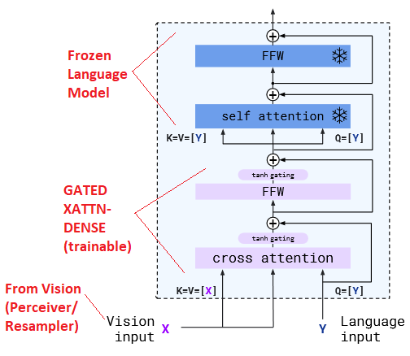
GATED XATTN-DENSE layer
Cross-attention layer is inserted into frozen Language Model
Used to condition LM on Vision inputs
K,V come from Vision while Q comes from Language
Alayrac, J.-B., Donahue, J., Luc, P., Miech, A., Barr, I., Hasson, Y., Lenc, K., Mensch, A., Millican, K., Reynolds, M., Ring, R., Rutherford, E., Cabi, S., Han, T., Gong, Z., Samangooei, S., Monteiro, M., Menick, J., Borgeaud, S., … Simonyan, K. (2022). Flamingo: A Visual Language Model for Few-Shot Learning (arXiv:2204.14198). arXiv.

Slide 9
Approach (Perceiver Resampler)
Maps variable-size grid/time to fixed number of tokens

Slide 10
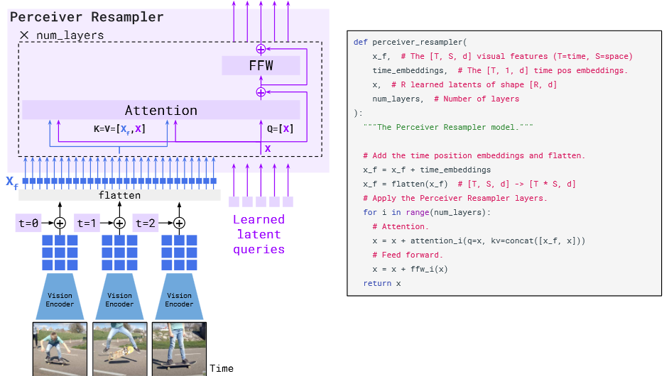
Approach (Perceiver Resampler)
Perceiver Resampler

Slide 11
Multi-image/video attention mechanism
Alayrac, J.-B., Donahue, J., Luc, P., Miech, A., Barr, I., Hasson, Y., Lenc, K., Mensch, A., Millican, K., Reynolds, M., Ring, R., Rutherford, E., Cabi, S., Han, T., Gong, Z., Samangooei, S., Monteiro, M., Menick, J., Borgeaud, S., … Simonyan, K. (2022). Flamingo: A Visual Language Model for Few-Shot Learning (arXiv:2204.14198). arXiv.

Slide 12
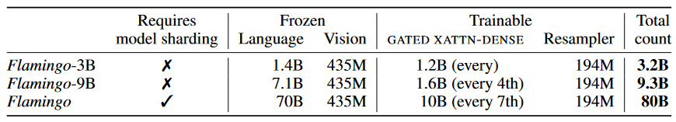
Experiments
3 model sizes
Alayrac, J.-B., Donahue, J., Luc, P., Miech, A., Barr, I., Hasson, Y., Lenc, K., Mensch, A., Millican, K., Reynolds, M., Ring, R., Rutherford, E., Cabi, S., Han, T., Gong, Z., Samangooei, S., Monteiro, M., Menick, J., Borgeaud, S., … Simonyan, K. (2022). Flamingo: A Visual Language Model for Few-Shot Learning (arXiv:2204.14198). arXiv.

Slide 13
MW3 dataset creation
Processing MW3 samples during training
Collecting LTIP and VTP

Slide 14
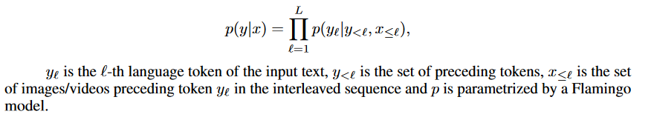

Slide 15
ViLBERT
ViLBERT = “Vision and Language BERT”
Facebook Research 2019
“Learning a joint representation of language and visual content from paired data (…) specifically static images and corresponding descriptive text” (1)
Applies BERT architecture to both NL and Vision data, adding a co-attention bridge between them
Lu, J., Batra, D., Parikh, D., & Lee, S. (2019). ViLBERT: Pretraining Task-Agnostic Visiolinguistic Representations for Vision-and-Language Tasks (arXiv:1908.02265). arXiv.

Slide 16
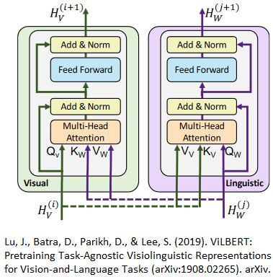
ViLBERT Approach
Parallel transformers (modalities mostly independent)
“Co-attention” layers pass keys and values across modalities
Depth is different for each modality

Slide 17
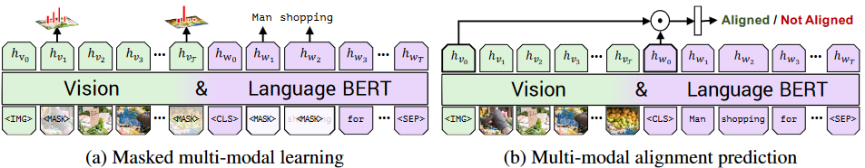
ViLBERT Training Tasks
Two tasks: a)Masked multi-modal learning, b) Multi-modal alignment prediction
  a) reconstruct masked image region categories, masked words
  b) predict whether caption describes the image content
Lu, J., Batra, D., Parikh, D., & Lee, S. (2019). ViLBERT: Pretraining Task-Agnostic Visiolinguistic Representations for Vision-and-Language Tasks (arXiv:1908.02265). arXiv.

Slide 18
ViLBERT
ViLBERT Pre-training Dataset
Conceptual Captions dataset (3.3M images w/ captions)
Language stream: Start with BERT-Base pretrained on BookCorpus and Wikipedia.
Vision stream: start with Faster R-CNN pretrained on VisualGenome

Slide 19
ViLBERT Pre-Training
Masked word, masked image (predict the masked word/image)
15% masked (90/10 zero, unaltered)
  Predicting text segment / image correlation (does the text go with the image)

Slide 20
3.2 – ViLBERT Downstream tasks (VQA, VCR)
Visual Question Answering:
  Choosing single word answer from dictionary, given image and NL question (a multi-class classification problem)
  VQA 2.0 (Virginia Tech, Georgia Tech) is 260K images, 5 questions and 10 answers per image.
Visual Commonsense Reasoning
  Given image and NL question, select answer and rationale where A and R are NL (a pair of multi-choice selection problems)
  VCR dataset (U.Washington et al) is 110K images, 290K questions, answers and rationales. Q,A,R are natural language.

Slide 21
3.2 – ViLBERT Downstream tasks (Referring Expressions, Caption-based Retrieval)
Referring expressions
  Localize an image region based on natural language expression
  RefCOCO dataset is 142k referring expressions for 50k objects in 20k images
  ViLBERT fine tuning uses IoU on the area, 20 epochs
Caption-based image retrieval
  Choosing an image from a pool based on caption
  Flickr30k dataset is a 31K image dataset with 5 human annotated natural language captions per image (150K captions)
  Fine tuning uses 4-way multi choice (3 distractors) per image (1 pos, 3 negative)

Slide 22
Results
ViLBERT is better than single-stream models (i.e. ViLBERT vs BERT)
Pre-training improves performance (ViLBERT vs ViLBERT*)
Fine tuned ViLBERT extends state of art on all 4 target tasks

Slide 24
CLIP: Contrastive Language – Image Pre-training
“Learning visual representations from natural language” (https://openai.com/research/clip)
OpenAI 2021 (https://openai.com/research/clip)

Slide 25
Ground truth data:
  Start with a paired image and text (found on internet)
Create a pretext task:
  Given 32,768 randomly sampled text snippets ask which was actually paired with it
To solve this task CLIP models need to learn to recognize a wide variety of visual concepts in images and associate them with their names.

Slide 26
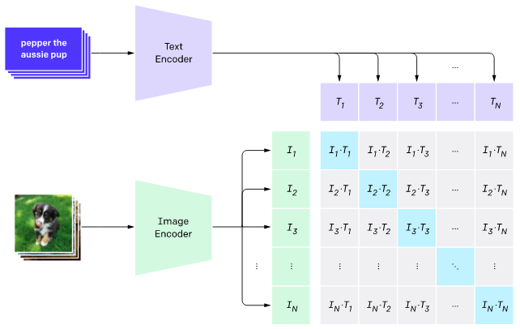
Contrastive Pre-training
(image and text encoders + cross-correlation)

Slide 27
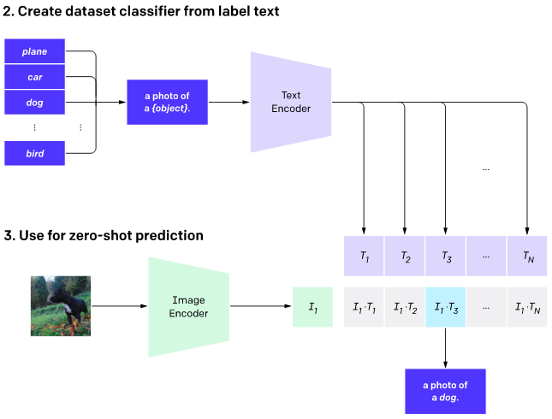
Zero-shot Prediction
Each class converted to a caption, model predicts caption

Slide 29
PGM implemented in Torch
PGM is a set of random variables with direct dependencies. One implementation of a RV is CPD table.
cpd_table (torch.nn.Module)
__init()__:
cpd_table = nn.Linear()
Softmax = torch.Softmax()
def forward(x): //i.e. p(y|x)
X = cpd_table(x)
y_x = softmax(x)
Def posterior(y): //i.e. p(x|y)
x|y = p(y|x)p(x) / p(y)
p(y|x)

Slide 31
Challenges in Multi-modal Machine Learning
Representation: how to represent data from each of the different modalities, and their fusion
Translation: how to map data from one modality to another
Alignment: identifying relationships between modalities. For example associating something in one modality with another modality
Fusion: bringing together data into a single representation.
Co-learning: transferring knowledge from one modality to another

Slide 32
Representation
Joint (common space) vs Coordinated (separate but shared constraint)

Slide 33
Translation
Entity in one representation to entity in another
Example: given image generate sentence describing it
Example-based
Generative: given a source instance, generate target instance

Slide 34
Alignment

Slide 35
x

Slide 36
xxx
xxx

