Slide 1
Memorizing Transformers
Chris Winsor
DL4NLP COMP 5300
4/21/23
(1) Wu, Y., Rabe, M. N., Hutchins, D., & Szegedy, C. (2022). Memorizing Transformers (arXiv:2203.08913). arXiv. https://doi.org/10.48550/arXiv.2203.08913

Slide 2
Motivation
Problem:
  Traditional transformer is limited to context length of attention
  But long documents have references that are far away
  Examples: Novel, source code, theorem proofs
Idea:
  Increase size of attention context using kNN lookup
  Context length > sequence length
Unique:
  No gradient backprop through memory. Instead re-use keys/values from prior step
  kNN does not use averaging or summarization – retrieves
  Allows external memory of 262k tokens on single TPU
100k sequence
has sequence size (N)
For a sequence of length 22Kis lthe
Notes:
Attention over long sequences:
Transformer attention is limited to sequence length.
For long sequences this is problematic.
Think novel or network traffic
Can consider K/V pair in Transformer as a memory lookup. But standard transformer needs large number of samples to “write” to memory.
Memorizing Transforms makes this memory lookup explicit, and can do it in one shot.

Slide 3
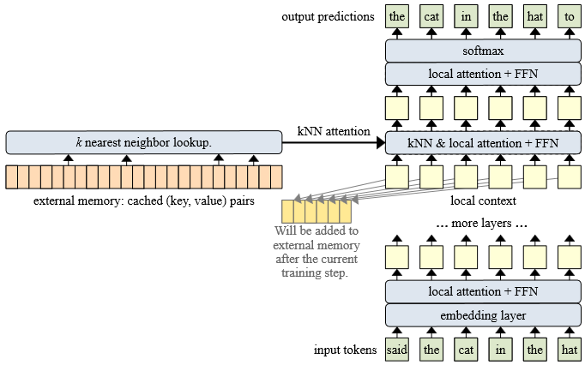
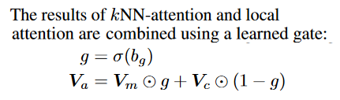
Main Contribution of the Paper
The external memory keeps a cache of the prior M (key, value) pairs, where M is the memory size.
The kNN lookup will return a set of retrieved memories, which consist of the top-k (key, value).
Notes:
Decoder-only model (causal language masking)
Unique to this paper:
* Approximate k-nearest neighbor for memory lookup.
No averaging or summing of tokens at distance
Gradients not backpropagated into external memory
Instead – prior values of external memory are used.
the external memory keeps a cache of the prior M (key, value) pairs, where M is the memory size.
The kNN lookup will return a set of retrieved memories, which consist of the top-k (key, value)
The results of kNN-attention and local attention are then combined using a learned gate:

Slide 4
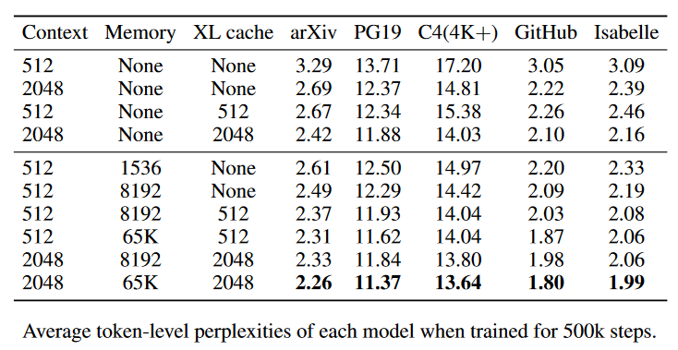
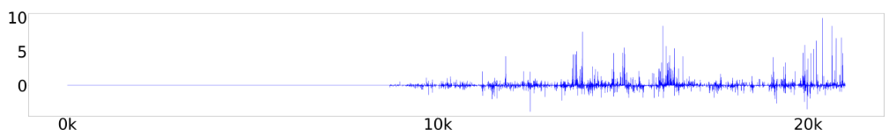
Results
Q: briefly describe the 5 benchmarks
Q: Explain the 3 columns (Context, Memory, XL cache)
Q: why the line in the middle?
Q: Briefly, what is perplexity?

