Slide 1
Memorizing Transformers
Chris Winsor
DL4NLP COMP 5300
4/24/23
(1) Wu, Y., Rabe, M. N., Hutchins, D., & Szegedy, C. (2022). Memorizing Transformers (arXiv:2203.08913). arXiv. https://doi.org/10.48550/arXiv.2203.08913

Slide 2
Motivation
Problem:
  Long documents have references that are far away
    Traditional transformer attention is limited to context length
  A document may only have one occurrence of reference
    Traditional transformer backprop requires thousands of examples
Examples:
  Novel, source code, theorem proofs… far away and infrequent
Idea:
  Add external memory to transformer for learning long distance relation
  Runtime memorization - no training loop or backprop for these
Approach:
  FIFO memory + KNN lookup to retrieve prior key/value pairs
Notes:
Attention over long sequences:
Transformer attention is limited to sequence length.
For long sequences this is problematic.
Think novel or network traffic
Can consider K/V pair in Transformer as a memory lookup. But standard transformer needs large number of samples to “write” to memory.
Memorizing Transforms makes this memory lookup explicit, and can do it in one shot.

Slide 3
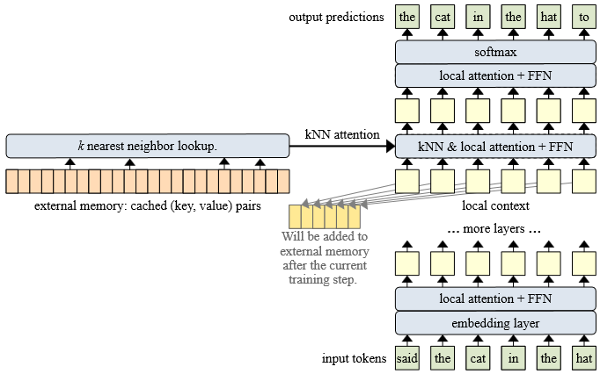
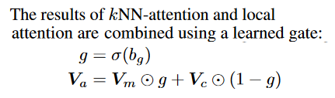
Main Contribution
The external memory keeps a cache of the prior M (key, value) pairs, where M is the memory size.
The kNN lookup will return a set of retrieved memories, which consist of the top-k (key, value).
Notes:
Decoder-only model (causal language masking)
Unique to this paper:
* Approximate k-nearest neighbor for memory lookup.
No averaging or summing of tokens at distance
Gradients not backpropagated into external memory
Instead – prior values of external memory are used.
the external memory keeps a cache of the prior M (key, value) pairs, where M is the memory size.
The kNN lookup will return a set of retrieved memories, which consist of the top-k (key, value)
The results of kNN-attention and local attention are then combined using a learned gate:

Slide 4
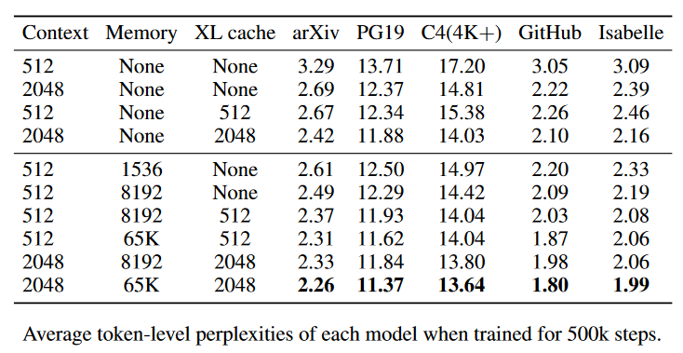
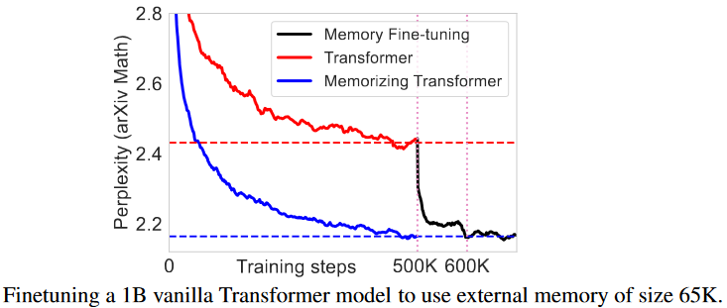
Results
External memory resulted in significant perplexity reduction compared to vanilla transformer (all datasets)
Best performance combined memory with XL cache
Non-memory transformer can be fine-tuned using memory
(Dai et al. 2019)

