Slide 1
Predicting Tweet Popularity in Twitter GeoCoV19 Dataset
Chris Winsor
Update 4/11/2023

Slide 2
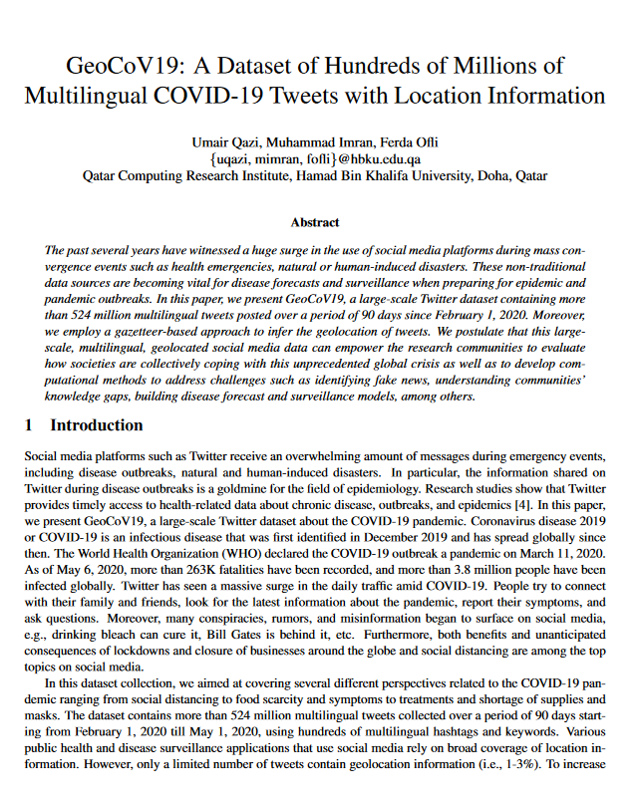
From Prior Weeks:
Q: What are we predicting?
A: Number of re-tweets given text of tweet.
Q: What attributes are available?
  Tweet ID and full tweet text
  User IDs (sending), follower/friend counts
  Lots of relevant tweet info (retweet, favorite counts)
Target:
  Number of re-tweets given text of a tweet.

Slide 3
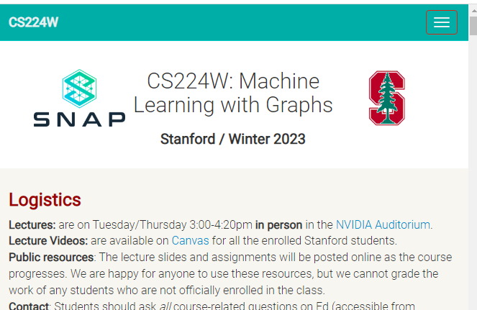
Prior Weeks (Tools and Process) additional detail in slides from 4/4
PyG: Pytorch Geometric
Getting Started: https://pytorch-geometric.readthedocs.io/en/latest/get_started/colabs.html
Supporting Materials
Stanford CS224 (Machine Learning with Graphs)
http://web.stanford.edu/class/cs224w/index.html
Lots of good references including:
"Self-Supervised Learning For Graphs"
https://medium.com/stanford-cs224w/self-super
vised-learning-for-graphs-963e03b9f809

Slide 4
This week
Infrastructure: self-supervised learning for heterogenous graph
Preprocessing

Slide 5
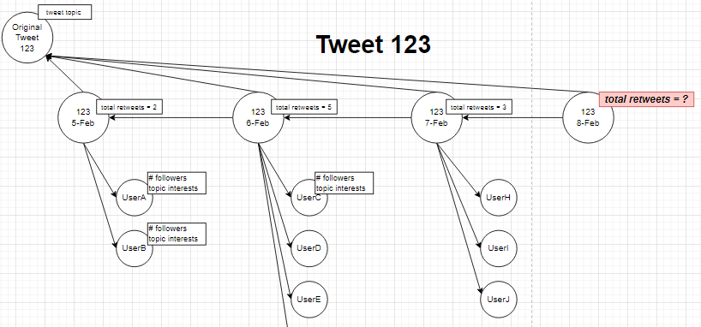

Slide 6
Three node types:
original_tweet
activity_summary_by_tweet
user

Slide 7
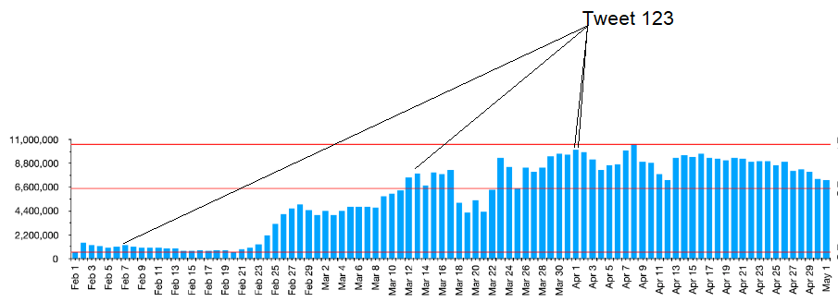
Preprocessing – the “why”

Slide 8
Preprocessing
Grouped based on original tweet ID (each original tweet will be a graph)
  1) read fresh tweets from raw .ijson, select relevant data, sort by original tweet ID, write to standard format .json
  2) merge that day’s tweets into group files
Stream oriented file processing (not in-memory)

Slide 9
Preprocessing Output
original_tweet_id 1220585270115876900
original_tweet_text [THREAD] On Friday, January 24, the death toll in China's viral novel coronavirus outbreak has risen to 25, with the number of confirmed cases also leaping to 830, the government said. Here's what we know so far on the novel coronavirus. https://t.co/ytrVoisbKh
retweet_user_ids [141914884, 177141319, 1186367835129438200, 58208791, 808923263955071000, 3690705794, 408438147, 140382263, 913692795554033700, 78956685]
retweet_dates ['Sat Feb 01 07:37:29 +0000 2020', 'Sat Feb 01 03:28:19 +0000 2020', 'Sat Feb 01 04:34:13 +0000 2020', 'Sat Feb 01 05:31:44 +0000 2020', 'Sat Feb 01 07:35:50 +0000 2020', 'Sat Feb 01 07:03:30 +0000 2020', 'Sat Feb 01 04:31:44 +0000 2020', 'Sat Feb 01 01:53:18 +0000 2020', 'Sat Feb 01 05:28:21 +0000 2020', 'Sat Feb 01 04:39:28 +0000 2020']
number_retweets 10

Slide 10
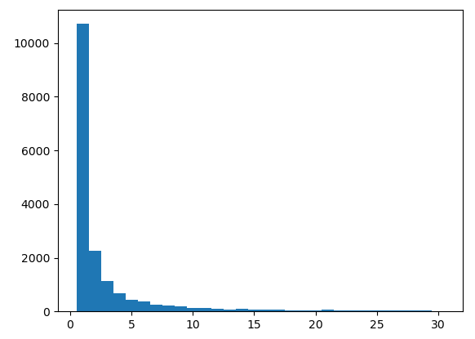

Feb 1, 2020

Slide 11
PyG Dataset and DataLoader (resources/references)
Dataset download and rehydration
  https://paperswithcode.com/dataset/geocov19
  https://crisisnlp.qcri.org/covid19
  https://github.com/docnow/hydrator
Code for self-supervised graph learning, downstream task
  https://medium.com/stanford-cs224w/self-supervised-learning-for-graphs-963e03b9f809
Preprocessing into hetrogeneous graph dataset (HeteroData), NLP encoding
  https://pytorch-geometric.readthedocs.io/en/latest/tutorial/heterogeneous.html
  https://pytorch-geometric.readthedocs.io/en/latest/tutorial/load_csv.html
  https://pytorch-geometric.readthedocs.io/en/latest/tutorial/create_dataset.html
  https://www.sbert.net/ (sentence transformer-based encoding)

Slide 12
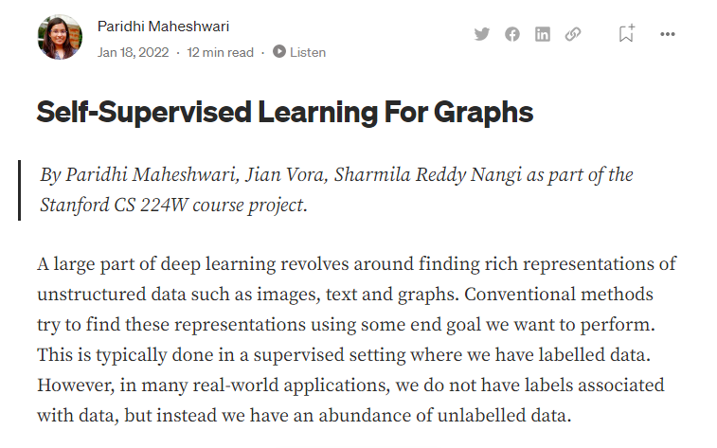
Maheshwari, P. (2022, January 18). Self-Supervised Learning For Graphs. Stanford CS224W GraphML Tutorials. https://medium.com/stanford-cs224w/self-supervised-learning-for-graphs-963e03b9f809

Slide 13


Slide 14
Plans for this coming week
Complete preprocessing
Download April 1-5 and merge in
Attempt first graph using PyG

Slide 15
That’s it for today

Slide 16
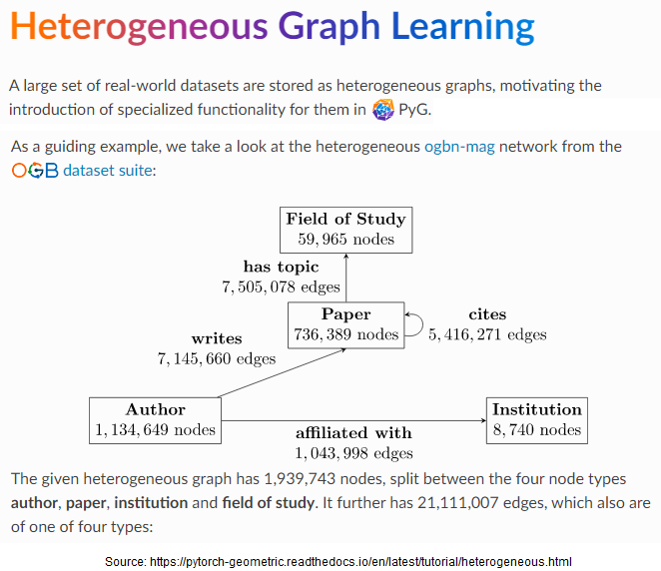

Slide 17
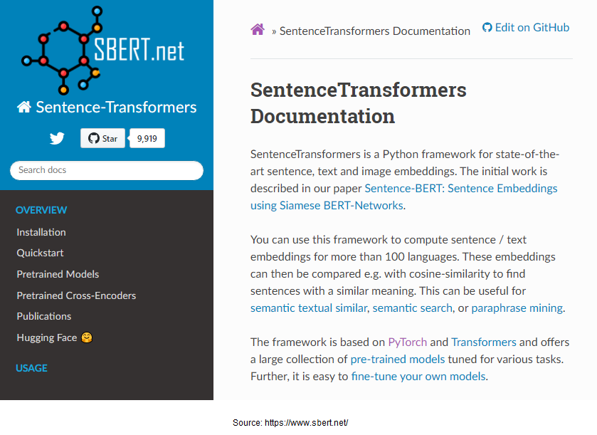

Slide 18
Interesting Paper
Graph Isomorphic Network (GIN)
Xu, K., Hu, W., Leskovec, J., & Jegelka, S. (2019). How Powerful are Graph Neural Networks?
Given the goal of a GNN is to model a graph, the question is:
  What are the limits of the expressive power of a GNN architecture?
  How do we evaluate the expressive power GNN architectures?
The paper:
Introduces framework to evaluate expressive power of a given GNN architecture
Finds certain GNN architectures (GCN, GraphSage) are limited in the types of graph can be represented
Establishes “a simple architecture that is provably the most expressive among the class of GNNs”
“Our results characterize the discriminative power of popular GNN variants, such as Graph Convolutional Networks and GraphSAGE, and show that they cannot learn to distinguish certain simple graph structures.”
“We then develop a simple architecture that is provably the most expressive among the class of GNNs”

Slide 19
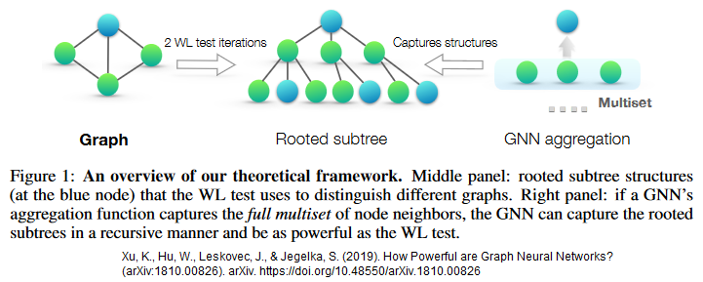
Graph Isomorphic Network (GIN)
Our framework is inspired by the close connection between GNNs and the Weisfeiler-Lehman (WL) graph isomorphism test (Weisfeiler & Lehman, 1968)

Slide 20
Graph Isomorphic Network (GIN)
A node’s representation captures the structural information within its k-hop network neighborhood
For graph classification, the READOUT(*) function aggregates node features (…) to obtain an entire graph’s representation
“The choice of AGGREGATE(*) and COMBINE(*) in GNNs is crucial” (in determining a GNN’s expressive power)
Xu, K., Hu, W., Leskovec, J., & Jegelka, S. (2019). How Powerful are Graph Neural Networks?

Slide 21


Slide 22
K-hop Neighborhood
In a K-layer GNN, every node has a “receptive field” of its K-hop neighborhood.
Two main operations in a GNN layer
  1) Aggregate messages from all neighboring nodes
  2) Combine with the previous embedding of the given node.
Above achieves:
  GNN can operate on graphs of arbitrary size and shape
  Independent of ordering of nodes (permutation invariance)
Maheshwari, P. (2022, January 18). Self-Supervised Learning For Graphs. Stanford CS224W GraphML Tutorials. https://medium.com/stanford-cs224w/self-supervised-learning-for-graphs-963e03b9f809

Slide 23
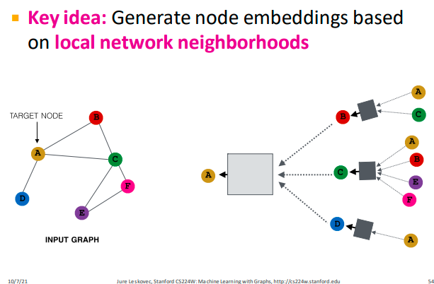

Slide 24
GeoCoV19 Graph Structure
Set of Graphs (one graph per Original Tweet)
Nodes:
  Original Tweet
  Users
  Dates
Vertices
  Daily Summary to Original Tweet
  Daily Summary to Daily Summary (prior day)
  Daily Summary to User IDs (who re-tweeted)

Slide 25
GeoCoV19 Graph Structure
Each graph relatively small (order of 100K retweets or less)
Millions of graphs (one for each original tweet)
Embeddings:
  1) Aggregate messages from neighboring nodes
  2) Combine with the previous embedding of the given node.

Slide 26
Current Activity: Dataset Creation
TUDataset (derives from PyG.InMemoryDataset)
For larger (not in memory) PyG:Dataset additionally requires:
  Dataset.len(): Returns the number of examples in your dataset.
  Dataset.get(): Implements the logic to load a single graph.

Slide 27
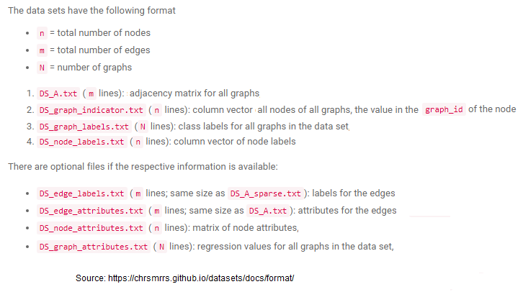
TUDataset Format

Slide 28
That’s it for today.

Slide 29
Additional slides on Self-supervised Learning on Graphs...

Slide 30
Maheshwari, P. (2022, January 18). Self-Supervised Learning For Graphs. Stanford CS224W GraphML Tutorials. https://medium.com/stanford-cs224w/self-supervised-learning-for-graphs-963e03b9f809

Slide 31
Self-supervised Learning
Unlabeled data
Augmentations create positive and negative pairs (“contrastive learning”)
Loss function pulls positive pairs together, negative pairs apart
Fine tune resulting model for downstream tasks
Maheshwari, P. (2022, January 18). Self-Supervised Learning For Graphs. Stanford CS224W GraphML Tutorials. https://medium.com/stanford-cs224w/self-supervised-learning-for-graphs-963e03b9f809

Slide 32
Augmentations and Graphs
Node/Embedding prediction – predict if a node should exist and/or it’s embeddings
Edge prediction – predict if an edge should exist
Graph prediction - is the graph class A or class B
Augmentation defines the goal of the learning exercise, not necessarily the final task

Slide 33
Augmentations on Graphs
Edge Perturbation: randomly add or remove edges (entries in adjacency matrix) considered "first order"
Diffusion: "a denoising filter (that) allows messages to pass through higher-order neighborhoods" (Hassani et al. [1])
Node Dropping: randomly drop nodes
Random Walk based Sampling: starting from a node randomly walk pre-decided number of nodes creating a sub-graph
Node Attribute Masking: Mask features of some nodes
Maheshwari, P. (2022, January 18). Self-Supervised Learning For Graphs. Stanford CS224W GraphML Tutorials. https://medium.com/stanford-cs224w/self-supervised-learning-for-graphs-963e03b9f809
[1] Hassani, Kaveh, and Amir Hosein Khasahmadi. “Contrastive multi-view representation learning on graphs.” International Conference on Machine Learning. PMLR, 2020.

Slide 34
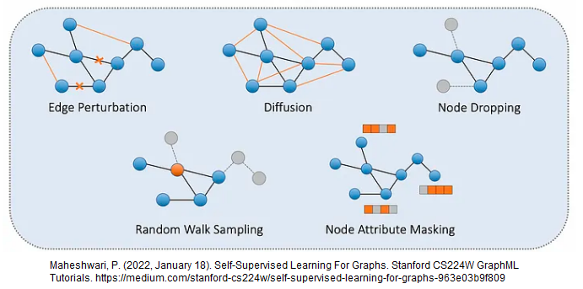
Augmentations

Slide 35
K-hop Neighborhood
In a K-layer GNN, every node has a “receptive field” of its K-hop neighborhood.
Two main operations in a GNN layer
  1) Aggregate messages from all neighboring nodes
  2) Combine with the previous embedding of the given node.
Above achieves:
  GNN can operate on graphs of arbitrary size and shape
  Independent of ordering of nodes (permutation invariance)
Maheshwari, P. (2022, January 18). Self-Supervised Learning For Graphs. Stanford CS224W GraphML Tutorials. https://medium.com/stanford-cs224w/self-supervised-learning-for-graphs-963e03b9f809

Slide 37
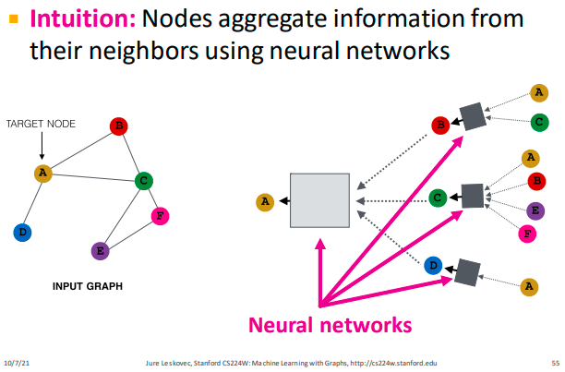

Slide 38
Neural Network vs Graph
Graph is the Data
Neural Network is a Computational Mechanism

Slide 39
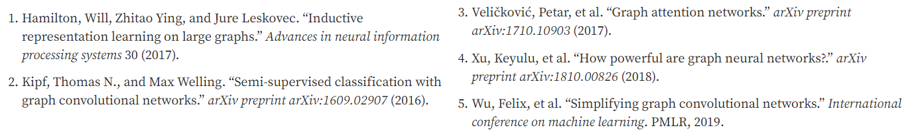
Aggregating and Combining
GraphSAGE [1]
Graph Convolutional Network [2]
Graph Attention Network [3]
Graph Isomorphism Network [4]
Simple Graph Convolution [5]

Slide 40
Next Steps
Preceding gives a Model in PyTorch (layers and "forward" method).
To train we need Objective Function
Contrastive loss: positive pairs scored higher than negative pairs

Slide 41
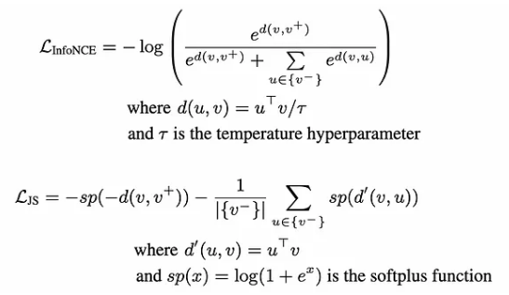
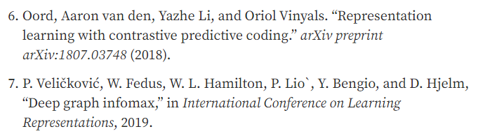
InfoNCE objective [6]
Jensen-Shannon Estimator [7]

Slide 42
Downstream Tasks
With above we have a model that will produce embeddings that …
  Predict nodes and/or Node embedding
  Edge presence
  Graph Classification - embed entire graphs s.t. separable given a graph

Slide 43
MUTAG (https://chrsmrrs.github.io/datasets/)
Each graph is a chemical compound with binary label "mutagenetic effect" (note label)
188 graphs, 18 nodes, 20 edges on average
Supervised + cross-entropy loss + Adam optimizer
  60% accuracy
Pretrain w/augmentations (edge perturbation, node dropping) + InfoNCE objective function + fine tune using supervised
  75% accuracy.

