Slide 1
how does gender impact wages?

Slide 2
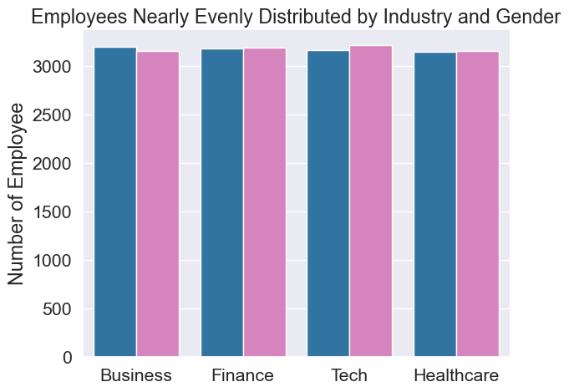
to find out, we have analyzed a data set of 25,439 employees. as you can see below, the data is very evenly distributed by gender and industry.

Slide 3
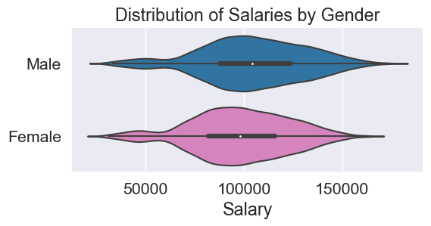
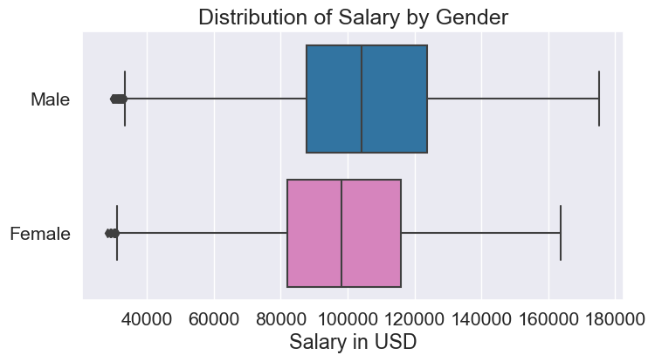
so, what does the data tell us?

Slide 4
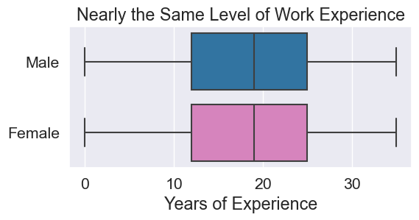
what is the explanation? maybe males have more industry experience in the data set?
maybe it’s because women take time away to raise their families?

Slide 5
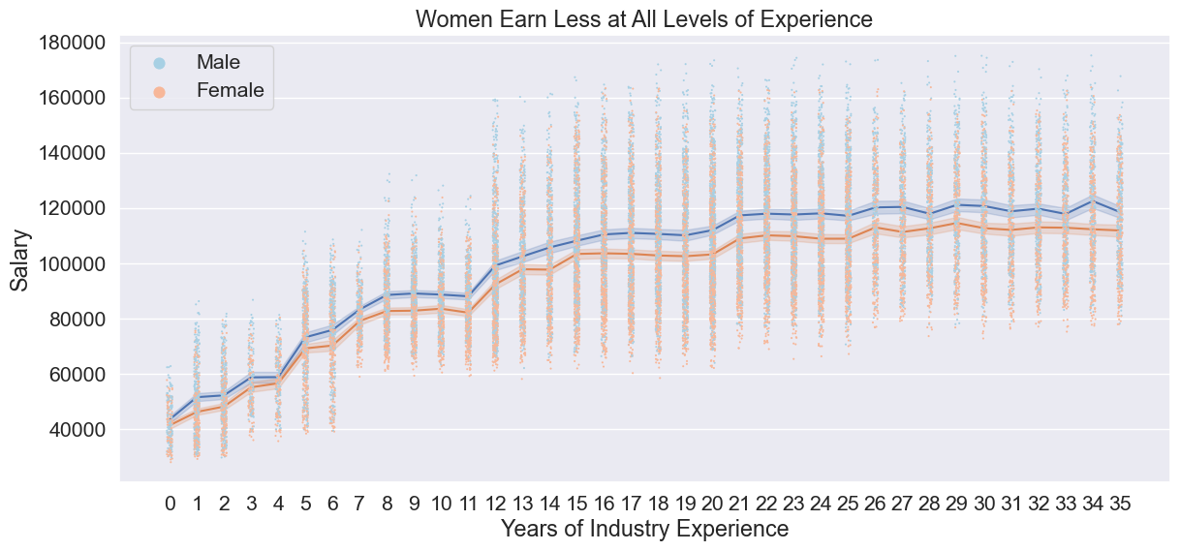
women actually earn less at at all levels of experience!

Slide 6
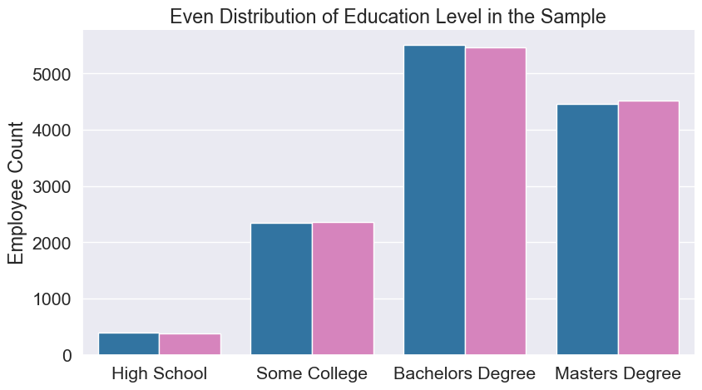
maybe the average education level for men is greater?

Slide 7
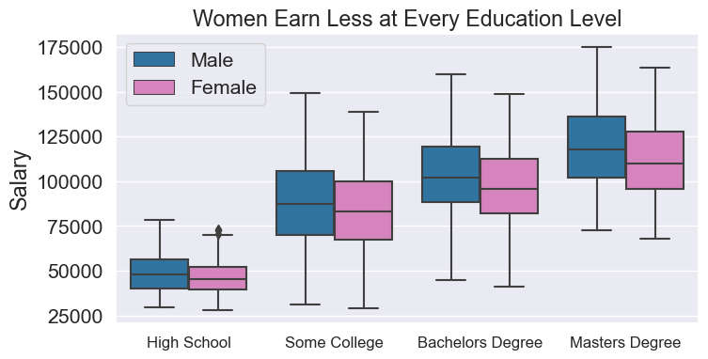
women are earning less at every education level!

Slide 8
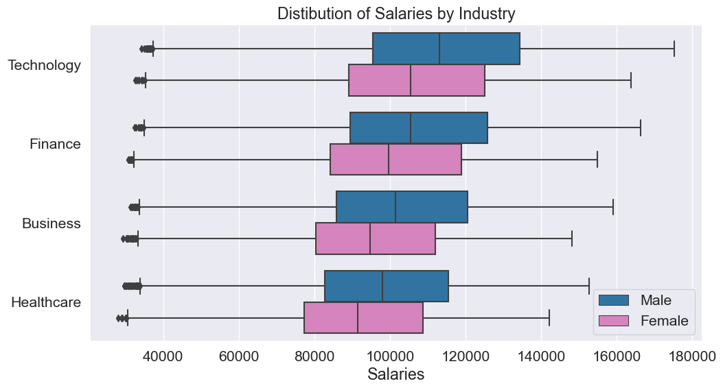
how about one last guess? Industry dispersion?

Slide 9
conclusion
through our analysis of this data set it is apparent that females tend to earn less than males, all other things being equal. neither industry experience, education level, or industry seems to explain the wage gap. it seems the best explanation would be a gender bias or some other factor we have not analyzed.

