Slide 1
COVID-19 Briefing
Suggestion to Vaccination Plan in New York State
(17 Feb 2021)

Slide 2
Content
Current Pandemic Situation in US
Current Pandemic Situation in New York State (NYS)
Why need Vaccine
Proposed Vaccination Plan
Tracking Progress

Slide 3
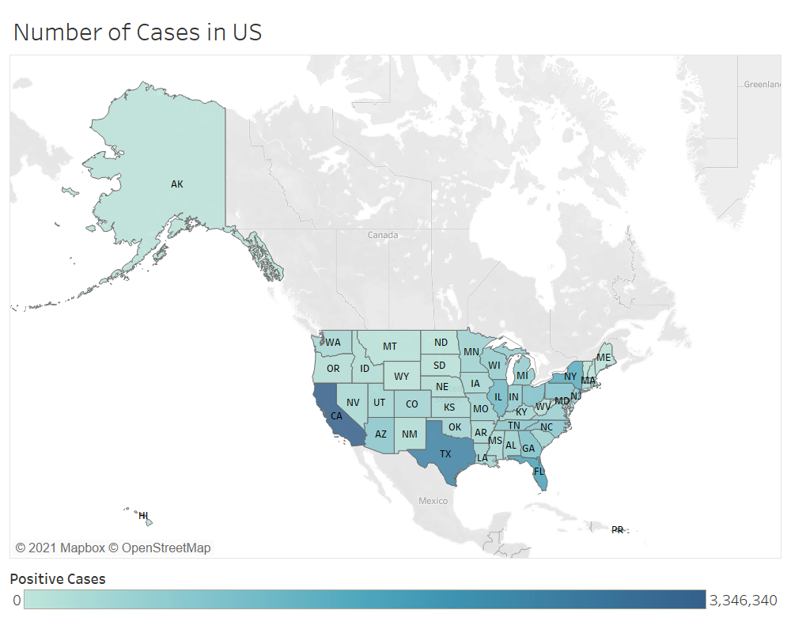
1. Current Pandemic Situation in US
Notes:
Total Case: 27 M
Total Deaths: 483 K

Slide 4
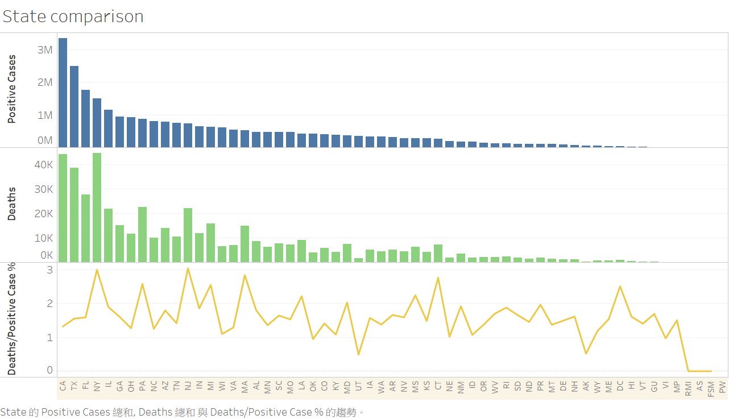
1. Current Pandemic Situation in US
Notes:
CA – California
TX – Texas
FL – Florida
NJ – New Jersey

Slide 5
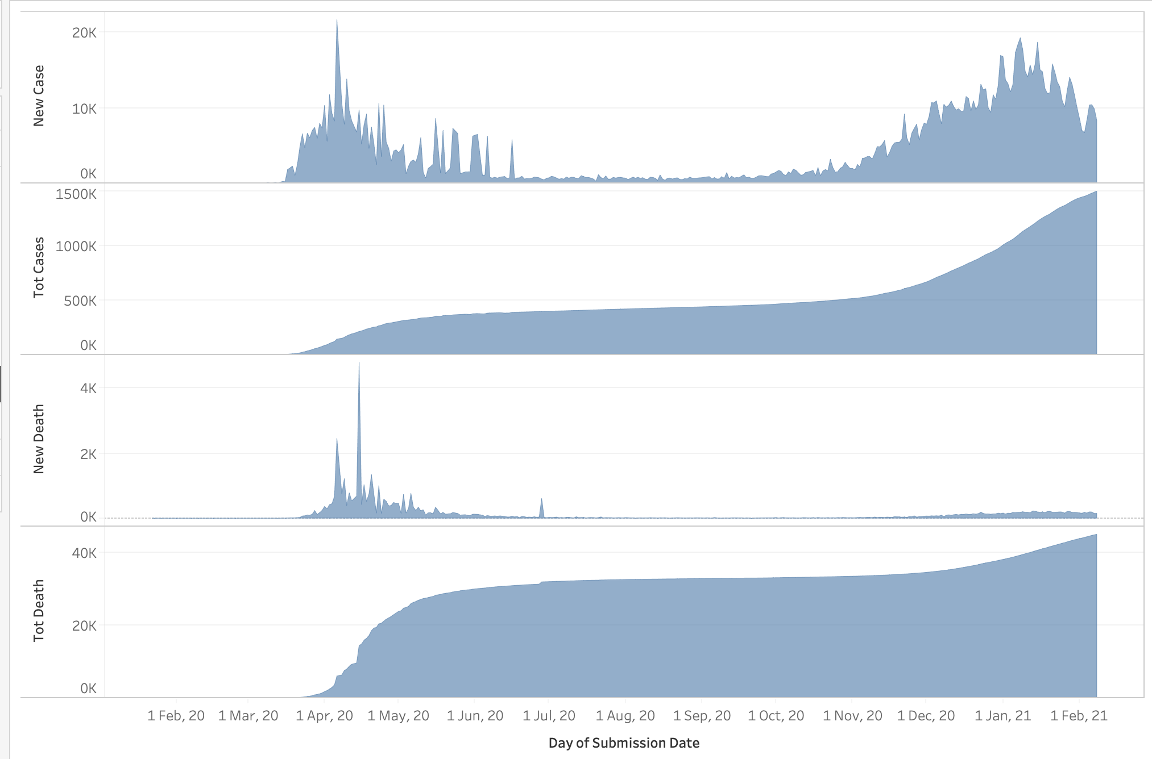
2. Current Pandemic Situation in New York State (NYS)
Notes:
- There were two waves – 1st from mid March 2020 – mid June 2020, 2nd from Nov 2020 till now
- The death rate in 1st wave was much higher

Slide 6
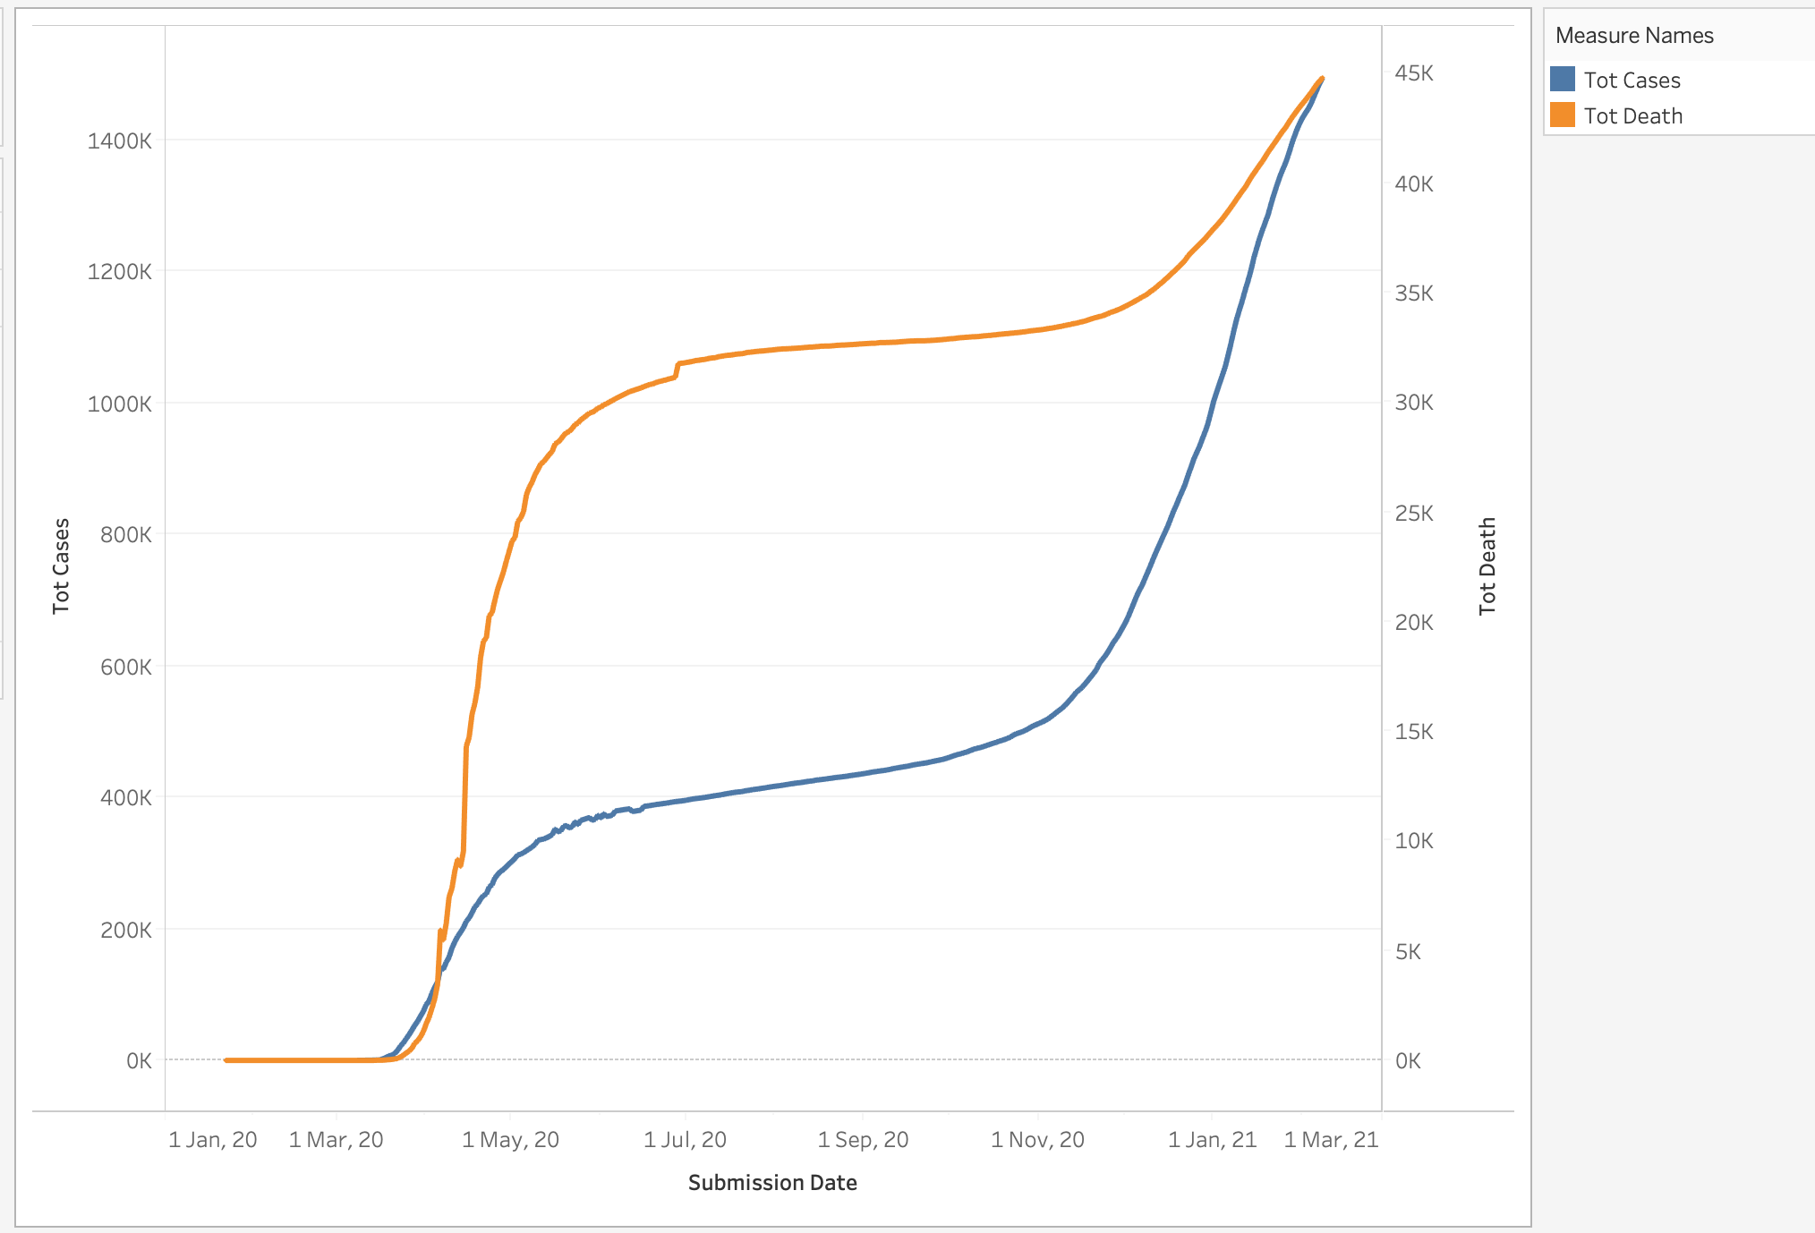
2. Current Pandemic Situation in New York State (NYS)

Slide 7
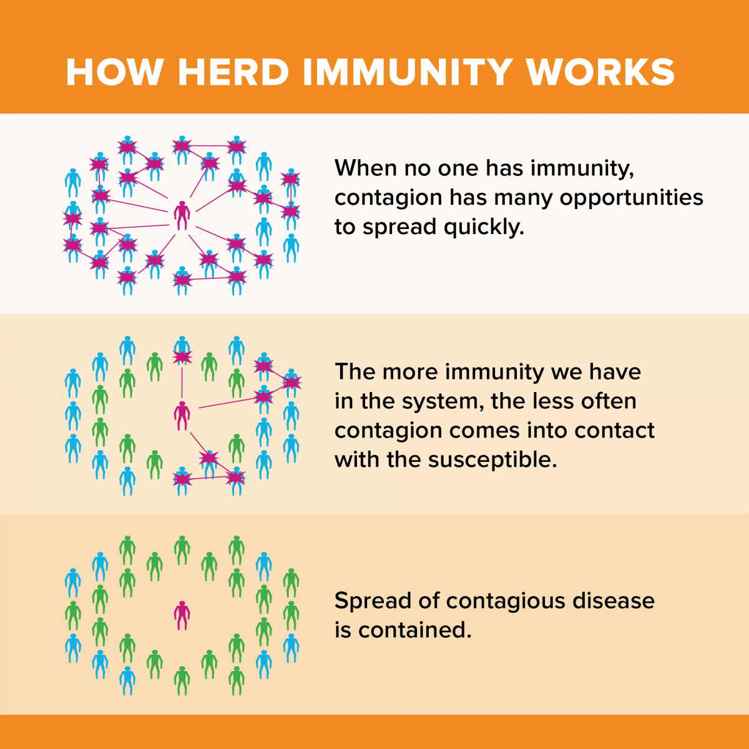
3. Why need vaccine?
What is herd immunity?
When most of a population is immune to an infectious disease, this provides indirect protection—or herd immunity (also called herd protection)—to those who are not immune to the disease.

Slide 8
3. Why need vaccine?
What is herd immunity?
When most of a population is immune to an infectious disease, this provides indirect protection—or herd immunity (also called herd protection)—to those who are not immune to the disease.
How to achieve?
· A large proportion of the population gets infected.
· A large proportion of the population gets a protective vaccine.

Slide 9
3. Why need vaccine?
What is herd immunity?
When most of a population is immune to an infectious disease, this provides indirect protection—or herd immunity (also called herd protection)—to those who are not immune to the disease.
How to achieve? (for other infectious diseases, e.g., Measles, chickenpox)
· A large proportion of the population gets infected.
—— circulate among children, and infect those with weakened immune systems
· A large proportion of the population gets a protective vaccine.
—— these dieases are rare now
Notes:
for other infectious diseases, e.g......that were once very common in the U.S. , because vaccines helped to establish herd immunity( click ). these dieases are rare now
before the vaccine was developed, people sometimes exposed themselves intentionally as a way of achieving immunity. but even if many adults have developed immunity because of prior infection,( click ) the disease can still circulate among children and can still infect those with weakened immune systems.

Slide 10
3. Why need vaccine?
What is herd immunity?
When most of a population is immune to an infectious disease, this provides indirect protection—or herd immunity (also called herd protection)—to those who are not immune to the disease.
How to achieve? (for COVID-19)
· A large proportion of the population gets infected.
——high infection fatality ratio (0.3–1.3%)
· A large proportion of the population gets a protective vaccine.
——safest way
Notes:
for COVID-19, it is not wise to expose intentionally as a way of achieving immunity. because
(click) current data suggest that it has high infection fatality ratio (0.3–1.3%) ,which is higher among vulnerable groups like the elderly and people with weakened immune systems. and if our doctors and hospitals are overwhelming, the death rate may get higher.
(click) therefore it is saftest to ....

Slide 11
4. Proposed Vaccination Plan
The plan is about how we are able to build up a supply of vaccines and how we are planning to deploy them. The plan has four key parts:
Vaccine Type and Supply
Priority for Vaccination
Places used for Vaccination
People
Notes:
Ref:
[1]UK COVID-19 vaccines delivery plan 2.1

Slide 12
Vaccine Type and Supply Available
Vaccine types available in NYS
*With Emergency Use Authorization by the FDA
Supply Available in NYS
The Federal Government determines how much vaccine each state receives
Approximately 300,000 vaccines/week is distributed to NYS
Supply is very limited
Vaccine Type | Doses | Applicable to Age* | Vaccine efficacy | Storage
Pfizer/BioNTech | 2 doses given 3 weeks apart | 16+ | 95% | -94°F
Moderna | 2 doses given 1 month apart | 18+, but lower efficacy for individuals older than 65. | 94.1% | -4°F
Notes:
Emergency Use Authorization (EUA)
Food and Drug Administration (FDA)
Ref: https://covid19vaccine.health.ny.gov/frequently-asked-questions-0

Slide 13
Priority for Vaccination
As the supply of vaccine is limited at the early stage, priority should be given to people with higher risk, which includes:
First responder or support staff for First Responder Agency
Staff in fire, police, school, public transit, hospital and so on.
Patients with major diseases (cancer, chronic kidney disease, el.)
Age of 60 or higher
Notes:
Ref: https://covid19vaccine.health.ny.gov/phased-distribution-vaccine

Slide 14
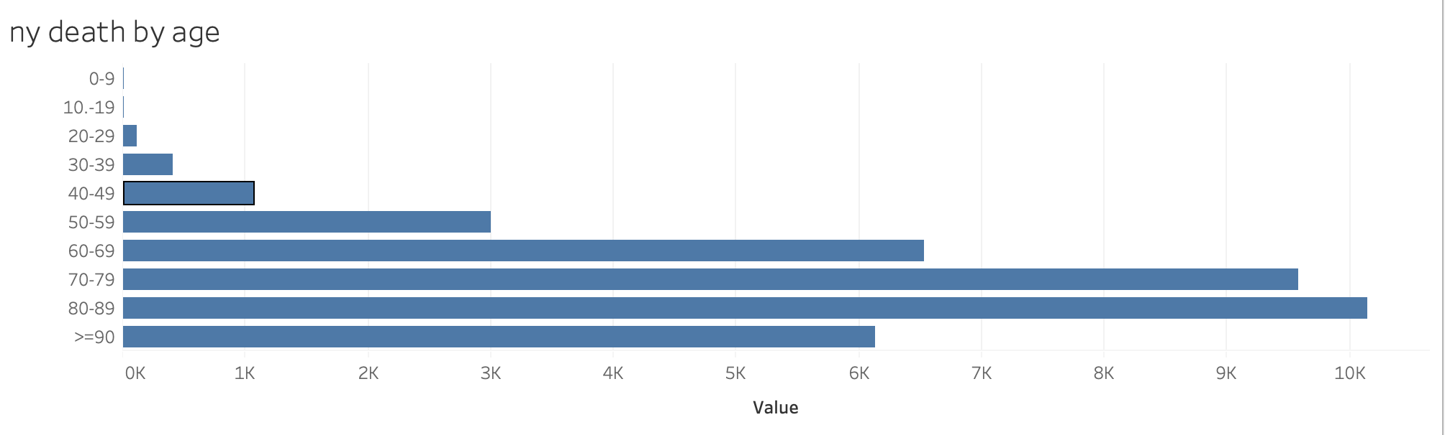
Priority for Vaccination
Notes:
Chart of Death Number by Age Group

Slide 15
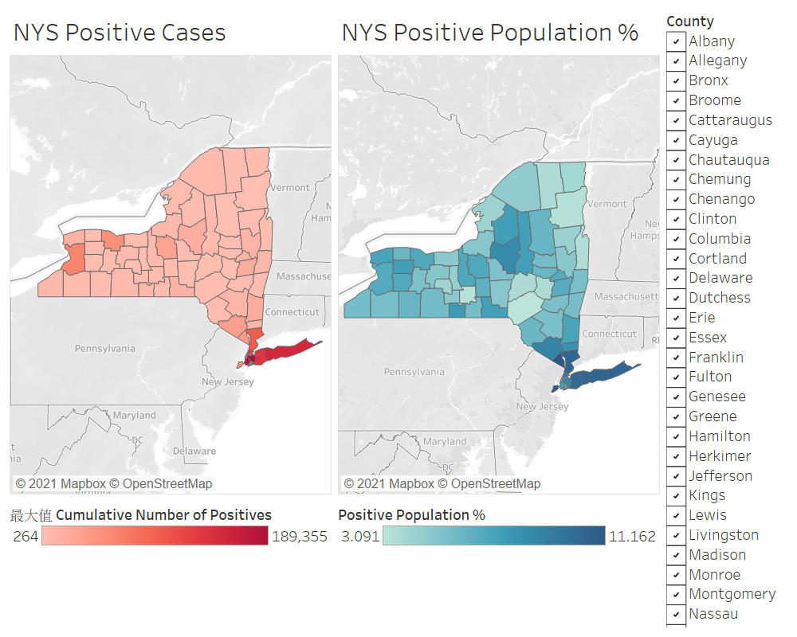
Priority for Vaccination (By Location)
Both the number of positive cases and the positive population % are relatively higher in the southern part of the New York State
Higher portion of vaccine should be distributed to counties including the whole New York City (including Bronx, New York, Kings, Queens and Richmond) and 4 counties in Rest of State (including Westchester, Rockland, Nassau and Suffolk)
Notes:
Ref:
Positive cases: https://health.data.ny.gov/Health/New-York-State-Statewide-COVID-19-Testing/xdss-u53e
Population: https://www.newyork-demographics.com/counties_by_population

Slide 16
Places used for Vaccination
State-run vaccination sites
Pharmacies: CVS, Walgreens and Costco pharmacies
Pop-up & community vaccine sites
Federal mass vaccination sites
Notes:
Ref:
[1] https://states.aarp.org/new-york/covid-19-vaccine-distribution

Slide 17
People
Promote the importance of vaccination
Develop registration mechanism
Strengthen preventive measures:
social distancing
surgical mask
personal hygiene
Notes:
Ref:
[1] https://states.aarp.org/new-york/covid-19-vaccine-distribution

Slide 18
5. Tracking Progress
To estimate the time needed for NYS to achieve herd immunity, it is suggested to track the following throughout the vaccination phase:
Infected number
Exposed period
Recovered number
Reproduction number
Vaccine efficacy
Vaccinated population
Vaccine Supply
Registered population
Notes:
R0
Estimated through daily positive cases recorded
Affect the % of population needs immunity to achieve herd immunity
Vaccine efficacy
Estimated through the infected % of vaccinated population
Affect the % of population needs immunity to achieve herd immunity

Slide 19
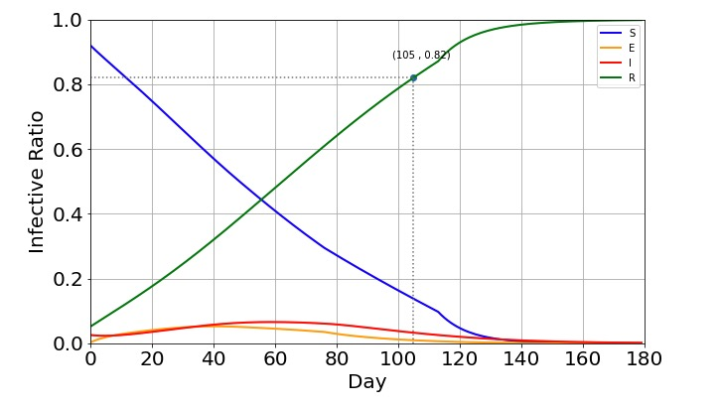
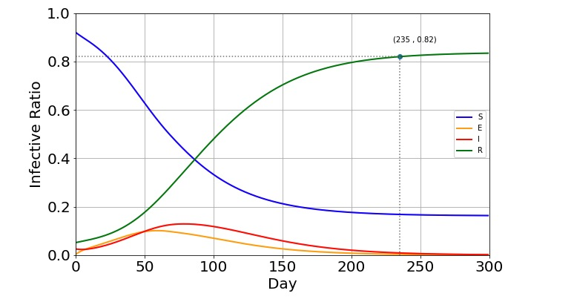
5. Tracking Progress (Prediction Model)
With the latest figures available and some assumptions, we can compare the time needed to achieve certain % of population immunity with/without vaccination
With Vaccination
Without Vaccination
Notes:
N = 19,465,200 total population of NYS
# susceptible to exposed rate: lambda = 0.16*S, (R0 = 2.28, exposed period = 14 days, 2.28/14=0.16)
# infected to recover rate: gamma = 1/20 (average recovery time = 20 days, daily average = 1/20)
# exposed to infected rate: sigma = 1/14 (exposed period = 14 days, daily average = 1/14)
With Vaccine
s[t + 1] = s[t] - lambda * s[t] * i[t] - beta*vac/N
e[t + 1] = e[t] + lambda * s[t] * i[t] - sigma * e[t]
i[t + 1] = i[t] + sigma * e[t] - gamma * i[t]
r[t + 1] = r[t] + gamma * i[t] + beta*vac/N

Slide 20
Q & A

Slide 21
Thank you

Slide 22
Backup slides

Slide 23
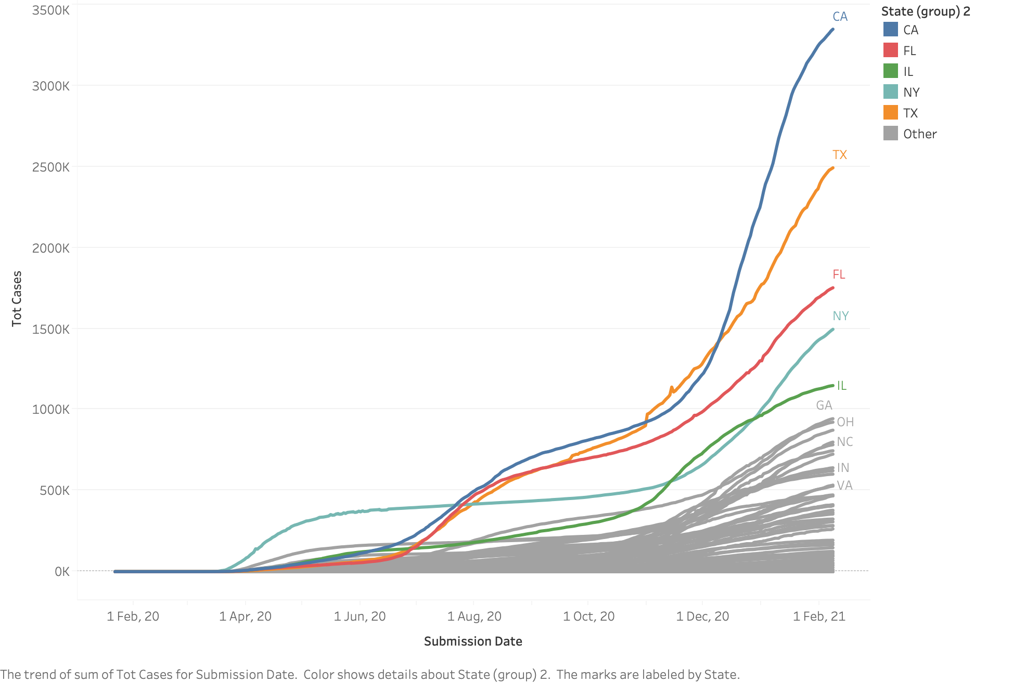
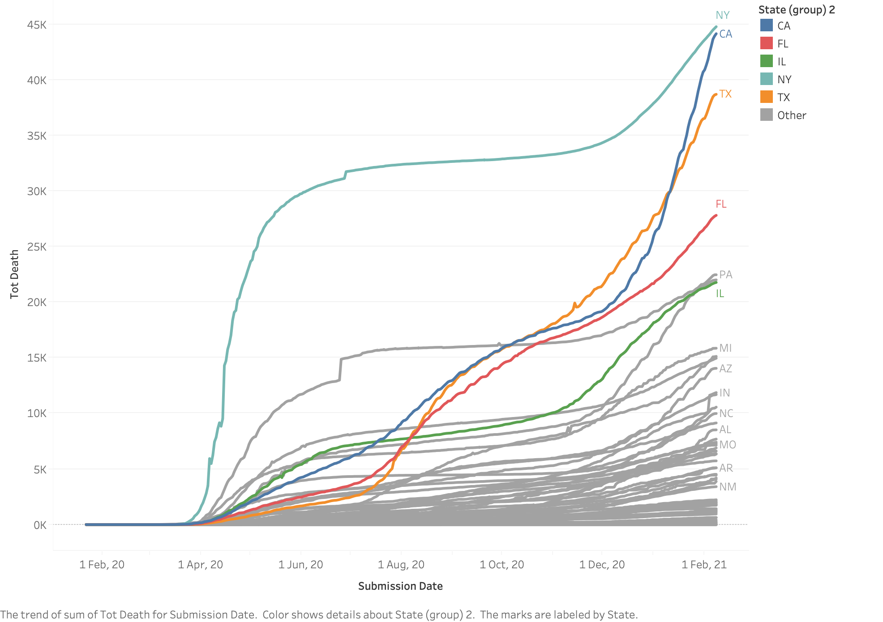
Current Pandemic Situation in US (State comparison)
Total cases by states
Total death by states

Slide 24
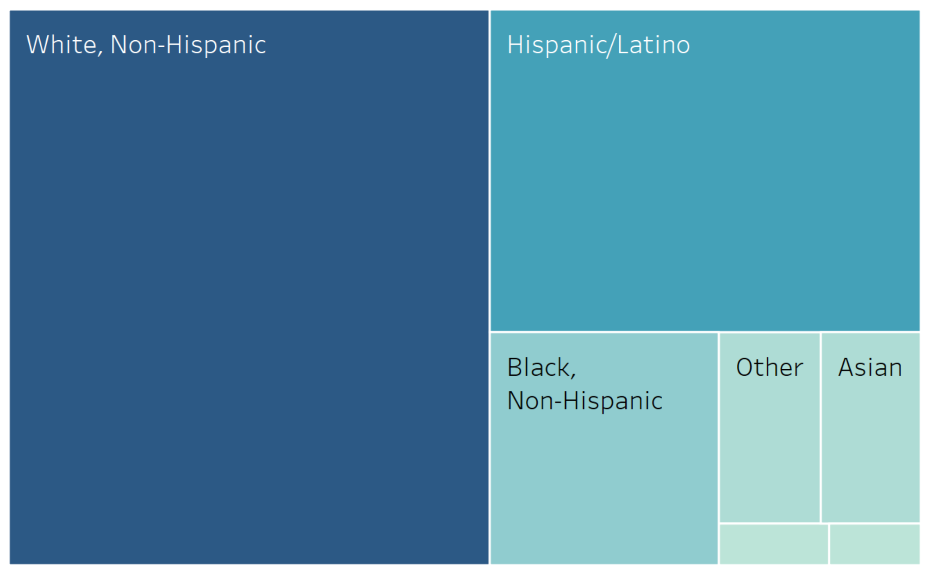
Current Pandemic Situation in US (By Race)
3
Notes:
Source: https://data.cdc.gov/Case-Surveillance/COVID-19-Case-Surveillance-Public-Use-Data/vbim-akqf

Slide 25
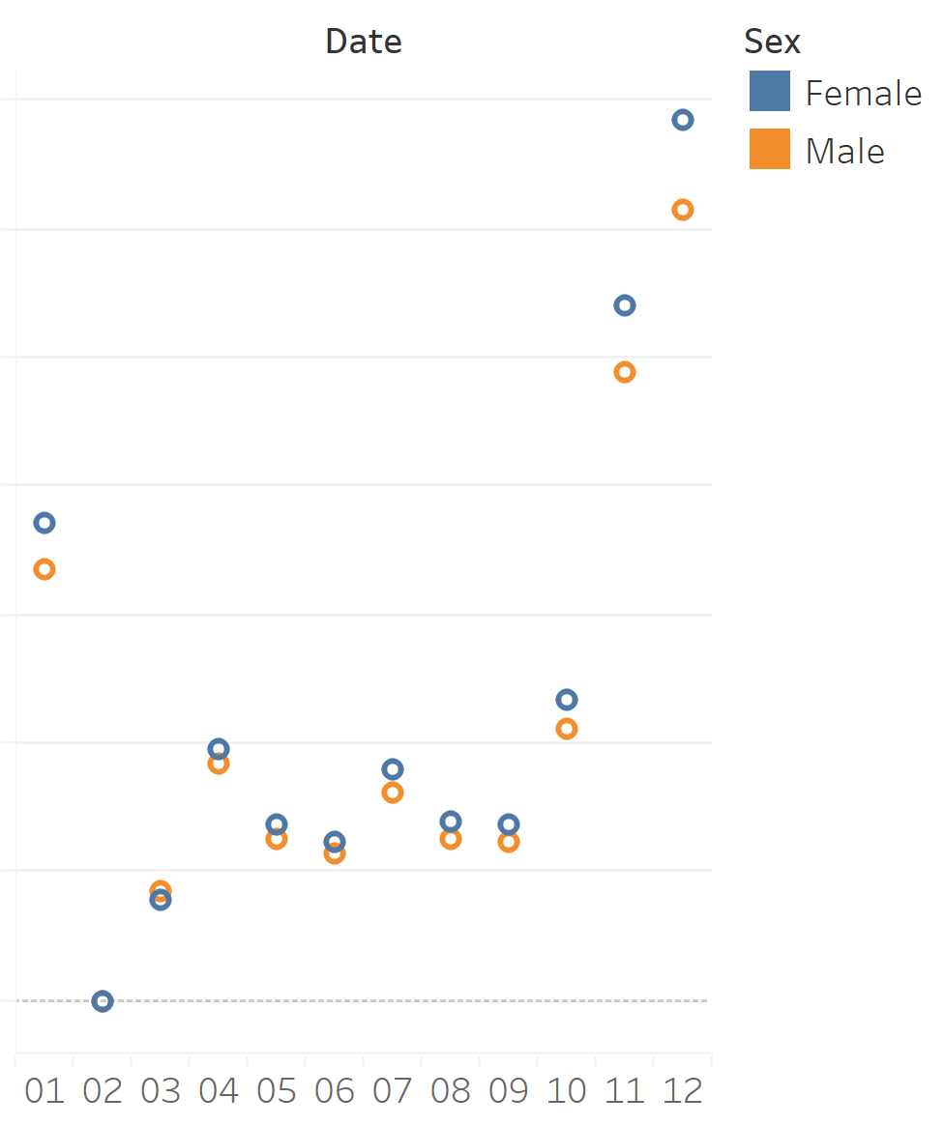
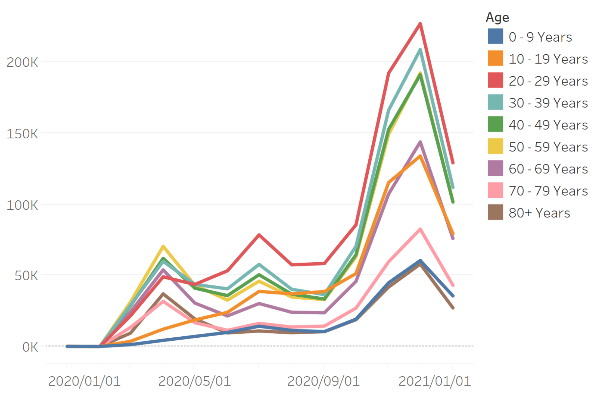
Current Pandemic Situation in US (By Gender and Age Group)
4

Slide 26
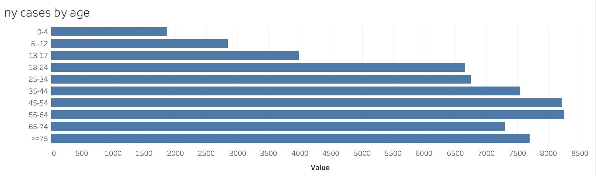
Current Pandemic Situation in New York State (NYS)
5

Slide 27
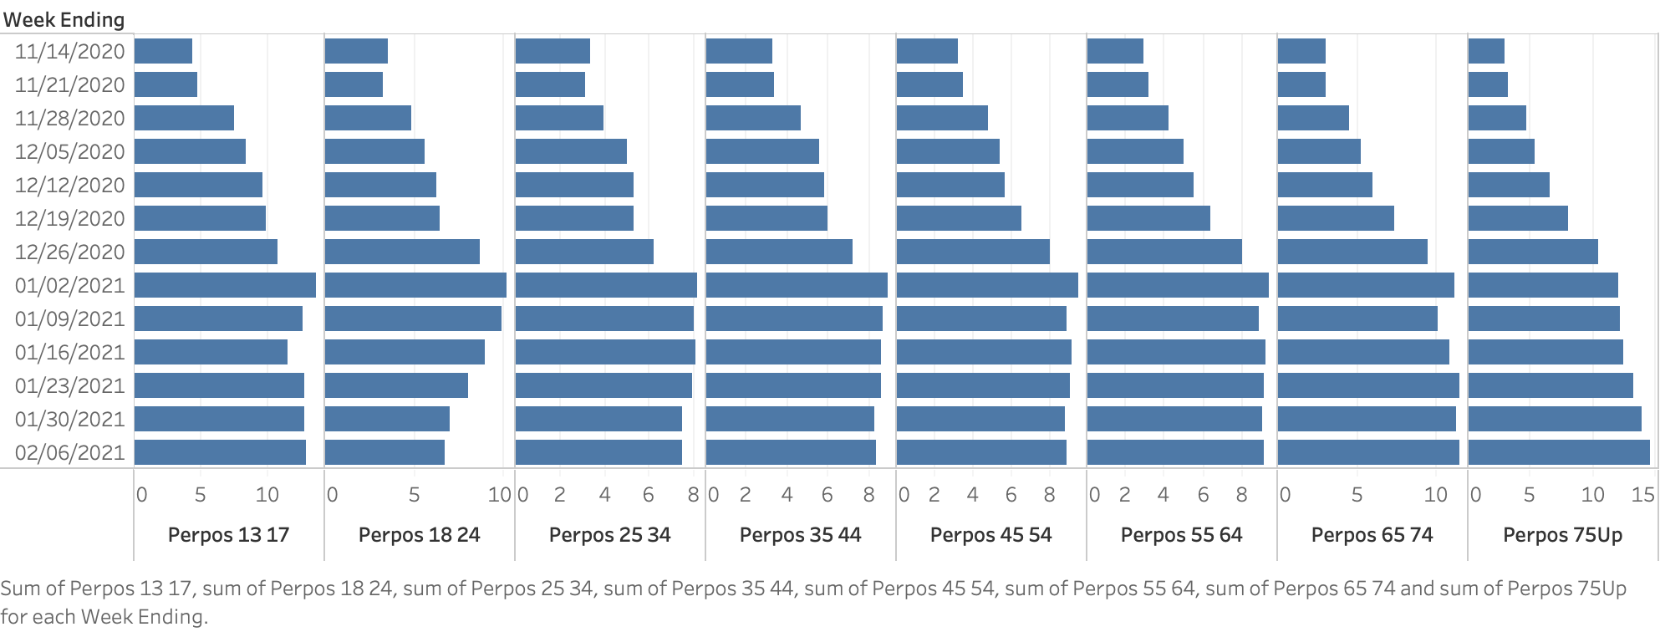
Current Pandemic Situation in New York State (NYS)
New Cases per 100 by age groups
5
Notes:
Latest New Cases by Age Group

Slide 28
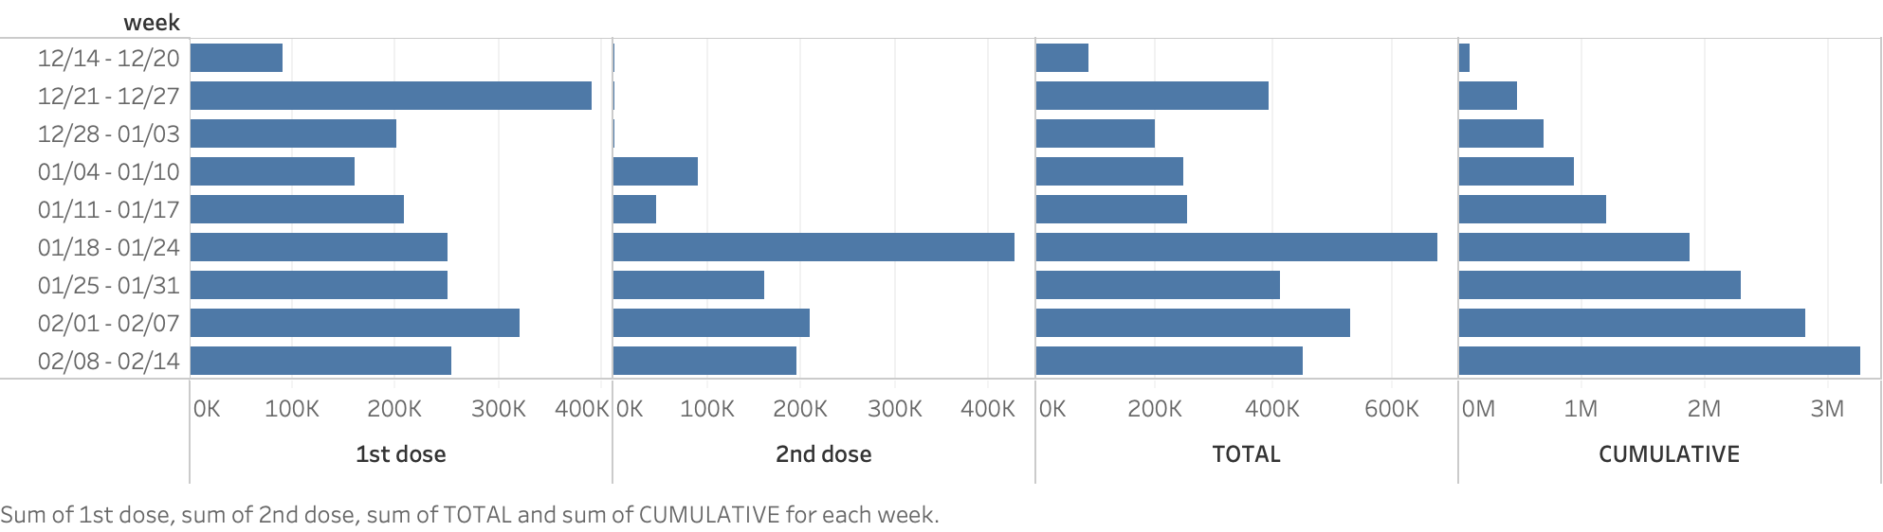
Current Pandemic Situation in New York State (NYS)
Vaccine number by week
5
Notes:
Vaccinated Figures

Slide 29
Tracking Progress (Prediction Model Detail)
N = 19,465,200 total population of NYS
# susceptible to exposed rate: lambda(t) = 0.16*s(t), (R0 = 2.28, exposed period = 14 days, 2.28/14=0.16)
# infected to recover rate: gamma = 1/20 (average recovery time = 20 days, daily average = 1/20)
# exposed to infected rate: sigma = 1/14 (exposed period = 14 days, daily average = 1/14)
With Vaccine
s[t + 1] = s[t] - lambda * i[t] - beta*vac/N
e[t + 1] = e[t] + lambda * i[t] - sigma * e[t]
i[t + 1] = i[t] + sigma * e[t] - gamma * i[t]
r[t + 1] = r[t] + gamma * i[t] + beta*vac/N

