Slide 1
Uranus
By Owen Andrews,
Dan Jones &
James Smith

Slide 2
Facts about Uranus
Like Saturn, the thick atmosphere of Uranus is made up of methane, hydrogen and helium. But Uranus is an extremely cold planet. It has been called the "ice giant."
Uranus orbits the Sun on its side. Its south pole is pointed towards Earth. The angle of the tilt of the axis of Uranus is 97 degrees. This is probably due to an object the size of Earth smashing into Uranus during its formation billions of years ago.
It is believed that long ago a very large object smashed into this planet, the crash was so powerful that it completely changed the direction of Uranus' planetary rotation.
Five of these moons Five of the moons are large and the rest are small.
Uranus also has rings, though they don't stretch out as far as the rings of Saturn. The rings of Uranus are made up of black dust particles and large rocks.
If we were able to see Uranus' moons orbiting the planet, they would go over and under the planet like lights on a ferris wheel.
It would take you many years to fly a rocket to Uranus. When you arrived you would weigh less because Uranus' gravity is not as strong as the Earth's. If you weigh 70 pounds (32 kg) on Earth, you would weigh 62 pounds (28 kg) on Uranus.
After Saturn, a space-craft would have to travel 1,500,000,000 km to reach Uranus. This means the planet is almost twice the distance from the sun that Saturn is.

Slide 3
Seen in visible light, Uranus is a boring blue ball. You can’t see the amazing bands of clouds and storms that we see on Jupiter and Saturn. But look closer in other wavelengths, like infrared, and you’ll see that Uranus does have bands and cloud patterns. Early observations of Uranus didn’t show anything, but improved telescopes in the 1990s showed that Uranus has bright regions in its atmosphere. Some of these clouds only last for hours, while others have been around since the Voyager flyby in 1986. Astronomers have also been able to chart the wind speeds on Uranus, and have found they can go to the speed of 250 miles per second!
Only one spacecraft in the history of spaceflight has ever made a close approach to Uranus. NASA’s Voyager 2 zipped pass Uranus in January, 1986, coming within 81,000 km of the surface of Uranus. It took thousands of photographs of Uranus and its moons, and then sped off onto towards its next target: Neptune. No other spacecrafts have ever been sent towards Uranus, and there are no plans to send any more.
More Facts about Uranus
A day on Uranus is only about 17 hours. But the tilt of Uranus works out so that one pole or the other is usually pointed towards the Sun. This means that a day at the north pole of Uranus lasts half of a Uranian year – 84 Earth years. So, if you could stand on the north pole of Uranus, you would see the Sun rise in the sky, circle around for 42 years, and finally dip down below the horizon. Then you would have 42 years of darkness.
The first set of rings was discovered in 1977 and the second set was discovered in 2003 by the Hubble Space Telescope
It is believed that Uranus is made up of rock and ice and has a large rocky core. Because of the tremendous planetary pressure of Uranus, there could possibly be trillions of large diamonds in or on the surface of this planet.
Uranus is mainly made up of hydragen and hielium.

Slide 4
Information about Uranus
Mass: 86,810,300,000,000,000 billion kg (14.536 x Earth)
Circumference at Equator: 159,354.1 km
Average Distance from Sun: 2,870,658,186 km (19.22 AU)
Known Satellites: 27
Average Diameter: 51,118 km
Notable Satellites: Oberon, Titania, Miranda, Ariel and Umbriel
Length of Orbit: 30,687.15 Earth days (84.02 Earth years)

Slide 5
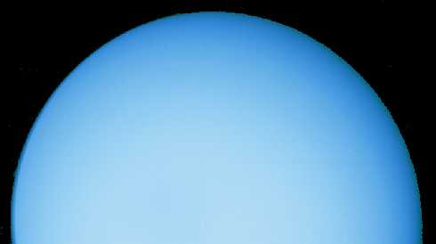
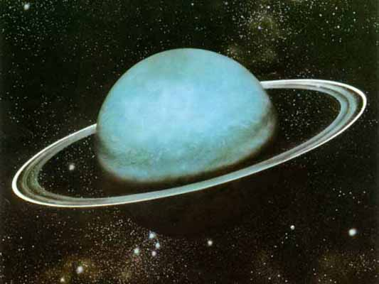
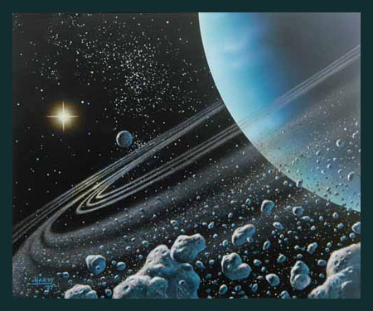
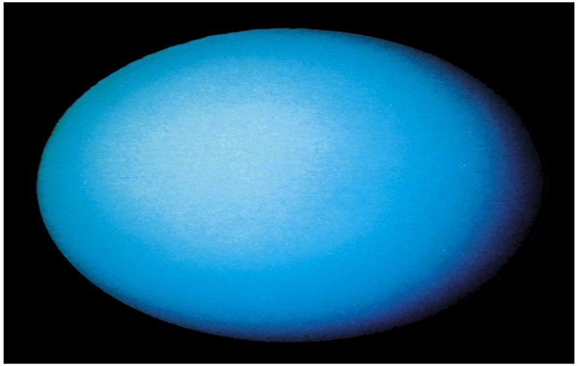
Images of Uranus

Slide 6
By Owen Andrews,
Dan Jones &
James Smith

