Slide 1
Open Source tools for data analytics: R-Studio, SAS Studio, PYCHARM Edu
MIS 500 Critical Thinking Module 2
Cecil Kitch
Notes:
Title Slide

Slide 2
Overview: @forEach(‘tool’)
Brief Historical Background
Job Perspective
Availability / Cost
Ease of usage/learning
Data handling capabilities
Visualization capabilities
Statistical capabilities
Data task scenarios
Deep Learning Support
Customer service support and Community
Future Outlook of Tool.
Notes:
For each tool I will give a brief overview with 2-3 slides per tool depending on how technical the tool is, SAS Studio got slightly less space because it is so point and click.
As listed, we will be covering a brief historical background of the tool, job market perspective, open course or commercial nature, customer service, ease of learning and more.

Slide 3
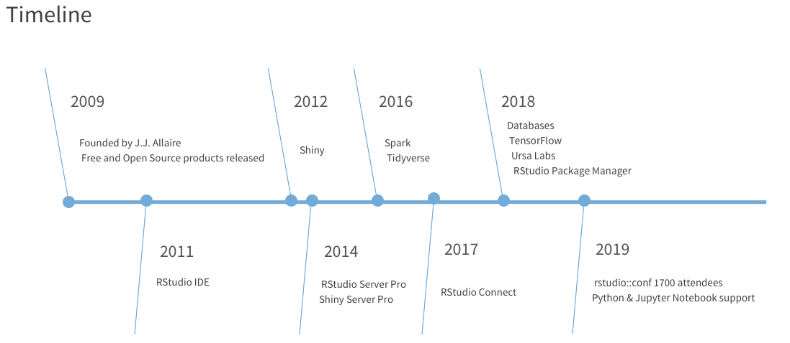
RStudio includes a console, syntax-highlighting editor that supports direct code execution, as well as tools for plotting, history, debugging and workspace management.
RStudio is available in open source and commercial editions and runs on the desktop (Windows, Mac, and Linux) or in a browser
The R Consortium is a collaboration between the R Foundation, RStudio, Microsoft, TIBCO, Google, Oracle, HP and others.
Figure 2 – Timeline of R project - Source https://rstudio.com/about/ 01/26/2019
Notes:
The first tool we are going to start with is RStudio. RStudio is a mature product, with the named release in 2011. R has been developed by univerisities and is widely in use for statistical analysis. RStudio now offers a browser based flavor that’s compatable with Python and Jupyter Notebooks. This is revolutionary in terms of cost and ability to control the data analytics ecosystem.

Slide 4
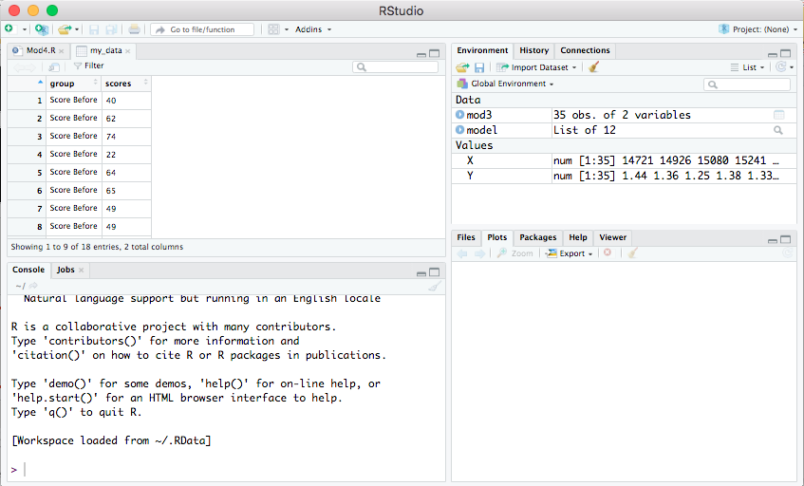
Figure 1 – Screenshot of RStudio on MacOS. 01/26/2020
Notes:
In addition, the RStudio interface is moderately elegant, I found. The environment tab makes it very easy to keep track of objects that are in memory. There is a script editor built in, as well as a console. Plots generated are output on the plots tab in the lower right.

Slide 5
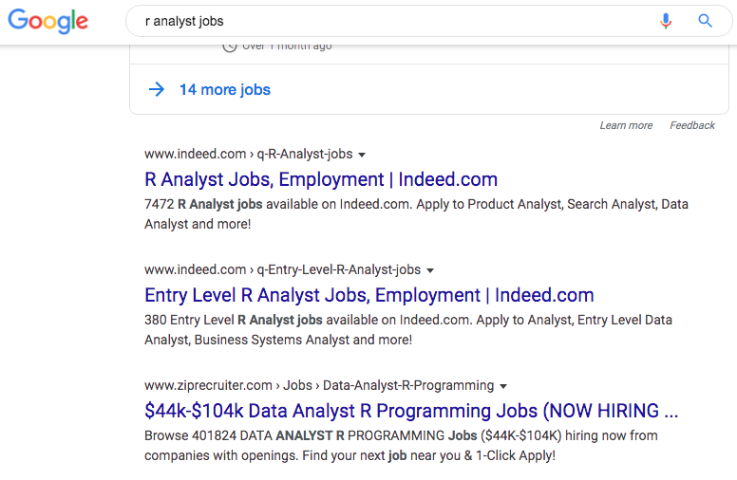
Job outlook for RStudio and R programming skills is high.
Easy access to learning materials, large community
Thousands of open source packages designed for statistical analysis.
Data handling capabilities are very robust, object oriented, environment manager
Statistical capabilities are strong, built for statistics.
Large and growing community of developers at https://community.rstudio.com/, 1700 conference attendees in 2019.
Figure 3 - Screenshot Google Search 01/26/2020
Notes:
A quick Google search revealed the demand for R analysts is high (see figure 3, there are ~40k job openings in the U.S.). The R consortium, R-CRAN all provide a robust layer of documentation and make access to learning materials a breeze. R is a simple language to learn, and there are thousands of packages that support data analysis and machine learning. There is also a large amount of existing code in R out there for reference and review on RStudio community.

Slide 6
SAS® Studio
Figure 4– Sample rendering of histogram checking sample for normality SAS Studio desktop Source: https://www.sas.com/en_us/software/studio.html
Notes:
A screenshot of SAS Studio IDE. This depicts the generation of a histogram with an overlay of the distribution curve. We might do something like this to test the distribution in a dataset. The intuitive point and click interface makes loading data a breeze, as well as customizing the outputs. I liked the ease of use but disliked the lack of actual code.

Slide 7
SAS® Studio
Browser based interface that allows you to access your data anywhere you have a browser. Includes a Code editor for direct programming.
SAS skills are in demand by many organizations for BI. SAS is rated the top skill to have in today’s market. Free resources. Learn SAS quickly without a significant financial or time commitment.
World Class Support Services, contact vendor for pricing. Trial options and university editions, according to SAS more than 3,000 educational institutions are teaching SAS.
It is designed for the novice user. The interface provides many point-and-click functions for data handling, visualization, and statistics.
Data is assigned roles for analysis, customizing visualization output and database interfacing is very easy through the interface, can be done without coding.
“SAS Visual Data Mining and Machine Learning includes the latest statistical, machine learning, deep learning and text analysis algorithms that accelerate structured and unstructured data explorations, while also supporting popular open source languages.” (SAS.com,https://www.sas.com/en_us/news/analyst-viewpoints/forrester-names-sas-leader-in-predictive-analytics-machine-learning.html, 01/26/2020)
Notes:
Even without knowing the pricing, SAS Studio can be seen as very cost-effective solution for business, as it doesn’t require actual programming. The interface is elegant and has a robust feature-set for mining, visualization, analysis. SAS Deep learning is an industry leader in predictive analytics. The support from the vendor, and training materials, ease of use make it likely the top choice for many businesses.

Slide 8

PyCharm EDU IDE
Free and open source, Apache License Version 2, maintained by JetBrains, makers of IntelliJ for Java.
Python, not necessarily PyCharm, has many mature libraries supporting machine learning and data analytics and visualization, such as scikit-learn, numpy, scipy, and pandas
PyCharm provides coding assistance, syntax highlighting, version control support such as git.
Professional edition required to obtain support for Django, web2py, and flask. There are more than a thousand plugins available for PyCharm.
Deep learning is evolving in Python, several packages to get started with such as Keras (DataCamp, 2019).
Notes:
PyCharm IDE is a great choice for Python developers, Anaconda is an alternative. We like the amount of support IntelliJ provided at their website for the product, there was extensive getting started tools. The coding assistance, syntax highlighting, and integrated GIT support are also a bonus for teams. I was disappointed that some of the popular frameworks were unavailable in this product without professional edition. This could be a barrier to learning outside the enterprise environment, despite the ease of Python syntax.

Slide 9
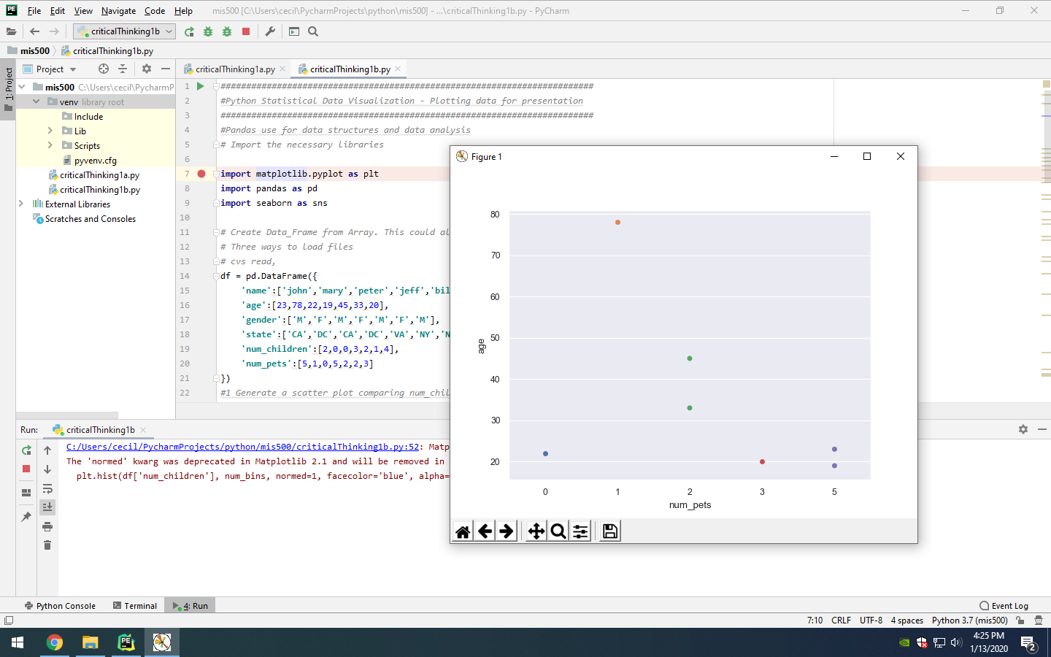
PyCharm EDU IDE
Figure 5 – Screenshot demonstrating some data visualization in Python with PyCharmEDU.
Notes:
The PyCharm interface has a code editor (script editor), as well as a project layout tab. The console or terminal output at the bottom shows the output where the code has been executed, any visualizations generated pop up in a new window with PyCharm. The debugging toolset is very robust in this console, allowing us to set breakpoints in our script for troubleshooting.

Slide 10
References
DataCamp. (2019, December 10). (Tutorial) KERAS Tutorial: DEEP LEARNING in PYTHON. Retrieved January 27, 2020, from https://www.datacamp.com/community/tutorials/deep-learning-python
Dietrich, D., Heller, B., & Yang, B. (2015). Data science & big data analytics: Discovering, analyzing, visualizing and presenting data.
SAS. (n.d.). SAS Studio. Retrieved January 27, 2020, from https://www.sas.com/en_us/software/studio.html
R Consortium. (n.d.). RStudio. Retrieved January 27, 2020, from https://rstudio.com/products/rstudio/
IntelliJ Netbeans. (n.d.). Get PyCharm EDU. Retrieved January 27, 2020, from https://www.jetbrains.com/education/download/#section=pycharm-edu

