Slide 1
Logistic regression
MIS 470 Critical Thinking Module 4
Cecil Kitch

Slide 2
Objectives
Survey of the built-in mtcars dataset (summary statistics)
Observe the relationship between transmission (am) and miles per gallon (mpg)
Create a scatter plot of am vs mpg, evaluate the suitability of linear regression
Using am and mpg, fit a logistic regression model using the glm() function
Write the estimated model
Given 16 mpg, how can you predict (classify) the transmission?

Slide 3
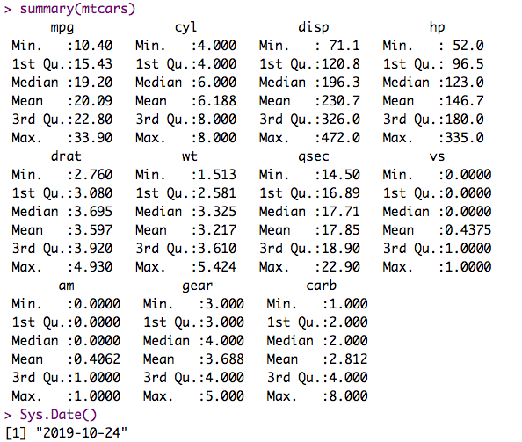
Summary mtcars
Notes:
Given the output of the summary, we see that the minimum mpg is 10.40, the maximum is 33.90, and the mean is 20.09 (mpg) respectively.
We also note here there are a lot of other variables but for this exercise we are really only concerned with the am variable.
It is is a binary or categorial variable, am Transmission (0 = automatic, 1 = manual).
The summary statistics don’t tell us much about transmission without transforming into into factors.

Slide 4
Strip Plot (Jitter)
Notes:
As you can see the vertical strip plot with jitter is a very elegant way of visualizing this data, particularly there is some overlap in values, and the jitter offset allows us to better see the overall number of values in the set. However, the strip plot in R is not provide the means for us to perform the linear regression.

Slide 5
Box Plot
Notes:
Since we are using a binary variable as a factor, we first us the as.factor() to convert, and use the levels() function to apply a label.
I found the box plot very useful to visual, as it allows us to succinctly observed that about seventy-five percent of cars in the data set with greater than 20mpg have manual transmission.
Conversely, only twenty-five percent of cars with automatic transmissions have greater than twenty miles per gallon.
This corresponds to the well known fact that manual transmissions have superior fuel economy, even though the data set is roughly forty years old. In addition the box plot was an excellent way to determine if there were any outlier, and there are none.

Slide 6
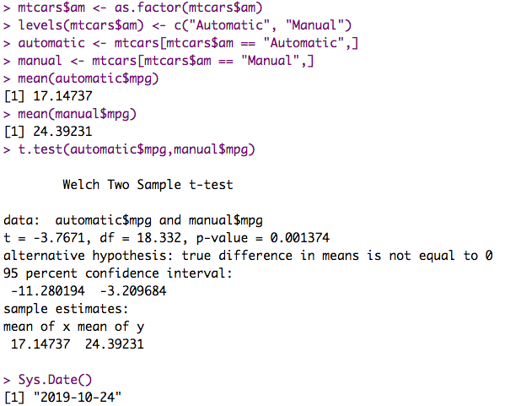
Hypothesis Testing
Notes:
We can also perform a sample t-test to compare the mpg of automatic and manual transmissions.
Null Hypothesis: The difference in mean MPG between automatic cars and manual cars is not significant.
Alternative Hypothesis: The difference in mean MPG between automatic and manual cars is significant.
Conclusion:
The outcome here is a p-value less than 0.05, so the null hypothesis is rejected. I liked this function, particularly because it generated the means for x and y, which I demonstrated above using mean(automatic$mpg) and mean(manual$mpg).
But we can get this output at the same time we run our t—test.
Not necessarily the point of this exercise but useful nonetheless.

Slide 7
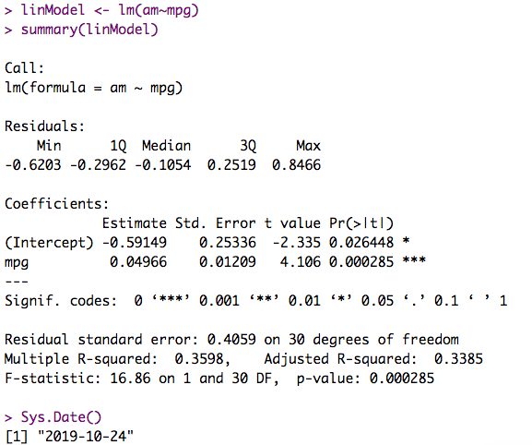
Linear Regression Model
Notes:
Using the linear regression model we learned in the previous module, we first plot the data and then generate then fit and plot the linear regression line.
We can also generate the summary statistics of our regression model so that we can examine the p-value.
Based on the output p-value, it is close to much closer to zero than one. We have a measure to see that this it is not really a good fit.
Evenly though we can visually look at this plot and line and say its not a good fit, we are actually able to quantify it using r-squared and the p-value.
In other words, even though we can use the the linear model, when trying to predict binary variable, the linear model is typically not the the best predictor.
Linear regression would be more useful applied to a categorical/binary variable if were trying to determine if the difference in mean mpg in automatic vs manual was significant.

Slide 8
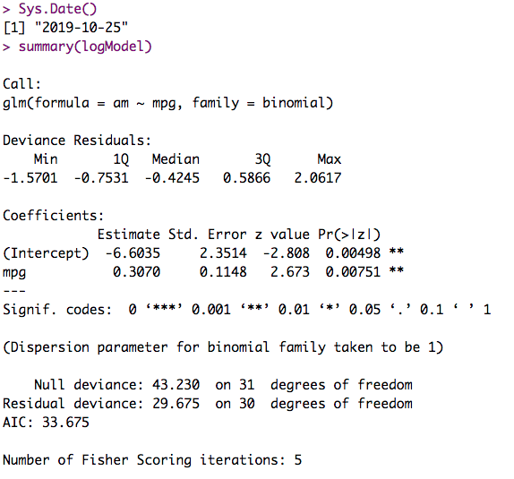
Logistic Regression Model
Notes:
When we plot the logistic regression model, we see that it is still not great, but it much closer in most cases is it a much better model for binary data.
Unlike in the linear model, don’t really have a number to quantify how great the fit is, but we do have the AIC (Aikake Information Criterion)
In practice, we should make several models looking at more than just the two variables and compare them, and we can compared the AIC output of those models.
If we had others models to compare to, in general we are looking for the AIC with the lowest values.

Slide 9


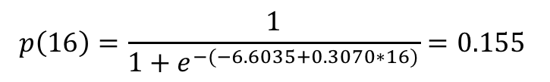
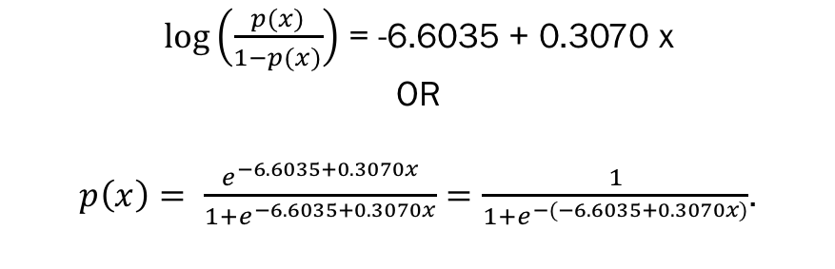
Prediction
$log⁡\left(\frac{p(x)}{1−p(x)}\right)$ = -6.6035 + 0.3070 x
OR
$p\left(x\right)= \frac{e^{−6.6035+0.3070x}}{1+e^{−6.6035+0.3070x}}=\frac{1}{1+e^{−(−6.6035+0.3070x)}}$.
So, if a car has 16 mpg, the estimated probability
of being automatic is :
$$p\left(16\right)=\frac{1}{1+e^{−(−6.6035+0.3070∗16)}}=0.155$$
Notes:
The results of predicting

Slide 10
References
Berrier, J., Nestler, S., Pardoe, I., Sturdivant, R., & Watts, K. (2018). ZyBook: Mis 470: Data Science Foundations. DSS - Interpreting Regression Output. (2007). Retrieved October 25, 2019, from https://dss.princeton.edu/online_help/analysis/interpreting_regression.htm.
Karimi, M. (2017, August 2). RPubs - Regression Models - MPG vs AM analysis for mtcars dataset. Retrieved October 25, 2019, from https://rpubs.com/mkarimi926/296145

