Slide 1
Predicting BEHAVIOR with Logistic regression
MIS 470 Critical Thinking Module 5
Cecil Kitch

Slide 2
Objectives
Import and Validate Dataset using R
Using R separate the dataset into training and testing sets
Fit a logistic regression model to the training set
Examine the fitted model to determine significant factors.
Explain the significant factors
Examine the fit / accuracy of the model
Predict behavior using logistic regression

Slide 3
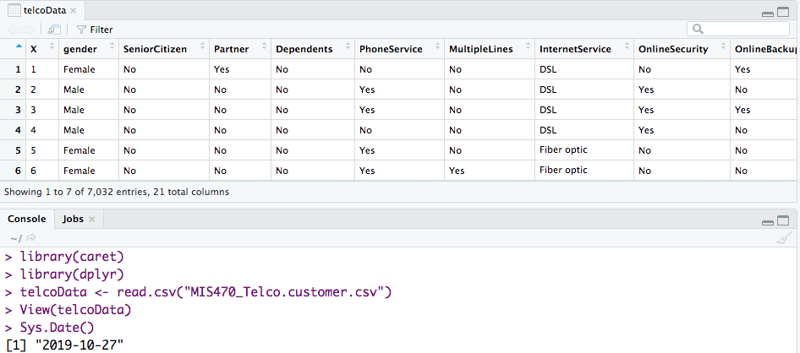
Import Data
Notes:
Read in our data from the csv using read.csv().
Viewing the data, we see that the first column X represents customer number, and is not relevant for analysis.

Slide 4
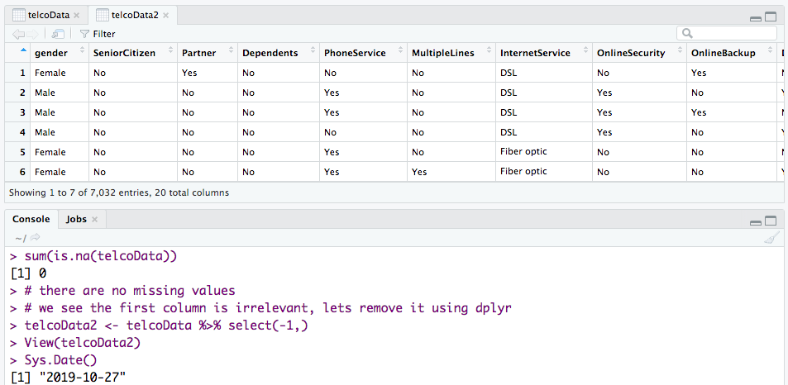
Validate/Sanitize
Notes:
I checked to see if there were any NA values, it seems our dataset was prepared for us, with those already removed.
If there had been any missing values we could have used na.omit(dt) to remove those rows.
Or we could have filled them using the mean or median values, analyst preference.
With a data set this large, I would consider it safe to simply remove them.
The first column (seen in the last slide, represented Customer Number) was not relevant, using the %>% select() function,
The “infix” operator (%>%) passes the telcoData into the select() function.
I could have equivalently said: telcoData2 <- select(telcoData, -1);
The select function is part of the dplyr package, and the infix operator is used heavily within it as well.
I removed and and created a new dataframe telcoData2.

Slide 5
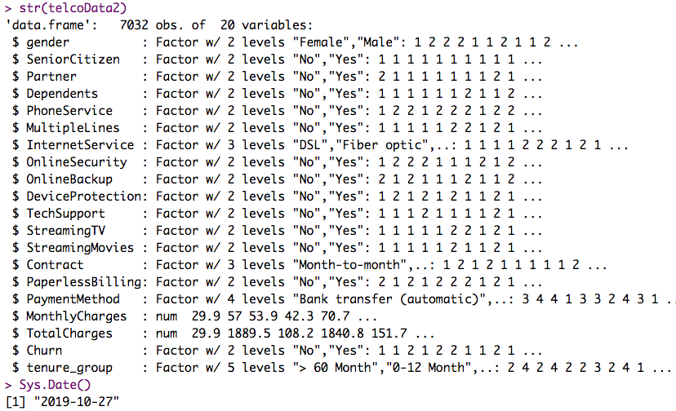
Structure of the Object
Notes:
Knowing this data set was already prepared for us, we trust but confirm.
Everything is already in a factor or numeric form.
Now lets look at a visualization of this on the next slide.

Slide 6
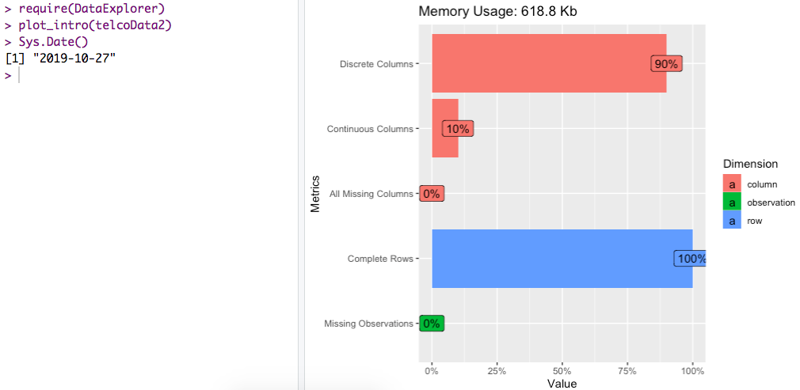
Visualization
Notes:
The DataExplorer package offers an easy way to visualize the state of our data
We see that 90% of the data is in the form discrete values, and 10% is continuous.
We already validated all of this and in the R output on the previous slides, but visualization is a powerful tool
And one of the great benefits of R is plotting.
Again, this is just confirmation that we understand the data we are working with.
https://rdrr.io/cran/DataExplorer/man/plot_intro.html

Slide 7
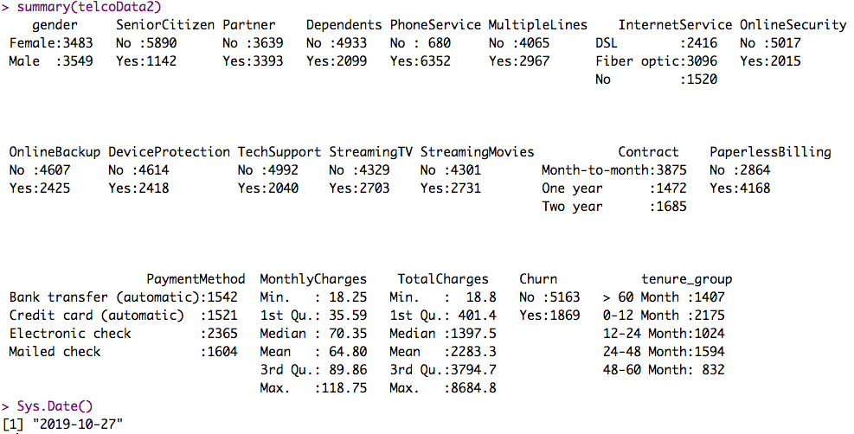
Summary
Notes:
Summary() output of the final dataset we are going to analyze.
Take a moment to look at the results, most of these are counts of the occurrences of discrete types as we would expect.
Although we do have the two continuous variables monthly charges and total charges.

Slide 8
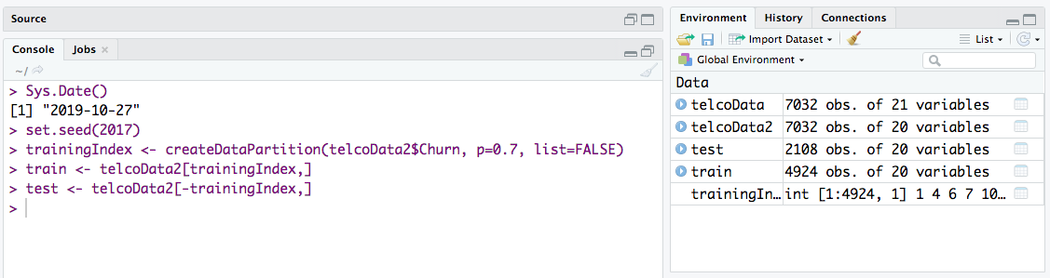
Partition (70/30)
Notes:
Using the above R code we split the data into training and testing.
This is because we want to use a portion of the data to train our model with,
And the another portion of the data to test our model.
So, here we end up with 4924 observations in our training set, and 2108 in our testing set.
The proportion is obtained by specifying p=some value, here we used 0.7 or 70%.
Further, we specified that we wanted to partition is it as balanced as possible on the factor “telcoData2$Churn”.
Then we created two additional data frames, one containing the 70% random sampling for training (trainingIndex).
The second is the testing dataset, or the remaining 30% after we subtracted the trainingIndex.

Slide 9
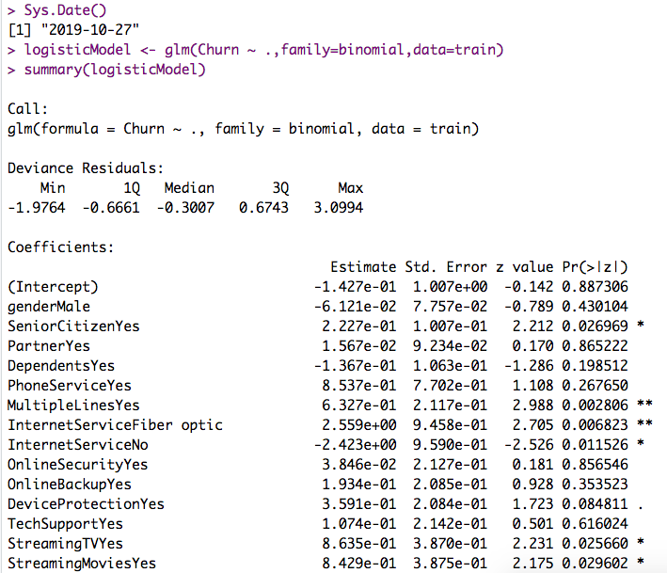
Logistic Regression Model
Notes:
R code used to generated the logistic model is the function glm() with parameters (formula, family, data)
The formula here is Churn regressed on all variables, in R we also often say that ~ can be read as “explained by”
Family binomial, in the given code for this example we have a (link=logit). I looked up this parameter and logit is the default when used on binomial. This means the estimates (coefficients of the predictors) are in units called logits.
The data set we are using is the training set, of course because we want to train our model with that part of the data,
So we can test it with the testing set.
This is continued on the next slide.

Slide 10
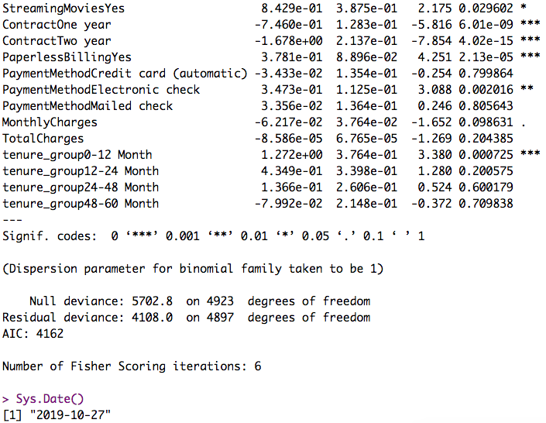
Logistic Regression Model (cont.)
Notes:
As you can see there is a lot of information here, but we are most concered with our coefficients and p values, as they relate to the significance codes.
The null deviance and residual deviance are also a measure of the fit.
The AIC is also used, when we have multiple models to compare them to one another, and help us select the best model.
I did run several different regressions, and found this one to have the lowest AIC.

Slide 11
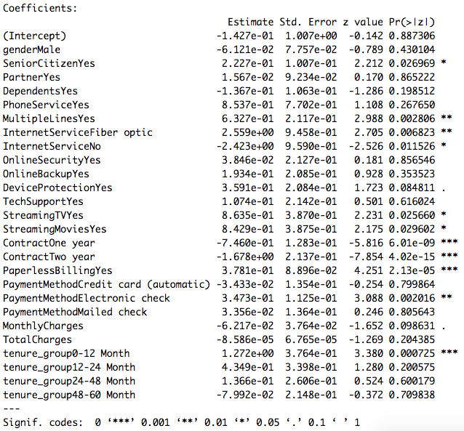






Which factors are significant?
Notes:
R has conveniently labeled those values which are beneath the significance levels with the asterisks.
So in this case we can say the most significant are those where the p value is less than the significance level.
Using the highlighting tool I have highlighted those values that are beneath the levels so we can easily scan the image.
Items highlighted in blue have a positive influence on churn, while items highlighted in red have a negative influence in churn.
Of all the factors here, contracts seem to have the greatest impact on preventing churn, and the longer the contract, the less likely the customer is to churn.
Which makes sense qualitatively, because people are often inclined to uphold their contract due to repercussions of breaking them.

Slide 12
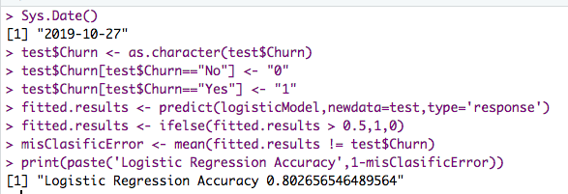
Accuracy: How good is the fit?
The model successfully predicted churn in 80% of the test data.
Notes:
We now can use our testing data in our model to make predictions, and compare those predictions to the actual values.
The above R code does the prediction calculation and compares those results against the real values, and then prints for us a basically the percentage.
What is does is first takes our Churn factor and converts it to a character, so we can replace those with 0 or 1 in order for it to work with the predict() function.
The we run store the results of our prediction, then we reformat it to binary values using the if-else (if prob > 0.5 then 1, else 0)
Then we find the mean where the predicted values do not equal the actual values.
I ran several iterations of models actually, removing some variables from the regression.
The model that regressed on all of the variables had the lowest AIC and the highest logistic regression accuracy output from this code.
I did not include this in the presentation as I felt it would have been unnecessary fluff, but you should try it yourself.
(I wrote these notes as if I were giving a presentation, not directed at the instructor here.)

Slide 13
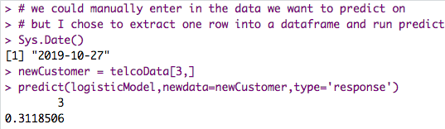
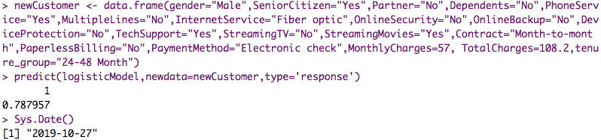
How can we use the R and the model to predict if a customer will churn?
Notes:
This predict function does the calculations for us, using our model and given new data.
In the first example, customer 3 from the original data set had a 31% probability of churn.
In the customer I built long hand with R, there was a 78% possibility of churn.

Slide 14
References
Berrier, J., Nestler, S., Pardoe, I., Sturdivant, R., & Watts, K. (2018). ZyBook: Mis 470: Data Science Foundations.
Lillis, D. (n.d.). Generalized Linear Models in R, Part 2: Understanding Model Fit in Logistic Regression Output - The Analysis Factor. Retrieved October 28, 2019, from https://www.theanalysisfactor.com/r-glm-model-fit/
Plot introduction. (2019, May 2). Retrieved October 27, 2019, from https://rdrr.io/cran/DataExplorer/man/plot_intro.html

