Slide 1
Bayes’ Theorem
600.465 - Intro to NLP - J. Eisner

Slide 2
Remember Language ID?
Let p(X) = probability of text X in English
Let q(X) = probability of text X in Polish
Which probability is higher?
  (we’d also like bias toward English since it’s more likely a priori – ignore that for now)
“Horses and Lukasiewicz are on the curriculum.”
p(x₁=h, x₂=o, x₃=r, x₄=s, x₅=e, x₆=s, …)
Pipil
Let’s revisit this
600.465 – Intro to NLP – J. Eisner

Slide 3
Bayes’ Theorem
p(A | B) = p(B | A) * p(A) / p(B)
Easy to check by removing syntactic sugar
Use 1: Converts p(B | A) to p(A | B)
Use 2: Updates p(A) to p(A | B)
Stare at it so you’ll recognize it later
600.465 - Intro to NLP - J. Eisner

Slide 4
Language ID
Given a sentence x, I suggested comparing its prob in different languages:
  p(SENT=x | LANG=english) (i.e., p_{english}(SENT=x))
  p(SENT=x | LANG=polish) (i.e., p_{polish}(SENT=x))
  p(SENT=x | LANG=xhosa) (i.e., p_{xhosa}(SENT=x))
But surely for language ID we should compare
  p(LANG=english | SENT=x)
  p(LANG=polish | SENT=x)
  p(LANG=xhosa | SENT=x)
After all, x is the evidence that we observed!
600.465 - Intro to NLP - J. Eisner

Slide 5
Language ID
For language ID we should compare
  p(LANG=english | SENT=x)
  p(LANG=polish | SENT=x)
  p(LANG=xhosa | SENT=x)
For ease, multiply by p(SENT=x) and compare
  p(LANG=english, SENT=x)
  p(LANG=polish, SENT=x)
  p(LANG=xhosa, SENT=x)
Must know prior probabilities; then rewrite as
  p(LANG=english) * p(SENT=x | LANG=english)
  p(LANG=polish) * p(SENT=x | LANG=polish)
  p(LANG=xhosa) * p(SENT=x | LANG=xhosa)
a posteriori
sum of these is a way to find p(SENT=x); can divide back by that to get posterior probs
a priori
likelihood (what we had above)
“likelihood of a theory” means “probability of the evidence according to the theory”
600.465 - Intro to NLP - J. Eisner

Slide 6
Let’s try it!
“First we pick a random LANG, then we roll a random SENT with the LANG dice.”
  p(LANG=english) *
  p(LANG=polish) *
  p(LANG=xhosa) *
best
0.7
  p(SENT=x | LANG=english)
  p(SENT=x | LANG=polish)
  p(SENT=x | LANG=xhosa)
0.00001
0.2
0.00004
0.1
0.00005
best
prior prob
likelihood
from a very simple model: a single die whose sides are the languages of the world
from a set of trigram dice (actually 3 sets, one per language)
=
=
=
0.000007
  p(LANG=english, SENT=x)
  p(LANG=polish, SENT=x)
  p(LANG=xhosa, SENT=x)
0.000008
best compromise
0.000005
joint probability
p(SENT=x)
total over all ways of getting SENT=x
probability of evidence
0.000020
600.465 - Intro to NLP - J. Eisner

Slide 7
Let’s try it!
“First we pick a random LANG, then we roll a random SENT with the LANG dice.”
=
=
=
0.000007
  p(LANG=english, SENT=x)
  p(LANG=polish, SENT=x)
  p(LANG=xhosa, SENT=x)
…
0.000008
best compromise
0.000005
joint probability
p(SENT=x)
total probability of getting SENT=x
one way or another!
add up
probability of evidence
0.000020
normalize
(divide by
a constant
so they’ll
sum to 1)
  p(LANG=english | SENT=x)
  p(LANG=polish | SENT=x)
  p(LANG=xhosa | SENT=x)
0.000007/0.000020 = 7/20
0.000008/0.000020 = 8/20
best
0.000005/0.000020 = 5/20
posterior probability
given the evidence SENT=x,
the possible languages sum to 1
600.465 - Intro to NLP - J. Eisner

Slide 8
General Case (“noisy channel”)
“noisy channel”
mess up a into b
“decoder”
a
b
p(A=a)
p(B=b | A=a)
most likely
reconstruction of a
language → text
text → speech
spelled → misspelled
English → French
maximize p(A=a | B=b)
= p(A=a) p(B=b | A=a) / (B=b)
= p(A=a) p(B=b | A=a)
/ Σ_{a’} p(A=a’) p(B=b | A=a’)
600.465 - Intro to NLP - J. Eisner

Slide 9
Language ID
For language ID we should compare
  p(LANG=english | SENT=x)
  p(LANG=polish | SENT=x)
  p(LANG=xhosa | SENT=x)
For ease, multiply by p(SENT=x) and compare
  p(LANG=english, SENT=x)
  p(LANG=polish, SENT=x)
  p(LANG=xhosa, SENT=x)
which we find as follows (we need prior probs!):
  p(LANG=english) * p(SENT=x | LANG=english)
  p(LANG=polish) * p(SENT=x | LANG=polish)
  p(LANG=xhosa) * p(SENT=x | LANG=xhosa)
a posteriori
a priori
likelihood
600.465 - Intro to NLP - J. Eisner

Slide 10
General Case (“noisy channel”)
Want most likely A to have generated evidence B
  p(A = a1 | B = b)
  p(A = a2 | B = b)
  p(A = a3 | B = b)
For ease, multiply by p(B=b) and compare
  p(A = a1, B = b)
  p(A = a2, B = b)
  p(A = a3, B = b)
which we find as follows (we need prior probs!):
  p(A = a1) * p(B = b | A = a1)
  p(A = a2) * p(B = b | A = a2)
  p(A = a3) * p(B = b | A = a3)
a posteriori
a priori
likelihood
600.465 - Intro to NLP - J. Eisner

Slide 11
Speech Recognition
For baby speech recognition we should compare
  p(MEANING=gimme | SOUND=uhh)
  p(MEANING=changeme | SOUND=uhh)
  p(MEANING=loveme | SOUND=uhh)
For ease, multiply by p(SOUND=uhh) & compare
  p(MEANING=gimme, SOUND=uhh)
  p(MEANING=changeme, SOUND=uhh)
  p(MEANING=loveme, SOUND=uhh)
which we find as follows (we need prior probs!):
  p(MEAN=gimme) * p(SOUND=uhh | MEAN=gimme)
  p(MEAN=changeme) * p(SOUND=uhh | MEAN=changeme)
  p(MEAN=loveme) * p(SOUND=uhh | MEAN=loveme)
a posteriori
a priori
likelihood
600.465 - Intro to NLP - J. Eisner

Slide 12
Life or Death
Does Epitaph have hoof-and-mouth disease?
He tested positive – oh no!
False positive rate only 5%
p(hoof) = 0.001 so p(¬hoof) = 0.999
p(positive test | ¬hoof) = 0.05 “false pos”
p(negative test | hoof) = x ≈ 0 “false neg”
so p(positive test | hoof) = 1-x ≈ 1
What is p(hoof | positive test)?
  don’t panic - still very small! Let’s work it out.
600.465 - Intro to NLP - J. Eisner

Slide 13
Odds Ratio
Relative probabilities of 2 things
  “5:2 odds in favor”
  ⬄ 5/7 probability it happens, 2/7 it doesn’t
  odds ratio p(yes)/p(no) = 5/2 = 2.5
  “3:1 odds against”
  ⬄ 3/4 probability it doesn’t happen, 1/4 it does
  odds ratio p(yes)/p(no) = 1/3 = 0.333
  Useful with Bayes’ Theorem
  p(LANG=english) / p(LANG=xhosa) = 0.7 / 0.1 = 7
600.465 - Intro to NLP - J. Eisner

Slide 14
Life or Death
Does Epitaph have hoof-and-mouth disease?
He tested positive – oh no!
False positive rate only 5%
Odds ratio in favor of hoof-and-mouth disease:
Bayes’ Theorem twice
p( hoof | pos)
p( hoof) ∙ p(pos | hoof) / p(pos)
=
p(¬hoof | pos)
p(¬hoof) ∙ p(pos | ¬hoof) / p(pos)
posterior
odds ratio
prior
odds ratio
likelihood
ratio
20
1
.001
1
1-x
20
<
<
=
<
1
999
50
.999
999
0.05
1
600.465 - Intro to NLP - J. Eisner

Slide 15
Life! (probably)
Does Epitaph have hoof-and-mouth disease?
He tested positive – oh no!
False positive rate only 5%
Odds ratio in favor of hoof-and-mouth disease:
p( hoof | pos)
1
So p( hoof | pos) < 1/51
p(¬hoof | pos) > 50/51
<
p(¬hoof | pos)
50
posterior
odds ratio
[Don’t euthanize the horse!]
20
1
<
<
999
50
600.465 - Intro to NLP - J. Eisner

Slide 16
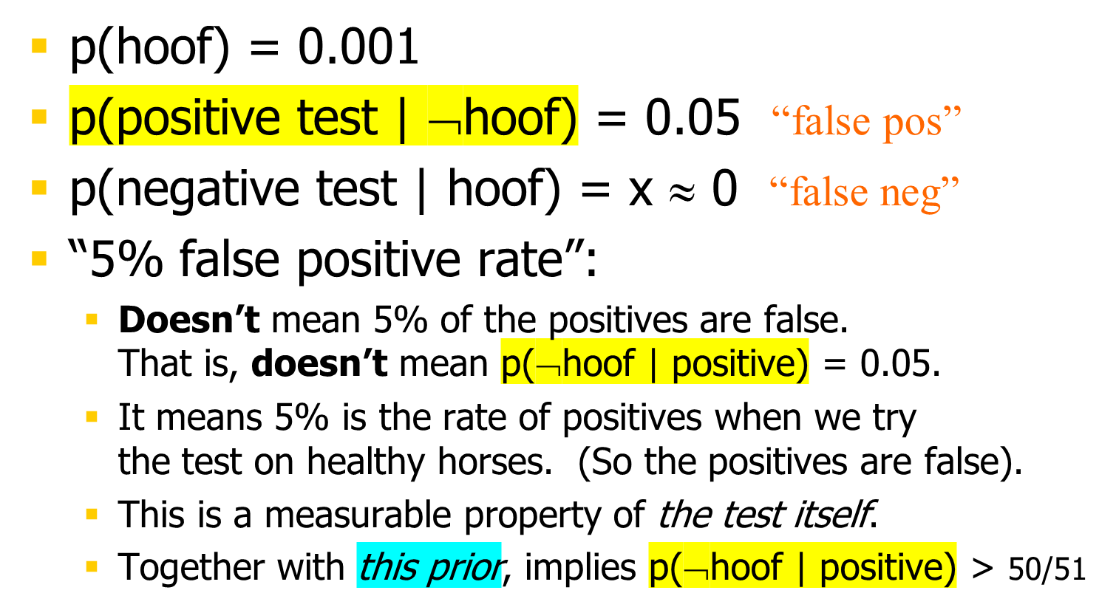
Life! (probably)
Does Epitaph have hoof-and-mouth disease?
He tested positive – oh no!
False positive rate only 5%
600.465 - Intro to NLP - J. Eisner

Slide 17
Odds Ratio for Language ID
  = ＊
  p(A=a1 | B=b) p(A=a1) p(B=b | A=a1)
  p(A=a2 | B=b) p(A=a2) p(B=b | A=a2)
posterior
odds ratio
prior
odds ratio
likelihood
odds ratio
  p(LANG=english)
  p(LANG=polish)
  p(LANG=xhosa)
0.7
  p(SENT=x | LANG=english)
  p(SENT=x | LANG=polish)
  p(SENT=x | LANG=xhosa)
0.00001
0.2
0.00004
0.1
0.00005
prior
likelihood
A priori, English is 7 times as probable as Xhosa (7:1 odds)
But likelihood of English is only 1/5 as large (1:5 odds)
So a posteriori, English now 7 ＊1/5 = 1.2 times as probable (7:5 odds)
  That is: p(English) = 7/something, p(Xhosa) = 5/something
600.465 - Intro to NLP - J. Eisner

Slide 18
Growing evidence eventually overwhelms the prior
Maybe we expected English text but actually it’s Polish
What happens as we read more & more words?
  The prior odds ratio (which favors English) stays the same
  But the likelihood odds ratio becomes extreme (much bigger or much smaller than 1, depending on which hypothesis is correct)
    Suppose each trigram is 1.001 times more probable under the Polish model than the English model
    Then after 700 trigrams, the likelihood ratio is > 2 in favor of Polish (1.001⁷⁰⁰ > 2)
    And after 7000 trigrams, the likelihood ratio is > 2¹⁰ in favor of Polish!
  Unless the prior p(Polish) = 0, eventually we come to believe it’s Polish a posteriori. We get surer and surer with more evidence.
600.465 - Intro to NLP - J. Eisner

Slide 19
Direct modeling vs. Bayes’ Theorem
For French-to-English translation, we want p(e | f).
If p(e,f) is the actual distribution of translation pairs,
then it is certainly true that
p(e | f) p(f) = p(e, f) = p(e) p(f | e)
We could build a direct model of p(e | f),
and train it on lots of bilingual text.
  Learn a model such that log p(e | f) is high for training pairs (e,f).
  Or just learn a function such that f ≈ translate(e) for training pairs.
  In either case, hope that this generalizes to test pairs (e,f).
600.465 - Intro to NLP - J. Eisner

Slide 20
Direct modeling vs. Bayes’ Theorem
For French-to-English translation, we want p(e | f).
If there really is a distribution p(e,f) over bilingual text,
then it is certainly true that
p(e | f) p(f) = p(e, f) = p(e) p(f | e)
So why build p(f | e) instead?
  Well, p(e | f) needed to know two things:
    Fluency: What does fluent English look like?
    Adequacy: How does English correspond to French?
  By using Bayes’ Theorem, we can modularize this
    There’s a lot more monolingual text available to train p(e)
    p(e) can have a relatively simple structure (e.g., n-gram model)
    p(f | e) can have another structure (translate and reorder words)
600.465 - Intro to NLP - J. Eisner

