Slide 1
EE307 Topic 1: Combinational logic review and Complementary MOSFET: CMOS
Complementary MOSFET: The first logic family (The first way to build gates from transistors)

Slide 2
Overview of topic 1
SOP, POS, KMaps or something to come up with a gate representation of a truth table.
Gate based schematics are “block diagrams” of what a circuit looks like but not directly what goes into silicon. The “blocks” are the gate symbols.
Transistors, resistors, capacitors, inductors and memristors are what actually goes into silicon.
SO: You need to convert gates to transistors, resistors, inductors, and/or capacitors if you actually want to make a chip.

Slide 3
Up-front comment
VHDL and Verilog don’t give you an optimized circuit
Big 3: Speed, area and power
To optimize a circuit you must design at transistor level
Steps to get optimized transistor level circuit:
Make truth table
Find gate level circuit (SOP, POS, Kmaps etc)
Design each gate in transistors
Step 1: Remember how to do SOP & POS

Slide 4
REVIEW: SOP & POS Logic Gates – Combinational logic
Things to know about every basic gate
Gate name
Truth Table
Symbol
Notation (how it looks in an equation)

Slide 5
Gate list:
AND (mathematical partner: A x B)
NOT/Inv (mathematical partner: -1 x A)
OR (mathematical partner: A + B)
XOR
NAND
NOR
XNOR
Buffer (mathematical partner: A)

Slide 6
Symbol (AND) and notation
AND Gate
Notation
A•B=OUT
A
OUT
Input |  | Output
A | B | OUT
0 | 0 | 0
0 | 1 | 0
1 | 0 | 0
1 | 1 | 1
B

Slide 7
Symbol (3-input AND) and notation
Input |  |  | Output
A | B | C | OUT
0 | 0 | 0 | 0
0 | 0 | 1 | 0
0 | 1 | 0 | 0
0 | 1 | 1 | 0
1 | 0 | 0 | 0
1 | 0 | 1 | 0
1 | 1 | 0 | 0
1 | 1 | 1 | 1
AND Gate
Notation
A•B•C=OUT
A
B
OUT
C

Slide 8

Symbol (XOR) and notation
XOR Gate (Exclusive OR gate)
Notation
A ≠ B (For a two-input XOR)
Input |  | Output
A | B | OUT
0 | 0 | 0
0 | 1 | 1
1 | 0 | 1
1 | 1 | 0
A
OUT
B

Slide 9
Symbol (Multi-input XOR)
Input |  |  | Output
A | B | C | OUT
0 | 0 | 0 | 0
0 | 0 | 1 | 1
0 | 1 | 0 | 1
0 | 1 | 1 | 0
1 | 0 | 0 | 1
1 | 0 | 1 | 0
1 | 1 | 0 | 0
1 | 1 | 1 | 1
XOR Gate (Exclusive OR
gate)
Notation
A B C=OUT
Meaning
An odd number of ones
A
B
OUT
C

Slide 10
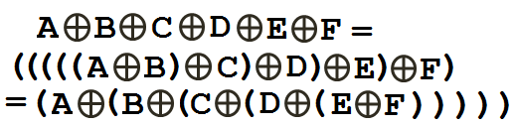
XOR
XOR is associative in nature
A
B
C
E
OUT
F
D

Slide 11
NAND gate : SOP
Change this table to a sentence:
(A • B) + (A • B) + (A • B)
= Output
Look at “1”s in Output column
and make sentence
Input |  | Output
A | B | TRUE?
0 | 0 | 1
0 | 1 | 1
1 | 0 | 1
1 | 1 | 0
Sum of products!!!!

Slide 12
SOP
Find 1s in output column
Look at the inputs
Find an equation ANDing inputs that equals 1 for only those inputs – this is called a “Minterm”:
“A product (ANDed) term in which each of the n variables appears once (in either its complemented or uncomplemented form) is called a minterm”.
Find all the 1s (outputs) and do steps 1-3 for each
OR all the minterms

Slide 13
Product of sums example
Make believe example. Nothing to do with NAND gate discussion
Product of sums:
Something like: (W+X)(Y+Z)
Look at “0”s. You want to find a sum for each row that gives the right output:
(A + B) (A + B)= Output
Input |  | Output
A | B | TRUE?
0 | 0 | 1
0 | 1 | 0
1 | 0 | 1
1 | 1 | 0

Slide 14
POS
Find 0s in output column
Look at the inputs
Find an equation ORing inputs that equals 0 for only those inputs – this is called a “Maxterm”:
“A sum term in which each of the n variables appears once (in either its complemented or uncomplemented form) is called a maxterm.”.
Find all the 0s (outputs) and do steps 1-3
AND all the maxterms

Slide 15
Practice: Which is for SOP? Why?
SOP practice
POS practice
Input |  |  | Output
A | B | C | OUT
0 | 0 | 0 | 0
0 | 0 | 1 | 1
0 | 1 | 0 | 0
0 | 1 | 1 | 0
1 | 0 | 0 | 1
1 | 0 | 1 | 0
1 | 1 | 0 | 0
1 | 1 | 1 | 1
Input |  |  | Output
A | B | C | OUT
0 | 0 | 0 | 1
0 | 0 | 1 | 1
0 | 1 | 0 | 1
0 | 1 | 1 | 1
1 | 0 | 0 | 1
1 | 0 | 1 | 0
1 | 1 | 0 | 0
1 | 1 | 1 | 0

Slide 16
Truth table
A | B | C | D | Z
0 | 0 | 0 | 0 | 1
0 | 0 | 0 | 1 | 0
0 | 0 | 1 | 0 | 1
0 | 0 | 1 | 1 | 0
0 | 1 | 0 | 0 | 0
0 | 1 | 0 | 1 | 1
0 | 1 | 1 | 0 | 1
0 | 1 | 1 | 1 | 0
1 | 0 | 0 | 0 | 0
1 | 0 | 0 | 1 | 0
1 | 0 | 1 | 0 | 1
1 | 0 | 1 | 1 | 1
1 | 1 | 0 | 0 | 0
1 | 1 | 0 | 1 | 1
1 | 1 | 1 | 0 | 1
1 | 1 | 1 | 1 | 1

Slide 17
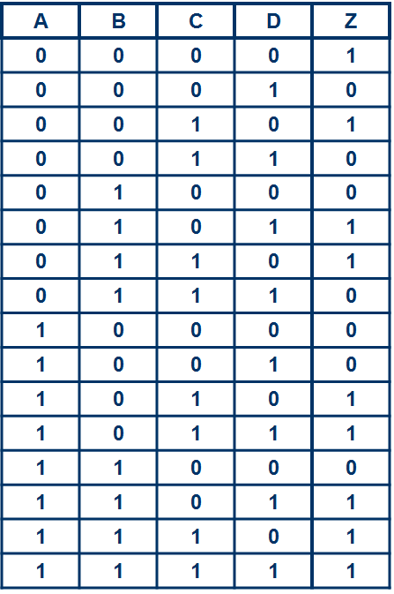
Kmap - SOP
CD\AB | 00 | 01 | 11 | 10
00 | 1 | 0 | 0 | 0
01 | 0 | 1 | 1 | 0
11 | 0 | 0 | 1 | 1
10 | 1 | 1 | 1 | 1

Slide 18
Kmap - POS
CD\AB | 00 | 01 | 11 | 10
00 | 1 | 0 | 0 | 0
01 | 0 | 1 | 1 | 0
11 | 0 | 0 | 1 | 1
10 | 1 | 1 | 1 | 1

Slide 19
Logic Families

Slide 20
Logic families
Logic families
Static Logic
Adiabatic Logic
Current steering Logic
Clocked Logic
Pass transistor Logic
Ratioed Logic
Probability based Logic
CMOS
Slow,
Low power
Not used much now,
Power sucking,
Larger,
Complicated,
R2R
New family, Usually R2R
Newly popular,
Larger,
Not R2R
Can be:
Fast,
Low power, Can do non-inverting
Not R2R,
Older family,
Many styles
Can pass analog values too,
Simple,
Can be:
Small, Fast,
R2R,
Can do non-inverting
Most popular, Rail to rail,
Robust,
Pretty fast,
Easy to design with…
And others….

Slide 21
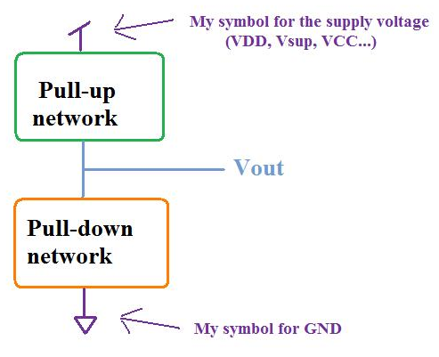
Complementary MOSFET
Basics:
“Static” logic family = low impedance path to VDD or GND to Vout
Low Z path to VDD
When you want Vout=High
Low Z path to GND
When you want Vout=Low
Two circuits:
Pull-up Network to pull Vout High
Pull-down Network to pull Vout Low

Slide 22
How to design PU and PD networks
We’ll start with a logic equation and make the circuits from there.
So all the combinational logic design steps through generating logic equations have come before we can do what we will do today.

Slide 23
How CMOS works

Slide 24
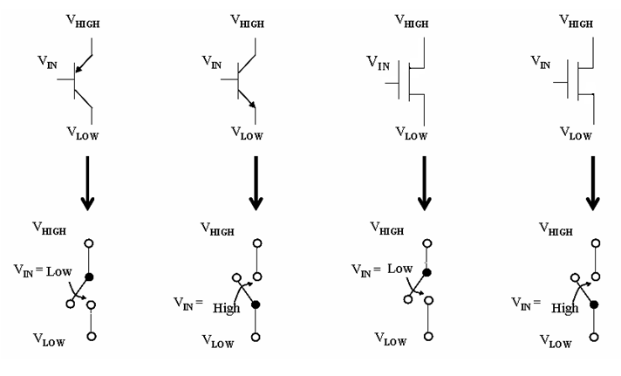
Transistors can be treated as switches
Bipolar Transistors
MOSFET* Transistors
PMOS: (pnp)
NMOS: (npn)
pnp
npn
E
C
S
D
B
G
B
G
B
B
C
E
D
S
E: Emitter
C: Collector
B: Base
S: Source
D: Drain
G: Gate
B: Bulk
*metal–oxide–semiconductor field-effect transistor

Slide 25


Two types of switches: Type 1
V_{DD}
V_{DD}
PMOS
or
pnp
V_{IN}
This node is pulled up to V_{DD}
V_{IN}
Low
V_{DD}
V_{LOW}
This node is pulled up to V_{DD}
V_{IN}
This node is pulled up to V_{DD}
Better for pulling values up
Conducts when Vin is low

Slide 26


Two types of switches: Type 2
This node is pulled down to GND
This node is pulled down to GND
V_{IN}
V_{IN}
GND
High
This node is pulled down to GND
V_{IN}
GND
Better for pulling values down
GND
Conducts when Vin is high

Slide 27

Why NMOS can’t pull voltage up
3.3V
Say… 3.3V supply and VT=0.6V
VDS=VD – VS
We’ll raise VS and watch current
Voltage at VS only changes when current flows
We’ll hold VG and VD constant at 3.3V
VGS > VT for the transistor to conduct
D
3.3V
G
S
IDS
VS
0 0.5 1.0 1.5 2.0 2.5 3.0 3.3

Slide 28
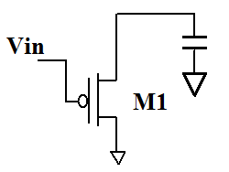
Why PMOS can’t pull voltage down
VDD
Say… 3.5V supply and VT=0.8V
Vout=VDD
Then change Vin from VDD to GND
S
G
IDS
VSG
(Vout)
3.5 3.0 2.5 2.0 1.5 1.0 0.5

Slide 29
Pull up and pull down networks
Pull-up network:
pnp or PMOS
(Because it has to be able to pull up Vout to VDD)
Pull-down network:
npn or NMOS
(Because it has to be able to pull down Vout to GND)

Slide 30
First example: Inverter
First draw truth table:
First try at circuit: (Next slide)
INPUT | OUTPUT
Vin | Vout
0 | 1
1 | 0

Slide 31
Inverter using switches
V_{SUP} or
Logic 1
V_{HIGH}
V_{IN}
Low
Input | TRUE?
A | OUT
0 | 1
1 | 0
This node is pulled up to V_{HIGH}
A
Low
V_{LOW}
OUT
A
V_{HIGH}
This node is pulled down to V_{LOW}
A
High
V_{IN}
High
GND or
Logic 0
V_{LOW}

Slide 32
Inverter using transistors
This node is pulled down to GND
V_{SUP} or
Logic 1
V_{IN}
A
GND
Low
OUT
This node is pulled down to GND
A
V_{IN}
A
High
GND or
Logic 0
GND

Slide 33
Inverter using transistors
V_{DD}
V_{SUP} or
Logic 1
V_{IN}
This node is pulled up to V_{DD}
A
Low
OUT
V_{DD}
A
V_{IN}
A
This node is pulled up to V_{DD}
GND or
Logic 0

Slide 34
MOSFETs vs BJTs for inverters
You can build an inverter using MOSFETs or BJTs BUT:
MOSFETs are easier to automate and design with because I_{gate}=0 whereas I_{base} ≠0.
Power
Loading
MOSFETs are easier to fabricate (= cheaper)
MOSFETs give more options for low voltage design.
We’ll use CMOS=MOSFETs

Slide 35
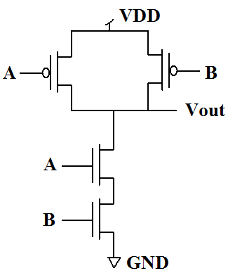
NAND gate Built with Switches
(A • B) + (A • B) + (A • B) = Output
Input |  | Output
A | B | TRUE?
0 | 0 | 1
0 | 1 | 1
1 | 0 | 1
1 | 1 | 0
VSUP
VSUP
A
0
B
0
A
1
B
1
GND

Slide 36
Rules for implementing (complex) logic equation in transistors (CMOS) (1/5)
Step 1: Try to get an equation with a bar all the way across the equation
Good:
The bar covers the entire equation
Not good (1):
The bar isn’t continuous
Not good (2):
Though there’s a bar across entire equation, internally, there’s a bar across more than one input

Slide 37
Example….
A | B | C | Out
0 | 0 | 0 | 0
0 | 0 | 1 | 0
0 | 1 | 0 | 1
0 | 1 | 1 | 0
1 | 0 | 0 | 1
1 | 0 | 1 | 0
1 | 1 | 0 | 1
1 | 1 | 1 | 0
C\AB | 00 | 01 | 11 | 10
0 | 0 | 1 | 1 | 1
1 | 0 | 0 | 0 | 0

Slide 38
Example: Getting single bar across entire equation
Let’s take this equation:
First negate entire equation twice:
Keep top bar but “DeMorgan” inside:
Not done because of internal bar across more than one input. “DeMorgan” again:

Slide 39
What we have at this point
You have an equation with a bar over the whole thing:
You know that the order of operations say you do the AND before the OR.
You know the inputs to your circuit:
This means that A and B must be inverted (put through an inverter) before they are used by this circuit. C is not inverted so OK as is.

Slide 40
Black box picture of circuit
Final equation and its inputs:

Slide 41
Practice:
If the equation is:
What is the converted equation?
What are the inputs?
.

Slide 42
Rules for implementing (complex) logic equation in transistors (CMOS) (2/5)
Creating pull-down network:
Use NMOS (conduct-on-high switches)
Take equation under bar.
So if equation is:
The equation you want is: (Just remove top bar)
>> Continued on next slide

Slide 43
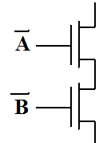
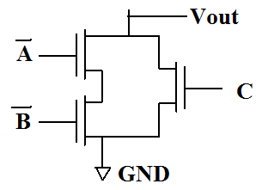
Rules for implementing (complex) logic equation in transistors (CMOS) (3/5)
Creating pull-down network:
In pulldown network, ANDs are in series and ORs are in parallel. (Assume inputs are given even if they are negated)
are ANDed so they go in series:
so it goes in parallel:

Slide 44
Checking pulldown network (1/2)
The equation we are trying to implement probably came from a truth table but we started with an equation. We need the truth table to be able to check our circuit. Here’s the original equation:
A | B | C | Out
0 | 0 | 0 | 0
0 | 0 | 1 | 0
0 | 1 | 0 | 1
0 | 1 | 1 | 0
1 | 0 | 0 | 1
1 | 0 | 1 | 0
1 | 1 | 0 | 1
1 | 1 | 1 | 0

Slide 45
Checking pulldown network (2/2)
This must pulldown for Vout=0 and open circuit for Vout=1.
A | B | C | Out
0 | 0 | 0 | 0
0 | 0 | 1 | 0
0 | 1 | 0 | 1
0 | 1 | 1 | 0
1 | 0 | 0 | 1
1 | 0 | 1 | 0
1 | 1 | 0 | 1
1 | 1 | 1 | 0

Slide 46
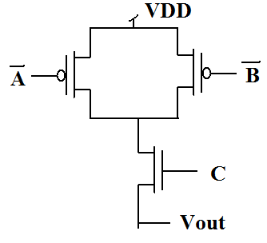
Rules for implementing (complex) logic equation in transistors (CMOS) (4/5)
Creating pull-up network:
Use PMOS (conduct-on-low switches)
Anything that was in parallel in the pulldown network is now in series.
Anything that was in series in the pulldown network is now in parallel.

Slide 47
Checking pull-up network
This must pull up for Vout=1 and open circuit for Vout=0.
A | B | C | Out
0 | 0 | 0 | 0
0 | 0 | 1 | 0
0 | 1 | 0 | 1
0 | 1 | 1 | 0
1 | 0 | 0 | 1
1 | 0 | 1 | 0
1 | 1 | 0 | 1
1 | 1 | 1 | 0

Slide 48
Summary so far
Find equation from truth table
KMaps are good because simpler equations are simpler to implement
Manipulate equation so it has a bar over entire equation
Create pulldown network from equation under bar
AND is series
OR is parallel
Open circuit when output is high
Short circuit when output is low
Create pullup network
AND is parallel
OR is series
Open circuit when output is high
Short circuit when output is low

Slide 49
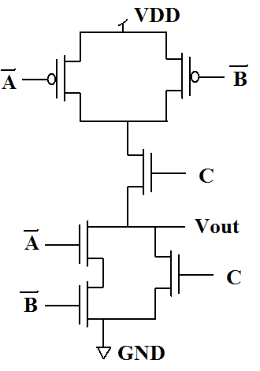
Rules for implementing (complex) logic equation in transistors (CMOS) (5/5)
Final design:

Slide 50
Final things to note
We’ve ignored details:
Larger transistors = More current = faster transitions
Increase in current = Increase in power
Region of operation = Affects current
Larger transistors = More capacitance = slower transitions
Stacking transistors increases delay exponentially
We’ll continue to practice design but next we’ll delve into these details for the next week

Slide 51
More notes on CMOS
Transistors are naturally inverting. They like NAND, NOR and inverters.
If you want to implement a non-inverting circuit like an AND or OR, you need to implement a NAND or NOR and then put the NAND or NOR output through an inverter or use inverted inputs.
The pull-up network can be found from the original equation but inputs must be inverted. If you are interested in creating the pull-up network this way, figure out the rules yourself.

Slide 52
Practice
Implement a half-adder summing circuit
Implement a half-adder carry circuit
XNOR

Slide 53
Answers to practice problems
Problem 1: ➔ On homework so all yours
Problem 2: AND
Change the equation to get a bar over the entire equation:
That tells you that the inputs to the PU and PD networks are and .
The logic for the PD network is:

Slide 54
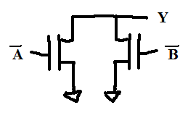
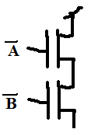
Answers to practice problems
Problem 2 continued:
PD network for . It’s an OR so the transistors go in parallel (AND is in series, OR is in parallel):
PU network puts anything that was in parallel in the PD network in series and anything that was in series in parallel:

Slide 55
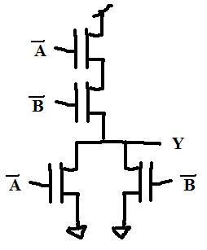
Answers to practice problems
Problem 2 continued:
Complete circuit
Note that the inputs are inverted. That means you need some inverters before this circuit. NAND and NOR are inverting and their inputs don’t need to be inverted. Non-inverting circuits will need extra circuitry around them. Either an inverter on the output or inverters on the inputs. Naturally inverting circuits like NAND, NOR and INV won’t.

Slide 56
Answers to practice problems
Problem 3: Implement a half-adder summing circuit ➔ On homework…
Problem 4: Implement a half-adder carry circuit ➔ On homework…
Problem 5: XNOR
Already has a bar across the top so it’s in the form we need to design PD and PU networks.

Slide 57
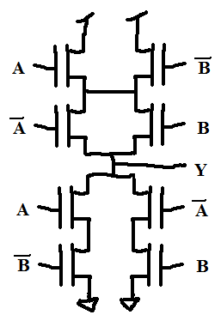
Answers to practice problems
Problem 5 continued:

Slide 58
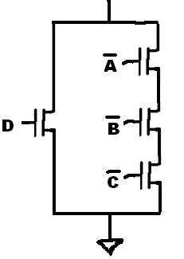

Practice Problem 6:
Pulldown network
From the equation, look for ANDs and ORs:
ORs translate into parallel transistors
ANDs translate into serial transistors

Slide 59
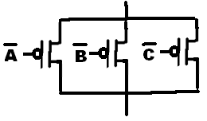
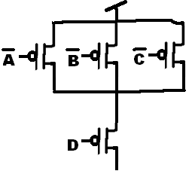
Practice (CMOS)
Pullup network

Slide 60
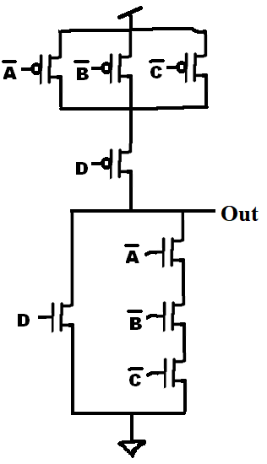
Practice (CMOS)
Step 6: Put PU network together with PD network:

Slide 61
EXTRA SLIDES

Slide 62
AND gate Built with Switches
(A • B) + (A • B) + (A • B) = Output
Input |  | Output
A | B | TRUE?
0 | 0 | 0
0 | 1 | 0
1 | 0 | 0
1 | 1 | 1
VSUP
VSUP
VSUP
A
0
B
0
0
VOUT
1
1
A
GND
B
1
GND

Slide 63
XNOR gate Built with Switches
VSUP
VSUP
Input |  | Output
A | B | OUT
0 | 0 | 1
0 | 1 | 0
1 | 0 | 0
1 | 1 | 1
A
0
A
0
B
0
B
0
OUT
A
1
A
1
B
B
1
1

