Slide 1
EE307 Topic 3: Elmore Delay

Slide 2
Overview of topic 3
Another technique to calculate delay in situations where circuit is complicated RC network

Slide 3
Interconnect Modeling
Slight change of topic (we’ll return to circuits in a few slides)

Slide 4
Model 1: Schematic wire
Ideal…..

Slide 5
Modeling
Just as we could calculate the resistance of an ON transistor in multiple ways (all of which gave different answers), we can model wires in different ways…

Slide 6
Model 2: The Lumped C Model
If R is small, f small-ish, R and L can be ignored
Simply one more source of loading

Slide 7
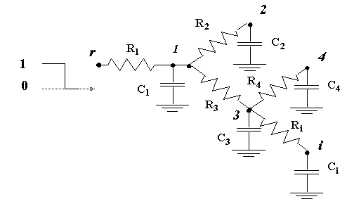
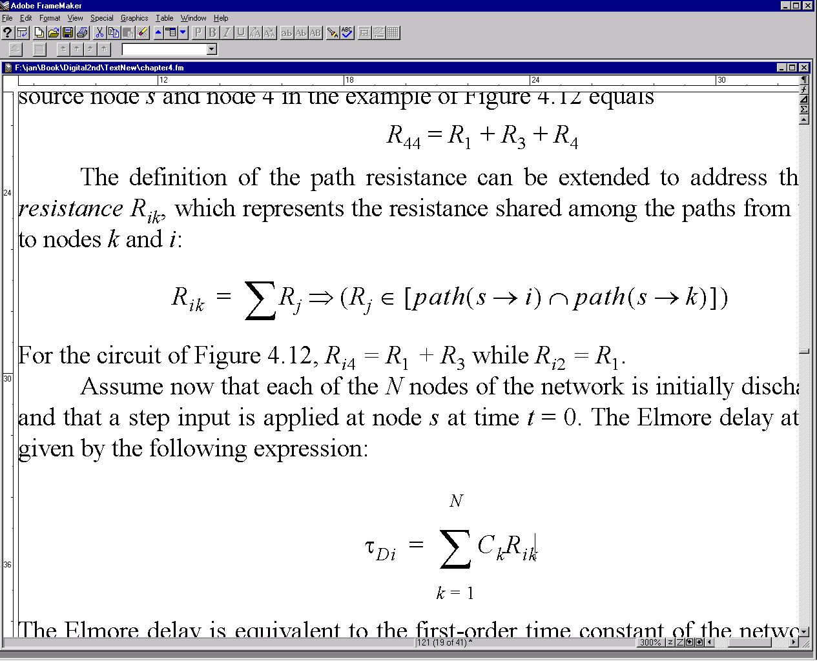
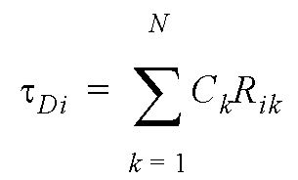
Model 3: The Elmore Delay algorithm
As wire gets longer, this method gets less accurate.
Lumps into single R and C.

Slide 8


Elmore delay example

Slide 9
Sum of 1 to N

Slide 10
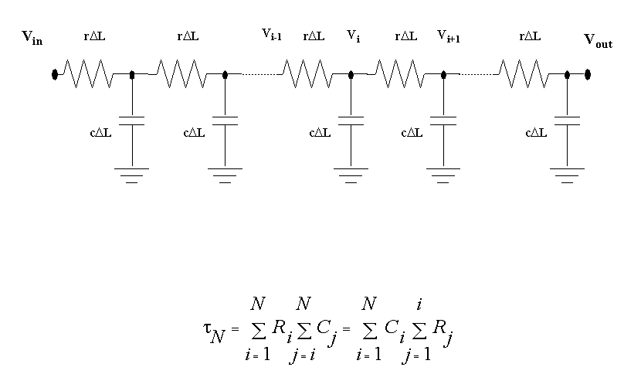
The Elmore Delay RC Chain

Slide 11
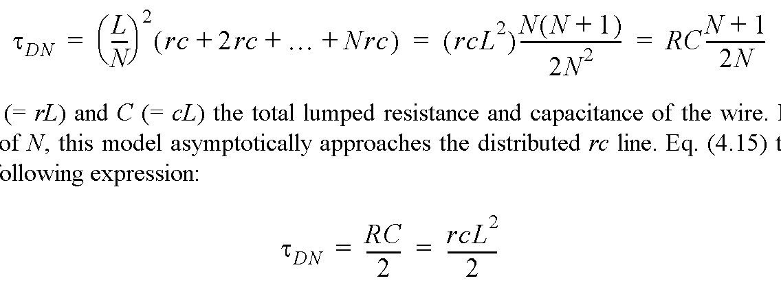
Wire Model
Assume: Wire modeled by N equal-length segments
For large values of N:

Slide 12
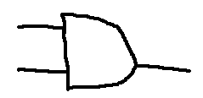
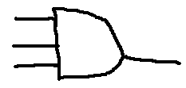
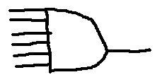
Using Elmore to find Fan-in delay
Fan-in is the number of inputs to a gate
Fan in of 2
Fan in of 3
Fan in of 6

Slide 13

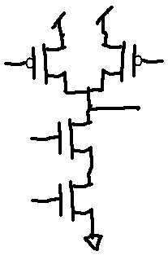
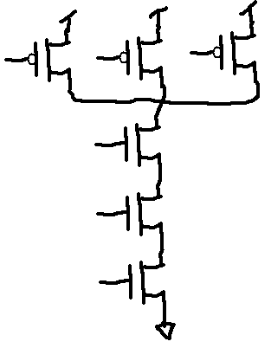
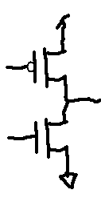
Fan-in circuit
Fan-n of 1 Fan-in of 2 Fan-in of 3

Slide 14
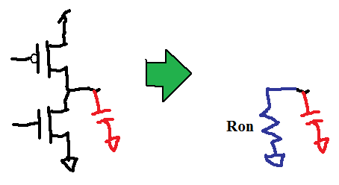

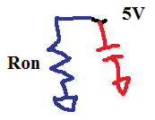
Elmore analysis of fan-in 1 circuit
Vin 0 → 1 transition

Slide 15
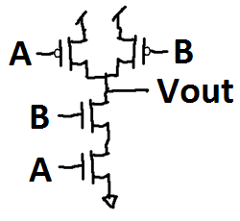
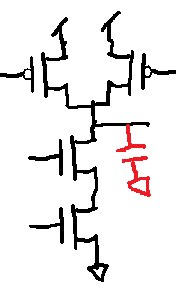
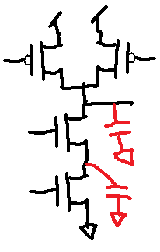
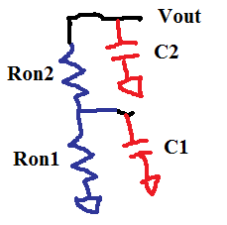
Elmore analysis of fan-in 2 circuit
A=0 and B=1 to A: 0 → 1 transition

Slide 16
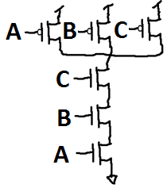
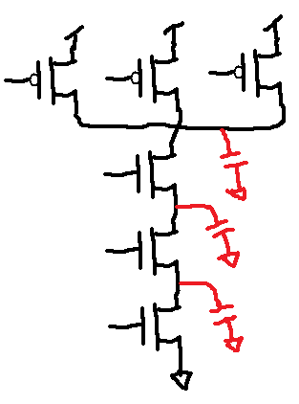
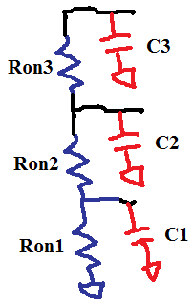
Elmore analysis of fan-in 3 circuit
A=0 and B=C=1. Then A: 0 → 1 transition

Slide 17
As fan-in increases
Fan-in of 1
Fan-in of 2
Fan-in of 3
Let’s make the math easier and assume that the Rs and Cs are all the same:

Slide 18
Delay increases “exponentially”
22
20
18
16
14
12
10
8
6
4
2
 | 1 | 2 | 3 | 4 | 5 | 6 | 7 | 8 | 9 | 10 | 11 | 12 | 13

Slide 19
Delay increases “exponentially”

Slide 20
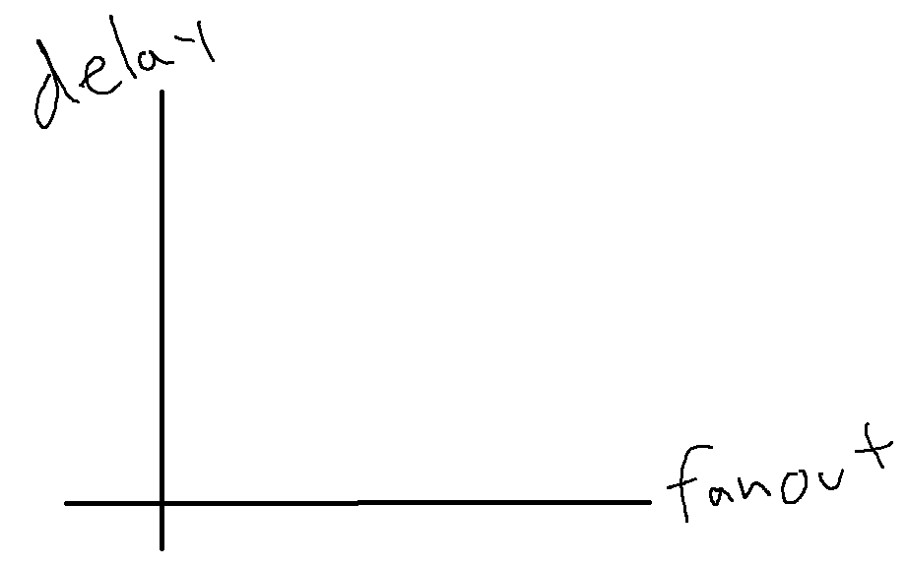
What about fan-out?
You have the driving circuit’s R_{drive}
You have the driving circuit’s C_{drive} plus the driven circuit’s C_{driven}
If no fan-out, Ƭ=R_{drive}C_{drive}
If fan-out=1, Ƭ=R_{drive}(C_{drive}+C_{driven})
If fan-out=2, Ƭ=R_{drive}(C_{drive}+2C_{driven})
If fan-out=3, Ƭ=R_{drive}(C_{drive}+3C_{driven})

Slide 21
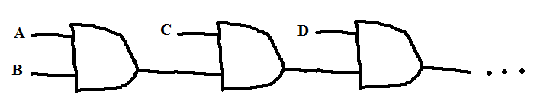
One more scenario
Verses a fan-in of four AND gate
Cacscaded 2-input AND gate will have a delay of: 3RC + 3RC + 3RC = 9RC
A 4-input AND gate would have a delay of 10RC
For 5-input: 12RC vs 15RC
For 6-input: 15RC vs 20RC
For 7-input: 18RC vs 26RC

Slide 22
One more scenario
Verses a fan-in of four AND
This will have a delay of:
3RC + tdg + 3RC + tdg + 3RC
A 4-input AND gate would have a delay of 10RC
For 5-input: 12RC+3tdq vs 15RC
For 6-input: 15RC+4tdq vs 20RC
For 7-input: 18RC+5tdq vs 26RC

Slide 23
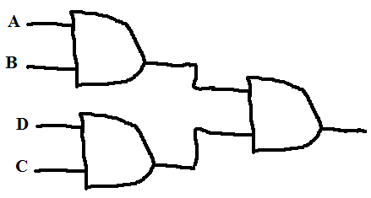
An aside
4-input AND:
3RC+3RC → New configuration (Parallel, tree)
9RC → 2-input gates cascaded
10RC → 4-input AND gate
8-input AND:
9RC → New configuration (Parallel, tree)
21RC → 2-input gates cascaded
36RC → 8-input AND gate

Slide 24
An aside
3RC+tdq+3RC → New configuration
Vs 9RC+2tdq → 2-input gates cascaded
Vs
NOT FINISHED…

Slide 25
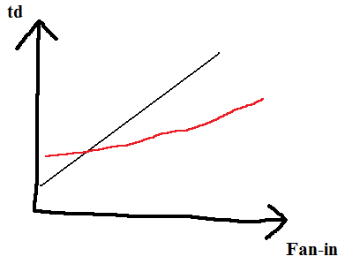
Summary: Fan-in
Fan-in increases delay exponentially
Solution? After a certain number of inputs, smaller ANDs cascaded will be faster

Slide 26
# of RC
Single gate, large fan-in
2-input, cascaded
2-input, parallel & cascaded
# of inputs

Slide 27
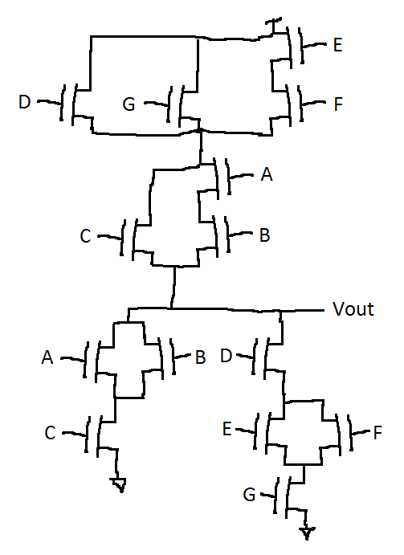
Using Elmore delay on complex gates (1/)
Add caps at all nodes
Name them

Slide 28
Using Elmore delay on complex gates (1/8)
C6
Add caps at all nodes
Name them
C5
C4
CL
C3
C1
C2

Slide 29
Using Elmore delay on complex gates (2/8)
Get inputs:
For this example:
A=1
B=C=F=0
D=E=G=1
Replace transistors with open circuits or Ron and leave node capacitances.
C6
C5
C4
CL
C3
C1
C2

Slide 30







Using Elmore delay on complex gates (3/8)
Get inputs:
For this example:
A=1
B=C=F=0
D=E=G=1
Replace transistors with open circuits or Ron
Leave node capacitances.
C6
C5
C4
CL
C3
C1
C2

Slide 31
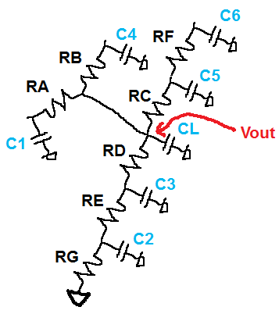
Using Elmore delay on complex gates (4/8)
Find node voltages
0
C6
0
C5
C4
0
0
CL
0
0
C3
C1
0
C2

Slide 32
That was just practice….
What you care about is what happens on a transition. You want to know how long it takes to change.
So here comes the transition:

Slide 33
Using Elmore delay on complex gates (5/8)
Change inputs:
Initial inputs:
G=1
B=C=F=0
D=E=A=1
➔Zeroed all nodes
New inputs:
G=0
B=C=F=0
D=E=A=1
➔Will ”High”s all nodes
C6
0
C5
C4
0
0
0
CL
0
C3
0
C1
C2
0

Slide 34

Using Elmore delay on complex gates (6/8)
New inputs:
G=0
B=C=F=0
D=E=A=1
Replace transistors with open circuits or Ron
Leave node capacitances.
C6
C5
C4
CL
C3
C1
C2

Slide 35
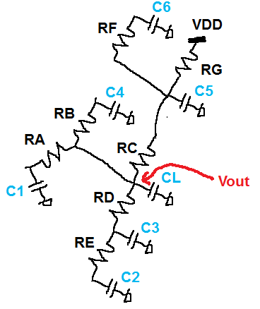
Using Elmore delay on complex gates (7/8)
C6
C5
C4
CL
C3
C1
C2

Slide 36
Elmore delay (8/8)

Slide 37
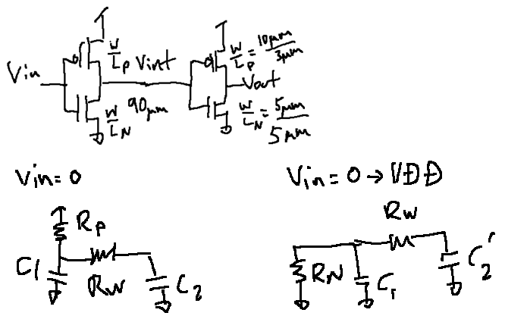
Problem from Topic 2:
Vint=VDD
Vin=0
VDD=0
Rwire=10Ω/sq
Rwidth=2µm

Slide 38
Delay
C1=12.476fF+9.438fF=21.914fF
RN = 6V / 1mA = 6KΩ
RW=(10Ω/sq)(L/W)=(10Ω/sq)(10µm/2µm)=50Ω

Slide 39
C2=644.128fF+485.83fF=1129.958fF

Slide 40
Delay
C1=12.476fF+9.438fF=21.914fF
RN = 6V / 1mA = 6KΩ
RW=(10Ω/sq)(L/W)=(10Ω/sq)(10µm/2µm)=50Ω
C2=1129.958fF

Slide 41
C1=12.476fF+9.438fF=21.914fF
RN = 6V / 1mA = 6KΩ
RW=(10Ω/sq)(L/W)=(10Ω/sq)(10µm/2µm)=50Ω
C2=1129.958fF

