Slide 1
ECL
W2018: EE307

Slide 2
Official Naming
ECL:
  VDD (supply) is GND
  VSS (lowest V) is something negative
  Idea: Noise will be put on negative rail instead of GND
PECL
  VDD (supply) is positive
  VSS (lowest V) is GND
  Idea: Easier to implement
W2018: EE307

Slide 3
Advantages and disadvantages
Advantages:
  Smaller swing = faster
  Robust against noise (differential)
  Keeps supplies quiet (constant current)
  Lower power for high α_{0→1}
Disadvantages:
  More transistors
  Smaller noise margins
  Not rail to rail so R and transistor size matters
  Constant current
W2018: EE307

Slide 4
More circuit details
Analog: “Differential pair”
Digital: “ECL” (BJT), “PECL” (BJT) or MCML (MOSFET)
Same circuit but, again, it’s whether you look at the part of the VTC that is changing (analog) or when the VTC is high or low (digital)
The following slides are stolen from my EE308 class which is analog.
W2018: EE307

Slide 5


Differential pair circuits
V_{SUP}
V_{SUP}
V_{SUP}
V_{IN+}
V_{IN--}
V_{OUT+}
+
--
V_{OUT--}
V_{OUT+}
W2018: EE307
V_{IN+}
V_{IN--}
V_{SUP}
V_{OUT+}
V_{IN+}
V_{IN--}
+
--
V_{OUT--}

Slide 6
VIN vs VOUT+ and VOUT-
Current
V_{SUP}
V_{SUP}
V_{OUT--}
V_{OUT+}
W2018: EE307
V_{IN+}
V_{IN--}
V_{IN--}
V_{IN+}
V_{OUT}
V_{OUT}S
V_{IN+}
V_{IN--}

Slide 7
Second amplifier on…
V_{SUP}
V_{SUP}
V_{OUT--}
V_{OUT+}
Vin
W2018: EE307
V_{IN+}
V_{IN--}
Vout

Slide 8
Differential mode
V_{SUP}
V_{SUP}
RD
Vout1, Vout2
RD
Vout2
V_{OUT1}
V_{OUT2}
Vout1
W2018: EE307
Vid
V_{IN1}
V_{IN2}
M1
M2
V_{N}
0V Vod
V_{tail}
I_{SS}
vid

Slide 9
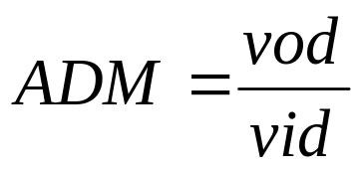
Differential mode gain
Vin
V_{SUP}
V_{SUP}
VDD
RD
RD
V_{OUT1}
V_{OUT2}
time
W2018: EE307
V_{IN1}
V_{IN2}
M1
M2
Vout
VDD
V_{N}
V_{tail}
I_{SS}
time

Slide 10
http://www.ecestudents.ul.ie/Course_Pages/MEng_CS/Modules/EE6471/web/lecture%20notes/Microsoft%20PowerPoint%20-%20Lecture6.pdf
W2018: EE307

Slide 11
NEXT SLIDES COME FROM A DIGITAL CLASS
W2018: EE307

Slide 12
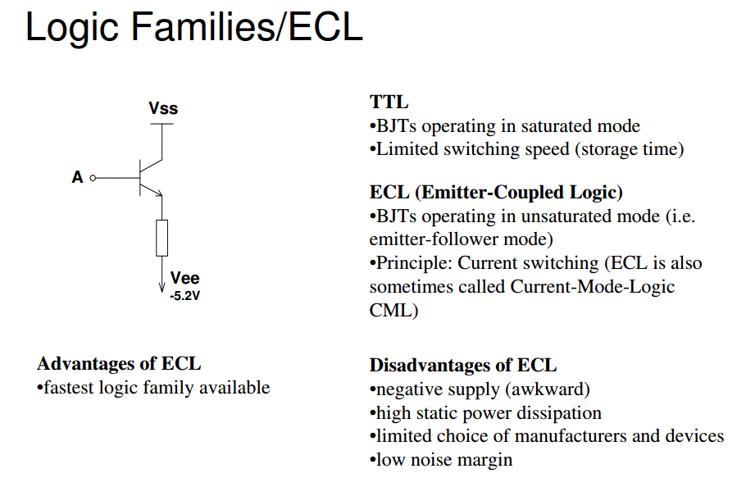
PECL
W2018: EE307

Slide 13
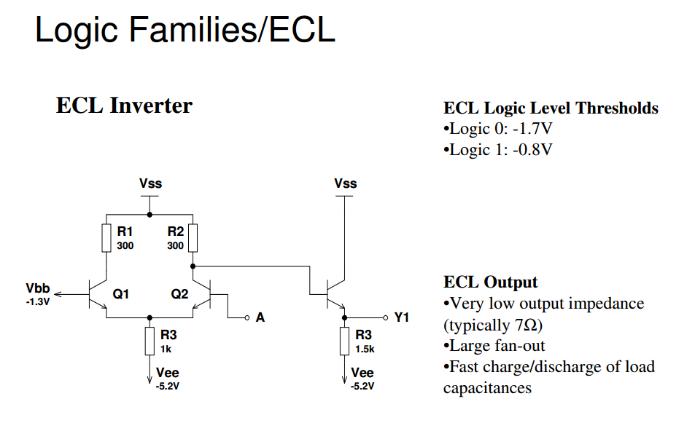
PECL
W2018: EE307

Slide 14
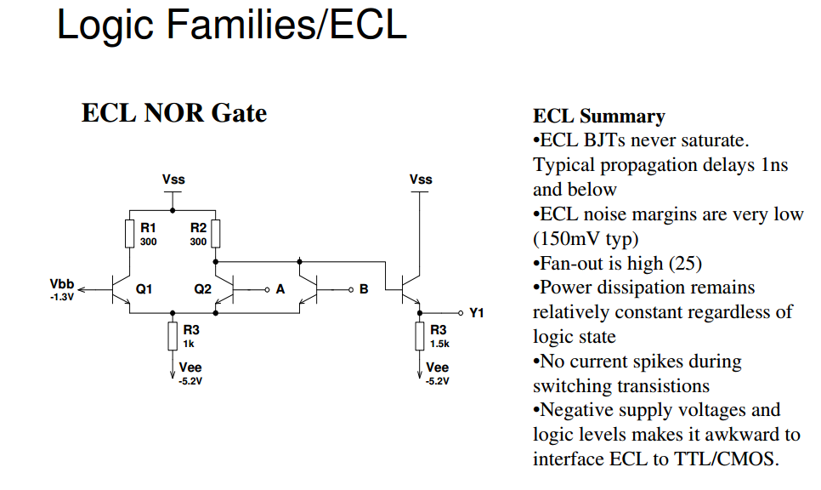
PECL
W2018: EE307

Slide 15
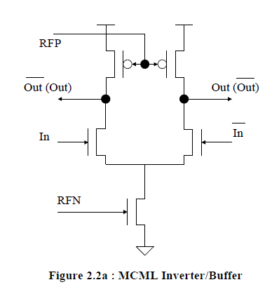
MCML Inverter(Buffer)
Same as ECL/PECL
W2018: EE307

Slide 16
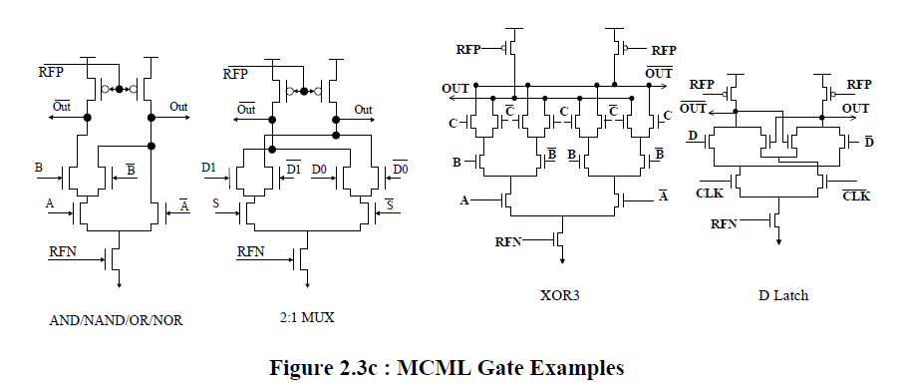
Other MCML gates
W2018: EE307

Slide 17
How to get there: OBDD (Ordered Binary Decision Diagrams)
A | B | C | F
0 | 0 | 0 | 0
0 | 0 | 1 | 1
0 | 1 | 0 | 1
0 | 1 | 1 | 0
1 | 0 | 0 | 0
1 | 0 | 1 | 1
1 | 1 | 0 | 1
1 | 1 | 1 | 0
0
A
1
B
B
0
1
0
1
W2018: EE307
C
C
C
C
0
1
0
1
0
1
1
0
1
1
0
0
1
1
0

Slide 18
How to get there: OBDD (Ordered Binary Decision Diagrams)
A | B | C | F
0 | 0 | 0 | 0
0 | 0 | 1 | 0
0 | 1 | 0 | 0
0 | 1 | 1 | 1
1 | 0 | 0 | 0
1 | 0 | 1 | 1
1 | 1 | 0 | 0
1 | 1 | 1 | 1
0
A
1
B
B
0
1
0
1
W2018: EE307
C
C
C
C
0
1
0
1
0
1
1
0
0
0
0
1
0
1
0
1
Rule 1: If both arrows point to the same value, that input doesn’t matter

Slide 19
How to get there: OBDD (Ordered Binary Decision Diagrams)
A | B | C | F
0 | 0 | 0 | 0
0 | 0 | 1 | 0
0 | 1 | 0 | 0
0 | 1 | 1 | 1
1 | 0 | 0 | 0
1 | 0 | 1 | 1
1 | 1 | 0 | 0
1 | 1 | 1 | 1
0
A
1
B
B
0
1
0
1
W2018: EE307
C
C
C
C
0
1
0
1
0
1
1
0
0
0
0
1
0
1
0
1
Rule 1: If both arrows point to the same value, that input doesn’t matter

Slide 20
How to get there: OBDD (Ordered Binary Decision Diagrams)
A | B | C | F
0 | 0 | 0 | 0
0 | 0 | 1 | 0
0 | 1 | 0 | 0
0 | 1 | 1 | 1
1 | 0 | 0 | 0
1 | 0 | 1 | 1
1 | 1 | 0 | 0
1 | 1 | 1 | 1
0
A
1
B
B
0
1
0
1
W2018: EE307
C
C
C
0
1
0
1
1
0
0
0
1
0
1
0
1
Rule 2: If both arrows point to the same place, that node doesn’t matter

Slide 21
How to get there: OBDD (Ordered Binary Decision Diagrams)
A | B | C | F
0 | 0 | 0 | 0
0 | 0 | 1 | 0
0 | 1 | 0 | 0
0 | 1 | 1 | 1
1 | 0 | 0 | 0
1 | 0 | 1 | 1
1 | 1 | 0 | 0
1 | 1 | 1 | 1
0
A
1
B
B
0
1
0
1
W2018: EE307
C
C
0
1
0
1
0
0
1
0
1
Rule 2: If both arrows point to the same place, that node doesn’t matter

Slide 22
How to get there: OBDD (Ordered Binary Decision Diagrams)
A | B | C | F
0 | 0 | 0 | 0
0 | 0 | 1 | 0
0 | 1 | 0 | 0
0 | 1 | 1 | 1
1 | 0 | 0 | 0
1 | 0 | 1 | 1
1 | 1 | 0 | 0
1 | 1 | 1 | 1
0
A
B
1
0
1
W2018: EE307
C
C
0
1
0
1
0
0
1
0
1
Rule 2: If both arrows point to the same place, that node doesn’t matter

Slide 23
How to get there: OBDD (Ordered Binary Decision Diagrams)
A | B | C | F
0 | 0 | 0 | 0
0 | 0 | 1 | 0
0 | 1 | 0 | 0
0 | 1 | 1 | 1
1 | 0 | 0 | 0
1 | 0 | 1 | 1
1 | 1 | 0 | 0
1 | 1 | 1 | 1
0
A
1
B
0
1
W2018: EE307
C
C
0
1
0
1
0
0
1
0
1
Rule 3: If there is a node that does the same thing as another node, merge them

Slide 24
How to get there: OBDD (Ordered Binary Decision Diagrams)
A | B | C | F
0 | 0 | 0 | 0
0 | 0 | 1 | 0
0 | 1 | 0 | 0
0 | 1 | 1 | 1
1 | 0 | 0 | 0
1 | 0 | 1 | 1
1 | 1 | 0 | 0
1 | 1 | 1 | 1
0
A
B
0
1
1
W2018: EE307
C
0
1
0
0
1
Rule 3: If there is a node that does the same thing as another node, merge them

Slide 25
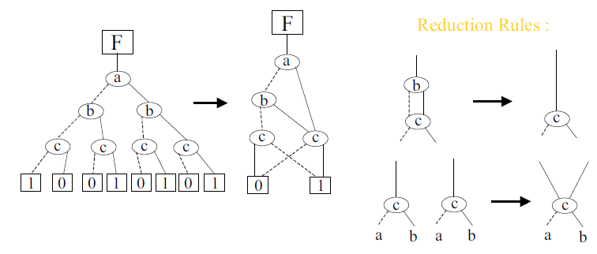
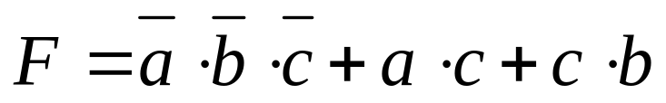
Building OBDDs from gates
Generate the canonical form (SOP or POS)
W2018: EE307

Slide 26
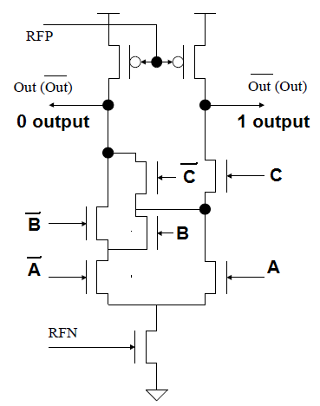
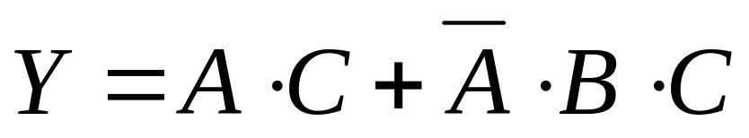
Creating MCML logic from ROBDDs
0
A
B
0
1
1
C
0
1
W2018: EE307
0
0
1

Slide 27
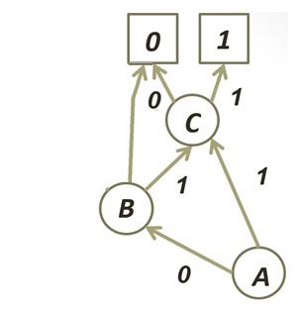
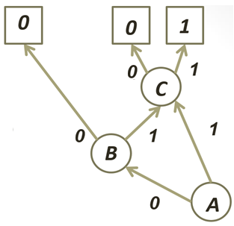
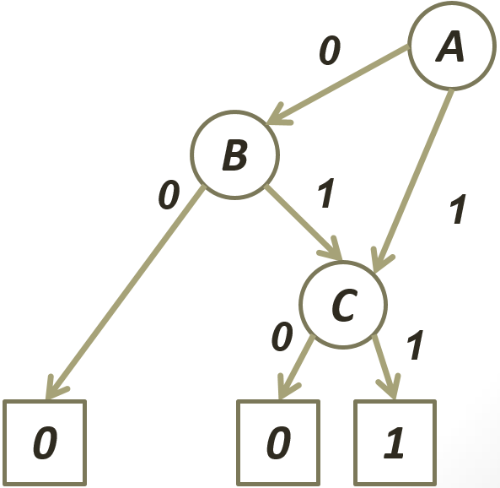
Checking circuit
A | B | C | F | Out | OutBar
0 | 0 | 0 | 0 | 0 | 1
0 | 0 | 1 | 0 | 0 | 1
0 | 1 | 0 | 0 | 0 | 1
0 | 1 | 1 | 1 | 1 | 0
1 | 0 | 0 | 0 | 0 | 1
1 | 0 | 1 | 1 | 1 | 0
1 | 1 | 0 | 0 | 0 | 1
1 | 1 | 1 | 1 | 1 | 0
W2018: EE307

Slide 28
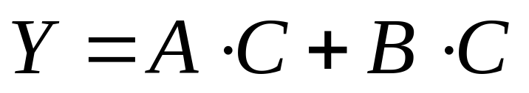
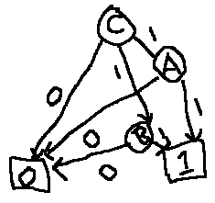
Actual minimum logic
ROBDD gave:
KMAPs give:
You can use this to create MCML just as easily. Making an OBDD will make it easiest:
W2018: EE307

Slide 29
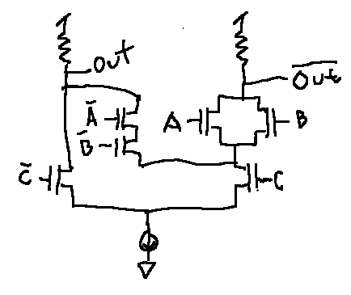
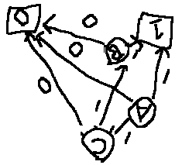
Actual minimum logic
ROBDD gave:
KMAPs give:
You can use this to create MCML just as easily:
W2018: EE307

Slide 30
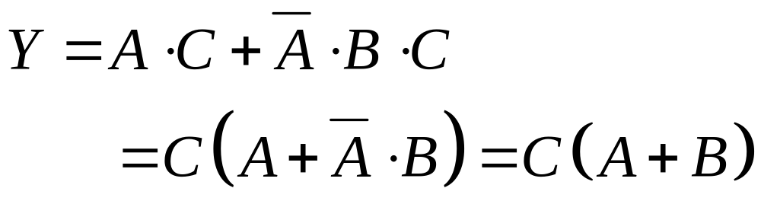
Actual minimum logic
Boolean logic rule:
Which is what KMAPS gave:
W2018: EE307

Slide 31
So why do ROBDD?
KMAPs have a limit to inputs. ROBDD doesn’t.
KMAPs double the rows for each additional input. ROBDD only adds one row.
ROBDD is easier to program.
W2018: EE307

Slide 32
Class problem: Draw MCML for:
A | B | C | F | Out | OutBar
0 | 0 | 0 | 0 | 0 | 1
0 | 0 | 1 | 0 | 0 | 1
0 | 1 | 0 | 0 | 0 | 1
0 | 1 | 1 | 1 | 1 | 1
1 | 0 | 0 | 0 | 0 | 1
1 | 0 | 1 | 1 | 1 | 0
1 | 1 | 0 | 0 | 0 | 0
1 | 1 | 1 | 1 | 1 | 0
W2018: EE307

Slide 33
PASS TRANSISTOR LOGIC
W2018: EE307

Slide 34
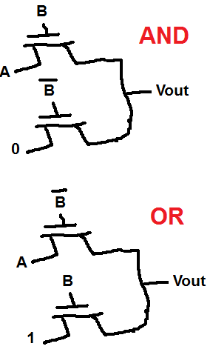
Pass transistor logic
Two techniques:
Logic equation broken into ANDs and Ors – (Only 2-input gates)
ROBDD based design
W2018: EE307

Slide 35
TECHNIQUE 1: JUST AND AND OR GATES
W2018: EE307

Slide 36
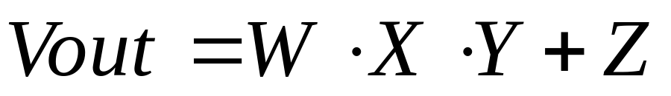
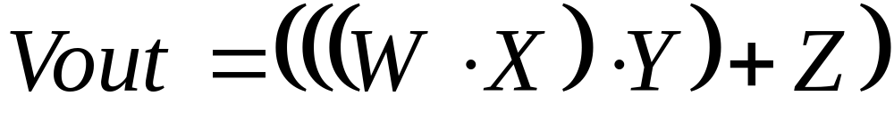
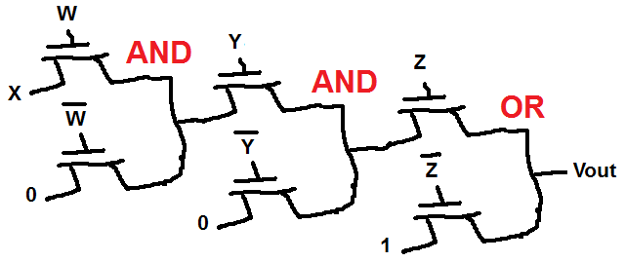
An example
Put into groups of 2-input functions:
Start with innermost AND or OR and go outwards:
W2018: EE307
Vout1
Vout2

Slide 37
Problem:
Need to be careful when cascading
4.3V
4.3V
5V
4.3V
5V
5V
5V
W2018: EE307

Slide 38
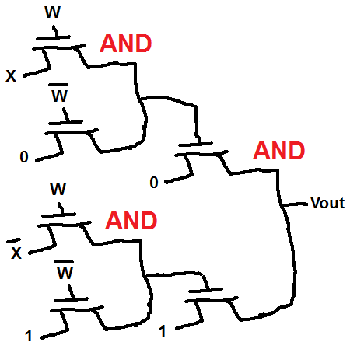
Problem: (Random nonsense example)
Need to be careful when cascading
4.3V
5V
3.6V
5V
W2018: EE307
5V

Slide 39
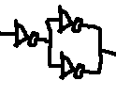

Buffers
Non-inverting: Even number of inverters
Inverting: Odd number of inverters
W2018: EE307

Slide 40

Problem: (Random nonsense example)
Need to be careful when cascading
With non-inverting buffers
4.3V
5V
5V
4.3V
5V
5V
W2018: EE307
5V

Slide 41
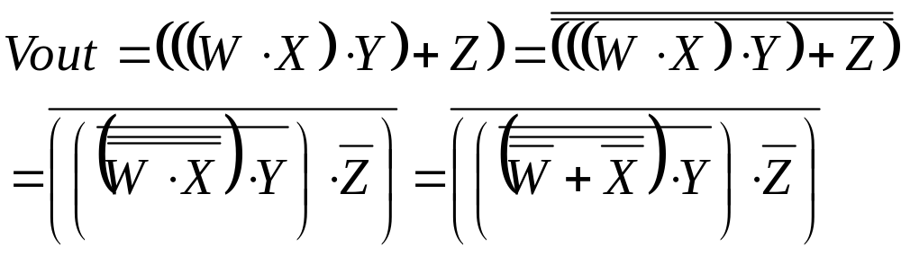
An example: Inverting buffer
Need to manipulate equation
  Bar over each AND and/or OR
  Start at top
W2018: EE307

Slide 42
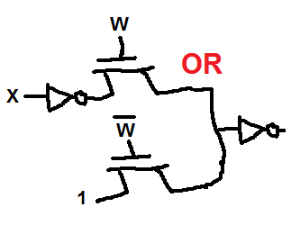
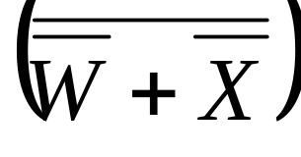
Building pass transistor logic
W2018: EE307

Slide 43
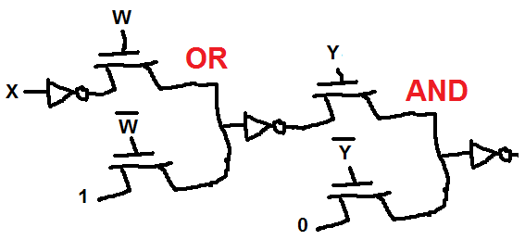
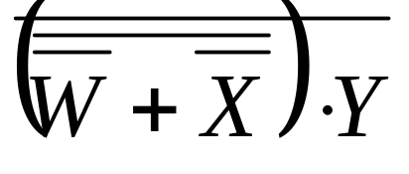
Building pass transistor logic
W2018: EE307

Slide 44
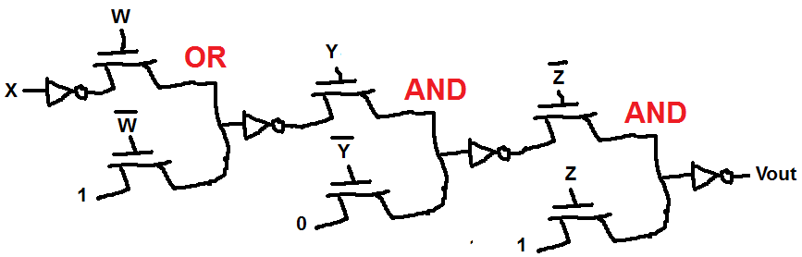
Building pass transistor logic
W2018: EE307

Slide 45
TECHNIQUE 2: ROBDD
W2018: EE307

Slide 46
How to get there: OBDD (Ordered Binary Decision Diagrams)
A | B | C | F
0 | 0 | 0 | 0
0 | 0 | 1 | 0
0 | 1 | 0 | 0
0 | 1 | 1 | 1
1 | 0 | 0 | 0
1 | 0 | 1 | 1
1 | 1 | 0 | 0
1 | 1 | 1 | 1
0
A
B
0
1
1
W2018: EE307
C
0
1
0
0
1

Slide 47
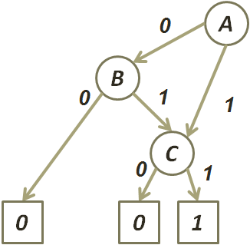
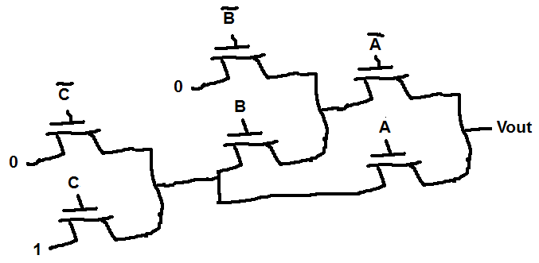
How to get there: OBDD (Ordered Binary Decision Diagrams)
W2018: EE307
C

Slide 48
How to get there: OBDD (Ordered Binary Decision Diagrams)
W2018: EE307

