Slide 1
Sequential Logic Design

Slide 2
Introduction to Sequential Logic
Sequential Logic: Logic that does things in sequence
Design Problem: A Counter
Counts up to 3 Then Starts Over at 0
OK… Count up 1.
Can’t Count up Unless You Know What Present Value… You Need Memory. You Need The Present STATE to Figure out the Next STATE. If it’s 2 now then it’ll be 3 next.
When Do You Count up? → On a Signal: Clock

Slide 3
Clock Pulse Definition
Clock
edge 1
Clock
edge 2
Clock
edge 3
Clock
edge 4
Clock
edge 5
CLK
Period
(= 1/frequency)
Duty cycle
=% high of period
Positive Pulse
Negative Pulse
Positive Edge
=Rising Edge
Negative Edge
=Falling Edge
Negative Edge
=Falling Edge
Positive Edge
=Rising Edge

Slide 4
Clock Pulse Definition
90%
10%
time
tr
=rise time
tf
=fall time

Slide 5
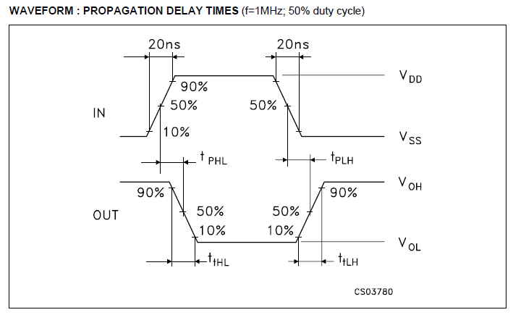

Slide 6
Storing values: Flip-flops and Latches

Slide 7
Pull-up and pull-down resistors
BIG so little current flows through it
Puts “default” value on wire
V_{INA}
VOUT
=?????
=V_{INA}
=V_{INB}
V_{INB}

Slide 8

Pull-down resistors
BIG so little current flows through it
Puts “default” value on wire
V_{INA}
VOUT
=V_{INA}
=?????
=V_{INB}
=GND
RBIG
V_{INB}

Slide 9

Pull-up resistors
BIG so little current flows through it
Puts “default” value on wire
V_{INA}
R=BIG
VOUT
=V_{INA}
=?????
=V_{INB}
=VDD
V_{INB}

Slide 10
Latches and Flip-flops
Latches and flip-flops have two stable states (Saves 0 or saves 1)
You’ll hear this this called “bistable”
A latch or flip-flop stores a single bit of data
A group of N flip-flops or latches is called an N-bit register or just a register
A rising edge flip-flop can only change its value on a rising clock edge (falling edge on falling edge, dual-edge on both rising and falling edges)
A (transparent high) latch grabs the last value it sees before a falling edge and holds it until the enable signal goes high again. Input goes to output when enabled.
Flip-flops are synchronous
Latches are asynchronous when clock high

Slide 11
Sequential Logic Components
Memory: D Flip-Flops
Clock happens Here
D Q Q⁺
0 0 0
0 1 0
1 0 1
1 1 1
D Q
CLK

Slide 12
Sequential Logic Components D Flip-Flop behavior
D Q
CLK
Clock
edge 1
Clock
edge 2
Clock
edge 3
Clock
edge 4
Clock
edge 5
CLK
D
Q

Slide 13
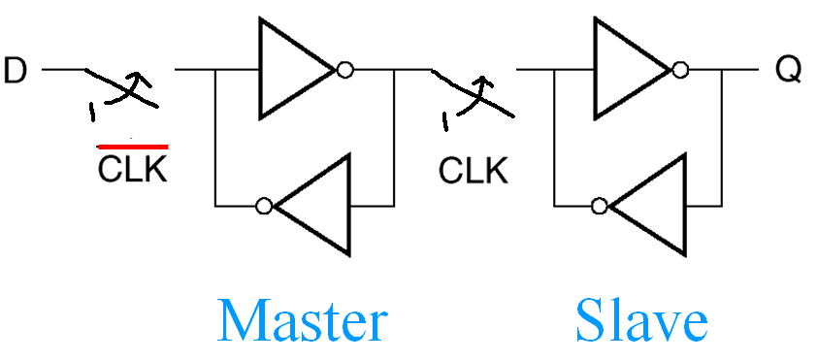
Flip-Flop on RT54SX-A
klabs.org/richcontent/Tutorial/MiniCourses/.../3_Sequential.ppt

Slide 14
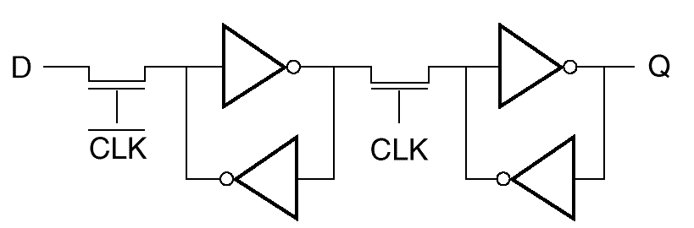
(Master-Slave) Flip-Flop
Master Slave

Slide 15
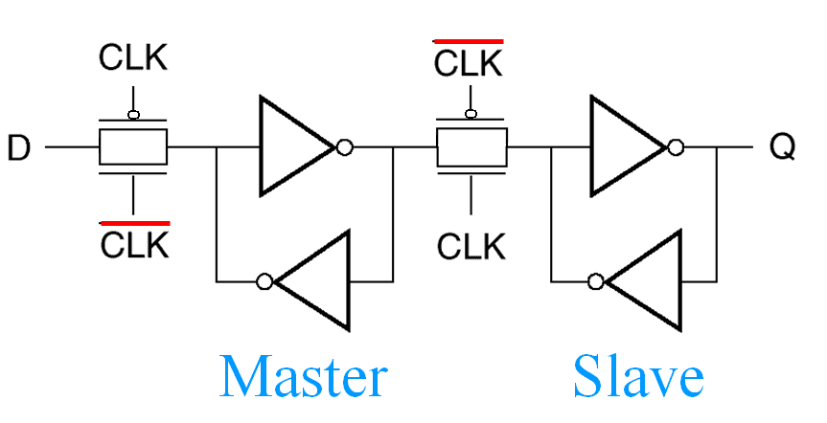
(Master-Slave) Flip-Flop version 2

Slide 16
Transistor level
Driving input node

Slide 17
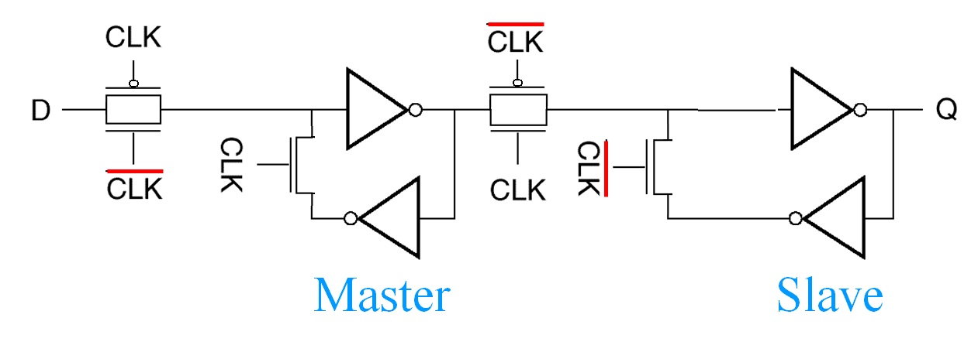
(Master-Slave) Flip-Flop version 3

Slide 18
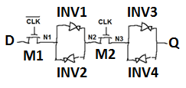
Design of flip-flop
Two steps:
Look at inverter that input must drive and determine minimum Vin to that inverter that will flip its value: Vm
Size input (pass) transistor so that it can generate Vm and switch the inverter
First find Vm on inverter.
INV1 needs to be switched

Slide 19
Vm
At Vm both inverters are in the active region and currents are equal:
In homework, VT, k’ and VDD are given so it’s often easier to plug in known values and then solve for Vm in terms of and .
One equation two unknowns… So need another equation… (In HW I give you W/L values)

Slide 20
After finding Vm….
Need to drive the input to INV1 to Vm (Set the input to INV1 to Vm)
Next identify circuit that drives the input to INV1 (Next slide)

Slide 21
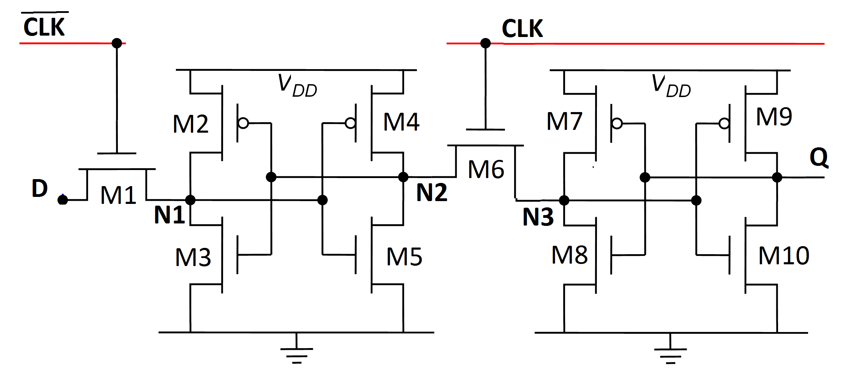
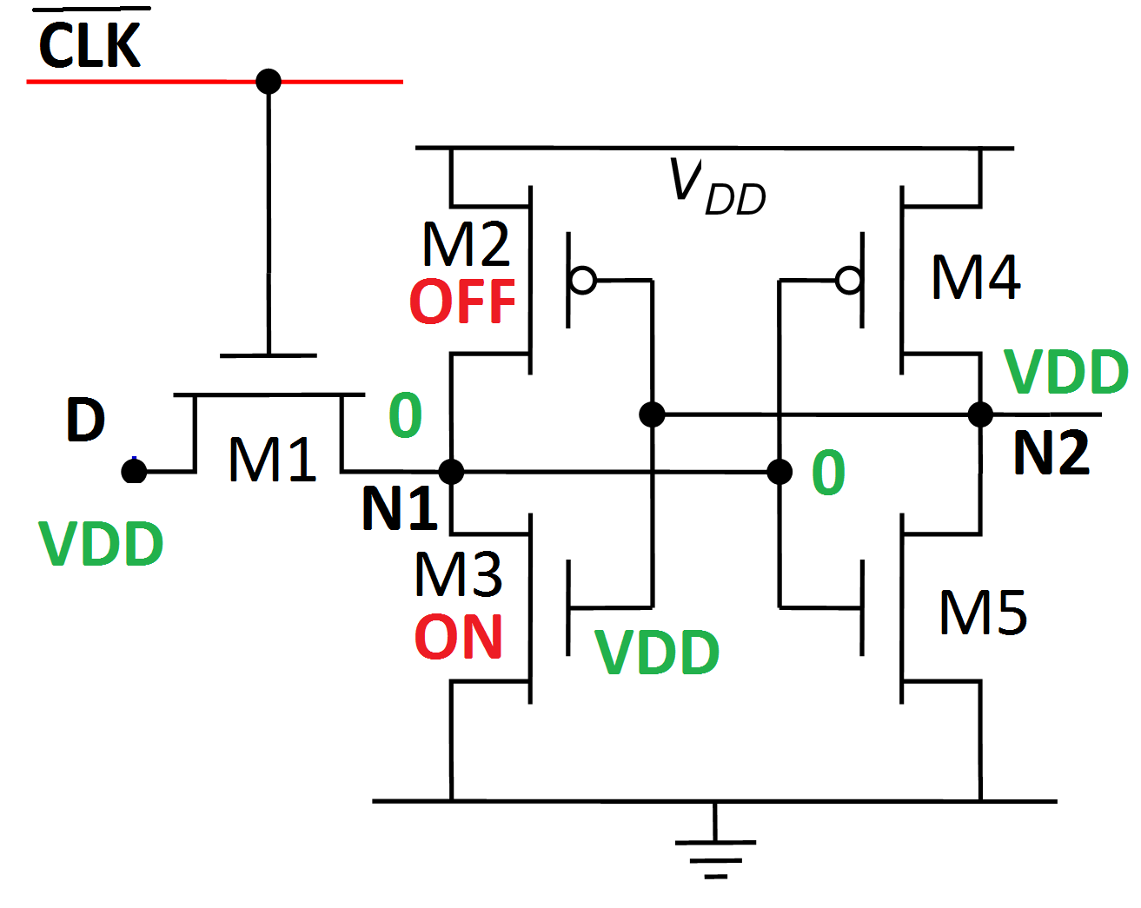
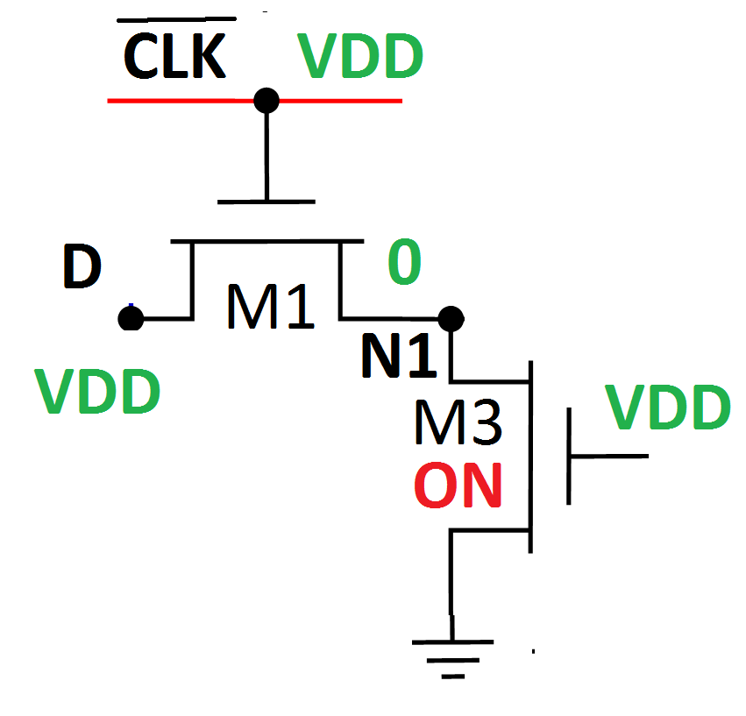
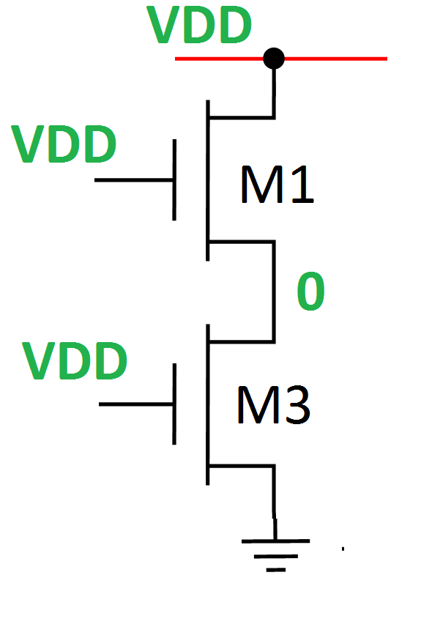
The problem you are actually solving
INV1
First half of FF:
Case: D=VDD, N1=0
Remove OFF transistors: Redraw:
INV1
This node drives INV1

Slide 22
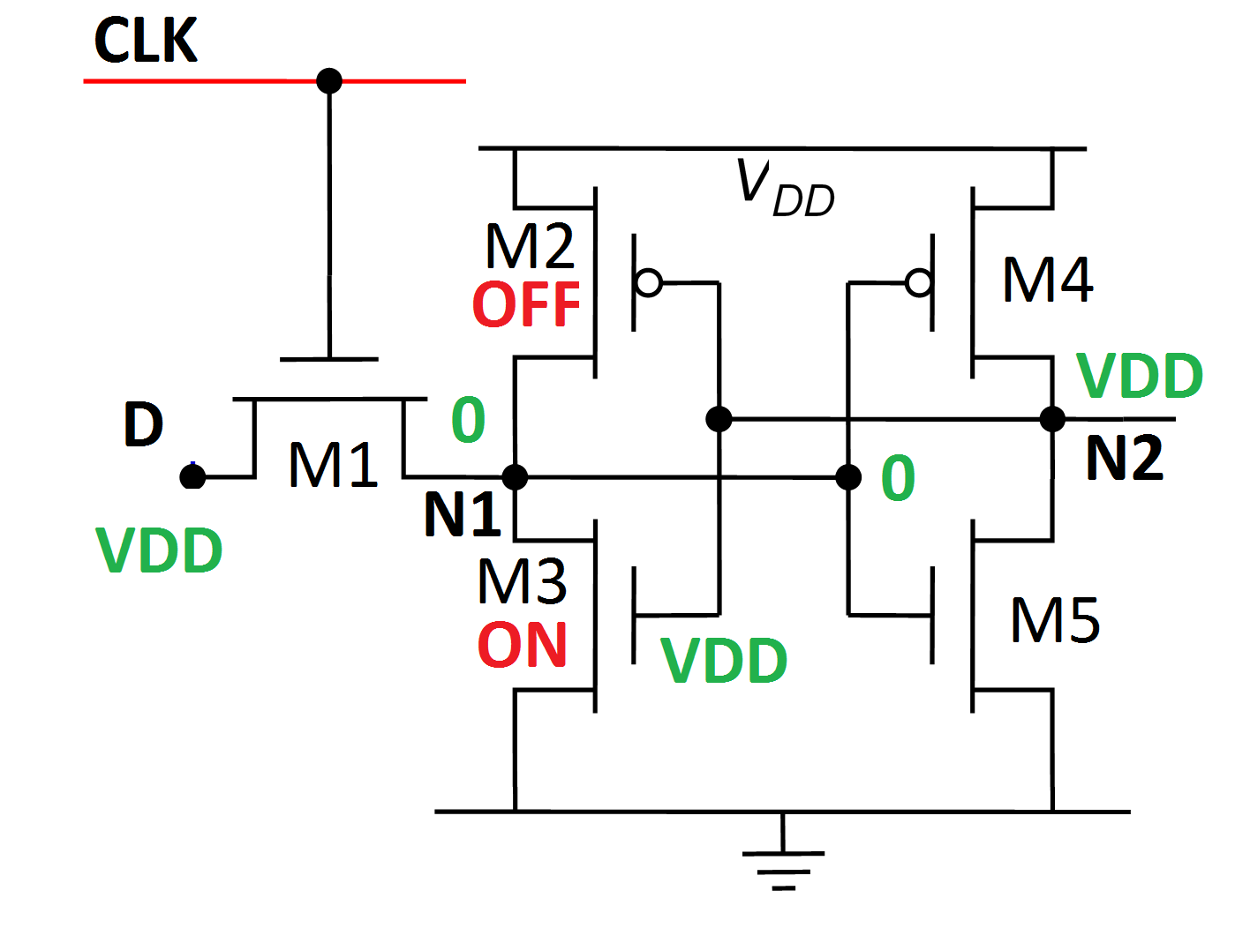
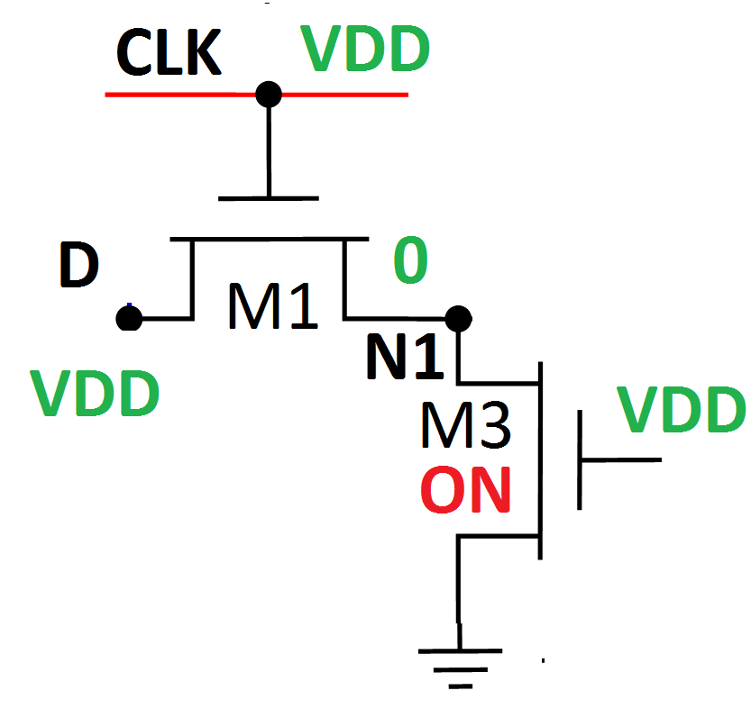
Driving circuit
M3 starts in linear, M1 in active
Given: VDD, k’, and VT

Slide 23
What you have
You have the voltage Vm needed to switch INV1
You have the circuit driving INV1
For the homework, M3, M4 and M5 are the same size and you pick an M1 size that makes all this work.

Slide 24
Comments
EE306 is no design. EE307 there’s some design. EE308 there’s more. Then EE409 is all you doing design.
In this homework I give you the size of M3, M4 and M5 but in real life you’d have to pick sizes yourself. If you don’t have enough equations to find a value, you need to pick one – It’s random. If you need fast then smaller is better. For more predictability, larger. But the first sizing can be, basically, random.

Slide 25


Analysis
WL
V
DD
BL
M
4
BL
Q
=
0
Q
=
1
M
6
M
5
V
DD
M
1
V
DD
V
DD
C
bit
C
bit

Slide 26
Sequential Logic Components
Memory: JK Flip-Flops
Clock happens Here
J K Q⁺
0 0 Q⁻
0 1 0
1 0 1
1 1 Q⁻
J
K Q
CLK
J: Jam a ‘1’ in
K: Kill the value

Slide 27
Sequential Logic Components JK Flip-Flop behavior
J
Q
K
CLK
Clock
edge 1
Clock
edge 2
Clock
edge 3
Clock
edge 4
Clock
edge 5
Clock
edge 6
Clock
edge 7
Clock
edge 8
CLK
J
K
Q

Slide 28
Sequential Logic Components
Memory: T Flip-Flops
Clock happens Here
T Q⁺
0 Q⁻
1 Q⁻
T Q
CLK

Slide 29
Sequential Logic Components Toggle Flip-Flop behavior
T Q
CLK
Clock
edge 1
Clock
edge 2
Clock
edge 3
Clock
edge 4
Clock
edge 5
CLK
T
Q

Slide 30
Sequential Logic Components Toggle Flip-Flop behavior
T Q
CLK
Clock
edge 1
Clock
edge 2
Clock
edge 3
Clock
edge 4
Clock
edge 5
CLK
1
T
Q

Slide 31
Sequential Logic Components
Memory: Latch
Din Clk Q⁺
0 0 Q (Hold)
0 1 0
0 Q (Hold)
1 1 1
Din Q
D Q
CLK
Level sensitive circuit (not edge triggered circuit)

Slide 32
Sequential Logic Components D Flip-Flop & Latch behavior
Flip-flop
Latch
D Qf
D QL
CLK
CLK
Clock
edge 1
Clock
edge 2
Clock
edge 3
Clock
edge 4
Clock
edge 5
CLK
D
Qf
QL

Slide 33
Master-Slave Flip-Flop Version 4
Y
Y’
S
R
CP
S
R
S
R
Q
Q’
Master
Slave
MASTER-SLAVE FLIP-FLOP
klabs.org/richcontent/Tutorial/MiniCourses/.../3_Sequential.ppt

Slide 34
Clocked D Latch
D
CP
3
1
Q
Q’
2
4
5
The present state is held when CP is low.
klabs.org/richcontent/Tutorial/MiniCourses/.../3_Sequential.ppt

Slide 35
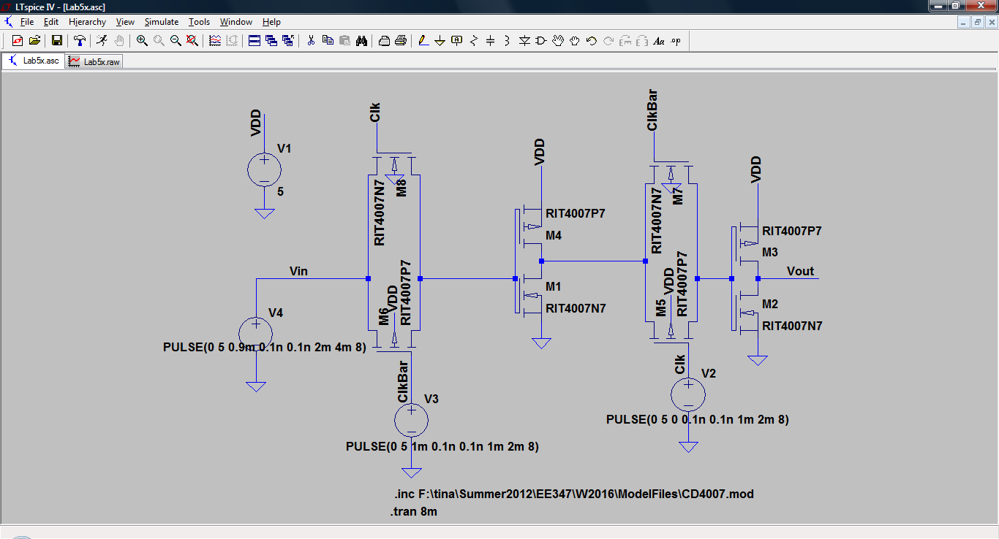

Slide 36
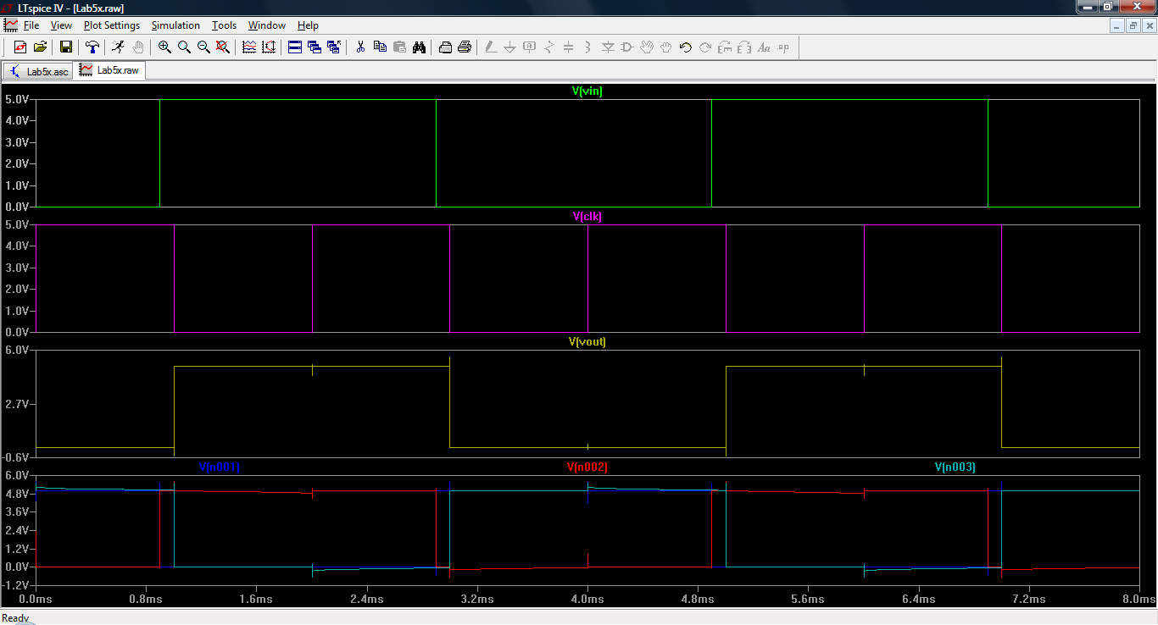

Slide 37
Inverter sizing and generating clock signals

Slide 38
Ring oscillators
One way to generate an on-chip clock signal (a square wave)
Other on-chip signal generation techniques may require RLC circuits and are often too slow for modern circuits.
Clock
edge 1
Clock
edge 2
Clock
edge 3
Clock
edge 4
Clock
edge 5
CLK
Period
(= 1/frequency)
Duty cycle
=% high of period

Slide 39
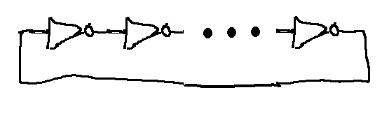

Ring oscillator
Needs to be an ODD number of inverters
Simplest is three inverters:
More inverters

Slide 40
Ring oscillator
Simplest is three inverters:
tp_{LH}
tp_{LH}
tp_{HL}
1
tp_{LH}
tp_{HL}
tp_{HL}
1
0
1
0
0

Slide 41
Frequency of ring oscillator
Frequency= 1/T
Slides to add current starved

Slide 42
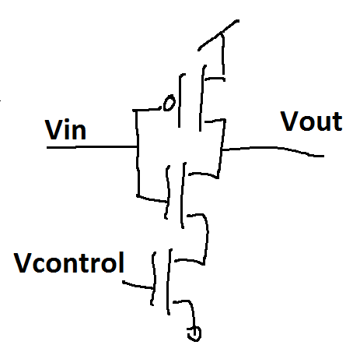
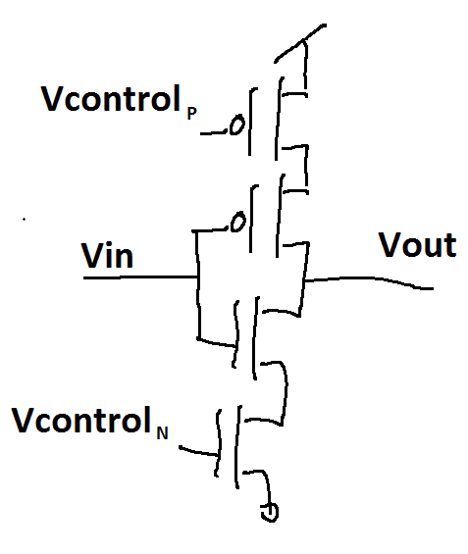
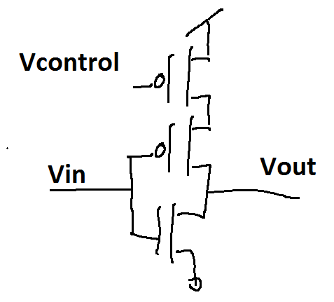
Current starved ring oscillator
The speed that a node changes:
You can change tp by changing the current or capacitance but it’s hard to change capacitance
Current starved ring oscillators change the current by adding a current choking transistor

Slide 43
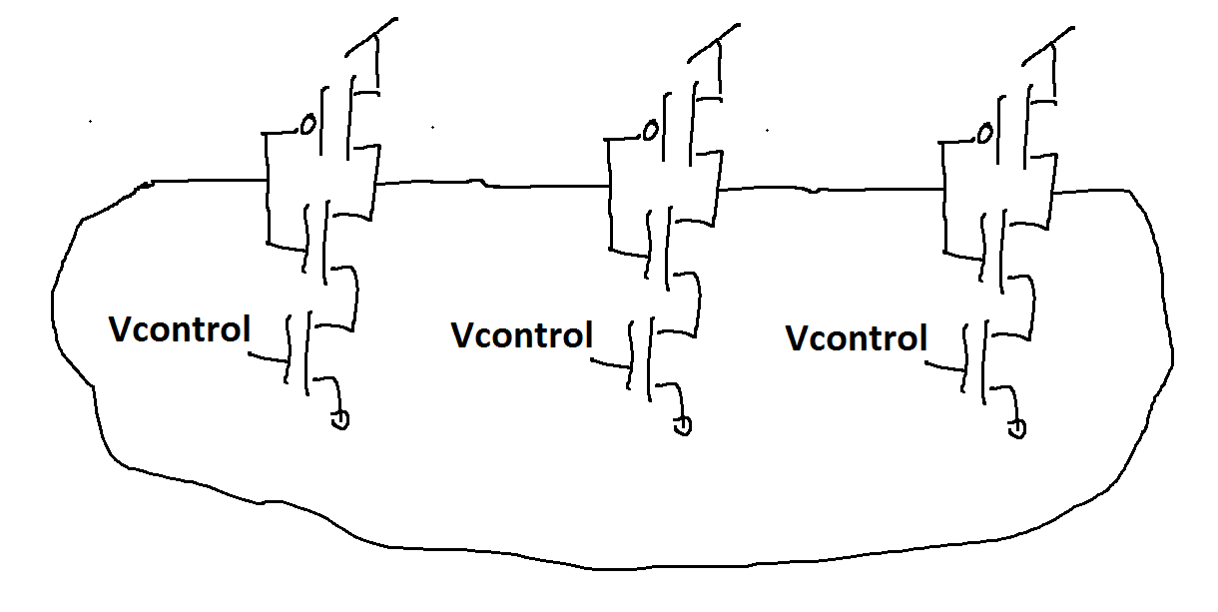
Current starved ring oscillator
Example:

Slide 44
Sequential Logic: Introduction

Slide 45
Counter comments to here
Remember, we’re building a sequential circuit
Flip-flops hold information about present value ➔ The value in the flip-flops is called “Present state” because it tells you where you are in the sequence
“Next state” logic take the “Present state” and calculates what the NEXT STATE will be when the clock ticks
We’ve seen two of the most important blocks

Slide 46
Complete sequential circuit
A sequential circuit is made up of three parts:
Present state (PS) flip-flops
Next state (NS) logic block
Output logic block
From here we’ll look at the process used to create a sequential circuit

Slide 47
Sequential Logic: Design Steps and types of sequential logic

Slide 48
Sequential Circuit Design
Steps in Designing a Sequential Circuit
Step 1:
UNDERSTAND PROBLEM!!!!!!!!!
Step 2:
Determine I/O
Step 3:
Timing Diagram (To Describe & Understand Behaviour)
Step 4:
Decide FSM Type (Meally or Moore)
Step 5:
Draw State Transition Diagram
Step 6:
Write out State Transition Table
Step 7:
Generate Logic Equations
Step 8:
Draw Logic

Slide 49
Sequential Circuit Design
Example:
A 2-Bit Up-Down Counter
Step 1: Understand Problem
A Circuit That:
Counts UP on 1 Input (dir)
Counts DOWN on 0 Input (dir)
Starts at 0 After RESET Input
Start-up Value Not Guaranteed
What’s missing?

Slide 50
Sequential Circuit Design
Example:
Step 2: Determine I/O
dir direction
2
Q1Q0
(Count value)
RESET reset
clk

Slide 51
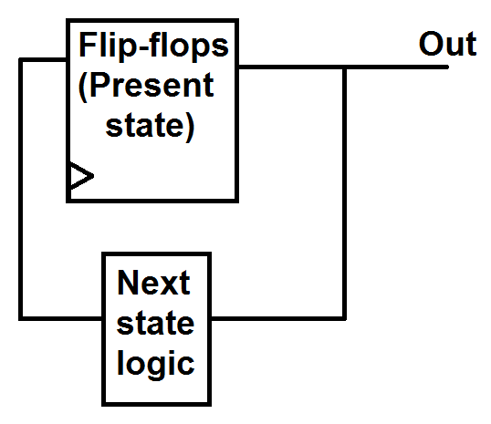
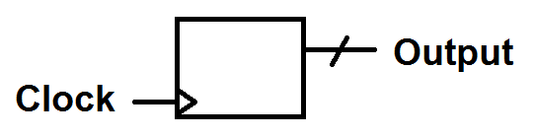
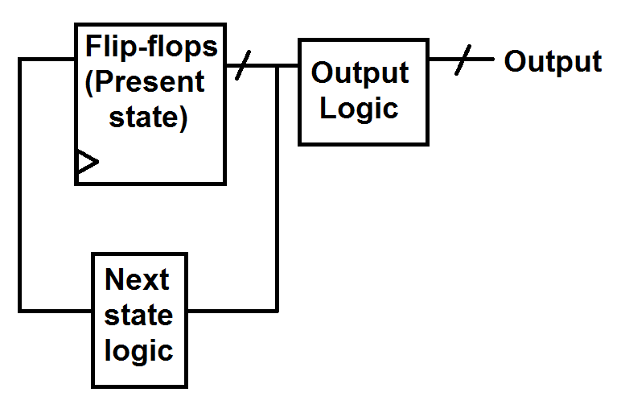
NOTE: What to draw on an IO block
IO only of complete circuit
No input counter:
Second design:
IO Diagram
IO Diagram

Slide 52
Sequential Circuit Design
Example: (State = output)
Step 3: Describe Behavior with Timing Diagram
CLK
Q1
Q0
RESET
dir
Q1Q0 XX 00 01 10 11 00 01 00 11 10 01
State XX 00 01 10 11 00 01 00 11 10 01

Slide 53
Sequential Circuit Design
Steps in Designing a Sequential Circuit
Step 1:
UNDERSTAND PROBLEM!!!!!!!!!
Step 2:
Determine I/O
Step 3:
Timing Diagram (To Describe & Understand Behaviour)
Step 4:
Decide FSM Type (Meally or Moore)
Step 5:
Draw State Transistion Diagram
Step 6:
Write out State Transition Table
Step 7:
Generate Logic Equations
Step 8:
Draw Logic

Slide 54
Alternate picture of Meally and Moore Machines (Maybe easier to understand)
Models: Input doesn’t go to Output Logic block for Moore
Meally Machine
Moore Machine
(Output Depends on Input and Present State)
(Output Depends Only on Present State)
Flip-flops
Combinational
Logic
Flip-flops
Combinational
Logic
CLK
FF Holding
Present State
CLK
FF Holding
Present State
Output Logic
Output Logic
Output
Takes Present State and Produces Next State.
Takes Present State and Produces Next State.
Combinational
Logic
Combinational
Logic
Input
Input

Slide 55
Sequential Logic Models
Models: Input doesn’t go to Output Logic block for Moore
Meally Machine
Moore Machine
(Output Depends on Input and Present State)
(Output Depends Only on Present State)
Combinational
Logic
Combinational
Logic
Input
Takes Present State and Produces Next State.
Input
Takes Present State and Produces Next State.
Output
Output
Output Logic
Output Logic
FF Holding
Present State
FF Holding
Present State
CLK
CLK

Slide 56
Sequential Logic Models
Meally Machine
Possible Gains:
Less Logic
Fewer States
Quicker Results
Possible Dangers
Glitching
Feedthrough Loop
Meally Machine
(Output Depends on Input and Present State)
Flip-flops
Combinational
Logic
CLK
FF Holding
Present State
Output Logic
Output
Takes Present State and Produces Next State.
Combinational
Logic
Input

Slide 57
Sequential Logic Models
Moore Machine
Possible Gains:
Robust
Synchronized
Possible Drawbacks
Larger Area
Moore Machine
(Output Depends Only on Present State)
Combinational
Logic
Input
Takes Present State and Produces Next State.
Output
Output Logic
FF Holding
Present State
CLK

Slide 58
Sequential Logic Models
CLK
Input
Output
Flip-flops
Combinational
Logic
CLK
FF Holding
Present State
Output Logic
Meally Machine
Output
(Output Depends on Input and Present State)
Takes Present State and Produces Next State.
Combinational
Logic
Input

Slide 59
Sequential Logic Models
CLK
Input
Output / D
Moore Machine
Combinational
Logic
(Output Depends Only on Present State)
Input
Takes Present State and Produces Next State.
Output
Output Logic
FF Holding
Present State
CLK

Slide 60
Sequential Logic Models
Meally Machine
CLK
Input
Output / D
Moore Machine
CLK
Input
Output / D

Slide 61
Sequential Logic Models
CLK
Q3
Q2
Q1
Q0
Reset
Q3Q2Q1Q0 0000 0001 0010 0011 0100 0101 0110 0111→0000 0001 0010 0011…
Meally or Moore?

Slide 62
Sequential Circuit Design
Example:
Step 4: Select Model Type. Meally or Moore?
CLK
Q1
Q0
RESET
dir
Q1Q0 XX 00 01 10 11 00 01 00 11 10 01
Moore

Slide 63
Sequential Circuit Design
Example:
Step 4: Select Model Type. Meally or Moore?
CLK
Q1
Q0
RESET
dir
Q1Q0 XX 00 01 10 11 00 01 00 11 10 01
Meally

Slide 64
Sequential Logic Models
CLK
Q3
Q2
Q1
Q0
Q3Q2Q1Q0 0000 0001 0010 0011 0100 0101 0110 0111 1000 1001 1010 1011…
Meally or Moore?

Slide 65
Sequential Logic Design
Steps in Designing a Sequential Circuit
Step 1:
UNDERSTAND PROBLEM!!!!!!!!!
Step 2:
Determine I/O
Step 3:
Timing Diagram (To Describe & Understand Behaviour)
Step 4:
Decide FSM Type (Meally or Moore)
Step 5:
Draw State Transistion Diagram
Step 6:
Write out State Transition Table
Step 7:
Generate Logic Equations
Step 8:
Draw Logic

Slide 66
State Transition Diagrams
Different for Meally & Moore Models
Meally
Moore
[Input/Output Value]
[Input Value]
Next State
Next State
State Name
State Value
State Name
State Value
[Output Value]

Slide 67
Selecting State Bubble Stuff (1)
State name: Something descriptive of the state’s function. Words are good. For humans.
ie “Add numbers”
State Value: Each state must have a numerical name. It must be unique (different from all other state values in the machine). For computer.
ie For a four-state machine: 00, 01, 10, 11.
ie For a five state machine: 000, 001, 010, 011, 100, 101
ie For a four state machine: 0000, 1001, 1010, 1011, 1100

Slide 68
Selecting State Bubble Stuff (2)
Output value: A list of ‘1’s and ‘0’s corresponding to the outputs of the state machine.
ie [1011] for a state machine with outputs [Enable, Add, Subtract, SaveResult]
Input value: A list of ‘1’s and ‘0’s corresponding to the inputs of the state machine (often come from blocks the FSM controls).
ie [010] for a state machine with outputs [ResetAll, MultiplyDone, Negative?]

Slide 69
Selecting State Bubble Stuff (3)
Legend/Key – for input and output
You can write inputs and outputs as 0s and 1s OR you can write the names of the signals. For example the counter’s outputs were: OP1 and OP0
The output can be written: 10 or
Non-negated means ‘1’ and negated means ‘0’
BUT: If you write ‘10’, you need to tell me what that means. You need a legend. Here’s an example (on next slide)

Slide 70
Sequential Circuit Design
State name: Zero, One
State value: 00, 01
1011
Zero
00
One
01
[010]
0001
[111]
1101
0101
0000
1100
• • •
• • •
Key: Input: Button1, Button2, DoorOpen, KeyTurned
Output: StartCar, TurnOnStartLight, LockDoors

Slide 71
Sequential Circuit Design
Example:
Step 5: Draw the State Transition Diagram
RESET
RESET
1
Zero
00
One
01
RESET
[0]
0
[1]
1
0
RESET
0
1
RESET
Three
10
Two
11
0
[3]
1
[2]

Slide 72
Sequential Circuit Design
Example:
Step 5: Draw the State Transition Diagram
RESET
RESET
1
Zero
00
One
01
RESET
[00]
0
[01]
1
0
RESET
0
1
RESET
Three
10
Two
11
0
[11]
1
[10]

Slide 73
Sequential Circuit Design
Example:
Step 6: Draw the State Transition Table
Output Logic
2
Output Logic
2
Present State
Output
Next State Logic
direction
Next
State
Logic
2
RESET
Next State
Present State
2

Slide 74
Sequential Circuit Design
Example:
Step 6: Draw the State Transition Table
2
2
Present State
Output Logic
Output
1
RESET
Zero
00
One
01
P1 P0 O1 O0
[0]
0
[1]
0 0 0 0
0 1 0 1
1 0 1 1
1 1 1 0
1
0
0
1
Three
10
0
Two
11
[3]
1
[2]

Slide 75
Sequential Circuit Design
NOTE: This truth table won’t be acceptable in this class unless I say so in question
Example:
Step 6: Draw the State Transition Table
direction (dir)
Next
State
Logic
2
RESET (rst)
Next State
Present State
2
rst P1 P0 dir N1 N0
1
RESET
Zero
00
One
01
0 0 0 0 1 0
0 0 0 1 0 1
0 0 1 0 0 0
0 0 1 1 1 1
0 1 0 0 1 1
0 1 0 1 0 0
0 1 1 0 0 1
0 1 1 1 1 0
1 X X X 0 0
[00]
0
[01]
1
0
0
1
Three
10
0
Two
11
[11]
1
[10]

Slide 76
Sequential Circuit Design
Example:
Step 7: Derive Logic
Output
O1=P1
O0=P1⊕P0
Next State
N1=(P1⊕dir)•rst
N0=(P1⊕dir)•rst
P1 P0 O1 O0
0 0 0 0
0 1 0 1
1 0 1 1
1 1 1 0
rst P1 P0 dir N1 N0
0 0 0 0 1 0
0 0 0 1 0 1
0 0 1 0 0 0
0 0 1 1 1 1
0 1 0 0 1 1
0 1 0 1 0 0
0 1 1 0 0 1
0 1 1 1 1 0
1 X X X 0 0

Slide 77
Sequential Circuit Design
Example:
Step 8: Draw Logic
O1=P1
O0=P1⊕P0
N1=P1⊕IN
N0=P1⊕IN
Moore Machine
N1=P1⊕IN
N0=P1⊕IN
2
Input
2
O1=P1
O0=P1⊕P0
2
Output
2
FF
CLK

Slide 78
Sequential Logic Design
Steps in Designing a Sequential Circuit
Step 1:
UNDERSTAND PROBLEM!!!!!!!!!
Step 2:
Determine I/O
Step 3:
Timing Diagram (To Describe & Understand Behaviour)
Step 4:
Decide FSM Type (Meally or Moore)
Step 5:
Draw State Transistion Diagram
Step 6:
Write out State Transition Table
Step 7:
Generate Logic Equations
Step 8:
Draw Logic

Slide 79
State Transition Diagrams
Same Example Except Use Meally Model:
Step 1Thru 2 are the Same
Step 3: Describe Behavior with Timing Diagram
Step 4: Meally or Moore?
Meally
CLK
Q1
Q0
Reset
Q1Q0 XX 00 01 10 11 00 01 10 11 00 01

Slide 80
State Transition Diagrams
Different for Meally & Moore Models
Meally
Moore
[Input/Output Value]
[Input Value]
Next State
Next State
State Name
State Value
State Name
State Value
[Output Value]

Slide 81
Sequential Circuit Design Non-Mealy Mealy, No need for Mealy
Example:
Step 5: Draw the State Transition Diagram
RESET
/01
RESET/00
1
/00
Zero
00
One
01
RESET/00
Doesn’t work
0/01
1
/11
RESET/10
/01
RESET/11
1
0/00
0/10
Three
10
Two
11
0
/11
1
/10

Slide 82
Sequential Circuit Design
Example:
Step 5: Draw the State Transition Diagram
RESET
/00
RESET/00
1
/01
Zero
00
One
01
RESET/00
0/00
1
/00
RESET/00
/10
RESET/00
1
0/11
0/01
Three
10
Two
11
0
/10
1
/11

Slide 83
Sequential Circuit Design
Same Example Except Use Meally Model :
Step 5: Draw the State Transition Diagram
1/01
Zero
00
One
01
RESET/00
0/00
1/00
0/11
0/01
1/10
Three
10
Two
11
0/10
1/11

Slide 84
Sequential Circuit Design
Same Example Except Use Meally Model :
Step 6: Draw the State Transition Table
Output Logic
direction
Output Logic
2
2
Present State
Output
RESET
Next State Logic
direction
Next
State
Logic
2
2
Next State
Present State
RESET

Slide 85
Sequential Circuit Design
Same Example Except Use Meally Model :
Step 6: Draw the State Transition Table
direction
Output Logic
2
2
Present State
Output
RESET
rst P1 P0 dir O1 O0
0 0 0 0 1 1
0 0 0 1 0 1
0 0 1 0 0 0
0 0 1 1 1 0
0 1 0 0 1 0
0 1 0 1 0 0
0 1 1 0 0 1
0 1 1 1 1 1
1 X X X 0 0
1/01
Zero
00
One
01
0/00
1/00
0/11
0/01
1/10
Three
10
0/10
Two
11
1/11

Slide 86
Sequential Circuit Design
Same Example Except Use Meally Model :
Step 6: Draw the State Transition Table
direction
Next
State
Logic
2
2
Next State
Present State
RESET
rst P1 P0 dir N1 N0
0 0 0 0 1 0
0 0 0 1 0 1
0 0 1 0 0 0
0 0 1 1 1 1
0 1 0 0 1 1
0 1 0 1 0 0
0 1 1 0 0 1
0 1 1 1 1 0
1 X X X 0 0
1/01
Zero
00
One
01
0/00
1/00
0/11
0/01
1/10
Three
10
0/10
Two
11
1/11

Slide 87
Sequential Circuit Design
rst P1 P0 dir O1 O0
Example:
Step 7: Derive Logic
Output
O1=(P0⊕dir)•rst
O0=(P1⊕P0)•rst
Next State
N1=(P0⊕dir)•rst
N0=(dir⊕P1)•rst
0 0 0 0 1 1
0 0 0 1 0 1
0 0 1 0 0 0
0 0 1 1 1 0
0 1 0 0 1 0
0 1 0 1 0 0
0 1 1 0 0 1
0 1 1 1 1 1
1 X X X 0 0
rst P1 P0 dir N1 N0
0 0 0 0 1 0
0 0 0 1 0 1
0 0 1 0 0 0
0 0 1 1 1 1
0 1 0 0 1 1
0 1 0 1 0 0
0 1 1 0 0 1
0 1 1 1 1 0
1 X X X 0 0

Slide 88
Sequential Circuit Design
Example:
Step 8: Draw Logic
Output
O1=(P0⊕dir)•rst
O0=(P1⊕P0)•rst
Next State
N1=(P0⊕dir)•rst
N0=(dir⊕P1)•rst
Meally Machine
Combinational
Logic
Input
N1=(P0⊕dir)•rst
N0=(dir⊕P1)•rst
O1=(P0⊕dir)•rst
O0=(P1⊕P0)•rst
Output
FF Holding
Present State
CLK

Slide 89
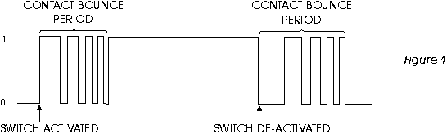
Class Problem: Digital Debouncer
Push-button switches, toggle switches, and electro-mechanical relays bounce:
Let’s say you know that the maximum time a switch can bounce is 1μs+ (a bit more than 1μs) and your clock is at 3MHz. Build (separately) a Meally and a Moore machine that tells you when you’ve stopped bouncing and have gone from 0 to 1.

Slide 90
Sequential Logic Design
Steps in Designing a Sequential Circuit
Step 1:
UNDERSTAND PROBLEM!!!!!!!!!
Step 2:
Determine I/O
Step 3:
Timing Diagram (To Describe & Understand Behaviour)
Step 4:
Decide FSM Type (Meally or Moore)
Step 5:
Draw State Transistion Diagram
Step 6:
Write out State Transition Table
Step 7:
Generate Logic Equations
Step 8:
Draw Logic

Slide 91
Sequential Logic: Examples

Slide 92
My Specifications (Digital Debouncer)
If 4 clock cycles after I see a ‘1’, I see a ‘1’, again then I will assume that the input has switched from 0→1 and I should output a 1.
Whenever I am in the “found a 1” state and I see a 0, I will switch to the wait state.

Slide 93
Determine I/O (Digital Debouncer)
Button
Output
Cleaned
Button
Output
clk

Slide 94
Timing Diagram (Digital Debouncer)
CLK
Input
Output
Input
Takes Present State and Produces Next State.
Combinational
Logic
Moore Machine
Output
Output Logic
D Q
FF Holding
Present State
CLK
CLK

Slide 95
State Transition Diagram (Digital Debouncer)
0
X
1
Sensed 2
010
Wait/Low
000
Sensed 1
001
[0]
[0]
[0]
0
X
0
X
Three
101
Sensed 4
100
Sensed 3
011
1
[1]
[0]
[0]
1

Slide 96
Output Logic (Digital Debouncer)
3
Output Logic
Present State
Output
P2 P1 P0 Out
Out=P2•P1•P0
0 0 0 0
0 0 1 0
0 1 0 0
0 1 1 0
1 0 0 0
1 0 1 1
1 1 0 X
1 1 1 X

Slide 97
Next State Logic (Digital Debouncer)
3
Next State Logic
Present State
Output
Button Input
In P2 P1 P0 NS2 NS1 NS0
0 0 0 0 0 0 0
0 0 0 1 0 1 0
0 0 1 0 0 1 1
0 0 1 1 1 0 0
0 1 0 0 1 0 1
0 1 0 1 0 0 0
0 1 1 0 X X X
0 1 1 1 X X X
1 0 0 0 0 0 1
1 0 0 1 0 1 0
1 0 1 0 0 1 1
1 0 1 1 1 0 0
1 1 0 0 1 0 1
1 1 0 1 1 0 1
1 1 1 0 X X X
1 1 1 1 X X X
I’ll let you do the logic

Slide 98
Meally version: My Specifications (Digital Debouncer)
If 4 clock cycles after I see a ‘1’, I see a ‘1’, again then I will assume that the input has switched from 0→1 and I should output a 1.
Whenever I am in the “found a 1” state and I see a 0, I will switch to the wait state.

Slide 99
Determine I/O (Digital Debouncer)
Button
Output
Cleaned
Button
Output
clk

Slide 100
Timing Diagram (Digital Debouncer)
CLK
Input
Output
Input
Takes Present State and Produces Next State.
Combinational
Logic
Meally Machine
Output
Output Logic
D Q
FF Holding
Present State
CLK
CLK

Slide 101
State Transition Diagram (Digital Debouncer)
0/0
X/0
1/0
Sensed 2
010
Wait/Low
000
Sensed 1
001
X/0
0/0
X/0
Sensed 4
100
Sensed 3
011
1/1

Slide 102
Output Logic (Digital Debouncer)
In P2 P1 P0 Out
0 0 0 0 0
0 0 0 1 0
0 0 1 0 0
0 0 1 1 0
0 1 0 0 0
0 1 0 1 X
0 1 1 0 X
0 1 1 1 X
1 0 0 0 0
1 0 0 1 0
1 0 1 0 0
1 0 1 1 0
1 1 0 0 1
1 1 0 1 X
1 1 1 0 X
1 1 1 1 X
3
Output Logic
Present State
Output
By examination:
Out=In•P2

Slide 103
Next State Logic (Digital Debouncer)
3
Next State Logic
Present State
Output
Button Input
In P2 P1 P0 NS2 NS1 NS0
0 0 0 0 0 0 0
0 0 0 1 0 1 0
0 0 1 0 0 1 1
0 0 1 1 1 0 0
0 1 0 0 0 0 0
0 1 0 1 X X X
0 1 1 0 X X X
0 1 1 1 X X X
1 0 0 0 0 0 1
1 0 0 1 0 1 0
1 0 1 0 0 1 1
1 0 1 1 1 0 0
1 1 0 0 1 0 0
1 1 0 1 X X X
1 1 1 0 X X X
1 1 1 1 X X X
I’ll let you do the logic

Slide 104
Today…
Meally to logic
One-hot encoding

Slide 105
Class Problem
Pattern Finder
Build a circuit that takes a bit stream in and gives a single high pulse, one clock cycle long, when the pattern has been found. The pattern is: 0010. No overlapping allowed. For example, 00100010 counts as two sequences but 0010010 does not count as two patterns.

Slide 106
Terms
FSM: A sequential circuit with a finite number of states…
Sequential circuit/logic: A circuit that does things in a specific order
Register: A group of flip-flops

Slide 107
Sequential Logic: Cooperating FSMs

Slide 108
Cooperating FSMs
Simple definition: A system made up of more than one FSM where the system’s FSMs talk to each other and give each other information about what they are doing
Example 1: A computer
Instruction: C=A+B
Main FSM to memory FSM: Get ‘A’ for me
Memory FSM to Main FSM: ‘A’ ready at my output
Main FSM to memory FSM: Get ‘B’ for me
Memory FSM to Main FSM: ‘B’ ready at my output
Main FSM to datapath: Add ‘A’ and ‘B’
Main FSM to memory FSM: Store result in ‘C’ for me

Slide 109
Cooperating FSMs
Example 2: A doorbell that plays music. The doorbell is pushed. An FSM finds the rising edge of the button being pushed (see debouncing circuit example). When it finds an edge it tells another FSM that plays a song to start. The doorbell FSM turns off until music FSM says it’s done.

Slide 110
Cooperating FSMs
Another important use for cooperating FSMs is to reduce debugging and simplify design
As the number of states increases in a FSM, debugging becomes exponentially more difficult
Large FSMs can be divided into smaller FSMs
Here’s an example:

Slide 111
Cooperating FSM from one large FSM
0
1
1
Sensed 2
010
Wait/Low
000
Sensed 1
001
[0]
[0]
0
[0]
0
0
1
0
Three
101
Sensed 4
100
Sensed 3
011
1
[1]
[0]
[0]
1
X
0

Slide 112
Cooperating FSM from one large FSM
0
1
1
Sensed 2
010
Wait/Low
000
Sensed 1
001
[0]
[0]
0
[0]
0
0
1
0
Three
101
Sensed 4
100
Sensed 3
011
[1]
[0]
[0]
1
1
X
0

Slide 113
Cooperating FSM from one large FSM
0
1
1
Sensed 2
010
Wait/Low
000
Sensed 1
001
[0]
[0]
0
[0]
0
0
1
0
Three
101
Sensed 4
100
Sensed 3
011
1
[1]
[0]
[0]
1
0
X

Slide 114
Cooperating FSM from one large FSM
KeyA: Input: IN, To_FSMA1, To_FSMA2, To_FSMA3
Output: OUT, To_FSMB
KeyB: Input: IN, To_FSMB
Output: OUT, To_FSMA1 , To_FSMA2
To_FSMA3
0XXX
0XX1
X000
Wait/Low
000
1XXX
1X
WAIT_A
110
Sensed 1
001
Sensed 2
010
[01]
0XXX
[00]
[0001]
0
[0100]
0XXX
11XX
0X
1X
XX1X
11
Three
101
1XXX
Sensed 4
100
Sensed 3
011
WAIT_A
110
[10]
[00]
0XXX
[0010]
1XXX
[0000]
XX
FSMA
FSMB
X0

Slide 115
Cooperating FSMs practice
A doorbell that has two FSMs
The edge detector to detect when the doorbell was pushed
An FSM that plays a song when the doorbell is pushed
The song is not interrupted when the doorbell is pushed while song is playing – button is ignored
Details on next slides. This could be a description that your boss brings you.

Slide 116
Rules:
In this system, a low voltage means a logic 0 and a high voltage means a logic 1.
Before the doorbell is pushed there is a high signal on the wire to your FSM.
While the doorbell is pushed the signal to your FSM is low.
Your FSM watches the signal from the doorbell and when the doorbell is pushed (when the signal from the doorbell goes from high to low) sends a signal to a music player – a single high pulse. Let’s call this the START signal.

Slide 117
Rules:
The music player plays and when it has finished its song sends a DONE signal (asserted high – it’s low and then goes high when it is done) back to your sequential circuit – again a single high pulse.
Your FSM is not allowed to send another START signal until it receives a DONE signal from the music player.
After receiving a done signal it should go back to waiting for another doorbell push.
A detail: Note that if the person at the doorbell pushes it and holds it until the song finishes, the song should not start again. As described in RULE iv), the must go from the released state to the pushed state for the song to be started.

Slide 118
Timing diagram
CLK
IN
DONE
START
CLK
IN
DONE
START

Slide 119
Sequential Logic: One-hot encoding

Slide 120
Comment On State Value
We’ve assigned state values such that we use the minimum number of flip-flops (possibly saving area and power but not guaranteed).
There are methods to assign state values such that logic transitions a minimum number of times (saving power) but we’ll leave that to those of you interested in CAD.
A method which saves logic at the expense of using many flip-flops is called “one-hot encoding”

Slide 121
One-hot Encoding
One-hot encoding assignment rules:
There are at least as many digits as states in state value.
All digits except one are zero.
(Ex: 000100, 100000 could be two state values of a six-state machine)
Common minimum flip-flop state value assignment for four state FSM:
00, 01, 10, 11
Common one-hot encoded state value assignment for four state FSM:
0001, 0010, 0100, 1000

Slide 122
Why One-hot Encoding?
Typically faster. Highly encoded machines get slower as more states are added. Transitions only depend on transitions into state.
Easy to design. In gates and HDL.
Modifications are straight forward.
Debugging is straight forward.
Critical path easy to find.
Usually FF extra resource on FPGAs. Area cost usually acceptable for other implementations.

Slide 123
AND…
You don’t need to make a truth table to find logic
When do you NOT want to use a truth table?

Slide 124
Example
direction (dir)
Next
State
Logic
2
RESET (rst)
Next State
Present State
1
1
Zero
00
One
01
Zero
0001
One
0010
[00]
0
[01]
[10]
0
[11]
1
0
0
1
1
0
0
1
Three
10
0
Two
11
Three
1000
Two
0100
0
[11]
1
[10]
[11]
[10]
1
rst P1 P0 dir N1 N0
rst P3P2P1P0 dir N3N2N1N0 O1O0
0 0 0 0 1 0
0 0 0 1 0 1
0 0 1 0 0 0
0 0 1 1 1 1
0 1 0 0 1 1
0 1 0 1 0 0
0 1 1 0 0 1
0 1 1 1 1 0
1 X X X 0 0
0 0 0 0 1 0 1 0 0 0 0 0
0 0 0 1 0 0 0 0 0 1 0 1
0 0 1 0 0 0 0 0 1 0 1 0
0 1 0 0 0 0 0 1 0 0 1 1
0 0 0 0 1 1 0 0 1 0 0 0
0 0 0 1 0 1 0 1 0 0 0 1
0 0 1 0 0 1 1 0 0 0 1 0
0 1 0 0 0 1 0 0 0 1 1 1
1 X X X X 0 0 0 0 1 State
OP Value

Slide 125
One-Hot Encoding Logic
1
Zero
0001
One
0010
RESET
[00]
0
[01]
1
0
0
1
Three
1000
0
Two
0100
[11]
1
[10]
Resulting logic (By examination)
NS3 = (P0•Dir + P2•Dir) •Reset
NS2 = (P3•Dir + P1•Dir) •Reset
NS1 = (P2•Dir + P0•Dir) •Reset
NS0 = (P1•Dir + P3•Dir) + Reset
O1 = P2 + P3
O0 = P1 + P3
You don’t need truth tables!!!!
STD to logic

Slide 126
One-Hot Encoding Logic
1
Zero
0001
One
0010
RESET
[00]
0
[01]
1
0
0
1
Three
1000
0
Two
0100
[11]
1
[10]
Resulting logic (By examination)
NS3 = (P0•Dir + P2•Dir)
NS2 = (P3•Dir + P1•Dir)
NS1 = (P2•Dir + P0•Dir)
NS0 = (P1•Dir + P3•Dir)
O1 = P2 + P3
O0 = P1 + P3
You don’t need truth tables!!!!
STD to logic

Slide 127
Class Question: One-Hot Encoding
Find the logic equations for output and next state by inspection. Input = IN, output=X, Y
1
Zero
0001
One
0010
[00]
0
[01]
1
0
1
0
Three
1000
0
Two
0100
[10]
1
[01]

Slide 128
Class Question: One-Hot Encoding
Find the logic equations for output and next state by inspection. Input = IN, output=X, Y
1
Zero
0001
One
0010
[00]
0
[01]
1X
0X
1
0
Three
1000
0
Two
0100
[10]
1
[01]

Slide 129
Sequential Logic: Jump counter designs – Thurs, 12-2 (Review)

Slide 130
Jump-Counter FSM Design
If a state machine basically just counts up, a counter can be used as the next state logic. The next state logic circuit for this STD is:
Zero
00
One
01
[0]
[1]
1
Three
11
0
Two
10
[3]
[2]
Dir
On Start-up
Load
Reset
D count
10
S1
S0
CLK

Slide 131
Class Question: Jump-Counter FSM Design
Assign state values and design next state logic circuit.
Zero
One
[0]
[1]
0
Three
Two
[3]
[2]
1

Slide 132
Sequential Logic: Microcontrollers and microprocessors

Slide 133
Microcontroller / Microprocessor
If something is sequential, might as well write a program to do it if:
Don’t care about substrate cost
Don’t care about fine tuning the timing
You are a CE or CS major
Don’t care about wasting power

Slide 134
MICRO-CONTROLLER
Instead of a FSM, a microcontroller runs its own program that does the same thing as a FSM
Sequential processing
Can be used to interpret another program

Slide 135
Summary of sequential and combinational design methods

Slide 136
Review of Combinational Logic Generation
Method | Good | Bad
TT→Logic
TT→Kmap→Logic
TT→ROM
TT→Logic→Decoder
Cascaded Logic

Slide 137
Review of Sequential Logic Generation
Method | Good | Bad
STD→STT→Logic | Mechanical-easy Easier to change than Kmap | Lotta gates Not good for a lot of Ips
STD→STT→Kmap→Logic | Saves gates Can find glitches | Not as clear what logic does Harder to change
STD→One-Hot Encoding | Easy Can do a lot of Ips Simple | Wastes bits/Flip flops
Cooperating FSMs | Truly easier to debug Modularity | For large STDs
Micro-controller | Just write a program | Waste Slower
Jump-Counter | Good for sequential, single arrow out of state, sequential circuits…

Slide 138
Logic generation
Gate level / Logic level design for
Minimum area
Maximum speed
Minimum power
Transistor level
Type of logic family for each
No software so that’s all we can do for now

Slide 139
Flip-flop timing issues

Slide 140
Digital circuit most common pattern
Flip-flop → Logic → Flip-flop
Meally Machine
Moore Machine
(Output Depends on Input and Present State)
(Output Depends Only on Present State)
Flip-flops
Combinational
Logic
Flip-flops
Combinational
Logic
CLK
FF Holding
Present State
CLK
FF Holding
Present State
Output Logic
Output Logic
Output
Takes Present State and Produces Next State.
Takes Present State and Produces Next State.
Combinational
Logic
Combinational
Logic
Input
Input

Slide 141
Flip-Flop Parameters
t_{setup}
Calculating Delay
t_{clkQ} ➔ Time From Clock Tick to Q Changing
t_{setup} ➔ Time Before Clock Tick that Input (D) Can’t Change (Value Must be Stable)
t_{hold} ➔ Time After Clock Tick that Input (D) Can’t Change (Value Must be Stable)
Clk
t_{hold}
D
D Q
Q
CLK
t_{clkQ}

Slide 142
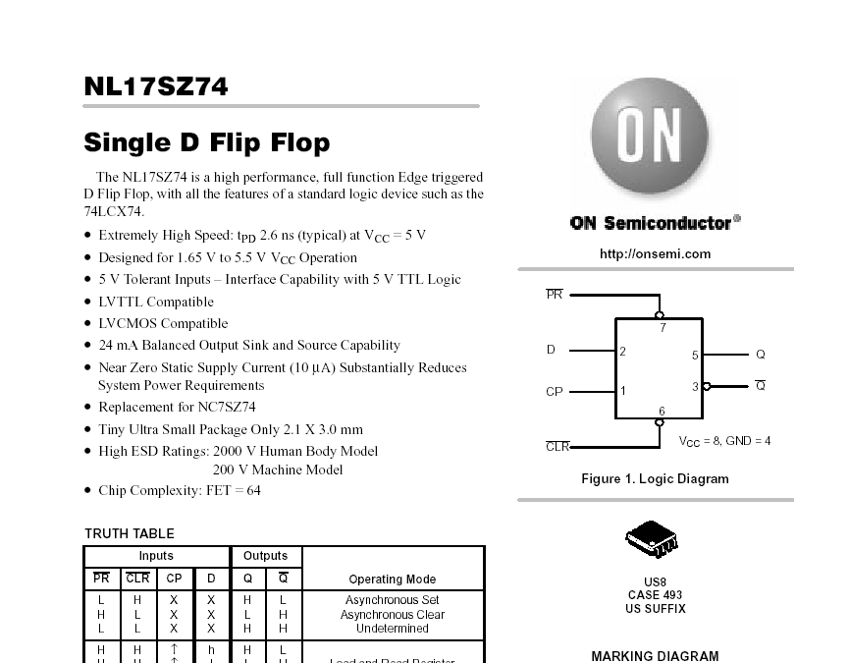
Flip-Flop Parameters
(http://www.onsemi.com/pub/Collateral/NL17SZ74-D.PDF)

Slide 143
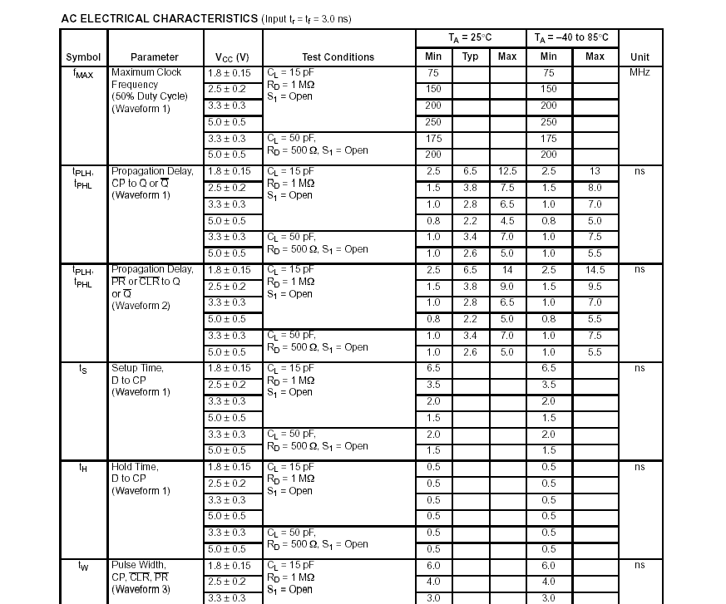
Flip-Flop Parameters

Slide 144
Flip-Flop Parameters Hold Time Failure
D1 Q1
D2 Q2
CLK
CLK
Why are these values important?
What happens when TclkQ is fast and there is a long hold time?
t_{setup}
Clk
t_{hold}
D1
Q1=D2
t_{clkQ}
Q2

Slide 145
Flip-Flop Parameters Hold Time Success
D1 Q1
D2 Q2
CLK
CLK
Why are these values important?
What happens when TclkQ is slow and there is a short hold time?
t_{setup}
Clk
t_{hold}
D1
Q1=D2
t_{clkQ}
Q2

Slide 146
Flip-Flop Parameters - Setup Time Failure
D1 Q1
D2 Q2
CLK
CLK
Why are these values important?
What happens when TclkQ is very slow and there is a long setup time?
t_{setup}
t_{setup}
Clk
t_{hold}
t_{hold}
D1
Q1=D2
t_{clkQ}
t_{clkQ}
Q2

Slide 147
Flip-Flop Parameters Setup Time Success
D1 Q1
D2 Q2
CLK
CLK
Why are these values important?
What happens when TclkQ is slow and there is a short hold time?
t_{setup}
t_{setup}
Clk
t_{hold}
t_{hold}
D1
Q1=D2
t_{clkQ}
t_{clkQ}
Q2

Slide 148
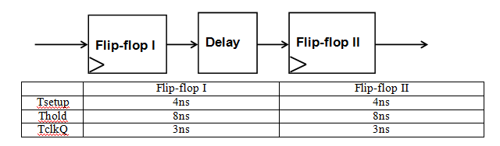
Example problem
Draw the timing diagram for the following cases. Tell me if there is a hold-time or setup-time violation or if they will work just as they are. If a violation occurs, identify the flip-flop where it occurs and what violation it is.
What happens if there is no delay (Delay = 0ns)?
What happens if there’s a 15ns period and delay=3ns?
What happens if there’s a 15ns period and delay=9ns?

Slide 149
Substrates

Slide 150
Substrates
FPGA
FPAA
Breadboard
PCB (Printed circuit board)
PAL (POS), PLA (SOP)
ASIC, Custom
When is each good?

