Slide 1
CMOS Power Dissipation

Slide 2
Schedule
Today:
Finish inverter delay
Power
Wednesday:
Power
Delay of complex CMOS
Friday
Complex circuit delay continued
If time, start sequential circuits (Gate level)

Slide 3
Big three
Area
Speed
POWER

Slide 4
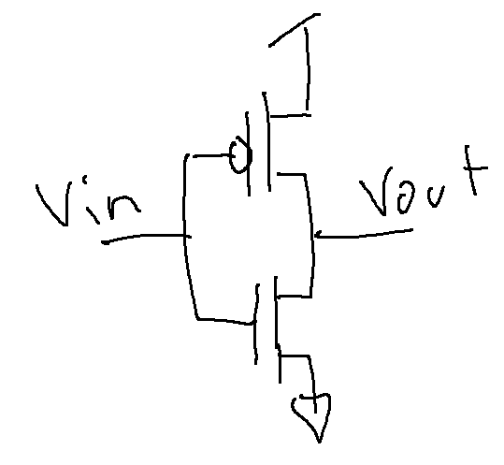
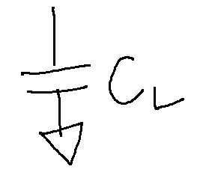
Power used by CMOS Power is only used when it comes off of the supply
Leakage
Leaking diodes and transistors
Dynamic Power Consumption
Charging and Discharging capacitors
0
VDD
VDD
0

Slide 5
Power used by CMOS Power is only used when it comes off of the supply
Leakage
Leaking diodes and transistors
Dynamic Power Consumption
Charging and Discharging capacitors
Short Circuit Currents
Short circuit path between supply rails during switching
0
VDD
VDD
0

Slide 6
Where Does Power Go in CMOS?
Dynamic Power Consumption
Charging and Discharging capacitors
Short Circuit Currents
Short circuit path between supply rails during switching
Leakage
Leaking diodes and transistors

Slide 7
Leakage / subthreshold conduction
Power

Slide 8
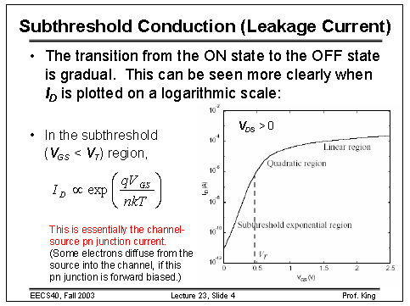

Slide 9
Subthreshold current (Leakage current)
Often nano-amps
http://www-inst.eecs.berkeley.edu/~ee130/sp06/chp7full.pdf

Slide 10
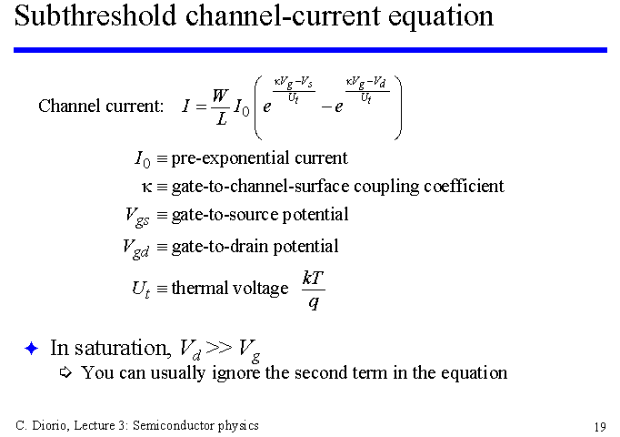
Leakage current https://courses.cs.washington.edu/courses/cse468/00wi/admin/Slides/Lecture3/img019.gif
Sub-threshold current one of most compelling issues
in low-energy circuit design!

Slide 11
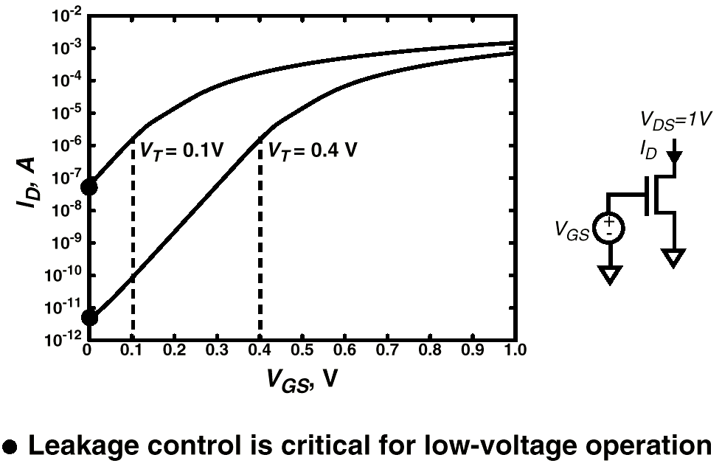
Subthreshold Leakage Component

Slide 12
Reverse-Biased Diode Leakage
JS = 10-100 pA/μm2 at 25 deg C for 0.25μm CMOS
JS doubles for every 9 deg C!

Slide 13
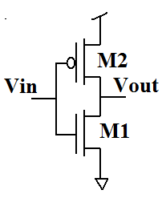

What leaks?
Everything:
$I_{M2}=I_{CAP}$+$I_{M1}$
P=I·V
V=VDD

Slide 14
Short circuit current
Power

Slide 15
Short circuit current
ON/OFF graph:
Vin on X-axis
ON/OFF on Y-axis
Example 1: (Add line for M1 and M2 )
VTN = 0.5V, VTP = -0.6V, VDD = 3.3V
ON
Vout Pulled up
Vout Pulled down
Short circuit current
OFF
Vin
0 0.5 1.0 1.5 2.0 2.5 3.0 3.5

Slide 16
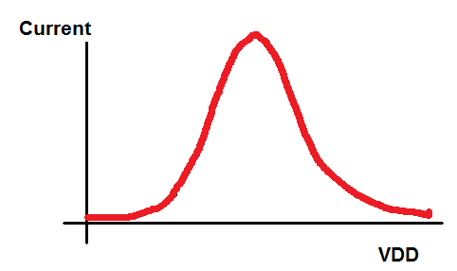
What current graph looks like
VDD > VTP+VTN

Slide 17
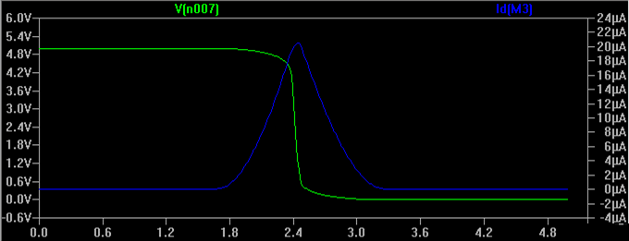
Short circuit current

Slide 18
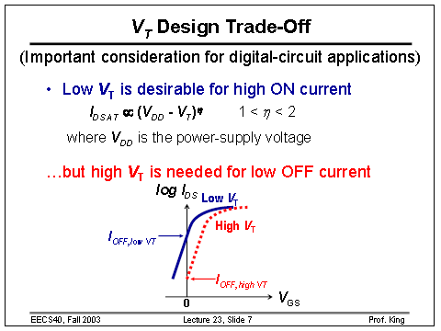

Slide 19
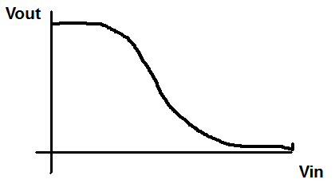
Moving VT (VTC)

Slide 20
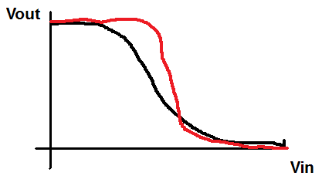
Increased VT (VTC)

Slide 21
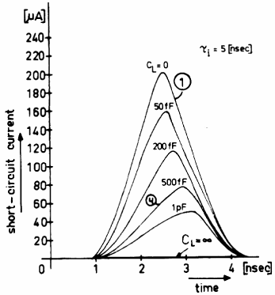
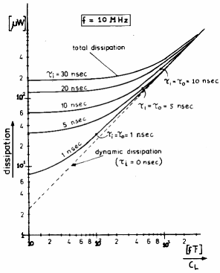
How to keep Short-Circuit Currents Low?
Quick transitions

Slide 22
Short circuit current
ON/OFF graph:
Vin on X-axis
ON/OFF on Y-axis
Example 1: (Add line for M1 and M2 )
VTN = 0.5V, VTP = -0.6V, VDD = 1V
What happens in that center section?
ON
Vout Pulled up
Open circuit
Vout Pulled down
OFF
Vin
0 0.2 0.4 0.6 0.8 1.0 1.2

Slide 23
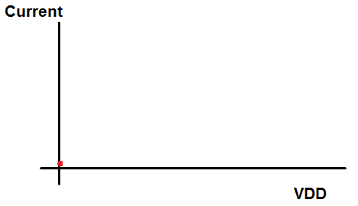
What current graph looks like
VDD < VTP+VTN

Slide 24
What current graph looks like
VDD < VTP+VTN
Vin
time

Slide 25
What current graph looks like
VDD < VTP+VTN
Vin
time

Slide 26
How to keep Short-Circuit Currents Low?
Quick transitions
??? Short circuit current goes to zero if t_{fall} >> t_{rise},
but can’t do this for cascade logic, so ...

Slide 27
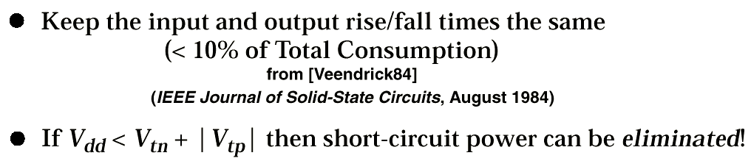
Minimizing Short-Circuit Power
Vdd =3.3
Vdd =2.5
Vdd =1.5

Slide 28
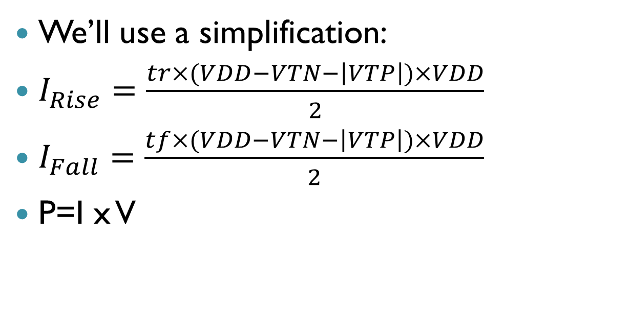
Short circuit current
We’ll use a simplification:
$I_{Rise}=\frac{tr×(VDD−VTN−\left|VTP\right|)×VDD}{2}$
$I_{Fall}=\frac{tf×(VDD−VTN−\left|VTP\right|)×VDD}{2}$
P=I x V

Slide 29
Dynamic power
Power

Slide 30
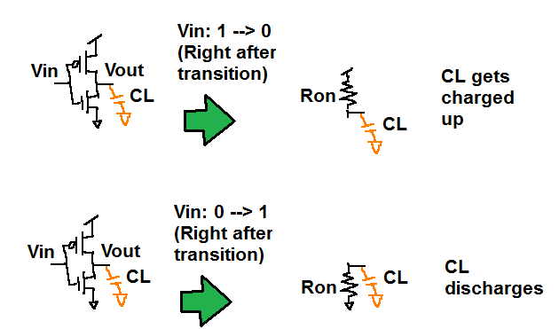
Dynamic power consumption
Uses power
Uses no power

Slide 31
Dynamic leakage math (Single transition)
Energy taken from supply: (Power used)
Energy put on capacitance: (Power stored)

Slide 32
Dynamic power consumption (Single transition)
Uses power
Power put onto cap:
Uses no new power
Power discharged from cap:

Slide 33
Once again….
Power is only used on LH transitions (output goes from low to high) ➔ Cap is being charged
Power is not used on HL transitions (output goes from high to low) ➔ Cap is discharged

Slide 34
Dynamic power consumption (Power=Energy/time)

Slide 35

How to reduce power
Vdd
fclk
CL
Α_{0→1}

Slide 36
Static Power consumption
Power

Slide 37
Static Power Consumption
Ratioed logic
Wasted energy …
Should be avoided in most cases,
Notes:
but could help reducing energy in others (e.g. sense amps)

Slide 38
Power reduction
Power

Slide 39
Principles for Power Reduction
Prime choice: Reduce voltage!
Recent years have seen an acceleration in supply voltage reduction
Design at very low voltages still open question (0.6 … 0.9 V by 2010!)
Reduce switching activity
Reduce physical capacitance
Device Sizing: for F=20
f_{opt}(energy)=3.53, f_{opt}(performance)=4.47

Slide 40
Power delay product
Power at maximum frequency times delay = Power delay product (PDP)
Can reduce by lowering VDD (since it’s squared) so not best metric
Energy delay product:

Slide 41
Optimal VDD

Slide 42
Sizing for minimum delay

Slide 43
Inverter Chain
In
Out
C_{L}
If C_{L} is given:
How many stages are needed to minimize the delay?
How to size the inverters?
May need some additional constraints.

Slide 44
Buffer Design
N f t_{p}
1 64 65
2 8 18
3 4 15
4 2.8 15.3
1
64
1
8
64
1
4
16
64
1
22.6
64
2.8
8

Slide 45
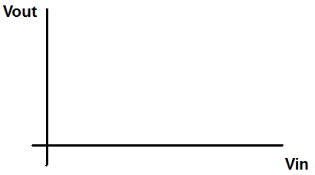
Delay
e

Slide 46
Inverter with Load
Delay
R_{W}
C_{L}
R_{W}
Load (C_{L})
t_{p} = 0.69 R_{W}C_{L}
Assumptions: no load → zero delay
W_{unit} = 1

Slide 47
Fan out
C_{P} = 2C_{unit}
Delay
2W
W
C_{int}
C_{L}
C_{N} = C_{unit}
Load

Slide 48
Example
In
Out
1
f
f²
C_{L}= 8 C₁
C₁
C_{L}/C₁ has to be evenly distributed across N = 3 stages:

Slide 49
Clock distribution

Slide 50
Clock trees
A path from the clock source to clock sinks
Clock Source
FF
FF
FF
FF
FF
FF
FF
FF
FF
FF
Notes:
The goal of a clock tree is to get the clock signal from a clock source to clock sinks. The relative arrival times, shape, and amplitude of the clock signal at the sinks need to meet certain criteria for the circuit to work correctly. Simple wires are susceptible to influences of signals in nearby wires and their own parasitics among other things that may compromise the integrity the signal and cause the signal arriving at the sinks to be unacceptable.

Slide 51
The clock distribution problem
Large Chip Area
Non-uniform distribution of flip-flops
It’d be nice if all flip-flops need to get clock signal at the same time
Power budget
Clock routing: Hard problem

Slide 52
Clock trees
A path from the clock source to clock sinks
Clock Source
FF
FF
FF
FF
FF
FF
FF
FF
FF
FF
Notes:
Buffering, which restores the signal and reduces delay, helps to guarantee the integrity of the clock signal. These are the two steps that are carried out in the clock tree generation steps in the SSHAFT flow.

Slide 53
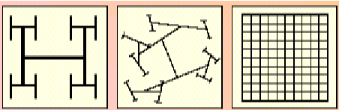
Clock Trees
 | + | - | Design
H-Tree | Timing Balanced Routing Easy | Slightly Power Wasteful | Top-down
Balanced | Power Tunable | Hard to Balance Buffers | Bottom-up
Grid | Routing Easy | Power Hungry | Design Independent
_{“Growing Your Own Clock-Tree”,}
EDN Magazine, March 14, 1997,J.Lipman

Slide 54
Stages of Clock design
Global Routing (matched impedance)
Impedance matching at every block
Local Routing within every block
Toplevel
B2
B3
B1

Slide 55
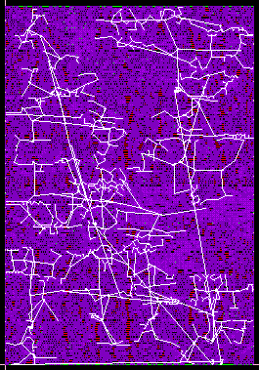
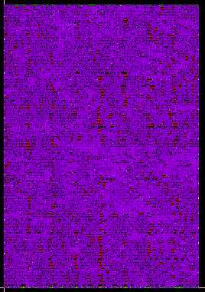

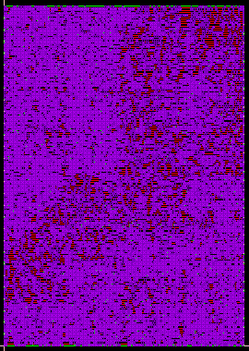
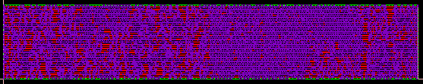
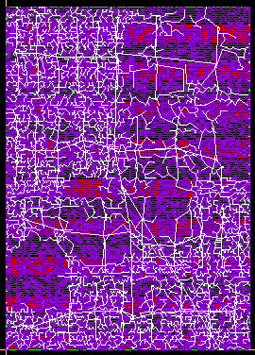
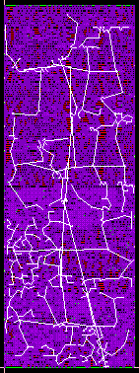
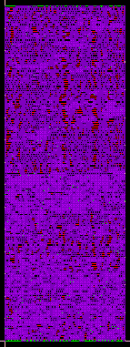
Hierarchical design
Toplevel
Worst Case Insertion Delay
Notes:
When we first started automating clock tree generation, we didn’t know yet how to use CTGen to build the top level clock tree and assumed we’d (read Rhett) would have to do it by hand. To make that as easy as possible, we decided to tell CTGen to make the insertion delays of each block, and therefore their skew, as close as possible. This would mean that the toplevel tree would be relatively easy to build with all its leaves with the same insertion delays.
In this scenario, the user tells the flow which block it thinks will have the worst insertion delay. The flow runs it with strict restrictions on the skew but allowing the block to take as much insertion delay as it needs. The resulting insertion delay for that block becomes the insertion delay requirement for the rest of the blocks.

Slide 56
Hierarchy
Building clock trees for hierarchical designs
Toplevel Block
Clock Source
Block 1
Block 2
FF
FF
FF
FF
FF
FF
FF
FF
Notes:
For hierarchical designs, the clock tree is built in a bottom-up fasion. Each block has its clock tree built separately. Then each block’s delay information is grabbed in a TLF file, generated using Cadence’s Affirma Pearl Timing Analyzer. These blocks are then turned into abstract view in views which contain them and CTGen run on the containing views.
One thing that I’ve been looking into is how to better build the clock trees for each block, such that the entire clock tree functions correctly, first of all, but also how different methods of inserting the clock tree into the blocks can affect power usage, process variation sensitivity and run time of the SSHAFT flow.

Slide 57
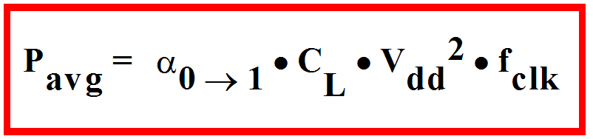
Back to: Power
What is switching probability of the clock?
What is the capacitive load?
How can you reduce power consumption?

Slide 58
AMD, Intel…
Adding circuitry to compare arrival time of parallel blocks
Reduce power to leading block
Reduce frequency → Lower supply voltage
Measure power of blocks and keep it under a certain level to control heat

Slide 59
Gating & Voltage levels
Hierarchical Levels
Global Clock(GC)
GC
EN
Block
GC
GC
EN
Block
Notes:
The reason we need to do this is that when a design enters the flow, it has no clock tree. Simulink is used as the design entry tool and the view that comes from Simulink includes the clock sinks but no clock nets. Simulink also offers optional enable signals to blocks represented here by the outputs of FSM blocks. These Enable signals are one of the SSHAFT flow’s power reduction methods and specify gated regions. The first job of clock tree generation is to attach the clocks, possibly through multiple levels of hierarchy, such that they are gated according to the Enable signals.
As you can see here, The Enable signals from the FSMs are disconnected and fed into the Enable of a clock gating circuit. The global clock is also fed into this block. The output of this block is exactly the global clock when enabled and unchanging when disabled. If there are nested gated regions, then the process is repeated at the lower level except that both the outer and inner FSMs must be enabled for the next level to be enabled.

Slide 60
Directives in clock tree design
M5 for horizontal lines
M6 for vertical lines

