Slide 1

NFL Matchup Predictor
Brian Cooper
Caleb Wolf
Matt Swanwick
Simone Allen

Slide 2
Purpose
To retrieve multiple, previous years of regular season NFL game results to predict the outcomes matchups outside of our dataset.
We planned to look at factors such as home team, visiting team, point differential, winning/losing streaks, location, and weather to see if they have an impact on the outcome.

Slide 3
Game Plan
To accomplish this, we planned to perform the following actions:
Retrieve historical data from Wikipedia by using a combination of Pandas and BeautifulSoup.
Clean the data and export it in CSV format using Pandas.
Consume the cleaned data in a machine learning model (TBD) to train the data for predictive purposes.
Build a user interface that accepts game parameters (including but not limited to) opponents, location, weather and produces a predicted outcome.

Slide 4
Assumptions
Different machine learning models will produce different outcomes. We expect to test-drive a few to dial-in our model such as Birch, Random Forest, and Neural Network.
A web user interface will be developed using JavaScript and Flask, but if we run into complexities we can't overcome, we will build a prompt-driven python script.
The initial data points we obtain will be sufficient for creating an accurate model. If they aren't, we may need to pull in more data/statistics to incorporate in the model.
Past results will be a contributing factor to future results. NFL teams have many variables year-to-year including roster moves, coaches, and injuries.

Slide 5
Audibles
Based on time constraints, we only pulled and cleaned one complete season of outcomes (2022 season).
Accuracy rates were much lower than desired using the models we initially tried (Random Forest, Neural Network), so we created KNN and Logistic Regression models as well, with the KNN model performing the best.

Slide 6
Grabbing the Data
Sources:
Wikipedia pages for each team’s 2022 season results.
Used a combination of pandas from_html for table data and BeautifulSoup screen scraping for individual game conditions (weather, kickoff time, and location).
Outputs:
Individual unclean CSV for each NFL team.

Slide 7
Wrangling the Data
Sources:
Individual unclean CSV for each NFL team.
Output:
Combined home and away participants into one outcome record.
Calculated win/loss ratio, win/loss streaks, average points for and against.
One, master CSV with all outcome data captured.

Slide 8
Building the Model
Sources:
One, master CSV with all outcome data captured.
Output:
Standard scaler for the data.
KNN model export with a testing accuracy score > 75%.
PCA model and seven other models that did we did not end up using due to lower accuracy results.

Slide 9
Application Building
Sources:
One, master CSV with all outcome data captured.
Referential CSV data for building HTML dropdowns.
Standard scaler for the data.
KNN model export.
Output:
Wizard based web user interface that captures matchup data (teams, location, weather conditions, and team statistics) that predicts the matchup winner, displaying the winning team’s logo.

Slide 10
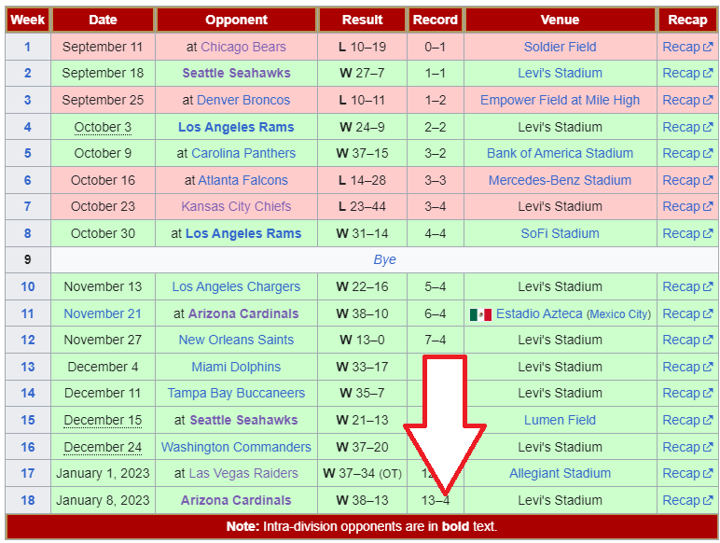
Mistakes Made/Lessons Learned
When grabbing the data from Wikipedia, we noticed that not all team data was consistently displayed. This made the exporting and cleaning the data a long and difficult task and was prohibitive for us pulling multiple years worth of statistics.
Here is one example, where the results table had an extra row, which caused issues with our parsing algorithm.

Slide 11
Live Demo

Slide 12
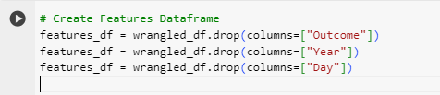
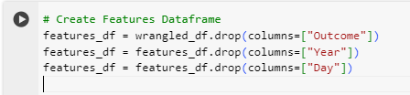
Mistakes Made/Lessons Learned

Slide 13
Post-Game Press Conference (Things we would have done differently)
Obtain multiple years worth of data.
Predict the actual score of the game – not just the winner.
Add the ability to predict multiple games or an entire season – instead of just one matchup at a time.
Use a relational database to store our raw data instead of CSV files.

Slide 14
Questions?

