Slide 1
Data
Pinned-Pinned
Load(lb) | Deflection(in)
8 | 0
21 | 0
34 | 0
51 | 0
60 | 0
67 | .015
74 | .031
83 | .060
91 | .099
97 | .145
104 | .217
110 | .412
116 | .490
121 | .618
Fixed-Pinned
Load(lb) | Deflection(in)
14 | 0
32 | 0
48 | 0
62 | 0
75 | 0
102 | 0
137 | 0
161 | -.009
175 | -.023
190 | -.045
206 | -.083
222 | -.21
228 | -.357
Fixed-Fixed
Load(lb) | Deflection(in)
28 | 0
60 | 0
103 | 0
135 | 0
184 | -.004
261 | -.034
289 | -.057
317 | -.099
335 | -.147
358 | -.215
378 | -.331
393 | -.470
395 | -.531

Slide 2
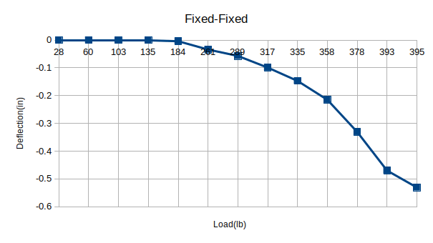
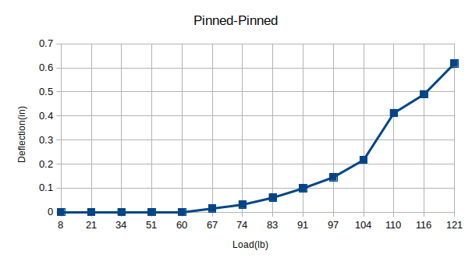
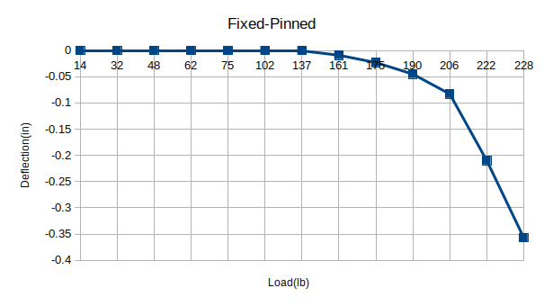
Data

Slide 3
Group Member Assignment
JoPaul Scavella – Mounting beams and applying loads
Jamaal Sherman – Recording data and applying loads
Logan Smothers – Calculations and recording data
Zachary Stovall – Mounting beams and applying loads
Cory Wolfe – Measuring beams and recording data

