Slide 1

FUSION CONNECT GROUP
COMPANY INTRODUCTION / 2026
The Next-Generation Global
Business Travel & Payment Network
Fusion Connect Group — started in China, now global, with China still our core strength.
13+
USD 3B+
4.35M+
220+
YEARS IN CORPORATE TRAVEL
CUMULATIVE PLATFORM GMV
GLOBAL HOTEL RECORDS
COUNTRIES COVERED
fusionconnectgroup.com
CONFIDENTIAL

Slide 2
SECTION 01 OF 04
01
About Us
Who we are, our decade-long track record, the clients we serve, and where we operate.
01 About Us
02 Network
03 Products
04 Ultimate Goal
FUSION CONNECT GROUP
CONFIDENTIAL
02

Slide 3
01 / OUR THESIS
We are rebuilding the rails of
global business travel.
Corporate travel still runs on centralized GDS infrastructure designed decades ago — intermediated, costly, and rigid. FCG is the modern alternative: a direct, AI-powered booking and payment network that connects buyers and suppliers worldwide.
Direct & Decentralized
AI-Native
Borderless
Buyers connect straight to suppliers — no middleman, no fees — across a network with no central point of failure.
Intelligence across the full chain — sourcing, booking, servicing, settlement.
Two-way by design: China outbound and global inbound, on one network.
FUSION CONNECT GROUP
CONFIDENTIAL
03

Slide 4
01 / ABOUT FCG
Fusion Connect Group
Founded 2013 in Shenzhen. A next-generation business-travel technology infrastructure group — grown from China into a global network, with our China presence being our deepest strength.
WHAT WE DO
2013
Hotel supply-chain business established in Shenzhen — direct contracting & RFP platform
Global Distribution Network
2015
Titan Cloud SaaS platform launched — hotel supply infrastructure
Decentralized hotel & flight supply across 220+ countries
2016
Connected to Ctrip & Meituan — annual GMV surpasses USD 150M
Cross-Border Payments
2017
System integration with the Top 60 domestic & global hotel groups
Compliant payment & settlement into and out of China
2019
AMT corporate-travel brand — unified booking & supply
Platforms & Tooling
2021
Resilient through COVID — revenue 300% above pre-COVID 2019 levels
CBT, AI Booking Tool, Atlas TMC OS & open API connectivity
2023
Flight supply established — F-Link with GDS, NDC & LCC connectivity
Enterprise Delivery
2025
Fusion Connect Group global brands — distributed worldwide supply network
Top-tier corporate travel programs, end to end
FUSION CONNECT GROUP
CONFIDENTIAL
04

Slide 5
01 / SCALE
Proven at enterprise scale
Over a decade compounding the deepest negotiated-hotel supply, the most demanding clients, and the strongest compliance record in the China market.
USD 3B+
13+ YRS
#1
CUMULATIVE PLATFORM GMV
OPERATING TRACK RECORD
CHINA NEGOTIATED-HOTEL SCALE
Transacted across the platform to date
Profitable through-cycle delivery
Largest & deepest provider
4.35M+
220+
50+
GLOBAL HOTEL RECORDS
COUNTRIES COVERED
ENTERPRISE CLIENTS
1.35M+ in China · 135K+ direct contract independents
GDS · NDC · LCC flight content worldwide
Central SOEs & Fortune Global 500
FUSION CONNECT GROUP
CONFIDENTIAL
05

Slide 6

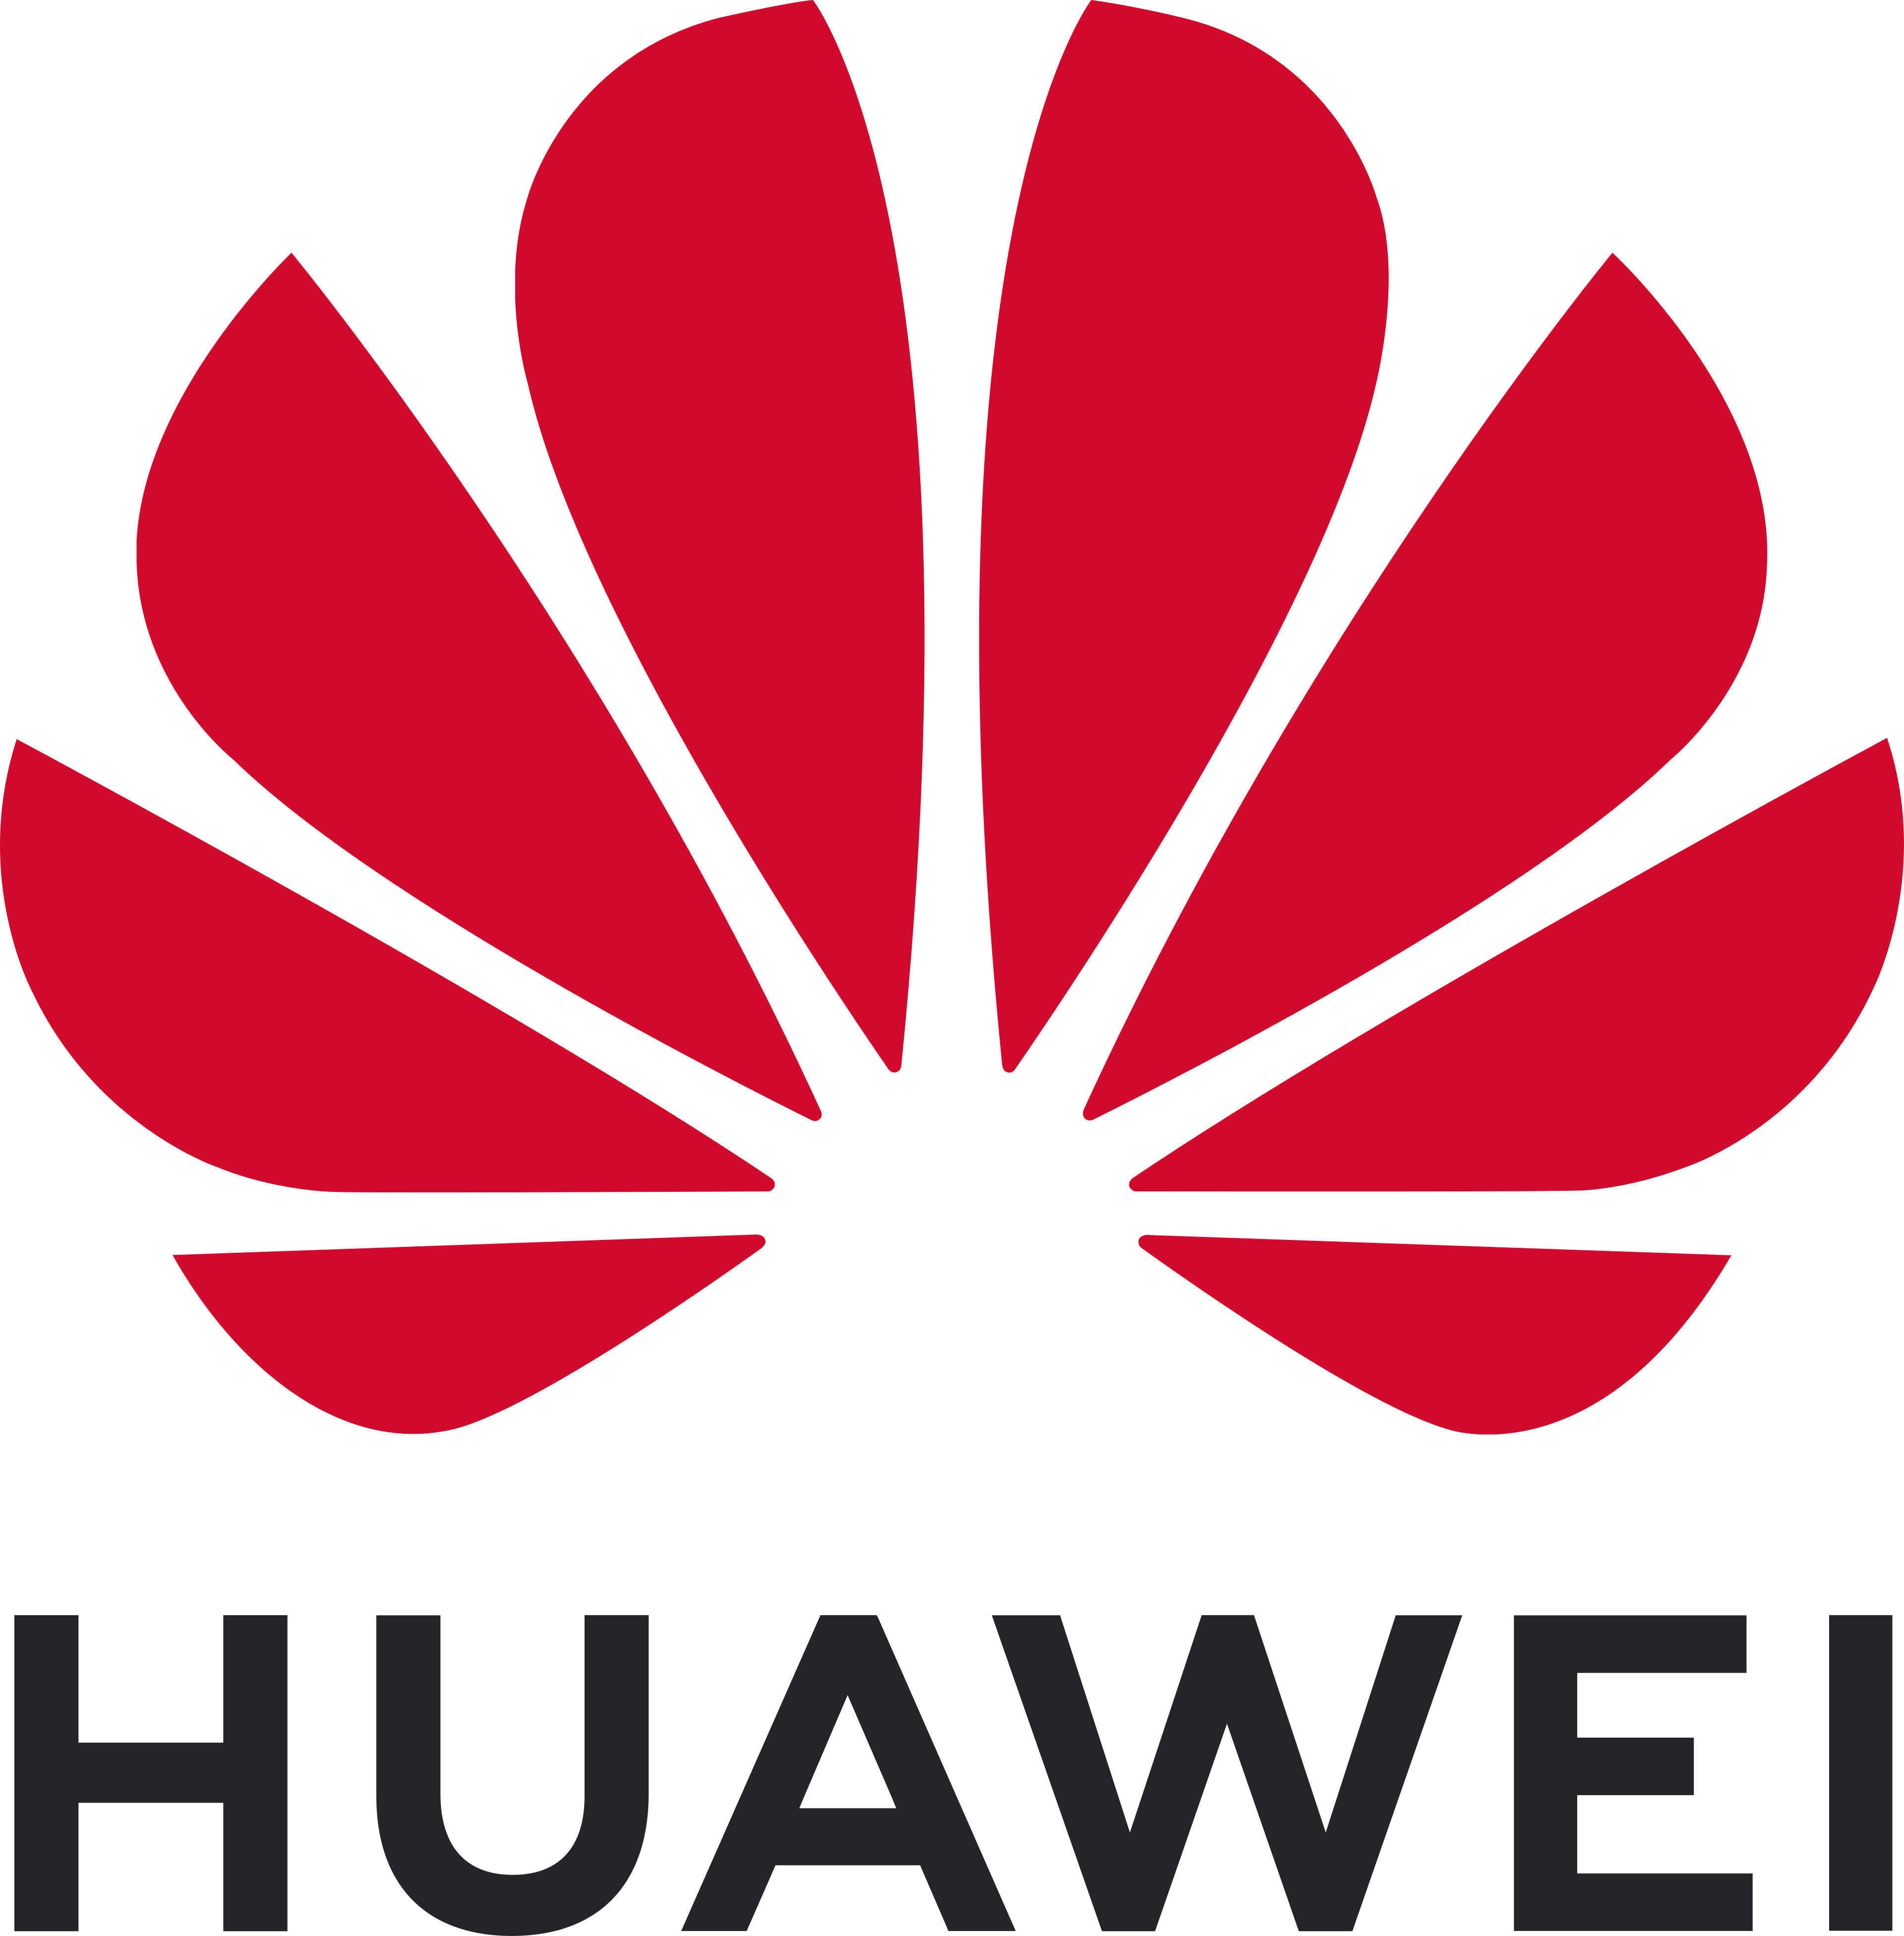


01 / CLIENTS
Trusted by China's leading enterprises
Long-serving central state-owned enterprises and Fortune Global 500 leaders rely on FCG to run mission-critical corporate travel.
+ State Grid · China Mobile · Ping An and many more across energy, technology, manufacturing & financial services.
FUSION CONNECT GROUP
CONFIDENTIAL
06

Slide 7







01 / GLOBAL FOOTPRINT
Where we operate
Headquartered in Hong Kong, strongest in China — global servicing from Kuala Lumpur, with APAC and European reach.
HEADQUARTERS
Hong Kong
Shenzhen
GLOBAL HEADQUARTERS
CHINA HQ & TECHNOLOGY CENTRE
SERVICING CENTRES
Kuala Lumpur
Wuhan
GLOBAL SERVICING CENTRE
CHINA SERVICING CENTRE
COMMERCIAL OFFICES
Beijing
Shanghai
Singapore
Thailand
Vietnam
London
COMMERCIAL
COMMERCIAL
COMMERCIAL
COMMERCIAL
COMMERCIAL
COMMERCIAL
FUSION CONNECT GROUP
CONFIDENTIAL
07

Slide 8
SECTION 02 OF 04
02
Network
The market, the gap, and the decentralized AI-native infrastructure — ADDN — that captures it.
01 About Us
02 Network
03 Products
04 Ultimate Goal
FUSION CONNECT GROUP
CONFIDENTIAL
08

Slide 9
02 / WHY NOW
Three shifts have opened the window
The architecture of travel distribution is up for grabs for the first time in a generation — and two-way China travel is wide open.
01
02
03
China travel is roaring back
The GDS lock is breaking
AI + cloud reset the cost base
Outbound is reclaiming its #1-in-the-world spot (~145M trips/yr) and inbound spend rose ~15% to USD 135B — demand surging in both directions.
Airlines are attacking GDS segment fees and pushing NDC; legacy TMCs are still not delivering it. The centralized model is loosening for the first time.
Cloud-native, AI-native challengers (Navan's USD 6.2B IPO, Spotnana) have proven the model — the infrastructure layer can be rebuilt from scratch, now.
THE OPENING Incumbents are distracted by consolidation (Amex GBT–CWT, Sabre, Amadeus). The window to own the next-generation network — and two-way China travel — is now.
Sources: GBTA Business Travel Index 2025 · WTTC 2026 · UN Tourism · public company disclosures.
FUSION CONNECT GROUP
CONFIDENTIAL
09

Slide 10

02 / THE PRIZE
A USD 1.6T market — and the two-way flow only we serve
Global business travel is at an all-time high — and its fastest-growing, least-served segment is two-way China travel.
USD 1.57T
China is the #2 market on earth at USD 373B — China + US alone are ~58% of the top 15 markets.
USD 2T+
GLOBAL BUSINESS-TRAVEL SPEND, 2025
BY 2029 · ~7% CAGR
USD ~280B
USD 135B
CHINA OUTBOUND
CHINA INBOUND
World's largest source market, ~145M trips/yr — and rebounding fast.
Foreign-visitor spend, up ~15% YoY — the fastest-growing major market.
THE WEDGE Legacy GDS serves the global market one way. No one bridges China in both directions, compliantly — that gap is FCG's.
Sources: GBTA Business Travel Index 2025 (US $395B, China $373B) · WTTC 2026 · UN Tourism · FMI. Figures rounded.
FUSION CONNECT GROUP
CONFIDENTIAL
10

Slide 11

02 / WHERE WE PLAY
Where FCG sits — in the white space no one owns
APPLICATION / TMC
THE CURRENT LANDSCAPE
Navan
Trip.com
Western platforms (Spotnana, GDS)
Global, but can't transact compliantly into China.
TravelPerk
REGIONAL · ONE-WAY
CHINA TWO-WAY + GLOBAL
China OTAs (Trip.com)
Deep in China, but no global network of their own.
Spotnana
New TMCs (Navan, TravelPerk)
Demand-side apps that rely on others' supply.
Legacy GDS
FCG
FCG — its own network, serving two-way China travel and scaling worldwide.
OWNED INFRASTRUCTURE
Illustrative positioning. Sources: company disclosures · Tracxn · industry analysis 2025–26.
FUSION CONNECT GROUP
CONFIDENTIAL
11

Slide 12
02 / THE OPPORTUNITY
Legacy GDS was not built for this world
The incumbent distribution model is costly and rigid, leaving a market gap no global player has closed — least of all in two-way China travel.
Centralized & dated
High take-rate
Rigid & one-way
Poor market fit
Decades-old, monolithic architecture — slow to evolve, single points of failure.
Layered commissions and fees inflate the cost of every transaction.
Closed, one-directional distribution that's hard to adapt or scale.
Cannot adapt to China's rules, local supply, or compliant cross-border payment.
The opportunity
A low-cost, high-efficiency, fully traceable network — China-compliant and globally replicable — that closes the gap legacy GDS leaves open on both sides of the border.
FUSION CONNECT GROUP
CONFIDENTIAL
12

Slide 13


02 / STRATEGY
In China · Out China — a two-way global network
China as the central hub of a worldwide accommodation, distribution and cross-border payment network — flowing in both directions.
OUT CHINA
OUT
IN CHINA
China outbound — enterprises going global
Global inbound — the gateway into China
Connect Chinese multinationals to global hotel supply, overseas travel inventory and cross-border payment — one-stop procurement, control and settlement.
Open standardized China hotel supply and localized, compliant payment to overseas TMCs, international agencies and foreign business travelers.
CHINA
HUB
Global supply for central SOEs & large enterprises
Ready-to-integrate China local supply chain
Standardized, centralized overseas travel management
Localized, compliant cross-border payment
Unified cost control & compliance, worldwide
Closes the gap legacy GDS cannot serve
IN
FUSION CONNECT GROUP
CONFIDENTIAL
13

Slide 14
02 / TECHNOLOGY
ADDN — the AI-native decentralized network
The AI-Powered Decentralized Distribution Network — an industry-first, independently deployable travel & payment infrastructure that replaces the centralized GDS core.
01
02
03
Always on, scales on demand
No middleman, no markup
Full-Chain AI Intelligence
Cloud-native and distributed — runs across many independent hubs, with no central system to overload or crash.
Demand connects straight to supply — cutting out the intermediaries and the fees they add to every booking.
AI runs the whole journey — sourcing, mapping, booking, servicing and settlement, end to end.
THE RESULT
Low cost
High efficiency
Fully compliant
End-to-end traceable
Globally replicable
FUSION CONNECT GROUP
CONFIDENTIAL
14

Slide 15

02 / TECHNOLOGY · LIVE NETWORK
The ADDN network — live and expanding
Three live hubs today — Hong Kong, Singapore and China (Wuhan) — with new regions and countries able to join on demand.
HOW THE NETWORK WORKS
+
Decentralized & autonomous
Each hub runs the full system on its own — no central server, no master hub.
Hong Kong
Singapore
Shares only what’s needed
HUB · HK
HUB · SG
Hubs exchange only what a booking needs — never bulk data — so it stays in its home region.
ESSENTIAL DATA ONLY
+
+
Resilient by design
If one hub goes offline, the rest keep running — no single system failure can take it all down.
China · Wuhan
HUB · CN
Scale on demand
Add a hub in any new region or country — it joins automatically, with no central rebuild.
LIVE · 3 HUBS
EXPANSION-READY — ADD ANY REGION OR COUNTRY
FUSION CONNECT GROUP
CONFIDENTIAL
15

Slide 16
02 / TECHNOLOGY · WHY IT WINS
ADDN vs. legacy GDS
LEGACY GDS
FCG ADDN
Architecture
Decades-old, all-in-one system
Cloud-native and flexible
Connectivity
Intermediated, one-directional
Direct buyer-to-supplier
Cost model
Layered commissions & fees
Low-cost, transparent pricing
Flexibility
Rigid, slow to evolve
Modular, independently deployable
China fit
Poor localization, one-way
China-compliant, two-way
Intelligence
Added-on, fragmented
AI built in, end to end
FUSION CONNECT GROUP
CONFIDENTIAL
16

Slide 17
02 / WHY WE WIN
A moat that compounds — and can't be bought
Every hub, client and transaction deepens our supply, data and reach — an advantage a new entrant can't replicate.
Supply that can't be rebuilt
Owned, decentralized network
4.35M+ global hotel records, 1.35M+ China hotel records, 35K+ direct independents, and SOE & Fortune 500 trust built over 13 years — a head start a new entrant can't buy.
ADDN is ours, end to end — no GDS fees, no central dependency, deployable in any market.
In and out of China
Compliant yet expandable
Compliant cross-border payment in both directions. Western systems can't enter China; China OTAs can't go global on owned on a network of their own currently.
Controlled where it must be, deployable wherever it must scale.
NET-NET Supply, network and trust compound together — the moat widens with every hub we add.
FUSION CONNECT GROUP
CONFIDENTIAL
17

Slide 18
02 / TRAVEL CONTENT
Hotel & flight supply
HOTEL SUPPLY
FLIGHT SUPPLY
4.35M+
1.35M+
GDS
Full Amadeus & Sabre connectivity — ticketing, seat maps, corporate fares
GLOBAL HOTEL RECORDS
CHINA HOTEL RECORDS
NDC
35K+
220+
Next-generation airline direct distribution for richer content
DIRECT CN INDEPENDENTS
COUNTRIES
LCC
REGIONAL BREAKDOWN — RECORDS BEYOND CHINA
Low-cost carrier coverage completing the fare ecosystem
RATE LOADING
Corporate rates loaded directly into Amadeus & Sabre GDS
OPEN API PLATFORM · open.fusionconnectgroup.com
Aggregated records across all sources; our API de-duplicates them into unique bookable supply.
FUSION CONNECT GROUP
CONFIDENTIAL
18

Slide 19
SECTION 03 OF 04
03
Products
The modular stack that runs on the network — supply, booking, operations, procurement and payments.
01 About Us
02 Network
03 Products
04 Ultimate Goal
FUSION CONNECT GROUP
CONFIDENTIAL
19

Slide 20
03 / PLATFORM
One modular stack, end to end
Every layer is independently deployable on ADDN — adopt one module or the full network.
FRONT-END
Corporate Booking Tool (CBT)
AI Booking Tool
Booking experiences
MID-END · ATLAS TMC OS
OpsHub
Inbox
Finance
Duty of Care
Reports
Operate & service
BACK-END
G-Link · Hotel Supply
F-Link · Flight Supply
Supply & distribution
SERVICES WRAP
AgreeEase · RFP
Cross-Border Payments
API / Developer Platform
Procure, pay & build
POWERED BY ADDN — AI-powered decentralized distribution & payment network
FUSION CONNECT GROUP
CONFIDENTIAL
20

Slide 21
03 / SYSTEMS
Booking tools
CORPORATE BOOKING TOOL (CBT)
AI BOOKING TOOL
White-label booking for partners
Natural-language travel booking
Fully white-labelled on your own domain
Book via natural-language chat interface
Simple deploy or fully custom build
Book via voice commands
Built for TMCs, resellers & partner agencies
AI trip planning & itinerary builder
Zero heavy IT lift — fast go-to-market
AI-native recommendations
Travel policy & approval workflows built in
Connects to FCG's full content stack
FUSION CONNECT GROUP
CONFIDENTIAL
21

Slide 22
03 / SUPPLY AGGREGATION
G-Link & F-Link
G-LINK
F-LINK
Hotel supply aggregator
Flight supply aggregator
Aggregates hotel supply from GDS, corporate rates, third-party suppliers and Amadeus Value Hotels into one unified, reliable inventory layer.
Centralizes flight inventory, fares and availability across GDS, NDC and LCC — improving booking stability and commercial control.
GDS
Amadeus & Sabre full connectivity
GDS
Amadeus & Sabre global connectivity
CORPORATE RATES
Negotiated & custody rates
NDC
Airline direct distribution standard
3RD-PARTY SUPPLIERS
Aggregated OTA & wholesaler content
LCC
Low-cost carrier content
AVH
Amadeus Value Hotels inventory
BOOKING STABILITY
Pre-validation reduces failures
GDS RATE CUSTODY — corporate hotel & flight rates loaded directly into Amadeus & Sabre
FUSION CONNECT GROUP
CONFIDENTIAL
22

Slide 23
03 / ATLAS
Atlas — TMC Operating System
FCG's centralized operating system for travel teams — communications, operations, finance and duty of care in one platform.
Consolidated Inbox
Operations Hub
Omni-channel unified inbox — Email, WhatsApp, WeChat, SMS, etc — across every traveller touchpoint.
Attach & manage service requests per booking, with escalation workflows & SLA tracking.
Finance & Reconciliation
Duty of Care
Accurate financial reporting and reverse-PNR look-up for fast, clean reconciliation.
Live traveller map, world-events feed, risk policy and AI next-step recommendations.
FUSION CONNECT GROUP
CONFIDENTIAL
23

Slide 24
03 / PROCUREMENT & PAYMENTS
Sourcing & cross-border settlement
AGREEEASE · RFP & PROCUREMENT
CROSS-BORDER PAYMENTS
End-to-end sourcing for modern travel teams
Compliant settlement, in and out of China
Replaces spreadsheets and email — source, negotiate, contract and enforce hotel rates globally.
In partnership with Conferma — solving the structural failure of cross-border hotel payment into China.
>70%
market VCC-to-China failure rate today — the gap FCG & Conferma are built to close.
Full RFP lifecycle Sourcing, negotiation & contracting in one place
AI rate monitoring Automated compliance checks & real-time tracking
Global-to-China VCC Pay any China hotel by virtual card — even local & regional chains that can’t accept international cards.
Global rate custody Guaranteed rate access across every channel
Traveller incidentals On request, FCG settles in-stay charges — Wi-Fi, F&B and more — for a seamless trip.
Audit trails Detailed reporting on every procurement action
GDS billing Consolidated billing & reconciliation
FUSION CONNECT GROUP
CONFIDENTIAL
24

Slide 25
SECTION 04 OF 04
04
Ultimate Goal
Where this is going — and the network we intend to become.
01 About Us
02 Network
03 Products
04 Ultimate Goal
FUSION CONNECT GROUP
CONFIDENTIAL
25

Slide 26
04 / ULTIMATE GOAL
The default network for global
business travel & payments
Displace the centralized GDS model — and become the network that every enterprise, TMC and traveller runs on, worldwide.
TODAY
1
NEXT
2
ULTIMATE
3
Live across three hubs
A multi-region network
The global default
Three live hubs — Hong Kong, Singapore and China (Wuhan) — running the two-way network, In & Out of China.
New country and regional hubs join on demand — extending coverage, capacity and data residency.
Decentralized, AI-native and borderless — the network business travel and payments run on, everywhere.
FUSION CONNECT GROUP
CONFIDENTIAL
26

Slide 27
One network.
China and the world.
The next-generation, decentralized business-travel and payment network — In China · Out China.
GLOBAL FOOTPRINT
Hong Kong Global HQ Shenzhen China HQ & Tech Kuala Lumpur Global Servicing Wuhan China Servicing
+ commercial offices in Beijing · Shanghai · Singapore · Thailand · Vietnam · London
GET IN TOUCH
hello@fusionconnectgroup.com fusionconnectgroup.com open.fusionconnectgroup.com
© 2026 Fusion Connect Group. All rights reserved.
CONFIDENTIAL

