Slide 1
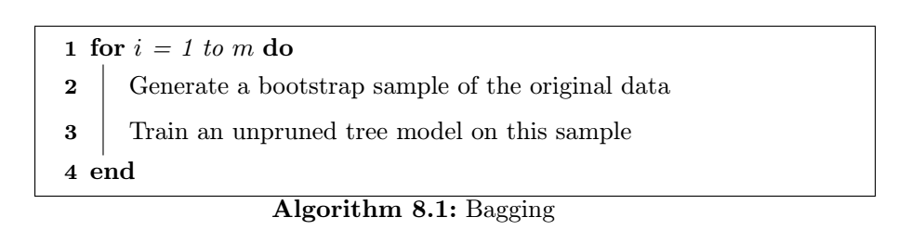
Bagged Trees Introduction
“Bagging predictors is a method of for generating multiple versions of a predictor and using these to get an aggregated predictor”
Leo Breiman, University of California
Bagging Predictors – September 1994
Bootstrap Aggregation aka “Bagging“

Slide 2
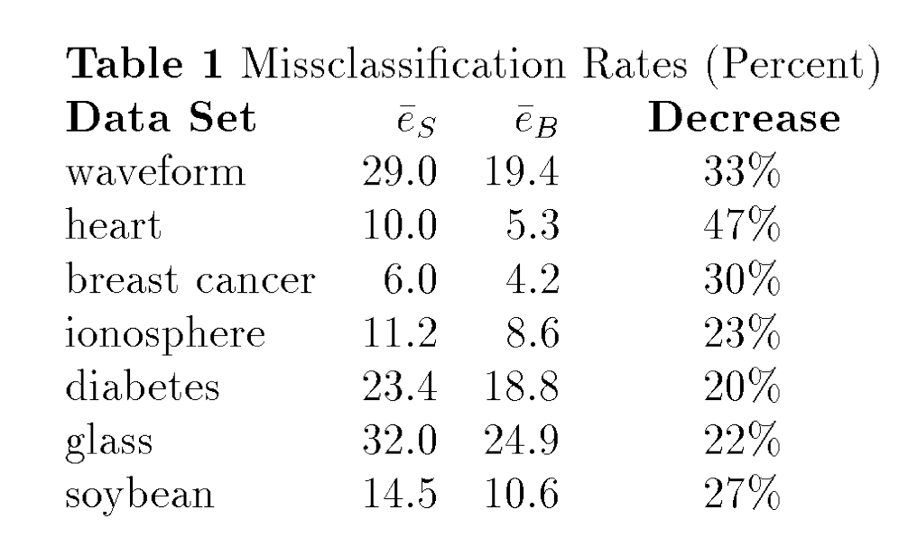
Why use bagging
Bagging effectively reduces the variance of a prediction through its aggregation process
﻿For models that produce an unstable prediction, bagging reduces ﻿the variance in the prediction
Breiman states that we can see a reduction in test set misclassification rates from 20% to 47%

Slide 3
Why use bagging
﻿Bagging models can provide their own internal estimate of predictive performance that correlates well with either cross-validation estimates or test set estimates
﻿Out-of-bag can be used to assess the predictive performance of that specific model
﻿Out-of-bag estimate

Slide 4
Conditions
﻿Bagging can push a good but unstable procedure a significant step towards optimality, however, can degrade the performance of stable procedures
﻿Computational costs and memory requirements increase as the number of bootstrap samples increases
﻿Bagged model is much less interpretable than a model that is not bagged

Slide 5
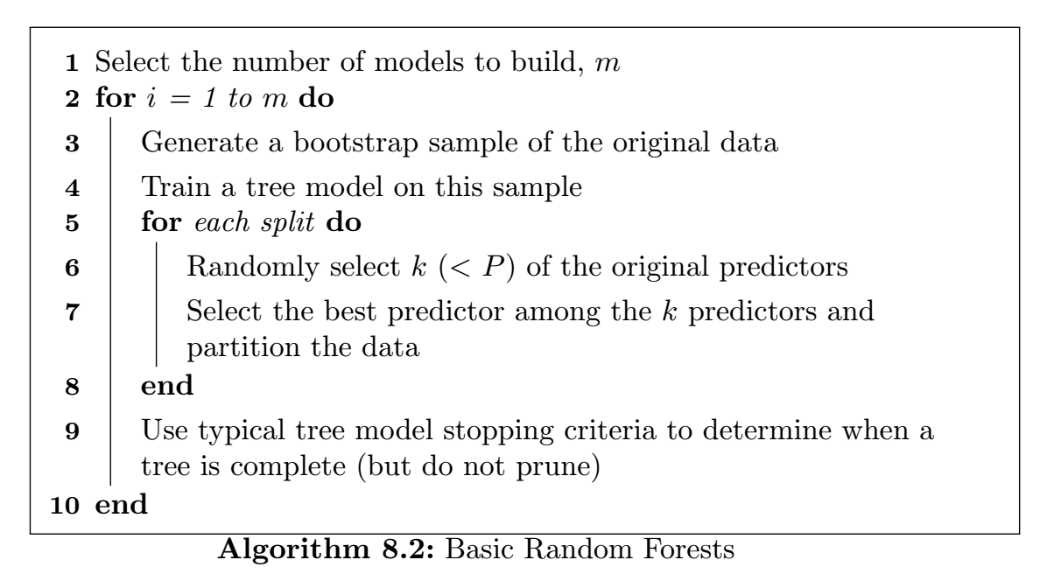
Random Forest Introduction
﻿Reducing correlation among trees, known as de-correlating trees, is then the next logical step to improving the performance of bagging
Through ﻿multiple attempts of generalization the original bagging algorithm, in 2001, Breiman constructed a unified algorithm called random forests

Slide 6
Why use Random Forest
﻿With bagging, the trees are not completely independent of each other since all of the original predictors are considered at every split of every tree
﻿Reducing correlation among trees, known as de-correlating trees, is then the next logical step to improving the performance of bagging.
﻿Compared to bagging, random forests is more computationally efficient on a tree-by-tree basis since the tree building process only needs to evaluate a fraction of the original predictors at each split

Slide 7
Conditions
The larger the forest, the better the results
﻿a starting point, the authors suggest using at least 1,000 trees. If the cross-validation performance profiles are still improving at 1,000 trees, then incorporate more trees until performance levels off
﻿The ensemble nature of random forests makes it impossible to gain an understanding of the relationship between the predictors and the response. However, because trees are the typical base learner for this method, it is possible to quantify the impact of predictors in the ensemble.

