Slide 1
What I've Been Building
Chulwoo Ahn | Elbaph First Meetup

Slide 2
4 Projects
01
Korean Date Guide
AI date course planner
02
Draft
AI English writing coach
03
YouTube / Instagram
Content & social media
04
Elbaph Bot
AI Slack bot for the community

Slide 3
01 Korean Date Guide
AI-powered date course planner for Korean couples
https://korean-date-guide.lovable.app/
What It Does
User Flow
Plan a full date course in under 3 minutes
Input: location, time, activities, mood, budget
AI generates restaurant/cafe/activity recommendations
Build course with drag-and-drop, real-time ETAs
Share via link, image card, or KakaoTalk
1
Location, date, time, duration
2
Pick activities (food, cafe, movie...)
3
Set mood & budget
4
AI recommends places on map
5
Build & reorder your course
6
Share with your partner
Target
Tech Stack
Korean couples in their 20s-30s
Mobile-first, Korean UI
Vite + React 18 + TypeScript + Tailwind + shadcn/ui
Gemini AI (via Supabase Edge Functions)
Kakao Maps SDK + TMAP routing + Google Places
Supabase (auth, DB, edge functions)

Slide 4
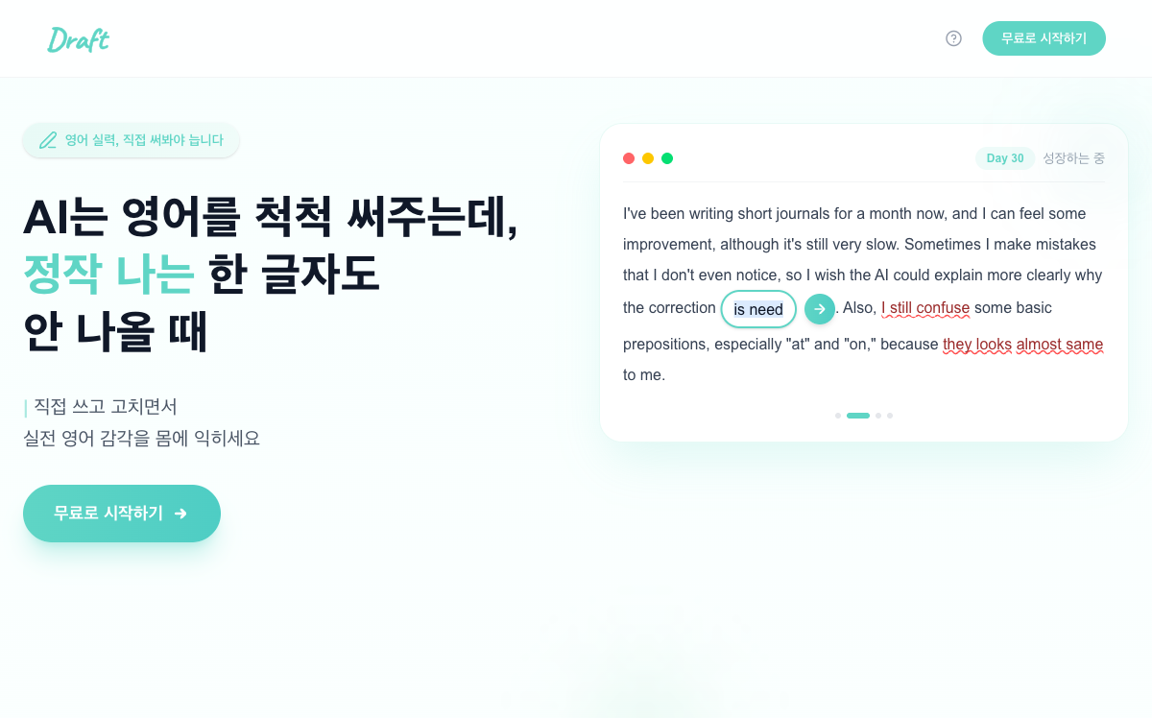
02 Draft — AI English Writing Coach
draft-ai.vercel.app
Problem: AI writes English for you, but YOUR skills never improve
Solution: Write yourself, get AI corrections, actively rewrite to internalize
Tagline: "Write, make mistakes, fix them"
Target: Korean users — study abroad students, foreign company workers
Status: Live in production

Slide 5
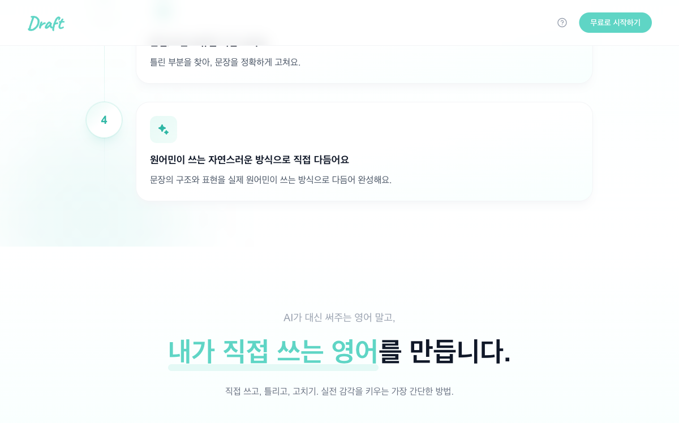
02 How Draft Works
1
Pick a Topic
Daily prompts or free writing
2
Write Freely
No hints, no corrections — just write
3
Guided Rewrite
Fix grammar & structure errors yourself
4
Native Polish
Rewrite toward natural, native phrasing

Slide 6
02 Draft — Traction in 3 Days
Soft launch: Feb 24-27, 2026 | ₩10,000 marketing spend
3,218
61
35
191
Page views
Signups (Kakao OAuth)
Writing sessions
AI corrections generated
88.6%
0%
185
$0
Session completion rate
Checkout → Paid conversion
Peak unique visitors/day
Customer acquisition cost
2 paying subscribers (all churned) — validated willingness to pay
Post-draft-submit retention: 80-100% — AI correction is the magic moment

Slide 7
02 Draft — Funnel & Key Insights
Conversion Funnel
What Worked
Page views
3,218
100%
88.6% session completion — product flow works
50% checkout conversion — willingness to pay
80-100% post-draft retention — AI corrections keep users
#1 error: articles (21%) — clear problem validation
CTA clicks
118
3.7%
Signups
61
1.9%
Selected topic
15
23.4%
Submitted draft
5
7.8%
Completed flow
4
6.3%
What Didn't
Subscribed
4
6.6% of signups
76.6% drop at topic selection — choice paralysis
66.7% drop at draft submit — blank page problem
1.8% week-1 retention — no habit loop yet
All 4 paying users churned
Lesson: The product works once users engage. The challenge is activation and retention.

Slide 8
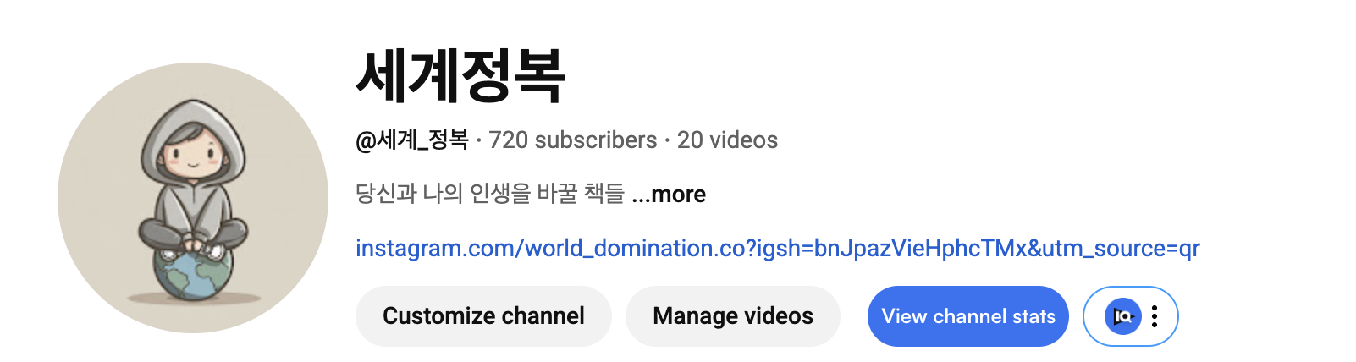
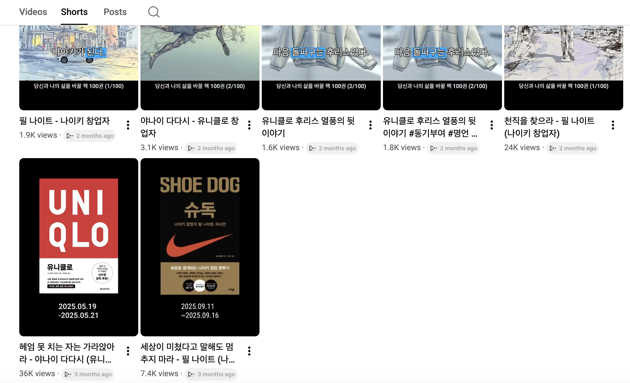
03 YouTube / Instagram
https://youtube.com/channel/UCTGZoUSDBqog8NcYzmY92cA?si=PclMImwPzfO3j5BH

Slide 9
04 Elbaph Bot — Loki
AI-powered Slack bot for the Elbaph community
Daily News Briefing
Tech Stack
5 topics: AI, Robotics, BCI, Medtech, Korea Startups
5 parallel agents fetch curated sources + web
#news → source thread → #lounge cross-post
Archived daily as markdown
Runtime
Next.js on Vercel (serverless)
Slack
Events API + signature verification
AI Triage
Gemini 3 Flash Preview (free)
Tag @Loki for Answers
Deep Research
Manus API (Pro subscription)
Gemini Flash — fast answers via Google Search
Manus API — deep research across 10+ sources
Smart routing by question complexity
State
Upstash Redis
Async
Manus webhook callback

Slide 10
04 Loki — Learnings & Gotchas
Vercel Serverless
Slack API
Manus API
after() does NOT run on Vercel
No shared memory between invocations
Lazy-init API clients for build compatibility
*bold* not **bold** — custom converter needed
Trailing whitespace in tokens breaks auth
>95% failure in 60 min disables events
Results in attachment files, not output_text
Auth: API_KEY header (not Bearer)
GET /tasks/{id} omits original prompt
Key Takeaway
Serverless + multiple external APIs = edge cases everywhere. Redis is essential for state. Every API has its own quirks.

Slide 11
Codex, ClaudeCode
Codex
Codex cli
Codex app(현재 2배 이벤트 중)
ClaudeCode
- skills, plugins, mcp…..

Slide 12
Q&A
Let's talk.

