Slide 1
THE NEW BIOLOGY OF AGING
Aging, Longevity &
the Programmable Cell
From the hallmarks of aging and immune profiling to virtual cells
and biological foundation models — a field-level briefing.
sj_lee · 2026-05-31 · Sources cited on every slide

Slide 2
TODAY'S ROADMAP
Five questions, one connected story
1
2
3
4
5
What is aging?
How do we measure it?
Can we slow it?
Immune profiling
Modeling life itself
Definition & scientific consensus
Hallmarks & biological clocks
Longevity interventions & trials
The immune system as a readout
Virtual cells & foundation models
The thread: aging is multi-dimensional — so are the tools we now use to read and rewrite it.

Slide 3
DEFINING AGING
Aging is a process, not just the passage of time
Two influential lenses
Working definition
The progressive accumulation of molecular, cellular and tissue damage that erodes physiological reserve, homeostasis and resilience — raising the risk of disease, frailty and death.
Information Theory of Aging (Sinclair) Aging = progressive loss of youthful epigenetic information; partially reversible. A powerful hypothesis — not the consensus.
Hallmarks of Aging (López-Otín et al.) The mainstream framework: ~12 interconnected drivers acting as a network — epigenetic drift is one axis among many.
Clinicians' view: no single mechanistic consensus — practice centers on frailty, intrinsic capacity and functional ability (WHO Healthy Ageing). Chronological age is an imperfect proxy.
López-Otín et al., Cell 2023, 186(2):243–278 · Yang et al. (Sinclair lab), Cell 2023, 186(2):305–326 · WHO, Decade of Healthy Ageing 2021–2030.

Slide 4
CLINICAL / FUNCTIONAL AGING
How medicine sees aging: function over mechanism
Functional aging = the age-related erosion of physiological reserve and intrinsic capacity that reduces an older person's functional ability and raises vulnerability to stressors — clinically captured as frailty.
 | Biological aging | Medical / functional aging
What it asks | “How damaged are the cells?” | “What can this patient still do?”
What is measured | Molecular / cellular damage & dysregulation | Reserve, function & frailty / vulnerability
Example tools | Epigenetic clocks, hallmark biomarkers | Frailty phenotype/index, CFS, gait speed, ICOPE
Intervention target | Underlying damage & aging mechanisms | Function, reserve, frailty, adverse outcomes
Clinical use today | Mostly research — not yet routine | Standard of care in geriatric assessment
CLINICAL MANAGEMENT
Comprehensive Geriatric Assessment — multidomain review → individualized care plan
Resistance & multicomponent exercise — counters sarcopenia, improves mobility & balance
Protein & nutrition optimization — treats malnutrition, preserves muscle mass
Deprescribing / polypharmacy review — stops inappropriate drugs, cuts adverse events
Fall-prevention programs — multifactorial risk assessment + exercise
WHO ICOPE intrinsic-capacity care — screen & manage 5 capacity domains in primary care
Biological clocks describe the mechanism of aging; clinical medicine measures and acts on function, reserve and the outcomes patients actually live with.
Fried et al., J Gerontol A 2001;56:M146 · Rockwood et al. (CFS), CMAJ 2005;173:489 · Cesari et al., J Gerontol A 2018;73:1653 · WHO ICOPE 2017 & Decade of Healthy Ageing 2021–2030.

Slide 5
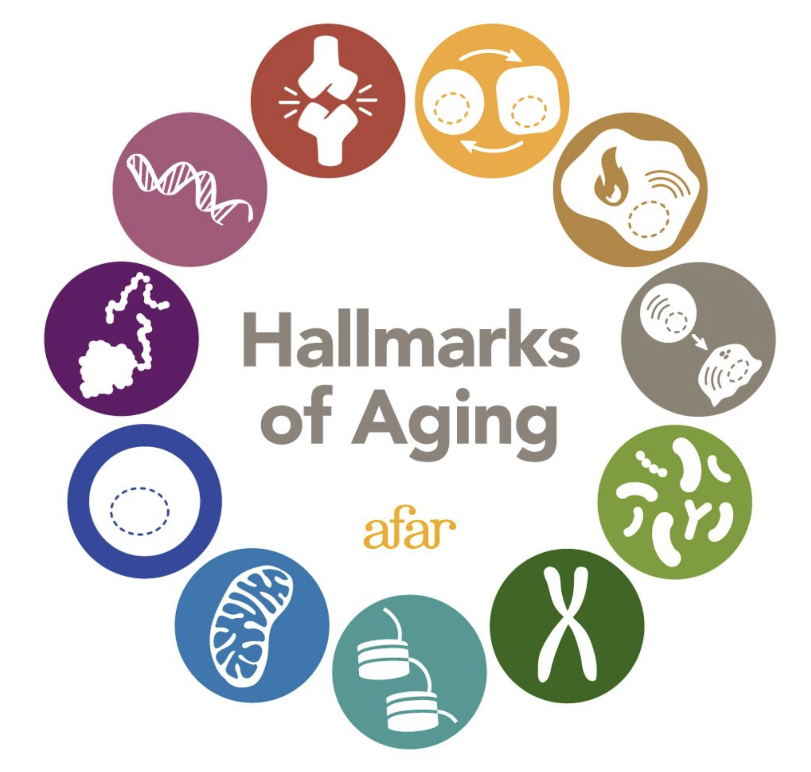
THE FRAMEWORK
The 12 Hallmarks of Aging
PRIMARY · the damage
Genomic instability
Telomere attrition
Epigenetic alterations
Loss of proteostasis
Disabled macroautophagy
ANTAGONISTIC · the response
Deregulated nutrient sensing
Mitochondrial dysfunction
Cellular senescence
INTEGRATIVE · the consequence
Hallmarks of Aging — AFAR
Stem cell exhaustion
Altered intercellular comm.
Chronic inflammation
Dysbiosis
López-Otín, Blasco, Partridge, Serrano & Kroemer. "Hallmarks of aging: An expanding universe." Cell 2023, 186(2):243–278. Figure: American Federation for Aging Research (AFAR).

Slide 6
READING THE CLOCK
Measuring biological age: epigenetic clocks
DNA methylation
→
ML clock model
→
Biological age
Genome-wide CpG
methylation pattern
Penalized regression
on methylation sites
Predicts healthspan,
disease & mortality risk
1st-gen vs 2nd-gen
Big benchmark
Caveat
Clocks trained on mortality/phenotype (PhenoAge, GrimAge, DunedinPACE) beat pure age-predictors for disease.
Across 14 clocks & 174 incident diseases, second-generation clocks most consistently track disease risk.
No single clock is a validated clinical test of "your true aging rate" — interpret with caution.
Mavrommatis, Belsky, Ying, Moqri … Marioni. "An unbiased comparison of 14 epigenetic clocks in relation to 174 incident disease outcomes." Nature Communications 2025 (10.1038/s41467-025-66106-y).

Slide 7
GEROSCIENCE
Can we slow aging? The intervention landscape
Geroscience hypothesis: target shared aging biology to delay many age-related diseases at once.
Lifestyle & public health
Strongest
Caloric restriction / mimetics
Trials ongoing
Senolytics
Early human
Exercise, nutrition, sleep, sanitation, vaccines — by far the largest real-world gains.
CR, fasting; rapamycin & metformin fool nutrient-sensing pathways.
Dasatinib+Quercetin, fisetin — clear and reduce senescent-cell burden.
NAD+ / metabolic
Inconclusive
Epigenetic reprogramming
First-in-human
Immune rejuvenation
Emerging
NR, NMN raise NAD+; biologically active, clinical benefit still unclear.
Partial OSK reprogramming rejuvenates cells without losing identity.
Thymus regeneration, mTOR tuning, inflammaging control.
Geroscience framework: NIA. Reviews: Guarente et al., Cell Metab 2024 · Kirkland & Tchkonia, senolytics. Reprogramming: Lu et al., Nature 2020.

Slide 8
EVIDENCE CHECK
What the human trials actually show
CALERIE
Caloric restriction
D + Q
Senolytics (Dasatinib+Quercetin)
2 yrs of 25% CR slowed the pace of aging (DunedinPACE) — but the effect was small and clock-dependent.
First human pilot reduced senescent-cell burden in tissue of diabetic kidney disease patients.
Waziry et al., Nature Aging 2023
Hickson et al., EBioMedicine 2019
SELECT
GLP-1 (semaglutide)
OSK
Epigenetic reprogramming
20% lower major cardiovascular events in overweight/obese adults — a metabolic drug with broad aging-relevant benefit.
Partial reprogramming restored youthful methylation and regenerated optic-nerve vision in mice — proof aging can be partly reversed.
Lincoff et al., NEJM 2023
Lu et al., Nature 2020
Independent randomized / pilot trials. Effect sizes vary; none yet establishes a routine "anti-aging" therapy for healthy adults.

Slide 9
IMMUNE PROFILING
The immune system as a high-dimensional readout
One "immune profile" = many layers measured together
Cellular Innate & adaptive subsets — T / B / NK / monocyte composition
THE HUMAN IMMUNOME PROJECT
A moonshot to map the immune system at scale
Activation Exhaustion & activation markers; cytokines / chemokines
Thousands of immunological parameters — cells, transcripts, antibodies, proteins, epigenetic marks, metabolites
Repertoire Antibodies, TCR / BCR diversity
Standardized IM-Kit assays measured at baseline and after vaccination
Omics Transcriptome · proteome · epigenome · metabolome
AI models to integrate modalities and predict immune health across populations (children → elderly)
Response Dynamics after perturbation (e.g. vaccination)
Human Immunome Project — Scientific Approach (humanimmunomeproject.org). An immune profile is a measurement package, not a single number.

Slide 10
IMMUNE AGING
Immunosenescence, inflammaging & the immune clock
How the immune system ages
Naïve T cells ↓
THE IMMUNE CLOCK
Thymic involution shrinks the pool of cells that fight new threats
iAge
Memory / exhausted T cells ↑
Repertoire narrows; responses to new antigens weaken
An inflammatory aging clock
Deep learning on the blood immunome of ~1,000 people produces a single inflammatory-age score that tracks multimorbidity, immunosenescence, frailty and cardiovascular aging.
Inflammaging
Chronic, low-grade inflammation rises even without infection
Vaccine response ↓
Reduced protection — a practical clinical signature of immune aging
Same caveat as DNA clocks: promising, not yet a settled clinical test.
Sayed et al. "An inflammatory aging clock (iAge)." Nature Aging 2021. See also longitudinal multi-omic immune-aging profiling, Nature 2025.

Slide 11
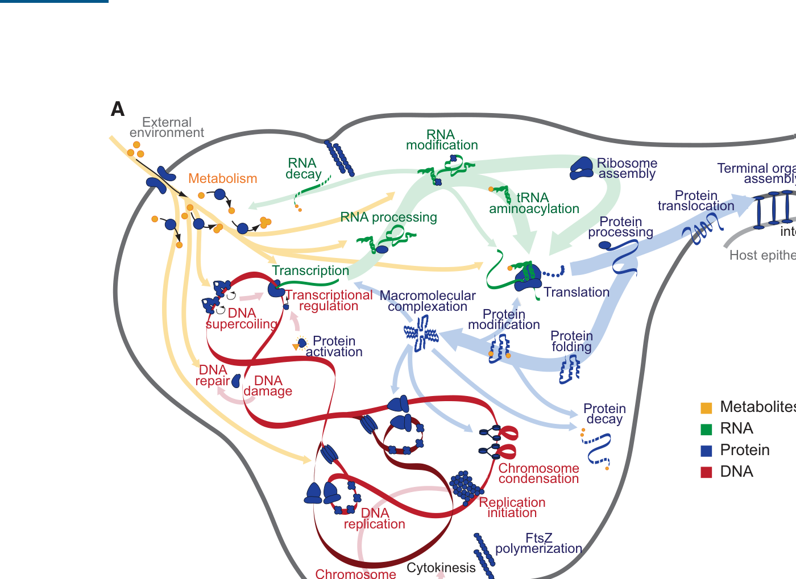
MODELING LIFE — 1
The virtual cell: from genotype to phenotype
A cell, simulated end-to-end
1
First whole-cell model
Every gene, RNA, protein and metabolite of the simplest free-living microbe, computed over its full life cycle.
2
Genotype → phenotype
Mechanistic simulation predicts observable behavior directly from the DNA sequence.
3
Why it matters for aging
A testbed for how molecular damage propagates to cell-level failure — the logic behind today's "AI Virtual Cell" ambitions.
Whole-cell model integrating 28 cellular submodels (M. genitalium)
Karr, Sanghvi, Macklin … Covert. "A Whole-Cell Computational Model Predicts Phenotype from Genotype." Cell 2012, 150(2):389–401.

Slide 12
MODELING LIFE — 2
Single-cell foundation models: cells as language
scGPT — a generative pretrained transformer that treats each cell as a "sentence" of genes and learns reusable cell & gene representations (Cui et al., Nature Methods 2024).
scRNA-seq
cell
→
Gene + value
tokens
→
Transformer
encoder
→
Cell & gene
embeddings
→
Downstream
tasks
Pretrained once on ~33 million human cells (CZI CELLxGENE), then transferred to many tasks.
INPUT
ARCHITECTURE
OUTPUT / TASKS
Per-cell gene-expression vector (scRNA-seq)
Gene + expression embeddings → learned vectors
Cell-type annotation & state classification
Tokenized as (gene token + binned value) pairs
Stacked transformer blocks, specialized masked attention
Batch integration across datasets
Optional condition tokens: batch · modality · perturbation
Self-supervised masked-expression pretraining
Gene regulatory network inference
Cell <cls> token aggregates cell state
Cell & gene representation heads
Perturbation / in-silico response prediction
Multi-omic integration (RNA + ATAC + protein)
Pretrain once on tens of millions of cells, then transfer to many tasks with little labeled data — a foundation for the "AI virtual cell."
Cui et al. scGPT. Nature Methods 2024;21:1470–1480 · Theodoris et al. (Geneformer), Nature 2023 · Hao et al. (scFoundation), Nat. Methods 2024 · Bunne, Leskovec, Regev et al. "How to build the virtual cell with AI," Cell 2024.

Slide 13
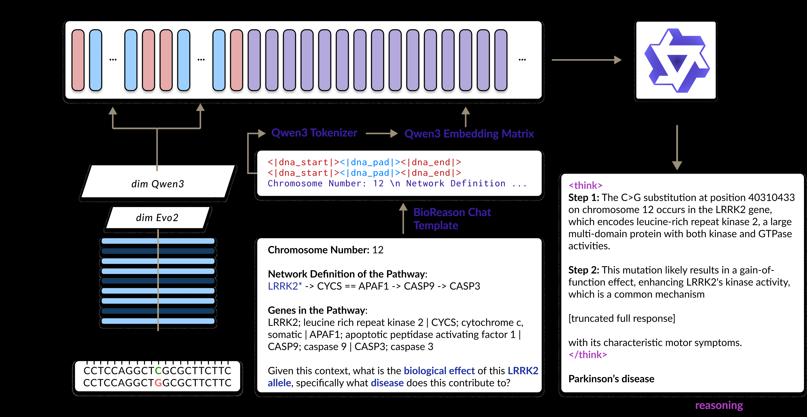
MODELING LIFE — 3
Biological multimodal LLMs: reading the genome like image
WHY IT'S NEW
DNA as language
Genome foundation models learn sequence "grammar" like LLMs learn text.
Multimodal reasoning
DNA encoder + LLM produces step-by-step biological explanations, not just labels.
Toward in-silico biology
The same paradigm powers virtual-cell and aging-mechanism prediction.
BIOREASON couples a DNA foundation model (Evo2) with an LLM (Qwen3) to reason from variant → mechanism → disease.
BIOREASON: "Incentivizing Multimodal Biological Reasoning within a DNA-LLM Model" (2025). Builds on Evo2 genome model + Qwen3 LLM.

Slide 14
INDUSTRY SIGNALS
Building virtual cells: the TechBio race
Across drug discovery, immuno-oncology and aging, companies are racing to build AI foundation models of cells, tissues and whole organisms.
Noetik
Spatial AI
Recursion
Phenomics
Arc Institute
Genome model
GSK licenses OCTO virtual-cell models
AI-found degrader posts clean early data
Evo 2 + Virtual Cell Challenge launched
GSK signed a 5-yr deal for Noetik's OCTO spatial multi-omics virtual-cell models (~$50M upfront/near-term).
REC-1245 (RBM39 degrader, platform-discovered): well-tolerated, dose-dependent PK, no DLTs in solid tumors.
Released the Evo 2 genome model and an annual challenge to predict cellular perturbation responses (1,200+ teams).
Jan 2026
May 2026
2025–26
Chan Zuckerberg Initiative
Virtual cell
CZI × NVIDIA
Data infra
THE THROUGH-LINE
rBio reasons over virtual cells
Scaling virtual cells to petabyte data
Data scale + foundation models are moving from genomics into spatial, cellular and whole-organism biology — turning the cell itself into a programmable, predictable model.
First reasoning model trained on virtual-cell simulations — predict gene interactions in plain language, no wet lab.
Expanded collaboration to train virtual-cell models across petabytes and billions of cellular observations.
Aug 2025
Oct 2025
Sources: noetik.blog · Recursion Q1-2026 results (SEC 8-K, May 2026) · Arc Institute (arcinstitute.org, Evo 2) · CZI rBio & CZI–NVIDIA virtual-cell collaboration (chanzuckerberg.com, 2025). Verified via fetched pages / search.

Slide 15
THE THROUGH-LINE
Aging and immunity resist a single number —
but they are becoming readable, and increasingly writable.
Multi-dimensional by nature
From description to intervention
Aging = a network of hallmarks; immune profile = layered omics. Neither reduces to one cause.
Lifestyle leads; senolytics, metabolic drugs & partial reprogramming move from mice to first humans.
Profiles, not point scores
Biology becomes computable
Clocks (DNA, iAge) stratify risk and track response — powerful, not yet definitive clinical tests.
Virtual cells & DNA-LLM foundation models turn aging biology into something we can simulate and reason over.
Read it. Track it. Slow it. Eventually, simulate it.

Slide 16
SOURCES
References
1. López-Otín, Blasco, Partridge, Serrano, Kroemer. Hallmarks of aging: An expanding universe. Cell 2023, 186(2):243–278.
9. Vinten et al. NAD+ precursor supplementation in human aging: clinical evidence and challenges. 2025–26.
17. Rockwood, Song, MacKnight et al. Clinical Frailty Scale. CMAJ 2005;173(5):489–495.
2. Yang et al. (Sinclair lab). Loss of epigenetic information as a cause of mammalian aging. Cell 2023, 186(2):305–326.
10. Borsky, Holmannova … Horvath. Plasmapheresis & biomarkers of aging (efficacy/safety trial). 2025.
18. Cesari et al. Domains supporting intrinsic capacity. J Gerontol A 2018;73(12):1653–1660.
3. Mavrommatis, Belsky, Ying, Moqri … Marioni. An unbiased comparison of 14 epigenetic clocks vs 174 incident disease outcomes. Nat. Commun. 2025 (10.1038/s41467-025-66106-y).
11. Lu et al. Reprogramming to recover youthful epigenetic information and restore vision. Nature 2020, 588:124–129.
19. WHO. Integrated Care for Older People (ICOPE) 2017 · Decade of Healthy Ageing 2021–2030.
4. Waziry et al. CALERIE: caloric restriction & pace of aging (DunedinPACE). Nature Aging 2023.
12. Karr, Sanghvi, Macklin … Covert. A whole-cell computational model predicts phenotype from genotype. Cell 2012, 150(2):389–401.
20. Cui et al. scGPT: a foundation model for single-cell multi-omics. Nature Methods 2024;21:1470–1480.
5. Bischoff-Ferrari et al. DO-HEALTH: vitamin D, omega-3, exercise & epigenetic clocks. Nature Aging 2025.
13. BIOREASON: Incentivizing Multimodal Biological Reasoning within a DNA-LLM Model. 2025 (Evo2 + Qwen3).
21. Theodoris et al. Transfer learning in network biology (Geneformer). Nature 2023;618:616–624.
6. Lincoff et al. SELECT: semaglutide & cardiovascular outcomes. New England Journal of Medicine 2023.
14. Human Immunome Project — Scientific Approach. humanimmunomeproject.org.
22. Hao et al. Large-scale foundation model on single-cell transcriptomics (scFoundation). Nat. Methods 2024;21:1481–1491.
7. Hickson et al. Senolytics (Dasatinib + Quercetin) in humans. EBioMedicine 2019.
15. Sayed et al. An inflammatory aging clock (iAge). Nature Aging 2021.
23. Bunne, Leskovec, Regev et al. How to build the virtual cell with AI. Cell 2024;187:7045–7063.
8. van Deursen. Senolytic therapies for healthy longevity. Science 2019.
16. Fried, Tangen, Walston et al. Frailty in older adults: a phenotype. J Gerontol A 2001;56(3):M146–157.
24. Industry: Noetik (noetik.blog) · Recursion Q1-2026 (SEC 8-K) · Arc Institute Evo 2 · CZI rBio / CZI–NVIDIA, 2025.

